Slide 1
NATIONAL ACADEMY OF SCIENCES OF TAJIKISTAN CHEMICAL, BIOLOGICAL, RADIOLOGICAL, AND NUCLEAR SAFETY & SECURITY AGENCY
Triennial Technical Meeting of States' Points of Contact for the
Incident and Trafficking Database (ITDB)
26 - 28 April 2022 | Vienna HQ and online WebEx
Prof. Ulmas MIRSAIDOV
Mr. Olimjon AZIZOV

Slide 2
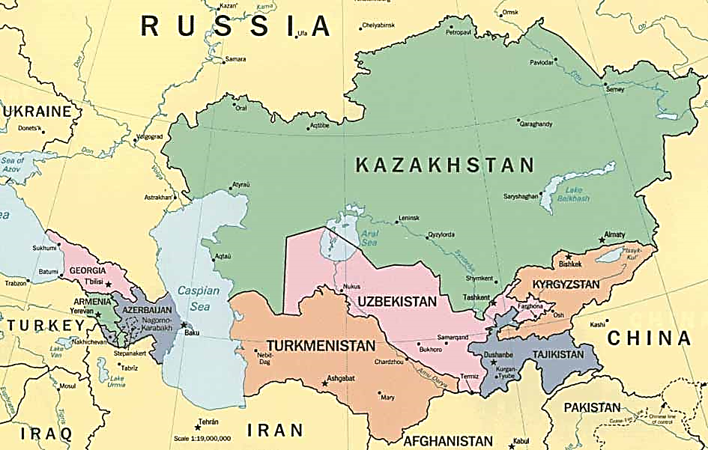
NATIONAL ACADEMY OF SCIENCES OF TAJIKISTAN CHEMICAL, BIOLOGICAL, RADIOLOGICAL, AND NUCLEAR SAFETY & SECURITY AGENCY
Tajikistan

Slide 3
THE NUMBER OF REGISTERED RADIOACTIVE SOURCES IN 2017-2021
NATIONAL ACADEMY OF SCIENCES OF TAJIKISTAN CHEMICAL, BIOLOGICAL, RADIOLOGICAL, AND NUCLEAR SAFETY & SECURITY AGENCY

Slide 4
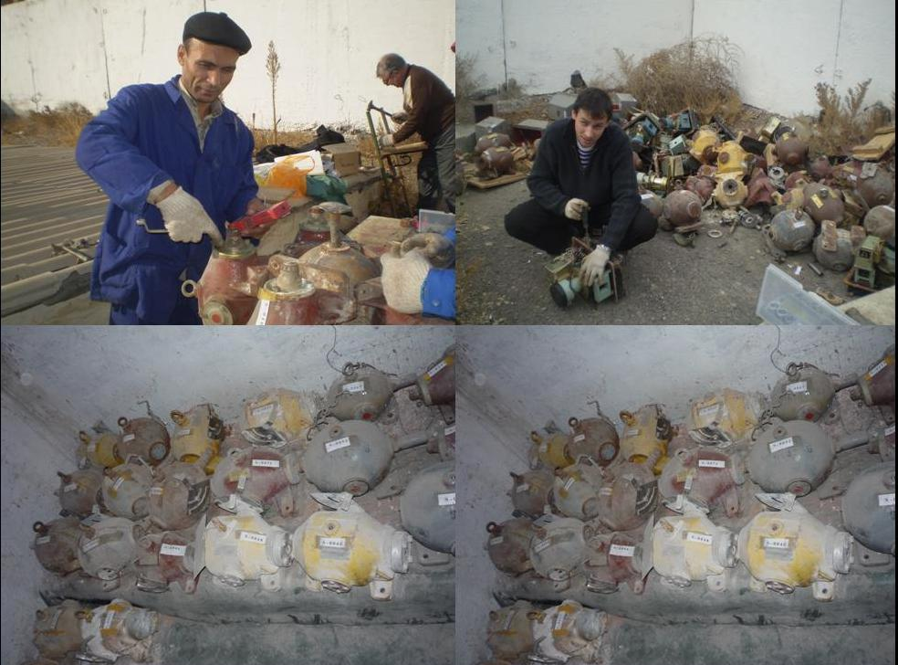
INVENTORY OF RADIOACTIVE SOURCE
NATIONAL ACADEMY OF SCIENCES OF TAJIKISTAN CHEMICAL, BIOLOGICAL, RADIOLOGICAL, AND NUCLEAR SAFETY & SECURITY AGENCY

Slide 5
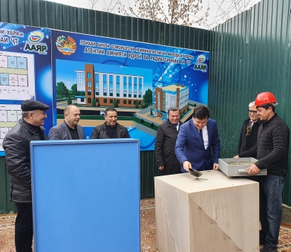
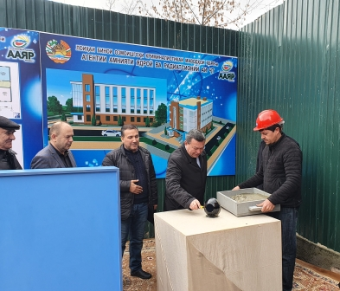
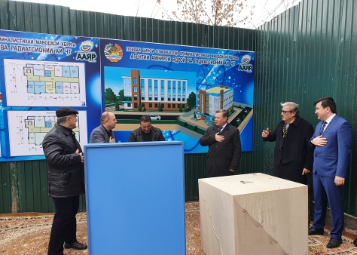
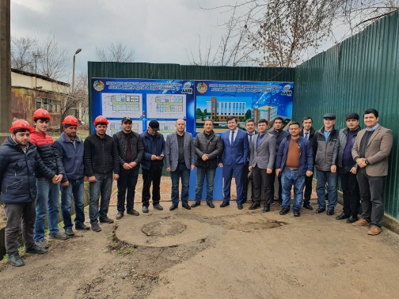
CBRN SSA ACHIEVEMENTS
NATIONAL ACADEMY OF SCIENCES OF TAJIKISTAN CHEMICAL, BIOLOGICAL, RADIOLOGICAL, AND NUCLEAR SAFETY & SECURITY AGENCY

Slide 6
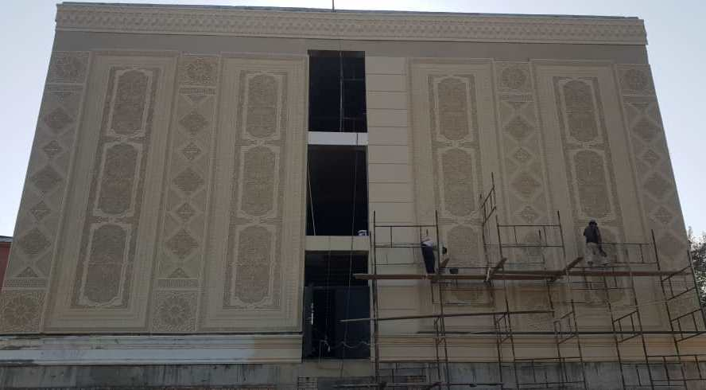
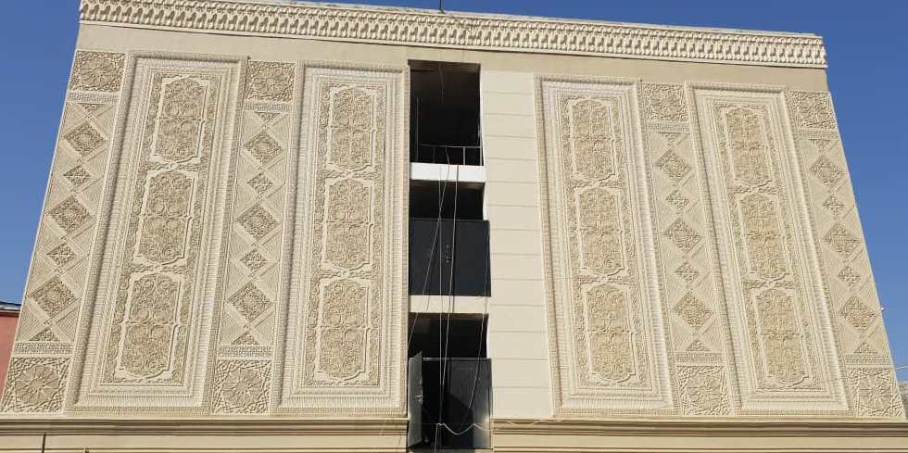
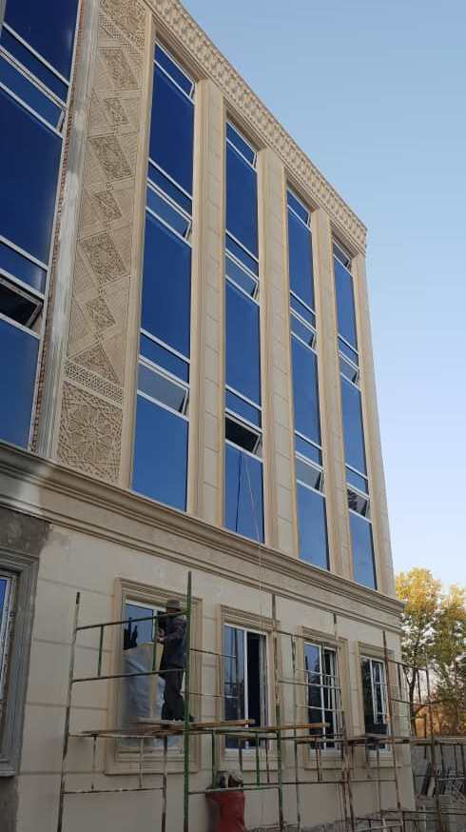
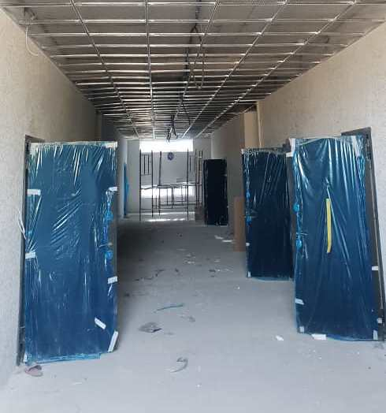
NATIONAL ACADEMY OF SCIENCES OF TAJIKISTAN CHEMICAL, BIOLOGICAL, RADIOLOGICAL, AND NUCLEAR SAFETY & SECURITY AGENCY
CBRN SSA ACHIEVEMENTS

Slide 7
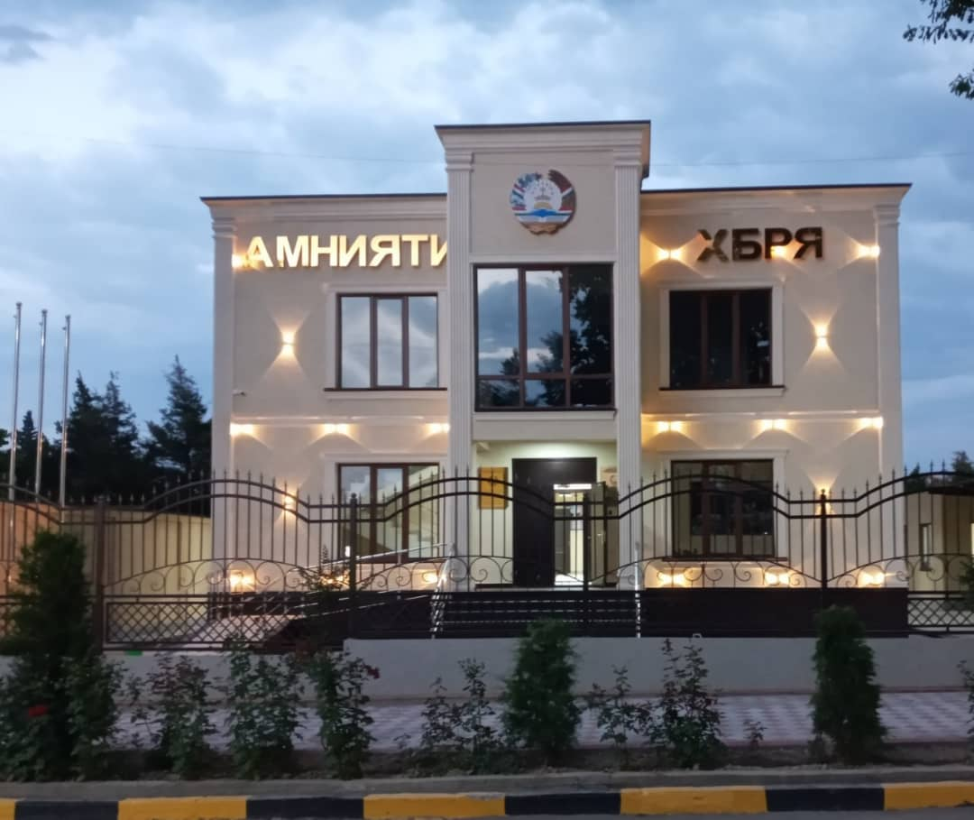
NATIONAL ACADEMY OF SCIENCES OF TAJIKISTAN CHEMICAL, BIOLOGICAL, RADIOLOGICAL, AND NUCLEAR SAFETY & SECURITY AGENCY
CBRN SSA ACHIEVEMENTS

Slide 8
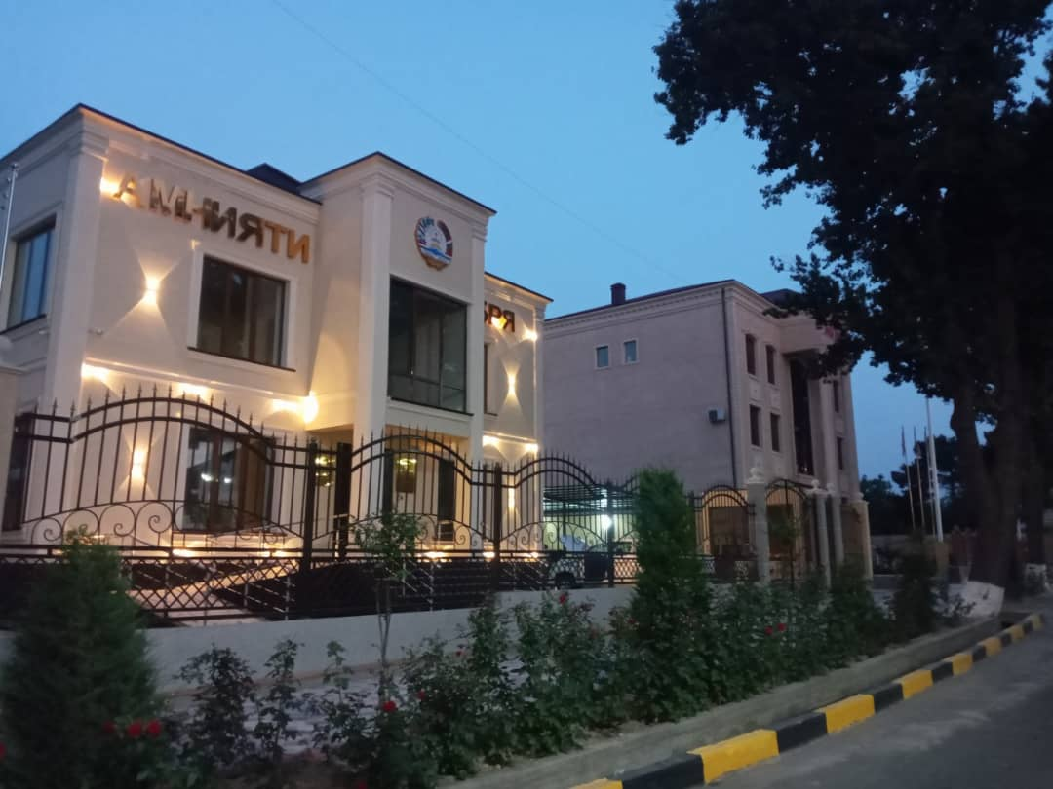
NATIONAL ACADEMY OF SCIENCES OF TAJIKISTAN CHEMICAL, BIOLOGICAL, RADIOLOGICAL, AND NUCLEAR SAFETY & SECURITY AGENCY
CBRN SSA ACHIEVEMENTS

Slide 9
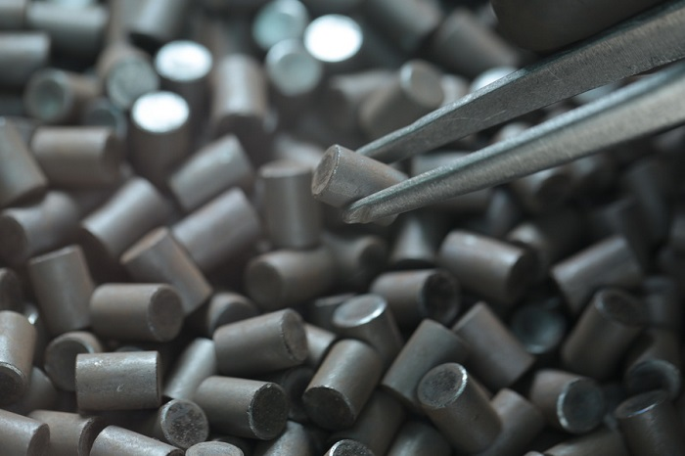
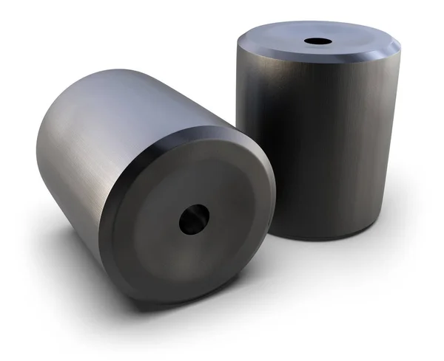
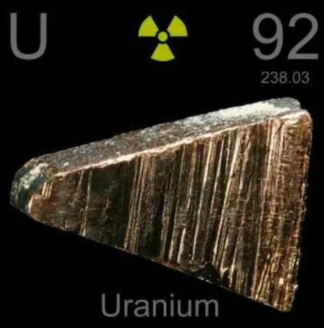
Illicit trafficking case in Tajikistan
NATIONAL ACADEMY OF SCIENCES OF TAJIKISTAN CHEMICAL, BIOLOGICAL, RADIOLOGICAL, AND NUCLEAR SAFETY & SECURITY AGENCY
State Committee for National Security of Tajikistan provided information to the Regulatory body of Tajikistan on May 27, 2021. During a special operation, several citizens of Tajikistan were detained in Dushanbe city (Capital of Tajikistan) and from them were found 133 pieces of nuclear material (uranium dioxide tablets) with a total weight of 607 grams.
Primary gamma-spectrometric analysis showed that this material contains isotopes of uranium U-235 (3-3.5% enrichment) and U-238.
Physical description: 133 pieces of cylindrical Pallets with cylindrical hole in the centre, 11 mm long, 7 mm diameter, 2 mm hole, weight 4.5-4.8 grams. The pallets had no serial numbers. Dose rate is 0,315-0,388 microSivert/hour.
Notes:
Materials were found in black plastic package in the glass bottle. There were no any shielding container or material. Materials are not from Tajikistan facilities.

Slide 10
Illicit trafficking case in Tajikistan
NATIONAL ACADEMY OF SCIENCES OF TAJIKISTAN CHEMICAL, BIOLOGICAL, RADIOLOGICAL, AND NUCLEAR SAFETY & SECURITY AGENCY
This group of people tried to find buyers in order to sell and get a large amount of money. Individuals planned to sell within the country or to Afghanistan. After investigation and judicial review citizen of Tajikistan. Mr. Haitmurodov M.T. has been convicted according to the Article 193, Part 1 of the Criminal Code of Tajikistan “Illicit trafficking of radioactive materials”.
Analysis performed by Canberra Gamma-spectroscopy, HPGe Detector at the Technical Services Laboratory of the Chemical, Biological, Radiological and Nuclear Safety and Security Agency (former NRSAof Tajikistan.
INF send to IAEA ITDB on 12.07.2021.

Slide 11
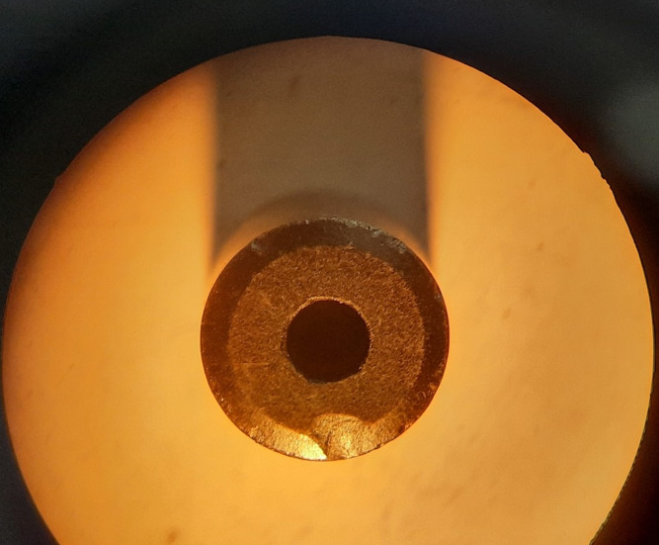
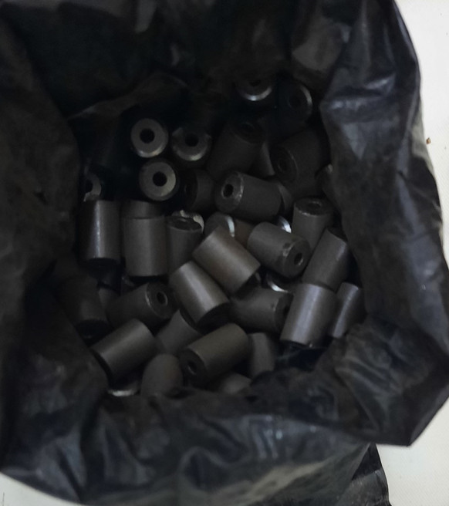
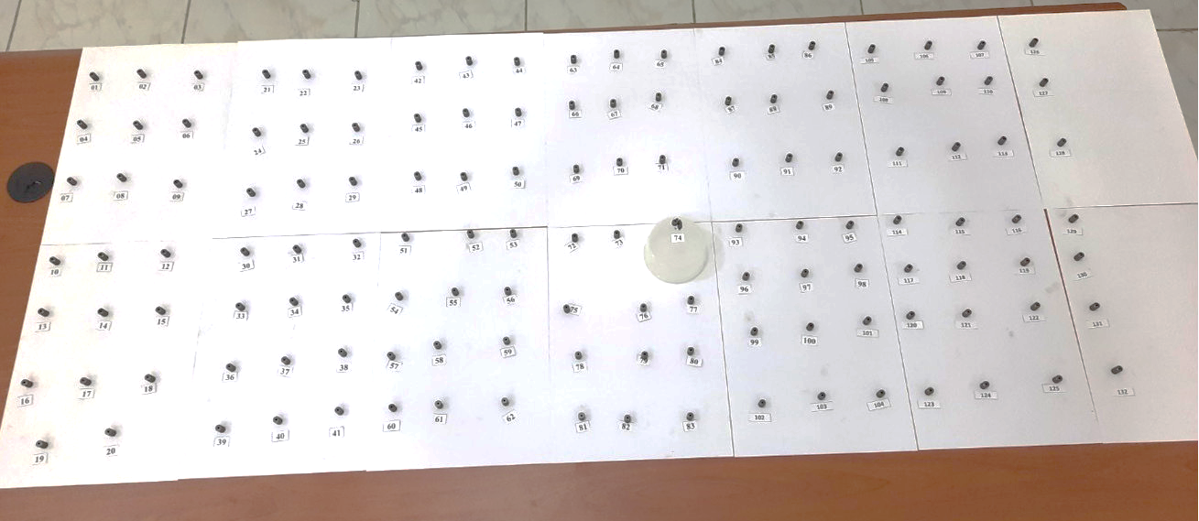
Original photos of the nuclear materials
NATIONAL ACADEMY OF SCIENCES OF TAJIKISTAN CHEMICAL, BIOLOGICAL, RADIOLOGICAL, AND NUCLEAR SAFETY & SECURITY AGENCY

Slide 12
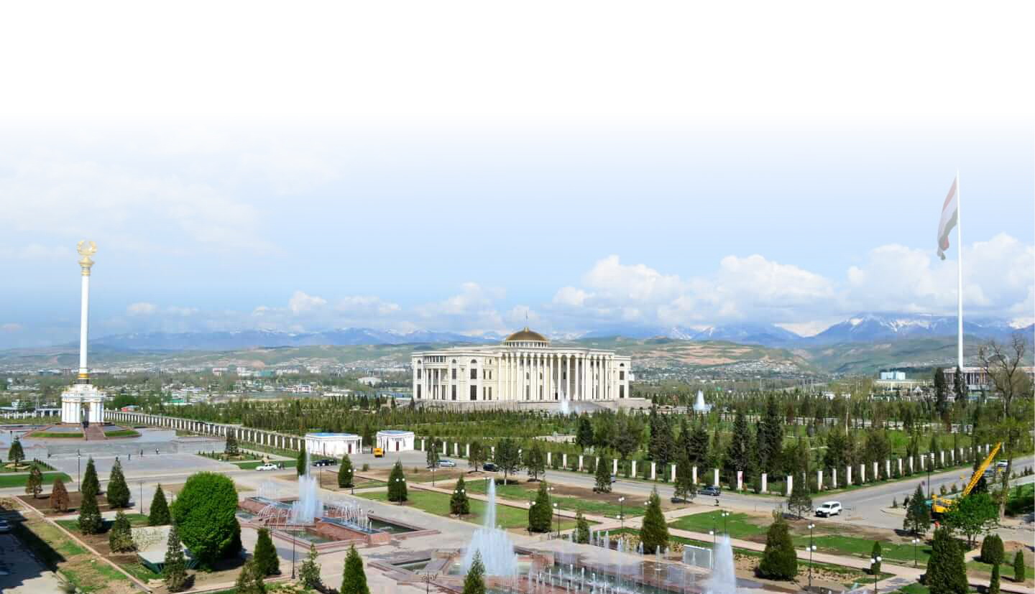
Thanks for your attention!
NATIONAL ACADEMY OF SCIENCES OF TAJIKISTAN CHEMICAL, BIOLOGICAL, RADIOLOGICAL, AND NUCLEAR SAFETY & SECURITY AGENCY

