Slide 1
Assessment of Nuclear Security and Safety Culture at Radiological Facilities across the United States.
Jason T. Harris, Ph.D.
Shraddha Rane, Ph.D.
Emma Rekeweg
Karina Paone
International Conference on the Safety and Security of Radioactive Sources
Vienna, 2022

Slide 2
Outline
Background
Research Methodology
Results
The ultimate purpose of the study
Conclusion
2

Slide 3
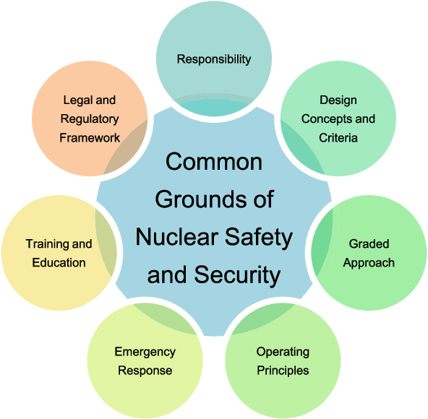
Background
Nuclear Safety Culture is defined as the core values and behaviors resulting from a collective commitment by leaders and individuals to emphasize safety over competing goals to ensure protection of people and the environment. (US NRC)
Nuclear Security Culture is defined as the assembly of characteristics, attitudes and behaviors of individuals, organizations, and institutions which serves as a means to support and enhance nuclear security. (IAEA)
Shared objective of nuclear safety-security culture is the protection
of people, society, and the environment from potentially
harmful consequences of a nuclear event.
Strengthening the organizational safety-security culture interface
would help raise awareness of nuclear safety-security intersection
and prevent and respond to nuclear accidents and nuclear terrorism.
Organizational culture is something that cannot be prescribed or
legislated but can be ASSESSED!
S. Choudary, 2017

Slide 4
Research Methodology
To provide a better picture of the extent to which radiological security and safety culture is part of an organization’s culture, a series of culture indicators were investigated.
Survey assessment was used as a method of data collection to measure current perceptions and identify areas of strengths and weaknesses in particular aspects of security culture.
A ‘Request for Participation’ email was sent through a listserv to various universities and medical centers.
The survey consisted of 22-23 questions depending on the type of institution and was taken only by radiation authorized users.
The survey response choices included a 5-point Likert scale, multiple choice and other forms of categorical scale options.
Results

Slide 5
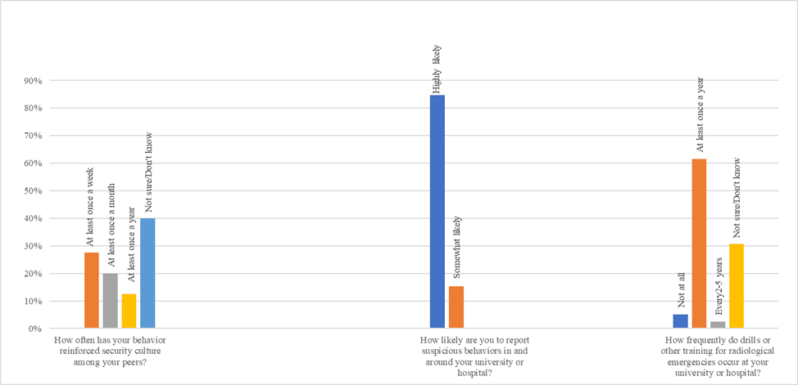



Categorical Scale Survey Questions (University and Medical Center) Response Rate
Takeaways:
40% of the combined university and medical center respondents could not recall any action that they had taken to influence their peers in a way that would enhance security culture in the institution.
Security culture indicator of vigilance for reporting suspicious behavior was self rated as ‘highly likely’
62% respondents noted that institutions practiced emergency drills at least once a year

Slide 6
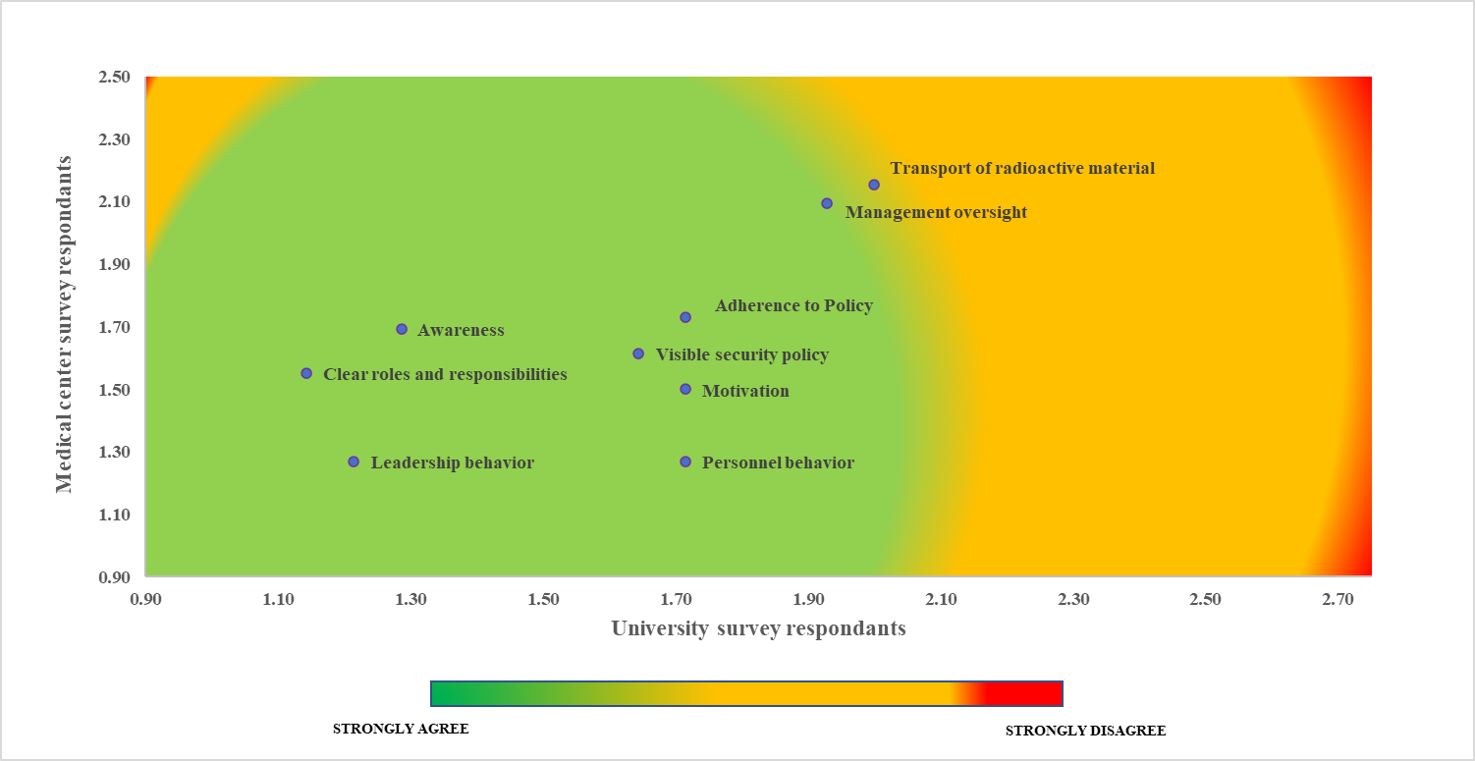
Mean Scores of IAEA Nuclear Security-Safety Culture Characteristics Among the University and Medical Survey Respondents
Takeaways:
Majority of characteristics subgroups fell in green segment of chart – strong points to be preserved and reinforced.
Management oversight and transport of radioactive material reported weakness
More experienced radioactive material users (>10 years) showed much more awareness than the less experienced (< 10 years). Fifteen percent of the total reported being unaware of transport security measures.

Slide 7
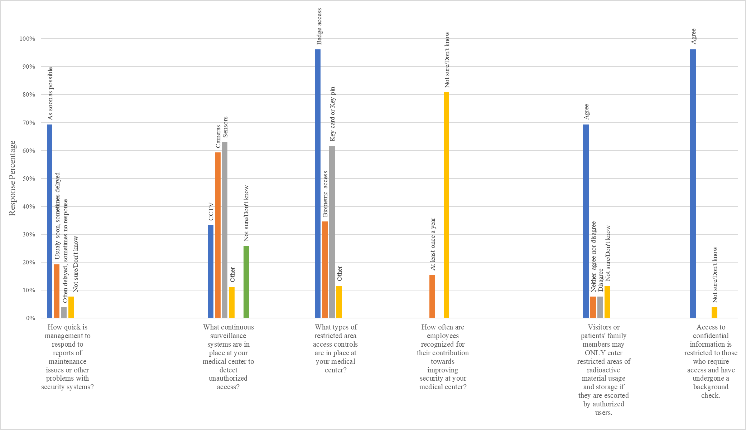




Percent Response of Medical Center Survey Categorical Questions
A strong consensus was seen among respondents on access controls. Badge was seen as a common credential. Sixty –nine percent reported escorted access to radioactive material area.
Staff rewards and public acknowledgements for proactively contributing to security was reported uncommon.

Slide 8
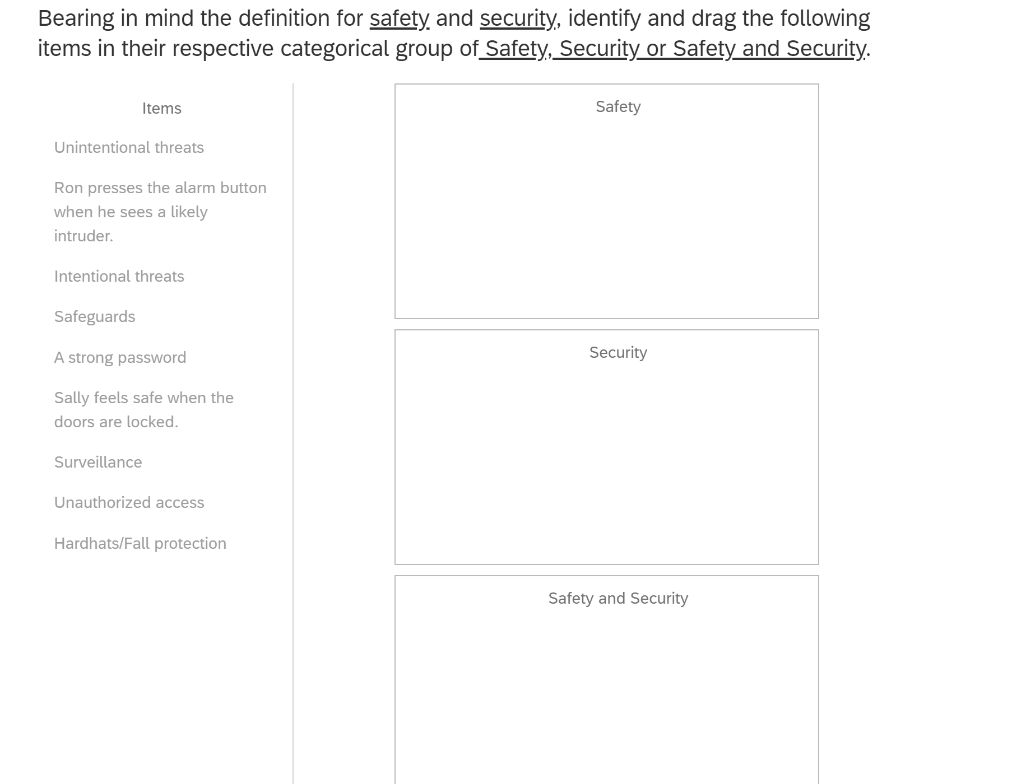
Survey Question on the Conceptual Knowledge Test of Safety and Security Among the University and Medical Center Respondents

Slide 9
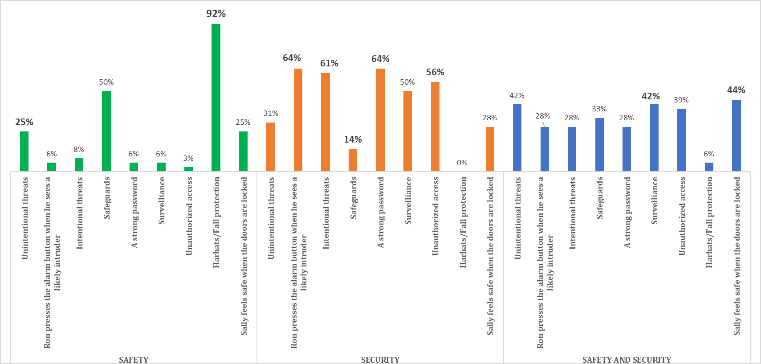




Results - The Conceptual Knowledge Test of Safety and Security Among the University and Medical Center Respondents
High variation in respondents’ answers was observed in keyword items of Intentional and Unintentional threats, safeguards and surveillance. Many professionals seem to have an ambiguous understanding of the concepts of safety and security

Slide 10
Results - The Conceptual Knowledge Test of Safety and Security Among the University and Medical Center Respondents
Surveillance: The term surveillance in security implies the monitoring of behavior, activities, or information for the purpose of detection and risk mitigation. The primary function of surveillance systems is to intercept a likely intruder or monitor for other malicious acts. In many organizations video surveillance also provides a definitive means to verify and validate employee’s adherence to procedures to better control employee safety, identify workplace injury and the potential hazards that may exist within the environment. A majority (51%) ranked surveillance as purely security category.
Safeguards: Safeguards as per the IAEA is defined as a set of technical measures that are applied on nuclear facilities and material to independently verify a State’s legal obligation that nuclear facilities are not misused, and nuclear material is not diverted from peaceful uses. The safeguard systems are implemented to deter and detect the diversion of nuclear or radioactive materials. With survey respondents ranking safeguards as majorly ( 51%) a safety concept, shows that the term safeguard is not as easily understood outside of restricted groups with specific expertise in the nuclear industry. This informational gap exists because there are no suitable parallels in other industries. Safeguards have more commonality with security than it does with safety.

Slide 11
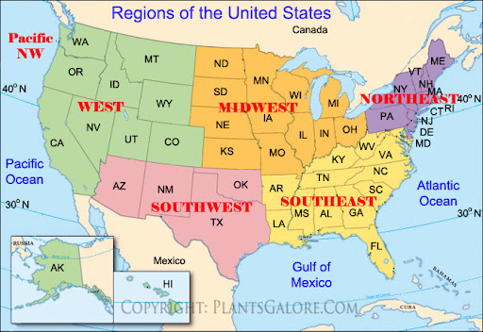
What is the Final Purpose of Our Study?
TO ASSESS! Our goal is to assess the radiological facilities across the United States for Radiological Security and Safety Culture.
To answer the following questions:
  How do such factors as the size, type, and location of the facility impact safety and security culture?
  Are larger medical center employees better trained in RAM transit than smaller medical centers?
  Are there any patterns in the distribution of safety and security culture strengths/weaknesses?
  How can facilities act on the research findings to enhance their safety and security culture?

Slide 12
In Conclusion ….
  The ultimate purpose of our research is enhancing security culture at radiological facilities
  Privacy concerns should not be a barrier to facilities participating in the study. Our published results will fully maintain the anonymity of the respondents – the names or other potential identifiers of facilities will never appear in any publications or other disclosures
  Participating facilities may request constructive feedback from our research group on their survey assessment. Facilities that choose to do so may receive an analysis highlighting possible gaps in security culture
  Survey respondents will be eligible to participate in training sessions or webinars provided by our Center for Radiological and Nuclear Security that address security culture fundamentals
  For our research to provide the full scope of potential benefits, we need many more survey respondents. Your facility can make a difference by answering a ten-minute survey.

Slide 13
Questions?
Thank you!

