Slide 1
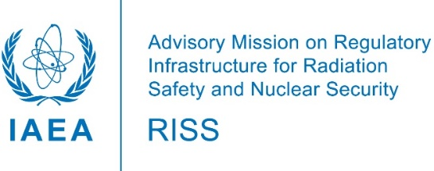
Advisory Missions on Regulatory Infrastructure for Radiation Safety and Nuclear Security (RISS) Vasiliki Kamenopoulou and Ronald Pacheco, IAEA/NS/NSRW Luisa Aniuska Betancourt Hernandez and Alessia Rodriguez y Baena, IAEA/NS/NSNS
definition
process
documents
scope
objectives
pictures
International Conference on the Safety and Security of Radioactive Sources, Vienna 20-24 June 2022

Slide 2
RISS what is?
A service of IAEA to raise awareness and provide high-level advice to States on the need to establish or strengthen regulatory infrastructure for radiation safety and nuclear security in line with IAEA publications.
Basis: the IAEA Safety Standards, the Nuclear Security Guidance and the relevant international instruments. In particular:
Click on the boxes
Countries: at the very early stages of developing a national regulatory infrastructure for radiation safety and nuclear security.
Duration of the advisory mission: four to five days.
GSR Part 1 (Rev.1)
GSR Part 3
NSS 20
NSS 14
Code of Conduct on the Safety and Security of Radioactive Sources

Slide 3
RISS Scope
The scope of each mission is adjusted according to the specific needs and interests of the requesting State.
The scope can be tailored to cover safety or security or both and may also include regulatory aspects for radiological emergency preparedness and response.
Radiation safety refers to the safety of radiation sources (generators and radioactive material), whereas nuclear security refers to the security of radioactive material.

Slide 4
RISS Objectives
Evaluate the status of the regulatory infrastructure for radiation safety and nuclear security, including radiological emergency preparedness and response, as appropriate.
Provide advice on any identified needs for improvement.
Prepare a report with observations, recommendations and an action plan for strengthening the national regulatory infrastructure for radiation safety and nuclear security, including radiological emergency preparedness and response, as appropriate.

Slide 5
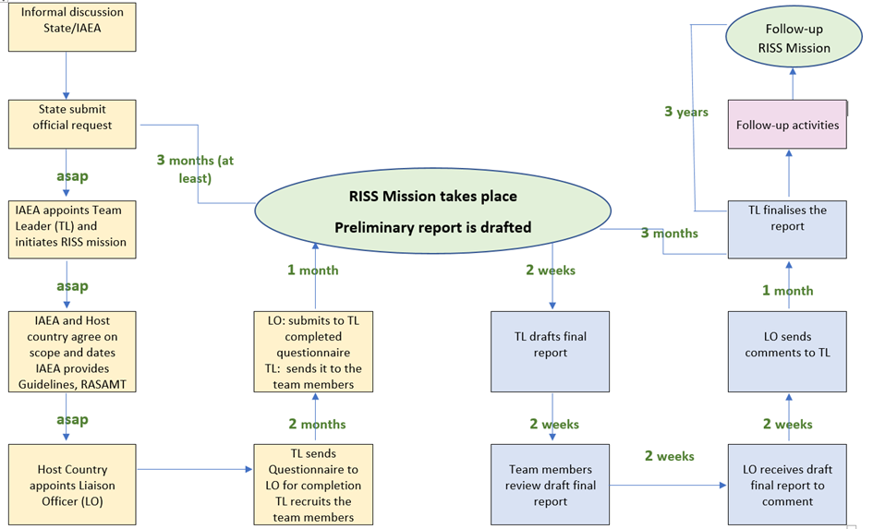
RISS Process

Slide 6
Official request: How to submit it
1. The request is to be addressed to the DDG NS:
Ms Lydie EVRARD
Deputy Director General
Head of the Department of Nuclear Safety and Security
International Atomic Energy Agency
Vienna International Centre, Wargamer Strasse 5,
PO Box 100, 1400 Vienna, Austria
Email: L.Evrard@iaea.org
2. In the request include:
(i) the scope: Safety, and/or Security, and/or EPR
(ii) the proposed dates
(iii) the designated RISS focal point (Liaison Officer) and his/her contact details.
3. The request needs to be sent through official channels.

Slide 7
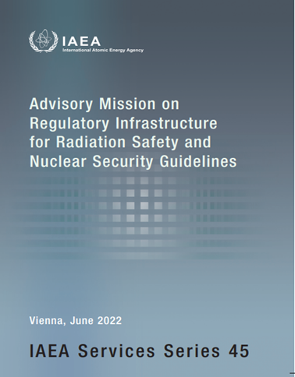
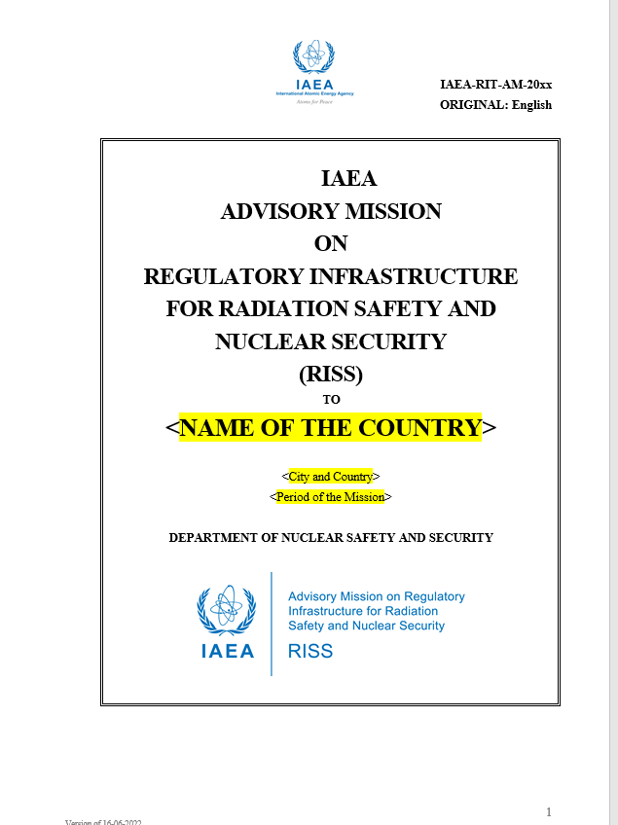
RISS Important Documents
Guidelines
Questionnaire
Report Template

Slide 8
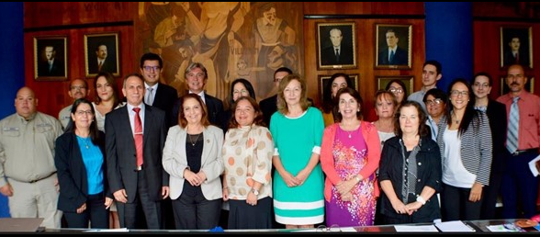
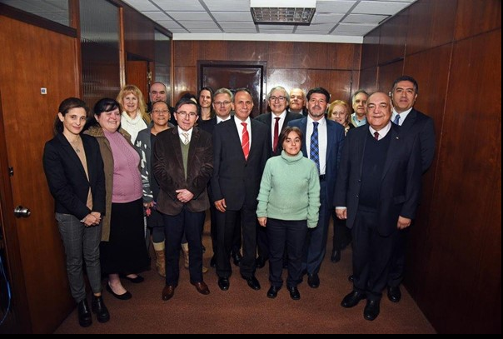
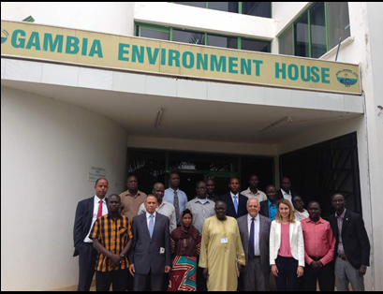
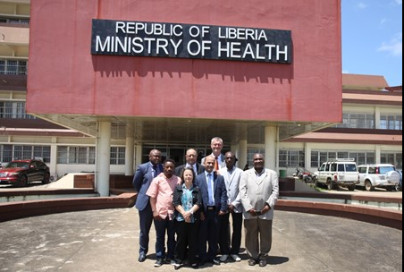
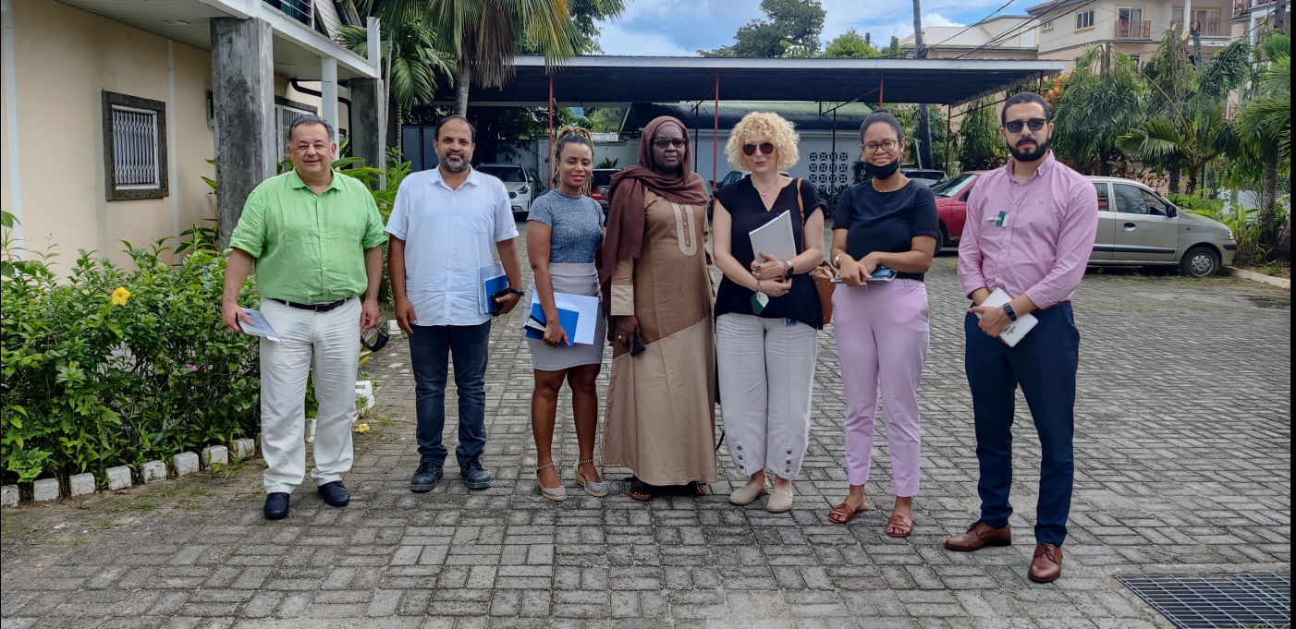
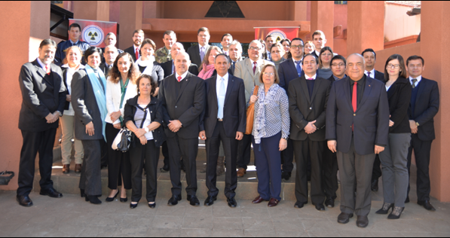
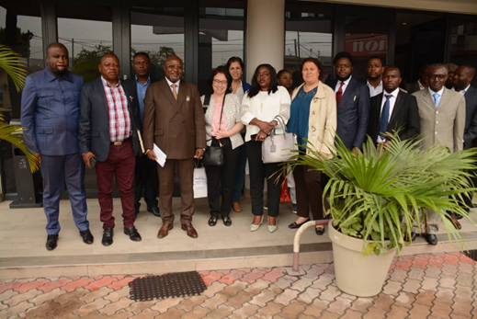
Costa Rica
Gambia
Uruguay
Liberia
DRC
Seychelles
Paraguay
Thank you

