Slide 1
Challenges of Inspection Program related to Activities and Facilities with Radiation Sources Helena Janžekovič , helena.janzekovic@gov.si IAEA IC on the Safety and Security of Radioactive Sources: Accomplishments and Future Endeavours 20–24 June 2022, Vienna, Austria
Inspection of facilities and activities with radiation sources is one of the core functions of RB.
Inspections are one of the most visible activities of RB as outcomes of inspections are under constant supervision of the general public.
Inspection of a complex facility
Inspector‘s rights and obligations
Building an inspection program
Who is an inspector?

Slide 2
Challenges of Inspection Program related to Activities and Facilities with Radiation Sources Helena Janžekovič , helena.janzekovic@gov.si Challenge No. 1: Who are inspectors?
There is no particular education for radiation safety inspectors, i.e., there is no school or internationally agreed program for inspectors.
RBs try to cope with this lack by recruitment of persons with technical background, e.g., physicist and other engineers, very often with MSc and PhD.
RB might recruit inspectors from the pool of RB staff already involved in authorization process.
As a rule, newcomers receive:
on job training including „self training“*;
training on inspector‘s duties and obligations;
training in radiation safety.
* using video materials about radiation sources available on the web
How to perform measurements?
How to check functionalty of a safety system?
How to implement justification and optimisation at inspections?
etc.
BACK

Slide 3
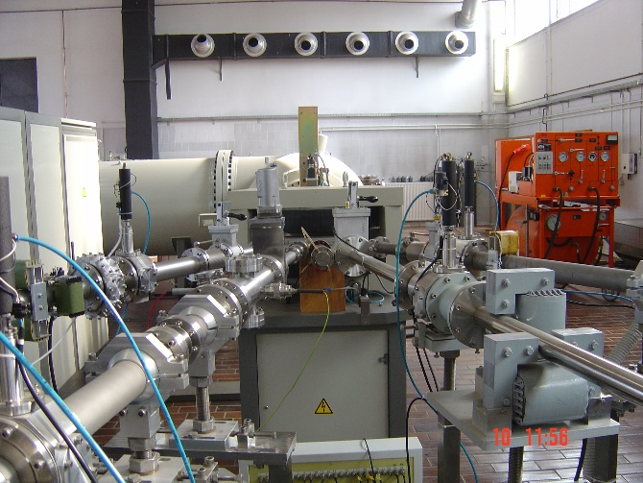
Challenges of Inspection Program related to Activities and Facilities with Radiation Sources Helena Janžekovič , helena.janzekovic@gov.si Challenge No. 2: How to inspect complex or „first of that kind“ operator?
As facilities are becoming more complex, safety requirements are becoming more complex.
Graded approach as demonstrated in IAEA TECDOC-1526 shall be applied.
The inspection program might be challenged by:
complexity of facility or activity e.g., industrial irradiator and nuclear medicine;
facility or activity which is „first of that kind“ in a state e.g., new industrial accelerator.
The challenges might be also known by RBs with already established programs.
Who has enough technical knowledge to cope with a complexity of a facility?
How to train inspectors on emerging technology using radiation sources?
Inspectors shall be specialised when inspecting high risk activities.
BACK

Slide 4
Challenges of Inspection Program related to Activities and Facilities with Radiation Sources Helena Janžekovič , helena.janzekovic@gov.si Challenge No. 3: Inspector‘s rights and obligations
The inspector shall have good knowledge of:
technology related to radiation sources and radiation safety*;
national requirements related to safety*;
overall legal system in the state including inspector‘s rights and obligations.
Note: Countries apply different arrangements regarding safety and security, e.g., several authorities might be involved.
Questions to be asked by an inspector:
Do I have a legal power to inspect this particular safety issue*?
What kind of safety requirements* exist regarding this particular issue?...
* and security as appropriate.
BACK

Slide 5
Challenges of Inspection Program related to Activities and Facilities with Radiation Sources Helena Janžekovič , helena.janzekovic@gov.si Challenge No. 4: Building an inspection program
Technical complexity of facilities and activities and extensive legislation contribute to complexity of inspections.
This challenge can be overcome by a systematic approach to building an inspection program.
How to establish effective and efficient inspection program?
Tip No. 1: Work with others
Tip No. 2: Learn using campaigns
Tip No. 3:
Use procedures
BACK

Slide 6
Challenges of Inspection Program related to Activities and Facilities with Radiation Sources Helena Janžekovič , helena.janzekovic@gov.si Good practice when building an inspection program: Work with others
Cooperation with others includes at least:
cooperation of inspection and authorization units in particular during a preparation of an inspection;
briefing inspector’s team before going on site about specific goals of an inspection and methods to be used including enforcement steps to be taken on site or when coming back to the office;
cooperation with other experts accompanying an inspector e.g., experts from TSOs as noted in IAEA TECDOC-1835;
cooperation with other inspection units, sharing experience and learning from others;
providing positive and negative feedback from inspections to other regulatory core processes…
BACK

Slide 7
Challenges of Inspection Program related to Activities and Facilities with Radiation Sources Helena Janžekovič , helena.janzekovic@gov.si Good practice when building an inspection program: Use inspection campaigns to learn
Inspection campaign is a set of inspections conducted in a limited time, e.g., one year, dedicated to different operators who perform same or similar type of activity with radiation sources.
Implementation of inspection campaigns allows inspectors to gain experience in a specific area, e.g., industrial radiography, nuclear gauges and handling smoke detectors with radioactive sources.
Campaigns have several other benefits:
Operators inform each other about safety requirements to be
implemented and put them in place even before an inspection.
Campaigns contribute to a visibility of inspections and the RB.
They also demonstrate the impartiality of the RB…
BACK

Slide 8
Challenges of Inspection Program related to Activities and Facilities with Radiation Sources Helena Janžekovič , helena.janzekovic@gov.si Good practice when building an inspection program: Use procedures
Consistency of inspectors in their activities is achieved by using procedures, e.g., on:
technical guidance how to conduct regular and reactive on-site inspections of specific activity with radiation sources, e.g., visual observations and measurements and prioritization of observations;
enforcement, follow-up activities and involvement of legal advisers;
managing documentation related to inspection and enforcement…
BACK

Slide 9
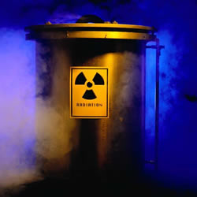
Challenges of Inspection Program related to Activities and Facilities with Radiation Sources Helena Janžekovič , helena.janzekovic@gov.si Conclusions
Establishing an effective and efficient inspection program dedicated to safety and security of radiation sources is always a challenge.
Learning and questioning attitude to be exercised by the inspection unit as well as by each individual inspector is a prerequisite to overcome this challenge.
Thank you!
BACK

