Slide 1
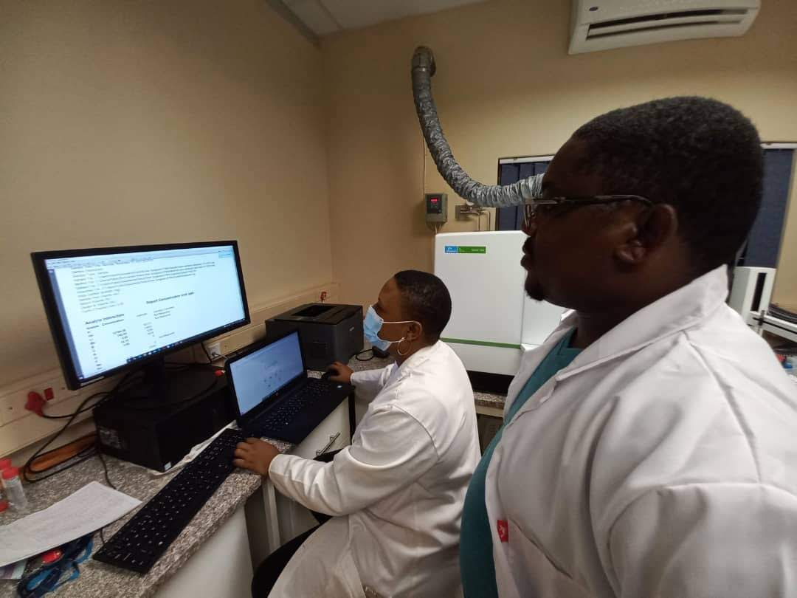
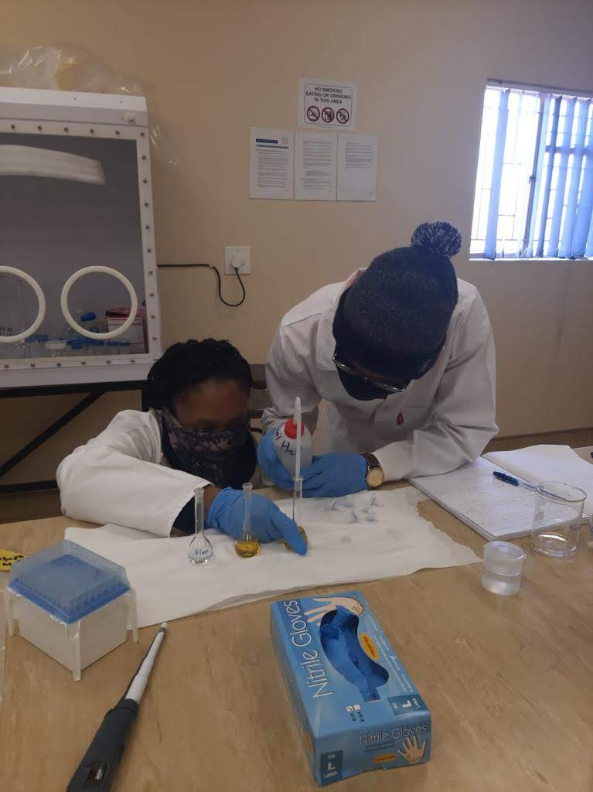
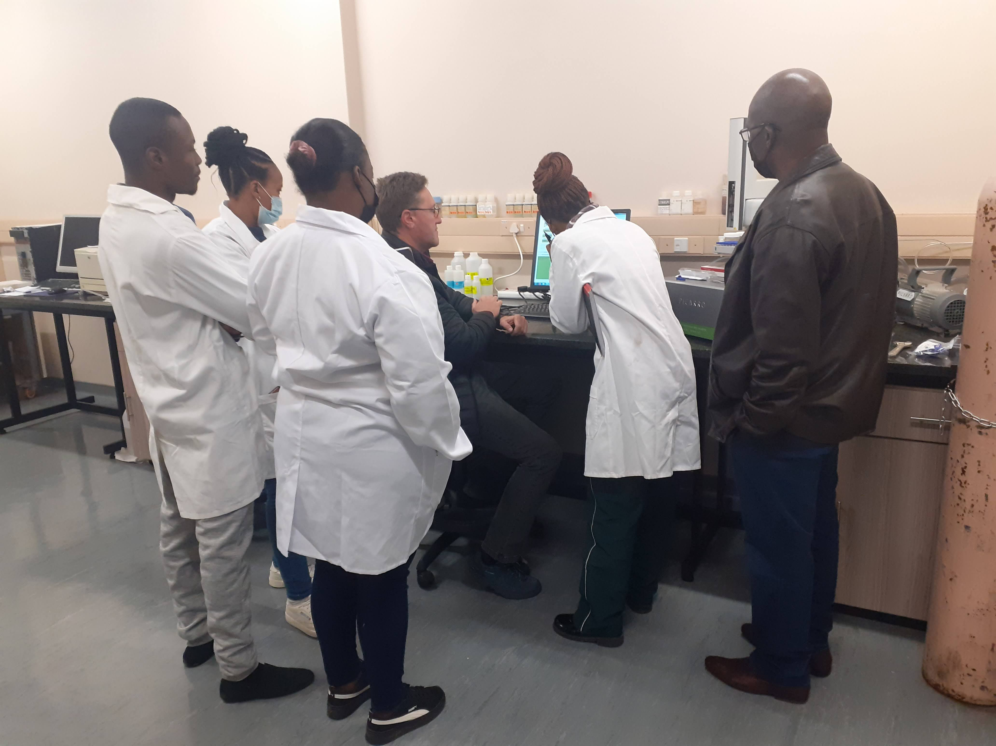
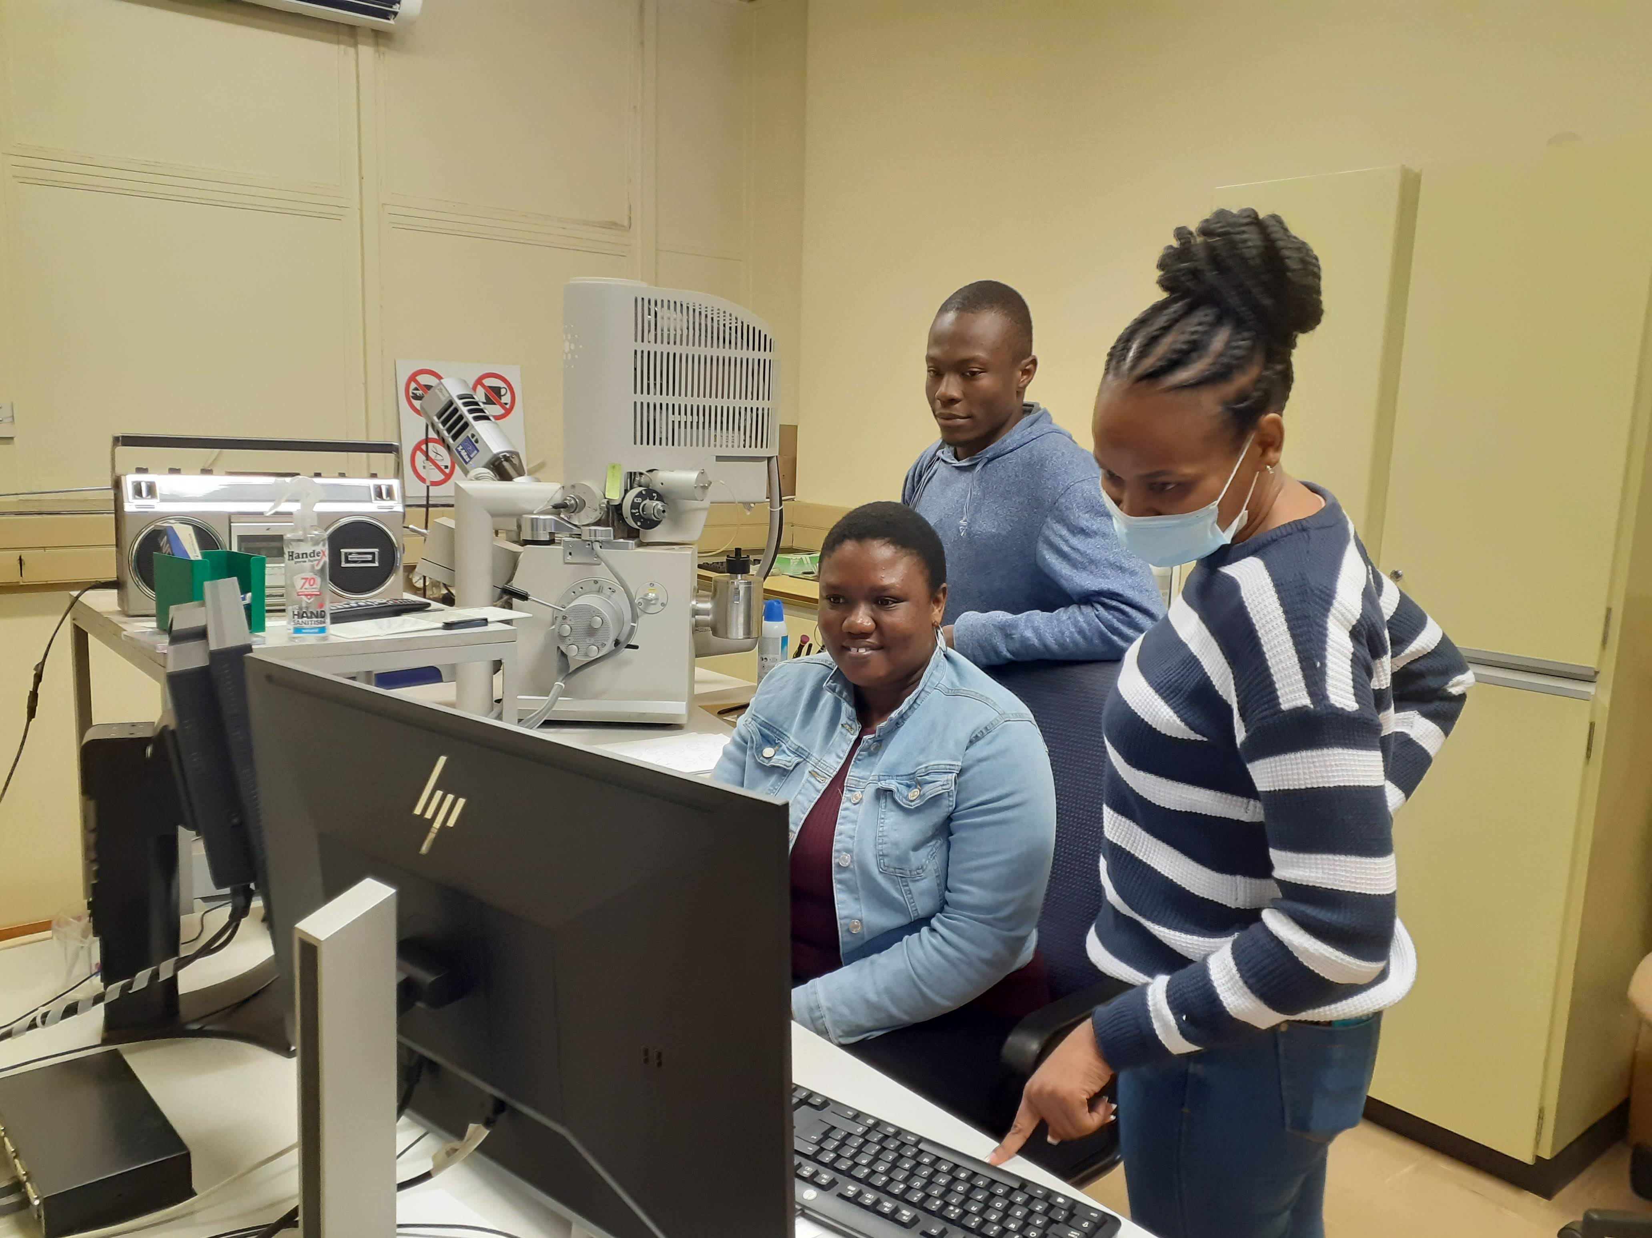
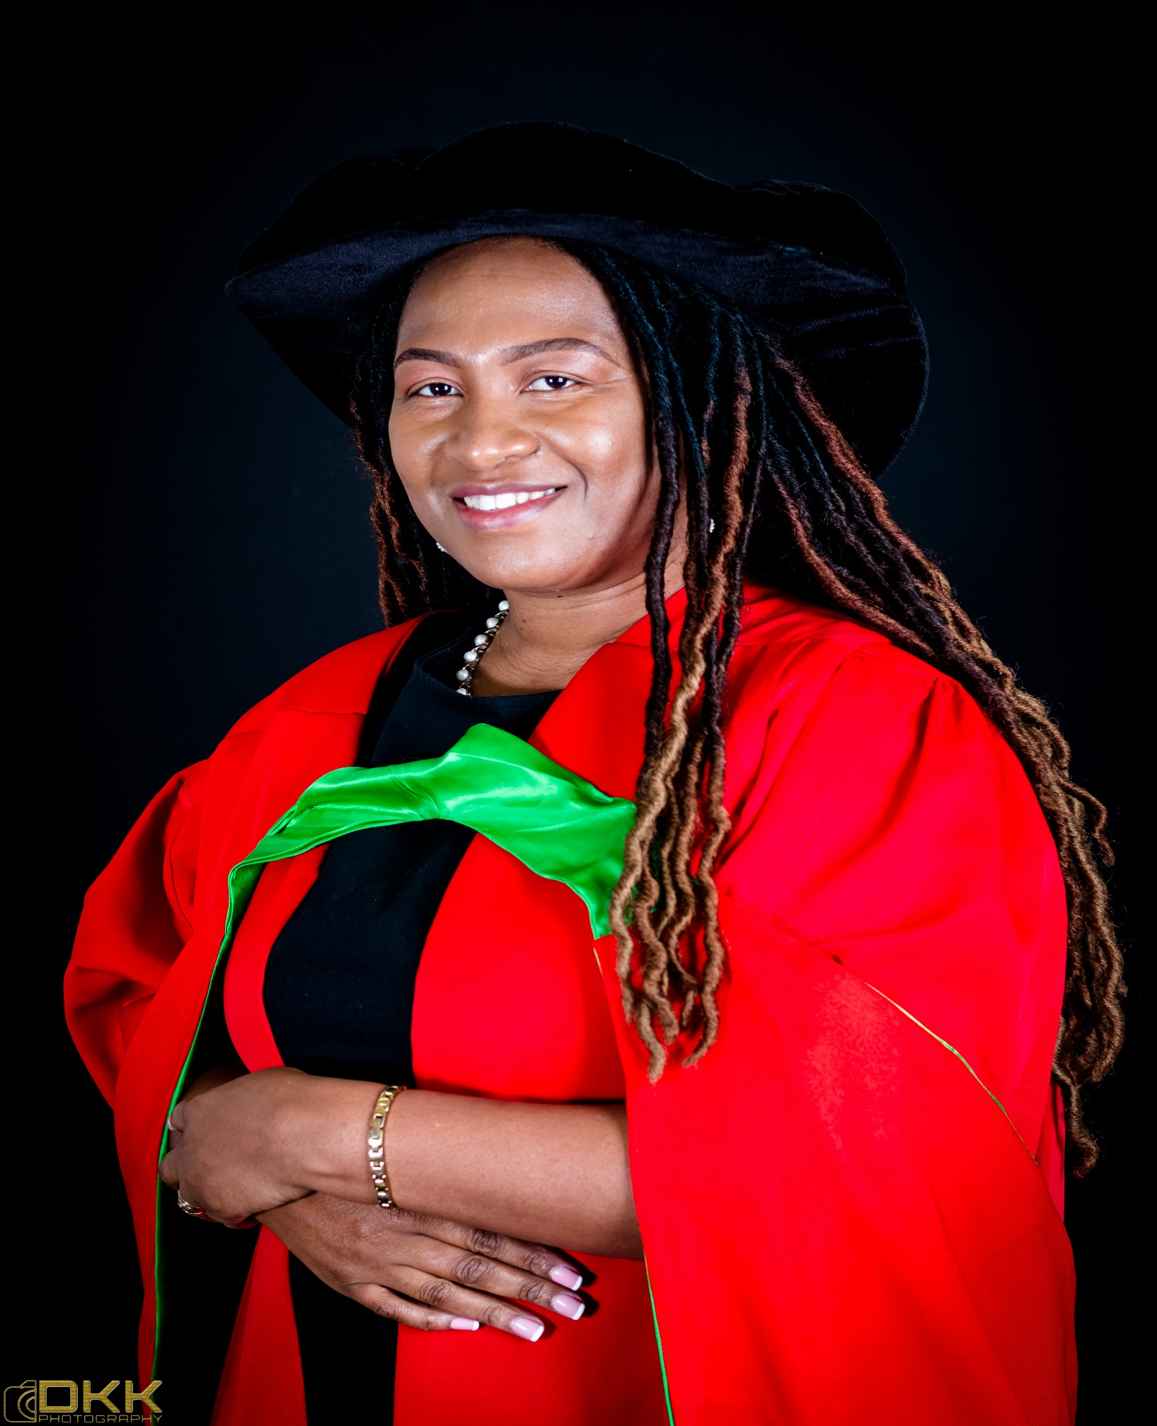
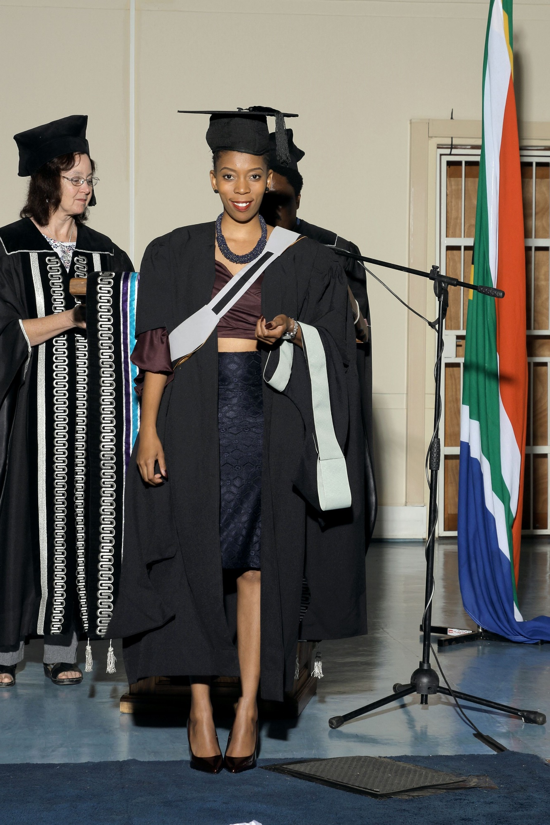
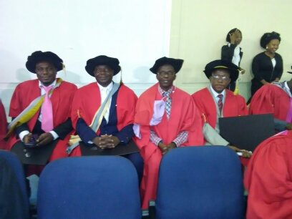
International Conference on Safety and Security of Radioactive Sources – Accomplishments and Future Endeavors #278
Strengthening the South African Network for Nuclear Education, Science and Technology through Postgraduate Training
Kgabo Seemela*, Naomi D. Mokhine*, Manny Mathuthu*, Margaret Mkhosi**
*Center for Applied Radiation Science and Technology (CARST), North-West University (Mafikeng), 4 Mmabatho, 2735, South Africa. Tel: +278 18 389 2777
**National nuclear regulator, Pretoria, South Africa
Abstract
This work investigated the training of Postgraduate students at the Centre for Applied Radiation Science and Technology (CARST), via a project on alkaline extraction of uranium. The aim of this research was to evaluate organic extraction ligands that can operate in alkaline media to remove uranium from the nuclear waste and the objective was to characterize the most effective organic solvent for extracting uranium only, from alkaline media. Uranium oxide was dissolved in ammonium carbonate solution to form the uranium tri-carbonate aqueous feed solution. Results showed that 0.2 M of ammonium carbonate and 0.01 M uranium at volume ratio of 1:5 to be the highest extraction parameters that can be used to extract uranium with a percentage of 98%. This has resulted two MSc graduates and one PhD Graduate by July 2022.
Post graduates from CARST trained on ICP-MS (left), and students performing experiments
Post graduates from CARST trained on Picarro equipment for water isotope analysis (left), and trained on SEM/EDS at NWU-Potchefsrtoom campus
Background
Nuclear Education and Knowledge management are still a challenge to many Institutions in South Africa. Skilled personnel are mandatory to Manage radioactive waste generated during the operation of nuclear facilities, in medicine, industry and other fields imposes a serious problem needing further development of nuclear technology and nuclear energy worldwide (1).
The processes applied for the purification, concentration 39 and subsequent recovery of uranium from nuclear waste, include ion-exchange (IX), direct precipitation or solvent 40 extraction (SX)(2).
It must be treated to reduce the volume of radioactive substances, enabling stabilization and then long-term storage or final disposal.
It has thus become necessary to extract uranium from the waste before final disposal.
The acid route is generally used in the industry to dissolve uranium powders and uranium is then purified by using liquid-liquid extraction processes (3).
This technique is used in order to increase the proliferation resistance features of the reprocessed nuclear waste (4).
Alkaline dissolution using carbonate medium is being considered as an alternative technique for uranium extraction in order to reduce corrosion as a secondary problem (5). The aim of this research project was to develop an alkaline extraction technology that can be used to purify uranium from post reactor, in order to capacitate our radioactive waste Scientists with an alternative technique.
Different students in the SADC Region were registered for training in nuclear forensics using ICP-MS & SEM equipment in our Labs.
Conclusion
The Centre for Applied Radiation Science and Technology (CARST) is now the Co-Coordinator of the South African Network for Nuclear Education, Science and Technology (SAN-NEST)
CARST has participated in the IAEA Expert Mission Visit to Mauritius
The Centre is also participating in the IAEA – DMRE Nuclear Knowledge Management School running from 20 June 2022 to 01 July 2022.
These are our examples of strengthening postgraduate training in NEST Programme
A total of 6 PhDs and 10 MSc are graduated annually from CARST
Post graduates from SA(Top left) and Top Namibia (right), Zimbabwe (From L-R), Ghana and Swaziland)

