Slide 1
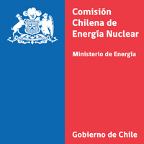
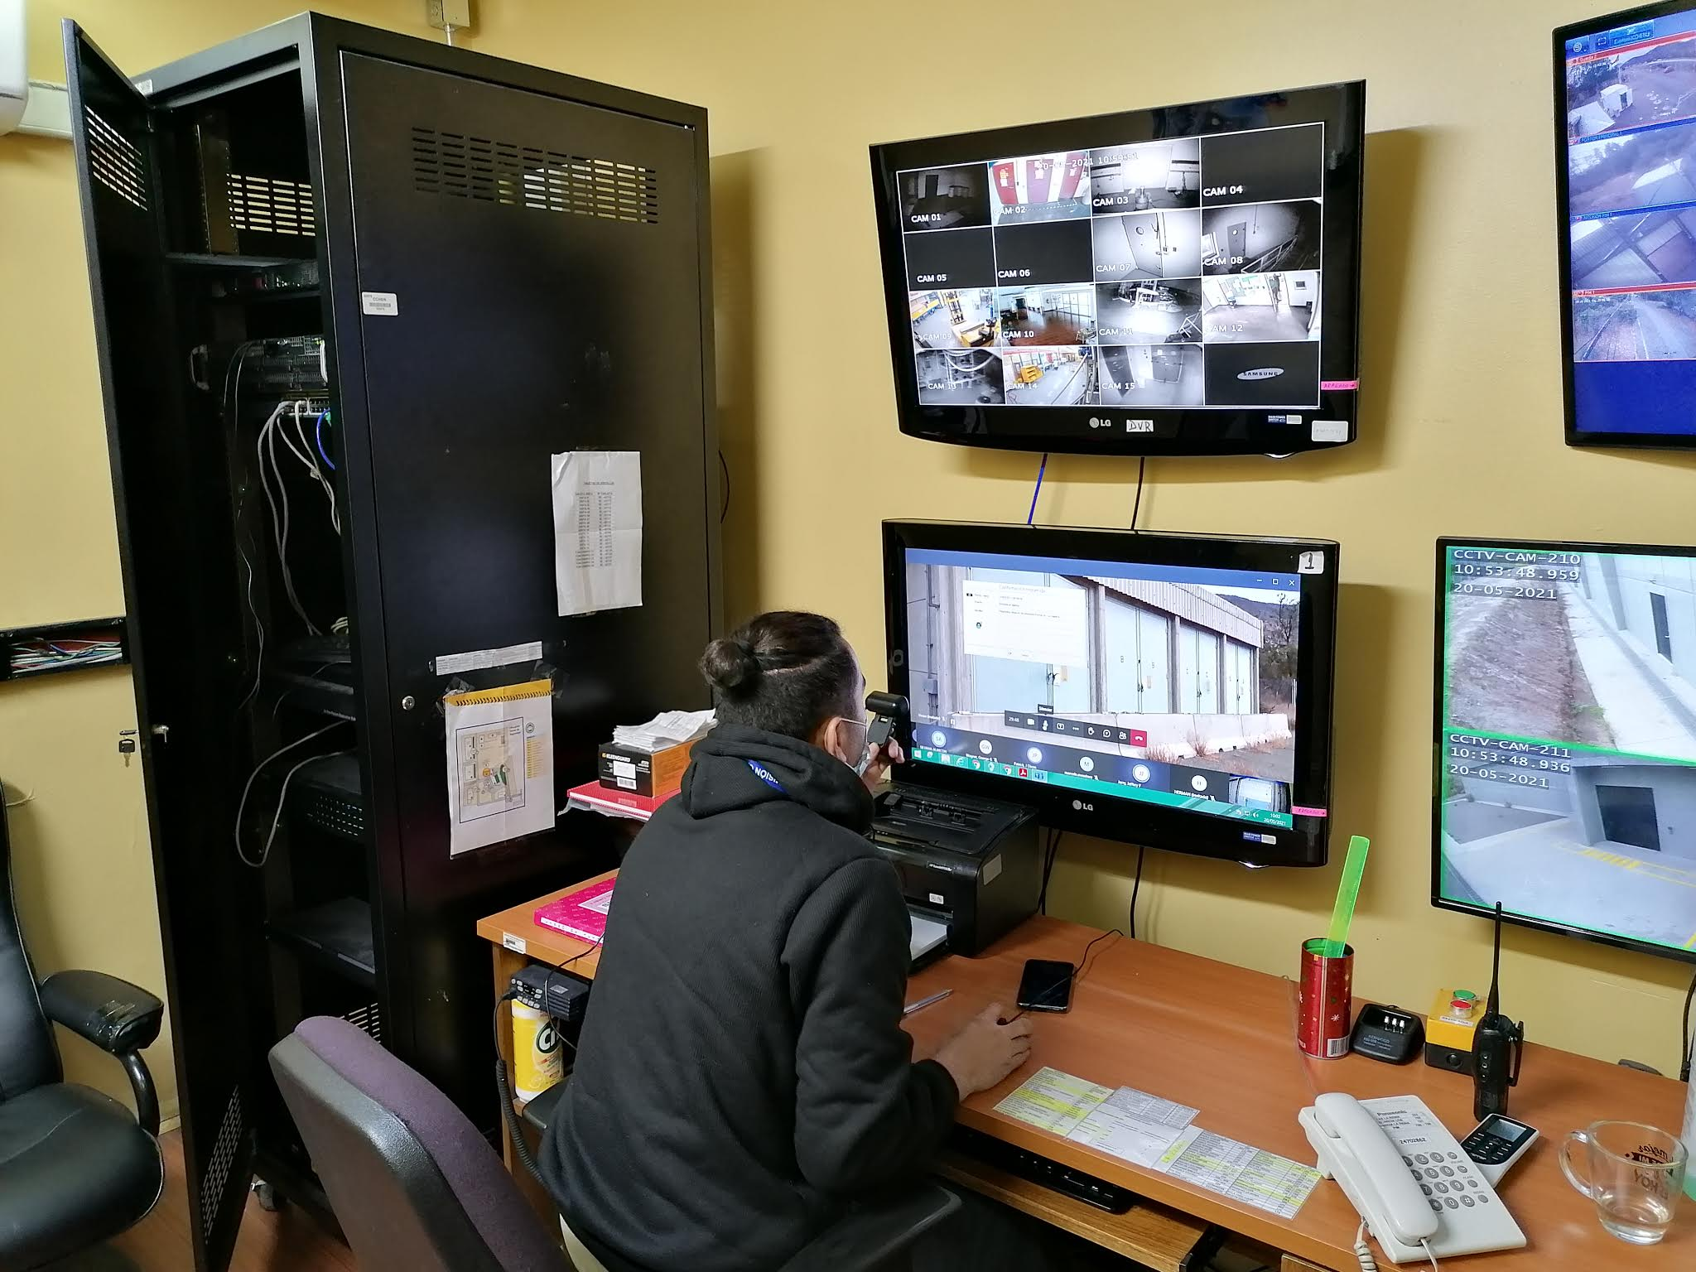
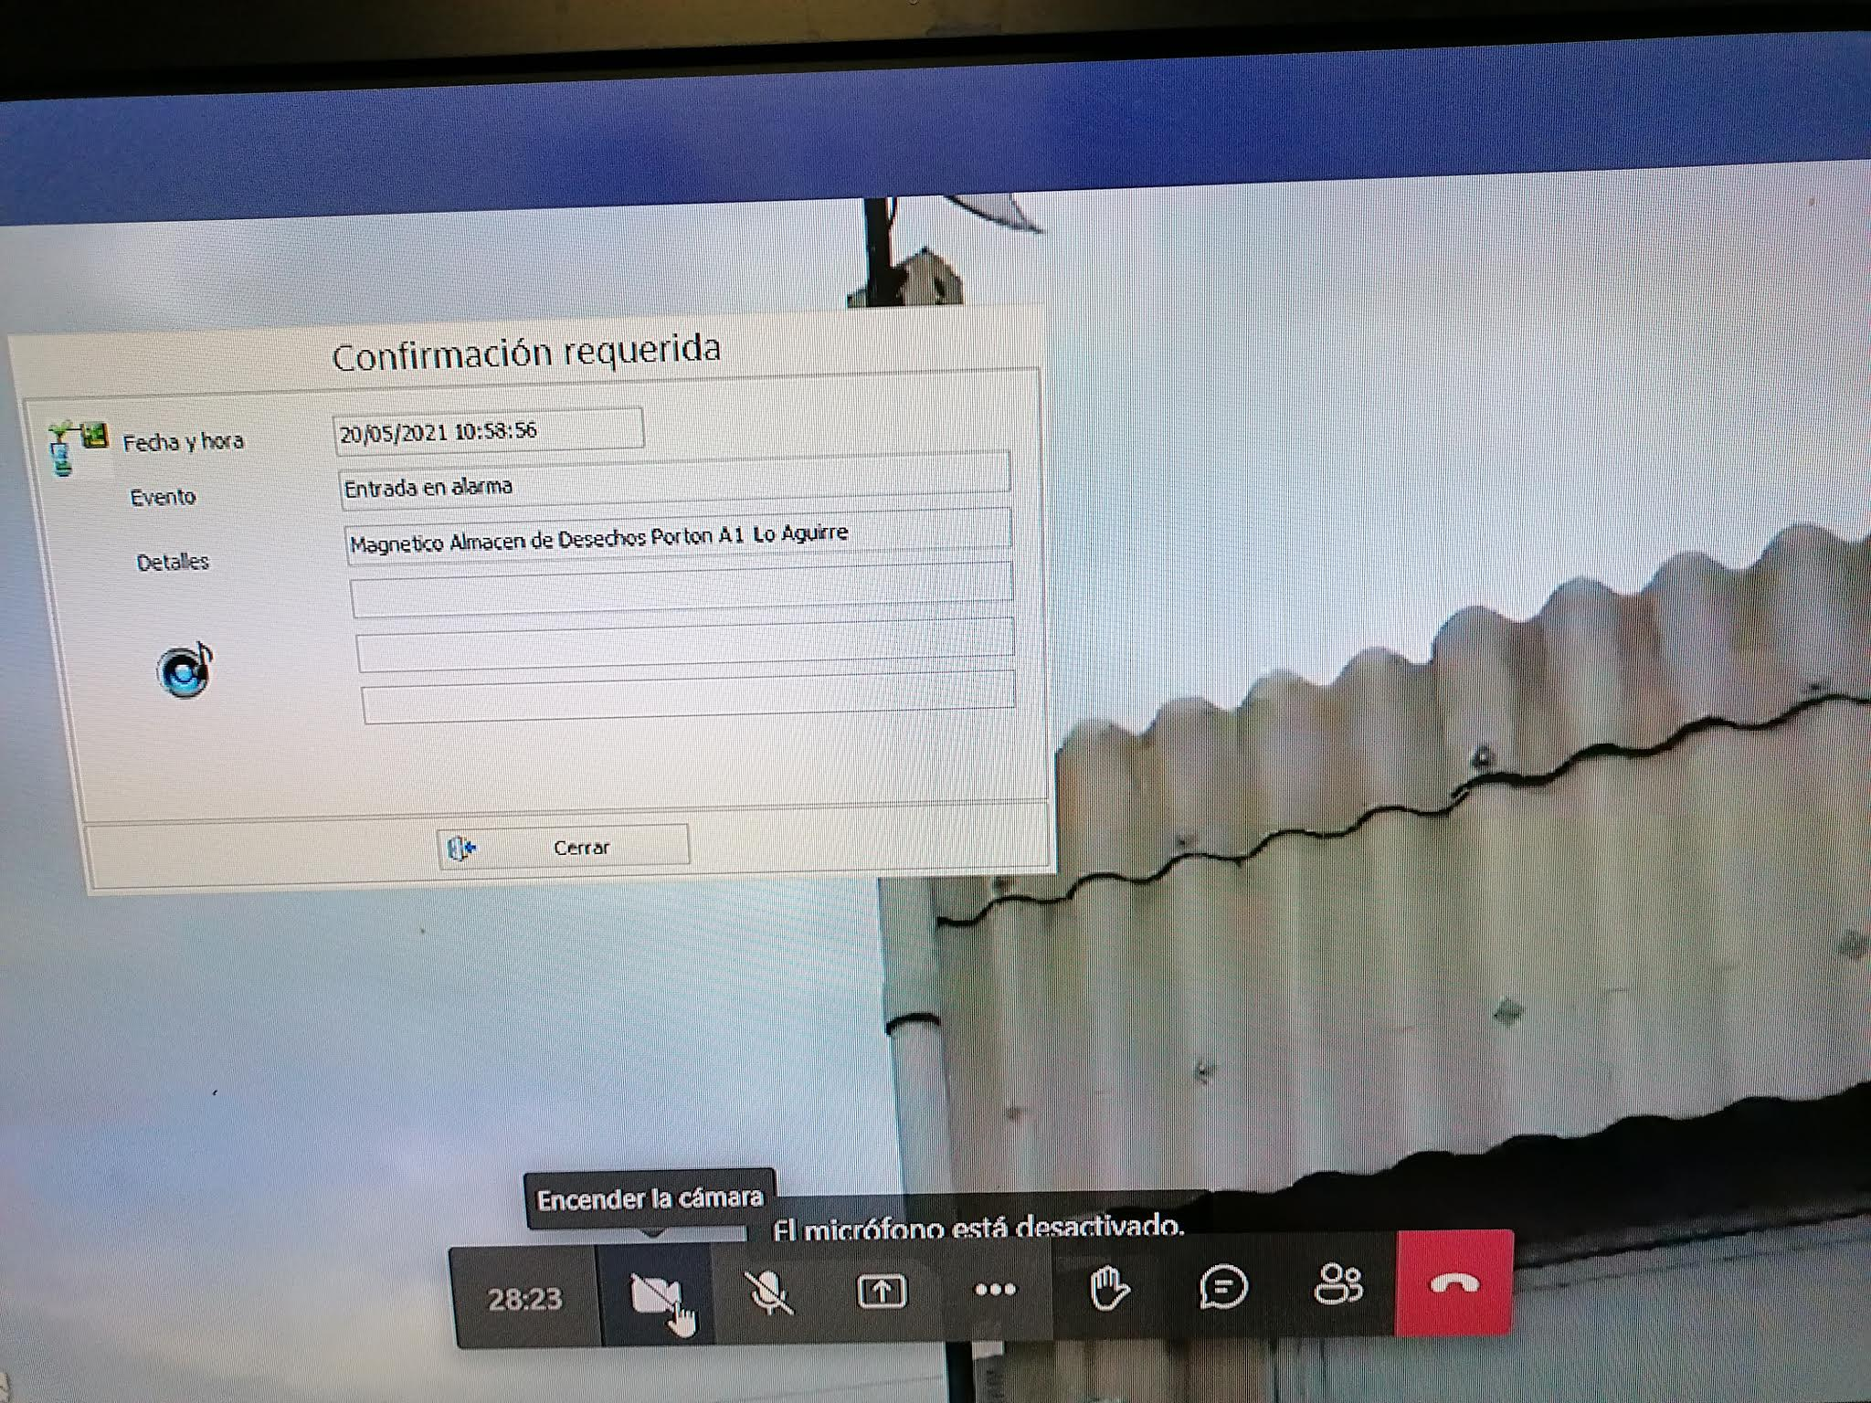
VIRTUAL TESTING:
CHECKING THE PHYSICAL PROTECTION SYSTEM OF THE CCHEN FACILITIES IN THE PANDEMIC TIME
Authors: Herman Zárate Segovia and Sergio Díaz Olate
Chilean Nuclear Energy Commission
herman.zarate@cchen.cl; sergio.diaz@cchen.cl
INTRODUCTION
In the framework of the continuous cooperation and support among the Department of Energy of the United States (DOE-US) and their Laboratories associated, and the Chilean Nuclear Energy Commission (CCHEN), was carried out a “Virtual Testing” to check the physical protection system (PPS) in the Lo Aguirre Nuclear Center of CCHEN. This kind of activity was planned, due to several international and national restrictions for the COVID-19 pandemic.
VIRTUAL TESTING
The program of this Virtual Testing was developed between personal of Sandia National Laboratories and CCHEN, to check the PPS in the following facilities: waste storage, military guard, center of alarms (CAS), reactor, irradiator, fabrication of fuel elements and conversion. For this purpose we used a platform for virtual conference, facilitated for Sandia. It was carried out in May 2021, in two days, to get check all the components of the PPS.
Every day started with an initial meeting to introduce the day activities and to arrange details, and then we went visiting to the facilities to test each physical protection components, the interface with the CAS and response for nuclear security events. At the end of the day, we had a final meeting to debrief the job. Finally, we had a meeting with professionals of Sandia and the Executive Director and Authorities of CCHEN, to present the results and establish a statement of work, SOW. This SOW is running, and the 1st stage are finishing. Personnel of SANDIA LABS was in CCHEN this last May 31^{st,} to check the project implementation.
TESTING THE SYSTEM
Picture 1. Testing CAS Alarm and Storage Facility
Picture 2. Testing CAS Alarm and Storage Facility
Alarm report
Supervisor of PPS in connection
with Operator in the Storage Facility
Virtual Meeting with SANDIA LABS,
by MEET Platform
CONCLUSION
The virtual testing was a good way to keep our system in evaluation and improvement, at this pandemic time, however, should be considered a complement and not a replacement of the revision activities face to face.
The Chilean Nuclear Energy Commission appreciates the continued support of the DOE-US and laboratories.
Poster Ref. Number: #309 – CN-295
International Conference on the Safety and Security of Radioactive Sources– IAEA – Vienna, Austria – 20 to 24 June 2022

