Slide 1
DESIGNED FOR SAFETY: 380-b TYPE B(U) PACKAGING FOR DISUSED RADIOACTIVE SOURCE RECOVERY
June, 2022
Mark Wald-Hopkins
Rebecca Coel-Roback
Frank Cocina
Wade Weyerman
Todd Bauer Los Alamos National Laboratory
Temeka Taplin National Nuclear Security Administration
Philip Noss
Orano Federal Service

Slide 2
Introduction
The Off-Site Source Recovery Program (OSRP)
Development of the 380-B
Design
Payloads
Safety Features
Operational Use

Slide 3
OSRP Mission and Accomplishments
Mission: Recover excess, unwanted, abandoned, and orphaned radioactive sealed sources in the interest of global security and public health/safety
OSRP has contributed to national and global security by removing more than 45,000 radioactive sources, totaling over 54,007 TBq of material.
OSRP has removed sources from 27 countries worldwide.
Isotope | Sources Recovered | TBq Recovered
⁶⁰Co | 6,772 | 12,715
⁹⁰Sr | 314 | 26,106
¹³⁷Cs | 5,506 | 13,854
²³⁸Pu | 2,546 | 596
²³⁹Pu | 1,193 | 50
²⁴¹Am | 26,311 | 665
All Others | 2,988 | 14
TOTALS | 45,710 | 54,007
OSRP is sponsored by the NNSA Office of Radiological Security (ORS), NA-212

Slide 4
Cat 1 and 2 Devices Commonly Recovered by OSRP
Self-shielded irradiators, primarily Cs-137 and Co-60, 4.81 TBq to 148 TBq decayed
High-Activity Beta/Gamma Devices
Gammacell 1000 |  | Gammacell 3000 |  | IBL 437c |  | Gammacell 40
 | Isotope: Cs137 Max. Activity: 120 TBq Weight: 1,361 kg |  | Isotope: Cs137 Max. Activity: 120 TBq Weight: 1,588 kg |  | Isotope: Cs137 Max. Activity: 208 TBq Weight: 2,018 kg |  | Isotope: Cs137 Max. Activity: 155 TBq Weight: 3,175 lbs
Gammacell 200/220 |  | J.L. Shepherd 143 |  | J.L. Shepherd Mark 1 |  | Theratron 780
 | Isotope: Co60 Max. Activity: 977 TBq Weight: 3,742 kg |  | Isotope: Cs137 Max. Activity: 122 TBq Weight: 907 kg |  | Isotope: Cs137 Max. Activity: 833 TBq Weight: 1,361 kg |  | Isotope: Co60 Max. Activity: 496 TBq Weight: 2,495 kg

Slide 5
Type B Container Development
In 2004, the U.S. NRC revised regulations to harmonize with the IAEA’s 1996 edition of “Regulations for the Safe Transport of Radioactive Material” (IAEA Safety Standards Series No. TS-R-1).
As a result, a number of Type B packaging models used by OSRP and industry for Type B shipments were phased out of use in October 2008.
NNSA’s Office of Radiological Security directed OSRP to design, test, certify and fabricate new Type B container models in anticipation of upcoming shortages of compliant containers.
NNSA and OSRP began work on the 380-B container in 2009.
OSRP worked with federal entities, industry experts, the IAEA and a other stakeholders over the course of a decade to bring the 380-B into operation.

Slide 6
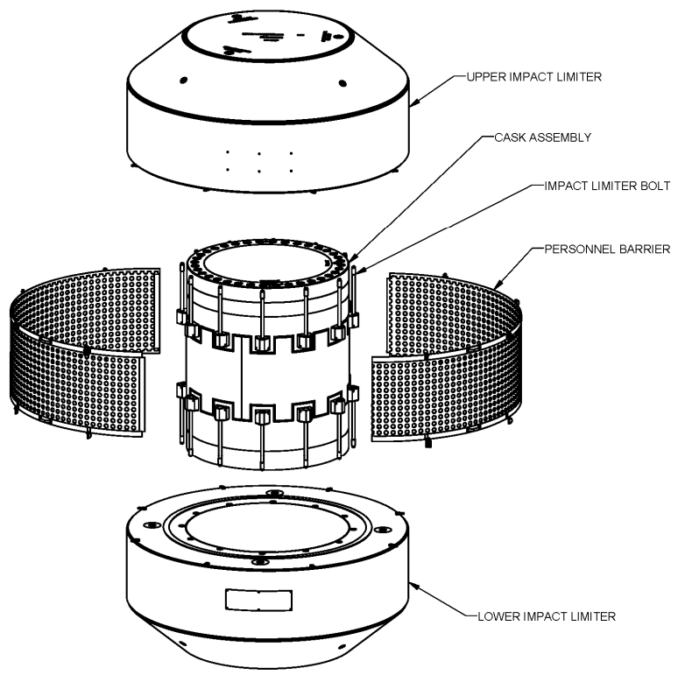
380-B Design
Leak-tight.
Lead shielded cask body and closure lid.
Upper and lower impact limiters filled with polyurethane foam.
Conventional materials and fabrication techniques.
When prepared for shipment:
3 m tall
2.5 m diameter
Maximum 30,391 kg
Shipped by ground on a dedicated trailer.

Slide 7
380-B Payloads
Transportation of sealed sources used for industrial, medical, and research purposes.
Maximum decay heat in the package is 205W
No shielding credit is taken for the devices during transportation
Maximum total device weight is 4,536 kg
Nuclide | Maximum Activity (TBq)
Co-60 | 285
Cs-137 | 1505
Sr-90 | 1132
Ra-226 | 41
Ra-226/Be | 0.2
Ir-192 | 1233

Slide 8
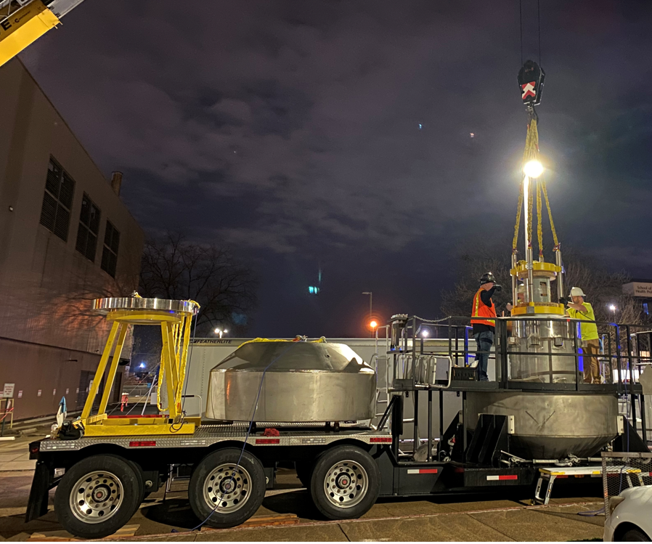
Custom Safety Features
380-B work platform. The 380-B is mounted on a dedicated trailer where it remains during source recoveries. For the crew to work safely around the 380-B during loading/unloading of payloads, a custom metal work platform was designed, fabricated, and installed on the dedicated trailer. With the railings in place, the crew can comfortably move around the 380-B during operations without the use of ladders, thus enhancing worker safety and improving operational efficiency.

Slide 9
Custom Safety Features
380-B lid and impact limiter stands. These stands were designed to be used on the dedicated trailer during source recovery operations. In addition to providing clean, controlled surfaces for these major 380-B components, they also serve to increase safety during their required inspections and radiological surveys. Inner surfaces of the lid and impact limiter can be inspected while on the stands, eliminating the need to work under suspended loads, thus enhancing worker safety.

Slide 10
Custom Safety Features
380-B dunnage assembly. To control unwanted movement of radioactive payloads during transportation, a custom dunnage assembly was designed and fabricated. This assembly is modular and customizable in design which allows for loading of devices of different shapes and sizes. It is loaded with the payload outside of the 380-B cavity. Once the payload is enclosed in the dunnage assembly, the full assembly (payload and dunnage) is lifted as a single unit and loaded into the 380-B cavity. This design minimizes the number of required lifts during loading operations, thus enhancing worker safety and operational efficiency.

Slide 11
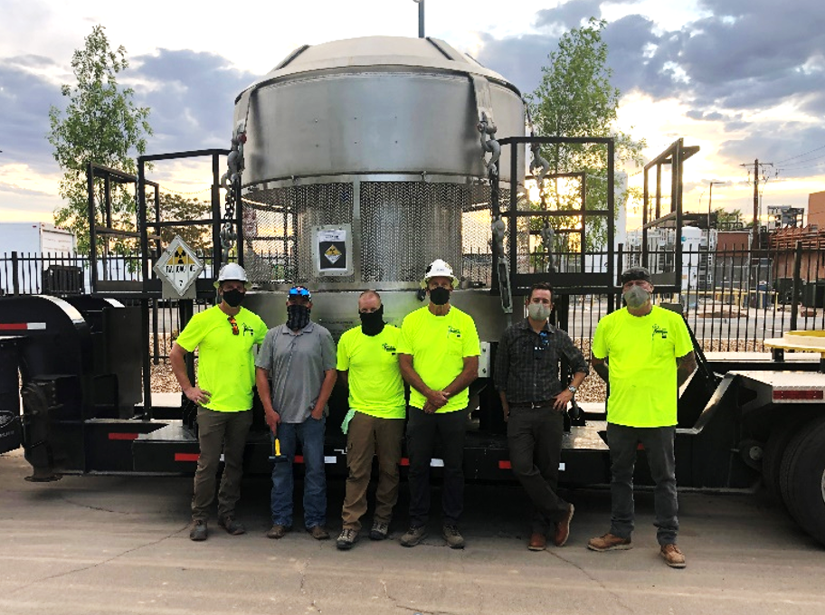
380-B Operational Use
First use in May 2021. Recovery of a Cs‐137 irradiator from a hospital in Albuquerque, New Mexico, more than a decade after container conceptualization.
The 380‐B operational procedure includes every step needed for safe and compliant operation of the container, and is a use‐every‐time procedure.
To date, the 380-B has been used to safely and compliantly recover over twenty high activity Cs-137 irradiators.
The container has proven to be highly robust and reliable and operational efficiency has markedly improved. Packaging evolutions that took eight hours during training can now be completed in five hours or less.
The custom equipment designed and fabricated for 380-B operations continue to function as intended and greatly enhance safety and security of OSRP’s source recovery work.
The reliability of the 380-B and custom equipment coupled with the extensive training and professionalism of operational staff, result in safe, secure, and efficient field operations.

Slide 12
ACKNOWLEDGEMENTS
Development of the 380-B and moving it into operations took an enormous effort and included multiple organizations and many individuals. We would like to acknowledge:
NNSA NA-212 and NA-531
LANL Carlsbad Office
Nuclear Waste Partnership
Orano Federal Services

Slide 13
Questions?

