Slide 1

US Transuranic Source Repatriation, Progress, and Accomplishments, 2010 - 2021
  J. Andrew Tompkins
  Conference of Radiation Control
  Program Directors (CRCPD)

Slide 2
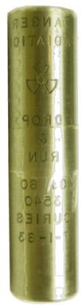
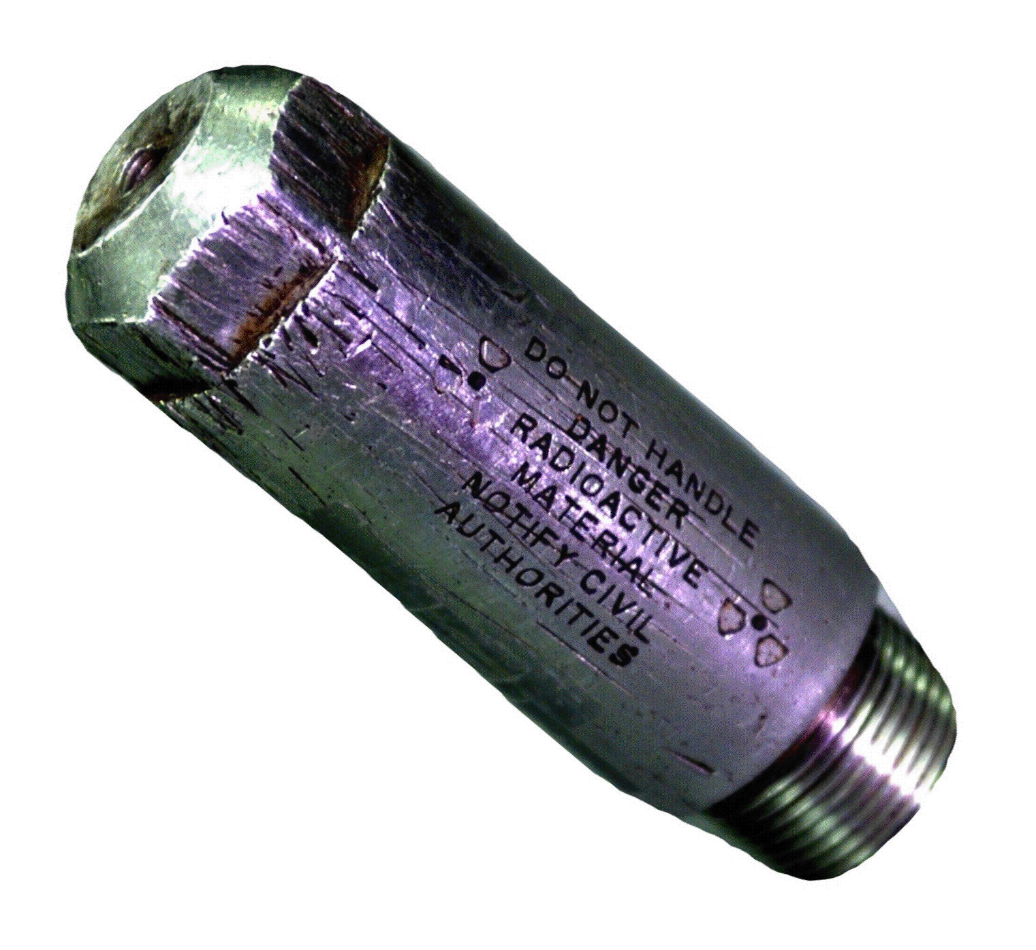
International Repatriation Background
The U.S. distributed radioactive material/sealed sources around the world under Eisenhower’s proposed “Atoms for Peace” in the early 1960s (including ²³⁹Pu, ²⁴¹Am, and ⁶⁰Co)
OSRP started in 1998 laid the groundwork for TRU source disposition in the USA
International source repatriations were approved in 2004 and began in 2005/2006
OSRP accepts only U.S.-origin sources on a case-by-case basis as directed by the Office of Radiological Security
Notes:
Since 2004 one manufacturer has made over 10,000 Russian origin 241Am sources (over 18,000Ci). Average of 1,000 non-US sources added annually. Typical source working life is 10-15 years.

Slide 3

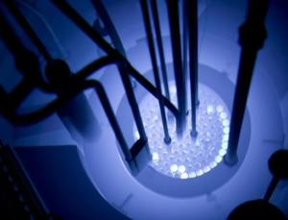
The Off-Site Source Recovery Program’s (OSRP) mission – 24 years of radioactive source disposition
OSRP is sponsored by the National Nuclear Security Administration’s (NNSA) Office of Radiological Security (ORS)
Since 1998, OSRP has recovered approximately 42,000 sources totaling more than 48,000 TBq (1.3M Curies)
²³⁸Pu | ⁹⁰Sr
²³⁹Pu | ¹³⁷Cs
²⁴¹Am | ⁶⁰Co
²⁵²Cf | ¹⁹²Ir
²⁴⁴Cm | ²²⁶Ra
Primary Isotopes Accepted by OSRP

Slide 4
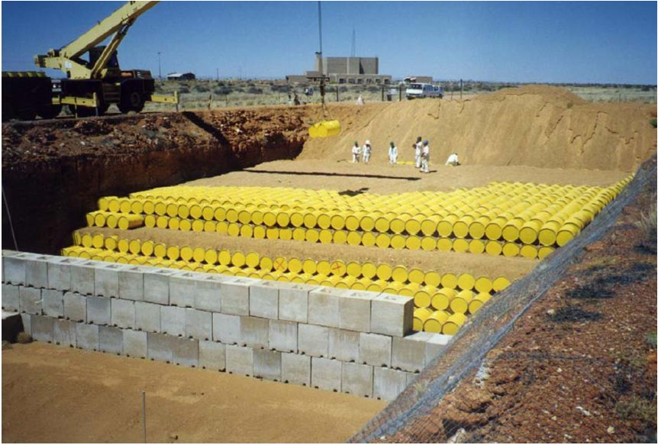
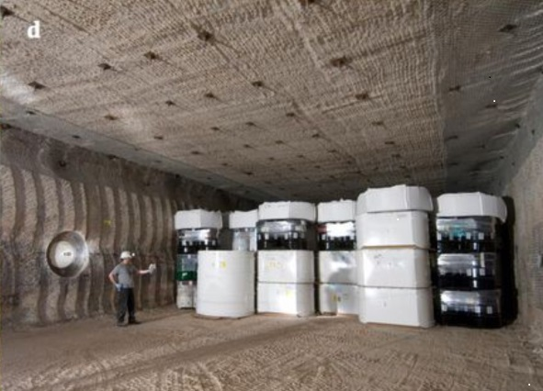
Importance of End-of-Life Management
Disused sources, improperly managed, pose both a security and safety risk.
Such materials are vulnerable to malicious use.
Radioactive materials are present in many forms, including long lived isotopes.
End-of-life management of sources is an integral part to a holistic approach to radioactive material security.
Proper planning can mitigate inherent risks to the public.

Slide 5







International Repatriations 2005-2010
Country | Sources Recovered | Activity (Ci)/TBq
Argentina | 19 | 49/1.8
Australia | 236 | 49/1.8
Brazil | 127 | 170/6.3
Canada | 3 | 3/0.1
Denmark | 11 | 43/1.6
Ecuador | 36 | 8/0.3
Israel | 7 | 29/1.1
Italy | 11 | 1208/44.8
Singapore | 1 | 0.005/0.0
South Africa | 69 | 24/0.9
Switzerland | 9 | 19/0.7
Uruguay | 3 | 0.0/0.0
Notes:
Some specific examples of our international activities include:
Packaging of a U.S.-origin Pu-239/Be source in Uruguay – this package is currently awaiting transport to the U.S.
Packaging of Am-241 in South Africa – this material was repatriated to the U.S. in January 2006.
Our staff assisted IAEA in preparing a Ra-226 source in Singapore for return to Germany.
Packaged U.S.-origin Pu-239, Pu-238 and Ra-226 sources in Australia for return to the U.S.
Plans are underway for recovery of Pu-238 sources from Italy as well.
Staff have also visited a number of Central American countries as well as Ecuador and Bolivia. More information on our international activities is presented on our posters.

Slide 6
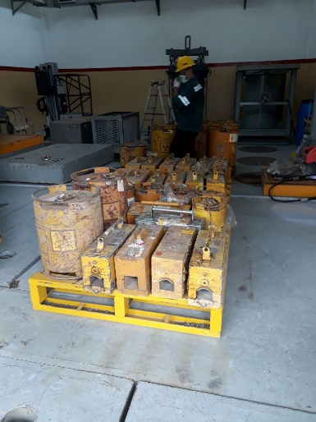
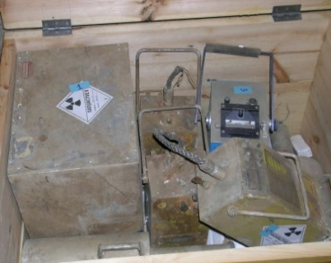
International Repatriations 2011-2021
Country | Sources Recovered | Activity (Ci)/TBq
Americas
Bolivia | 325 | 19/0.7
Brazil-II | 860 | 11,124/412
Mexico | 177 | 51,700/1915
Nicaragua | 40 | 3/0.1
Peru | 486 | 37/1.4
Puerto Rico | 600 | 4/0.1
Uruguay | 28 | 2,112/78
Europe
Austria | 1 | 8/0.3
France | 52 | 65,125/2412
Germany | 10 | 4719/174
Switzerland | 5 | 5/0.2
Asia-Pacific
Australia II | 29 | 10/0.4
Indonesia | 47 | 187/6.9
India | 101 | 263/9.7
Japan | 17 | 14/0.5
Malaysia | 56 | 10/0.4
Philippines | 73 | 21/0.8
Sri Lanka | 110 | 94/3.5
Notes:
Some specific examples of our international activities include:
Packaging of a U.S.-origin Pu-239/Be source in Uruguay – this package is currently awaiting transport to the U.S.
Packaging of Am-241 in South Africa – this material was repatriated to the U.S. in January 2006.
Our staff assisted IAEA in preparing a Ra-226 source in Singapore for return to Germany.
Packaged U.S.-origin Pu-239, Pu-238 and Ra-226 sources in Australia for return to the U.S.
Plans are underway for recovery of Pu-238 sources from Italy as well.
Staff have also visited a number of Central American countries as well as Ecuador and Bolivia. More information on our international activities is presented on our posters.

Slide 7
Guidance on the Management of Disused Radioactive Sources – IAEA 2017
    A source could be returned to its original supplier, provided the supplier is authorized to manage it safely and securely, …
    Paragraph 27 of the Code of Conduct indicates that the re-entry of disused sources for return to a supplier may be possible if authorized by National Law.
    Each State is encouraged to cooperate with other States and relevant regional and international organizations, as appropriate, to enhance the management of disused sources and their transport.

Slide 8
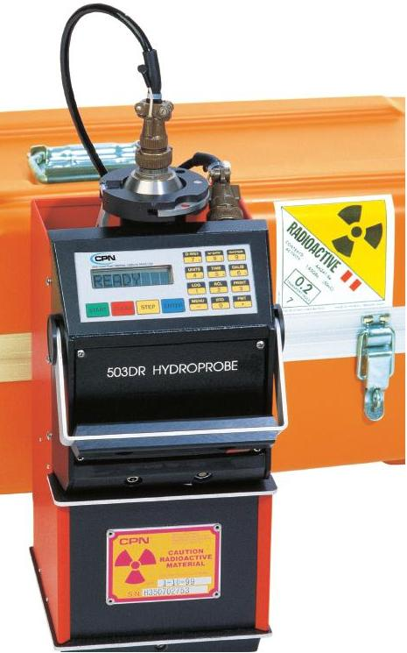
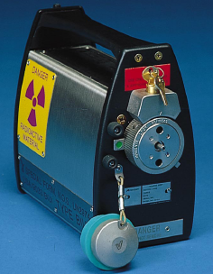
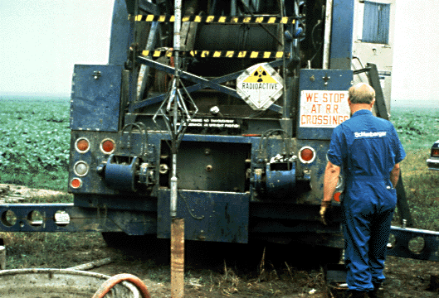
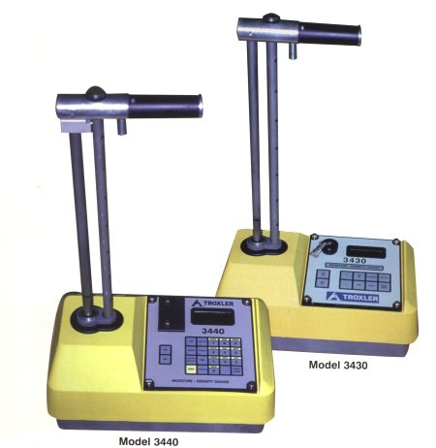
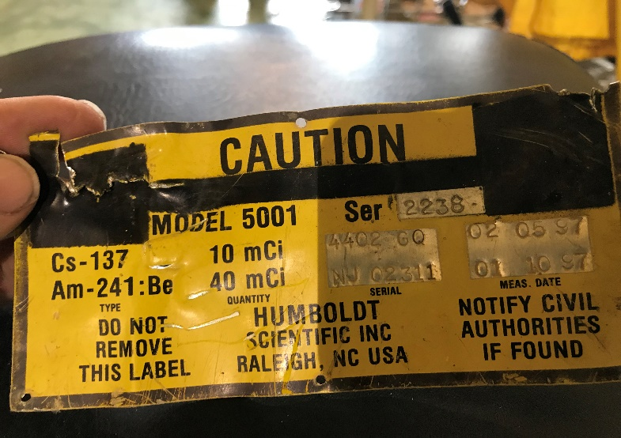
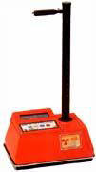
Device Examples
Well Logging
Radiography
Hydrology
Moisture Density Gauges

Slide 9
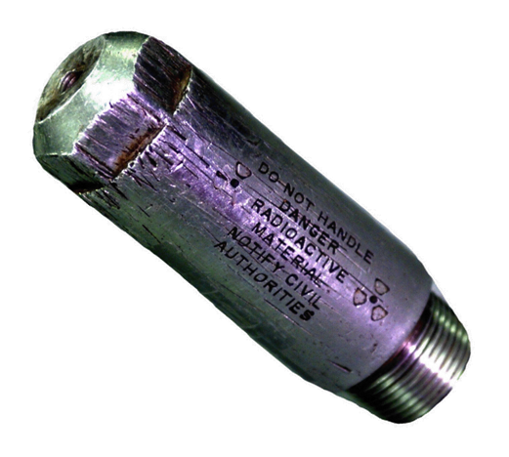
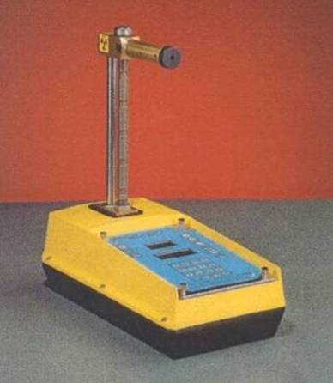
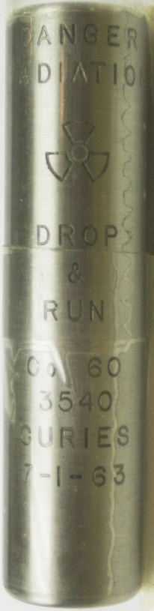
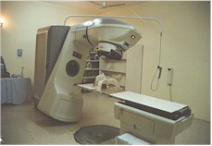
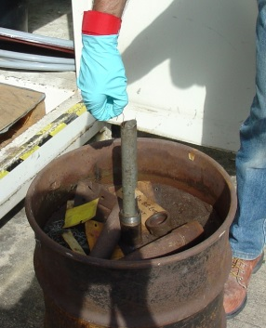
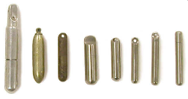
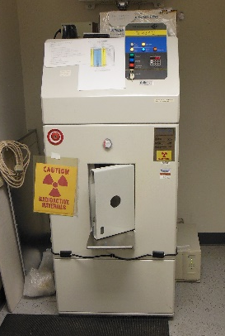
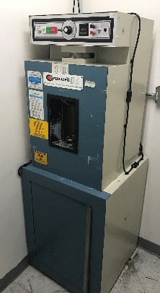
Types of Recoveries
Transuranic
  Primarily Am241, Pu239, Pu238
  Category 2,3,4,&5
  Type A shipments
  From Well Logging, Medical, Universities, and various other industries.
High-Activity Beta-Gamma
  Primarily Cs137, Co60, Sr90
  Category 1 and 2
  Type B shipments
  Blood and research irradiation devices from Medical, University and various industries.

Slide 10
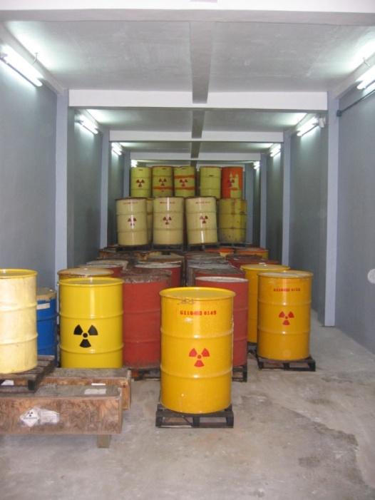
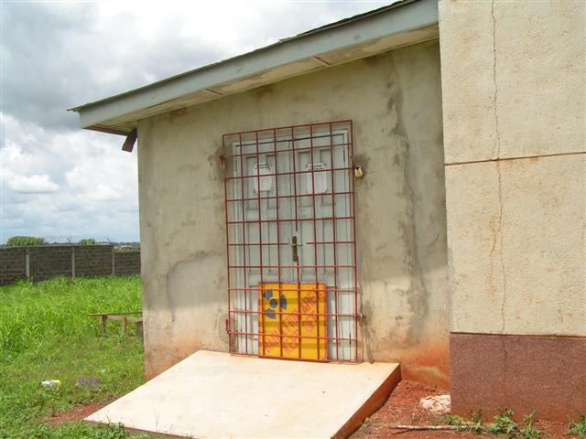
Starting the Process
Early engagement with the national regulator
Central Storage Place & Policy (National)
Detailed inventory of sources
Register Sources (http://osrp.lanl.gov)
Contact NNSA/ORS Country Officier

Slide 11
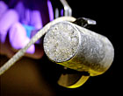
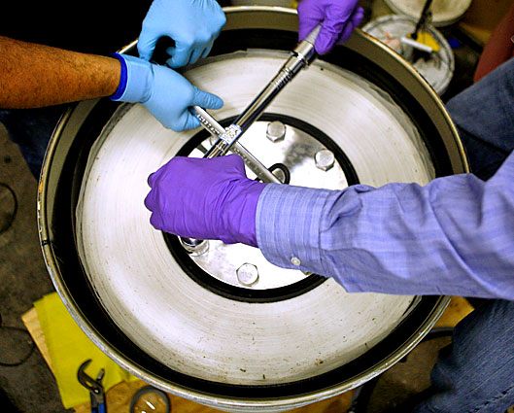
Regulatory
Authority
US DOE NNSA Office of Radiological Security (ORS)
Offsite Source Recovery Program
Logistics-Mission Planning (Import)
Device Disassembly & Source Packaging
Source Repatriation (Export)
Establishing International Cooperation

Slide 12
Point(s) of Contact
ORS Repatriation: Kristin Hirsch, Director ORS
Kristin.Hirsch@NNSA.DOE.GOV
IAEA POC: William (Bill) Stewart
W.Stewart@IAEA.org
J. Andrew Tompkins, CRCPD
jatalbq@gmail.com

