Slide 1
International Conference on Safety and Security of Radioactive Sources
IAEA-NSNS (CN-295)

Slide 2
Content
Introduction
Measures put in Management of disused sealed sources
Conclusion
References

Slide 3
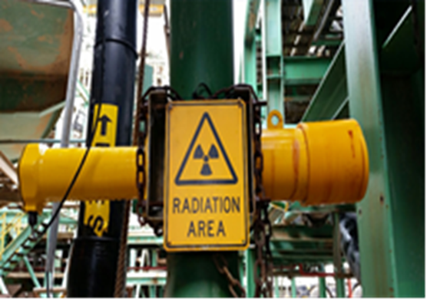
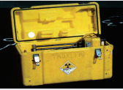
National Status on Disused Sealed Radioactive Sources
Sealed radioactive sources have been used in Zimbabwe in the manufacturing, construction, mining, research industries for socio-economic development.
A return to supplier requirements in place prior to import.
Since inception in 2010, the regulatory body has ensured adherence to these provisions.
However, some sources were imported into the country prior to the establishment of the regulatory body, these neither have return to supplier agreements nor do they have the documentation accompanying the sources.
Further, some companies have since folded operations and are financially incapacitated to send the sources back to the suppliers.
To date, there are over 200 disused sources in the country including those still stored within the licensed holder and under regulatory control (C0-60, Cs 137, Am-241).
The possibility of source’s vulnerability to theft, loss, or inappropriate management exists even in the presence of regulatory provisions.

Slide 4
Management Measures
A number of cases of damage and of sources while in storage and weak radiation safety and security arrangements albeit regulatory control.
Lack of effectiveness of the return to supplier policy.
Measures had to be put in place to deal with the overreliance of the return to supplier policy through deliberate government policy directives.
Government set out to strengthen the management of disused sealed radioactive sources from facility to national level as set out by the International Atomic Energy Agency (IAEA) Supplementary Guidance on the Management of Disused Sources.
Set up of Interim Waste Management Facility
Strengthening Temporary Storage at Licensed Facilities
Establishment of a Centralized Radioactive Waste Management Facility
Review of Law to Incorporate Financial Provisions

Slide 5
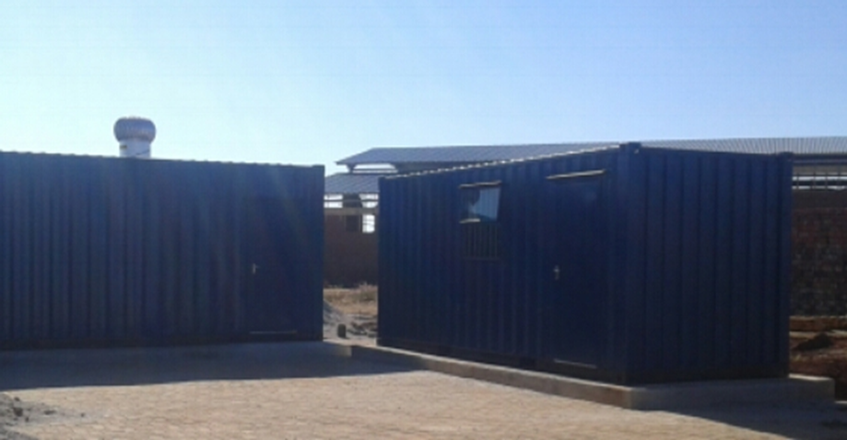
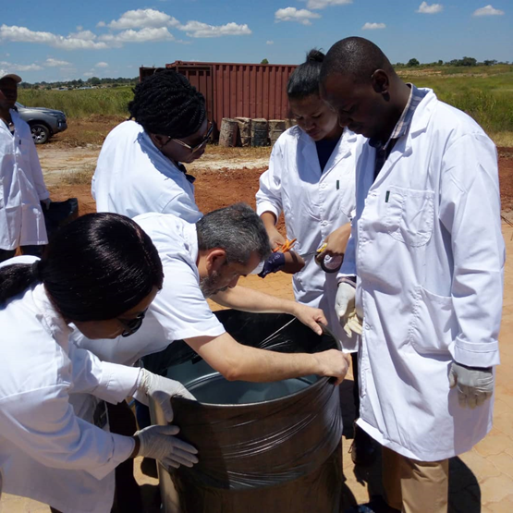
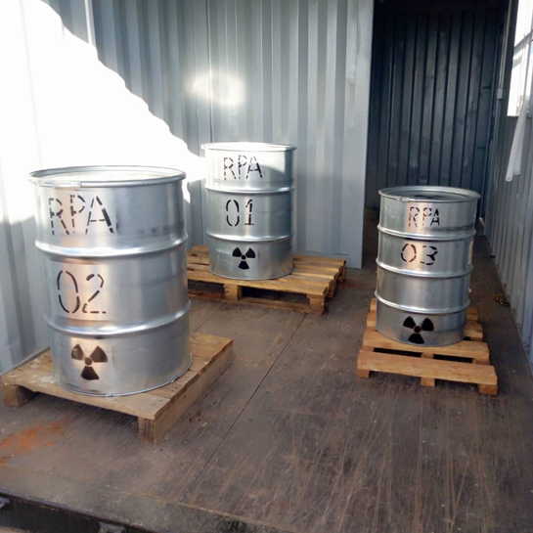
Interim Waste Management Facility
The Regulatory Body was assigned the responsibility to manage orphan sources through its Technical Services Department.
An interim facility to manage disused and orphaned sources was set up with capability for receiving, conditioning and storage of sources. This consisted of 3 ISO containers, one for source recovery from devices, and another for encapsulation and conditioning of recovered sources and the third for final storage of the sources.
Zimbabwe in collaboration with IAEA undertook a demonstration exercise to condition C0-60, Cs-137 and Ame-241 disused sources as part of training of local personnel and managing vulnerable disused sources.
The interim facility currently houses 3 drums of conditioned radium sources from a medical facility, 3 drums of conditioned low level gamma and neutron sources from industry and a number of orphaned sources from road construction and industry.

Slide 6
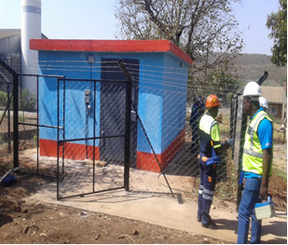
Strengthening Temporary Storage Arrangements at Facilities
The Regulatory Body’s Technical Services Department has been providing guidance on set up of adequate temporary storage to facilities for the safe storage of legacy disused sealed radioactive sources including those that are having challenges returning to supplier. This is to ensure licensed holders meet the requirements for storage of sources. This has significantly reduced the risk of loss, theft, and inadequate control of the sources.
Training of Radiation Safety Officers on safety and security of sources in storage(RSO Training)

Slide 7
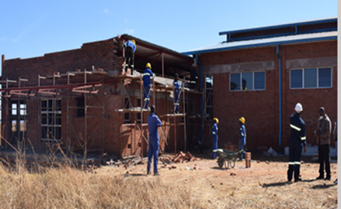
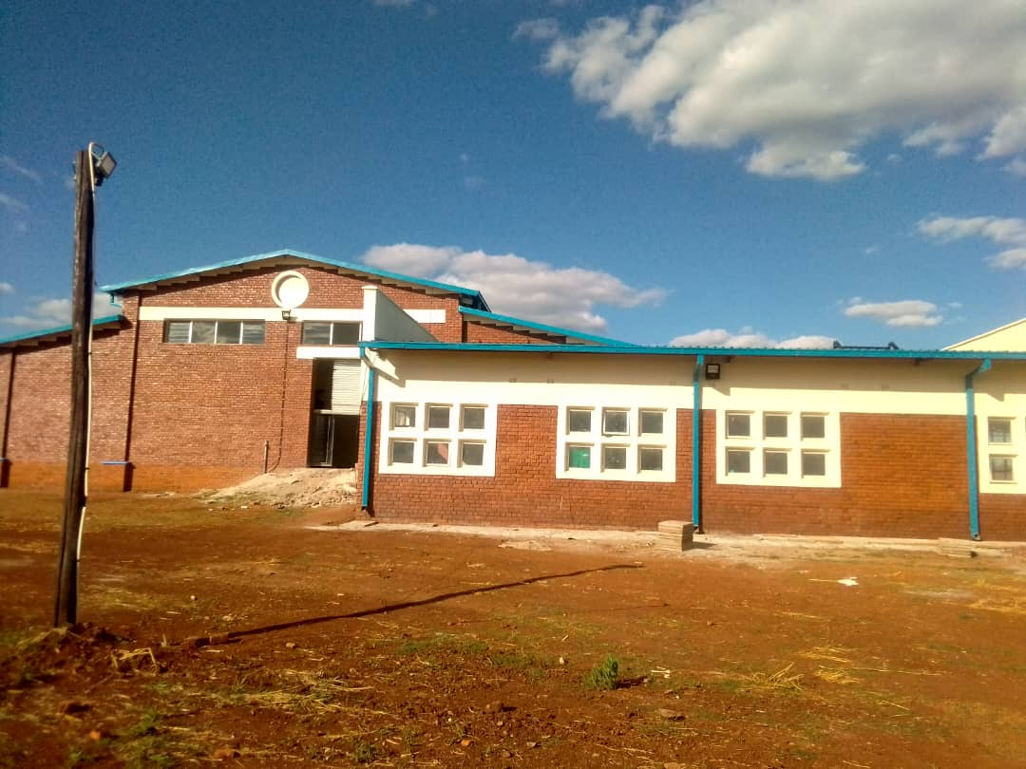
Establishment of a Centralized Radioactive Waste Management Facility
For the long-term management of radioactive waste and disused sources, Zimbabwe is developing a national centralized radioactive waste management facility to recover, condition and store radioactive waste and disused sealed radioactive sources for long term. Operationalization set for Q1 2023
This has been developed with IAEA expert support and funding from central government.
The facility will receive radioactive waste from licensed holders to ensure their proper handling and storage prior to return to supplier or for long term.
Physical protection measures have been strengthened through IAEA expert support.

Slide 8
Inclusion of Financial Provisions for Management of Waste
The Act is being reviewed to strengthen radiation safety and incorporate and security and safeguards provisions. The Radiation Protection Amendment Bill has provided for the establishment of financial mechanisms through a waste management fund for management of radioactive waste and disused sources. The objective of the Fund is to hold such levies as shall be prescribed in trust for the purpose of enabling the repatriation, management, storage, or disposal of radioactive sources previously in the custody of an authorised person who by reason of insolvency or any other event is incapable of discharging his or her obligations to repatriate, manage, store or dispose of the sources concerned. This shall ensure Zimbabwe has resources in place for cradle to grave management of sealed radioactive sources imported into the country and radioactive waste.
Recycling Options have also been considered should the option exist
Repatriation

Slide 9
Conclusion
Provisions for strengthening management of disused sealed radioactive sources in Zimbabwe allowed for the development of adequate infrastructure for receiving, recovery, conditioning, and storage of disused sources. The interim storage facility allowed for immediate arrangements for improving safety and security of sources while the centralized radioactive waste management facility presents long term measures for management of radioactive waste and disused sources. The implementation of provisions in the supplementary guidance on the management of disused sources have been essential.

Slide 10
Thank you for your kind attention

