Slide 1
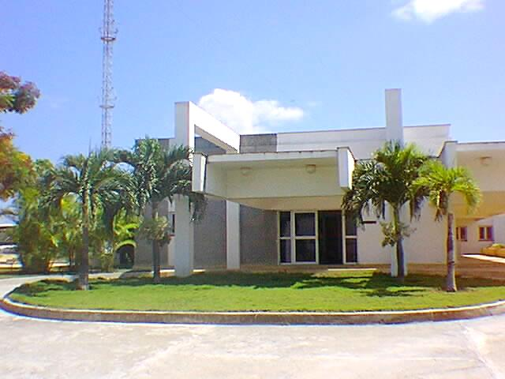
CPHR
CENTRO DE PROTECCION
E HIGIENE DE LAS RADIACIONES
IAEA-CN-295-057
International Conference on the Safety and Security of Radioactive Sources: Accomplishments and Future Endeavours
Vienna, Austria, 20-24 June 2022
TWENTY YEARS OF EXPERIENCE IN THE
MANAGEMENT OF DISUSED SEALED RADIOACTIVE SOURCES IN CUBA
Mercedes Salgado Mojena
Director of RMW – CPHR
cphrmercedes@ceniai.inf.cu
Para proteger tu mundo

Slide 2
Content
Introduction
Characterization of disused sealed radioactive sources
Conditioning of categories 3-5 DSRS
Management of high activity DSRS
Reuse of the DSRS
Conclusions

Slide 3
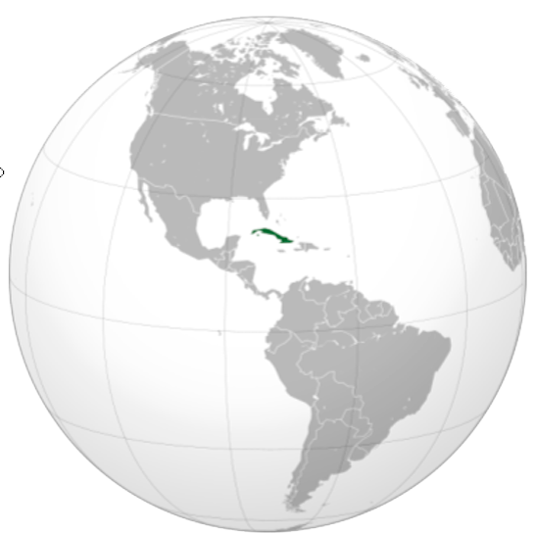
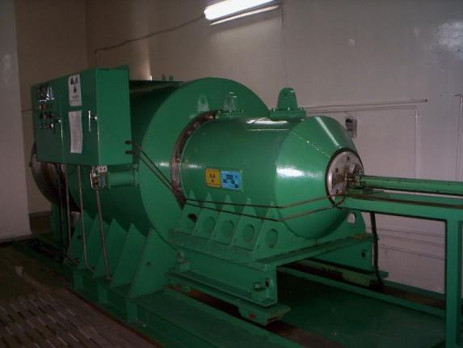
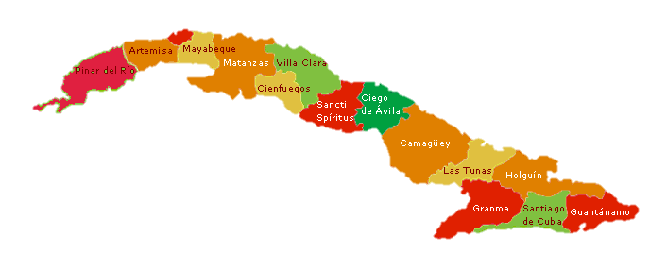
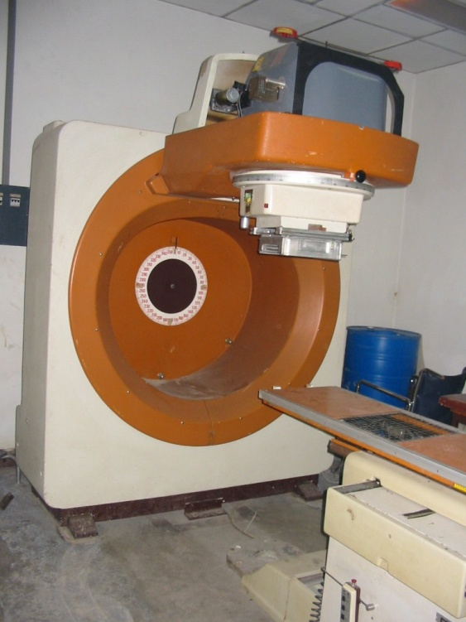
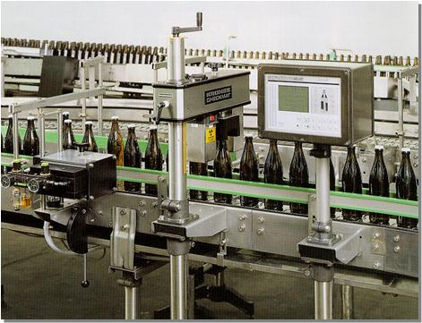
Introduction
Wide use of sealed radioactive sources in industry, medicine and research

Slide 4
Introduction
When SRS are declared disused:
return to the provider
reuse of the sources by other Licensee
transfer to the CPHR (Waste Management Organization)
Proper infrastructure for safe management of DSRS
First national collections of DSRS: ~1990
Characterization
Conditioning for safe storage

Slide 5
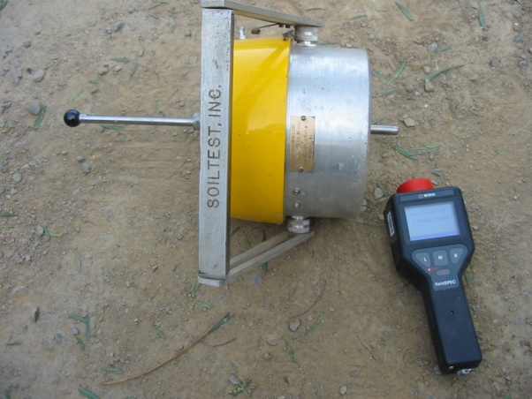
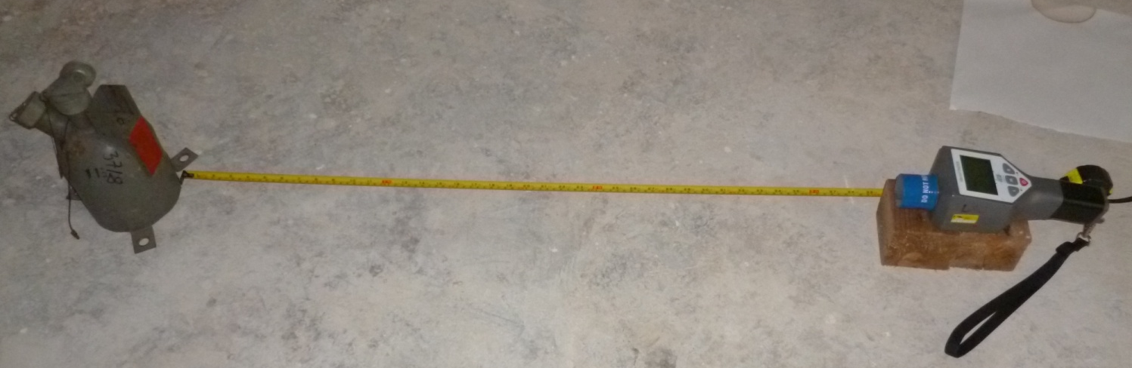
Characterization of DSRS
Identification of the radionuclides
Activity estimation from dose rates measurements
Updated inventory of DSRS
TD = Γ · A / r²

Slide 6
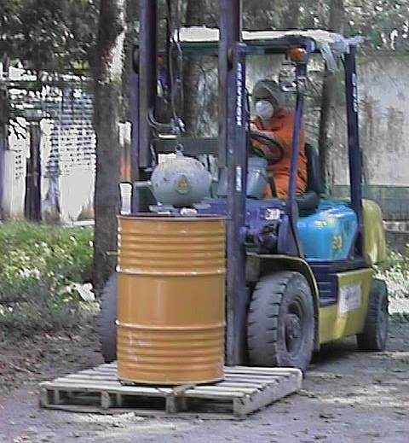
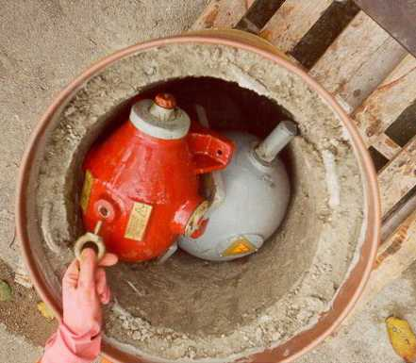
Conditioning of categories 3-5 DSRS
Conditioning of Cat 3-5 DSRS (T1/2 < 30 years) by emplacement of the devices in concrete lined drums

Slide 7
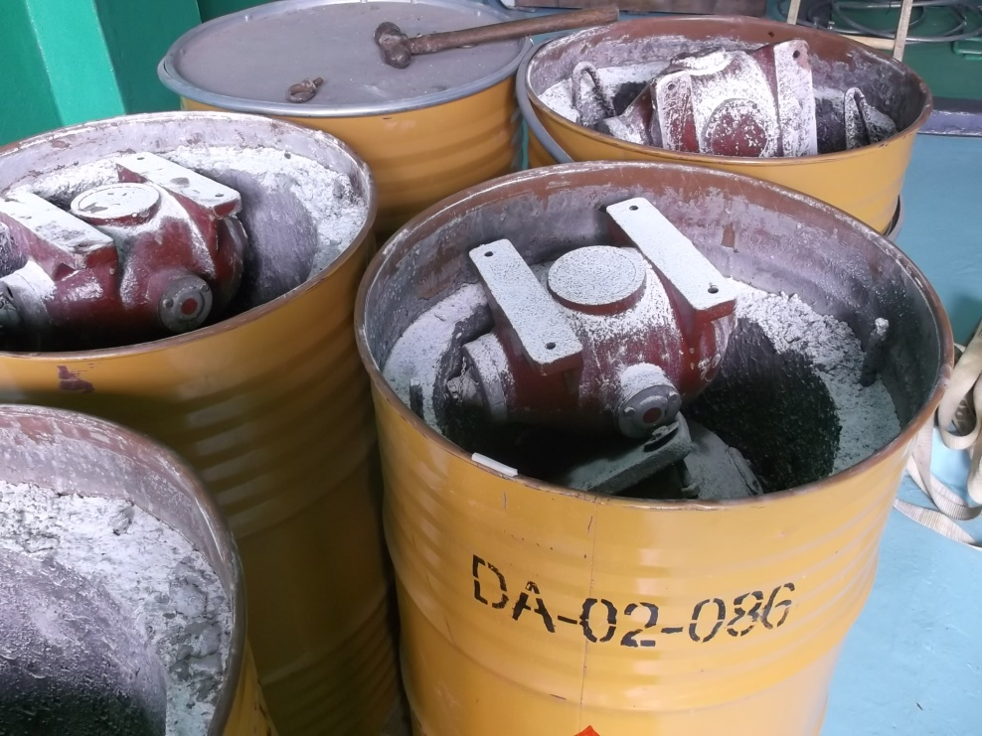
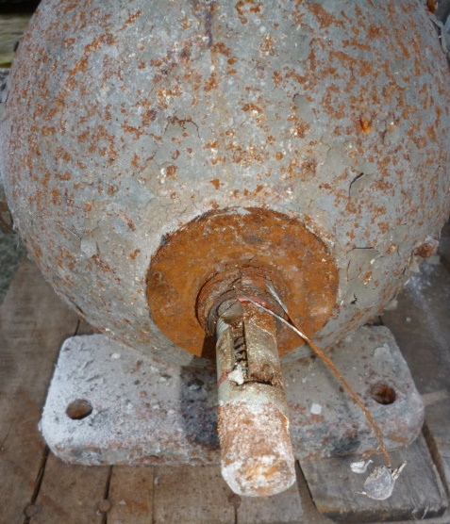
Conditioning of categories 3-5 DSRS
Conditioning of Cat 3-5 DSRS (T1/2 < 30 years) by emplacement of the devices in concrete lined drums

Slide 8
Conditioning of categories 3-5 DSRS
Conditioning of Cat 3-5 DSRS by re-encapsulation
Removal of sources from the devices,
Characterization,
Encapsulation in stainless steel capsules,
Transfer the conditioned capsule to an adequate container,
Safe storage.

Slide 9
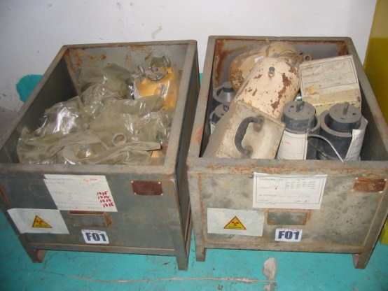
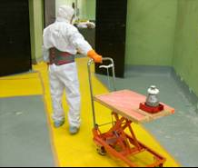
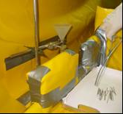
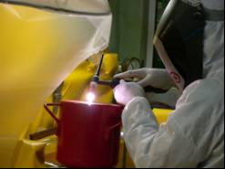
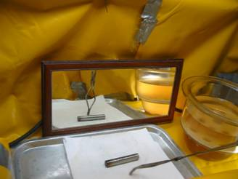
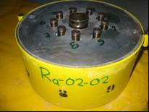
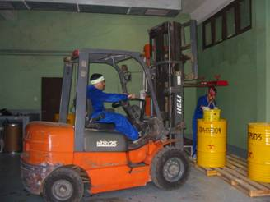
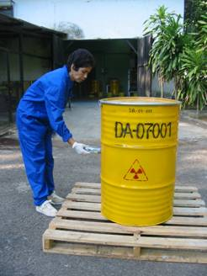
Conditioning of categories 3-5 DSRS
Examples: Conditioning of Ra-226 DSRS - 2007

Slide 10
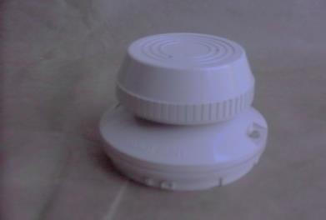
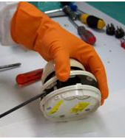
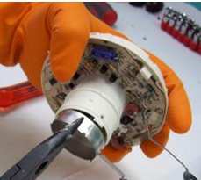
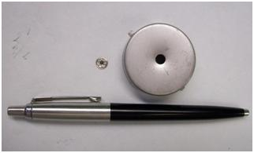
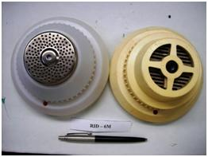
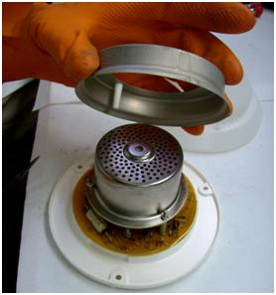
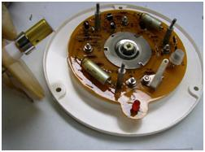
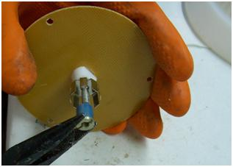
Conditioning of categories 3-5 DSRS
Examples: Other devices containing long lived radionuclides
Ionization smoke detectors (Am-241, Pu)

Slide 11
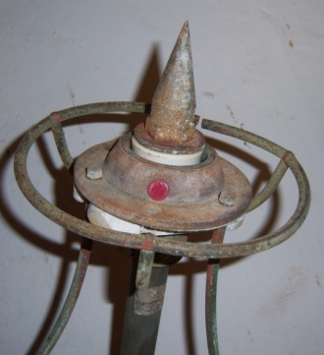
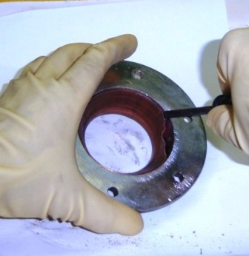
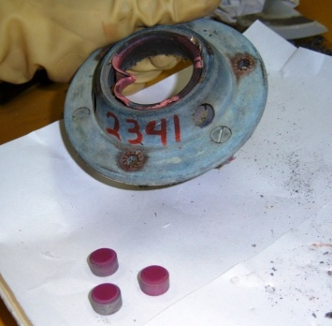
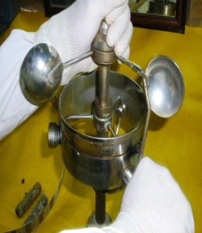
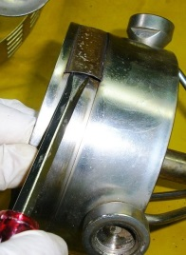
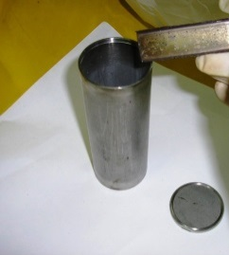
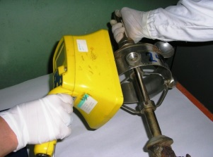
Conditioning of categories 3-5 DSRS
Examples: Other devices containing long lived radionuclides
Radioactive lighting conductors (Am-241)

Slide 12
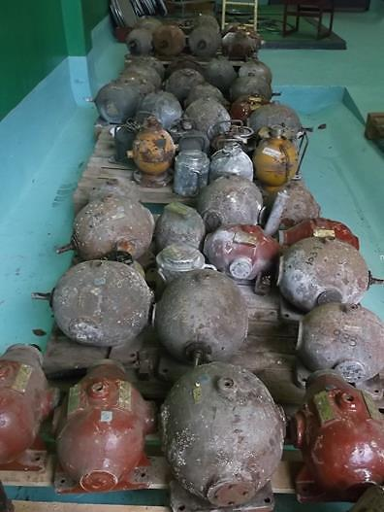
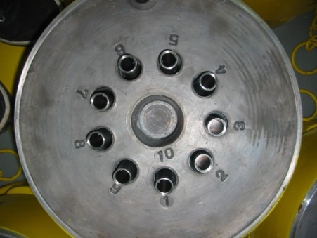
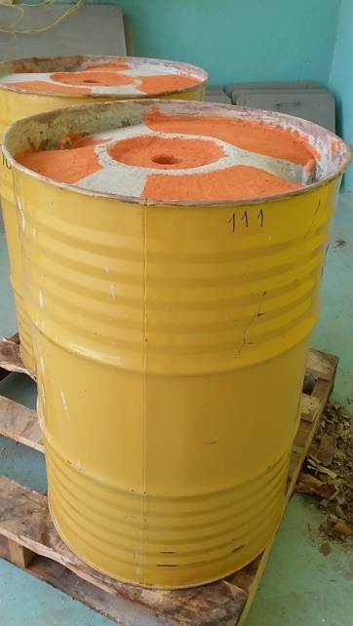
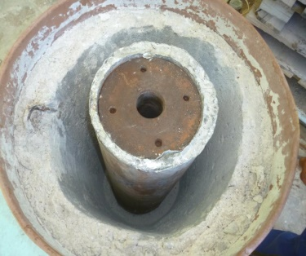
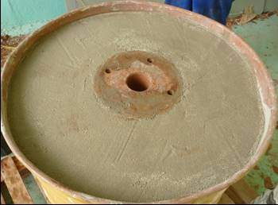
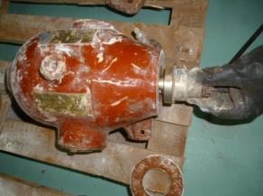
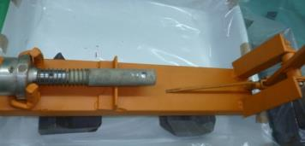
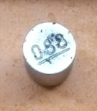
Conditioning of categories 3-5 DSRS
Examples: nuclear gauges containing Beta-Gamma sources

Slide 13
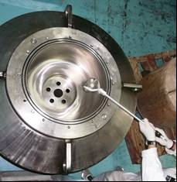
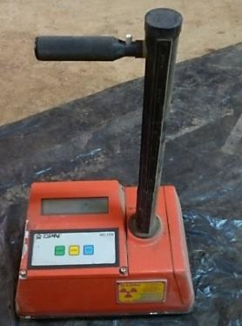
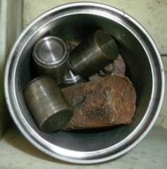
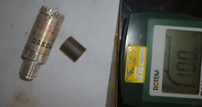
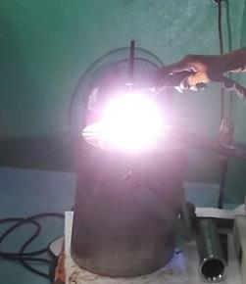
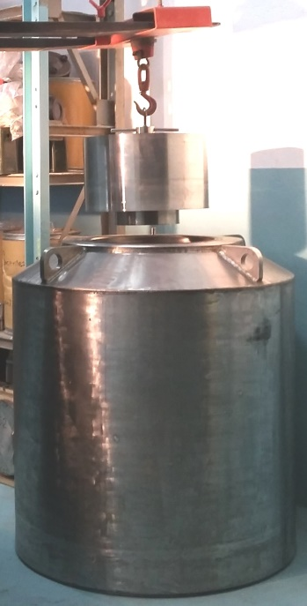
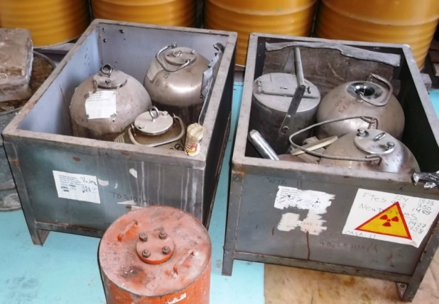
Conditioning of categories 3-5 DSRS
Examples: nuclear gauges containing neutron sources

Slide 14
Conditioning of categories 3-5 DSRS
Examples: nuclear gauges containing Beta-Gamma sources

Slide 15
Conditioning of categories 3-5 DSRS
Record keeping

Slide 16
Conditioning of categories 3-5 DSRS
Summary
Radionuclide | Type of sources or devices | Number of conditioned sources | Number of conditioned capsules | Total Activity GBq Ci
Ra-226 | Brachytherapy needles and tubes and others | 1071 | 84 | 188.5 | 5.09
Am-Be | Nuclear gauges and calibration sources | 32 | 6 | 1594 | 43.0
Pu-Be |  | 11 | 2 | 2109 | 57.0
Ra-Be |  | 1 |  | 1.06 | 0.03
Cs-137 | Nuclear gauges, calibration and teaching devices | 74 | 3 | 2248 | 60.8
Am-241 | 183 lightning conductors | 570 | 13 | 18.8 | 0.5
 | Smoke detectors | 1494
C-14 | 5 lightning conductors | 49 | 1 | 0.13 | 0.003

Slide 17
Management of high activity DSRS
29 teletherapy devices (30 DSRS) and 5 irradiators (125 DSRS),
DSRS are stored inside their devices, as the required technology is not in place for their safe conditioning,
DSRS from 2 irradiation facilities transferred from the user´s facility to adequate shielded containers for safe transport and storage.

Slide 18
Reuse of the DSRS
Teletherapy unit Theratron 1000E in the Radiotherapy Department at the Medical Research Centre in Havana
Teletherapy Unit Theratron Phoenix used for the calibration of therapy level dosimeters in the SSDL, CPHR

Slide 19
Conclusions
Adequate infrastructure exists in Cuba for the management of disused radioactive sources.
The conditioning of DSRS of categories 3-5 guaranties the safety and security of the radioactive sources during the long term storage.
Necessary actions have to be taken for the safe management of high activity disused radioactive sources

Slide 20
THANK YOU!
Para proteger tu mundo

