Slide 1
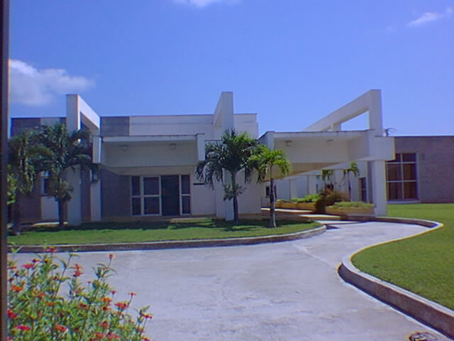
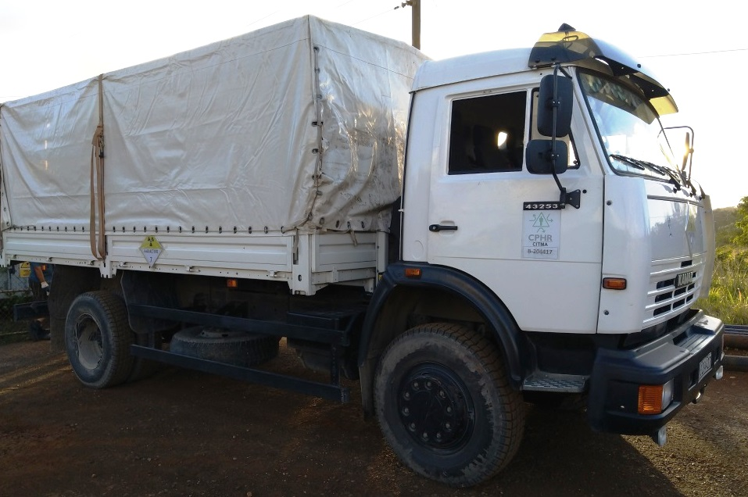
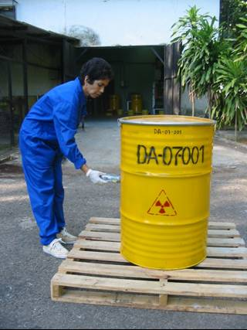
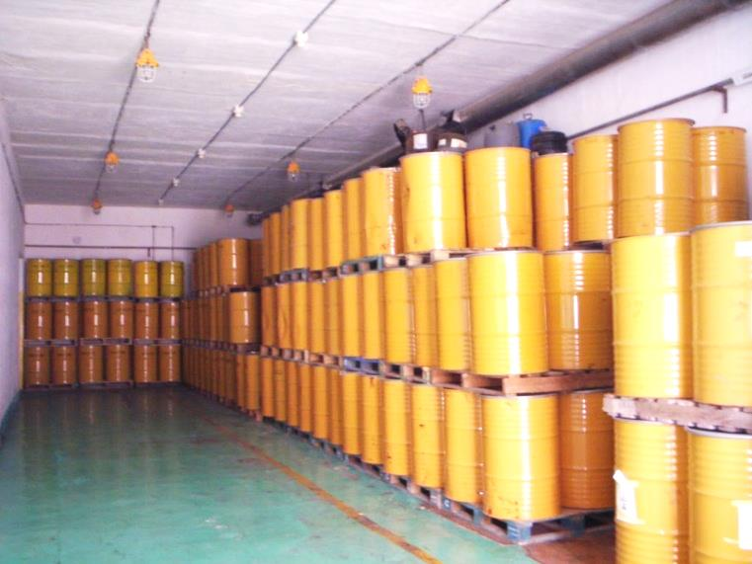
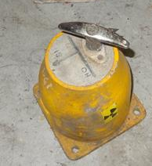
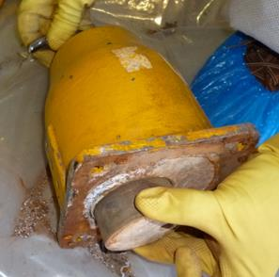
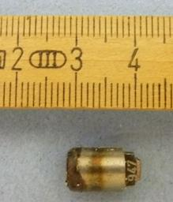
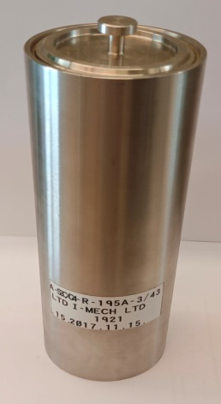
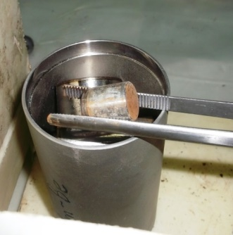
CPHR
CENTRO DE PROTECCION
E HIGIENE DE LAS RADIACIONES
CN-295-028
“FINANCIAL PROVISIONS FOR THE MANAGEMENT OF DSRS IN CUBA”
M. Muñoz Escobar, M. Salgado Mojena
Centre for Radiation Protection and Hygiene, Havana, Cuba
male@cphr.edu.cu
INTRODUCTION
The management of disused sealed radioactive sources (DSRS) requires, among others, to adopt a financing system ensuring sufficient funds to guarantee the availability of technical and safety provisions for all the stages. The financial resources for the management of DSRS in Cuba are mainly provided by the users, this requirement is established in the Law. Financial provisions are also provided by the State to the Centre for Radiation Protection and Hygiene (CPHR), the waste management organization in the country. In addition, significant contribution has been received from the IAEA for improving the safety and security of DSRS in Cuba.
The management of DSRS is a technical service provided by the CPHR at the national level. In order to ensure that the user will fund the management of DSRS, prepaid agreements are established between the users and the CPHR.
2.3 General components and indirect costs
Organization overhead (indirect costs) are all general management costs which cannot be conveniently traced to any particular service or product. This includes: indirect materials, indirect labour, and others, necessary for the performance of the service.
The indirect costs are charged on a pro rate basis among the productions or services that generated them. The direct labour cost is the base to allocate the indirect production cost defined by the CPHR:
Overheads or total indirect costs | = | Coefficient or indirect cost allocation rate
Direct labour cost
2.4 Price for the management of disused radioactive sources
The cost card based on costs plus a profit margin is prepared when using the cost-based pricing method. All cost incurred to carry out the management of DSRS should be determined. The percentage of profits is added to define the selling price. The production cost should be reflected broken by cost elements per unit of product. The measurement unit used to estimate the price for the management of DSRS is shown in the table.
2. METHODOLOGY FOR ESTIMATING THE DSRS MANAGEMENT PRICE
Determine the prices for the management of DSRS is important for the CPHR to obtain the funding to cover part of the costs of this activity. At the same time, this estimation facilitates the control of the resources used. The cost-based pricing method is used to determine the price and it consists in identifying and adding all the costs associated with the product or service. The desirable profit margin is then added to this result. The costs related to the provision of the services comprises of direct costs, indirect costs and general overheads.
The following steps are followed to determine the prices of the management of DSRS:
Define the stages of the management of DSRS,
Determine the influence of the direct components in the cost of activities,
Determine the general components and indirect costs,
Calculate the price.
2.1 Stages of the management of DSRS
The management of DSRS is divided in several stages. For the categories 3 to 5 DSRS this includes:
Collection and transport (including packaging),
Removal of the DSRS from devices, characterization and conditioning,
Storage of the conditioned package.
This approach facilitates to define the price for independent stages of the process. Categories 1 and 2 DSRS are not removed from the devices, so the stages of collection, transport and safe storage are considered to estimate the management price.
Stage of the management of DSRS | Measurement units (to determine the unit price)
Collection and transport | One hour of transportation
Conditioning of DSRS | A conditioned waste package
Storage of the waste packages | Storage of a conditioned waste package for one year
A cost card is elaborated for each stage of the management of DSRS. It consists in an Excel file containing spreadsheets for the different cost elements and a main spreadsheet to summarize the results and give the final price. The elements included in the main spreadsheet for conditioning of DSRS are presented:
Organization: | CPHR |  | Product or Service ID:
Product or Service: | Conditioning of DSRS Cat 3-5 |  | 700.17010-1
Elements: |  |  | No. | Expenses, CUP
Raw materials, direct materials and consumables |  |  | 1. | 9.746,79
 |  | Materials and consumables | 1.1 | 9.745.51
 |  | Fuel | 1.2 | 1,28
 |  | Energy | 1.3 | 0,00
 |  | Water | 1.4 | 0,00
Direct labour: |  |  | 2. | 1.447,82
 |  | Basic wage | 2.1 | 1.327,18
 |  | Vacations | 2.2 | 120,64
 |  | Extra payment | 2.3 | 0,00
Other direct cost |  |  | 3. | 83,99
Indirect costs associated with the CT Service |  |  | 4. | 2.995,33
TOTAL COSTS (1+2+3+4) |  |  | 5. | 14.273,93
General overheads and administrative expenses |  |  | 6. | 977,05
Sales and distribution Expenses |  |  | 7. | 0,00
Financial expenses |  |  | 8. | 0,00
Expenses for financing delivered to the OSDE |  |  | 9. | 0,00
Tax and Related Expenses |  |  | 10. | 275,08
TOTAL EXPENDITURES (6+7+8+9+10) |  |  | 11. | 1.252,13
Utility rule (%) |  |  | 12. | 10
Utilities (10% of 5) |  |  | 13. | 1.427,39
TOTAL COSTS AND EXPENSES (5 + 11) |  |  | 14. | 15.526,06
PRICE (13 + 14) |  |  | 15. | 16.953,45
Prepared by: |  |  | Date | Signature:
Name:
Approved by: |  |  | Date | Signature:
Name:
2.2 Influence of the direct components in the cost of each stage
The following direct components are considered to estimate the cost for each stage:
Raw material and other direct supplies:
Basic materials: containers, stainless steel capsules, office supplies, etc.
Auxiliary materials: tools, tongs, PPE, decontamination materials, pallets, etc.
Electricity, fuels and lubricants (if only used for the management of DSRS)
Direct labour. This is related to employees directly involved in the service and includes basic wage, any extra payment, holidays and vacations.
Depreciation of direct fixed assets. This is a method of allocating the cost of a tangible asset over its useful life.
Other direct expenses, not included in the previous mentioned elements, but that are essential for the management of DSRS:
Travel expenses and subsistence allowance,
Purchase of specialized services (calibration of equipment, spectrometric analysis of samples, maintenance, repair, etc.),
Licenses and other authorizations,
Security and physical protection of the waste management facility, etc.
To determine the price for conditioning a DSRS, the price obtained for producing one conditioned package is divided by the number of sources contained in the package.
The cost of transport is determined for the total amount of DSRS collected at the user premises. The annual costs for the operation of the storage facility, as well as the costs for maintenance, repairing, safety, security etc., are included in the cost card for storage of the waste package.
To determine the price for the management on a DSRS, the prices obtained for each stage of the process are considered.
3. CONCLUSIONS
A financing system ensuring sufficient funds to guarantee the availability of technical and safety provisions for the management of DSRS has been implemented in Cuba. The financial resources are mainly provided by the users. The cost-based pricing method is used to determine the price for the technical services. The paper describes economic considerations regarding costs incurred for the collection, characterization, conditioning, packaging, storage and transportation of DSRS.
International Conference on the Safety and Security of Radioactive Sources: Accomplishments and Future Endeavours (CN-295)
Vienna, Austria; 20-24 June 2022

