Slide 1
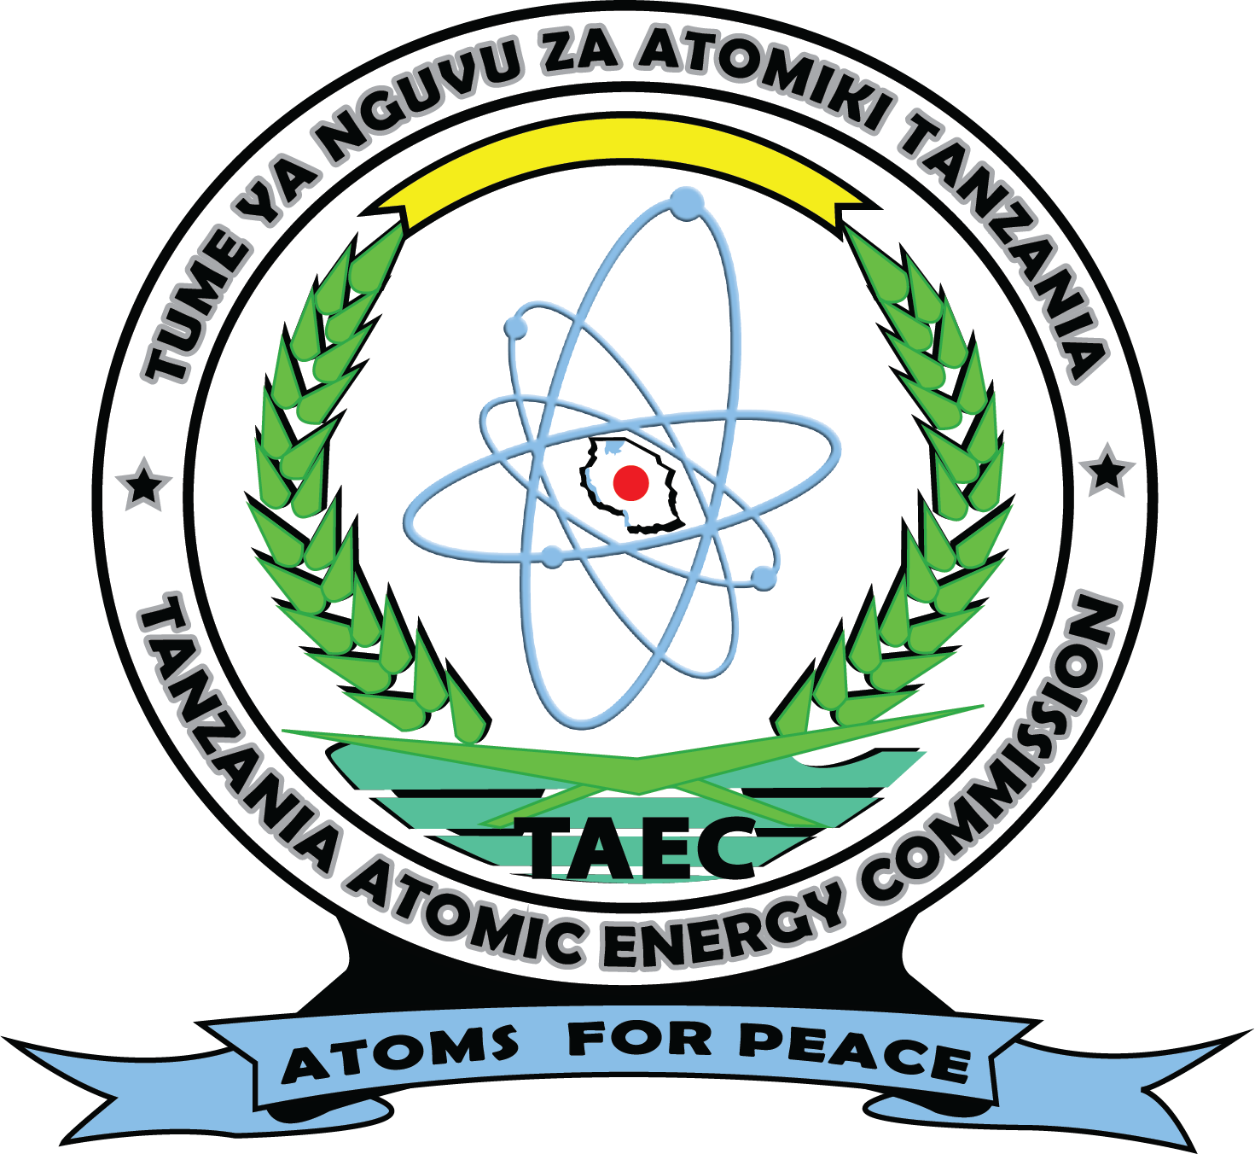
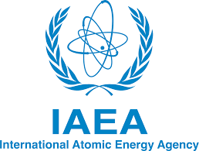
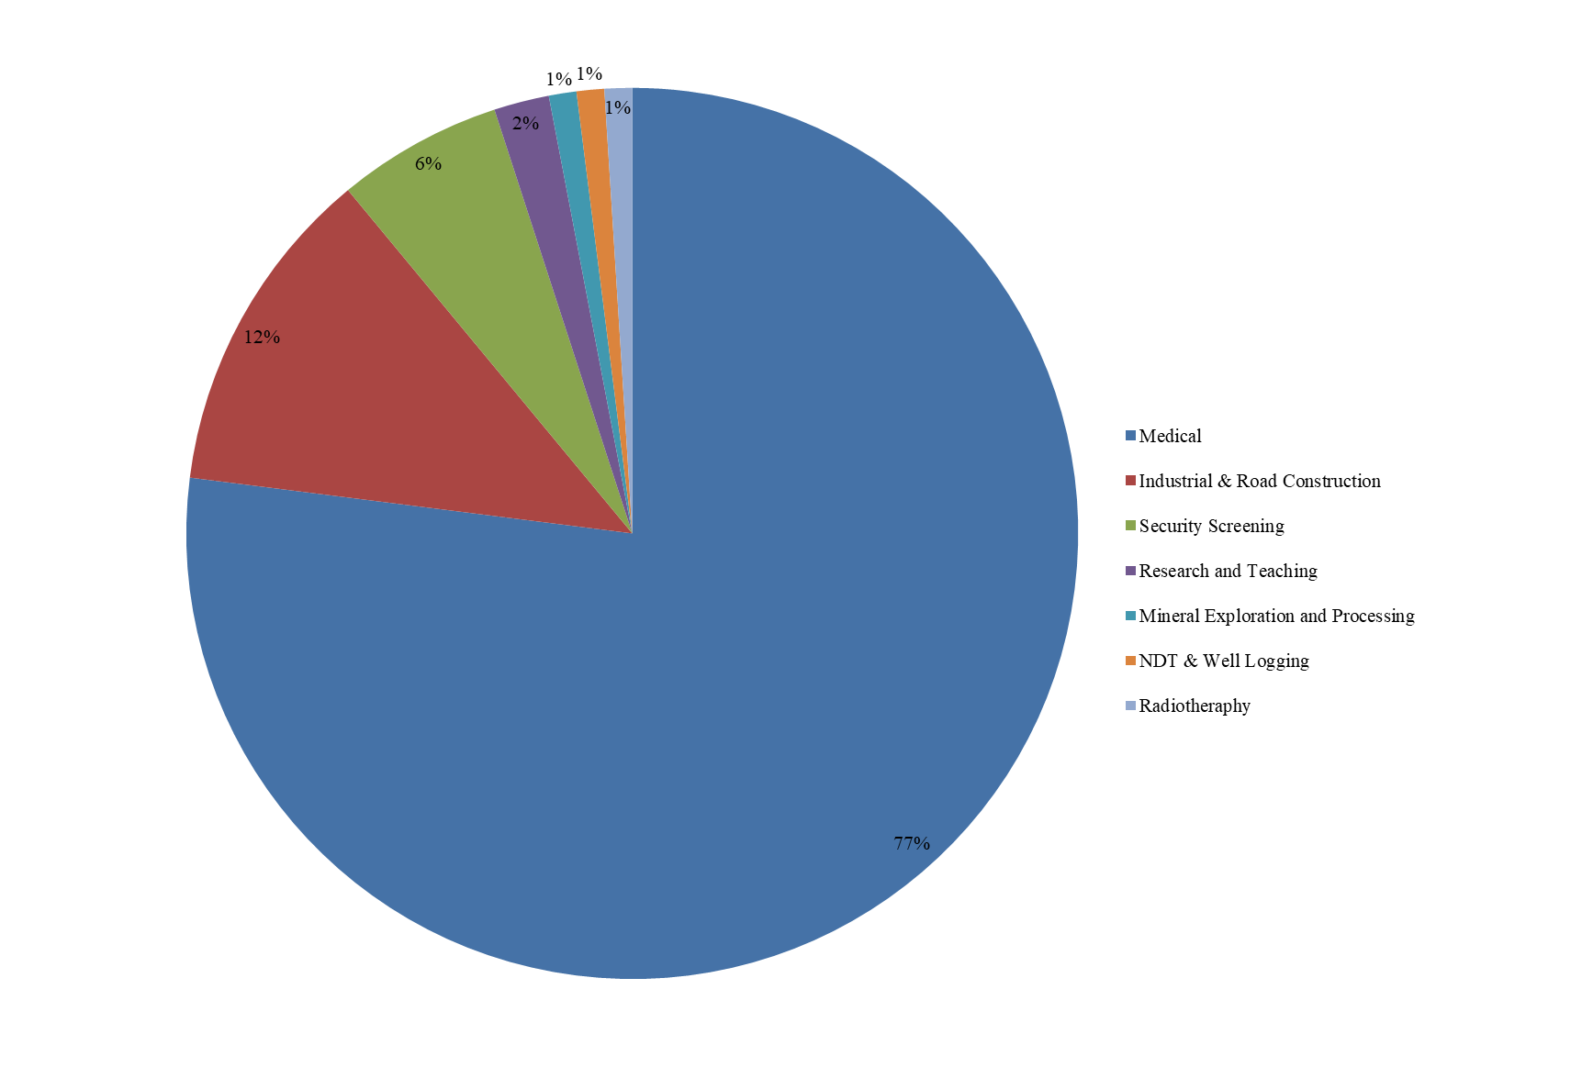
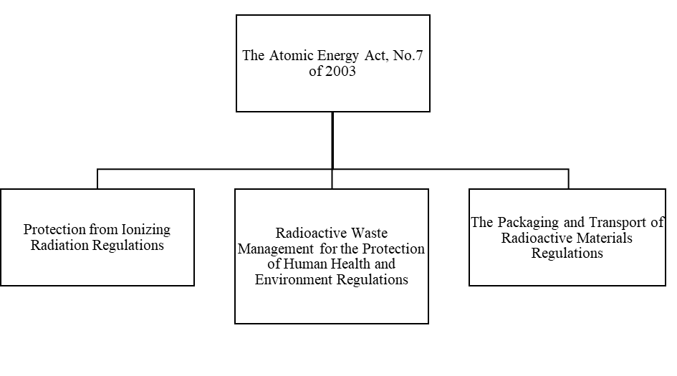
Challenges and Good Practices Associated with Ensuring the Safety and Security of Radioactive Sources throughout Their Life Cycle
Mujuni Rweyemamu
Tanzania Atomic Energy Commission, Arusha, United Republic of Tanzania
mujuni.rweyemamu@taec.go.tz
Introduction
Good Practices in Tanzania
Radioactive sources are widely used worldwide in various beneficial applications such as medical, agriculture, industry, and various research areas.
Management and control of radiation sources is very important throughout of their life cycle.
This is because these radiation sources may cause potential health hazards such as deterministic effects especially those radiation sources with a relatively high activity.
The security of the radiation sources is needed because in the absence of control measures, they can fall into illicit trafficking leading to terrorists and other malicious acts that may jeopardize the public safety.
Therefore, in order to avoid these radiation health hazards, it is important to ensure that the safety and security of these radiation sources are maintained throughout the life cycle of these sources.
It is the government responsibility to regulate the safety and security of radioactive sources.
However, radiation risk may cross the national boarders and cause harmful consequences to another nation(s).
Therefore, international cooperation is needed to exchange information and experience to promote safety and security worldwide.
Tanzania is among the users of radiation sources with various installations of which they may cause risk to the world community if they are not properly controlled.
The areas of application in Tanzania are indicated in Figure1.
The country established the regulatory infrastructure governed by the Atomic Energy Act, number 7 of 2003 (as shown in Fig.2).
The country has also established the system of managing the disused sealed radiation sources.
The management is through the Central Radioactive Waste Management Facility that takes care of the sources found outside the regulatory control.
Another good practice is the condition to return the radiation source to the manufacturer.
This condition is stated in the regulation regarding the importation of radiation sources.
It is an obligation for the importer (licensee) to return the source to the manufacturer once it is declared being disused source.
Also, Tanzania recognize international cooperation as useful tool of ensuring safe and security of radiation sources.
These international organizations that Tanzania collaborates with include the IAEA and its member states, US DOE and EU.
Through these cooperation, the country has the opportunity to gain experience and information that can helps to detect and prevent any unauthorized movement of radioactive materials across the national borders around the global.
Challenges in Tanzania
Illicit trafficking in which most of the cases the motive is unknown, whether for malicious purposes, or for economic gain or sometimes lack of knowledge.
Another challenge is the porous borders which also contribute to the Illicit trafficking. .
The country has extended porous borders sharing with eight (8) countries which are Kenya, Uganda, Rwanda, Burundi, Democratic Republic of Congo, Malawi, Zambia, and Mozambique.
Porous borders makes it difficult to control the movement of radiation sources even in the presence of the regulatory infrastructure.
Another challenge is the lack of detection equipment at the borders and ports.
Although the country has numerous borders and ports, not all of them has the portal monitors for the detection of radioactive materials.
The absence of portal monitors increase the possibility of the movement of undeclared radioactive materials across the borders .
Also, the discovery of orphan sources that are out of regulatory control is another challenge because their existence is not recognized by the regulatory authorities.
The other radiation concern is the lack of information on country of origin for the sources intercepted during illicit trafficking.
The lack of disposal option for the radioactive materials in the county is another challenge.
The disused sources are kept in the Central Radioactive Waste Management Facility for long term storage.
The accumulation of radiation sources in this facility reduce the storage space and increase the cost for the monitoring systems.
The facility after some time it will be full and will no longer be able to accommodate further sources.
Also, the accumulation of sources in a single facility increases the security risk and dose rate in that facility.
Fig.1. Applications of radiation sources in Tanzania (Source: Tanzania Atomic Energy Commission)
Fig.2. Atomic Energy Act No.7 of 2003 and associated Regulations for the control or radiation sources in Tanzania
Conclusion
The world has benefited economically and socially through the use of radiation sources in various legitimate applications such as medical, agriculture, industry, and various research areas.
However, the beneficial use of radiation has a radiological concern to the human health and the environment.
This is because of the increasing use of a number of radiation sources create challenges on the capacity on the management and control of these radiation sources
Today radioactive sources/materials are target for malicious use.
Therefore, their safety and security is of paramount and the regulatory framework is needed to address their management throughout their life cycle.
The United Republic of Tanzania has addresses some of these challenges.
Including establishing of the law and associated regulations concerning the management of radioactive sources

