Slide 1
Nuclear Security in Ghana, Progress, Challenges, and the way forward
Raymond Agalga, MInstP, CNSP
Nuclear Safety and Security Centre, RPI

Slide 2
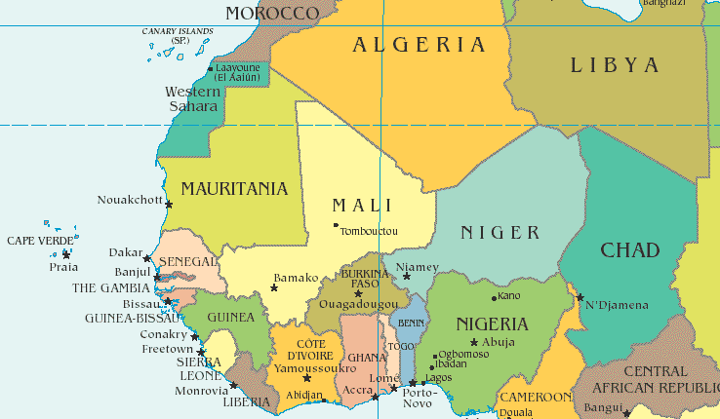

Slide 3
Population: 31.07 million (2020)
GNI per capita: 4,150 PPP dollars (2016)
Life expectancy: 61.49 years (2015)
Population growth rate: 2.2% annual change (2016)
Fertility rate: 4.12 births per woman (2015) world bank
Official language: English
Location: West Africa

Slide 4
Presentation Outline
Introduction
Threat to Nuclear Security in West Africa/Ghana
Nuclear Security in Ghana
Progress, Challenges, Way Forward
Concussion
Notes:
This template was inserted from Power-user, the productivity add-in for PowerPoint, Excel and Word.
Install Power-user to access thousands of templates, icons, maps, diagrams and charts with Power-user.
Visit https://www.powerusersoftwares.com/
©Power-user SAS, terms of license: https://www.powerusersoftwares.com/terms

Slide 5
Introduction
Nuclear and radiological terrorism remain a serious threat globally.
In Africa, inadequate prevention, detection, and response mechanisms to malicious acts involving nuclear or other radioactive materials have been identified as priority areas for urgent attention
The IAEA has significantly assisted African MS to improve their systems for protecting nuclear and other radioactive material during use, storage, and transport, and for combating the illicit trafficking of such material.

Slide 6
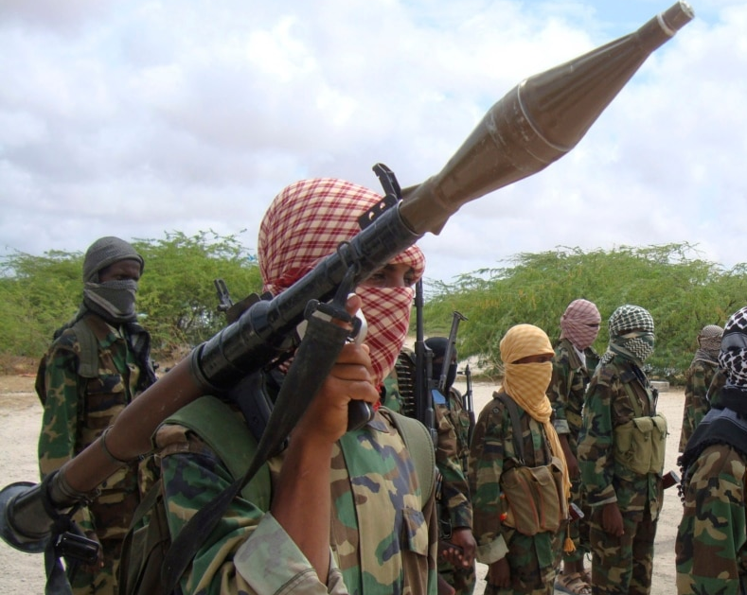
Threat to Nuclear Security in West Africa/Ghana
The last decade has seen a dramatic change in the character of violence in West Africa.
There has been a shift in large-scale conflict events and intrastate wars and an increase in low-level insurgencies and political violence by non-state actors.
In recent years, there have been recurrent attacks in Bamako in November 2015 (at the Radisson hotel), Abidjan in March 2016 (attack in the seaside resort of Grand-Bassam), and Ouagadougou in January 2016, and much recently in Nigeria.

Slide 7
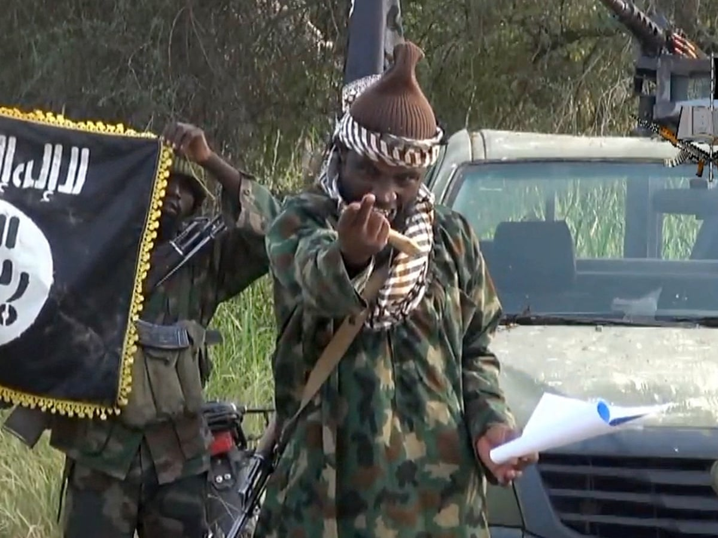
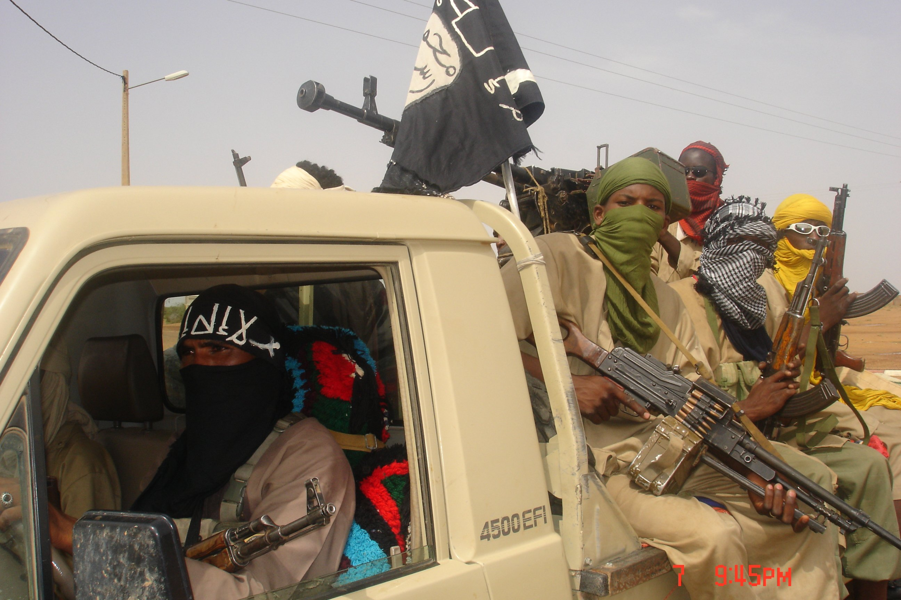
Threat to Nuclear Security in West Africa/Ghana
Al Qaeda in the Islamic Maghreb (AQIM)
Ansar al Din (“Defenders of the Faith”)
Jama’at Tawhid Wal Jihad fi Garbi Afriqqiya
(“Movement for Unity and Jihad in West Africa,” or MUJWA)
National Movement for the Liberation of Azawad (MNLA)
Jama’atu Ahlissunnah Lidda’awati wal Jihad (Boko- Haram)

Slide 8
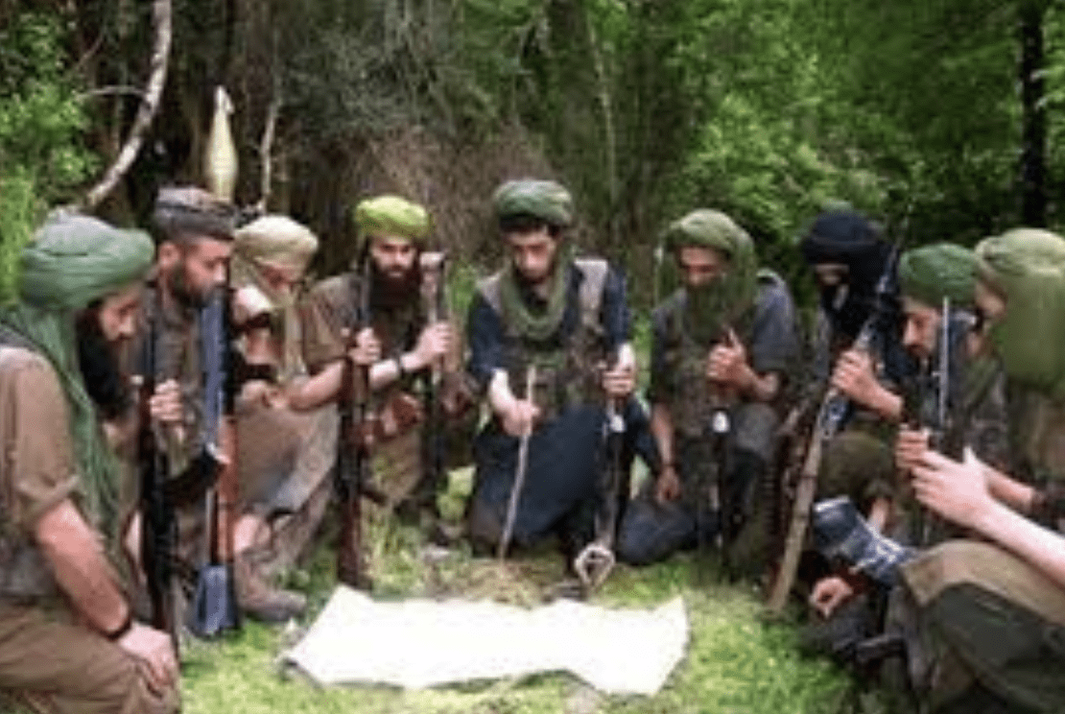
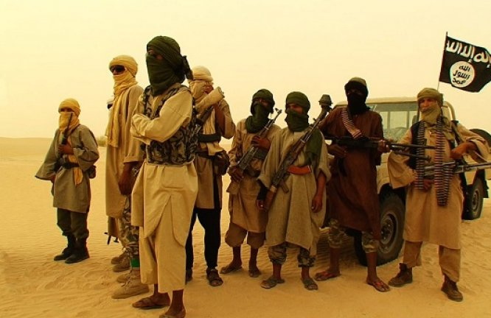
Threat to Nuclear Security in West Africa/Ghana
The potential for escalation of violence and the tendency that these groups could one day consider using nuclear or other radioactive materials to push their extremist agenda makes it imperative to address violent extremism and Nuclear Security in all its seriousness
Additionally counterterrorism efforts among governments within the region has remained largely uncoordinated and too narrowly focused to contain and confront long-term and sophisticated strategy these groups
Largely due to the fact that these strategies fail to address the underlying factors contributing to the outbreak of these crimes as well as the complex linkages between them

Slide 9
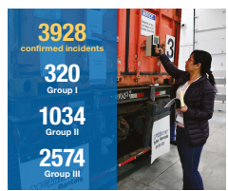
Threat to Nuclear Security in West Africa/Ghana
IAEA Incident and Trafficking Database (ITDB), 2022 Factsheet
Over 1205 incidents of nuclear and other radioactive materials outside of regulatory control have been recorded in 48 countries since 2013
few of these involved nuclear weapons-useable materials and at least 329 incidents involved materials highly suitable for radiological terrorism.
3 of such incidents happened in West Africa
In 2021, 120 incidents were reported to the ITDB by 32 States. These indicate that unauthorized activities and events involving nuclear and other radioactive material, including incidents of trafficking and malicious use, continue to occur.
James Martin Centre for Nonproliferation Studies (CNS)

Slide 10
Threat to Nuclear Security in West Africa/Ghana
Concern about cross border crime and its implications
Weak states, porous borders,
availability of small arms and light weapons (SALW),
Relatively free movement of persons and goods,
The youth bulge
the growing networks of transnational criminals

Slide 11
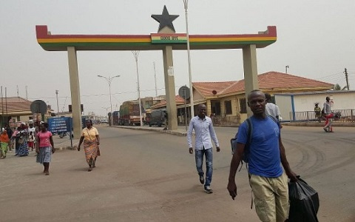
Threat to Nuclear Security in West Africa/Ghana
Borders of Ghana have become major transit points for human, firearm, and drugs trafficking– KAIPTC
In Ghana there are complex issues confronting border security
The response mechanisms instituted to address the problems do not meet the required standards to ensure effective security
Ultimately, if these issues remain unchecked, it posses a threat to nuclear security in the region as a whole and provides an avenue for non-state actors to exploit these same channels to smuggle stolen Nuclear Materials or Radioactive sources into the country posing a serious threat to the country’s national security.

Slide 12
Ghana’s Nuclear Security
INSServ Mission
IPPAS
Key recommendations at that time were that Ghana’s Legislation was not yet compatible with international standards and guidance
International
Nuclear Security Advisory Service
2006
Radiation Safety and Security of
Radioactive Sources, Infrastructure Appraisal
2006
International Physical Protection
Advisory Service
2007
RaSSIA

Slide 13
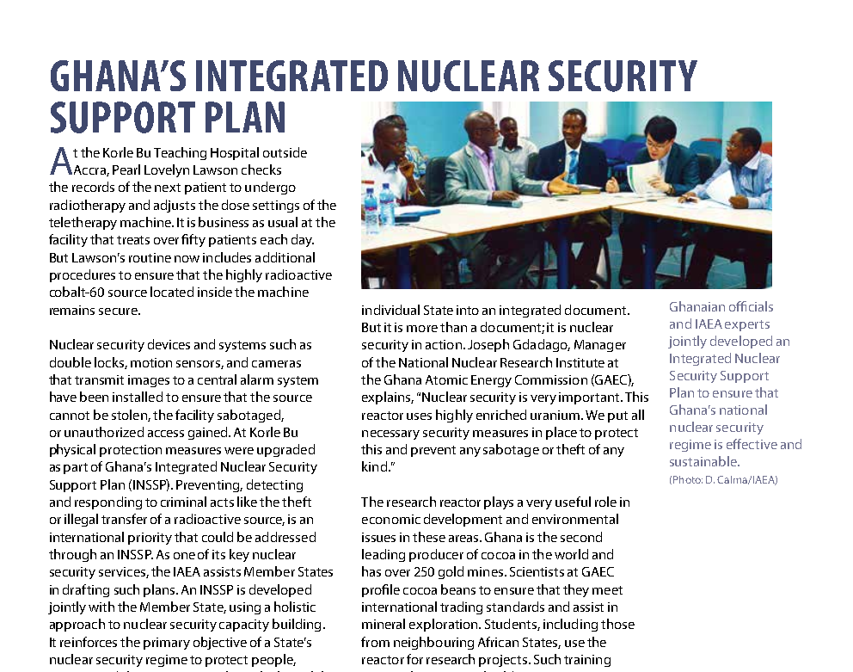
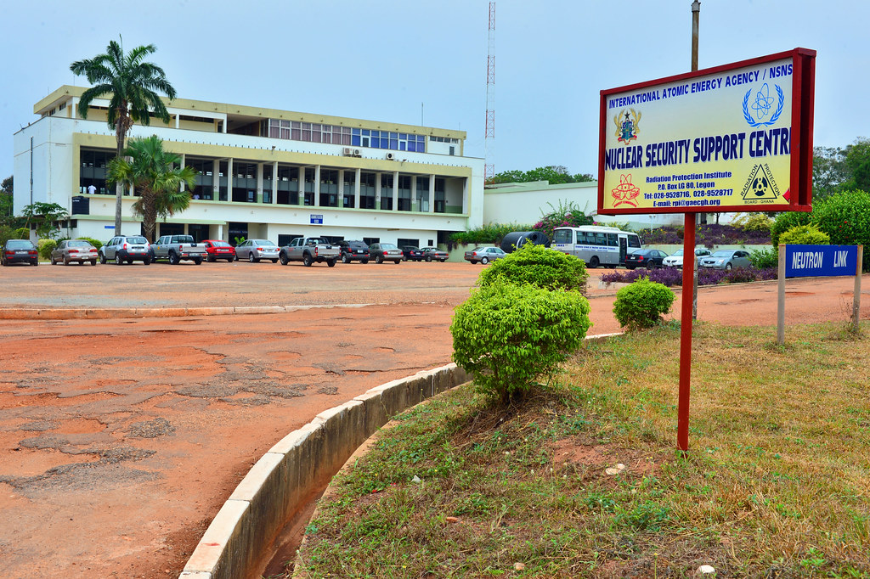
Ghana’s Nuclear Security
Development and adoption of the Ghana Integrated Nuclear Security Support Plan (INSSP) - forms the baseline guidance
document on nuclear security activities in the country
INSSP
Establishment of the Nuclear Security Support Centre with support from the IAEA – to provide technical Support Services for lifecycle equipment management and Scientific Support Services for the prevention, detection of, and response to nuclear security events.
NSSC
NSC
Establishment of the Nuclear Security Committee – Multi stakeholder coordinating body made up of representatives from various relevant institutions.

Slide 14
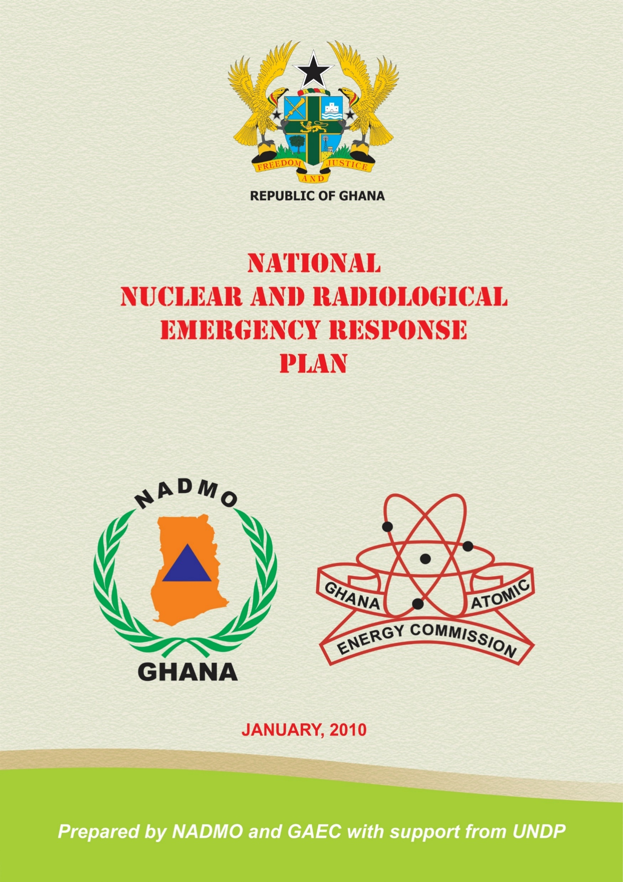
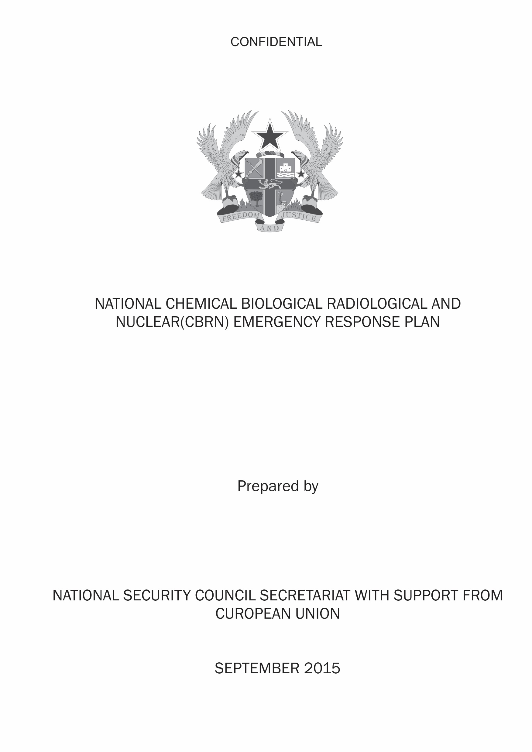
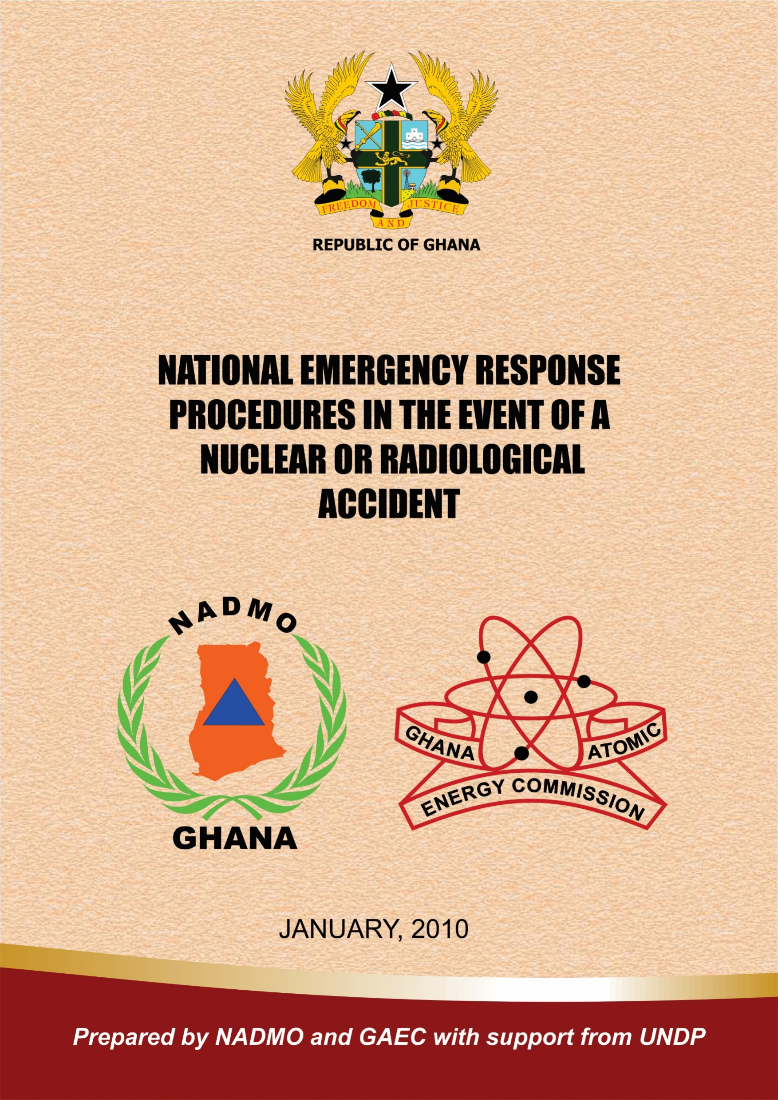
Ghana’s Nuclear Security
In 2010, Ghana developed The National Nuclear And Radiological Emergency Response Plan And Procedure document
The plan is to establish an organised emergency response capability for timely, coordinated action of the Ghanaian authorities in a peacetime nuclear or radiological emergency.
Currently Under Review

Slide 15
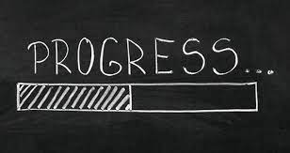
Major Progress and Challenges
Progress on Ghana’s Nuclear Laws and Regulations
Improving Security and Control
Progress on International Cooperation
The slow pace in the drafting of Regulations and guides
No force-on-force exercises.
Building Ghana’s nuclear cyber security
Promoting nuclear security culture

Slide 16
The way forward
Improving Security and Control
Nuclear Security Support Centre into a Centre of Excellence for Nuclear Security in the region.
Fast tracking the development of regulations.
Bolstering Nuclear Security Culture
Strengthening Greater Cooperation

Slide 17
Conclusions
Whiles Ghana has made substantial gains in its nuclear security, through improvements in legislations, security and control, security culture improvement and cooperation. There’s exist room for improvement

Slide 18
Thank You

