Slide 1

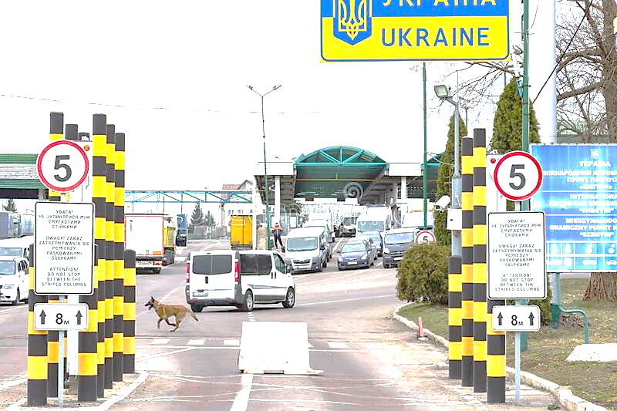

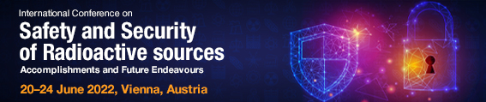

Gamma/Neutron detection and identification systems for tracking and inspection of radioactive sources
Alessandro Iovene, Massimo Morichi, Matteo Corbo, Erica Fanchini, Ferdinando Giordano, Giacomo Mangiagalli
CAEN SpA, Via Vetraia 11 – 55049 Viareggio (LU) – ITALY

Slide 2
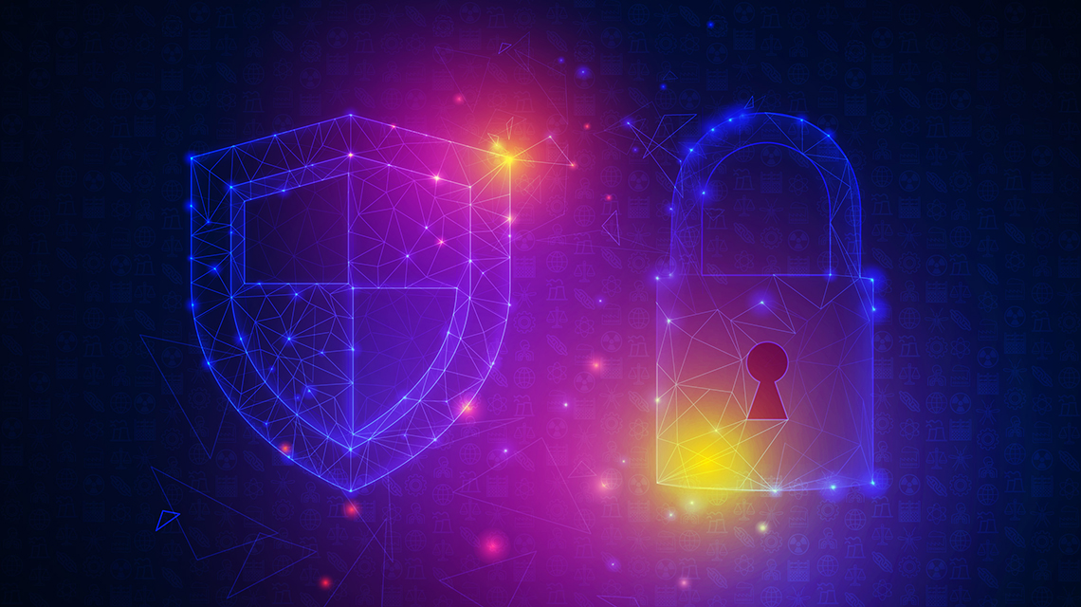
Abstract
The availability of monitoring and inspection tools is a critical asset for a distributed tracking, inspection, and control of radioactive sources.
Since more than 10 years our group is actively involved in the development of innovative tools and techniques aimed at supporting on-field operators for preventing and detecting illicit trafficking of Special Nuclear Materials (SNM) and other radioactive sources. This activity has been carried out with different approaches in various EU funded projects, such as MODES_SNM and C-BORD, within FP7 and H2020 programs respectively.
We will give an overview of what have been developed within these frameworks so far, deepening on the SNIPER-GN technology which is now the state-of-the-art for gamma/neutron sources detection and identification and which is the key technology for SNM detection in “SILENTBORDER”, a new H2020 project focused on non-intrusive inspection of cargos passing through European borders.

Slide 3
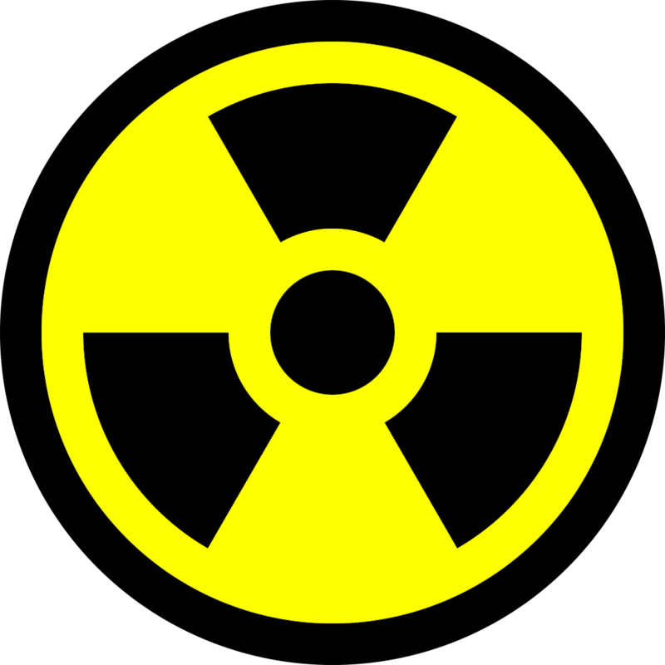
Summary
SLIMPORT-SLIMCHECK: the first idea of a passive/active multidetector SNM detection and identification system for border security
MODES_SNM: bringing the passive multidetector detection and identification to the next level
The concept of SNIPER-GN is born (multidetector compact passive system)
C-BORD: the passive/active multidetector detection & identification technology deployed in cargo border controls scenario, for multi-thread detection and identification
ENTRANCE: pushing the C-BORD state of the art of passive/active detection system to data fusion and usability enhancements
SILENTBORDER: Cosmic Rays Tomography + SNIPER-GN technology for CARGO scanning

Slide 4
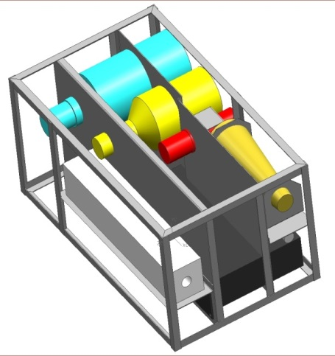
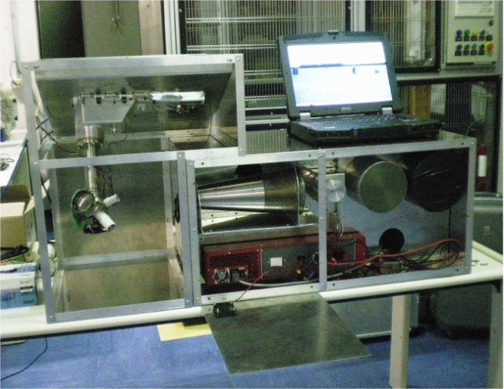

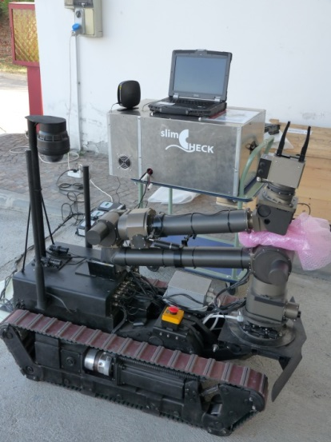
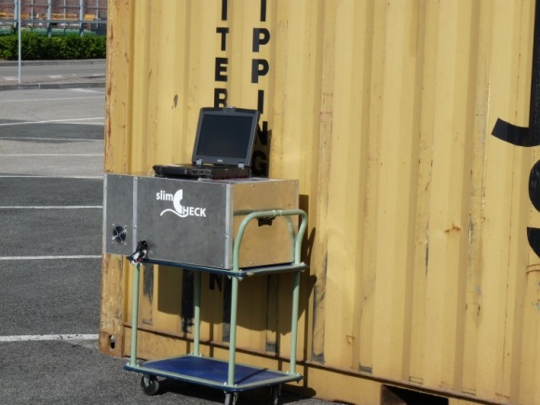





Slimport – Slimcheck (2009-2011)
CAEN, in collaboration with University of Padova, developed an integrated mobile system for port security as a part of the SLIMPORT project, funded by the Italian Ministry for the Economic Development (MISE) under the "Industria 2015" program.
This system, called SMANDRA, aimed to detect and identify different types of radioactive and nuclear materials hidden inside containers, and to identify dangerous and/or illegal materials inside volumes tagged as "suspect" by conventional surveys (as active NDA system).
The SMANDRA system consists in two different parts:
A PASSIVE UNIT featuring Gamma-ray detectors (NaI and LaBr) and neutron counters (Liq. Scintillator and 3He proportional counter)
AN ACTIVE UNIT that contains a EADS-SODERN sealed neutron generator with the associated particle detector to perform active interrogations using the tagged neutron inspection technique

Slide 5


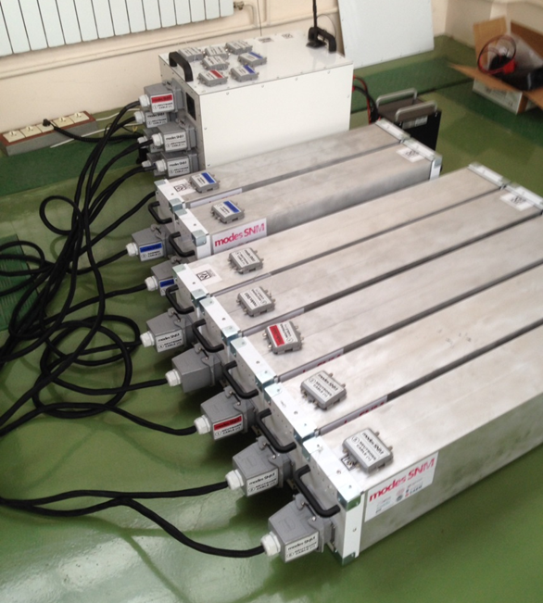
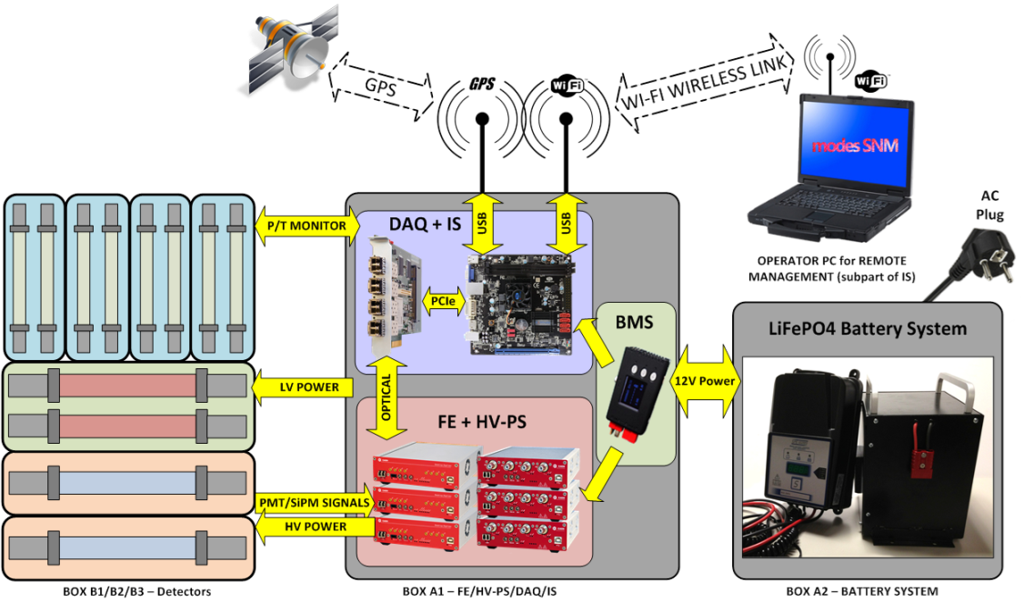
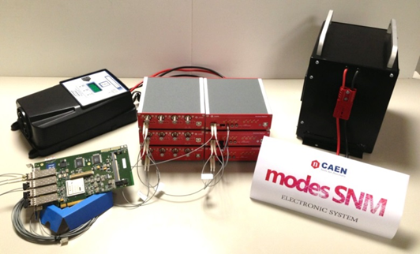





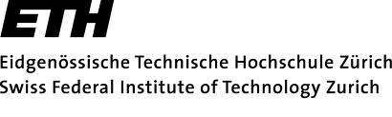
MODES_SNM (2012-2014)
MOdular DEtection System for Special Nuclear Materials
The MODES_SNM project aimed to carry out technical research in order to develop a prototype for a mobile, modular detection system for radioactive and Special Nuclear Materials (SNM).
To maximize the detection capability for SNM, the project developed new detectors for fast and thermal neutrons, as well as gamma-rays, based on the technology of high-pressure scintillation cells using noble gases (as ⁴He and Xe).

Slide 6
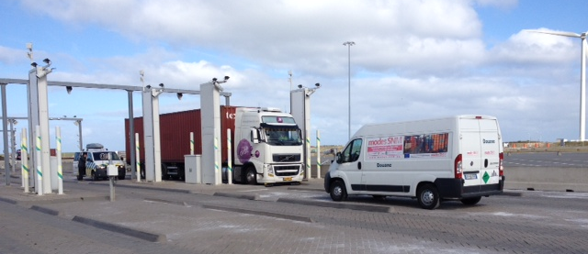
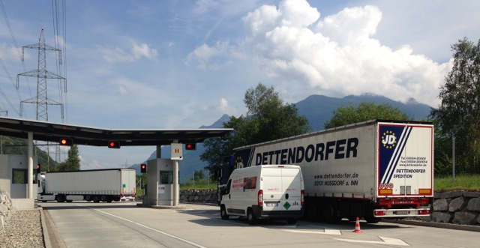
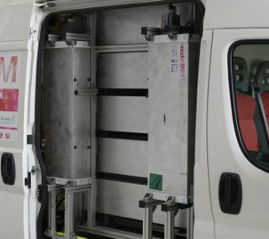
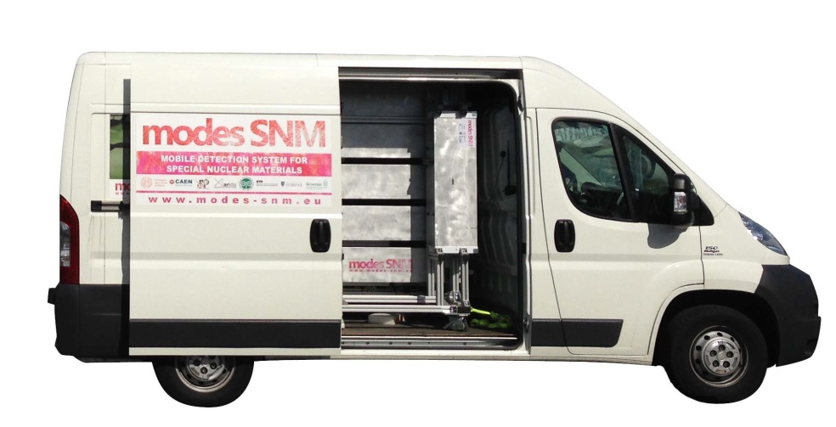
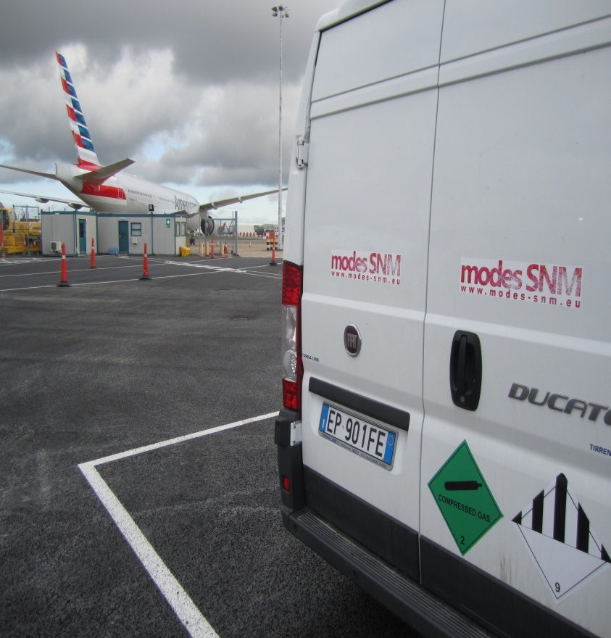
MODES_SNM (2012-2014)
Field trial in Rotterdam (NL)
Demonstrated identification of gamma-ray sources and NORMs
Demonstrated identification of neutron sources: 252Cf, Am/Be, Pu/Be
Demonstrated identification of SNM: Pu and U samples
The system was able to detect the presence of hydrogenated or lead shield around the neutron sources.
The system survived all transportations over 6000 km and end-user operation under different conditions.
The end-users were able to run the system without problems.
Field trial in Basel and Uri (CH)
The MODES_SNM van
Heathrow
Airport
(UK)
Software
interface
Detectors

Slide 7
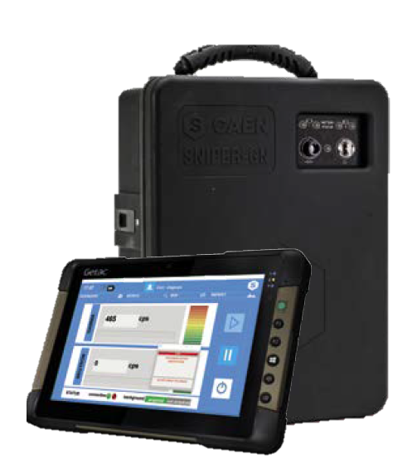
The SNIPER-GN technology
The most performant GAMMA and NEUTRON isotope identifier for
Special Nuclear Material
SNIPER-GN can detect and also identify in only 1 minute 5.6g of Plutonium placed at 2,5 m of distance
Passive detection systems used for security control in safety conditions and to avoid any interference with working procedures:
Fast response and Short time measurement
Versatile and simple to use
GAMMA detection/counting is the minimum requirement
GAMMA Spectroscopy identification is an added value
NEUTRON detection/counting is a plus
NEUTRONS identification (FAST NEUTRONS) was not implemented until today

Slide 8
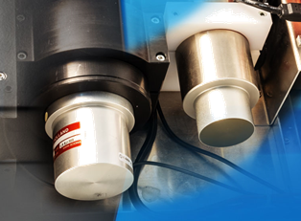
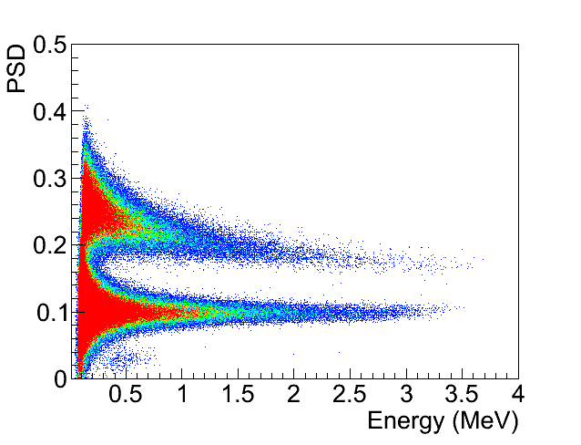

The SNIPER-GN technology
SNIPER-GN is equipped with 2 detectors
A CeBr3 for mid-high resolution gamma spectroscopy (<3,5% @662 keV)
  Gamma peak search is used also in neutron source identification algorithm
      enhances the SNM identification
      Allows enrichment level estimation
  Gamma/neutron liquid scintillator
      Real time gamma/neutron discrimination**
      Neutron source identification with discrimination between fissile material (Cf-252), alpha-n (Am/Be and Am/Li) sources, Plutonium and Uranium
** based on the same Pulse Shape Discrimination (PSD) algorithm tested and implemented by CAEN for the IAEA Fast Neutron Collar Monitor (fresh fuel verification)

Slide 9
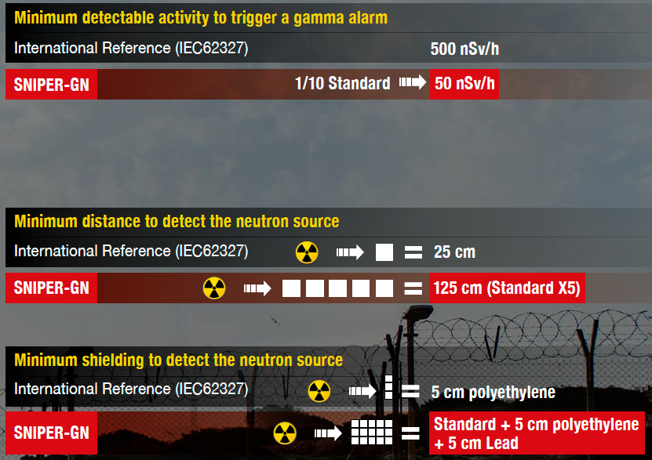
The SNIPER-GN exceeds the standards
IEC 62327 – 2017 (EU)
Hand Held Instruments for the Detection and Identification of Radionuclides
    1 s for gamma alarm (500 nSv/h above bkg, moving at 0,5 m/s @ 1m)
    2 s for neutron alarm (²⁵²Cf 20.000 n/s @25 cm)
    1 min or less for identification of isotope
    No requirement on the IDENTIFICATION of neutron sources through neutron measurement

Slide 10
The SNIPER-GN best measurements
    SNIPER GN IS ABLE TO DETECT AND ALSO IDENTIFY IN ONLY 1 MINUTE:
    5.6g of Plutonium mix @ 2.5 m of distance
      12 correct identification on 15 tries – 80%
    5.6g of Plutonium mix @ 1.5 m of distance
      105 correct identification on 105 tries – 100%
    5.6g of Plutonium mix @ 50 cm of distance with 6cm of polyethylene and 5 cm of lead shielding the source
      10 correct identification on 10 tries – 100%
    A Cf-252 source of 0.57 MBq @ 2 m of distance
      15 correct identification on 15 tries – 100%
    A Cs-137 source of 16.17 MBq encapsulated in 6 mm of lead at @ 10 m of distance
      < 10 nSv/h on the detector

Slide 11

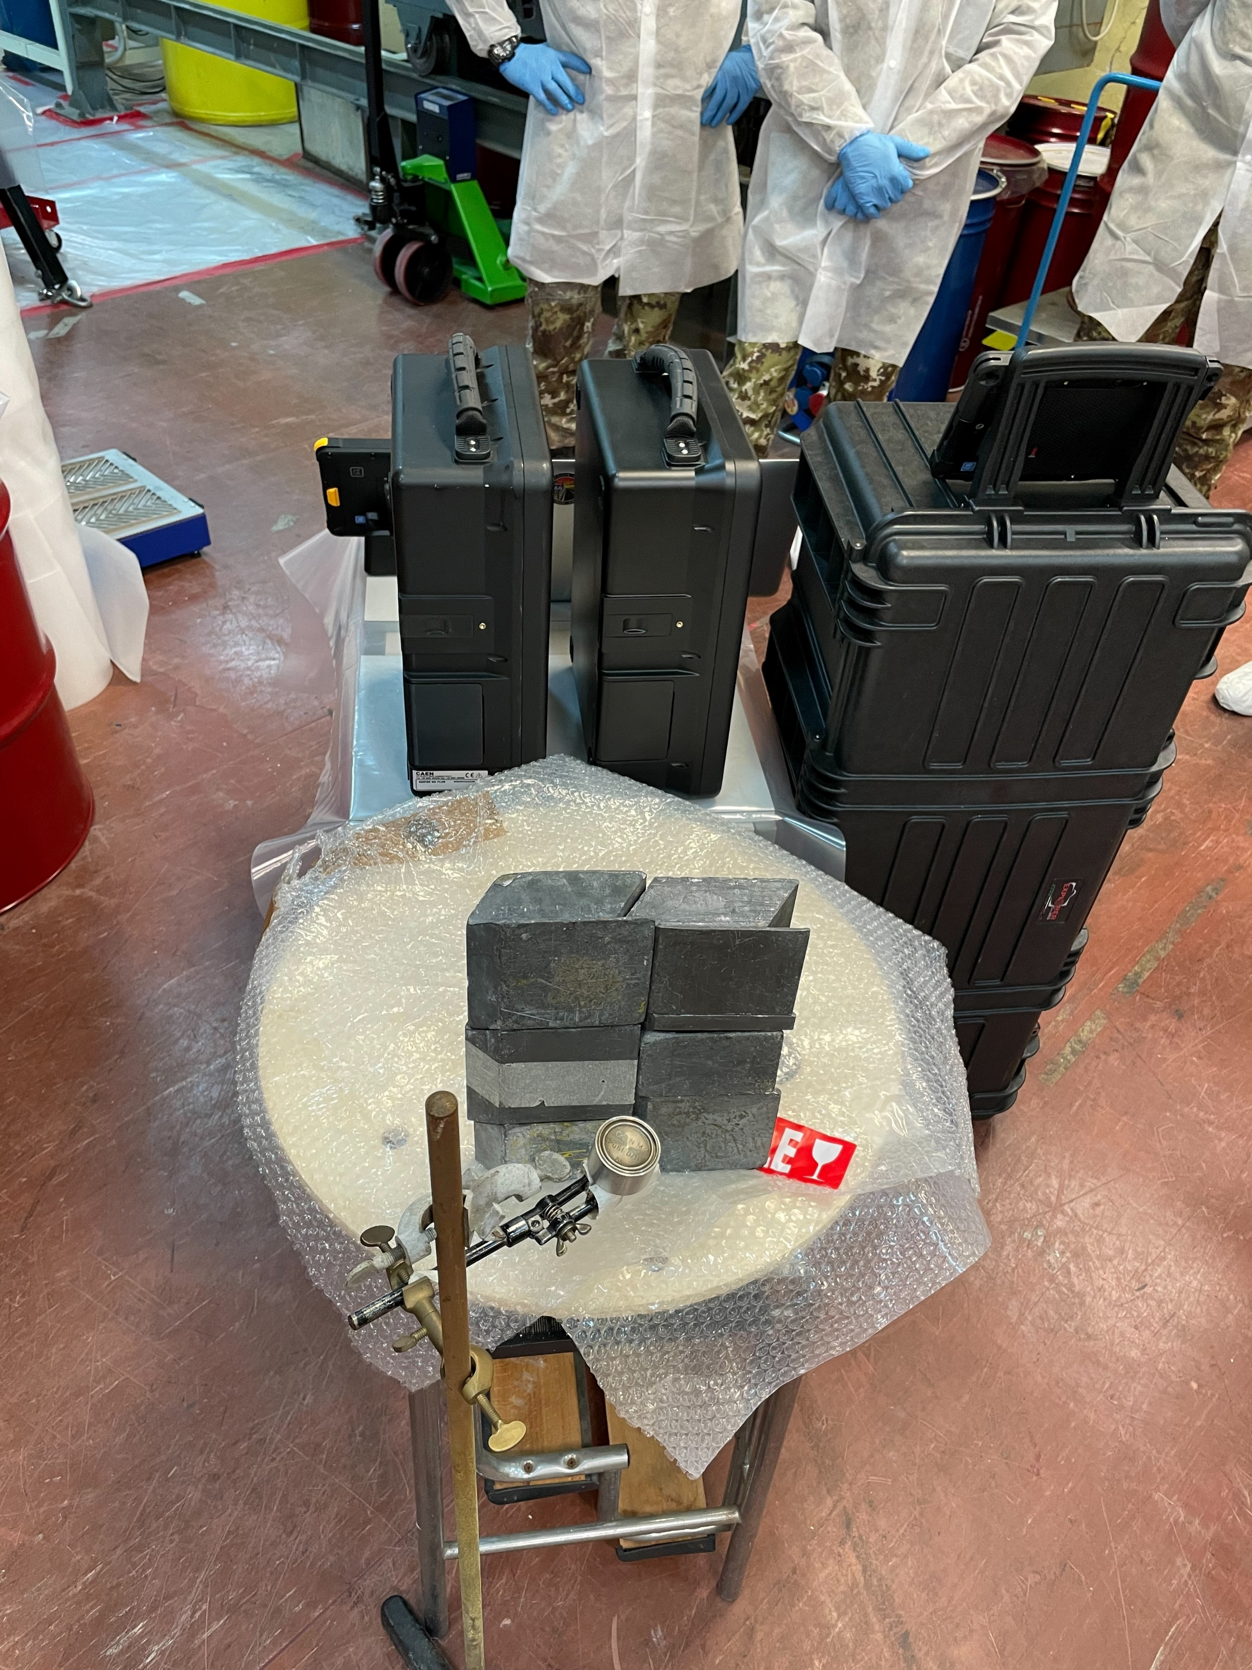
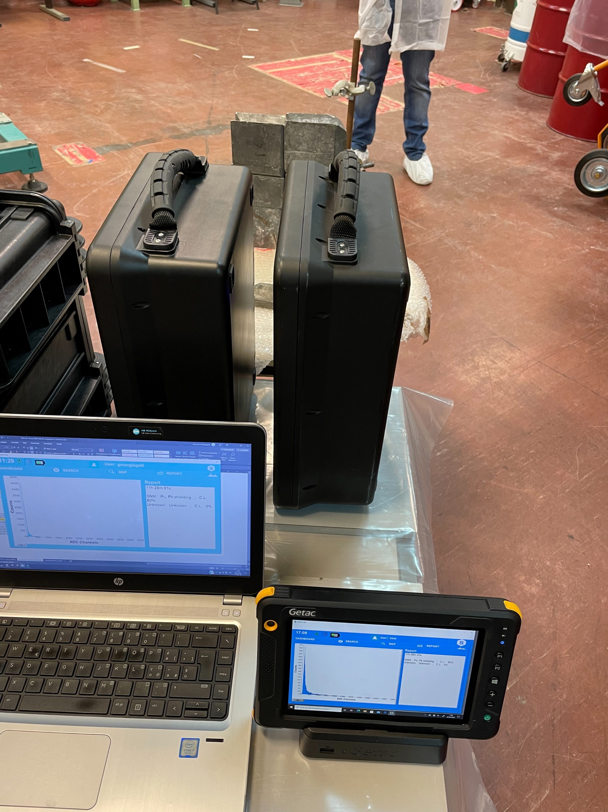
SNIPER-GN MILITARY CERTIFICATION
    TESTS PERFORMED @ ENEA Reference Laboratory
    In presence of Ministry of Defence (ARMY and NAVY) for NATO approval
NATO STOCK NUMBER
6650150265712

Slide 12







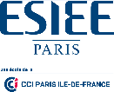












C-BORD (2015-2019)
effective Container inspection at BORDer control points
The project aimed at proving a complete system for cargo scanning in harbours
The C-BORD system the following technologies:
  X-RAY
  Rapidly Relocatable Tagged Neutrons Inspection System (TNIS)
  Passive Radiation sensors (RPMs)
  Photofission System
  Sniffer sensors
Funded by: EUROPEAN COMMISSION
Programme: H2020 – Secure Societies
Theme: Border Security, Supply chains

Slide 13
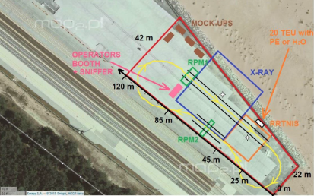
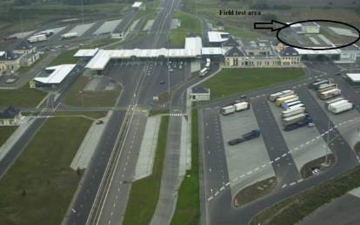
C-BORD (2015-2019) – Field Trials
Gdańsk seaport -Deepwater Container Terminal
“Rapidly relocatable checkpoint for ports”
Toolbox: 4 technologies
  Passive
  Improved X-ray
  Evaporation Based
  TNIS
April 2018
Hungarian Röszke land border crossing
“Mobile checkpoints”
Toolbox: 3 technologies
  Passive
  Improved X-ray
  Evaporation Based
May 2018
Rotterdam seaport
“Fully automated seaport”
Toolbox: 5 technologies
  Passive
  Improved X-ray
  Evaporation Based
  TNIS
  Photofission
June 2018

Slide 14





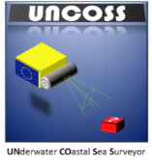
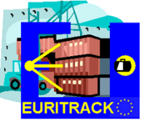


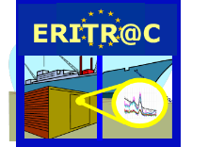




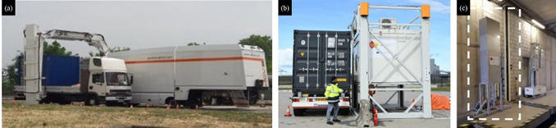
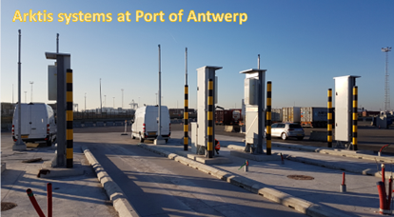

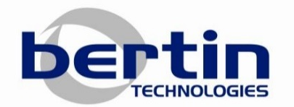



ENTRANCE (2020 - ongoing)
  Development and validation of a comprehensive user-based toolbox for risk-based non-intrusive inspection (NII) of cross-border freight movements, with particular focus on the EU borders
  Enhancement of border security practitioners’ capabilities to protect society against a wide range of dangerous and illicit materials with minimum disruption of cross-border flow of goods
Building on previous H2020 research
X-RAYS
TNIS
RPM

Slide 15

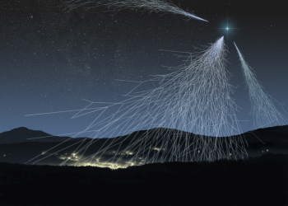


Silentborder (2021 - ongoing)
  Widely used technologies for scanning vehicles are gamma-ray and X-ray radiographies, but new ones are required for overcoming current shortcomings. Cosmic-ray tomography (CRT) is considered as beyond the state-of-the-art technology in cargo screening. Cosmic-ray muons are highly penetrating, with energies about 10,000 times the energy of typical X-ray and practically non-absorbable.
  Bridging the security gap for fast and safe inspection of large number of cargos by developing a Multi-Functional Passive Detection System. Which capability is based on high accuracy sensors for particle tracking in combination with beyond state-of-the art tomographic reconstruction and material classification algorithms.
SNIPER technology
For SNM detection
CRT for imaging

Slide 16

Acknowledgments
The project MODES_SNM has received funding from the European Union’s 7th Framework Programme (FP7) under grant agreement No 284842. This text reflects only the author’s views and the Commission is not liable for any use that may be made of the information contained therein.
The projects C-BORD, ENTRANCE and SILENTBORDER have received funding from the European Union’s Horizon 2020 research and innovation programme under grant agreements 653323, 883424 and 101021812 respectively. This text reflects only the author’s views and the Commission is not liable for any use that may be made of the information contained therein.

