Slide 1
A smart underwater sensor for localizing radioactive sources
C. Tsabaris, S. Alexakis , E.G. Androulakaki , D. L. Patiris
Hellenic Centre for Marine Research, Anavyssos, Greece

Slide 2
Motivation & Goals
Radiological surveys at the marine environment
Monitoring of radioactivity and dosimetry at coastal areas with enhanced nuclear and non industry
Monitoring at areas where pending new nuclear reactors constructions will operate
Hot spot identification
Smart detection systems
Supporting international policies for assessing the state of the sea environment.
To map rapidly radioactivity levels and dose rates.
To control systematically the state of the sea in terms of radioactivity.
To upgrade the database of marine radioactivity.
To develop new technologies and methods for hot spot identification in the marine environment.
To identify barried radioactive objects
To support safety and security tasks in national level.

Slide 3
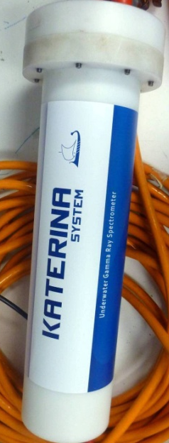
ΚΑΤΕΡΙΝΑ II detector
System control:
1) Stability of electronics,
2) calibration using laboratory reference samples
Request:
A methodology for providing activity concentration maps in a rapid way
Quantified data: Radioactivity maps do not require low uncertainty values
Description
A low resolution 3x3 NaI crystal
Underwater enclosure for subsea operations
Autonomous in terms of PC connection
Provides repeated measurements without computer
Low consumption (1W)
Loc cost and small dimentions

Slide 4
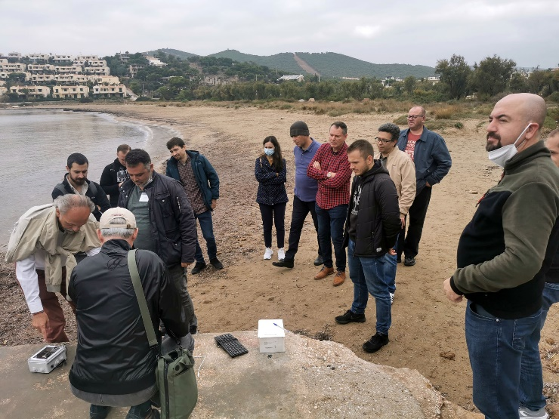
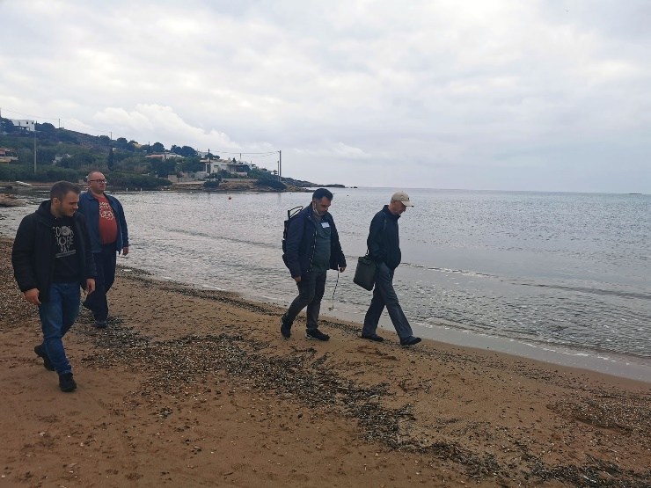
KATERINA II as a geo-referenced measuring detection system
A GPS is integrated in the KATERINA II detector
The position of the GPS is set in the middle of the transect (Start point, End point).
The trancects are made starting from round of the area and then following vertical and horizontal transects .
Each spectrum contains the counts per channel and the lan-lot coordinates (preset time 20-30s)
After the end of the experiment the data are transferred to the operational center
The maps are produced in a rapid manner using the R- language

Slide 5
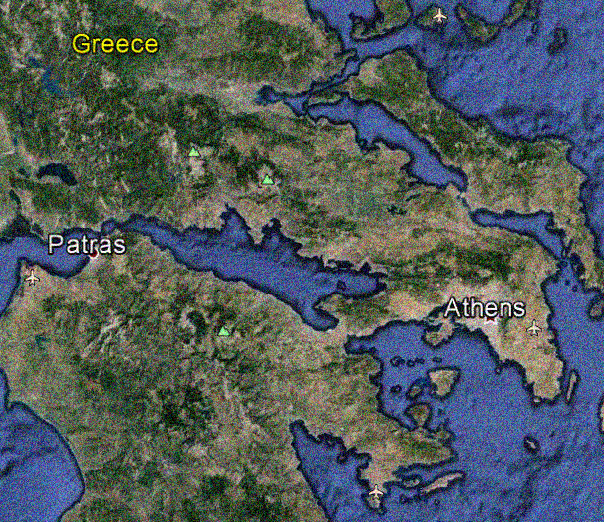
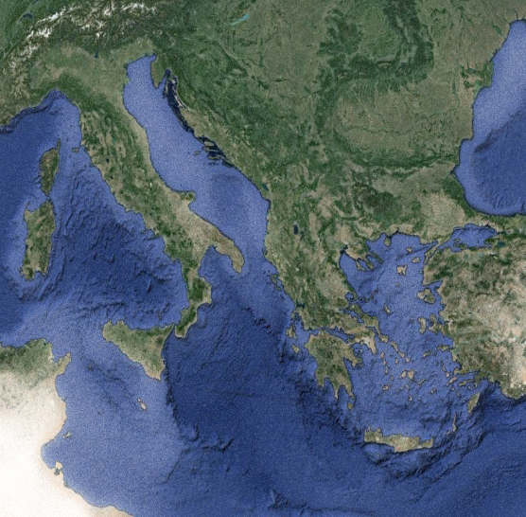
Recent study (IAEA workshop, April 22)
City of Lavrio (Limani Pasa)
Commercial port, mining activities, expanding urban area
Sounio (Legrena)
Natural area with the minimum anthropogenic activity

Slide 6
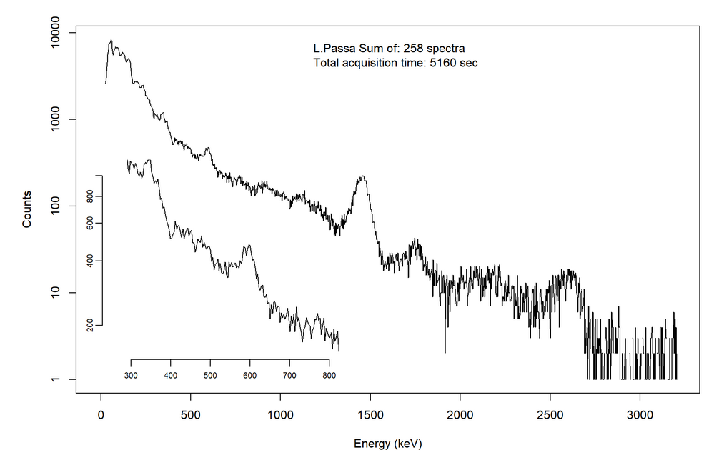
Total gamma-ray spectrum
Limani Pasa, April 2022
²¹⁴Bi
⁴⁰K
²¹⁴Bi
²¹⁴Bi
²⁰⁸Tl

Slide 7
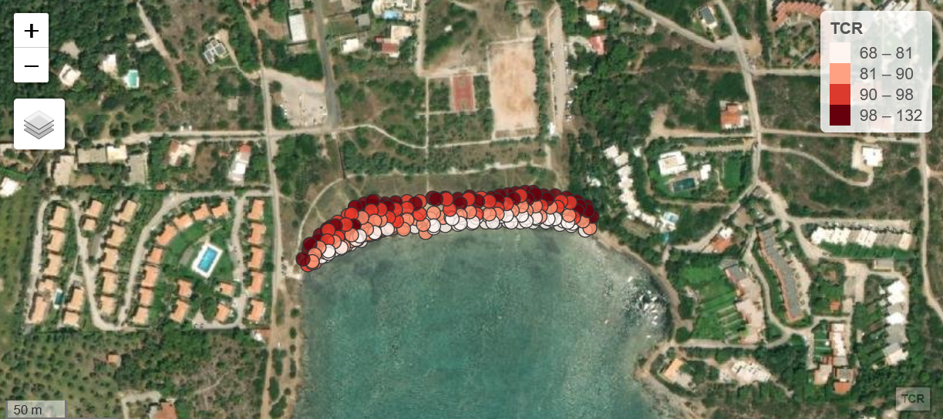
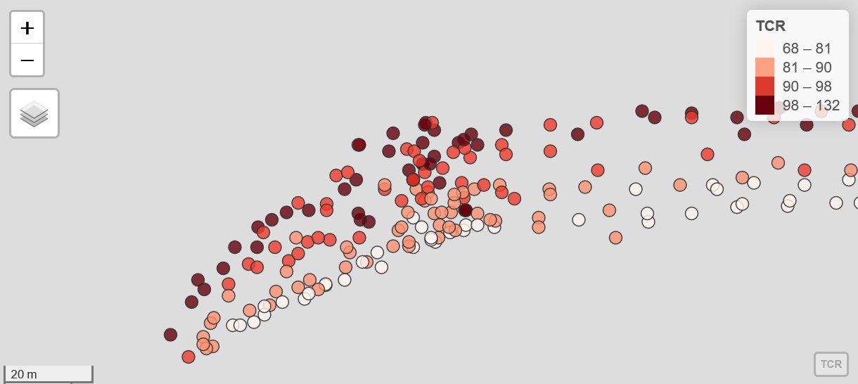
⁶⁰Co
¹³⁷Cs

Slide 8
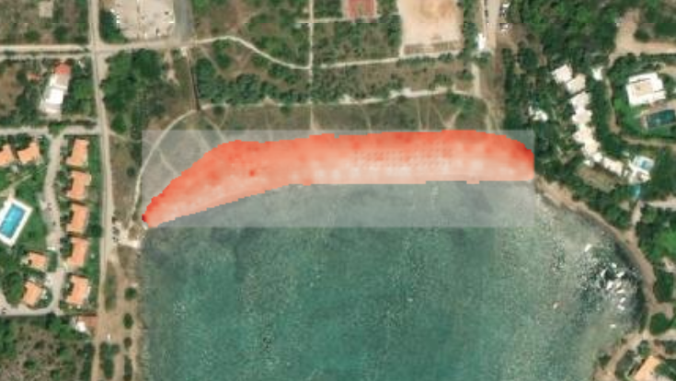
¹³⁷Cs

Slide 9
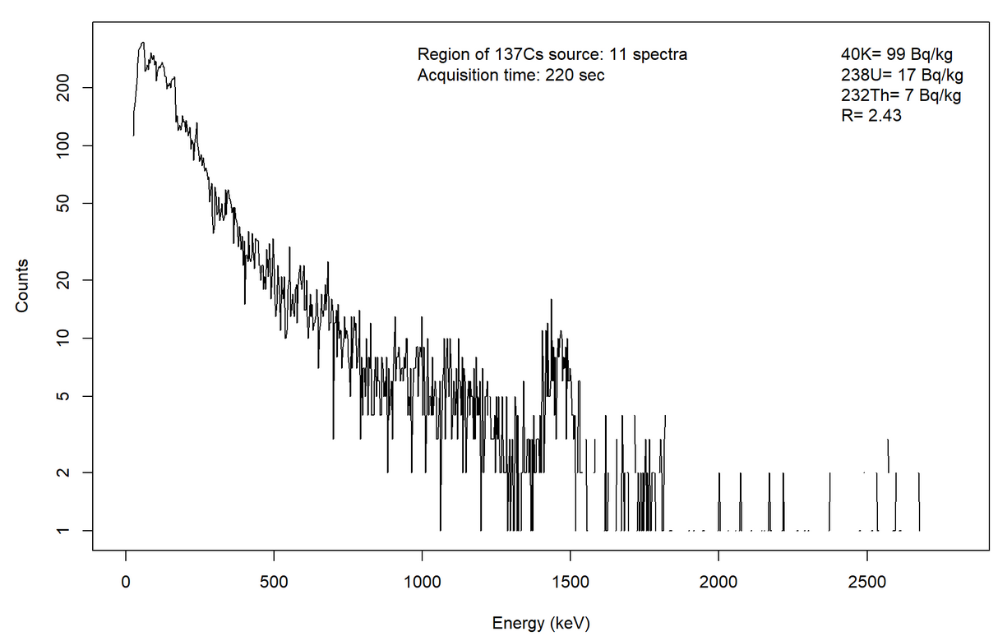
Gamma-ray spectrum (in an area of interest)
Limani Pasa, April 2022
¹³⁷Cs

Slide 10
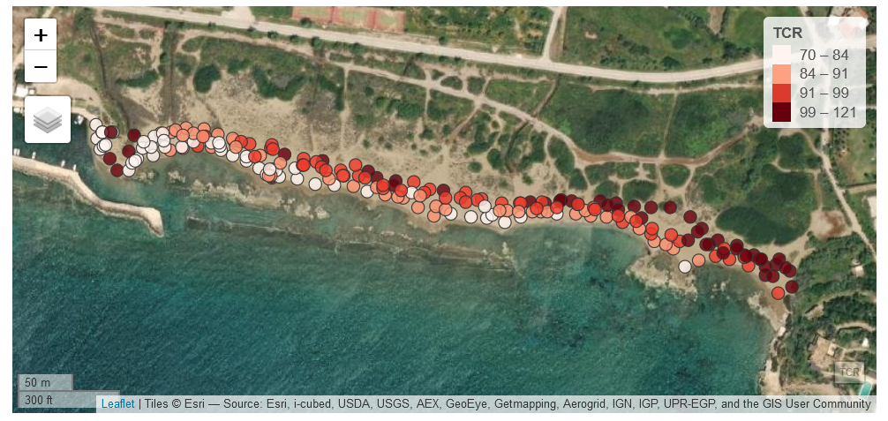
Spatial (surface) distribution of TCRs
Legrena May 2022

Slide 11
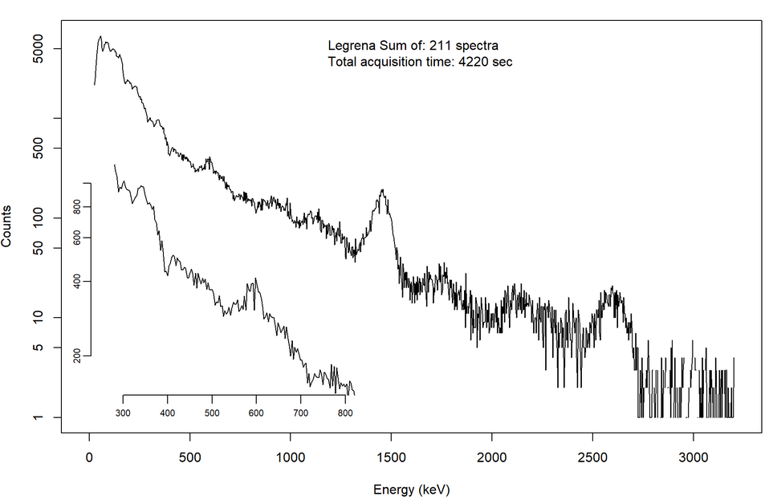
Total gamma-ray spectrum
Legrena May 2022

Slide 12
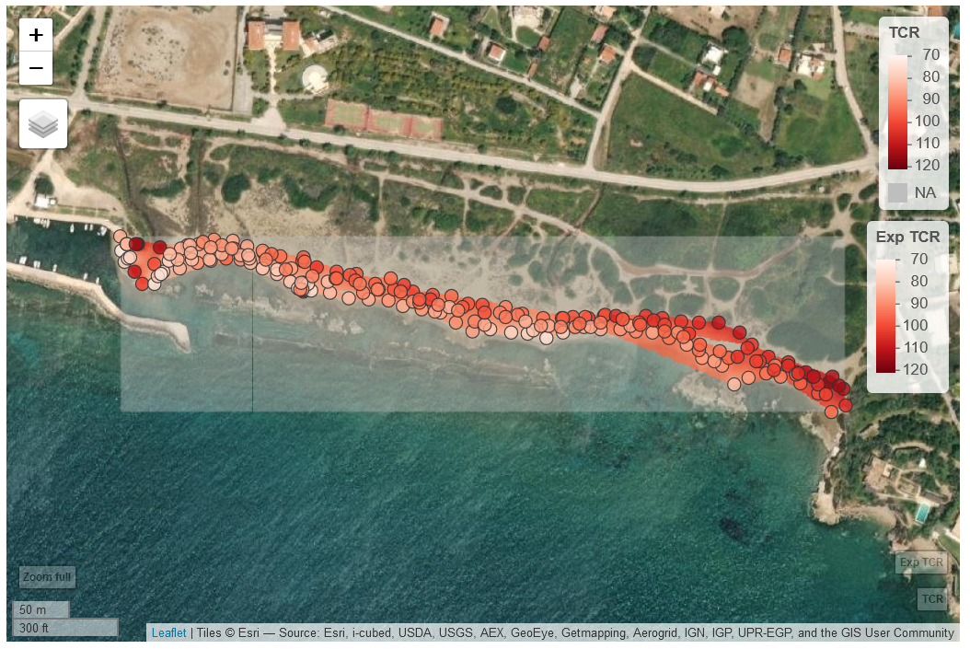
Map of TCR (IDW method)
Legrena May2022

Slide 13
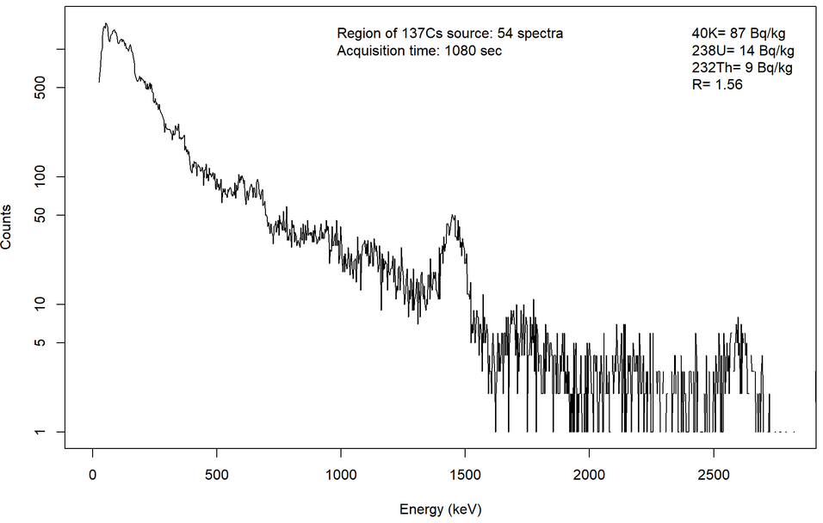
Gamma-ray spectrum (in an area of interest)
Legrena, May 2022
²¹⁴Bi
¹³⁷Cs

Slide 14
Advantages of geo-referenced system
Easy to transportthe detection system abroad
Rapid mapping of TCR
Rapid mapping of artificial and natural radionuclides
Hot spot identification using regions of interest in map
Easy to be integrated in marine drones due to small dimentions and light weight
Low cost method compared with lab-based methods
Optimised software for better identifying radioactive sources (IDW method was more efficient than kriging method)

Slide 15
Next steps
To perform many/dense transects for improving counting statistics.
Energy Window Analysis and system calibration for dose rates
Mapping areas close to coastal industry (mining, fertilizer, cement, bauxite, petrochemical etc) and enhanced volcanic activity
Method optimization enabling mobile unit (unmanned and autonomous)
Future training activities / workshops related to activities of gamma-ray mapping in beaches and seabeds.
Supporting national and international authorities related to nuclear security and safety.

Slide 16
Acknowledgements
IAEA for granting the presentation of this work.
IAEA Coordinated Research Project F22074, “Development of Radiometric Methods and modelling for measurement of sediment transport in coastal systems and rivers” (HCMR project: In-Situ Method for Radioactivity Mapping of Beach Sands to Study Transport Processes Using Radio-Tracers).

