Slide 1

International Conference on Safety and Security of Radioactive sources: Accomplishments and Future Endeavours
Indico ID: IAEA-CN-295-319
Safety and Security Interface within The Cameroon Centralized Storage Facility
Jean Félix BEYALA ATEBA
Ph.D in Applied Nuclear Physics
Senior Research Officer
Technical Directorate Chief Officer
National Radiation Protection Agency (NPRA)

Slide 2
Content
Introduction
Centralized storage facility
Safety measures within the facility
Security measures in Place
Conclusion

Slide 3

Introduction
  Law N° 2019/012 of 19 July 2019 provides the general framework for radiological and nuclear safety, nuclear security, civil liability and safeguards enforcement
As per Section 5 (3) of the Act:
The State shall establish the following nuclear policy principles:
…recognition of the urgent need to manage radioactive waste in order to protect current and future generations against excessive impacts…”,
In this frame, the Republic of Cameroon has established with the support of the International Atomic Energy Agency (IAEA) and the Department of Energy of United States of America (DOE/USA) the Centralized storage facility for safe and secure management of disused sealed radioactive sources (DSRS).

Slide 4
Introduction
The Republic of Cameroon centralized storage facility consists of two ISO containers used as source storage room and source conditioning room respectively.
An alarm monitoring station is also one component of the facility.
The facility has been designed in order to manage disused sealed radioactive sources (DSRS) in safety and security manner.
Safety measures and security measures have been designed and implemented in an integrated manner so that security measures do not compromise safety and safety measures do not compromise security.
In order to reduce and protect the disused sealed radioactive sources (DSRS) located at the Centralized storage facility, the security enhancements are based on the IAEA Nuclear Security Series No. 11 namely Security of Radioactive Sources [2].
The security enhancements have been incorporated into the source storage room, source conditioning room and alarm monitoring station.

Slide 5
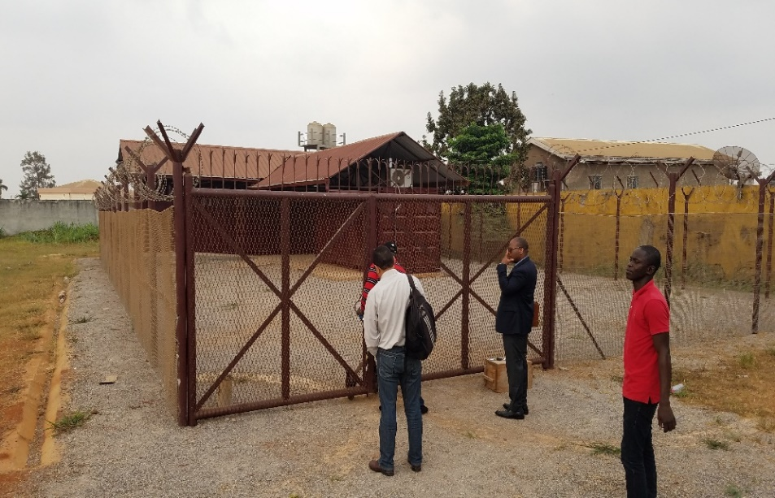
Centralized Storage Facility
The installation consists of a 40 feet container and a 20 feet container.
Safety measures in place will allow to dismantle and to load category 3 to 5 DSRS in the P-60 capsule and to transfer the capsule to the lead shield and then the whole to the 200l drum for the safe and secure storage.
The 200l drum packages will be locked, sealed and labelled according to the measured dose rates at 1 meter.

Slide 6
Centralized Storage Facility
Security measures in place take into account delay, detection measures as well as the response procedure.
Safety measures in place will contribute to improve security through the use of adequate seals and lock mechanisms.
In addition, the robust and heavy 200l drum increase the difficulty for an adversary to remove or sabotage the packages.

Slide 7
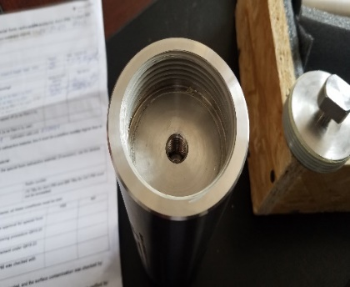
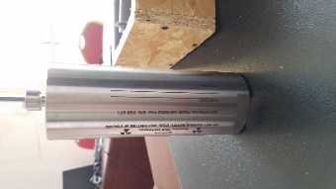
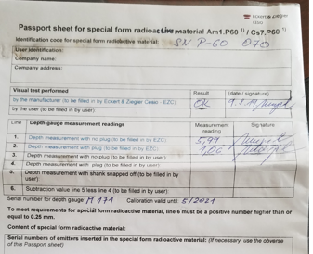
Safety Measures within the Facility
According the national waste management policy and strategy, the existing facility allow on to manage category 3 to 5 low activity disused sealed sources and to send back to the suppliers, category 1 to 2 disused sealed sources.
Operational measures planned consist in different steps.
First of all, a wipe test on the source associated equipment must be performed in order to check its radioactive contamination status.
The second step is the characterization of the source through the estimation of the source activity in order to have total activity to be transferred to the P60 capsule.
The third step is the transfer of the DSRS from their respective devices to the P60 capsule which is the special form radioactive material (SFRM).
All measurements and observations must be recorded in the Passport Sheet for the special form radioactive material.

Slide 8
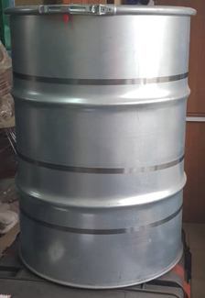
Safety Measures within the Facility
According the national waste management policy and strategy, the existing facility allow on to manage category 3 to 5 low activity disused sealed sources and to send back to the suppliers, category 1 to 2 disused sealed sources.
Operational measures planned consist in different steps.
By using tongs, DSRS must be transferred into the capsule according to the limit of activity, then capsule must be closed and the special form certificate duly filled and signed.
The P60 capsule containing DSRS must be transferred to the designated position in the lead shield which is transferred to the 200l concrete drum.
The drum is closed and sealed. The ambient dose rates at 1 meter to the drum must be recorded in order to categorize the package and to choose the label to be pasted on it.
Thus the last step was the transport of sources contained in the drum to the storage area.

Slide 9
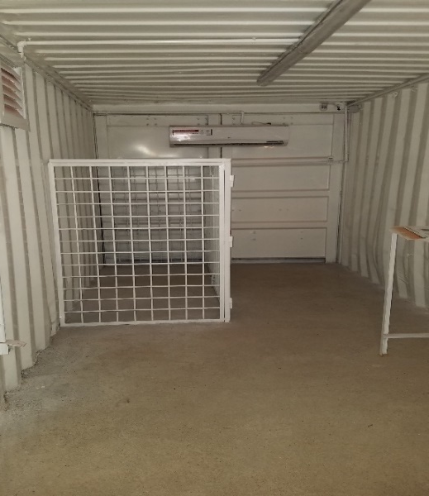
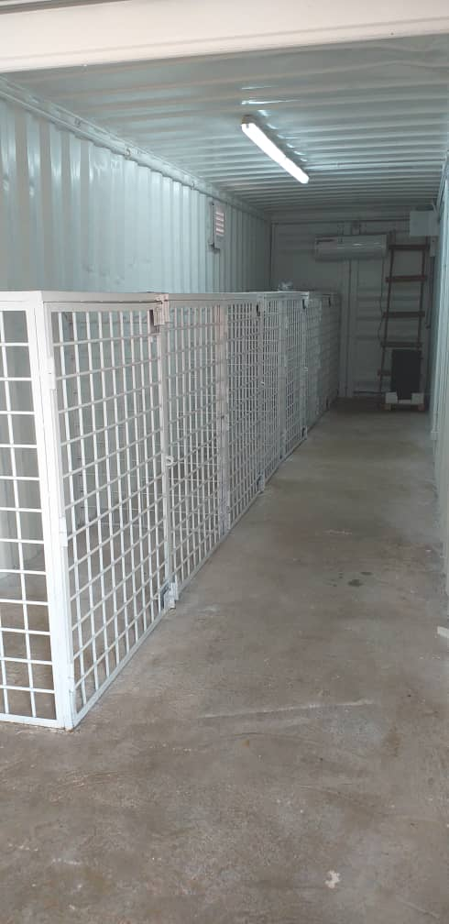
Safety measures within the Facility
Inside the 20 ft container where the 200 l drums are prepared
Inside the 40 ft container where the 200 l drums are stored

Slide 10
Nuclear Security measures in place
  Law N° 2019/012 of 19 July 2019 provides the general framework for radiological and nuclear safety, nuclear security, civil liability and safeguards enforcement
According to the above mentioned law 2019, any person intending to manage radioactive source(s) is required to put in place physical protection measures to guarantee the security of its installation.
In this frame, equipment to implement security functions are in place within the Centralized storage facility.

Slide 11
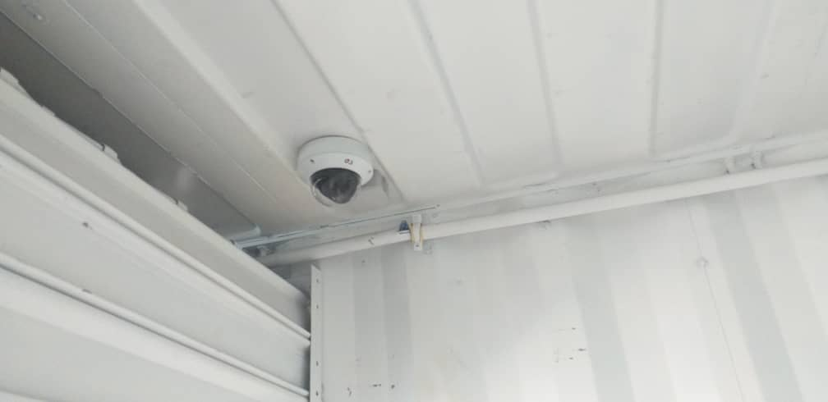
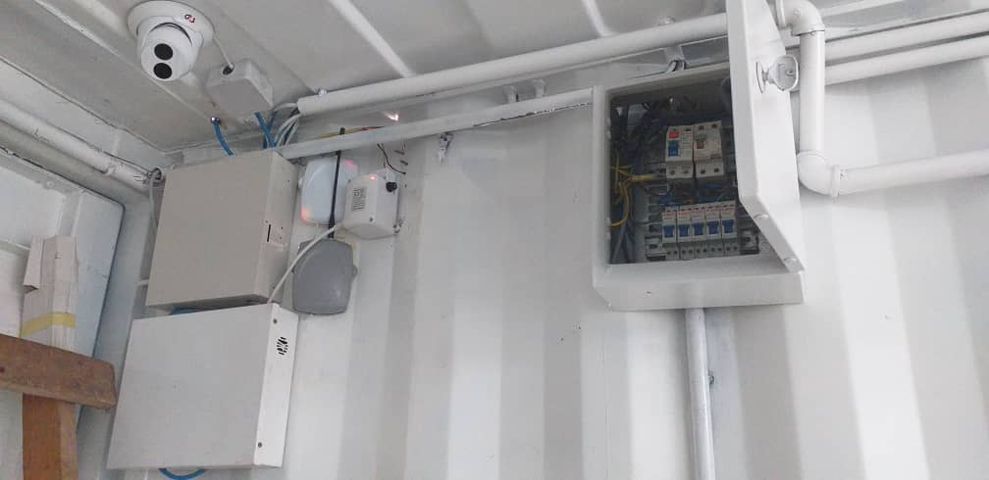
Nuclear Security measures in place
Detection measures are provided through the availability of the following equipment:
Color CCTV system in order to provide video surveillance of the installation.
Motion sensors installed in dedicated rooms.

Slide 12
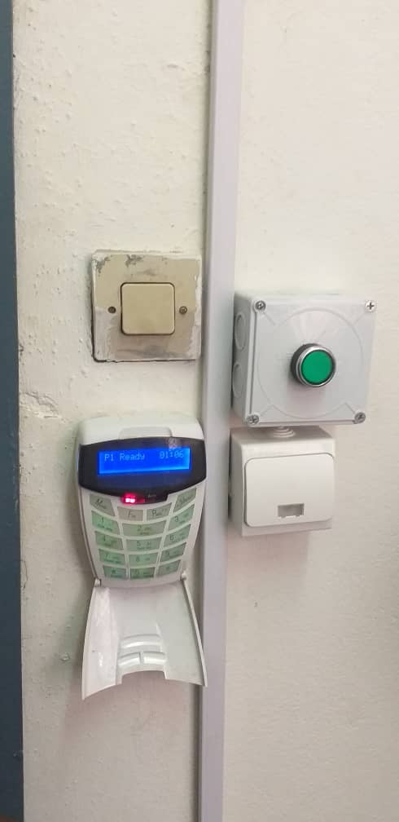
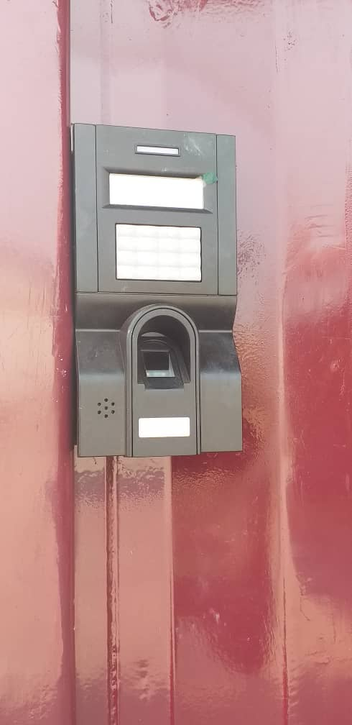
Nuclear Security Measures in Place
Delay measures are provided through :
A solid construction to provide sufficient delay to anyone attempting to gain access to the storage room;
The closure upon arming the alarm and opening upon disarm
The Use of an electro-magnetic lock mechanism
A biometric entry system at the entrance of the storage and conditioning containers as well as the alarm monitoring station.

Slide 13
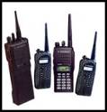
Nuclear Security Measures in Place
The response procedure is tested through initiation of alarm to verify:
The coordination with response force and actions for the staff to take in the event of a security Incident;
The response duration.

Slide 14
Conclusion
Within the Republic of Cameroon centralized storage facility, Safety measures planned to be taken consist of dismantling category 3 to 5 sources from their associated equipment and transferring them to the P-60 capsule which must be transferred to the lead shield and then the whole to the 200l drum.
The 200l drum packages must be locked, sealed and labelled according to the measured dose rates at 1 meter.
Security measures in place have been incorporated into the source storage room and source conditioning room respectively in order to implement nuclear security functions within the facility.
The planned safety measures will contribute to improve security through the use of adequate seals and lock mechanisms.
In addition, the robust and heavy 200l drum which are planned to be used increase the difficulty for an adversary to remove or sabotage the packages.

Slide 15
cameroon
THANK YOU

