Slide 1
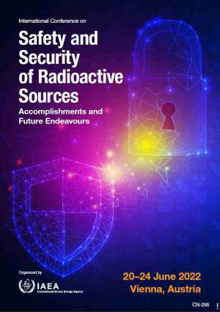
Safety plan as a mandatory document for obtaining a license to perform radiation activities
IAEA-CN295-014
Ivica T. Vujcic
Slobodan B. Masic
Department for Radiation Chemistry and Physics
Vinca Institute of Nuclear Sciences
Belgrade, Serbia
(ivica@vinca.rs)
INTRODUCTION
LICENSE
SAFETY PLAN
CONCLUSION

Slide 2
Safety plan as a mandatory document for obtaining a license to perform radiation activities
IAEA-CN295-014
INTRODUCTION
The Law on Radiation and Nuclear Safety and Security of the Republic of Serbia regulate activities of ra- diation and nuclear safety and security, conditions for performing activities with radiation sources, acting in the situation of planned, existing, and emergency exposure to ionizing radiation to protect individuals, popu- lation and environment from the harmful effects of ionizing radiation.
1/3

Slide 3
Safety plan as a mandatory document for obtaining a license to perform radiation activities
IAEA-CN295-014
The Radiation Unit in the Vinča Institute, Belgrade – Serbia, provides commercial services to industry mainly in the fields of sterilization of medical devices, food irradiation, and modification of polymer insulators. The facility has a maximum capacity of 25.000 m3 irradiated products per year. The facility core is cobalt–60 gamma irradiator with wet storage working in batch mode. The current activity of the source is around 100 kCi. The facility is designed for the maximum activity of 1MCi.
2/3

Slide 4
Safety plan as a mandatory document for obtaining a license to perform radiation activities
IAEA-CN295-014
Radiation activities performed in the Radiation Unit are industrial sterilization and conservation; and scientific research. The Radiation Unit must have licenses to perform both of these radiation activities. This license is issued by the Serbian Radiation and Nuclear Safety and Security Directorate.
3/3

Slide 5
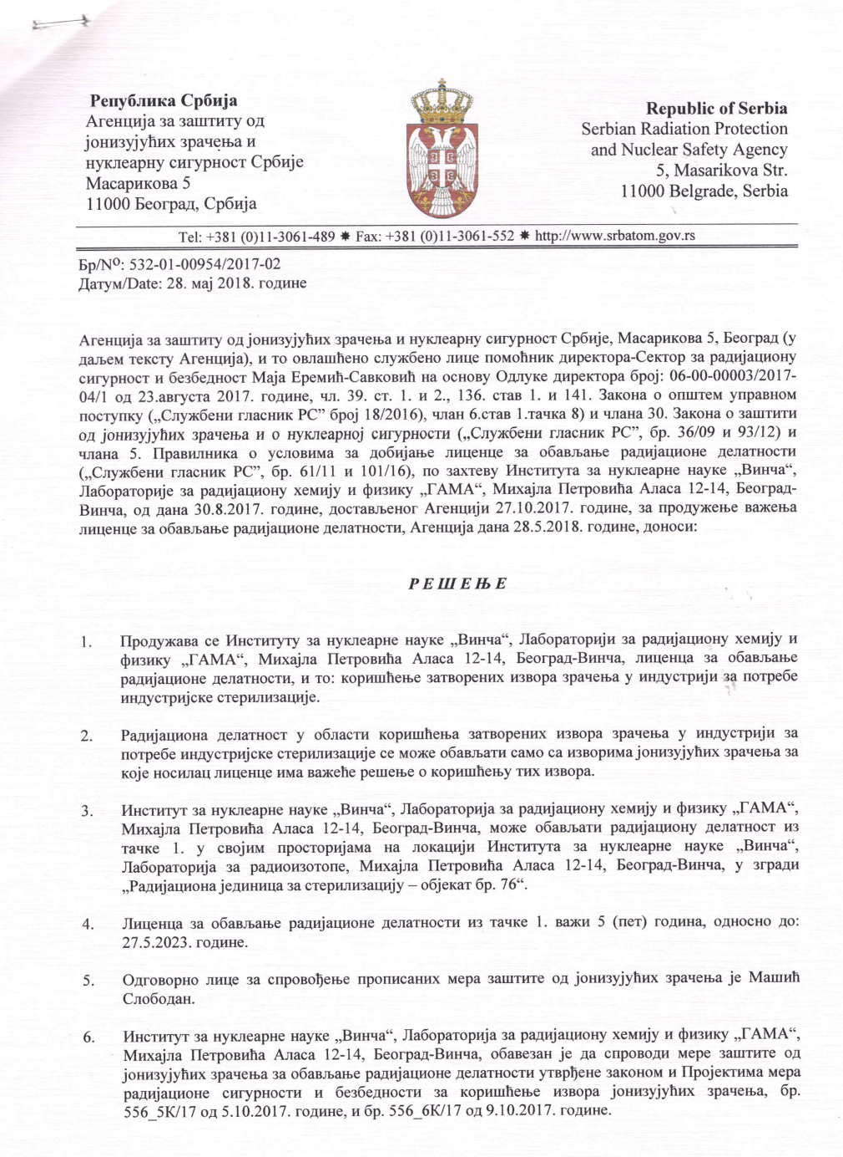
License
IAEA-CN295-014
BACK

Slide 6
Safety plan as a mandatory document for obtaining a license to perform radiation activities
IAEA-CN295-014
LICENCE
A license is a written act issued by the Directorate for the Performance of Moderate and High Risk Radiation Activities and Nuclear Activities in accordance with the conditions prescribed by that document
1/3

Slide 7
Safety plan as a mandatory document for obtaining a license to perform radiation activities
IAEA-CN295-014
The Directorate makes a decision on issuing a license for performing high-risk radiation activities when it determines that all the prescribed conditions have been met. The applicant for performing high-risk radiation activities is obliged to establish, maintain and implement an integrated management system. The license for performing high-risk radiation activities is valid for five years.
2/3

Slide 8
Safety plan as a mandatory document for obtaining a license to perform radiation activities
IAEA-CN295-014
In addition to the license for performing high-risk radiation activities, the Directorate also makes a decision on the use of radiation sources.
One of the necessary documents for obtaining a license is the Safety plan.
3/3

Slide 9
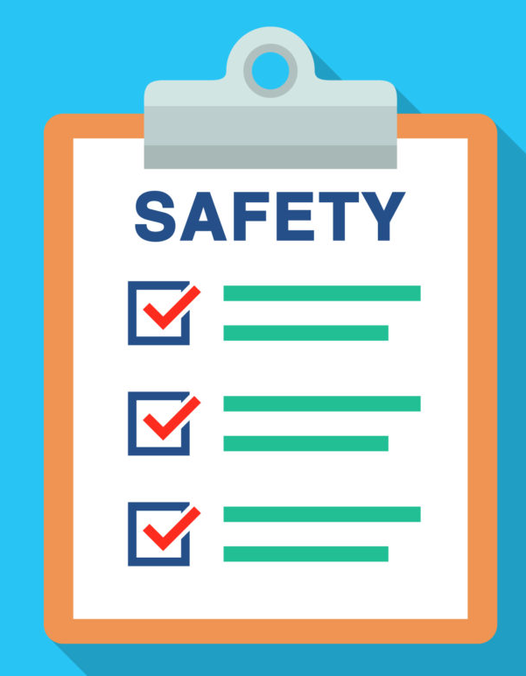
Safety plan
BACK

Slide 10
IAEA-CN295-014
Structure of Safety Plan:
NEXT

Slide 11
IAEA-CN295-014
Structure of Safety Plan:
1) description of security rates;
NEXT
2) project of the system of physical and technical protection;

Slide 12
IAEA-CN295-014
Structure of Safety Plan:
1) description of security rates;
NEXT
2) project of the system of physical and technical protection;
3) description of the area, plant, and other facilities in the area and the protected material with the attached categorization of materials;
4) list of internal documents related to security;

Slide 13
IAEA-CN295-014
Structure of Safety Plan:
1) description of security rates;
2) project of the system of physical and technical protection;
3) description of the area, plant, and other facilities in the area and the protected material with the attached categorization of materials;
4) list of internal documents related to security;
5) persons responsible for security;
6) action plan in case of a security event;
7) manner and plan for evaluating the efficiency of the security system.
BACK

Slide 14
Safety plan as a mandatory document for obtaining a license to perform radiation activities
IAEA-CN295-014
CONCLUSION
The safety plan is a necessary document describing radiation and nuclear safety measures. It must be maintained, reviewed and improved in accordance with all changes, so that the Plan always reflects the current state of the irradiation facility and its activities.
BACK

