Slide 1



A Methodology for Discriminating Phase and Amplitude Effects on Synchronization in Tokamak Pacing Experiments
T. Craciunescu, A. Murari, E.Peluso, P.T. Lang, G. Harrer, L. Spolladore and M. Gelfusa
Many thanks to JET Contributors and the ASDEX Upgrade Team

Slide 2
Control of macroscopic instabilities
an essential ingredient in the optimisation of scenarios for the next generation of Tokamaks
(ELMs and Sawteeth)
Various pacing experiments have been successfully carried out in many devices
Several details of their interactions remain poorly understood
in particular:
the assessment of the relative importance of phase and amplitude in frequency synchronization

Slide 3
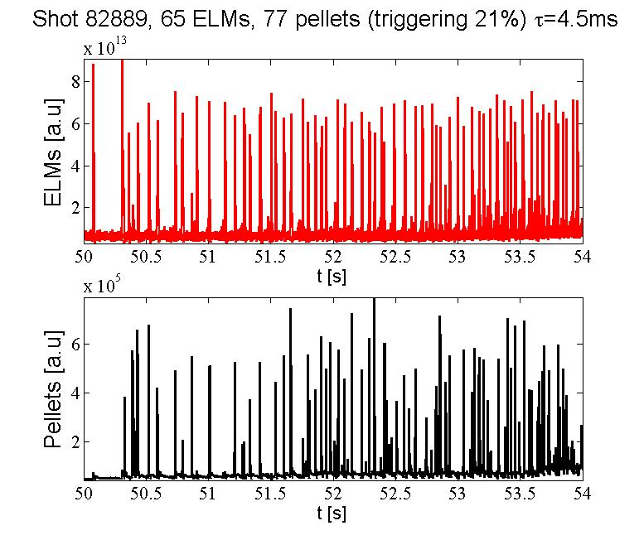
ELM Pacing with pellets
ELMs can have effect on the life of the divertor.
ELM pacing is therefore a very important field of activity (at least as a backup to the development of ELM free scenarios)
Since in the next generation of device the control of the density will be crucial and delicate, minimising the use of density for ELM pacing by optimising the phase of the pellets can be useful.
One of the main issues is to determine the relative effects of the amplitude and phase modulations
A. Murari, et al. “Application of transfer entropy to causality detection and synchronization experiments in tokamaks”, (2015), Nucl. Fusion 56
A. Murari et al. “How to assess the efficiency of synchronization experiments in tokamaks”, Nuclear Fusion, (2016), 56, pp 076008

Slide 4
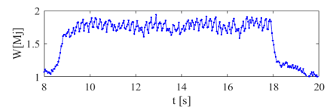
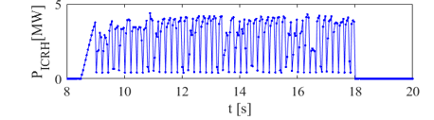
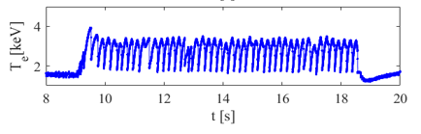
Sawteeth triggering with ICRH modulation
5Hz RF modulation: 150 ms ON, 50ms OFF
If the sawtooth crashes become too large they have the potential to trigger more deleterious instabilities.
(P_{max}=4MW, X[H]=4%)
In these experiments the population of fast ions is reduced by notches in the RF power, reducing their stabilising effect and triggering the sawtooth crash
ICRH power
It has become evident in the last years that ICRH is useful in many respects and therefore there are many requirements.
Central electron temperature
Also in this case, as for the ELMs, the robust determination of the triggering efficiency is not banal and there margins of optimisation
Plasma internal energy
A.Murari et al., On efficiency and interpretation of sawteeth pacing with on-axis ICRH modulation in JET, (2017) Nuclear Fusion, 57 (12), art. no. 126057.
T. Craciunescu et al., Image-based methods to investigate synchronization between time series, (2020) Entropy, 22 (7), art. no. 775.

Slide 5
The present approach
Evaluates coupling and synchronization based on time series describing the evolution of the pacing agent and instability
Uses wavelet decomposition of the signals in order to evaluate synchronisation across time scales
Information theoretic techniques are used to determine the basic form of the interactions

Slide 6
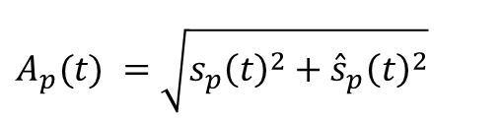
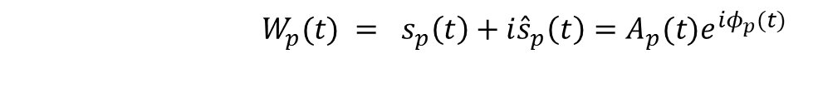
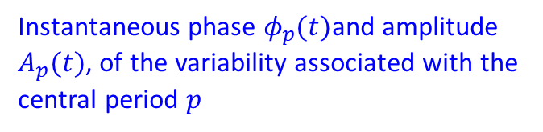
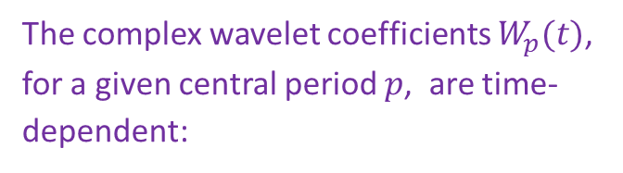
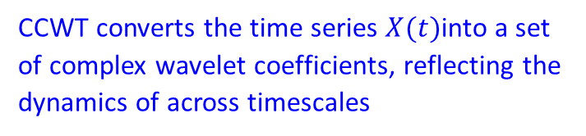
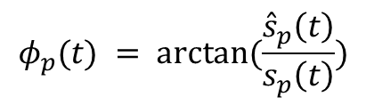
Wavelet decomposition - Phase and Amplitude
A scale-wise decomposition of the signals into (quasi) oscillatory components is necessary for the study of the interactions across time scales
A convenient way - the continuous complex wavelet transform (CCWT)
CCWT converts the time series $X(t)$into a set of complex wavelet coefficients, reflecting the dynamics of across timescales
The complex wavelet coefficients $W_{p}(t)$, for a given central period $p$, are time-dependent:
$W_{p}(t) = {s_{p}\left(t\right)+i{\hat{s}}_{p}\left(t\right)=A}_{p}(t)e^{iφ_{p}(t)}$
$$φ_{p}(t) = arctan⁡(\frac{{\hat{s}}_{p}\left(t\right)}{s_{p}\left(t\right)})$$
Instantaneous phase $φ_{p}(t)$and amplitude $A_{p}(t)$, of the variability associated with the central period $p$
$A_{p}(t) =\sqrt{{s_{p}\left(t\right)}^{2}+{{\hat{s}}_{p}\left(t\right)}^{2}}$

Slide 7
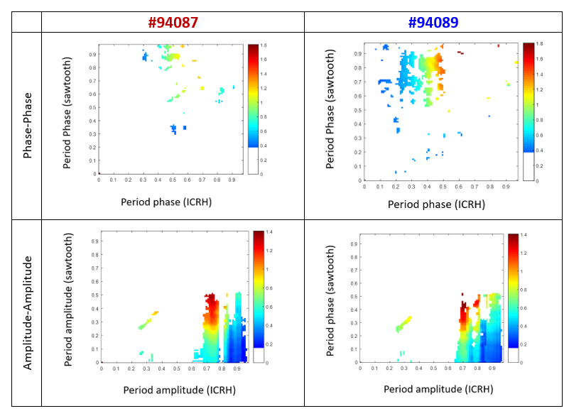


Wavelet decomposition - Phase and Amplitude
$${\left\{φ_{p}(t), A_{p}(t)\right\}}^{pel/ICRH}$$
A set of instantaneous phases and amplitudes can be derived for the pellets and ELM time series:
${\left\{φ_{p}(t), A_{p}(t)\right\}}^{ELM/sawtooth}$.
ELM
pellet
Notes:
A wide variety of methods for measuring the degree of synchronization in coupled dynamical systems have been proposed.
They all share Reichenbach’s common cause principle which states that, if variables are dependent, then they are in a causal relation or they depend on a common driver.
A vast majority of the techniques use the additional stronger hypothesis that causality can be assessed by predictability. This assumption promoted by Granger states that if a signal helps predicting another one, it can be considered to causally influence it.

Slide 8
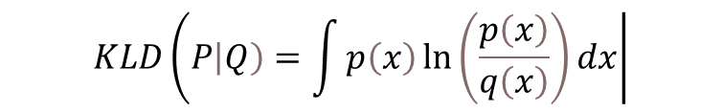
Mutual information (MI):
- Quantifies the amount of information obtained about one random variable by observing the other random variable
MI is the Kullback-Leibler divergence D_{KL} obtained for the marginal distributions $P_{X},P_{y}$and the joint distribution $P_{X,Y}$:
$$MI\left(X,Y\right)=D_{KL}\left(P_{XY} | \left|P_{X}\right|P_{Y}\right)$$
For distributions P and Q of a continuous random variable, KL-divergence is defined by:
$$KLD\left(P\left|Q\right)=\int{p\left(x\right)\ln\left(\frac{p\left(x\right)}{q\left(x\right)}\right)dx}\right|$$
average difference of the number of bits required for encoding samples of P using a code optimized for Q rather than one optimized for P
where p and q denote the densities of P and Q

Slide 9
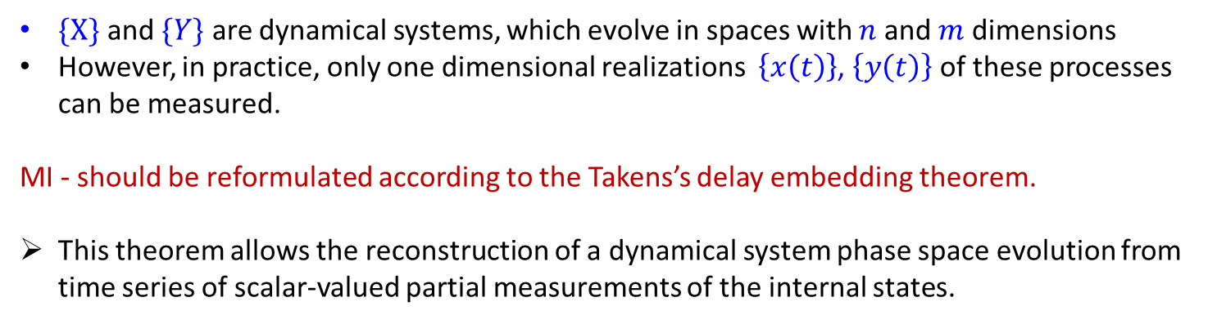
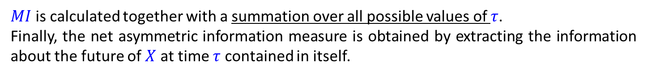
A process $\{Y\}$ may have not an instantaneous causal influence on the process$\{X\}$. The influence may occur after a certain lag time $τ$ has elapsed.
$MI$is calculated together with a summation over all possible values of $τ$.
Finally, the net asymmetric information measure is obtained by extracting the information about the future of $X$ at time $τ$ contained in itself.
$\{X\}$ and $\{Y\}$ are dynamical systems, which evolve in spaces with $n$ and $m$ dimensions
However, in practice, only one dimensional realizations $\left\{x\left(t\right)\right\}$, $\left\{y\left(t\right)\right\}$ of these processes can be measured.
MI - should be reformulated according to the Takens’s delay embedding theorem.
This theorem allows the reconstruction of a dynamical system phase space evolution from time series of scalar-valued partial measurements of the internal states.

Slide 10

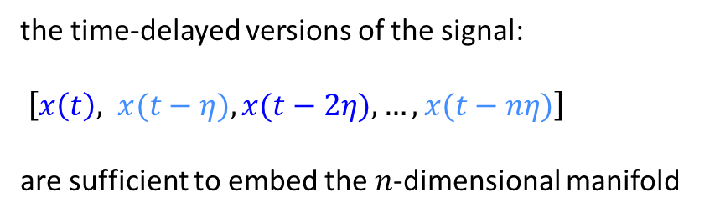
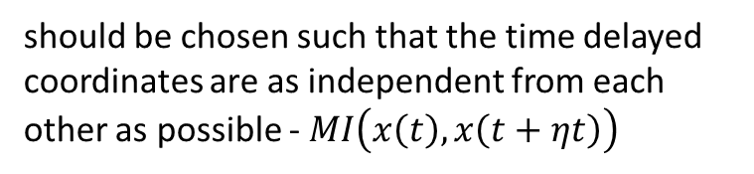


the time-delayed versions of the signal:
$\left[x\left(t\right), x(t−η), x(t−2η), …,x(t−nη)\right]$
are sufficient to embed the $n$-dimensional manifold
time series $\left\{x\left(t\right)\right\}$
should be chosen such that the time delayed coordinates are as independent from each other as possible - $MI\left(x\left(t\right),x\left(t+ηt\right)\right)$
$η$ - the embedded delay
$n$ - the embedding dimension
Determined by the ‘false neighbourhood’

Slide 11
Assessment of statistical significance
On the other hand, this nonlinearity could be not necessarily reflected in the measured signals and therefore the existence of nonlinear components should be proved
In principle, due to physical reasons, the causal interaction is expected to be a nonlinear process.
Surrogate data testing
Compare causal maps derived from:
the available experimental time series
obtained from a large number of time series satisfying a certain null hypothesis.
Null-hypothesis:
data was generated by a stationary linear Gaussian process, or equivalently, so data does not contain any nonlinear structure.
shifting the phases of the Fourier components
same spectrum but no interactions between processes at different time scales

Slide 12
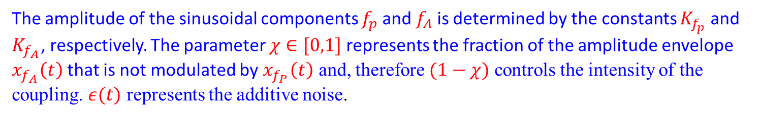
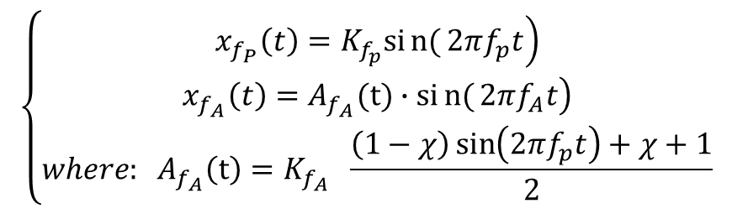
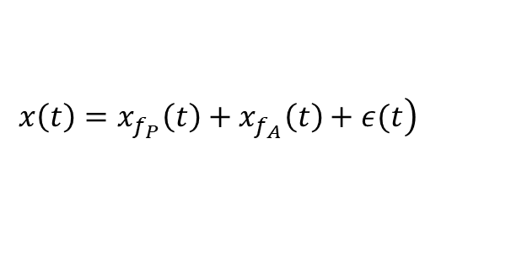
Numerical example
A widely used synthetic signal has been designed by Tort et al. The time series are obtained as the sum of two sinusoids and an additive noise component:
$$\left.x\left(t\right)=x_{f_{P}}\left(t\right)+x_{f_{A}}\left(t\right)+ε(t\right)$$
where the high-frequency component $x_{f_{P}}$is modulated by the phase of the low frequency component $x_{f_{A}}$:
$$\left\{\begin{matrix}\left.x_{f_{P}}\left(t\right)=K_{f_{p}}sin{(}2πf_{p}t\right) \\ \left.x_{f_{A}}\left(t\right)=A_{f_{A}}(t)∙sin{(}2πf_{A}t\right) \\ where: A_{f_{A}}\left(t\right)=K_{f_{A}} \frac{\left(1−χ\right)\sin\left(2πf_{p}t\right)+χ+1}{2}\end{matrix}\right.$$
The amplitude of the sinusoidal components $f_{p}$ and $f_{A}$ is determined by the constants $K_{f_{p}}$ and $K_{f_{A}}$, respectively. The parameter $χ∈[0,1]$ represents the fraction of the amplitude envelope $x_{f_{A}}\left(t\right)$ that is not modulated by $x_{f_{P}}\left(t\right)$ and, therefore $(1−χ)$ controls the intensity of the coupling. $ε(t)$ represents the additive noise.
A.B.L. Tort et al.,, J Neurophysiol 104: 1195–1210, 2010

Slide 13
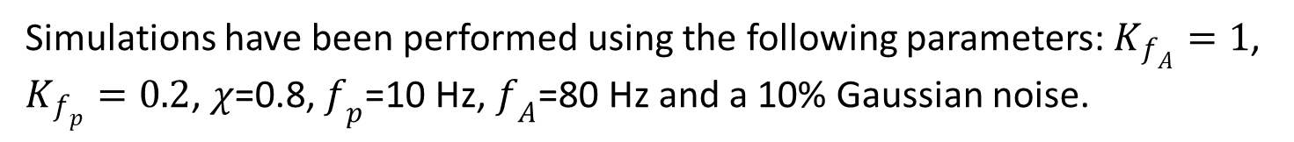
Numerical example
Simulations have been performed using the following parameters: $K_{f_{A}}=1$, $K_{f_{p}}=0.2$, $χ$=0.8, $f_{p}$=10 Hz, $f_{A}$=80 Hz and a 10% Gaussian noise.
As the phase of slow oscillation 10 Hz is coupled to the amplitude of the faster rhythm at 80 Hz a corresponding spot on the causal map should appear.

Slide 14
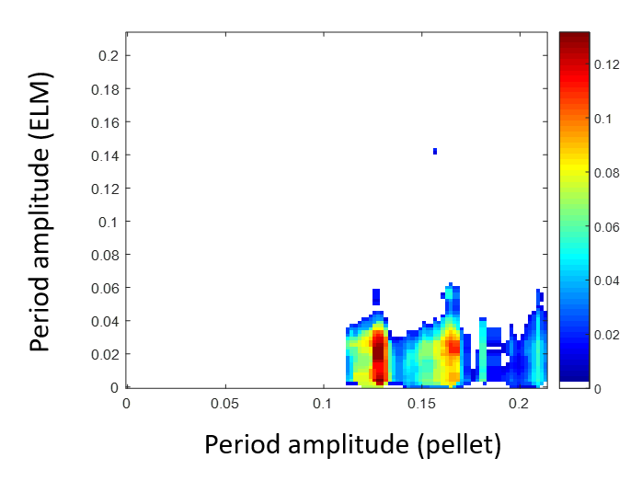
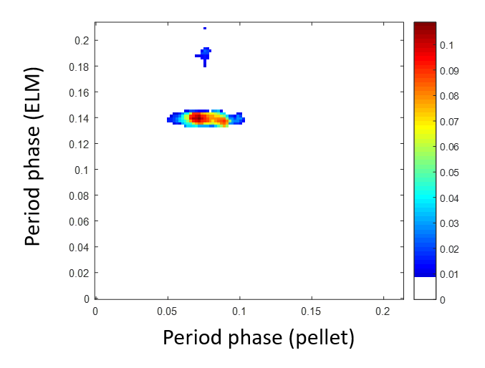
Amplitude and phase causality: AUG ELM pacing
  In case of the AUG the causality analysis indicates that both the phase and amplitude of the pellets influence the amplitude of the ELMs. The most relevant effect is amplitude-amplitude. Phase-phase is also significant.
Amplitude (pellet) – amplitude (ELM) causality for AUG pulse #34462 for the time interval 5.2-5.5s
Phase (pellet) – phase (ELM) causality for AUG pulse #34462 for the time interval 5.2-5.5s

Slide 15
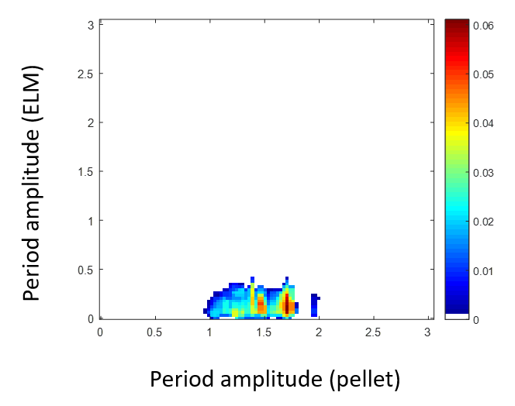
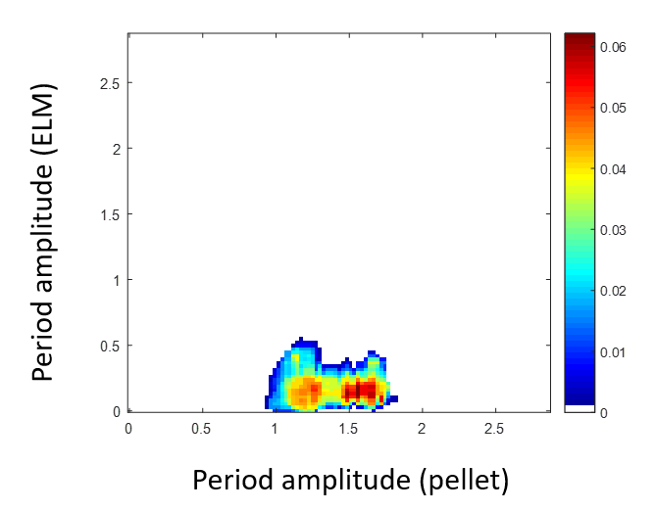
Amplitude and phase causality: JET ELM pacing
  In case of JET the causality analysis indicates that the most relevant effect by far is amplitude-amplitude
Amplitude (pellet) – amplitude (ELM) causality for the JET pulses #82885 (left) and #82854 (right).

Slide 16
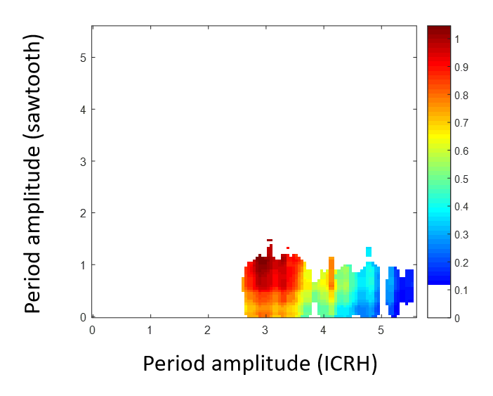
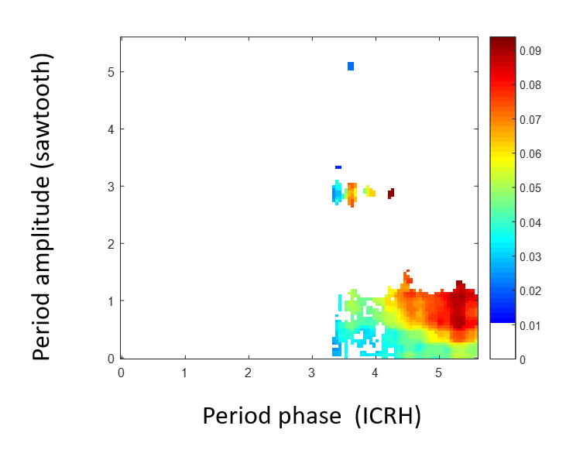
Amplitude and phase causality: sawteeth triggering
  In case of the JET discharge 9005 in H mode the causality analysis indicates that both the phase and amplitude of the ICRH influence the amplitude of the sawteeth (the phase amplitude is a much smaller effect).
Amplitude (ICRH) – amplitude (sawtooth) causality for JET pulse #90005 for the time interval 48.5-55.5 s
Phase (ICRH) – amplitude (sawtooth) causality for JET pulse #90005 for the time interval 48.5-55.5 s

Slide 17
Conclusions
Conditional Mutual Information is confirmed to be a quite powerful tool to identify causal relationships in time series.
Application to ELM pacing with pellets shows good coherence between the devices.
In both devices and for both hardware implementations of the pacing, the amplitude-amplitude effect is the real dominant one.
For AUG small ELMs the phase-phase synchronisation is also important
In all applications, there seem to be margins for improving the phase-amplitude driving by better timing of the external perturbations with respect to the natural cycle of both instabilities.

Slide 18
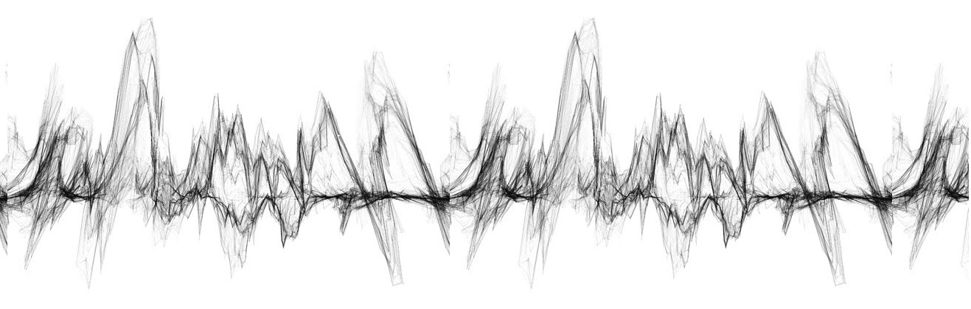
Thank You for Your Attention!

Slide 19
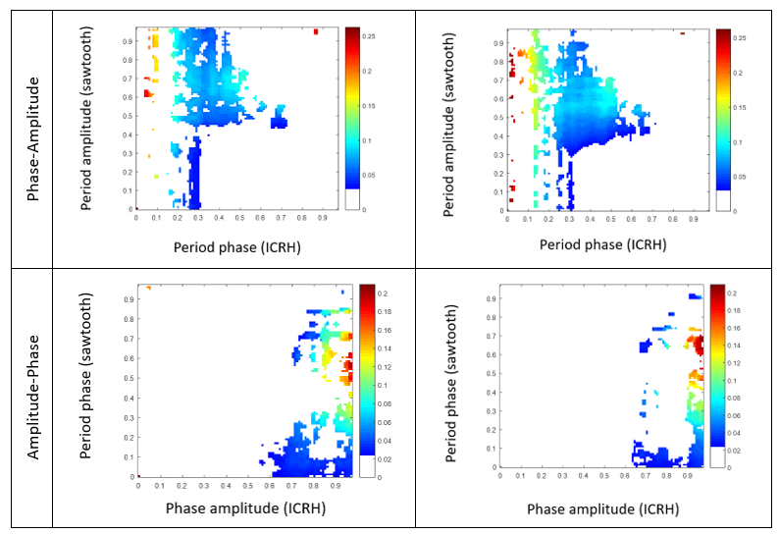
- 94087 ("some not paced")
- 94089 ("Perfect pacing")

