Slide 1
Implications of AI in cancer diagnosis, treatment and outcome prediction
Jan Seuntjens, Ph.D., FAAPM, FCCPM, FCOMP
Princess Margaret Cancer Centre, Toronto
Technical Meeting on Artificial Intelligence for Nuclear Technology and Applications
#AI4Atoms Virtual Event
25–29 October 2021
Notes:
Good morning everyone. My name is Jan Seuntjens and I am a medical physicist at the Princess Margaret Cancer Centre as well as a professor in the departments of radiation oncology and medical biophysics, in Toronto, Canada
In the healthcare environment, artificial intlelligence or AI is already present or making its entrance in a variety of subfields, including detection of disease and that includes both from medical imaging as well as from digital pathology, management of chronic conditions, optimization of healthcare services logistics, optimization of treatments, drug discovery and so on.
In this presentation I will concentrate on the diagnosis and treatment of cancer.
Modern oncology, although very advanced, still is largely a one-fit-for-all endeavour. With this I mean that treatments prescribed for patients with a particular disease are still very much generic, or in other words, the same from one to the other patient.
AI gives us the opportunity to make treatments much more personalized. Taking into account all the information or data that we have on that particular patient. This is known as precision medicine.

Slide 2
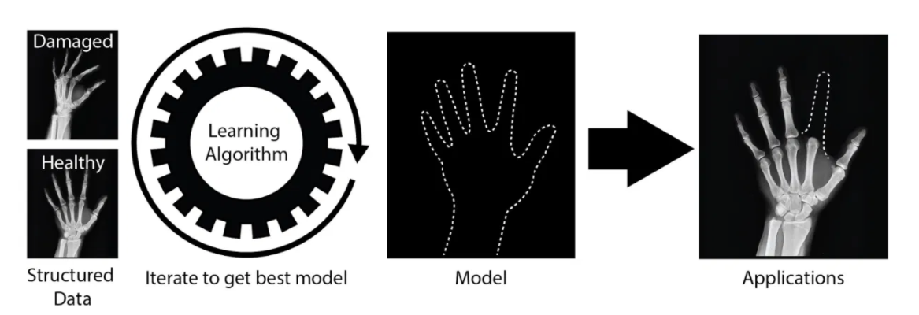
AI and machine learning
annotations
Modified from a figure by Sean Wilson in a blog post by Daniel Greenfield, Harvard University, 2019
Notes:
Within AI you will often hear the term “Machine learning”. In simple terms, machine learning is the study of computer algorithms that improve automatically through experience.
The computer algorithm is shown structured data (for example images) and labels or annotations (for example a classification, damaged versus healthy). The more variable data the algorithm can be given the better it can “learn” all the characteristics in the image that lead to a decision of the outcome being “health” versus ”damaged”. We call this the learning phase and in this particular case, since the images were annotated, we speak about supervised learning.
At some point the performance of the prediction is tested using a part of the annotated dataset that had been previously unseen. This is the testing phase – in the testing phase we can estimate the accuracy of the prediction.
Only when these tests are completed satisfactory can the algorithm be used on a new, not previously seen image and make a prediction.
Deep learning is a form of machine learning, where the algorithm can learn on a complex and variable dataset. Deep learning has been very successful in applications such as recognizing cats and dogs on photos.

Slide 3
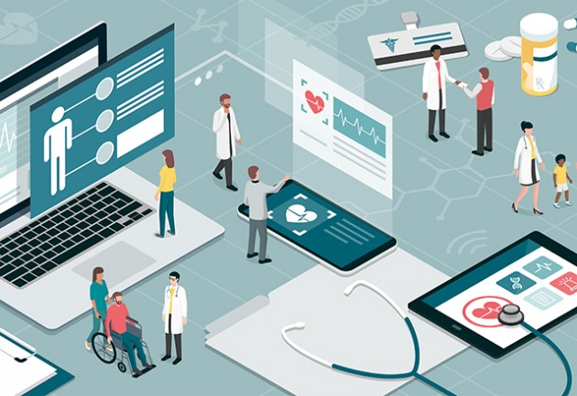
Notes:
There is a large amount of data floating around in a medical environment. As soon as the patient enters a medical centre, data is being generated and stored. For example, the patient registers at the hospital and basic personal data including address, age, sex, etc is entered into a database. The patient then continues to see a physician who enters a doctors note in the database and perhaps some tests are ordered. This could be an x-ray image, a blood test or a CT scan. The doctors note could also contain some glimpse of a diagnosis based on clinical examination. As the patient proceeds through the system all these data elements are being collected.

Slide 4
Observation
Humans can process only about 5 to 8 variables at any given time¹
Fewer than 3% of the patients participate in clinical trials², the gold standard of medical hypothesis testing
Rajkomar et al (2019) Machine Learning in Medicine. N. Eng. J. Med. 380: 1347 – 1358
Murthy VH et al (2004) Participation in clinical trials: Race-, sex and age-based disparities. JAMA 291: 2720 - 2726
Notes:
With all of these data it is becoming increasingly difficult for medical professionals to take into account all information they have access to. It has been shown, for example, that humans can process only about five to eight variables at a given time.
In addition, the participation rate in clinical trials, which is the gold standard of medical hypothesis testing is perhaps less than 3% for a variety of reasons.
This means with not learning from all data that presents itself, an opportunity is missed.
We can say that from the perspective of AI, healthcare is a big machine that generates real-world data (RWD)
With the capability of AI to ingest large amounts of data, we could use RWD to help us predict, using AI, how the patient will do.
We could optimize an intervention based on learned experience from previous patients combined with the data for that particular patient.
This type of precision medicine is the holy grail of a learning health care environment.

Slide 5
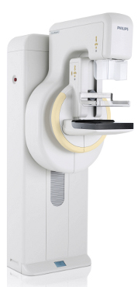
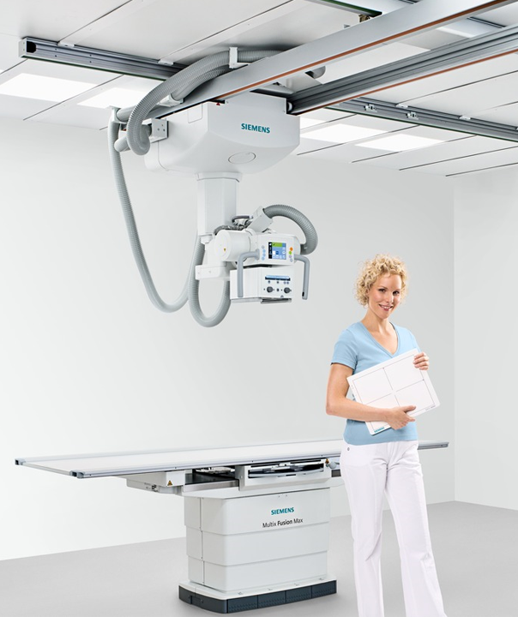
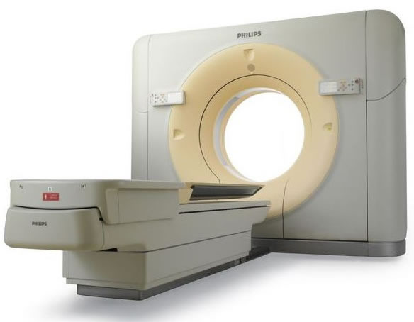
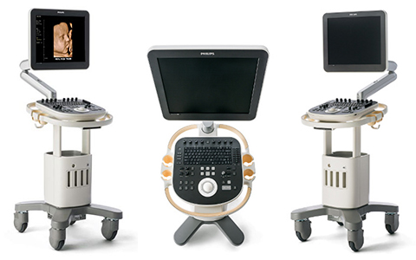
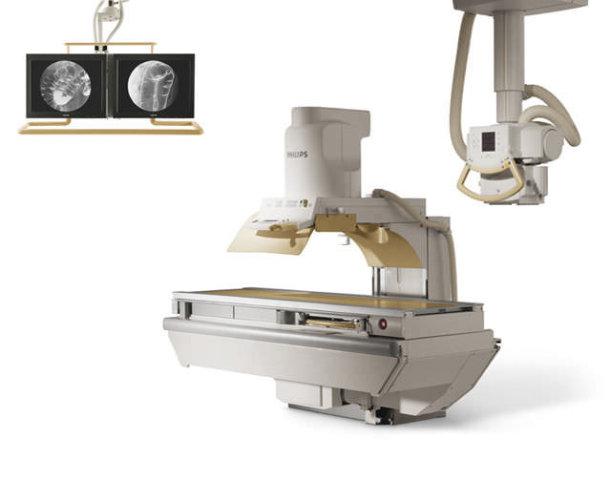
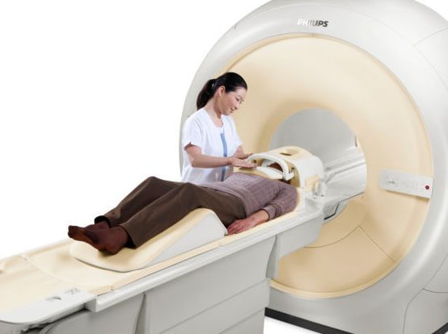
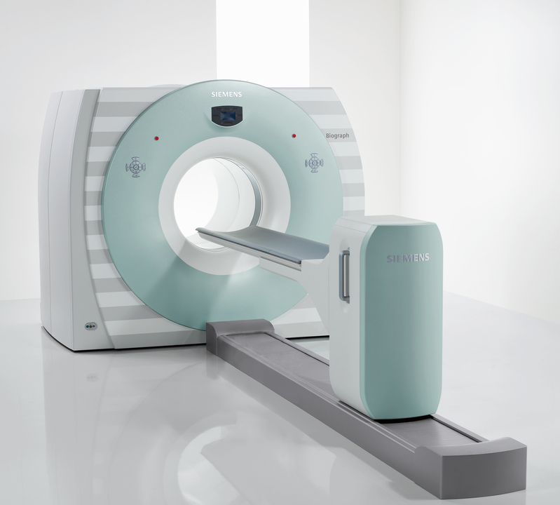
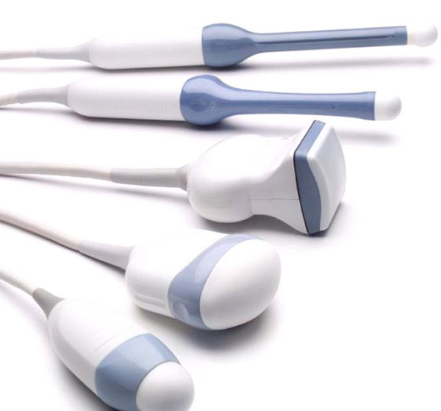
Imaging modalities used in medicine
X-ray based for diagnostic medicine:
  Radiography
  Mammography
  Fluoroscopy
  Computed Tomography
Nuclear medicine
  Positron Emission Tomography
  Single Photon Emission Computed Tomography
Ultrasound
Magnetic Resonance Imaging
philips.co.uk
philips.co.uk
philips.co.uk
healthcare.siemens.com
etmedical.eu
manifestmedical.com
healthcare.siemens.com
philips.co.uk
Notes:
We will now concentrate more on cancer and on medical images as data for AI. Patients undergo different types of imaging including X-ray based imaging including computed tomography, imaging in nuclear medicine, including positron emission tomography, ultrasound, or MRI with different sequences and scanning protocols. Different types of images represent different biological features, anatomical features, or metabolic processes.

Slide 6
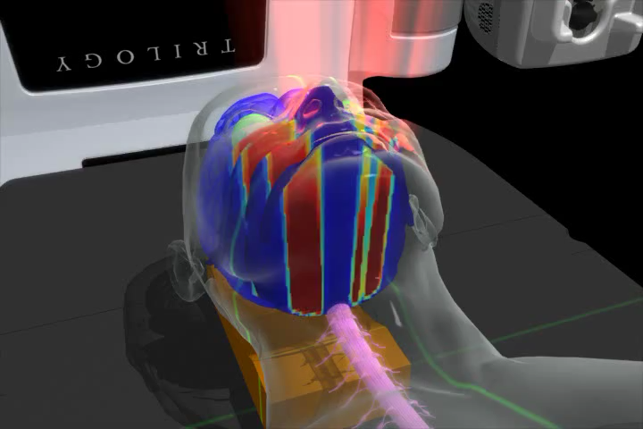
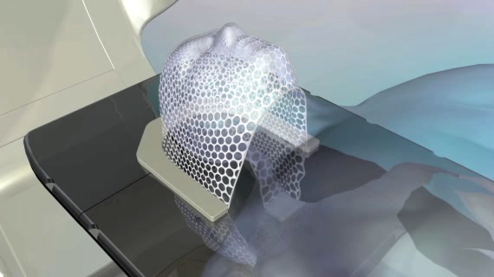
Radiotherapy technologies
volumetric arc therapy delivery
imaging for positioning of the patient
Movies, courtesy of Varian, Inc
Notes:
In radiation therapy the goal is to treat tumors and spare normal tissues as much as possible. This involves the annotation of what constitutes the so called “target volume”, and what constitutes normal tissues. This is established by using segmentation tools on 3dimensional patient images that define where the target and the different structures that need to be spared are. Computer algorithms are used to solve the optimization problem of maximizing radiation dose to the target and minimizing dose to critical structures. Nowadays AI is implicated with making this planning process, including the segmentation step and the optimization.
Radiotherapy is delivered in more than one session, and on the right we show how imaging is used to verify and correct the position of the patient for a particular session.

Slide 7
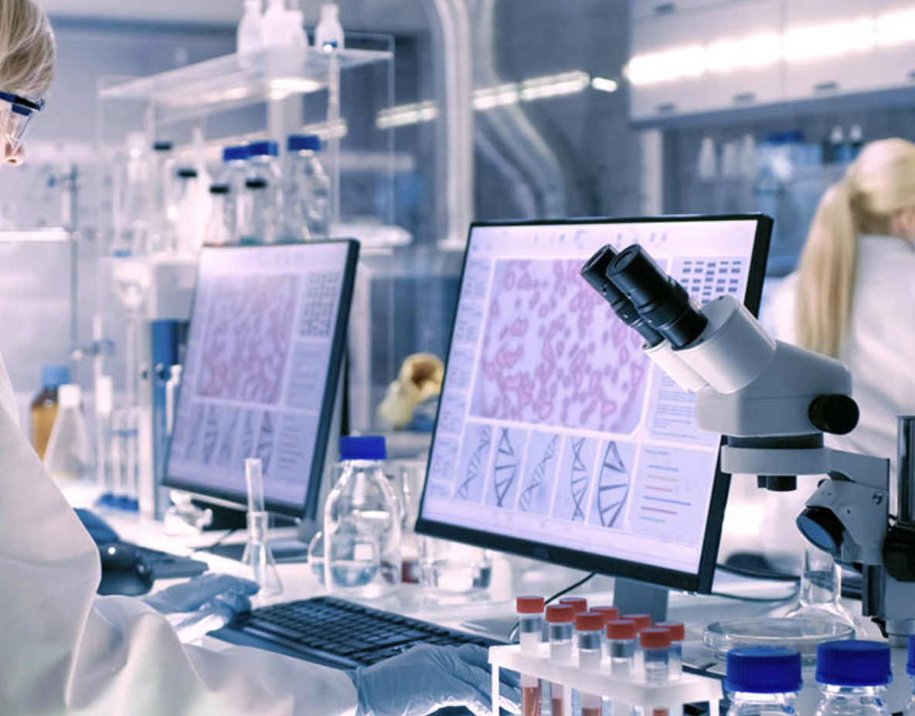
Application of AI
Segmentation
Image phenotyping and radiomics
Clinical outcome prediction
Dose quantification
Dose-response
Image generation
Classification
Detection
Segmentation
Registration
Annotation
Radiation oncology
Radiology & Pathology
Notes:
Here we bring together some of the main areas of application of AI in cancer radiation medicine and radiology.
These include the segmentation, quantitative image analysis (known as radiomics), outcome prediction where we use data about patients and try to learn outcome, dose quantification for fast dose calculation algorithms, dose response studies and generation of images, for example, synthetic computed tomography from MRI.
In radiology, aside from segmentation, applications can be found in classification for disease staging, point of care detection of disease, image registration where we align images of different types with each other and others.
In pathology, similar activities occur. In addition, feature identification on image patches from a whole slide image can be done using CNN and then overlaid with the whole slide image.

Slide 8
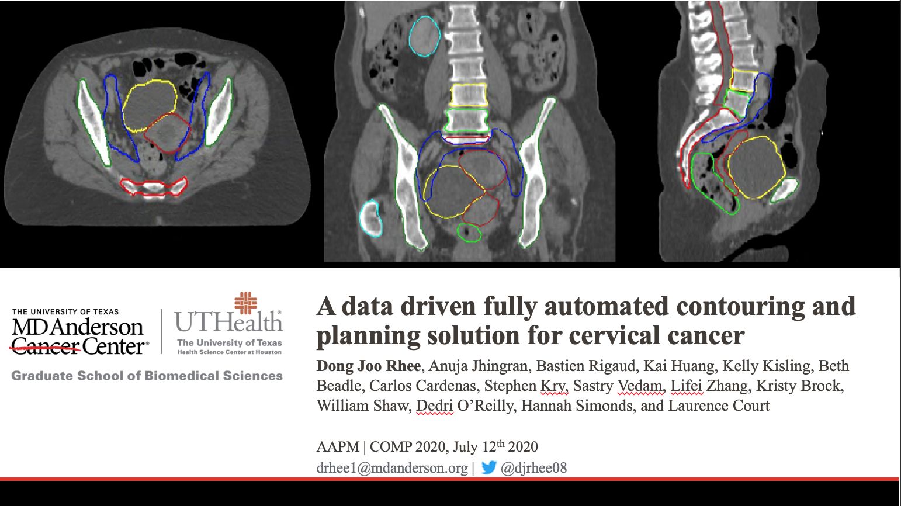



Notes:
As a first example, in the radiation oncology area, treatment planning starts from CT images where OAR and target (tumor) are contoured, beams are chosen and an optimal treatment plan is developed sparing OARs and delivering highest dose to target. This is an optimization process that is time consuming and introduces variability in plan quality.
This is an example from an international collaboration between researchers from University of Texas MD Anderson Cancer Center, UC San Diego, Stanford University and University of the Free State, Bloemfontein, and Stellenbosch University, South Africa on a data-driven fully automated contouring and planning solution for cervical cancer.
The context of this first contribution is automatic planning. Knowledge based planning, where algorithms based on dose prediction using conventional DVH based methods (such as the Varian Rapidplan) or through deep learning, are already in the clinic. These algorithms then spit out the constraints for the optimization algorithm to arrive at an optimal treatment plan. For these algorithms to work of course, OARs and targets already have to be contoured. On the other hand an increasing number of reports show up in the literature that talk about automatic contouring either via atlas-based methods (many of them using commercial tools) or deep learning based contouring. Whereas we expect that contouring generally will lead to less physician dependence, what is often concluded is that there still is a substantial editing phase and time gains over manual contouring can be modest.
This paper puts everything together: the entire pipeline from contouring, placement of beams, aperture selection and optimization to arrive at clinically sound plans – the study should be viewed in a global radiation oncology context.

Slide 9
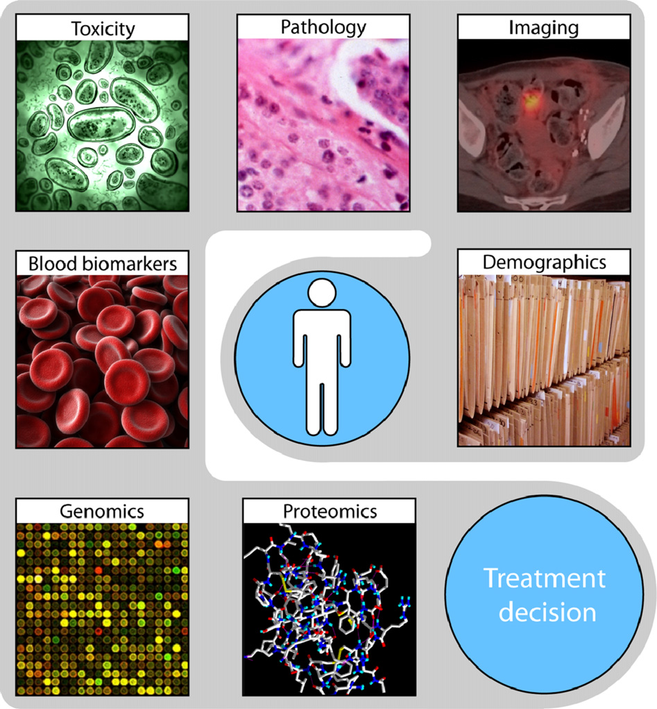
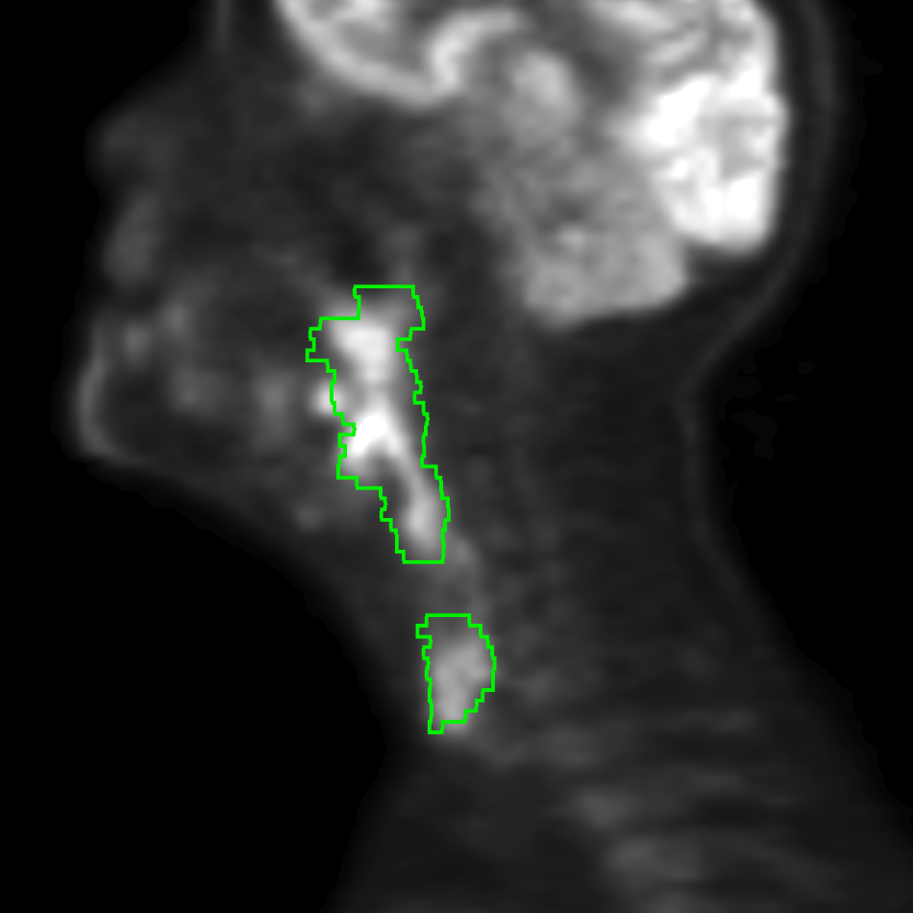

Radiomics for precision oncology
Tumour
sub-region
differences
Necrosis
Oxygenation levels
Blood vasculature
etc.
Hypothesis 1: genomic heterogeneity of aggressive tumours translates into heterogeneous characteristics at the anatomical scale.
Hypothesis 2: Intratumoral heterogeneity at the anatomical scale can be captured using quantitative image analysis.
Adapted from (Lambin P et al., Eur J Cancer 48, 2012)
Notes:
Here we focus on medical images used in precision oncology.
On the left we show a number different types of data that might be available for a given patient including medical images, pathology images, genomics profiles, proteomics, demographics, doctors notes, etc.
Focusing on medical images, radiomics refers to the use of quantitative information in images. For example, in quantifying aggressiveness of a tumor the underlying hypotheses is that heterogeneity at the genomic scale is translating in heterogeneity at the anatomical scale. The idea being that that type of information cannot be qualitatively discerned but can be captured using quantitative image analysis sometimes called higher order features.
So we extract these “features” or “descriptors” of the image such as parameters derived from image intensity, texture, etc. Features could also be as simple as volumes or shape parameters, but in general texture features are mostly meaningless for a human but they carry some very specific information present in the image.
Radiomics is typically applied to subregions of the image quantified by segmentation where it may be representative of or associated with necrosis, oxygenation levels, vasculature and so on.

Slide 10
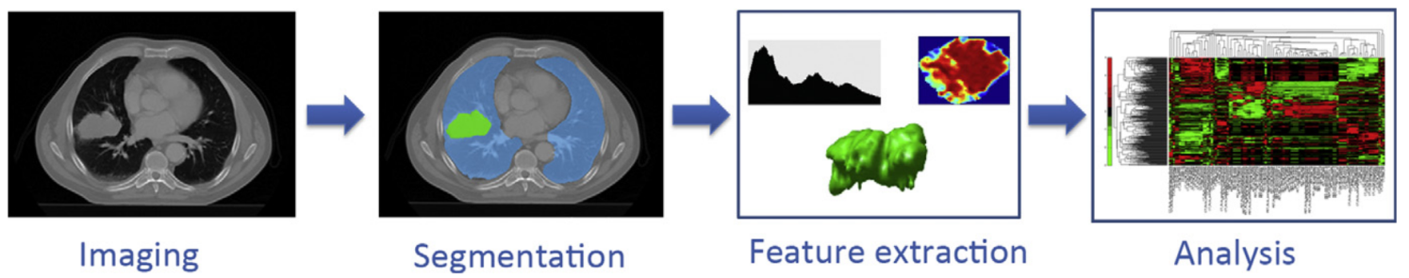
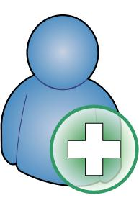
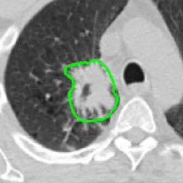
Outcome prediction from images
Training on a large data set
Machine Learning Model
New patient
Lambin P et al., Eur J Cancer 48, 2012
Outcome prediction
Notes:
Here we generically summarizs the process of a patient outcome prediction model using radiomics. At the top we have the imaging step, the segmentation step, followed by feature extraction, followed by feature analysis. Features are then used to generate a model using machine learning methods.
Once trained and validated the model can be used, new patient images can be fed into the model and an outcome prediction can be made.
In any outcome study it is important to control the way we arrive at the features which are subsequently used in a prediction model and standardization in these steps is important.

Slide 11
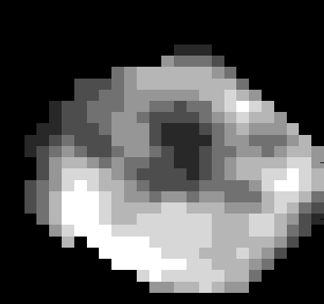
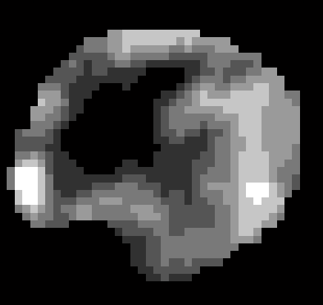
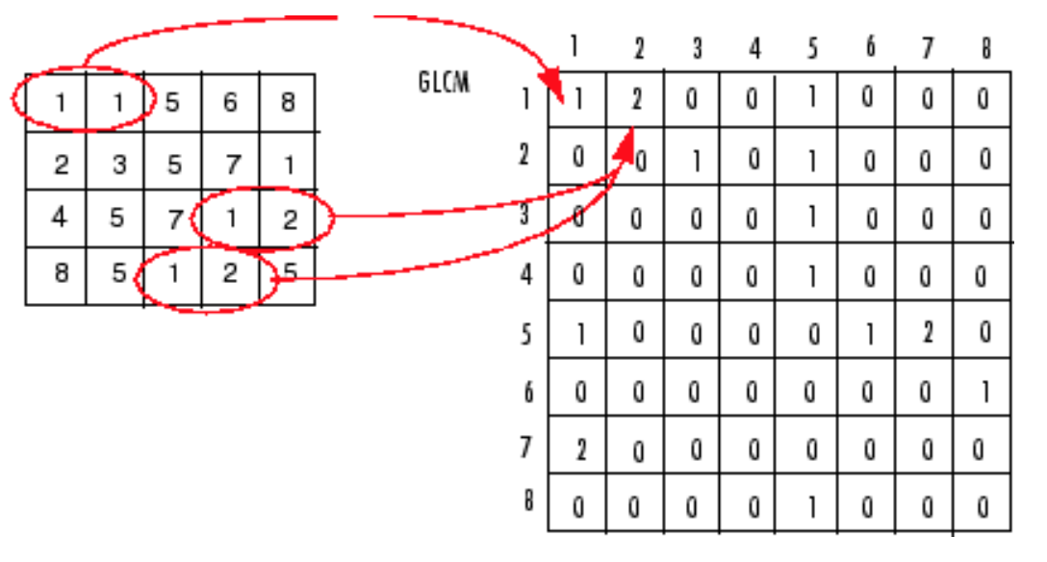
Example of GLCM textures
Patient developed metastases
Patient did not develop metastases
GLCM = grey level co-occurrence matrix
Energy: 0.03
Contrast: 1.61
Entropy: 3.57
Homogeneity: 0.64
Correlation: 0.80
Variance: 0.39
Energy: 0.06
Contrast: 0.73
Entropy: 3.09
Homogeneity: 0.74
Correlation: 0.87
Variance: 0.28
Vallières et al 2017
Texture analysis is concerned with the spatial distribution (patterns) of gray level variations within an image.
Notes:
Here is a simplified example of a texture calculation from the images, i.e., mathematical operations that provide, in this case a quantity called GLCM = grey level co-ocurrence matrix, a higher-dimensional features.
The left hand image is of a patient suffering from soft tissue sarcoma who ended up developing distant metastases in the lung, while the right hand image is from a soft tissue sarcoma patient that did not.
We can see the variation in the features below the image. So these texture tell us something about the spatial distribution of gray level variations
within an image.
Textures are meaningless for human but contain some information from the image that may or may not correlate with a clinical end-point of interest.

Slide 12
Soft tissue sarcoma – lung metastases prediction model
Training
Testing
Vallieres et al 2015 Phys. Med. Biol. 60: 5471
Vallieres et al 2018 PHIRO 6, 53–60
Notes:
Training and testing are illustrated here on the study of patients with soft-tissue sarcoma mentioned earlier .
On the left hand side we show the model training behaviour, with some estimates on the 95 CI in the datapoints. And we compare this with the uncertainty introduced through contouring/segmentation indicated by the vertical lines, which clearly limits the prediction capacity of the model.
On the right hand side the model is tested prospectively on a dozen or so new patients and we can see a reasonable but not perfect performance.

Slide 13
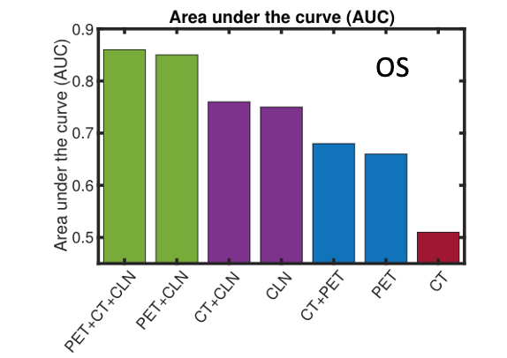
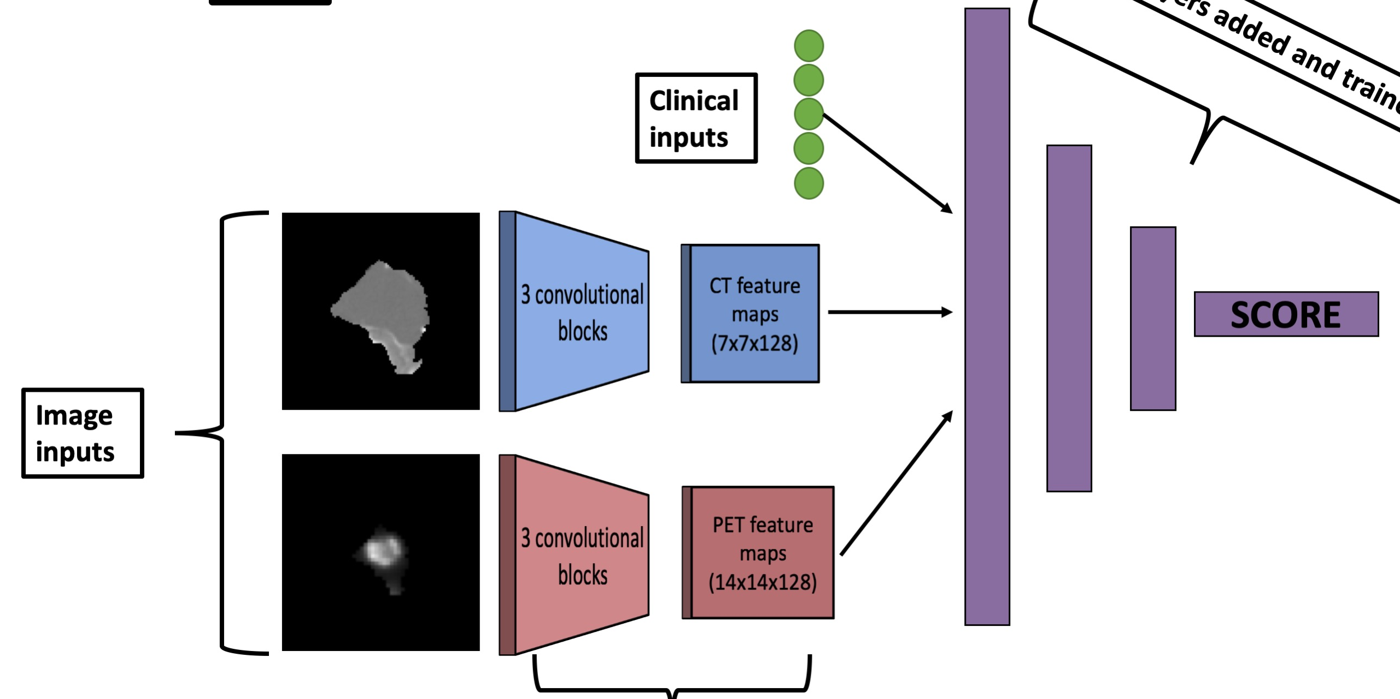
Outcome prediction from images
Head and neck cancer patients
clinical data
CT data
PET data
Prediction AUC of “Overall survival” in head and neck cancer patients based on CT, PET and clinical parameters.
Deep learning convolutional neural network
Diamant et al, 2019, 2020
Notes:
Radiomics analysis can also be done using deep learning. Deep learning is a very powerful machine learning technique that can work with the entire image and that can, if enough training images are available, be used to recognize patterns. We applied deep learning to predict outcome based on images and clinical parameters.
On the left, an example of a deep learning convolutional neural network (CNN) is shown, that takes image information from CT scans, PET information and clinical inputs such as clinical tumor staging of patients with head and neck cancer. All of this information can be used to generate a score that allows a classification of an outcome of interest, for example, disease recurrence, distant metastases or overall survival.
The bar plot on the right shows the metric AUC that quantifies how sensitive and how specific the prediction of in this case overall survival is. We can see that if the model is trained on patients with all three types of input variables CT, PET and clinical information available, then we can predict to high accuracy overall survival; when one of the modalities is not present, the prediction capability decreases.

Slide 14
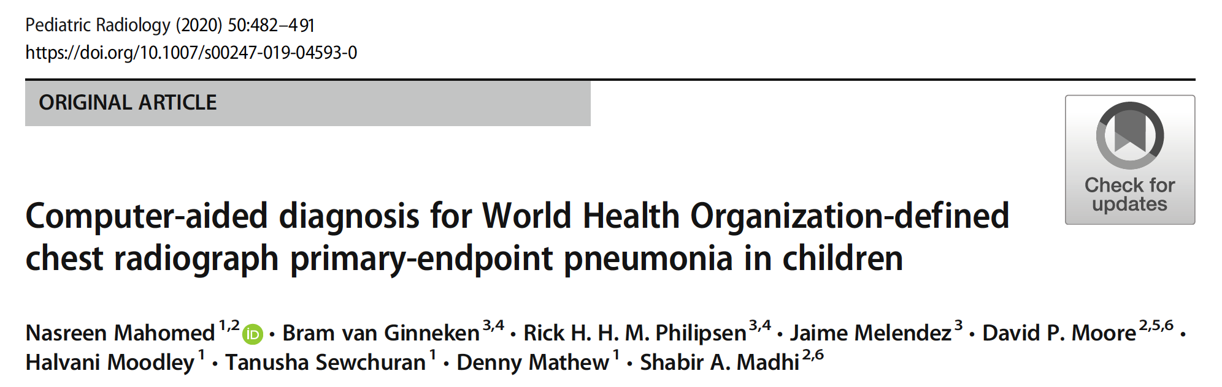
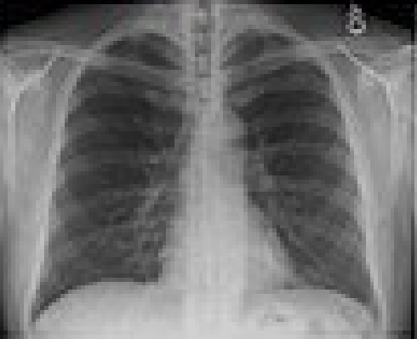
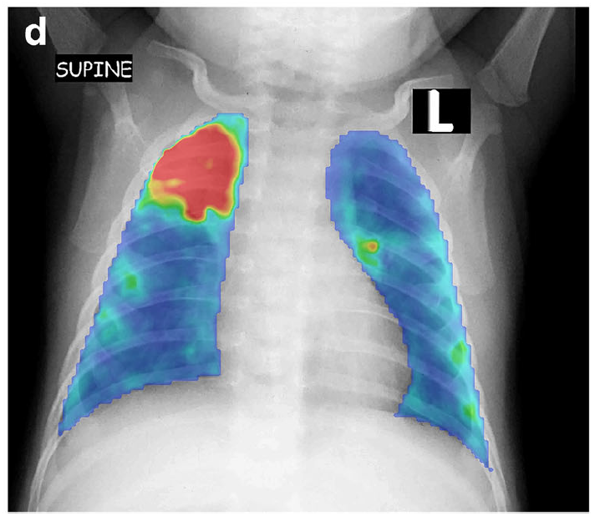
AI in CAD
Thoracic
image
data set
Automatic lung field segmentation
CAD4kids - collaboration between Diagnostic Image Analysis Group (Delft, The Netherlands) and the PERCH South African team, Johannesburg
Texture analysis
Texture abnormalities
diffuse change and structure (e.g., interstitial lesions),
focal abnormalities: isolated changes in density (e.g., pulmonary nodules)
abnormal shape, where the disease process changes the outline of normal anatomy
SVM classifier
CAD4Kids had a sensitivity of 76%, specificity of 80% and area under the ROC curve of 0.850 (95% CI 0.823–0.876)
Ground truth = expert radiologists.
Notes:
More in the radiology space, texture-based analysis plays an important role in diagnosis.
Here I highlight a study on the development of a tool called CAD4kids which is a collaboration between the Diagnostic Image Analysis Group in Delft, The Netherlands and a group in Johannesburg, South Africa. The goal is to develop a completely automated computed-assisted diagnosis tool for the fast diagnosis of pneumonitis in children based on a classification of imaging characteristics of the lesion as assessed using texture analysis.
The algorithm also indicates the region where it suspects that texture abnormalities occur. On the left the algorithm successfully classifies the severity of the lesion. A color representation of the area where lesion is detected allows physicians to fast review the images and validate the prediction model.
The curve on the right shows a measure of the combined specificity and sensitivity of the method. AUC of 0.85 is a respectable performance and certainly helps in speeding up diagnosis in situations where a large number of images need to be reviewed.

Slide 15
Repeatability and reproducibility
Repeatability = measure of precision under identical or near-identical conditions and acquisition parameters
  evaluated by ‘‘test-retest” analysis
  31 CT datasets Reference Image Database to Evaluate Therapy Response (RIDER)
Reproducibility = better to assess overall robustness
  Imaging system
  Imaging parameters
  Reconstruction
  ROI delineation
  Feature extraction and feature qualification
Notes:
In many of these applications the quality of the AI models hinges on parameters extracted from images.
In this type of discussion we address repeatability and reproducibility, where repeatability stands for measure of precision under identical or near-identical conditions and can typically be done via test-retest analyses. Reproducibility in this context quantifies robustness in a more comprehensive manner, including imaging system, parameters, reconstruction, delineation and feature extraction and qualification.

Slide 16
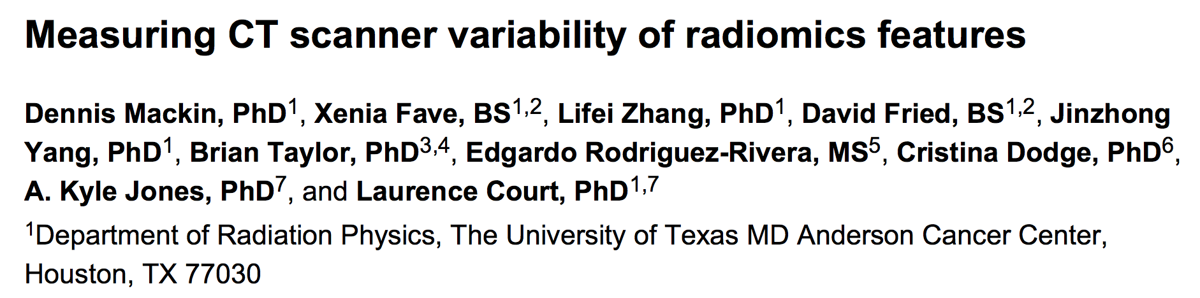
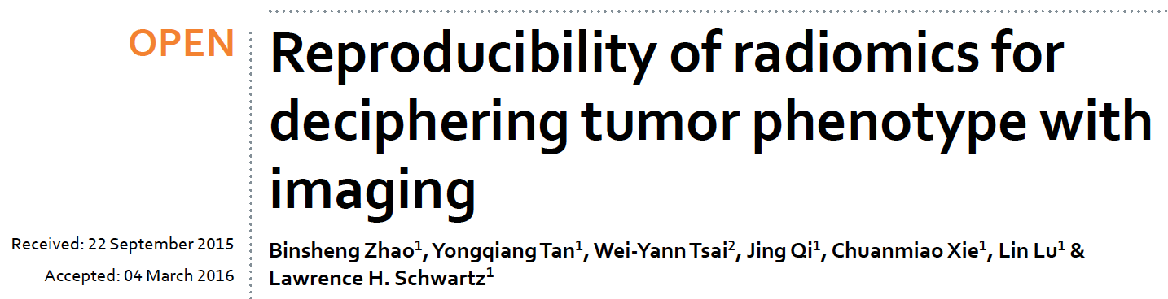
→ CT scanner variability is large compared to the interpatient variability in the NSCLC tumors for some features.
→ Imaging parameters that affect edge sharpness significantly affect radiomic features
Notes:
One area contributing to possible lack of reproducibility is that coming from CT scanner variability especially in the context of interinstitutional studies.
In this MDAnderson study the radiomics features calculated for non-small cell lung cancer (NSCLC) tumors from 20 patients was compared with those calculated for 17 scans of a specially designed radiomics phantom. They found that CT scanner variability can be large compared to patient-to-patient variability.
In another study by Zhao and colleagues, focus was on routine imaging acquisition techniques/parameters and how they affect reproducibility.
On the positive side they found that radiomic features were reproducible over a wide range of imaging settings. However, smooth and sharp reconstruction algorithms should not be used interchangeably.
The phantom comprised 10 cartridges, each filled with different materials to produce a wide range of radiomics feature values. The scans were acquired They found that variability between scanners of the feature values depended on both the cartridge material and the feature, and the variability was large relative to the variability between patients in the NSCLC tumors for some features. So

Slide 17
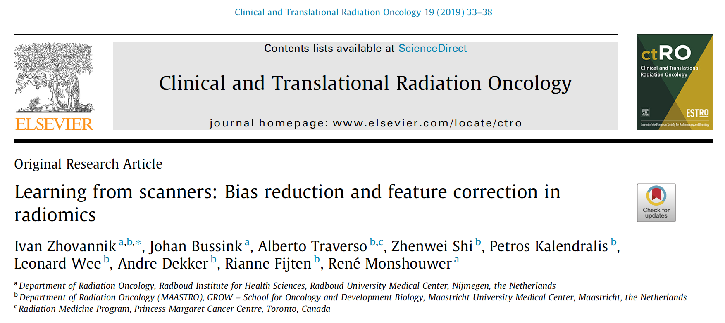
→ CT scanner variability is large compared to the interpatient variability in the NSCLC tumors for some features.
→ 2/3 of the radiomic features depend on the exposure setting of the scanner! Models can correct for this in a large part. Scanner SNR correction will result in more reliable radiomics predictions in NSCLC.
Notes:
In a recent Dutch study the authors investigated the impact of different SNR values, using a phantom with 17 regions of interest (ROI) . They found that 2/3 of the radiomic features depended on the exposure setting of the scanner. The authors developed an additive correction model for SNR, normalizing feature values to a standard exposure time, which then led to more reliable radiomics predictions.

Slide 18
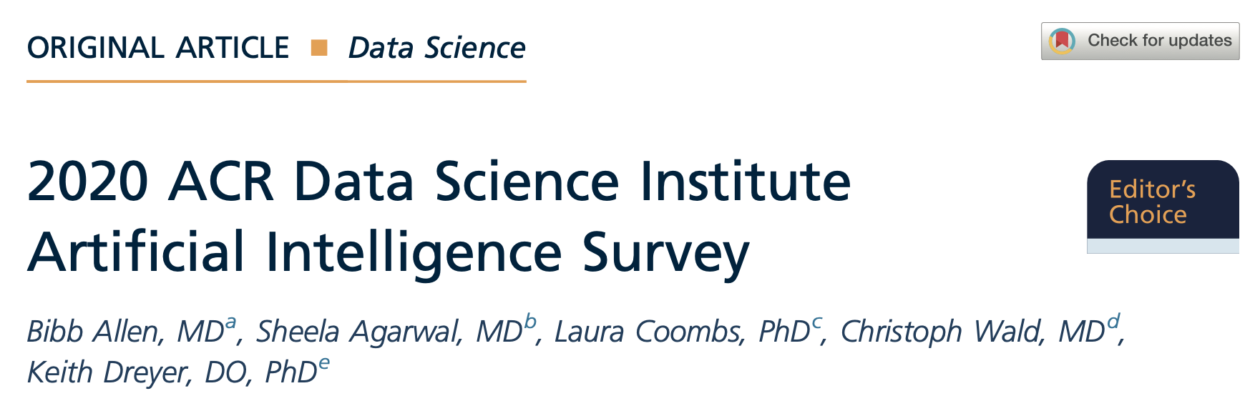
AI penetration in radiology - snapshot
Over 80 algorithms FDA approved
Clinical use of AI is modest due to inconsistent performance, potential decrease in productivity, and lack of reimbursement
Larger practices are more likely to use AI than smaller ones, and are using locally developed solutions
J Am Coll Radiol 2021;18:1153-1159
AI may add value to clinical practice, but because of inconsistent performance, no trust in AI for autonomous clinical use.
As barriers to implementation are mitigated, there is opportunity for future growth of AI in clinical practice.
Notes:
The impact of imaging acquisition and reconstruction on radiomic features is just one part of the challenges of AI in radiology.
A recent survey conducted by the American College of Radiology revealed that despite the fact that over 80 AI algorithms in the radiology space have been approved, its clinical use is modest and mostly limited to the larger centres. This has been attributed to variable performance, decrease in performance and lack of reimbursement. When large centres adopt a solution It would be mostly an in-house solution. It is concluded that there is strong potential that AI adds value to clinical practice but that in order for this to take place, these reliability issues need to be addressed. The authors expect a substantial opportunity to growth in AI in this space, once these barriers can be mitigated.

Slide 19

Reporting AI studies in medical physics
a new, required checklist for AI/ML applications in Medical Physics (CLAMP)
Description of requirements section-by-section
  Abstract, Introduction
  Materials
    Data description, partitioning, training, validation/tuning, testing, etc
    Devices used for data acquisition
    For imaging date: image or data acquisition modality, protocol, etc
  Methods
    ML algorithm
    ML performance and statistics
  Discussion
    Conclusions supported by data
    Limitations
Notes:
In recent years research publications on AI topics have boomed with some studies showing questionable quality of reporting methodology leading to lack of reproducibility of the results, even when using the same data. Like many other jounrals, The journal Medical Physics published an editorial with guidelines on the critical pieces of information to be included in papers reporting on an AI methodology and /or result. This leads to.a checklist for AI/ML applications in medical physics. The editorial contains a description of requirements, on a section-by-section basis of the information that needs to be provided with a trustworthy and reproducible AI study. Focusing briefly on the materials, authors are aked to provide great detail on data description, partitioning as well as the devices and protocols used on the imaging side. The methods section must contain details on the ML algorithm and the ML performance and statistics methods must be described in detail.

Slide 20
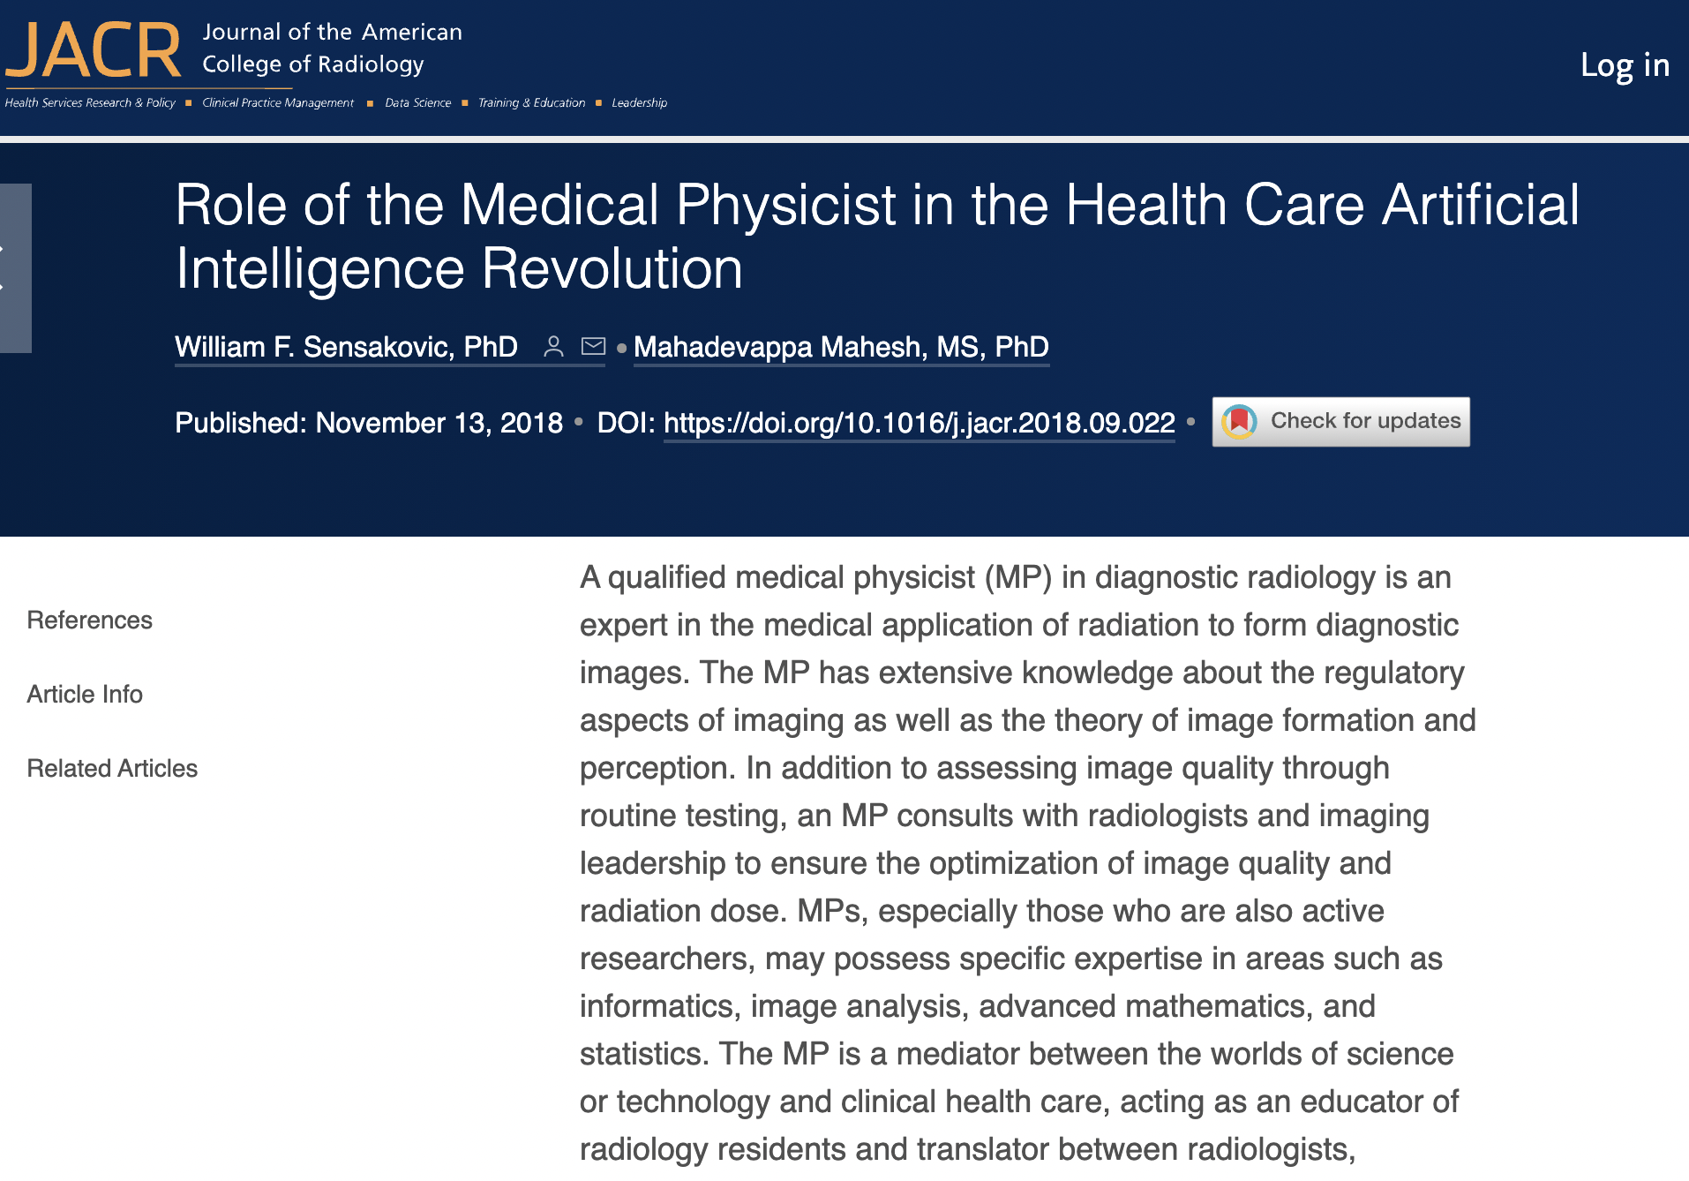
The role of clinical professionals – medical physicists
Notes:
Another important question is about the role of the qualified medical physicist with this changing landscape. As quantitative physical scientists, medical physicists have the mathematical and numerical background to implement AI algorithms, commission them (train, test, validate) and perform qaulity assurance on them. Qualified Medical physicists also have the clinical understanding to be able to put results obtained with the algorithms in the appropriate context and attach a reasonable interpretation to these results. With this dual role MPs are uniquely placed to be of great value for increasingly digital nature of the health care ssytem.

Slide 21
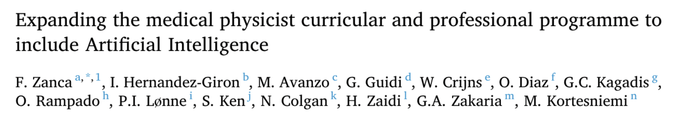
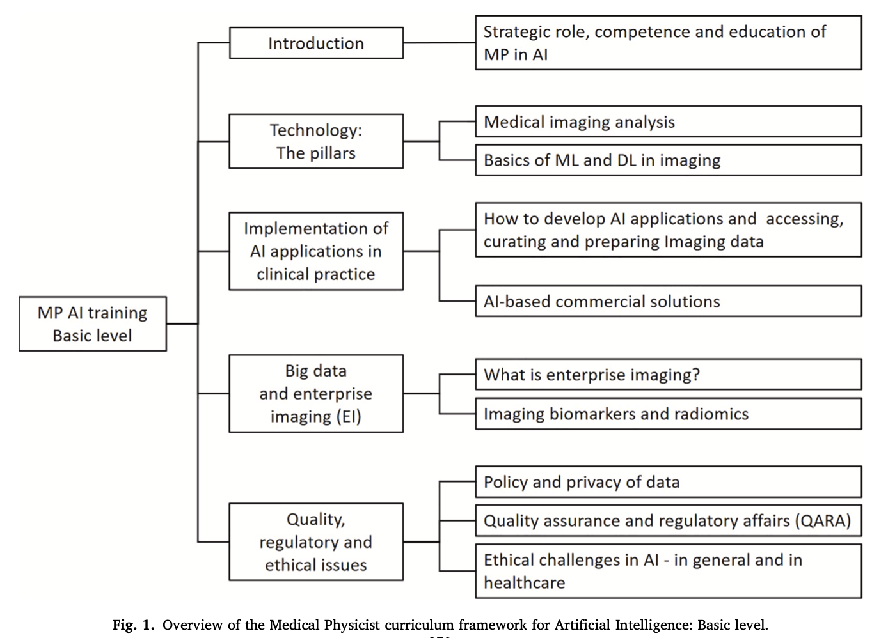
Training programs
Physica Medica 83 (2021) 174–183
Propose curriculum, two levels:
Basic
  intro to knowledge, development and applications of AI; results presented in the KSC approach
Advanced (sub-specialty)
  A block to be further specified by each subspecialty
Notes:
However, some adjustment to the training programs may be welcome. In this recent physica medica paper a proposal for an addition of an AI basinc training to the curriculum of the QMP is discussed. The authors propose a two-level approach with a basic level introducing the students to basic concepts of ML, statistical learning, development and applications of AI and an advanced, sub-specialty specific level.

Slide 22
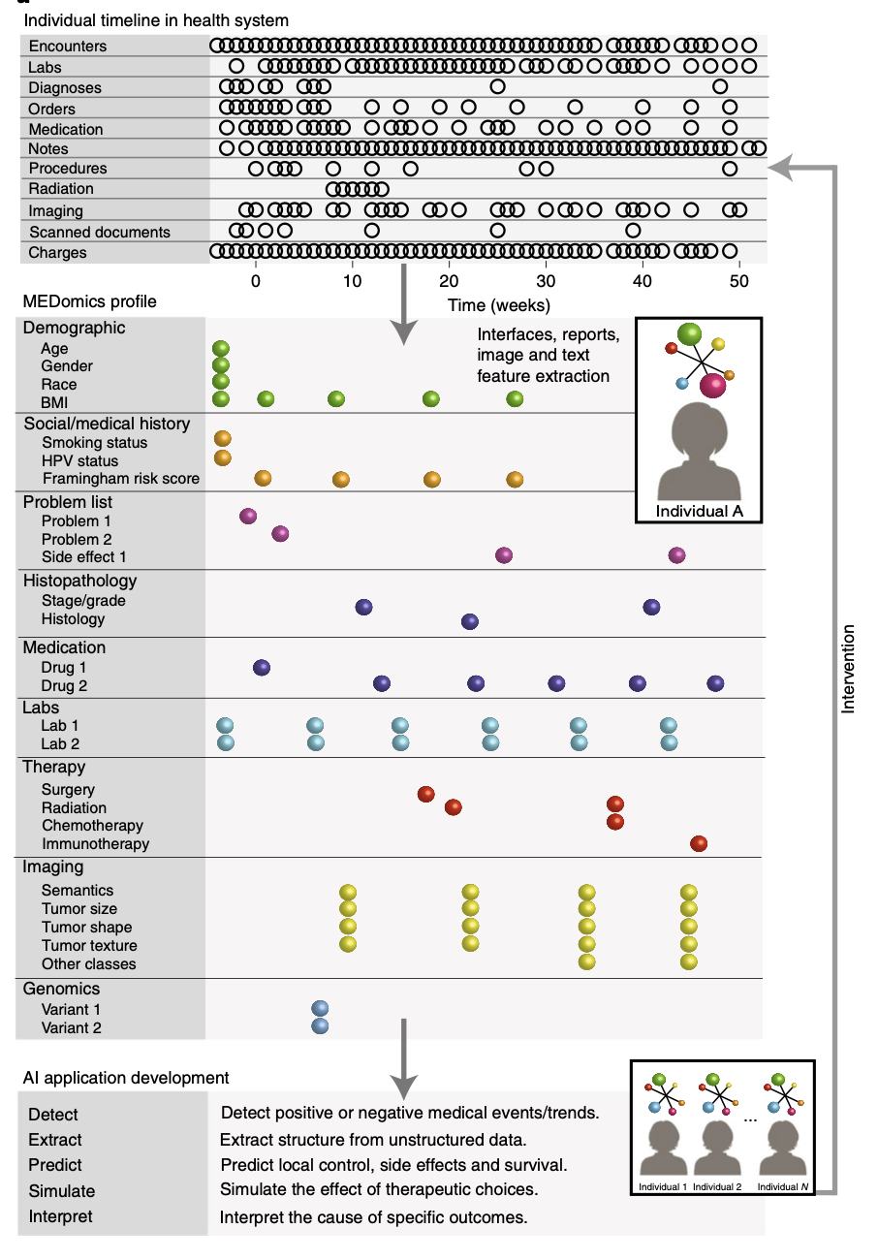
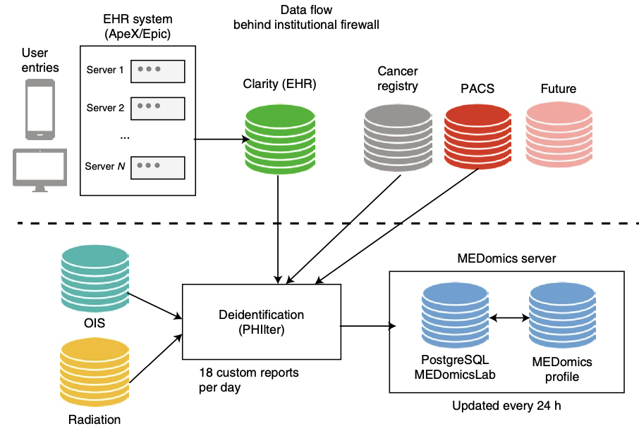
Learning from health care data
From Morin et al (2021) Nature Cancer 2:709–722
Notes:
To finalize we return briefly to the promise of AI in oncology, to use real-world data to make real time, precision predictions using actionable models.
Electronic multimodal health data currently lives in multiple, segregated systems across the healthcare system.
This is an example of an artificial intelligence framework called Med Omics that can integrate longitudinal electronic health records with real-world data and help to improve and personalize cancer treatments.
On the left, electronic health data records (encounters, labs, diagnoses, orders, medication, notes, procedures, radiation, imaging, scanned documents and financial charges) is shown for an individual with breast cancer across a timeline of typical cancer management. A MEDomics profile is constructed dynamically from software interfaces, reports, image feature extraction and text feature extraction algorithms to obtain structured tables of features at different points of care (presentation, imaging, therapy and survivorship). AI and medical informatics applications are then developed using the MEDomics profiles via an ‘in silico randomized clinical trial’ methodology to detect, extract, predict, simulate and interpret relevant clinical end points. Actionable interventions are ultimately communicated back into the health system using management dashboards and other forms of communication between health professionals and data scientists. BMI, body mass index; HPV, human papilloma virus.
On the right, the flow of medical data for the creation of MEDomics profiles and AI development is shown. Medical activities are recorded continuously in the EHRs and the Clarity relational database. Custom reports are generated out of Clarity and sent to the MEDomics server for deidentification, data formatting and feature extraction/calculation. Diverse other databases are processed into MEDomics, including the oncology information system (radiation), treatment planning systems and imaging. Data are ultimately recorded and updated on a daily basis into the MEDomics server installed behind the institutional firewall with double identification access.
There is an enormous potential when real-world multimodal health data can be integrated, thereby enabling continuous learning while simultaneously capturing and integrating longitudinal clinical records.

Slide 23
Conclusions
AI, machine learning and deep learning are powerful tools that have the potential to support health care in different contexts worldwide
Be aware:
  Interpretability of AI algorithm (black-box)?
  Quality and aggregation of the data (images, clinical data). Quality assurance deserves special attention!
  Ethical aspects!
Societies are publishing subspecialty-specific requirements on training and publication of novel findings
Notes:
I have tried to brief highlight a few areas of application of AI in medicine, focusing on cancer diagnosis and treatment using radiation.
The benefits of AI in those areas are numerous and include (1) redistribution of workload of the health workforce; (2) enable quicker detection, treatment planning and treatment delivery, therefore allowing for higher patient throughput; (3) in radiology, AI can enhance diagnostic infrastructure in resource constrained settings and alleviate the burdens related to pathology tests; (4) quantify disease progress and recovery and inform adaptive treatments.
But there are also warning flags that we should raise and these include:
The fact that AI deep learning models are not easy to interprete and have a black-box nature. Medical decision taking is still the responsibility of the medical professional, not an algorithm; we might see adaptations in the activities of the health professionals and efficiency gains, but the overall result should be better healthcare.
Trained ML models are prone to the quality of the data used and require a quality assurance step before they can be used in a particular setting. The design of this QA program must be thought out at the time the model is developed
I have not discussed the ethical aspects of the collection and systematic storage and access to data;
Societies within the field of radiology and oncology are in the process of formulating specialty-specific training requirements

Slide 24
Thank you!
Notes:
Thank you!

