Slide 1

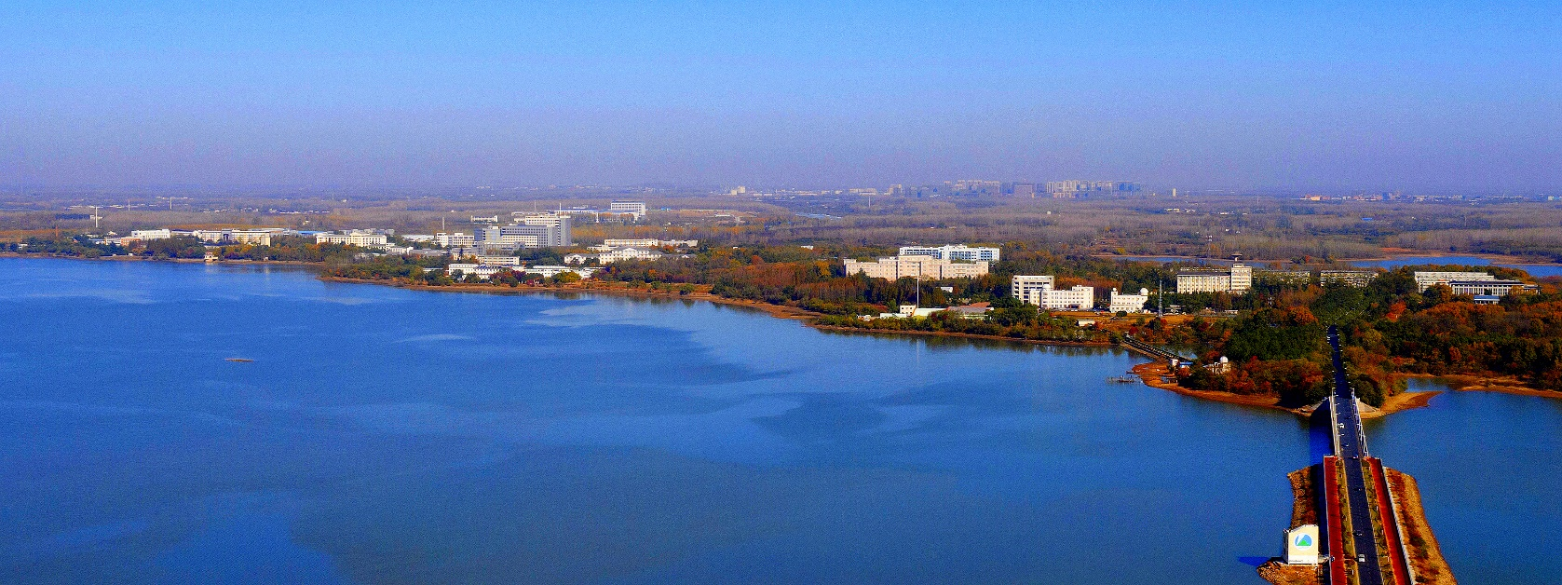
13th Technical Meeting on Plasma Control Systems, Data Management and Remote Experiments in Fusion Research 5-8 Jul 2021, Culham, United Kingdom
The realization of controlled plasma termination towards off-normal events in EAST PCS
Q.P. Yuan ª, Y. Huang ª, B.J. Xiao ^{a, b}, J.Q. Zhu ^{a, b}, R.R. Zhang ª, Z.P. Luo ª,
B. Penaflor ^{c}, D. Humphreys ^{c}
ª Institute of Plasma Physics, Chinese Academy of Sciences, Hefei, China
^{b} University of Science & Technology of China, Hefei, China
^{c} General Atomics, DIII-D National Fusion Facility, San Diego, CA, USA
qpyuan@ipp.ac.cn

Slide 2
Outline
Introduction
Control trajectory design
Algorithm implementation
Summary

Slide 3
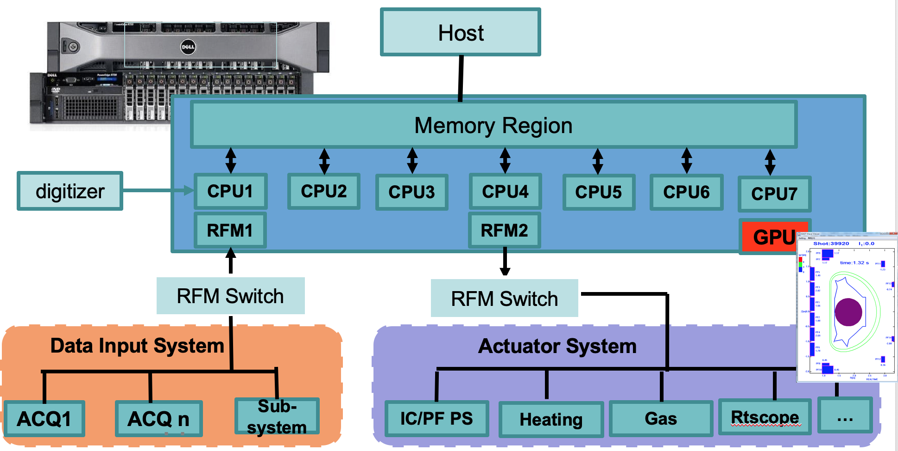
Introduction
PCS cluster：
Host + computing nodes
Fast data input/output: RFM network
GPU data
Sub-acq system
Actuator system
data display and remote system
Slow data input/output：Ethernet
Parameter setting
Data restore/archiving
Integrate current, position, shape, density, pressure, profile, heat load, and fault detection & protection
Notes:
EAST plasma control system PCS, adapted from DIIID PCS, is a mini linux cluster

Slide 4
Introduction
PCS provides the first level protection to the device.
Fault detected | Description
Plasma current error | fabs (Ip measured – Ip target) > threshold
Poloidal field coil current error | fabs (PF current measured – PF current target) > threshold
Poloidal field coil over current error | fabs (PF current measured) > threshold
Poloidal field power supply fault | When PS system sends effective DIO signal to PCS
Magnetic diagnostic signals error | When the rogowiskis coils, flux loops, probes signals used for control are abnormal
VDE event | When the real time calculated vertical displacement growth rate > threshold
Disruption prediction | When the disruption possibilities > threshold
How to handle these off-normal events?
Notes:
A series of off-normal event monitoring algorithms have been developed in EAST PCS, as shown in Table 1. The emergency termination gives up the plasma control with sending zero commands to all the actuator systems, which may cause the plasma disruption and damage the first wall material. Thus, the controlled discharge termination is studied in this paper.

Slide 5


Control trajectory design
Plasma current and shape control
(1) Error calculation
(2) PID calculation
(3) command
The termination control design
(1) change the executing sequence to enable the termination control algorithms.
(2) new targets for current and shape need to be calculated.
(3) choose the suitable PF feedforward current.
5
Notes:
The plasma shape control has the same processes. The target control points and X points are input to PEFIT, then the flux errors are generated and used for ISOFLUX control. The required poloidal field coil current is composed of feedforward current set in the GUI and feedback calculation from the IP and shape control loop. And a PID controller is applied to generate the commands.

Slide 6
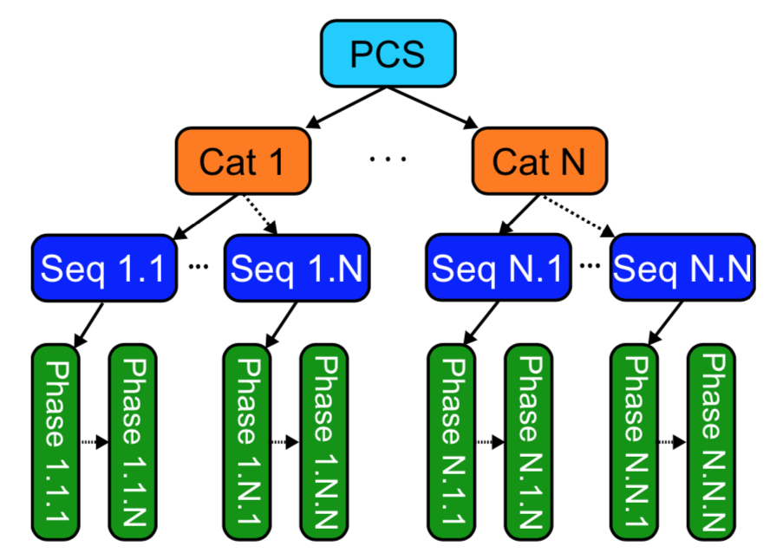
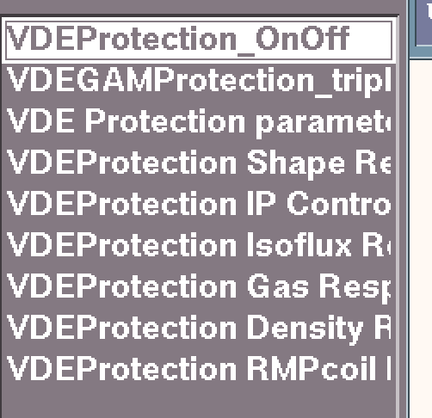
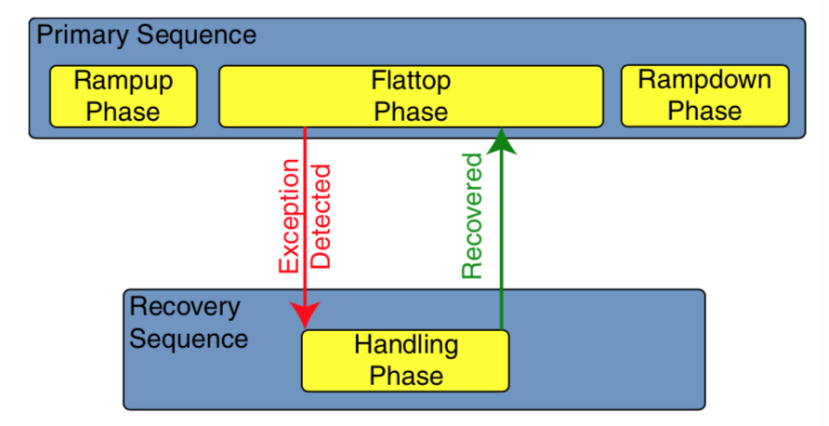
Control trajectory design
Execution sequence switching
 | E1 | E2 | E3 | E4 | …
Cat1 | 0 | 1 | 2 | 1
Cat2 | 0 | 2 | 1 | 3
Cat3
…
Event detection
Response decision
Categories: Algorithm set classified by actuator
Sequence: a time-dependent list of the control algorithms that will be called
Switching sequence
6
Notes:
In PCS, each category contains one or more ‘sequences’. The execution sequence can be switched when off-normal event happens.

Slide 7

Control trajectory design
Control target calculation
IP target: calculate in real time with ramp down rate and the current at the switching point
IP_{t0}
$${IP}_{target}={IP}_{t0}+\left(t−t_{0}\right)∗ramp_rate$$
Shape target: calculated with linear interpolation from the actual plasma shape at the switching point to the first set new target shape
Feedforward current
Use the measured PF current at the switching point and keep as a constant
7
Notes:
The difficulty of controlled plasma termination is to set suitable plasma parameter targets before shot, since the off-normal event trigger time is uncertain.
To avoid large control fluctuations when termination control starts, the feedforward current waveform is replaced with the measured PF current at the switching time as a constant value.

Slide 8
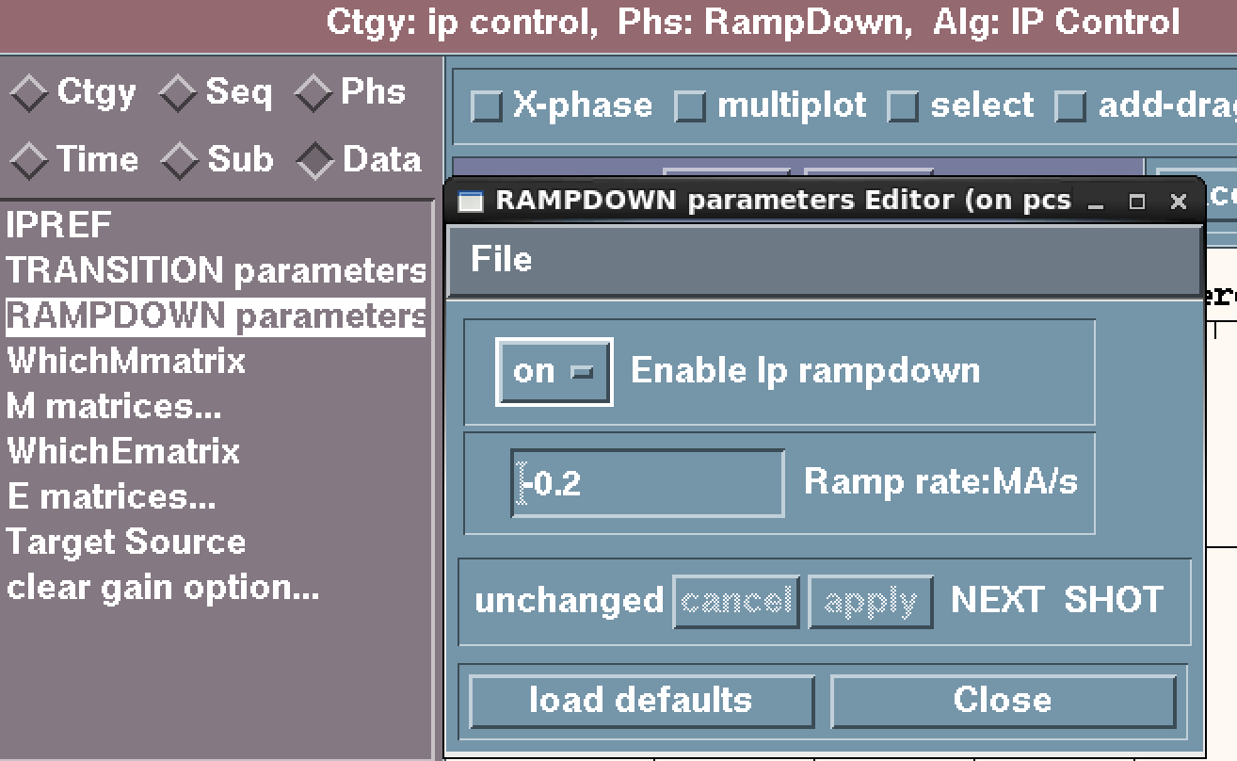
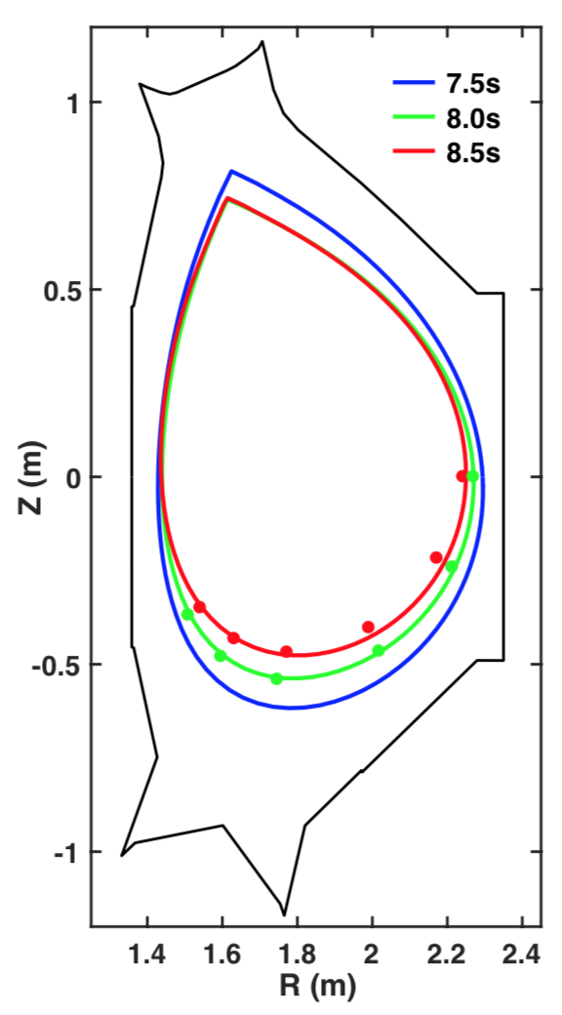
Algorithm implementation
PCS GUI
ramp down ON/OFF switch, ramp rate
Control point
Control logic realization
Current target calculation in real time
switching flag is sent to PEFIT, the linear interpolation is done by PEFIT and isoflux control errors are generated
8
Notes:
The difficulty of controlled plasma termination is to set suitable plasma parameter targets before shot, since the off-normal event trigger time is uncertain.
To avoid large control fluctuations when termination control starts, the feedforward current waveform is replaced with the measured PF current at the switching time as a constant value.

Slide 9
Algorithm implementation
Experiment result
VDE event
Ramp down
Trigged by VDE event at 7.5 s
Controlled termination with ramp rate -0.2MA/s, elongation from 1.65 to 1.5
9
Notes:
In 2019 EAST experiment, the plasma controlled termination mechanism is verified with VDE event trigging. The response sequence is set to execute plasma current and shape control with current ramp rate -0.2MA/s and lower elongation. The VDE fault is trigged at 7.5s, and the plasms control result is shown in Fig. 4 and Fig.5. As shown in the above figures, the plasma current was controlled to ramp down after execution sequence switched at 7.5s. The target shapes were linear interpolation from the actual shape at 7.5s and first set new target shape 2s later keeping in upper single null configuration and lower elongation. The shape was controlled quite stable with elongation from 1.65 to 1.5.

Slide 10
Summary and future work
The controlled termination trajectory toward off-normal events is studied.
The plasma current and shape were successfully controlled using certain current ramp rate and PEFIT/ISOFLUX control during termination phase.
Further research is undergoing for more event detection, and more suitable handling strategies.
Notes:
The summary is here

Slide 11
Thank you for your attention

