Slide 1
Decision logic in ASDEX Upgrade real time control system
I. Gómez Ortiz, W. Treutterer, B. Sieglin, O. Kudlacek and the ASDEX Upgrade Team
Max Planck Institute for Plasma Physics

Slide 2
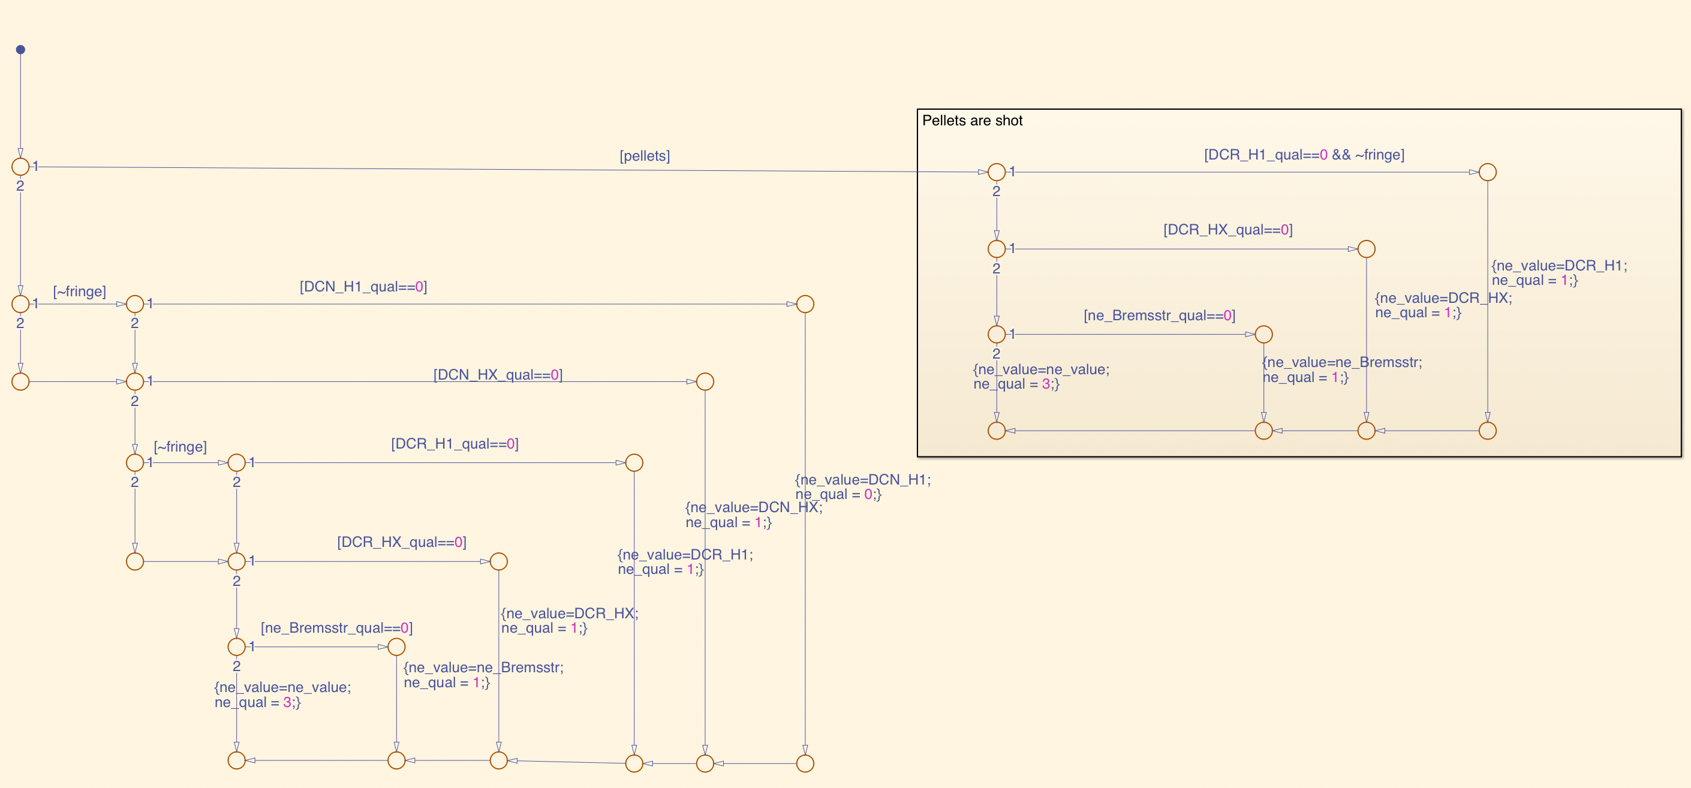
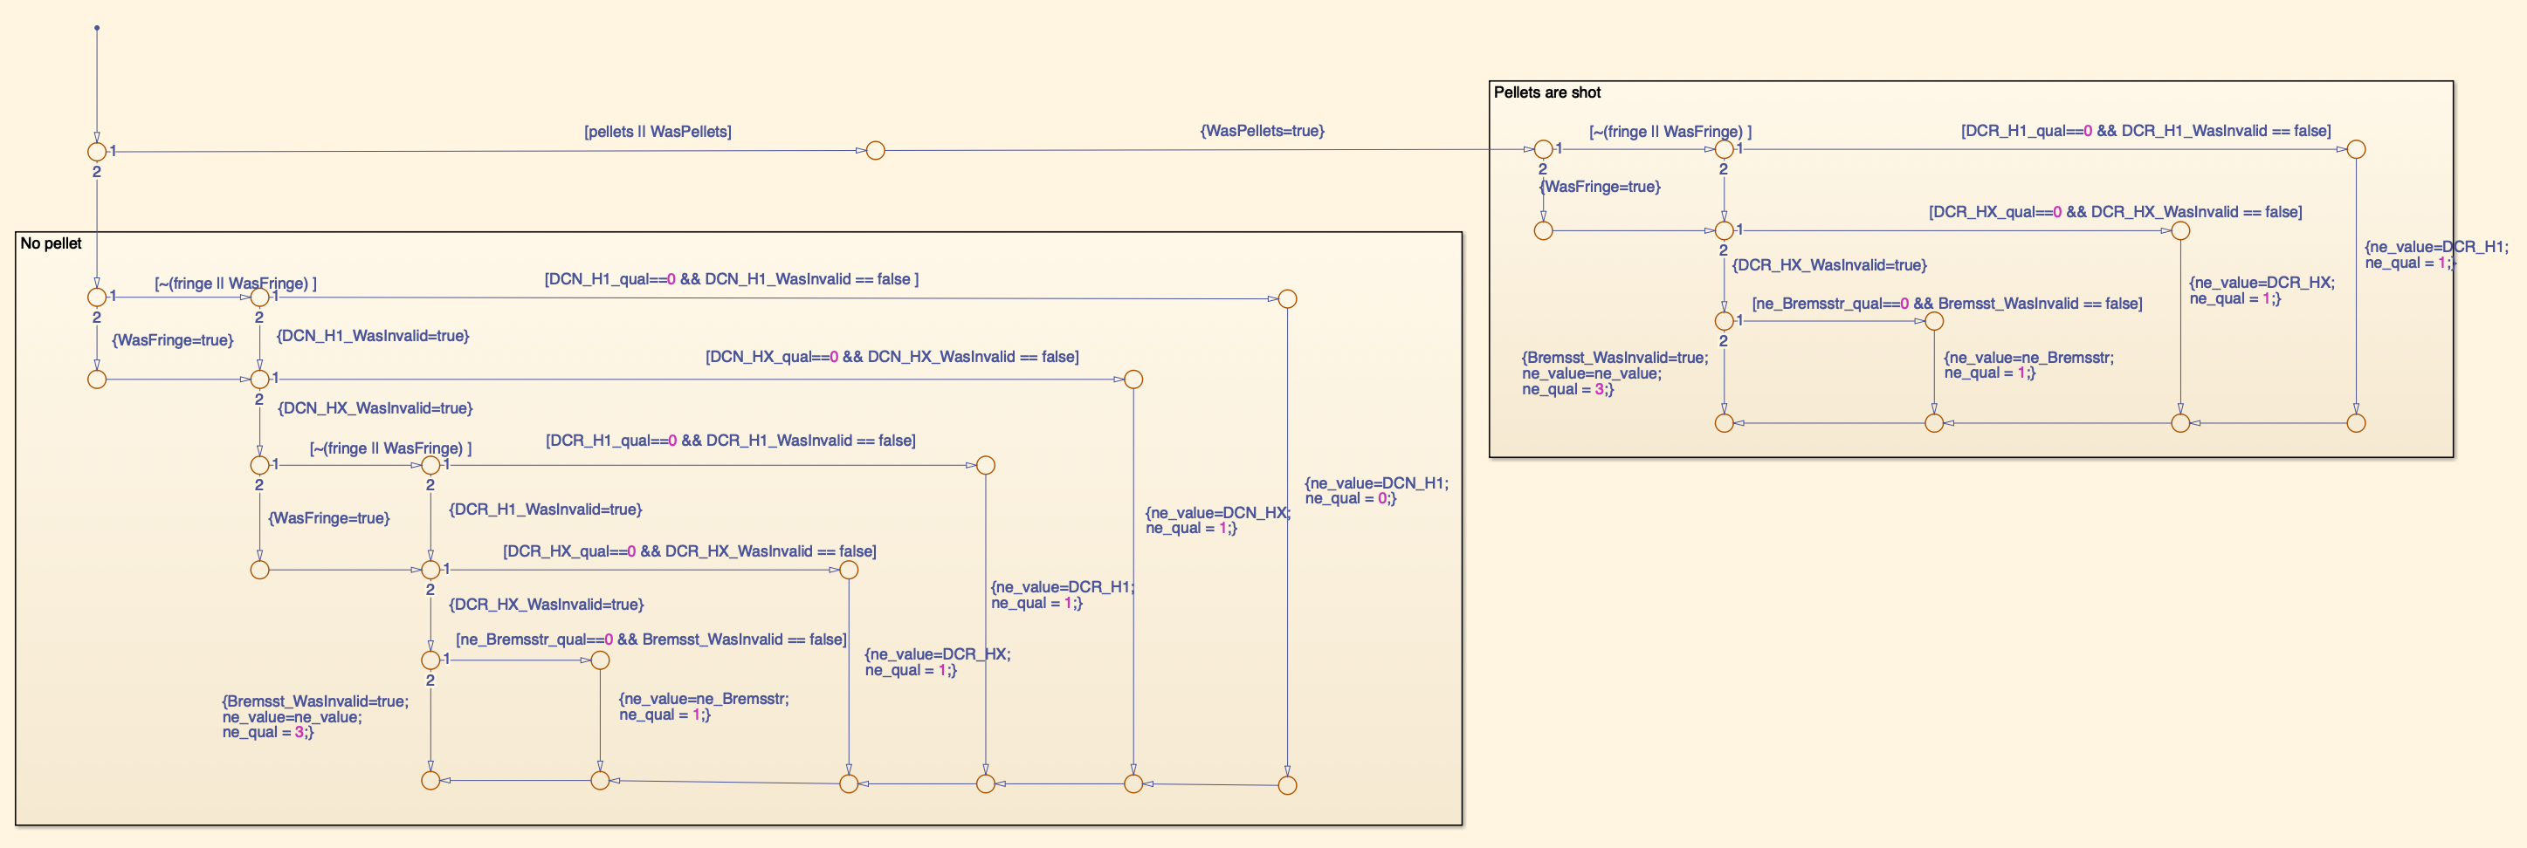
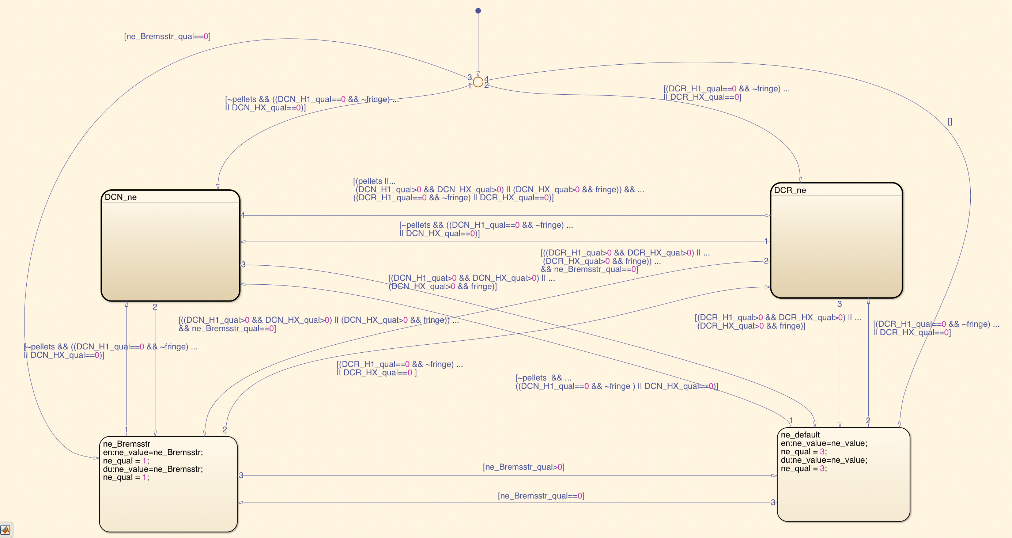
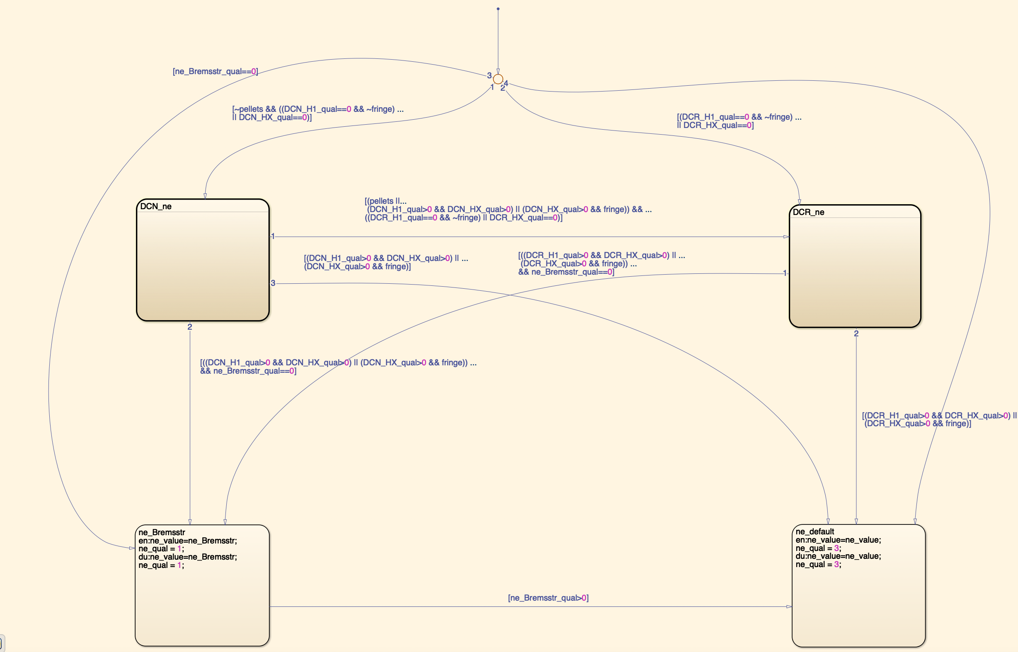
Our daily bread: A small change but a big impact
Own experience: benchmarking for a change in the electron density evaluator
Use recovered diagnostic sources
Do not use recovered diagnostic sources
IF THEN ELSE
HFSM(Hierarchical Finite State Machine)

Slide 3
Motivation and Proposal
Why do we need to do something?
Decisions in large Tokamaks are increasing in number and complexity
The most common decision algorithms, If-Then-Else and HFSM*, are hard to scale
Wrong decisions => Damages
Requirements for modern decision algorithms
What do we propose?
Behaviour trees, extensively used in robotics and the videogame industry
Tree structure dedicated to call functions
Suitable for deliberative and reactive architecture.
Main characteristics:
high flexibility:
configurability
stateful/ stateless behaviour
high node customizability
modularity: using subtrees
transparency: visual tree structure
- More informed/ aware
- Flexible
- Scalable
- Transparent
Behaviour Trees ≠ Decision Trees.
Behaviour trees ➜ build behaviours from simple actions.
Behaviour Trees: One point of change for adding or removing nodes
HFSM*: Review all the connections to other nodes
* HFSM: Hierarchical Finite State Machines
Notes:
Decisions in tokamaks: always more abundant and more sophisticated. The greater the system the more relevant due to the larger number of subsystems and the consequences of damages
Exceptions: A large number of exceptions, and their combination make the complicated to handle. Traditional approaches such as If-Then-Else are hardly scalable after a certain number of elements and hard to make them configurable. HFSM are difficult to maintain due to the intrinsic stateful nature, which force the designer to check all the connections every time it introduces a new node
ASDEX Upgrade make use of a large number of decision algorithms, most of them implemented as long nested If-Then-Else. These approach make configuration extremely complicated and update the logic an error prompt task
The tokamaks keep surprising us with new revelations about the system, which often lead to modifications in their control system. Large machines such as ITER require a short, but sure, development times to cope with new findings. The If-Then-Else, with their lack of configurability and transparency as they increase in size, and the HFSM with the obligation of checking all transitions every time a node is included, are no match for Behaviour Trees which tries to address these limitations with an intuitive tree structure, their modularity and configurability

Slide 4
What is a Behaviour Tree?
A Behaviour Tree is:
a software structure used to call functions based on some conditions
represented graphically as a directed tree composed of different nodes
Evaluated (ticked) in every cycle from top to bottom and left to right. From root node to leaf nodes.
Tasks are combined to achieve a goal
The nodes evaluate their action or their children’s result. The nodes pass their result to its parent node until they reach the root node. If the returned value is success or running the tick is over and it waits for the next tick.
Its strength comes from its ability to perform very complex activities by composing simple tasks.
Tick: Trigger to execute a node
Tick: Trigger to execute a node
Tick: Trigger to execute a node
Tick: Trigger to execute a node
Tick: Trigger to execute a node
Tick: Trigger to execute a node
Tick: Trigger to execute a node
_{Fallback}
_{Fallback}
_{Fallback}
_{Fallback}
_{Fallback}
_{Fallback}
_{Fallback}
_{Fallback}
_{A: Take Default}
_{A: Take Default}
_{A: Take Default}
_{A: Take Default}
_{A: Take Default}
_{A: Take Default}
_{A: Take Default}
_{Sequence}
_{A: Take Default}
_{Sequence}
_{Sequence}
_{Sequence}
_{Sequence}
_{Sequence}
_{Sequence}
_{Sequence}
_{Sequence}
_{Sequence}
_{Sequence}
_{Sequence}
_{Sequence}
_{Sequence}
_{Sequence}
_{Sequence}
_{Sequence}
_{Sequence}
_{Sequence}
_{Sequence}
_{Sequence}
_{Sequence}
_{Sequence}
_{Sequence}
_{A: Take Bremsstr}
_{A: Take Bremsstr}
_{A: Take Bremsstr}
_{A: Take Bremsstr}
_{A: Take Bremsstr}
_{A: Take Bremsstr}
_{A: Take Bremsstr}
_{C:}
_{Bremsstr valid?}
_{A: Take Bremsstr}
_{C:}
_{Bremsstr valid?}
_{C:}
_{Bremsstr valid?}
_{C:}
_{Bremsstr valid?}
_{C: Bremsstr valid?}
_{C:}
_{Bremsstr valid?}
_{C:}
_{Bremsstr valid?}
_{A: Take DCR}
_{C:}
_{Bremsstr valid?}
_{A: Take DCR}
_{A: Take DCR}
_{A: Take DCR}
_{A: Take DCR}
_{A: Take DCR}
_{A: Take DCR}
_{C:}
_{DCR valid?}
_{A: Take DCR}
_{C:}
_{DCR valid?}
_{C:}
_{DCR valid?}
_{C:}
_{DCR valid?}
_{C:}
_{DCR valid?}
_{C:}
_{DCR valid?}
_{C:}
_{DCR valid?}
_{Sequence}
_{C:}
_{DCR valid?}
_{Sequence}
_{Sequence}
_{Sequence}
_{Sequence}
_{Sequence}
_{Sequence}
_{inverter}
_{Sequence}
_{inverter}
_{inverter}
_{inverter}
_{inverter}
_{inverter}
_{inverter}
_{inverter}
Evaluation order
Evaluation order
Evaluation order
Evaluation order
Evaluation order
Evaluation order
Evaluation order
Evaluation order
_{C:}
_{Pellets?}
_{C:}
_{Pellets?}
_{C:}
_{Pellets?}
_{C:}
_{Pellets?}
_{C:}
_{Pellets?}
_{C:}
_{Pellets?}
_{C:}
_{Pellets?}
_{C:}
_{Pellets?}
_{C:}
_{DCN valid?}
_{C:}
_{DCN valid?}
_{C:}
_{DCN valid?}
_{C:}
_{DCN valid?}
_{C:}
_{DCN valid?}
_{C:}
_{DCN valid?}
_{C:}
_{DCN valid?}
_{C:}
_{DCN valid?}
_{A: Take DCN}
_{A: Take DCN}
_{A: Take DCN}
_{A: Take DCN}
_{A: Take DCN}
_{A: Take DCN}
_{A: Take DCN}
_{A: Take DCN}
Blackboard: Behaviour tree’s internal variables
Blackboard: Behaviour tree’s internal variables
Blackboard: Behaviour tree’s internal variables
Blackboard: Behaviour tree’s internal variables
Blackboard: Behaviour tree’s internal variables
Blackboard: Behaviour tree’s internal variables
Blackboard: Behaviour tree’s internal variables
Blackboard: Behaviour tree’s internal variables
Success
Failure
Running
Success
Failure
Running
Success
Failure
Running
Success
Failure
Running
Success
Failure
Running
Success
Failure
Running
Success
Failure
Running
Node Types
Composite node: Control the execution flow
Decorator node: Modify child node status
Leaf node: Execute a specific action
Success
Failure
Running
Node Types
Composite node: Control the execution flow
Decorator node: Modify child node status
Leaf node: Execute a specific action
Node Types
Composite node: Control the execution flow
Decorator node: Modify child node status
Leaf node: Execute a specific action
Node Types
Composite node: Control the execution flow
Decorator node: Modify child node status
Leaf node: Execute a specific action
Node Types
Composite node: Control the execution flow
Decorator node: Modify child node status
Leaf node: Execute a specific action
Node Types
Composite node: Control the execution flow
Decorator node: Modify child node status
Leaf node: Execute a specific action
Node Types
Composite node: Control the execution flow
Decorator node: Modify child node status
Leaf node: Execute a specific action
Node Types
Composite node: Control the execution flow
Decorator node: Modify child node status
Leaf node: Execute a specific action
Evaluation order
Evaluation order
Evaluation order
Evaluation order
Evaluation order
Evaluation order
Evaluation order
Evaluation order

Slide 5
Behaviour trees: A small change and still a small impact
Applying the same change as for the If-Then-Else and the HFSM in the first slide.
Changes applied on one point of contact
More complex tasks = combination of simple tasks
Recovering old sources
Not recovering old sources
?
?
?
?
?
?
?
?
?
?
?
➜
act
?
act
?
➜
?
?
➜
?
act
?
?
➜
act
➜
?
?
act
➜
➜
➜
act
act
➜
?
act
act
➜
?
act
➜
act
➜
➜
➜
?
?
➜
➜
?
➜
➜
➜
?
➜
➜
➜
?
?
➜
?
➜
?
➜
➜
?
?
➜
➜
➜
?
?
➜
?
?
➜
?
cmp
?
➜
➜
cmp
?
?
?
Subtree
Comp. with memory
Fail
Fail
➜
cmp
Fail
➜
cmp
?
cmp
➜
Fail
cmp
cmp
➜
➜
➜
➜
?
act
Fail
?
➜
act
cmp
➜
cmp
act
?
cmp
cmp
act
cmp
➜
act
cmp
cmp
cmp
cmp
➜
➜
act
➜
➜
Fail
cmp
➜
act
?
Fail
cmp
➜
?
cmp
act
cmp
Fail
➜
cmp
cmp
➜
cmp
?
Subtree
Comp. with memory
➜
➜
➜
act
act
➜
Subtree
Comp. with memory
act
➜
cmp
act
Fail
?
➜
cmp
act
Fail
cmp
cmp
➜
cmp
act
➜
➜
?
cmp
➜
Fail
?
act
cmp
cmp
act
➜
➜
cmp
act
?
➜
Fail
Fail
➜
?
➜
cmp
cmp
➜
➜
cmp
➜
?
cmp
?
act
?
cmp
➜
➜
Fail
cmp
act
➜
?
cmp
act
➜
Fail
Subtree
Comp. with memory
➜
?
act
Subtree
Comp. with memory
?
act
Fail
cmp
act
cmp
act
cmp
cmp
act
➜
act
?
act
cmp
?
act
➜
Fail
➜
cmp
act
Fail
cmp
➜
Fail
Fail
?
Fail
cmp
act
cmp
Fail
➜
cmp
act
cmp
cmp
cmp
cmp
act
act
cmp
?
act
➜
Fail
cmp
Fail
?
cmp
act
Fail
➜
cmp
act
Fail
cmp
?
cmp
act
act
cmp
act
cmp
act
cmp
act
Subtree
Comp. with memory
Fail
cmp
cmp
act
➜
Fail
cmp
➜
cmp
cmp
act
cmp
act
➜
Fail
cmp
cmp
act
➜
cmp
act
➜
Fail
cmp
cmp
act
➜
➜
Fail
➜
➜
Fail
➜
➜
cmp
cmp
act
cmp
act
➜
cmp
cmp
act
cmp
act
act
➜
cmp
➜
➜
cmp
cmp
act
➜
cmp
act
cmp
cmp
act
act
act
cmp
act
➜
act
cmp
act
cmp
act
cmp
cmp
act
cmp
act
cmp
act
act

Slide 6
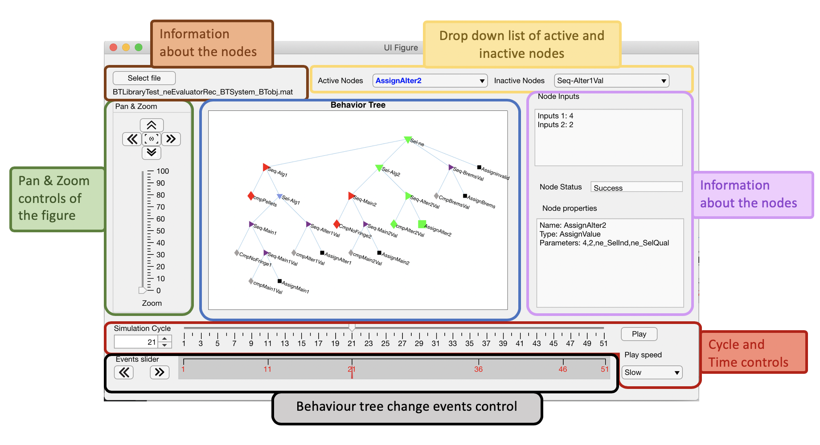
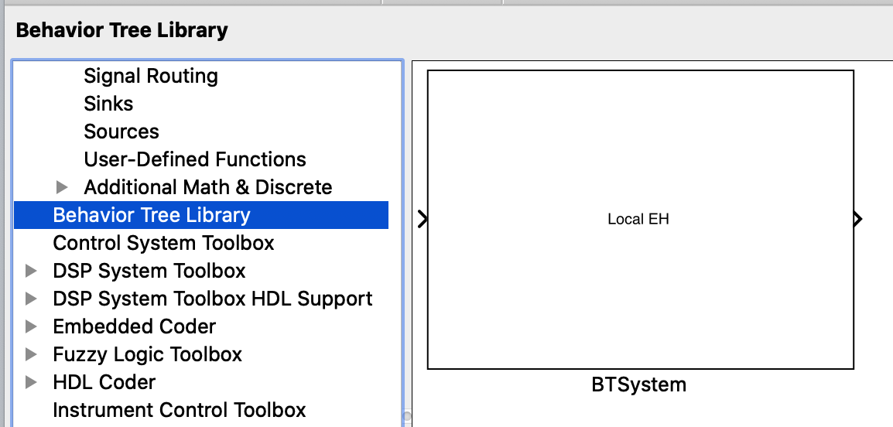
Implementation
Final implementation: in the DCS Framework (C++) in ASDEX Upgrade. Implementation under development.
C++ library: BehaviorTree.CPP library: developed at Eurecat with the joint efforts of the Italian Institute of Technology
Visual editor for behaviour trees: Groot
Prototype implementation: MATLAB/Simulink behaviour tree framework developed at IPP
Behaviour Tree Simulink Component in library
Development of control system specific nodes: Some examples
- Threshold comparison with debouncing node
- Signal reference generation
- Ramp down node
- Assign values node
Behaviour Tree simulation analyser

Slide 7
Electron density evaluation
Electron density evaluation in ASDEX Upgrade Discharge Control System (DCS): Interferometry and Bremsstrahlung
Currently implementation: if-then-else
If-Then-Else: complex nested structure=> hard to review => difficult to scale
Behaviour trees: visual approach => easier review of the logic => reduced possibility of failures
Decision Logic
Behaviour Tree
_{Fallback}
_{Sel ne}
Source | Channel | Usage conditions
Interferometry | DCN H1 | No pellets No fringe detected in DCN H1 DCN H1 interferometry signal valid
 | DCN Hx | No pellets No fringe detected in enough DCN Hx Above signal cannot be used DCN Hx interferometry signal valid
 | DCR H1 | No fringe detected in enough DCN Hx Above signals cannot be used DCR H1 interferometry signal valid
 | DCR Hx | No fringe detected in enough DCR Hx Above signals cannot be used DCR Hx interferometry signal valid
Bremsstrahlung |  | Above signals cannot be used Bremsstrahlung signal is valid
_{Sequence}
_{DCN}
_{Subtree}
_{Ne from DCR}
_{Sequence}
_{Bremsstr}
_{Action: Assign value ne}
_{Cond: No Pellets}
_{Subtree}
_{Ne from DCN}
Cond: Bremsstrahlung Signal Valid
_{Action: Assign value ne}
X=DCN
X=DCR
_{Fallback}
_{Source X}
_{Sequence}
_{H1}
_{Sequence}
_{HX}
_{Cond:}
_{No fringe}
_{Cond:}
_{H1 valid}
_{Action: Assign value ne}
_{Cond:}
_{HX valid}
_{Action: Assign value ne}
* This is a simplified version of the algorithm

Slide 8
Conclusion/ Future
Simulink Behaviour Tree framework
Coupling the Simulink Behaviour Tree framework with a simulation platform => learning system
Utilisation in ASDEX Upgrade:
Global level: Segment selector
Local level: Diagnostics, Controllers and Actuator Manager
Enabler technology: Behaviour Trees enables a “goal oriented” machine
New nodes => more sophisticated decision logic in ASDEX Upgrade (Ex: fuzzy or utility based decisions)

Slide 9
Thank you!

Slide 10
What is a behaviour tree made of?
Sequence
It runs its children nodes in order (left to right) until all are over or one returns failure
They are the executing elements triggered by a tick. The nodes must always return the result of their evaluation, either self evaluated or passed-through from their children nodes.
The result may be: success, failure or running. They return running if their evaluation is not finished during the tick.
Composite nodes
It runs its children nodes in order (left to right) until all are over or one returns success
Fallback
Switch
It runs the selected children based on a control signal
They control the execution
Inverter
It runs its child and inverts whatever result the child returns
Nodes
Decorator nodes
Always success
It runs its child and always return success to its parent node
Behaviour tree
They transform the result of the child node
Always failure
It runs its child and always return failure to its parent node
Comparison
Compares two values
They perform some specific action, it is fully customable. It is basically a function call
Leaf nodes
Assign value
Assign value to variable
Subtree
It collects a branch of the decision tree. It is useful for clarity and reuse.
Reference generation
Reference signal generation task
Note: The list below only shows the most common nodes types
Blackboard
It provides a key-value storage for the behaviour tree internal variables
Notes:
Always failure: This node could be confusing, without getting not details, this node could be used when a sequence node need to execute all its node independently of their return value, for instance compare to a variable and then another value which stores the past states of that variable

Slide 11
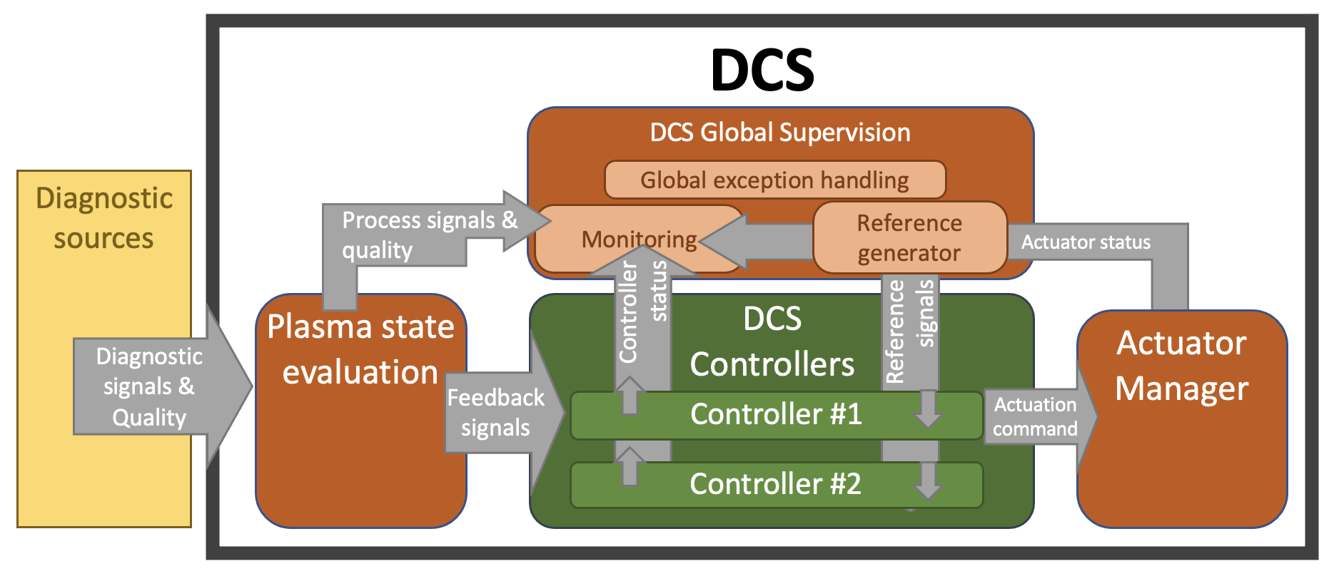
Use case 2: Discharge program segment selection
A highly configurable component implemented in ASDEX Upgrade Discharge Control System (DCS), the DCS global Supervisor, translates the plasma discharge configuration (pulse schedule) defined in XML into concrete waveform references as well as event detection and decision taking rules.
The Global Exception Handling, implemented using a behaviour trees permits more sophisticated decision taking during:
normal operation: selection of next segment
off-normal operation: repair or mitigation actions:
selection of a new segment
actions to modify one or more running trajectories
Example: increasing the requested NBI power to cope with a current excessively high level of impurities

