Slide 1


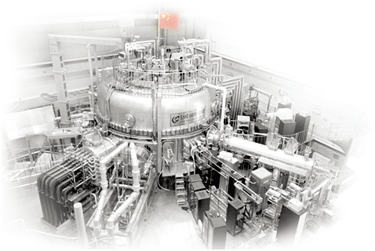

13th Technical Meeting on Plasma Control Systems, Data Management
and Remote Experiments in Fusion Research
5-8 July 2021,Culham ,United Kingdom
Application of RTF Architecture in EAST Radiation Control Subsystem
Huang.J.J^{a,b}, Yuan.Q.P^{a∗}, Xiao.B.J^{a,b}, Wu.Kª, Huang.Z.M^{a,b}, Zhang.R.Rª, LEE.W.R^{c}
ª Institute of Plasma Physics, Chinese Academy of Sciences, Hefei, China
^{b} University of Science & Technology of China , Hefei, China
^{C} organization, Saint-Paul-lez-Durance , France
Junjie.huang@ipp.ac.cn

Slide 2
Outline
Introduction
The radiation feedback control subsystem based on RTF
  Hardware structure
  Algorithmic logic
  Software design
  System implementation and testing
Summary
Notes:
Here is the outline of my speech.

Slide 3
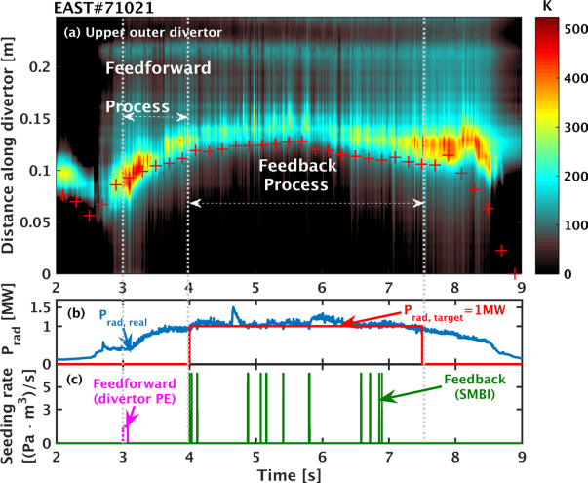
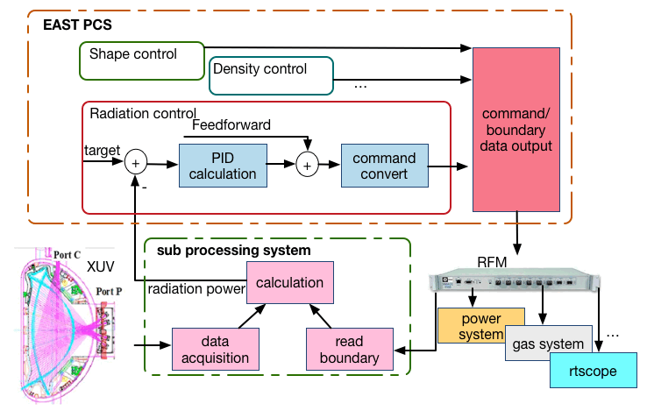
Introduction
The historical achievements
Fast impurity seeding was realized by employing SMBI.
Realized the control of radiated power without serious negative impact on the plasma performance.
Lowering the divertor target temperature effectively.
Original system
Control requirements
A sub processing system independent of PCS.
Configured with digitizer D-TACQ ACQ196-250 for 64 channels acquisition are acquired signals at 10 kHz.
Configured with RFM board for data transmission .
A new form of radiation control subsystem independent of the PCS system.
Radiation Control Subsystem Based on RTF
construct distributed real-time subsystems
[Wu.K, Yuan.Q. P, NF 2018]
Notes:
The Experimental Advanced Superconducting Tokamak (EAST) was an ITER like fully superconductive structure. Plasma radiation feedback control is an important research content of the EAST control system. In 2016, the feedback control of radiation power was realized for the first time on EAST, and this achievement was reported in the form of POST by Wu Kai at the 2017 IAEA TM Conference. The 2016 experiment achieved three goals：1 Fast impurity seeding was realized by employing SMBI. 2 Realized the control of radiated power without serious negative impact on the plasma performance. 3 Lowering the divertor target temperature effectively.
Among all the controlled variables of radiation feedback control, the radiation power calculation is the most complicated. In order to construct distributed real-time subsystems for control to reduce the burden of EAST (plasma control system) PCS and verify the performance of real-time framework (RTF) of ITER, the radiation control subsystem independent of the PCS was designed and implemented based on the ITER RTF.

Slide 4
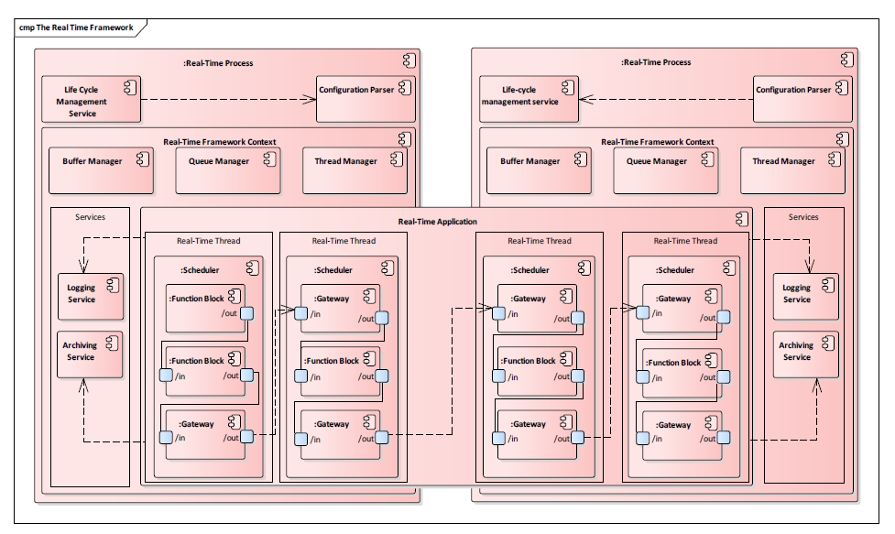
Introduction
ITER RTF architecture
Configuration parser
RT application
Life cycle management service
Schedule
Function Block
Gateway
scheduler
Real-time process
Life cycle management service
Real-time framework context
Lightweight Framework
Configuration parser
function block
distributed control
Real-time framework context
gateway
Notes:
4 The ITER team combined the features of MARTe lightweight framework and the advantages of DCS distributed control to develop RTF, which enables it to efficiently complete tokamak's various control tasks in real time. This figure shows the architecture of the Real-time Framework and an RT application including their main elements and how they interact. The main elements are RT application and real-time process :
The RT application contains the processing logic that runs on different threads, processes or computer nodes (hosts) and contains:
● The scheduler handles execution of processing of function blocks.
● The function block represents an operation with inputs and outputs.
● The gateway who is responsible for making sure that the input and output data is transported between function blocks when required.
● The real-time process is the main process that runs on a node. This process has been specifically configured for real-time. It contains:
● A life cycle management service manages the life cycle of the framework.
● A configuration parser parses input XML and transforms it into the fully expanded in-memory representation of the configuration needed by the framework.
● And the real-time framework context who is the key element of the real-time process.

Slide 5


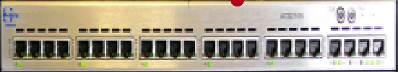
Hardware structure
Central Control System
Central Interlock System
Shot number
PON
Trig
Clock
TCN
CIN
RFM
D-TACQ digitizer
D-TACQ digitizer
radiation feedback control subsystem
EAST PCS
Hardware Environment
Server type：PowerEdge R710
Core：Linux 3529 3.10.0-693.2.1.el7.x86_64
CPU（16 Cores）：Intel(R) Xeon(R) CPU X5687 @ 3.60GHz
Memory capacity：16G
Operating system：Red Hat Enterprise Linux Workstation 7.4 (Maipo)
Notes:
5 This is the hardware structure of radiation feedback control subsystem and its peripheral systems. The subsystem obtains the ultraviolet (AXUV) signals, the trigger signal and clock signal from the central control system through the D-TACQ digitizer. Plasma boundary data and time data are obtained from PCS with RFM. The shot number is obtained from central control system with socket. The following are the performance parameters of the server where the subsystem is located, which can meet the control requirements

Slide 6
Algorithmic logic
Get shot number
Read PCS setting and data file
One-dimensional simplified algorithm：
Device init
Read stoptime,ctime from RFM
represents the distance from the midpoint of the chord where the measurement channel intersects the plasma boundary to the EAST geometric center plane；
no
Hardware trig
Ctime<
stoptime
yes
no
yes
represents the average width between two adjacent measurement strings, generally expressed as the distance between the midpoints of the two measurement chords；
Acquire baseline data
Acquire XUV data and read boundary data
Read stop time in RFM
Calculatie power and send to PCS
represents the single-channel raw voltage signal of the AXUV diagnostic output；
no
represents calibration coefficient of each measurement channel.
Stoptime>0
Save data to mdsplus
yes
Notes:
6 Here is the logic of radiation feedback control subsystem. After the shot number is obtained, the subsystem calculates radiation power with ultraviolet (AXUV) signals and plasma boundary data until ctime is less than stoptime.
There are many ways to calculate the radiation power. In order to obtain real-time and accurate radiation power values, we use a one-dimensional simplified algorithm in the control system to directly perform surface integral and volume integral on the sinusoidal integral signal to obtain the radiation power. The calculation formula is as follows:

Slide 7
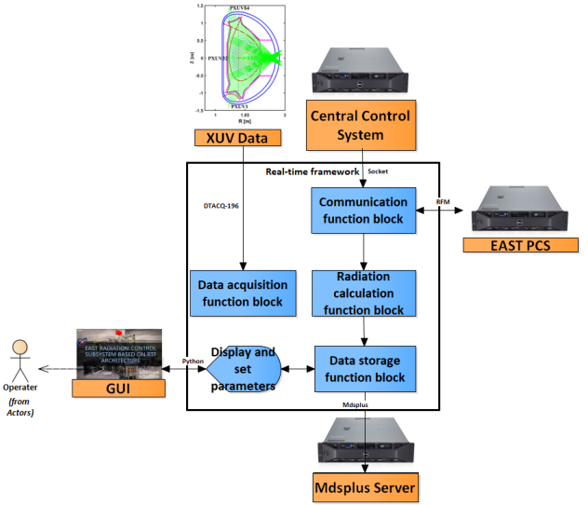
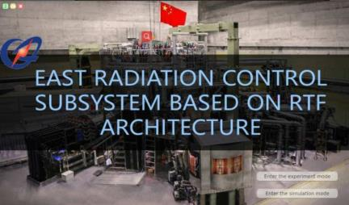
Software design
Data acquisition function block
Communication function block
Radiation calculation function block
Ensure real-time performance
GUI
Allocate radiation calculation function block and data storage function block on threads of different CPUs.
Data storage function block
Notes:
Such a logic shows that, to calculate the radiation power for PCS feedback control during discharge, this subsystem needs to communicate with the Central Control System for discharge information, acquire diagnostic signals to calculate the radiation power and exchange data with PCS during each control cycle, and store data to Mdsplus for further analysis. Corresponding to the above requirements, four RTF function blocks are designed, namely: communication function block, data acquisition function block, radiation calculation function block, and data storage function block. In order to meet the requirement of real-time control, radiation calculation function block and data storage function block are allocated on threads of different CPUs.

Slide 8

System implementation and testing
Communication function block
Slow data communication with Central Control System through Socket;
Fast data transmission with PCS through reflective memory network (RFM);
RTF
SEND
READ
RFM
Fast data transmission test within two servers with RFM;
The test time is 300 seconds, and a data is sent and read every 50 microseconds with RFM;
The waveform has no distortion.
Notes:
8 The communication function block can realize the slow data communication with Central Control System through Socket or fast data transmission with PCS through reflective memory network (RFM). A fast data transmission test of communication function block with RFM is completed as shown; The test time is 300 seconds, and a data is sent and read every 50 microseconds with RFM. The waveform has no distortion.

Slide 9
System implementation and testing
Data acquisition function block
EAST# 101317
Acquires 64 channels of absolute extreme ultraviolet (AXUV) signals synchronously in 20KHz using D-TACQ196 digitizer.
Comparing the data acquired from data acquisition function block with the data of EAST data acquisition system , the data is consistent.
Notes:
9 The acquisition function block acquires 64 channels of absolute extreme ultraviolet (AXUV) signals synchronously in 20KHz using D-TACQ196 digitizer. A test of comparing the data acquired from data acquisition function block with the data of EAST data acquisition system has been completed in EAST real experiment, we can see the data is consistent.

Slide 10
System implementation and testing
EAST# 81575
Open loop test result
Radiation calculation function block
The waveform obtained is basically consistent with the analysis database calculation result.
Function
Calculates the radiation power using AXUV signals from data acquisition function block and plasma boundary data which is read from PCS through communication function block.
EAST# 101456
Compared with historical data
The calculated waveforms are basically consistent with the historical data without distortion and delay.
Notes:
10 The radiation calculation function block calculates the radiation power using ultraviolet (AXUV) signals and plasma boundary data which is read from PCS through RFM. In order to test the performance of the entire subsystem and the accuracy of the radiation calculation function block, we used historical data to test. From the figure we can see that the calculated waveforms are basically consistent with the historical data without distortion and delay, which means the system is available.

Slide 11

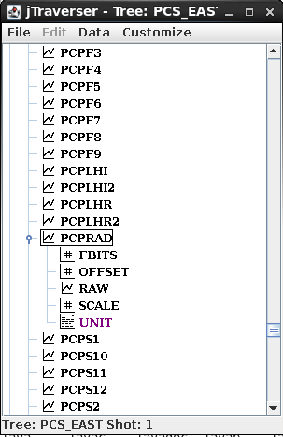
System implementation and testing
Data storage function block
All data generated by the acquisition and calculation function blocks are segmental saved in real time to Mdsplus tree and files in the data storage function block.
Real-time storage with Mdsplus facilitates the use of sliced data storage for long pulses operation.
To prevent problems such as data loss from Mdsplus real-time storage, file storage is also used.
Notes:
11 In the subsystem, all data generated by the acquisition and calculation function blocks are segmental saved in real time to Mdsplus tree in the data storage function block. Real-time storage with Mdsplus facilitates the use of sliced data storage for long pulses operation. To prevent problems such as data loss from Mdsplus real-time storage, file storage is also used.

Slide 12
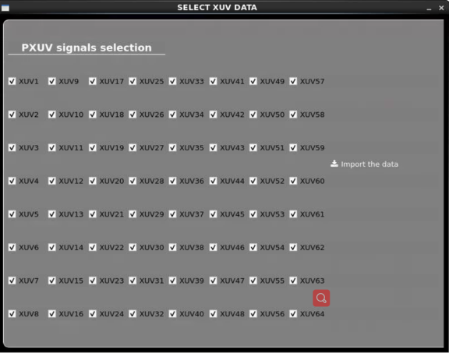
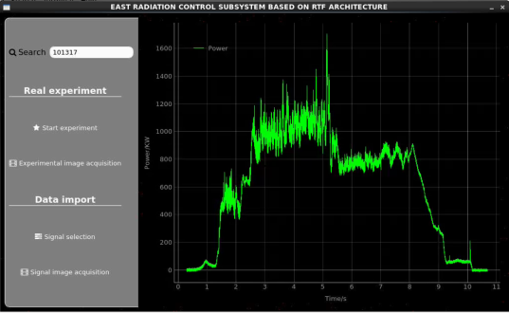
System implementation and testing
GUI
The development of such subsystem in RTF architecture has been completed with the GUI written in Python.
Simulation mode and experiment mode can be entered from the GUI;
The experimental waveform can be obtained in time after the experiment is completed.
Notes:
A friendly Graphics User Interface (GUI) is also necessary to set parameters. The development of such subsystem in RTF architecture has been completed with the GUI written in Python. In this GUI, Simulation mode and experiment mode can be selected and entered. The experimental waveform can be obtained in time after the experiment is completed. Also, the ultraviolet (AXUV) signal to be transmitted can be selected on the GUI.

Slide 13
Summary
The radiation control subsystem independent of the plasma control system was designed and implemented based on the real-time framework (RTF) of ITER.
Functions not previously available in RTF are developed, such as RFM communication, data acquisition with D-TACQ196 digitizer, MDSplus storage.
The performance of RTF and the radiation control subsystem base on RTF has been tested and verified.
In the 2021 EAST operation campaign, the subsystem will be applied for radiation power calculation, which is the first attempt of RTF on EAST.
Notes:
13 In this work，The radiation control subsystem independent of the plasma control system (PCS) was designed and implemented based on the real-time framework (RTF) of ITER. This is a distributed real-time subsystems and has been constructed for control in an ITER-like structure EAST.The performance of RTF and the radiation control subsystem base on RTF has been tested and verified.

Slide 14


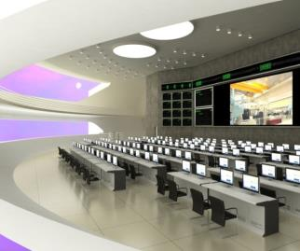
Thank you!
EAST – Test Bed for ITER & CFETR

