Slide 1
Startup studies of MT-1 Spherical Tokamak
Muhammad Athar Naveed and PTPRI Team
Pakistan Tokamak Plasma Research Institute
IAEA 13th Technical Meeting from 05-08 July 2021

Slide 2
Plan of Presentation
MT-1 chamber
Magnetic systems
Diagnostics
Chamber Conditioning
Pre-ionization
Experiments for Plasma Current
Summary
Pakistan Tokamak Plasma Research Institute
IAEA 13th Technical Meeting from 05-08 July 2021

Slide 3
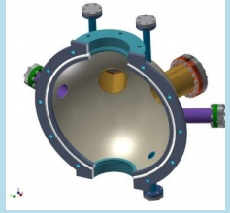
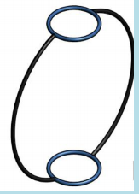
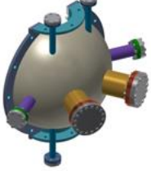

MT-1 chamber
MT-I is the modified version of GLAST-II (Glass Spherical Tokamak) wherein the glass vacuum vessel has been replaced by the metallic (SS304L). Wall thickness is 1mm.
Pakistan Tokamak Plasma Research Institute
IAEA 13th Technical Meeting from 05-08 July 2021

Slide 4
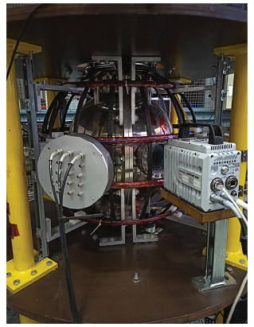
Major Radius =R= 0.15 m
Minor Radius=a=0.09 m
Aspect Ratio= A= 1.67
Toroidal Magnetic field = 0.1 T
Pakistan Tokamak Plasma Research Institute
IAEA 13th Technical Meeting from 05-08 July 2021

Slide 5
Magnetic systems
i) Central Solenoid
The central solenoid for the MT-I is 668 mm long and consists of a single layer winding (128 turns; 138 μH, 0.278 Ω) and two pairs of compensation coils (6 turns each) in series.
ii) Toroidal field coils
The toroidal field coil system for the MT-I consists of D-shaped coils made of copper strip (12.5 × 5 mm) joined in series (16 coils; 64.1 µH, 15 mΩ).
iii) Vertical field coils
The VF coil system for the MT-I consists of two pair of coils(30 turns each; 3.42 mH, 1.15 Ω) placed symmetrically.
Pakistan Tokamak Plasma Research Institute
IAEA 13th Technical Meeting from 05-08 July 2021

Slide 6
These coil systems are energized by capacitor banks through thyristor/Ignitrons controlled switching circuits.
No. | Circuit |  | Capacitance | Max charging voltage | Charging voltages normally used
1 | CS |  | 17.2 mF | 3000 V | Upto 2400V
2 | VF |  | 4.3 mF | 3000 V | Upto 150 V
3 | TF | Fast bank | 3.3 mF | 1600 V | 750 V
 |  | Slow bank | 600 mF | 350 V | 100 V
Pakistan Tokamak Plasma Research Institute
IAEA 13th Technical Meeting from 05-08 July 2021

Slide 7
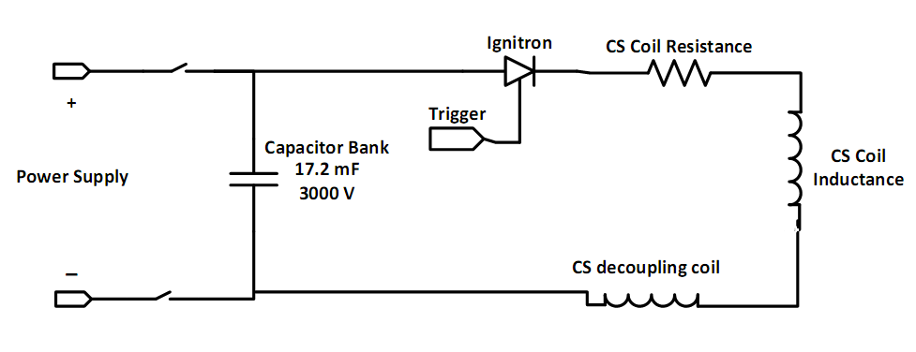
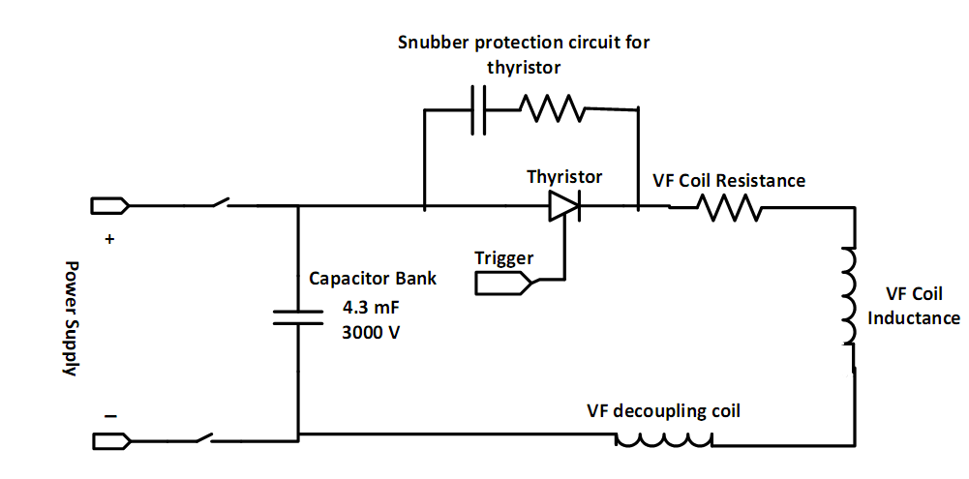
CS and VF charging circuits
Pakistan Tokamak Plasma Research Institute
IAEA 13th Technical Meeting from 05-08 July 2021

Slide 8
Diagnostics
Magnetic diagnostics
i) Rogowski coil
One Rogowski coil is installed which measures the eddy currents in the chamber and plasma current.
ii) Magnetic probes
Fourteen Probes are installed. Seven are in board side and seven out board side.
iii) Flux loops
Fourteen flux loops are installed out of which are seven inside or seven outside.
Pakistan Tokamak Plasma Research Institute
IAEA 13th Technical Meeting from 05-08 July 2021

Slide 9
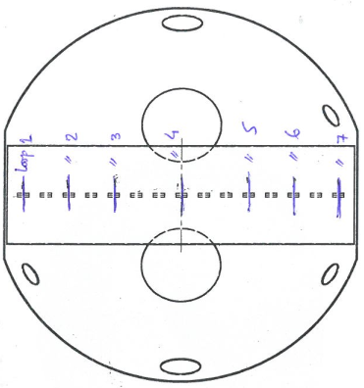
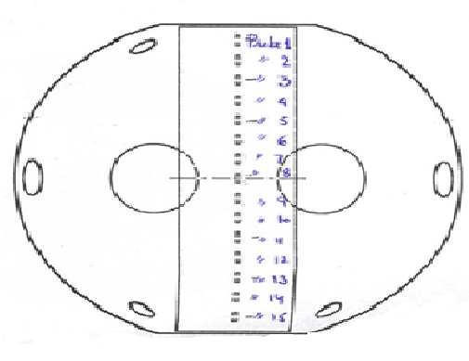
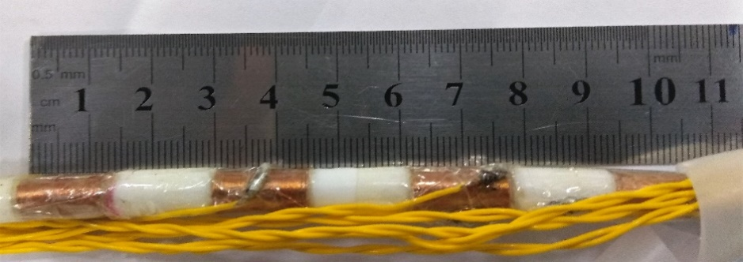
Flux Loops Position
Magnetic Probe Position
Pakistan Tokamak Plasma Research Institute
IAEA 13th Technical Meeting from 05-08 July 2021

Slide 10
2.Langmuir Probe
A TLP array is used to measure the number density, electron temperature, and floating potential at the plasma edge region in a time-resolved manner.
3.Optical emission diagnostics
A FastCam (PHOTRON SA-8) is used for high-speed imaging of plasma. A photodiode array fitted with optical filters, HR4000+ and HR2000+(Ocean-Optics )spectrometers, are used for optical emission spectroscopy.
Pakistan Tokamak Plasma Research Institute
IAEA 13th Technical Meeting from 05-08 July 2021

Slide 11
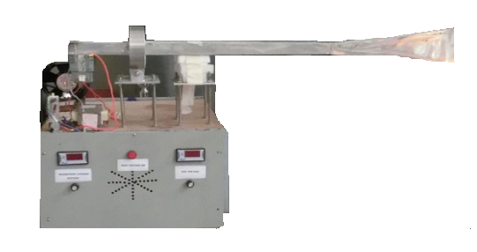
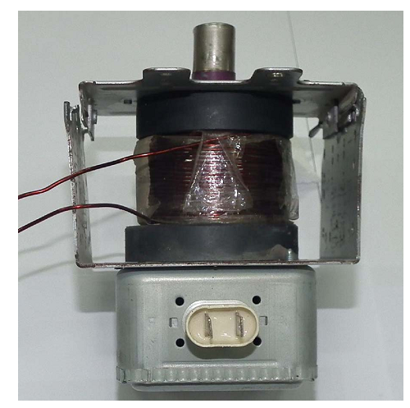
Pre-Ionization system
A commercially available magnetron operating at a frequency of 2.45 GHz and output power of 800 W is modified by winding copper wire between two magnets of magnetron tube in order to enhance the magnetic field strength. The modified system is capable of producing 2.45 GHz electromagnetic waves for startup with an enhanced output power of 1.6 kW and pulse length of about 4 ms.
Pakistan Tokamak Plasma Research Institute
IAEA 13th Technical Meeting from 05-08 July 2021

Slide 12
Data Acquisition system
The hardware for the DAQ system comprises of National Instruments USB based DAQ cards, high resolution Tektronix oscilloscopes and several onsite developed signal conditioning (SC) modules. The software layer for front and back end handling is developed using LabVIEW and MATLAB for acquisition, storage, data retrieval, and post-processing purposes. The main features of this system include system configuration, shot implementation, data saving and data sharing between the connected users.
Pakistan Tokamak Plasma Research Institute
IAEA 13th Technical Meeting from 05-08 July 2021

Slide 13
Chamber wall conditioning
Tape heating
Microwave heating
DC glow discharge heating
RGA Analysis
The partial pressures of the residual gases before glow discharge
The partial pressures of the residual gases very after glow discharge

Slide 14
Chamber wall conditioning
OES Analysis
Emission spectra of microwave helium plasma recorded in the beginning of the discharge at time of (2mins) and after time lapse of (35mins) at fill pressure of 1.6 mbar and microwave power of 800W

Slide 15
Field Mapping

Slide 16
Experiments for plasma current generation
Working gas : Hydrogen
Gas Pressure: 1 – 5 x10⁻⁴ mbar
Pre-ionization : Microwave at 2.45 GHz
Different Combinations of Charging Voltages of CS and VF coils were selected.
Firing time of VF with respect to CS was varied.

Slide 17
Suppressed VF current profile
Because of mutual induction effect Vertical field profile is suppressed as can be seen in the figure. In this situation the desired value and profile of vertical field can not be applied at time of break down.
Pakistan Tokamak Plasma Research Institute
IAEA 13th Technical Meeting from 05-08 July 2021

Slide 18
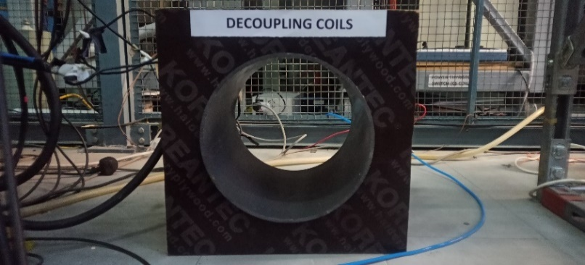
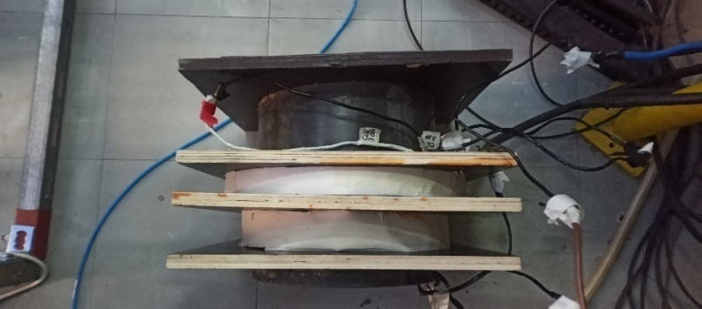
Mutual Inductance of CS and VF coils
Mutual inductance of CS and vertical coil system was measured and decoupling coils were fabricated
Number | Inductance (µH)at 1K Hz | Resistance(Ohm)
Coil-1 | 591 | 0 .097
Coil-2 | 144 | 0 .039
Coil-3 | 765 | 2.92
Coil-4 | 863 | 3.3
Coil-5 | 974 | 3.8
Pakistan Tokamak Plasma Research Institute
IAEA 13th Technical Meeting from 05-08 July 2021

Slide 19

CS and VF current profiles with decoupling transformer
CS
M₁₂
VF
Pakistan Tokamak Plasma Research Institute
IAEA 13th Technical Meeting from 05-08 July 2021

Slide 20
Experiment after installation of decoupling coils

Slide 21
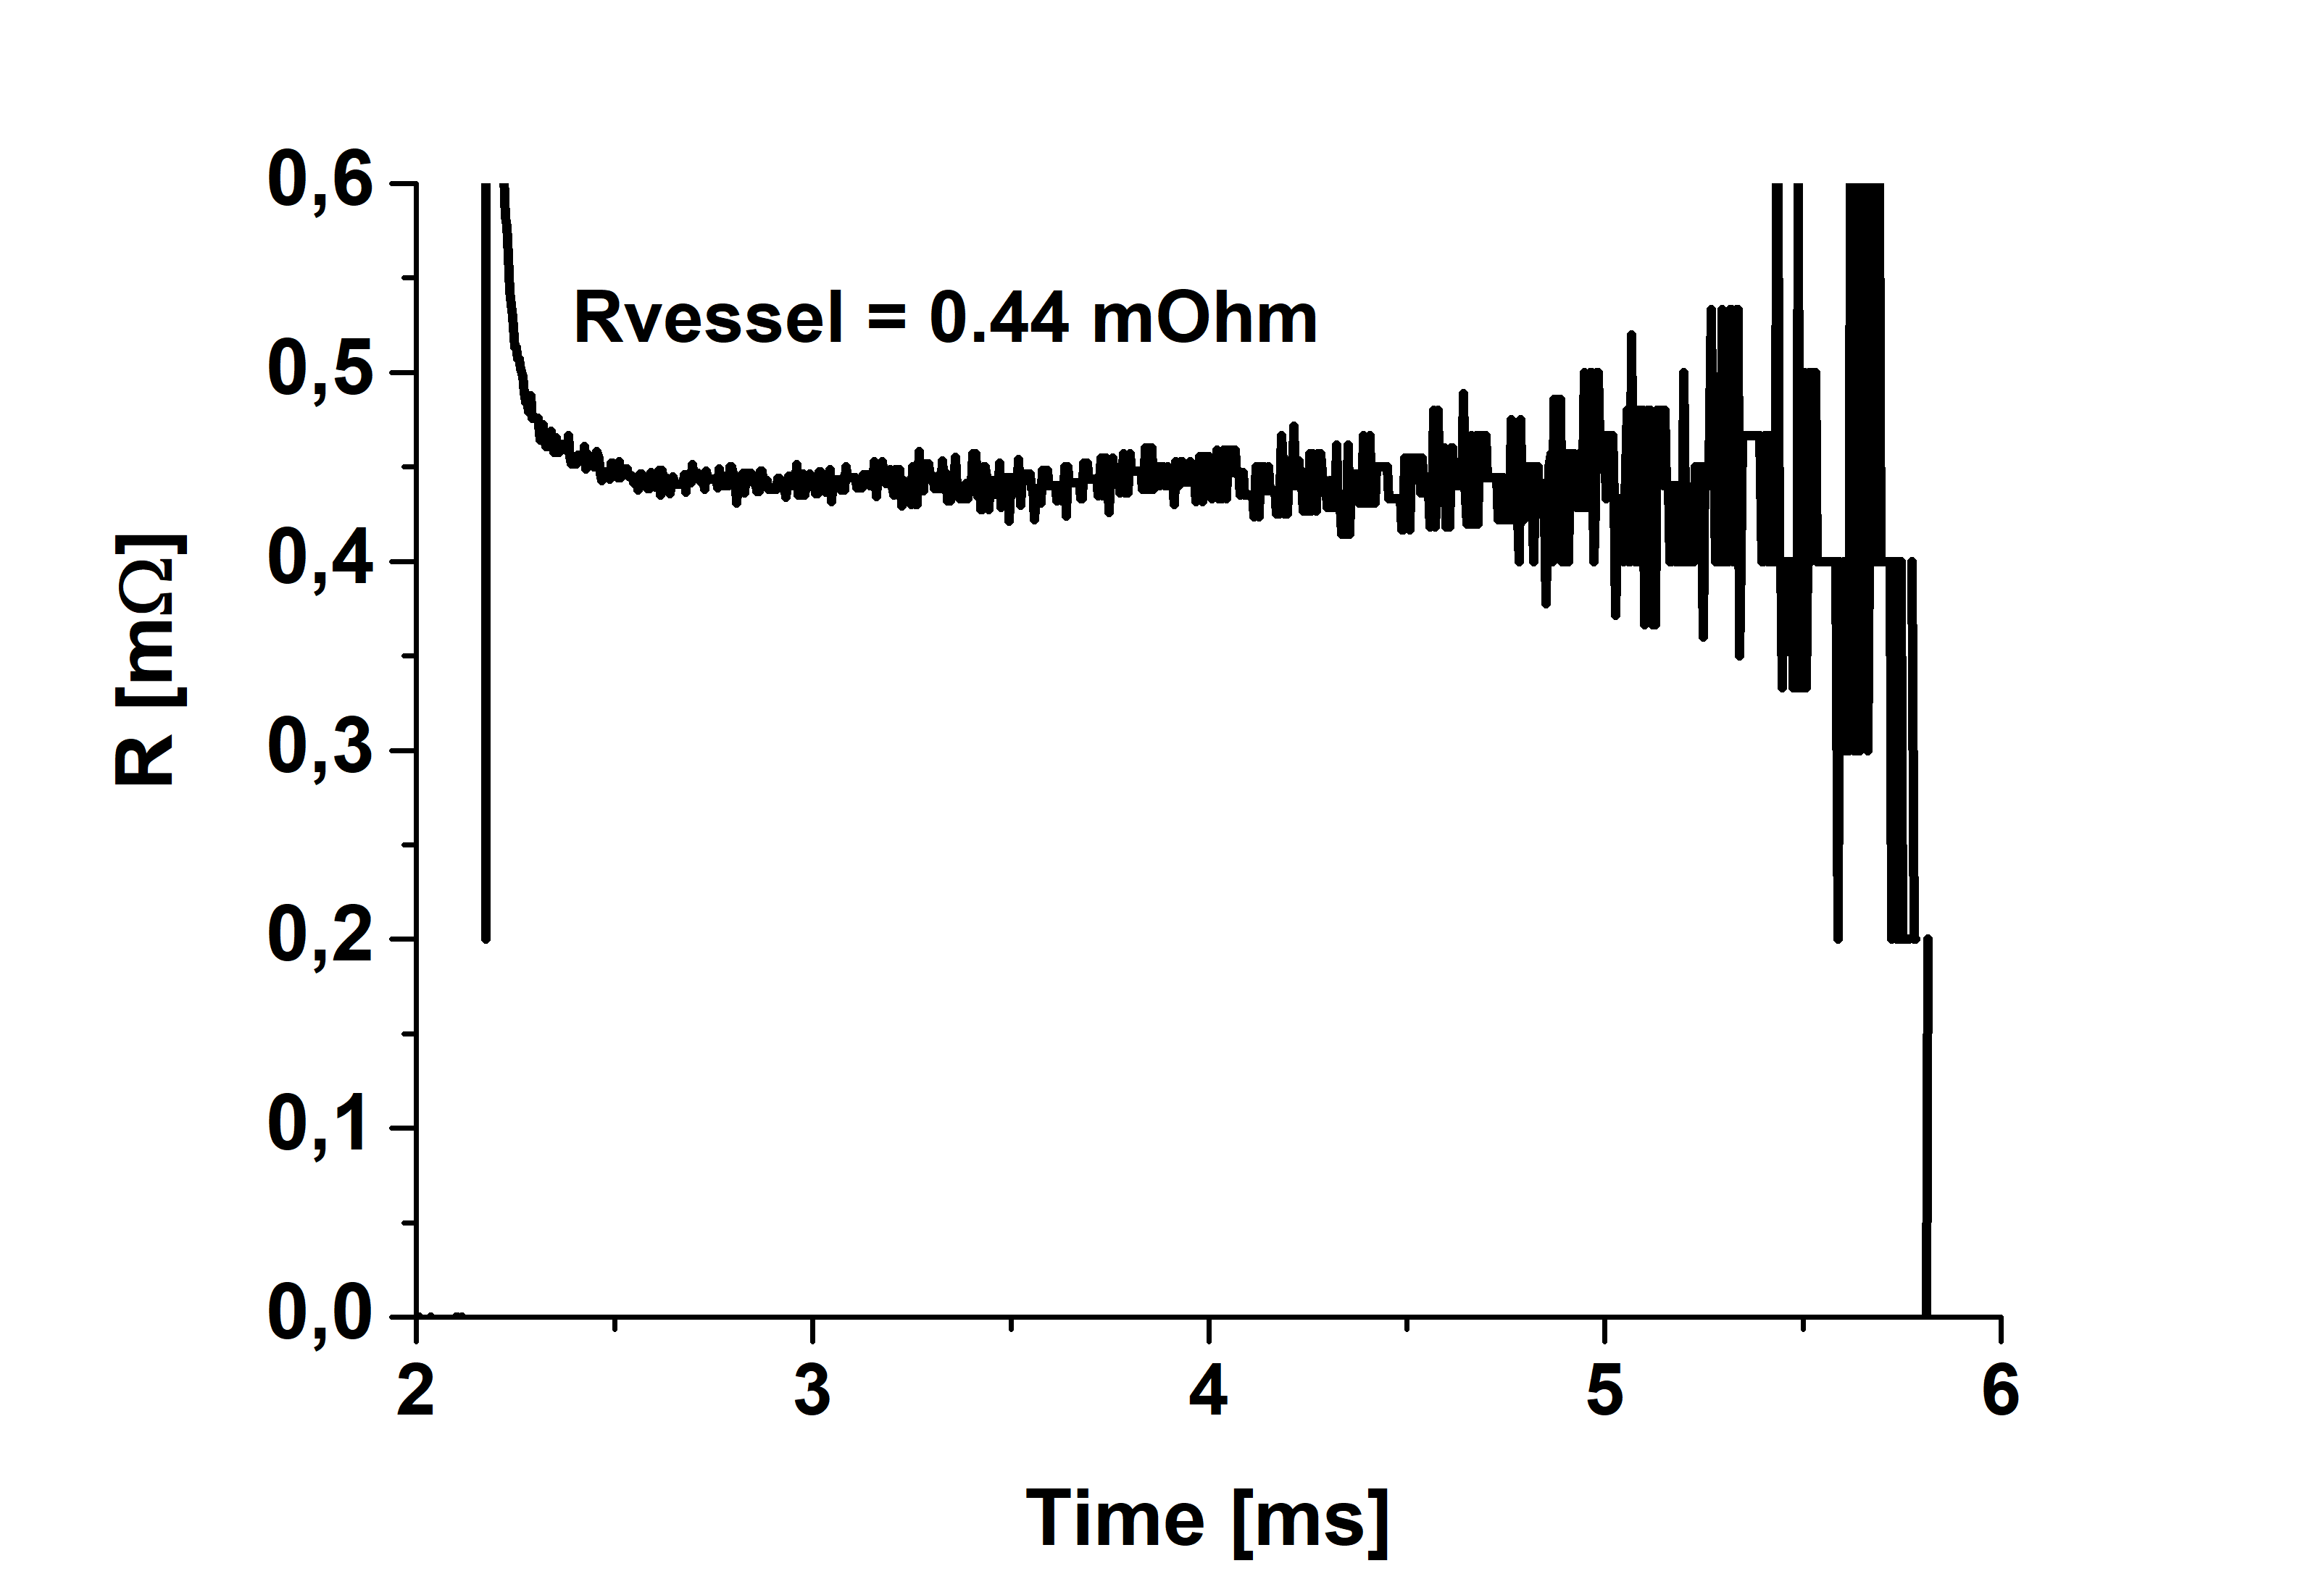
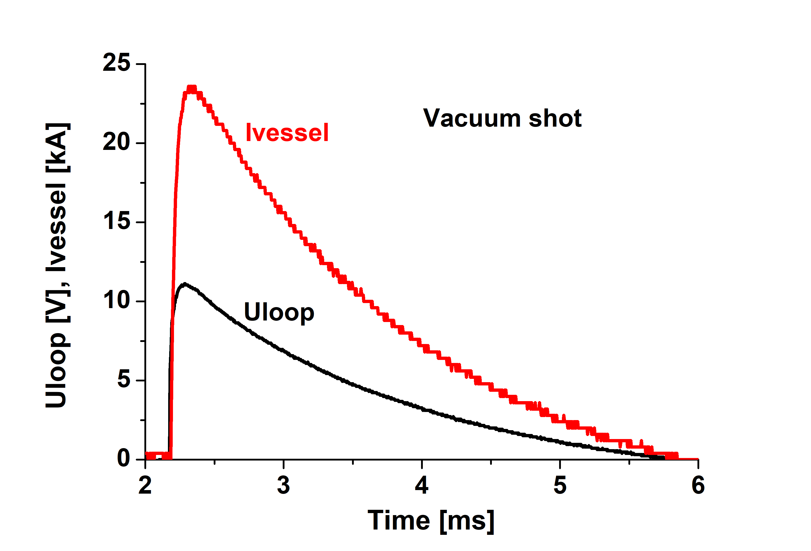

Method for estimation of plasma current
$$R_{vessel}=\frac{U_{loop}}{I_{vessel}}$$
Pakistan Tokamak Plasma Research Institute
IAEA 13th Technical Meeting from 05-08 July 2021

Slide 22
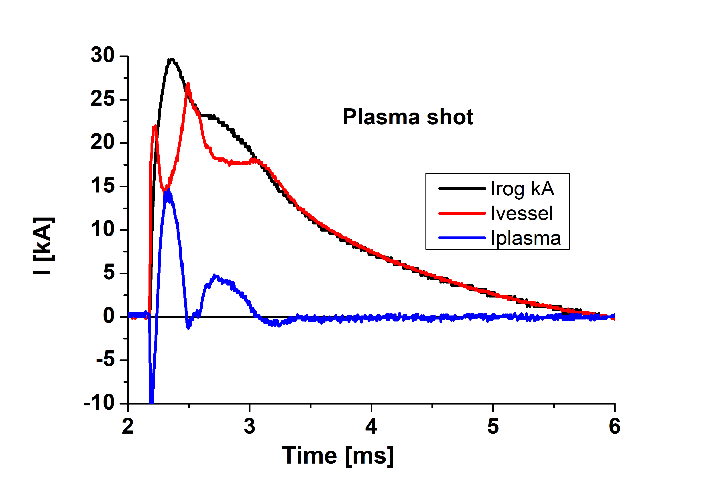
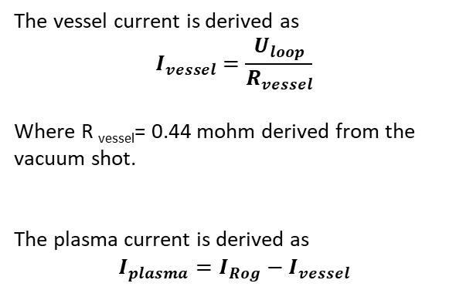
Plasma Current
The vessel current is derived as
$$I_{vessel}=\frac{U_{loop}}{R_{vessel}}$$
Where R _{vessel}= 0.44 mohm derived from the vacuum shot.
The plasma current is derived as
$$I_{plasma}=I_{Rog}−I_{vessel}$$
Pakistan Tokamak Plasma Research Institute
IAEA 13th Technical Meeting from 05-08 July 2021

Slide 23
Summary
Start up studies on MT-1, a small spherical Tokamak with major and minor radii 15 and 9 cm respectively are conducted. During initial experimentation for generation of plasma current, error vertical fields and mutual inductance of CS and VF coil systems are found main hindrance for plasma current generation. After removing mutual inductance of CS and vertical coils by using decoupling coils, vertical field was applied for compensation of error field and also for equilibrium of plasma column. These experiments resulted in short time plasma current with out flat top. This indicates that if vertical field profile is tuned precisely, the duration of plasma current can be increased.
Thank you very much

