Slide 1
Event reconstruction using KSTAR FIS event counter in hot KSTAR plasma
Myungkyu Kim, Seung-ju Lee, Jaesic Hong
Korea Institute of Fusion Energy, Republic of Korea

Slide 2
Contents
Motivation
What happened during plasma discharge?
System briefing
Implementation
Configuration
Programs(FPGA, User Panel, Analyzer)
Commissioning
KSTAR plasma shots
Conclusion and Future works

Slide 3
Motivation
To check and confirm of Who/Why killed plasma?
Event collecting in one place.
Fast processing time ~ 10 us.
The necessity of confirming the causal relationship of events occurring during plasma discharge.
For system stability improvement and PCS debugging.
FPGA in FIS

Slide 4
Implementation
What is event counter?
In 2017, KSTAR 4th version of Fast Interlock System adopts event counter, https://doi.org/10.1016/j.fusengdes.2020.111954
NI-cRIO (FPGA) based event counter.
Publishing clock counter for KSTAR’s various event.
EPICS IRIO driver was used for event PVs.
FIS Block diagram
Event counter logic
Link programs – FIS user panel, KSTAR PASS, Labview event analyzer

Slide 5
Implementation
FIS Block diagram
KSTAR FIS
Rogowski coil
NI-cRIO
FPGA
EPICS
IOC
PASS
Plasma current
CTU
Event Analyzer
Timing gate
Heating
STOP
Heating Sys.
PCS
SIS
CTU : Central Timing Unit
FIS : Fast Interlock System
PCS : Plasma Control System
SIS : Supervisory Interlock System
PASS : Pulse Automation and Scheduling System
Heating Sys. : NBI, ECH, LHCD, etc

Slide 6
Event counter Logic
Ip protection loop
Counter loop
Heating stop & reset loop
T1
i
Heating Stop
Ip<Ip_{th}
Heating Stop
S
PCS HBT
counter
Enable
i=i+1
PCS faults
counter
ANY
S
i=i+1
Reset
to Heatings
Ip>Ip_{th}
_{Then}
Ip<Ip_{th}
Heating Stop
Heating Stop
counter
S
i=i+1
T2
Faults
from
CCS
to PCS
S
NBI Faults
counter
i=i+1
100kHz
100kHz
[FIS] Heating Stop | [SIS] LV3-1 MG
[PCS] LV3-1 | [FIS] LV3-2 NBI PS
[PCS] LV3-2 | [FIS] LV3-2 NB1 Armor
[PCS] LV3-3 | [FIS] LV3-2 NB2 Armor
[PCS] HEARTBEAT | [FIS] LV3-2 PFC
[SIS] LV1,2,3 | [FIS] LV3-3 IPS
[SIS] LV3-1 MPS | [PCS] LV3-3 EC CUTOFF
…
100kHz
check
heartbeat
FIS, FPGA, PCS
S (14 I/O)
: Hard wired I/O,
EPICS PV I/O
Heartbeat loop
1kHz

Slide 7
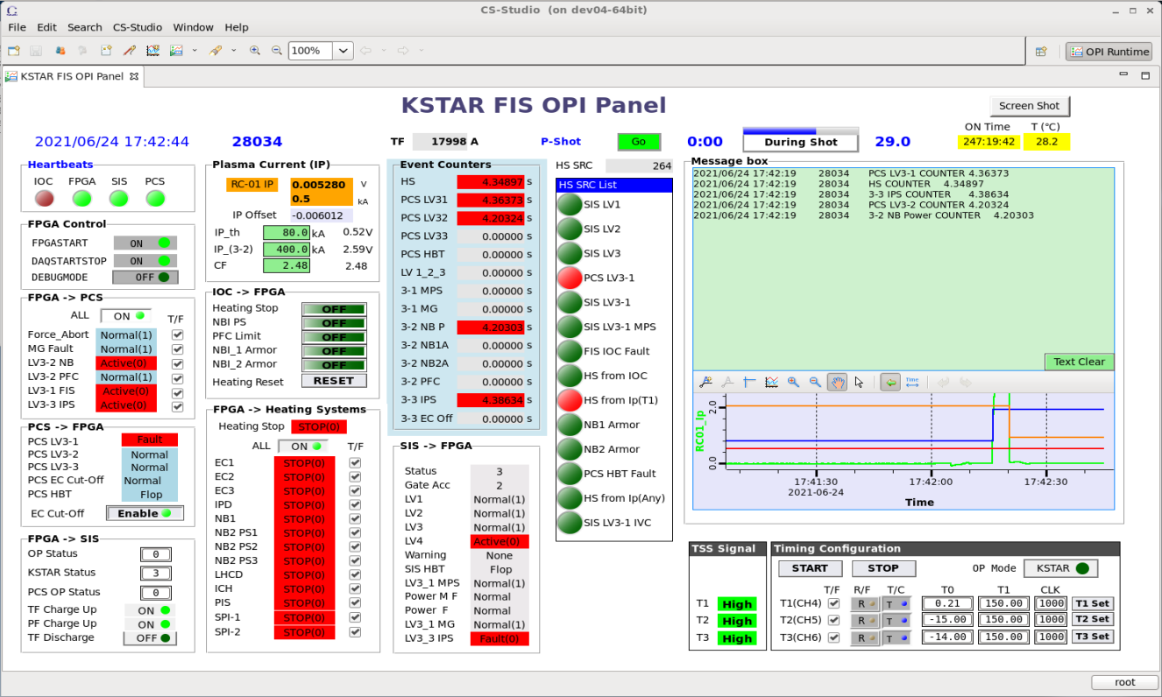
Implementation
FIS User Panel in usual operation
Event Counters show operation status

Slide 8
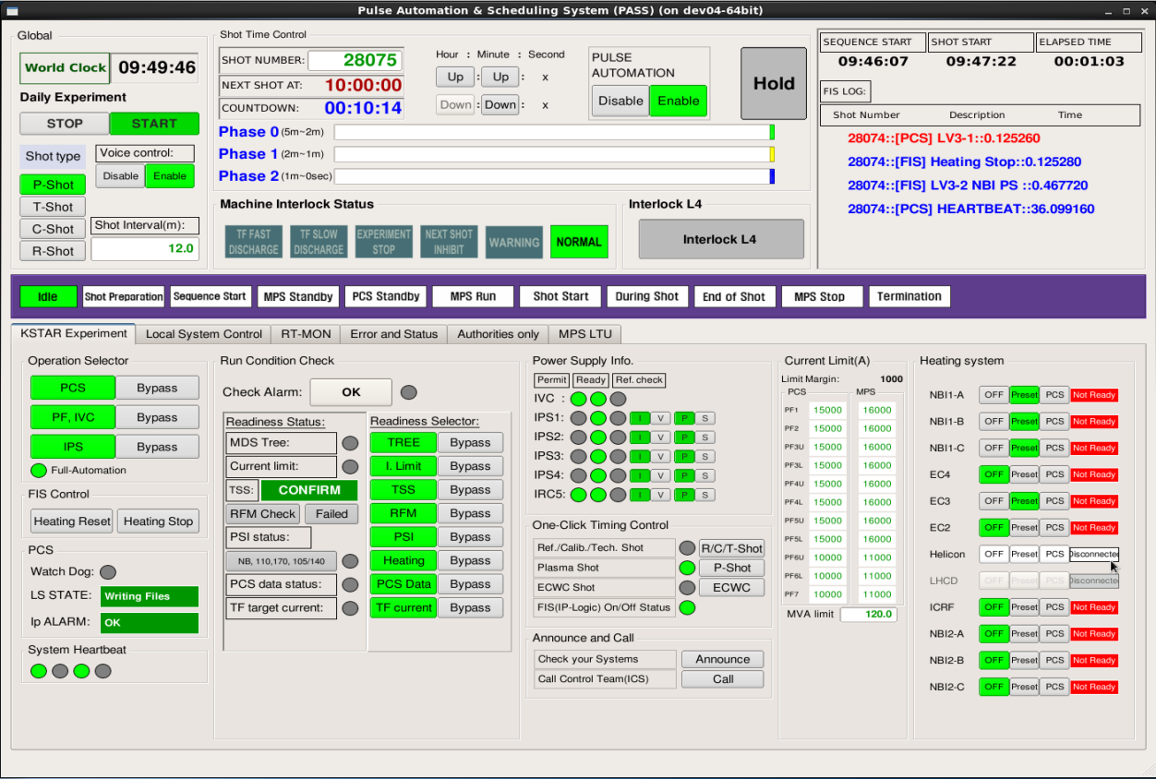
Implementation
KSTAR PASS User Panel
Event messages
from FIS

Slide 9
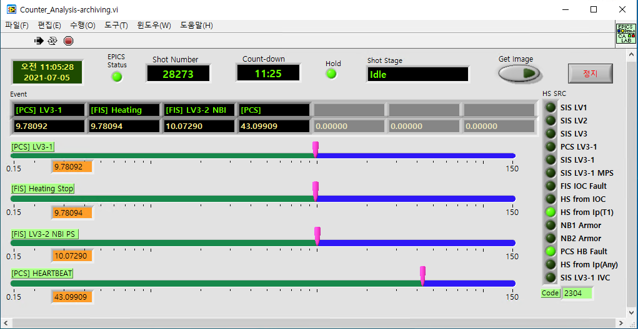
Event Message generation
Labview FIS counter analyzer program
Event counter read from FIS -> counter sorting by time
-> event name mapping -> caput to Event IOC

Slide 10
Commissioning
KSTAR Plasma Experiment
Special case(start-up failure, soft landing)
Event occurrence in plasma discharge
[FIS] Heating Stop(HS) : STOP by FIS(FPGA)
[PCS] LV3-1 : STOP by PCS

Slide 11
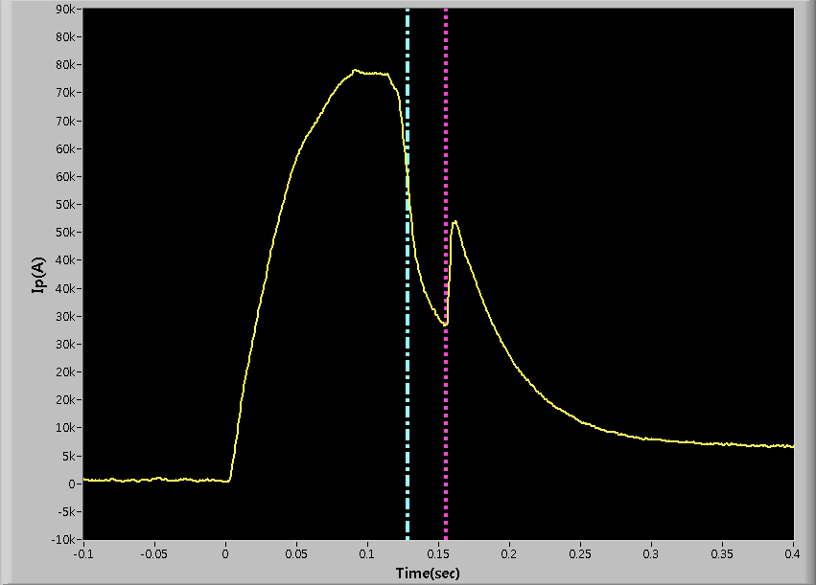
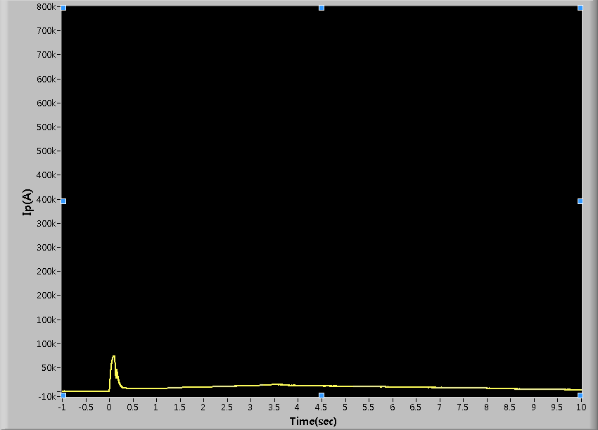
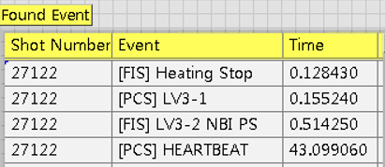
Commissioning
27122(start-up failure)
FIS HS
PCS 3-1
Ip from MDSplus
Start-up failure

Slide 12
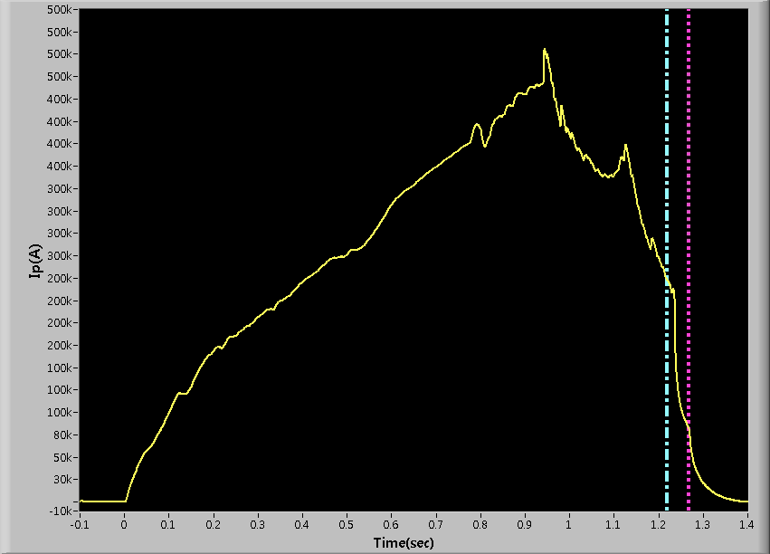
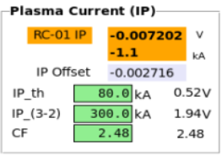
Commissioning
27124 (Soft landing)
FIS HS
PCS 3-1

Slide 13
Conclusion and Future works
Conclusion
It was helpful to understand anomalies that occur during plasma discharge using the event counter.
It was helpful to find the cause of the problem by analyzing the causal relationship of the occurrence of the event.
It was confirmed that the FPGA logic has sufficient stability and precision.
Future works
Extend to more events
Extended sharing of event messages (web, SNS, etc.)

