Slide 1
The metadata management system based on MongoDB for EAST experiment
13th IAEA Technical Meeting
on Plasma Control Systems, Data Management and Remote Experiments in Fusion Research
5-8 May 2021, Culham, United Kingdom
F. Wang*¹, H.Y. Ren^{1,2}, Z.Y. Shen^{1,2}, and D.X. Fan^{1,2}
¹Institute of Plasma Physics, Chinese Academy of Sciences, Hefei, China
²School of nuclear science and technology, University of Science and Technology of China
Notes:
Good morning everyone, the subject of my presentation is The metadata management system based on MongoDB for EAST experiment data

Slide 2
Outline
1. Introduction
2. System Design
3. Test Results
4. Summary
Notes:
Here is my presentation outline.

Slide 3
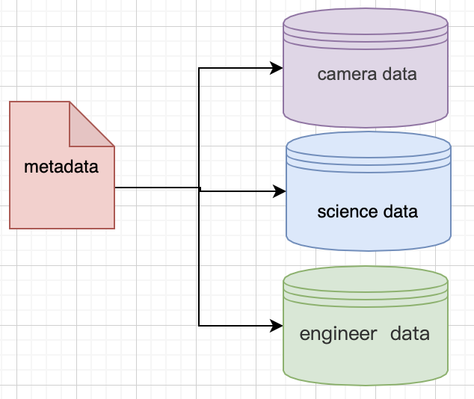
Introduction
-With the development of EAST experiment, the data in its data warehouse is getting bigger and bigger.
-Multi-source database stores abundant data, but lacks a resource directory, which makes it difficult for users to have a quick overview of experimental/engineering data.
 | size
mdsplus | 800TB
camera vod | 250TB
lzo files | 50TB
other files | 500TB
Notes:
Just as a library needs an index system, we also need an index system for our database, which we call it meta-database.

Slide 4
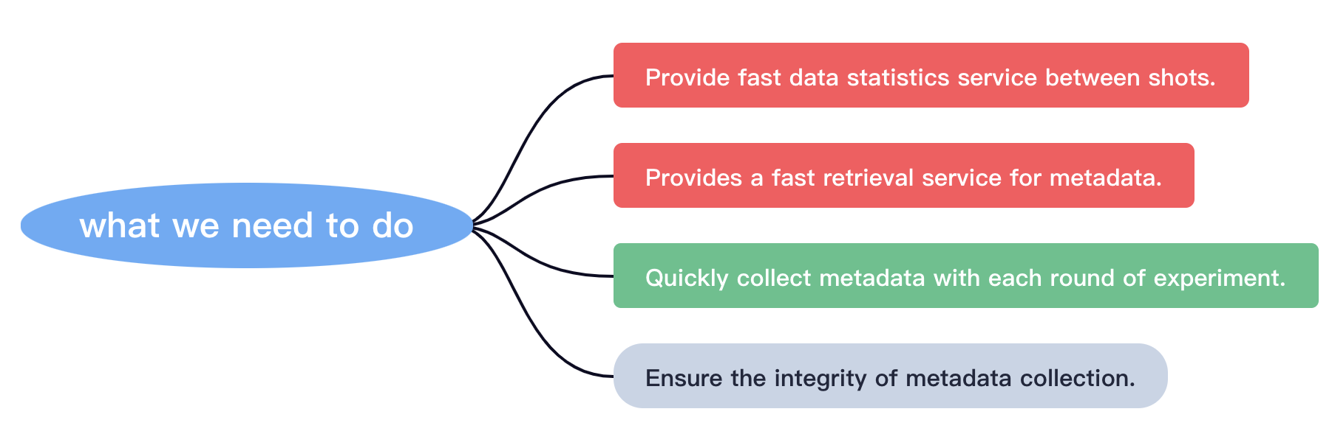
Motivation
To develop a metadata management system for all the experiment data.
Notes:
There are several things we need to do.

Slide 5
Outline
1. Introduction
2. System Design
3. Test Results
4. Summary

Slide 6
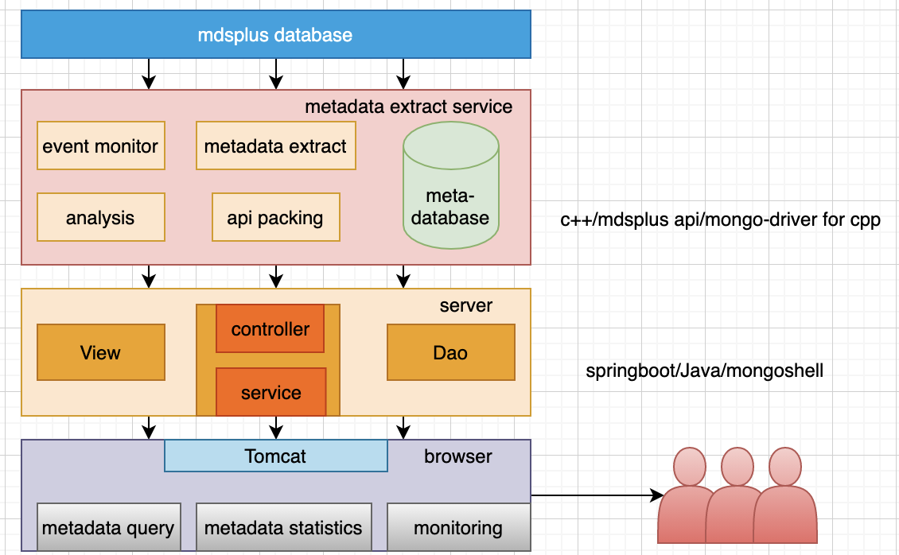
Architecture
system architecture
Notes:
At the top is the MDSPlus database, and of course more data sources will be added later.
Next comes the metadata extraction service, which extracts the metadata from the MDSPlus database and create meta-database.
In this layer, The system uses the interface of the meta-database.
Finally, The user uses the service through the browser.

Slide 7
Why mongoDB
 | RDBMS | NoSQL | remark
tree data | redundancy | support
Storage size | big | giant | NoSQL better
expansibility | hard | easy | data format flexible
transaction | strong | weak
MongoDB is the best.
Notes:
In the database selection, there are mainly four things of consideration. We need to store the tree data; We need APIs that support major high-level languages. We need flexible data storage and easy to extend. And we have no requirements for transaction at all.
So all of that，mongoDB is the best.

Slide 8
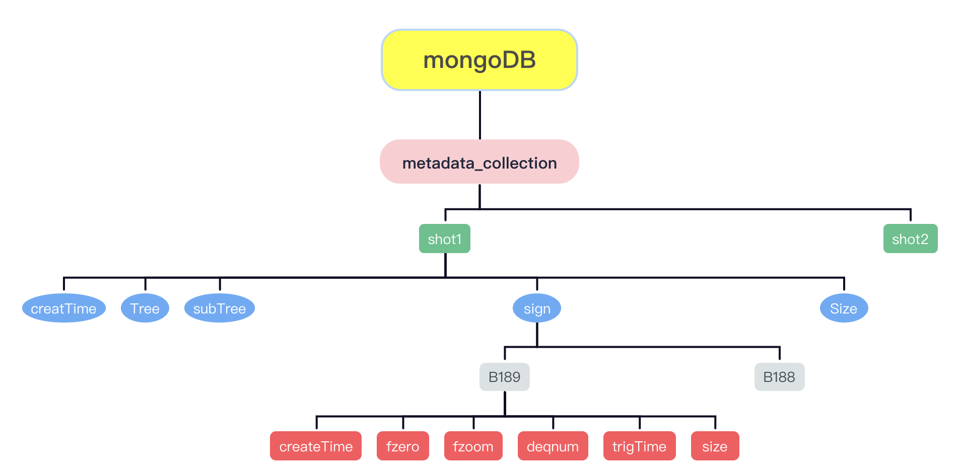
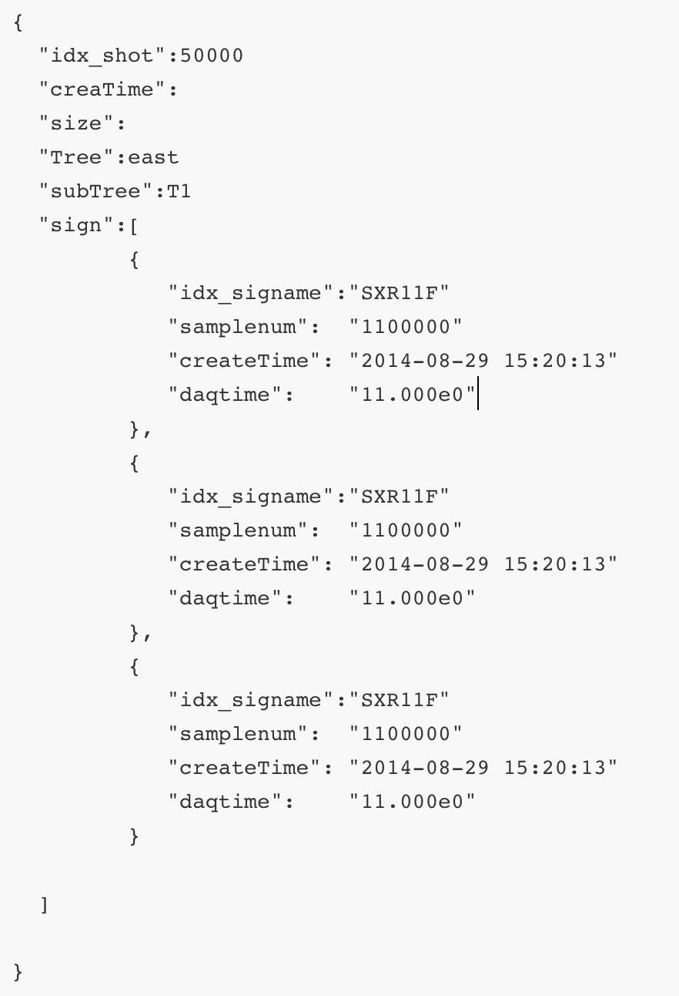
Database design
Document storage suitable for Tree data.
Notes:
This is a brief diagram of the metadata data structure. We store metadata by shot. There are many metadata under shot, such as Tree, subTree. There are 5000+ signals under signal. There is metadata under each signal, including FZERO, FZOOM, DEQNUM, etc.
MongoDB's basic storage unit ——document can gracefully store the tree data.

Slide 9
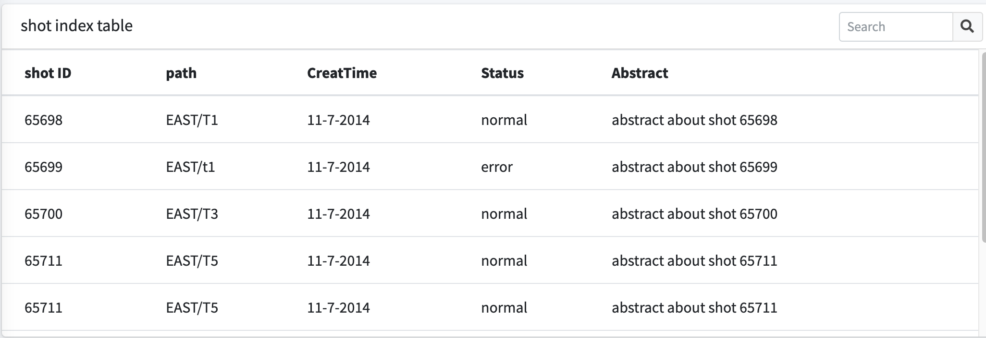
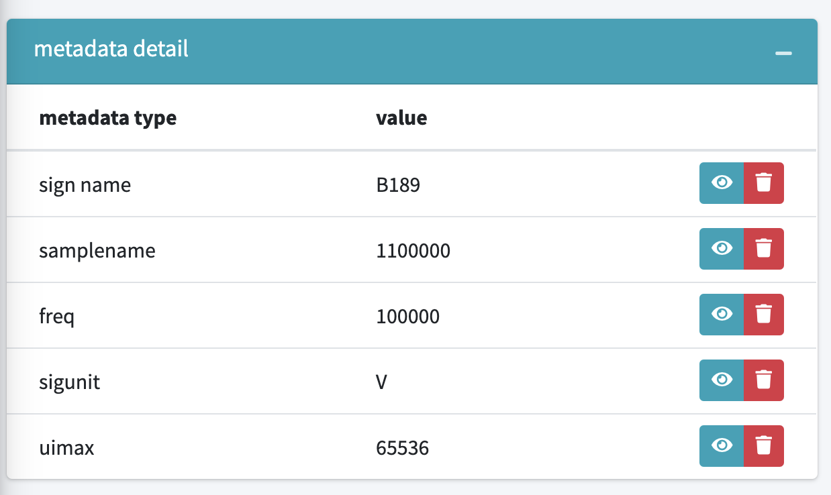
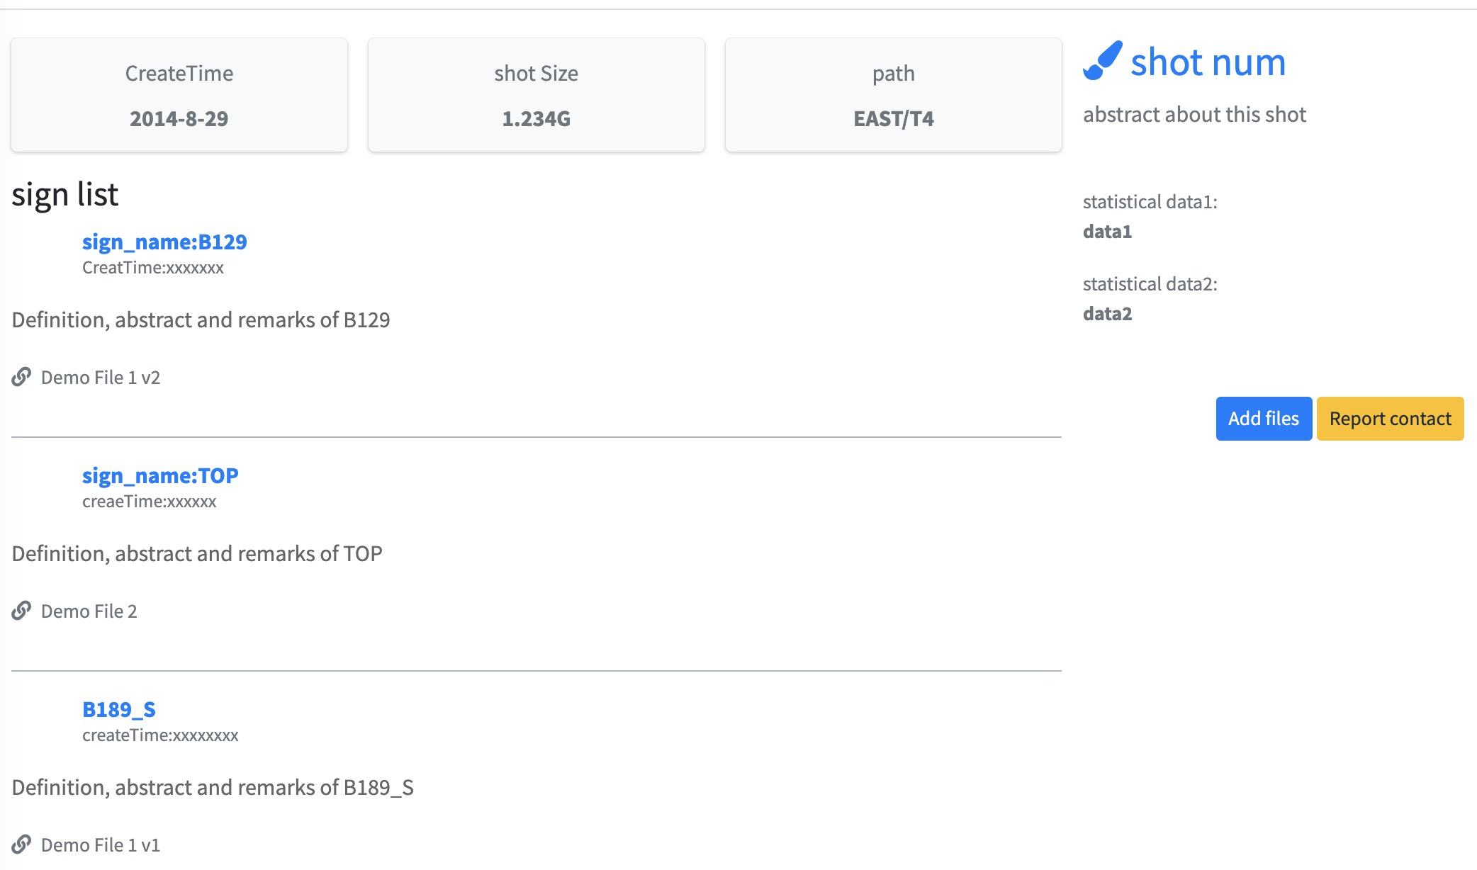
Metadata presentation design
Three-level tables based on JGrid to show tree data.
Notes:
As Metadata presentation ,We use the form of a three-level list.
The first level user sees a list of shot IDs,
the second level user sees information about the signal under that shot,
and the third level list user sees specific metadata information about a signal.

Slide 10
Outline
1. Introduction
2. System Design
3. Test Results
4. Summary

Slide 11
Database performance
Centos7.9-64bit 20000 shots 13.4G mongoDBv4.0.6
query operation | time | analysis
1 shot | 7ms | one document
1 shot sign count | 6ms | one document
1 shot 1sign | 7ms | one document
shot count | 9ms | document count
count group by sign | 214s | Aggregation
data group by sign | 248s | Aggregation
count by Tree | 274s | Aggregation
count by subTree | 246s | Aggregation
sum by shot | 242s | Aggregation
Query performance millisecond level, statistics cost 244s on average.
Notes:
The test mainly include the query operation and the global data statistics operation.

Slide 12
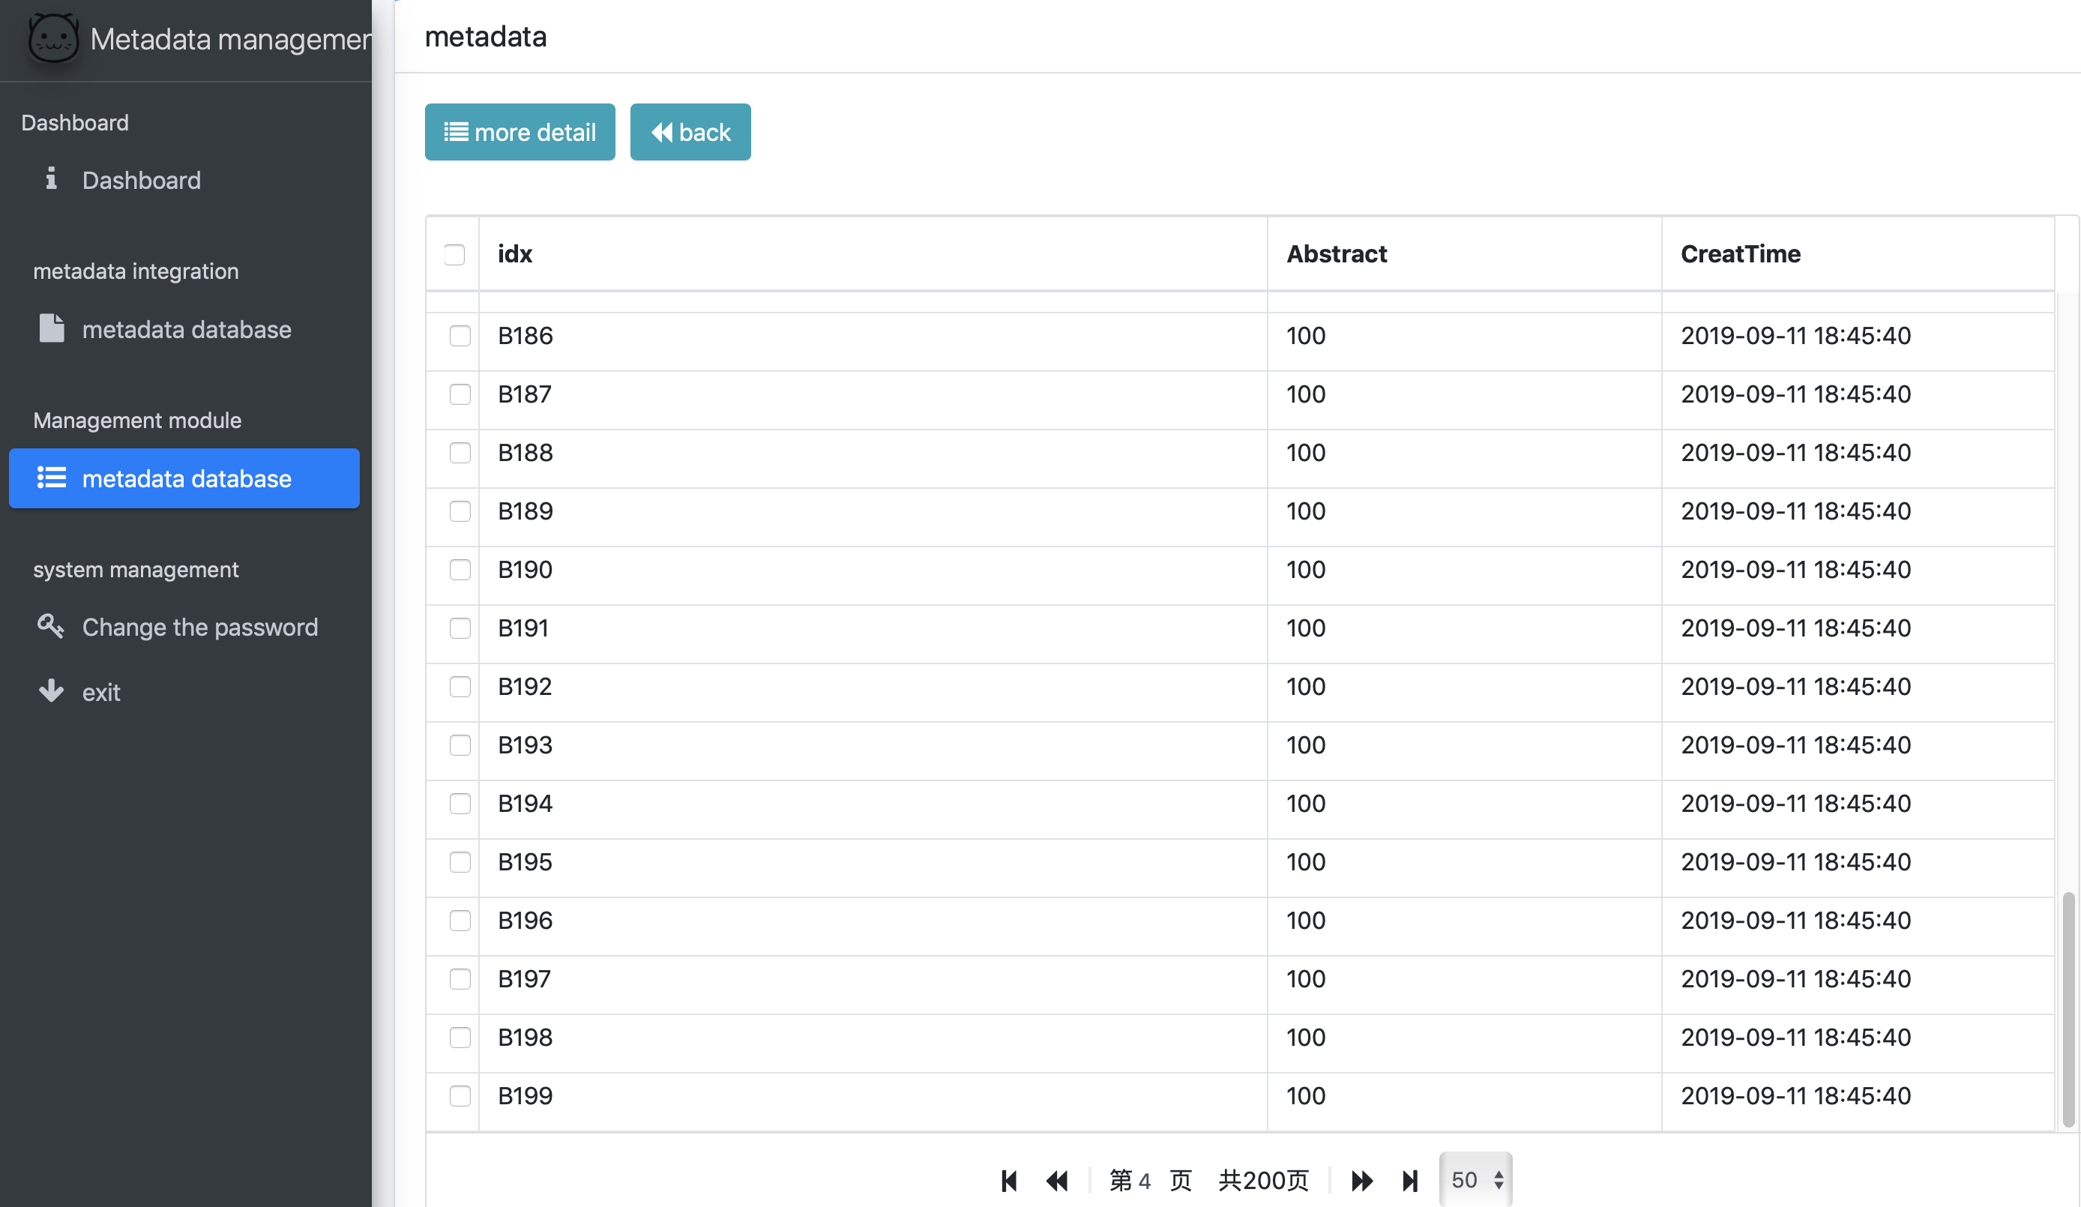
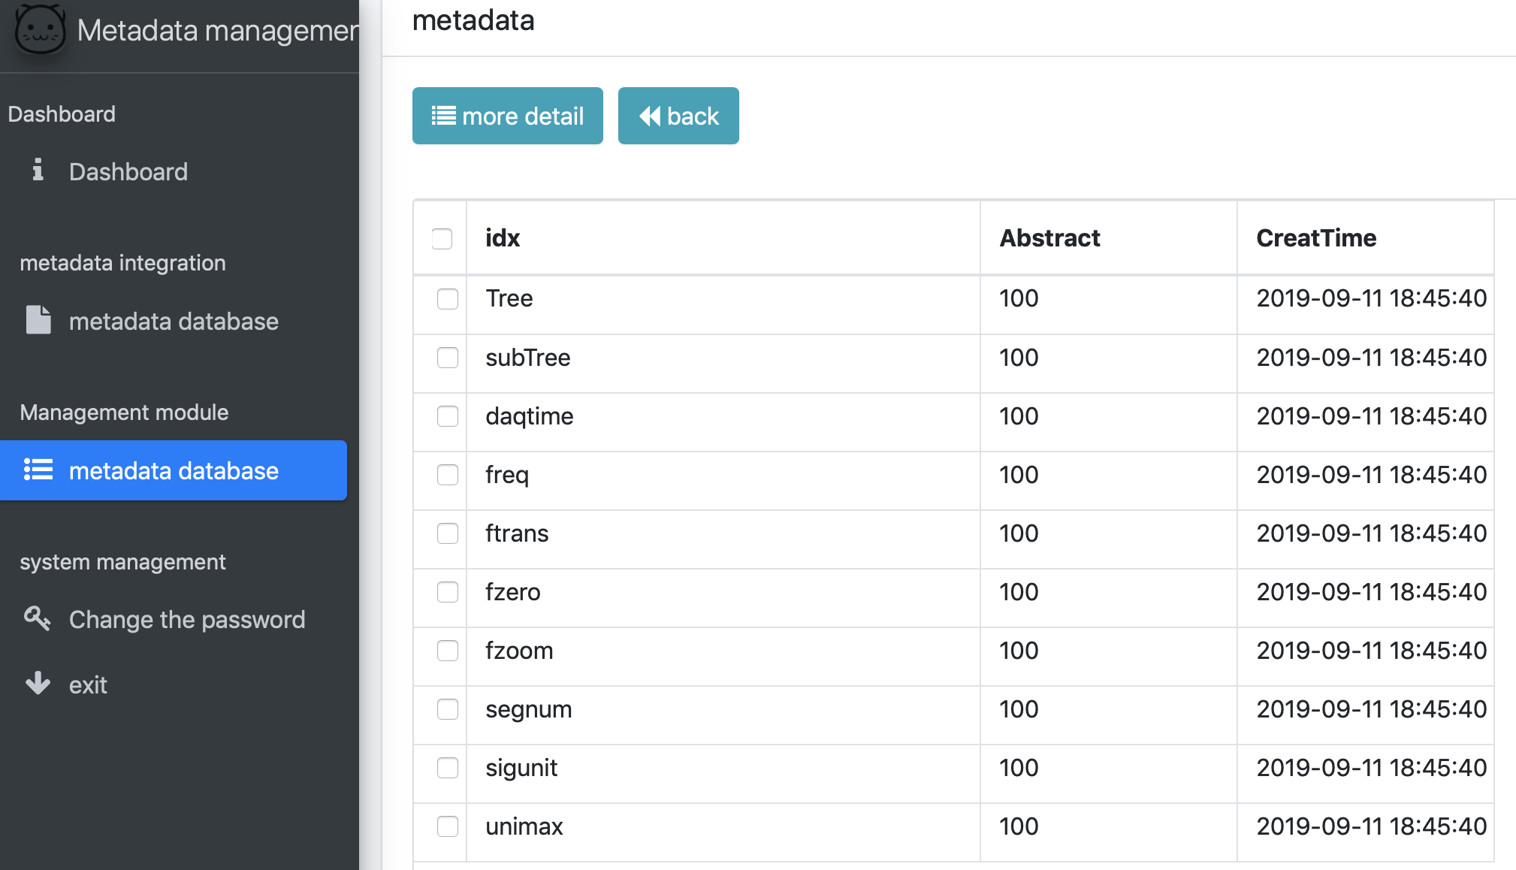
Metadata presentation
1000000000 sign metadata.Response time :3ms

Slide 13
Outline
1. Introduction
2. System Design
3. Test Results
4. Summary
Notes:
The last part is Summary

Slide 14
Summary
Create meta-database based on mongoDB.
Encapsulated query, statistics interface.
Design and complete the metadata display interface.
Future work:
Integration subsystems.
Optimize the data query and statistics performance of MongoDB database.
Improve the external API of the MongoDB-based meta-database.
Optimize the real-time metadata extract system.

Slide 15
Thank you for your attention！

