Slide 1
Simulation of EP-driven nonlinear collective effects using Landau closure methods
Don Spong,¹ M. Van Zeeland³, W. W. Heidbrink,⁴ Y. Ghai¹ J. Varela Rodriguez², L. Garcia²,
  ¹Oak Ridge National Laboratory
  ²Universidad Carlos III de Madrid
  ³General Atomics
  ⁴University of California – Irvine
  17th Technical Meeting on Energetic Particles and Theory of Plasma Instabilities in Magnetic Confinement Fusion
  December 9, 2021
Notes:
I would first like to thank the committee for choosing this talk and my many colleagues for their contributions. This talk s certainly an effort of a large team of contributors

Slide 2
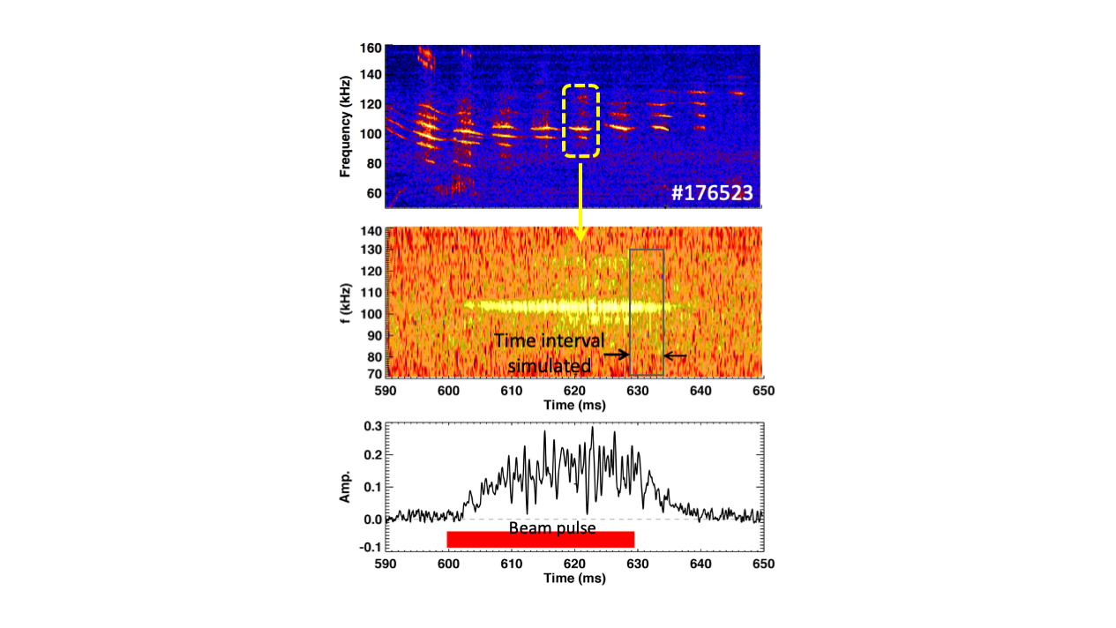
Long-time scale nonlinear simulations are required to understand/predict EP transport
8 to 10 msec
decay time
Fast ion profiles require many Alfvén periods to relax to critical stability profiles and this is a dynamic process
  Fast ions require time to encounter EP resonances
EP modified Alfvén modes drive Maxwell and Reynold’s stresses => zonal flows and currents
These undergo predator-prey cycles => impose intermittency on EP fluctuations and transport events – statistical averages needed to compare with experiment
Nonlinear couplings drive energy transfers between modes
=> Need for efficient reduced models

Slide 3
Global nonlinear simulations described here seek to answer three important questions relevant to energetic particle transport
Landau closure models (FAR3d, TGLF-EP, TAEFL) provide efficient EP simulation
Consistent treatment of nonlinear multi-physics effects
  Fast ion profile relaxation, zonal flows/currents, nonlinear energy flows
Computationally ready for extended nonlinear problems
  Uses hybrid parallelism (MPI, OpenMP), 3rd order semi-implicit time stepper, continuum fields – no particle noise
D. Spong, et al., Nonlinear dynamics and transport driven by energetic particle instabilities using a gyro-Landau closure model, Nuclear Fusion 61 116061 (2021)

Slide 4
Moments-based reduced models are motivated by the nature of field-particle coupling and computational efficiency
Kinetic components
Fields
Gyrokinetic particle/distribution function
5D phase space + time
Maxwell’s equations
Continuity equation
Momentum balance
3D space + time
Moments
Charge density
Current
Pressure tensor
Particles communicate with fields through moments
  Include amplitude rescaling, phase shifts, memory effects, etc.
Motivates replacing the right-hand box with moments hierarchy (Hammett, Perkins, PRL 1990)

Slide 5
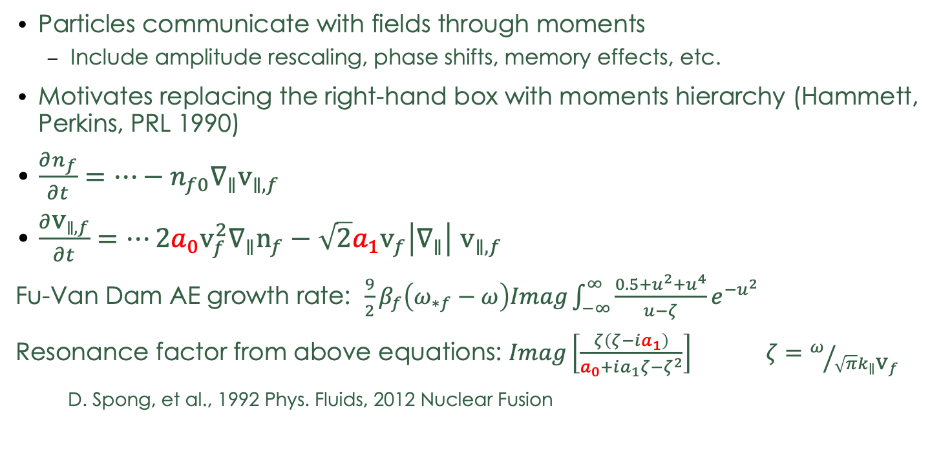
Moments-based reduced models are motivated by the nature of field-particle coupling and computational efficiency
Kinetic components
Fields
Gyrokinetic particle/distribution function
5D phase space + time
Maxwell’s equations
Continuity equation
Momentum balance
3D space + time
Moments
Charge density
Current
Pressure tensor
Particles communicate with fields through moments
  Include amplitude rescaling, phase shifts, memory effects, etc.
Motivates replacing the right-hand box with moments hierarchy (Hammett, Perkins, PRL 1990)
$\frac{∂n_{f}}{∂t}=⋯−n_{f0}∇_{∥}{\text{v}}_{∥,f}$
$\frac{∂{\text{v}}_{∥,f}}{∂t}=⋯2a_{0}{\text{v}}_{f}^{2}∇_{∥}{\text{n}}_{f}−\sqrt{2}a_{1}{\text{v}}_{f}\left|∇_{∥}\right|$ ${\text{v}}_{∥,f}$
Fu-Van Dam AE growth rate: $\frac{9}{2}β_{f}\left(ω_{∗f}−ω\right)Imag\int_{−∞}^{∞}{\frac{0.5+u^{2}+u^{4}}{u−ζ}e^{−u^{2}}}$
Resonance factor from above equations: $Imag\left[\frac{ζ\left(ζ−ia_{1}\right)}{a_{0}+ia_{1}ζ−ζ^{2}}\right]$ $ζ=ω/{\sqrt{π}k_{∥}{\text{v}}_{f}}$
D. Spong, et al., 1992 Phys. Fluids, 2012 Nuclear Fusion
Closure terms for energy
moment coupling

Slide 6
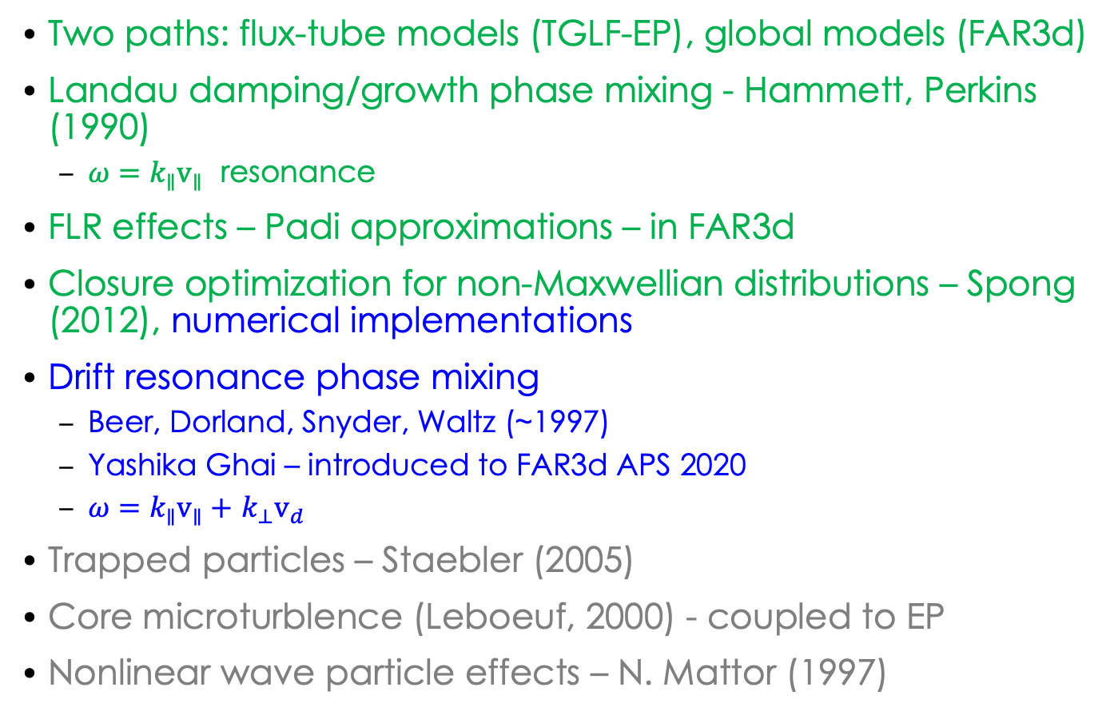
Moment methods have evolved to include kinetic effects important for EP instabilities
Two paths: flux-tube models (TGLF-EP), global models (FAR3d)
Landau damping/growth phase mixing - Hammett, Perkins (1990)
  $ω=k_{∥}{\text{v}}_{∥}$ resonance
FLR effects – Padi approximations – in FAR3d
Closure optimization for non-Maxwellian distributions – Spong (2012), numerical implementations
Drift resonance phase mixing
  Beer, Dorland, Snyder, Waltz (~1997)
  Yashika Ghai – introduced to FAR3d APS 2020
  $ω=k_{∥}{\text{v}}_{∥}+$ $k_{⊥}{\text{v}}_{d}$
Trapped particles – Staebler (2005)
Core microturblence (Leboeuf, 2000) - coupled to EP
Nonlinear wave particle effects – N. Mattor (1997)
Currently
available
In progress
Future

Slide 7
DIII-D pulsed beam experiments provide good test case for EP instability enhanced transport studies
Turning off incremental beam power => fluctuations decay over about 10 msec (~ 7000 Alfvén periods)
  Faster than slowing-down time (100 to 150 msec)
  Slow relative to instability dynamics
Profiles relax to marginal state
Large fluctuations present
What mechanisms determine the fluctuation decay timescale?
8 to 10 msec
decay time
Data/figures provided by Michael Van Zeeland

Slide 8
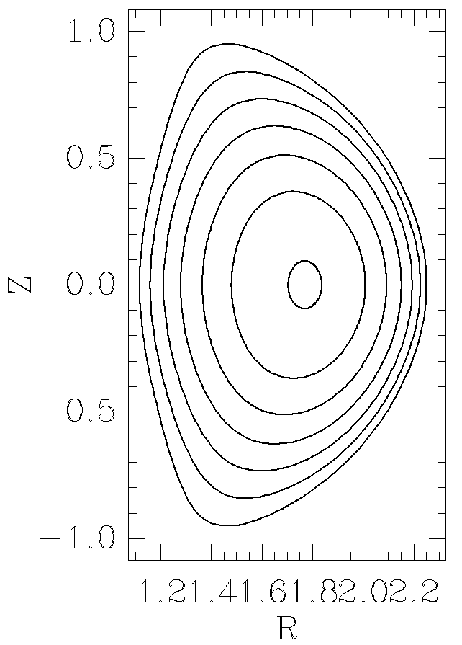
We use DIII-D discharge #176523 as a benchmark case, taking TRANSP-derived profiles as a starting point
176523 profiles
176523 flux surface shape
Lundquist number
Spitzer
S
Level used in simulations
Spitzer
+ neoclassical
T_{beam}(0) = 35 keV to match avg. energy of slowing-down distribution

Slide 9
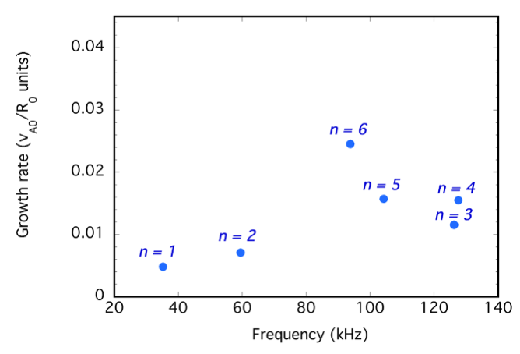
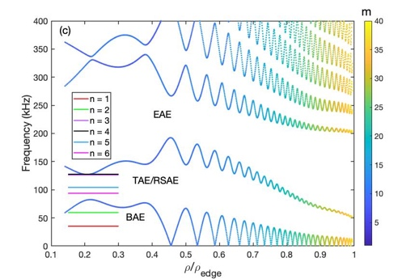
Linear stability analysis shows the fastest growing instabilities for these parameters are in the TAE/RSAE gap
Nominal parameters for discharge #176523
  n_{e}(0) = 2.2 x 10¹⁹ m⁻³, n_{i}(0) = 1.7 x 10¹⁹ m⁻³, T_{i}(0) = 1.6 keV, T_{e}(0) = 1.9 keV
  <v_{fast}>/v_{A0} ~ 0.12, 𝞫_{fast} = 0.007, 𝞫_{thermal} = 0.016, S = 1 to 3 x 10⁷
Linear growth rates vs. frequency
n = 3 Alfvén continuum
  <v_{fast}>/v_{A0} = 0.12, 𝞫_{fast} = 0.01, S = 1x10⁶
Rho = (normalized toroidal flux)^{1/2}

Slide 10
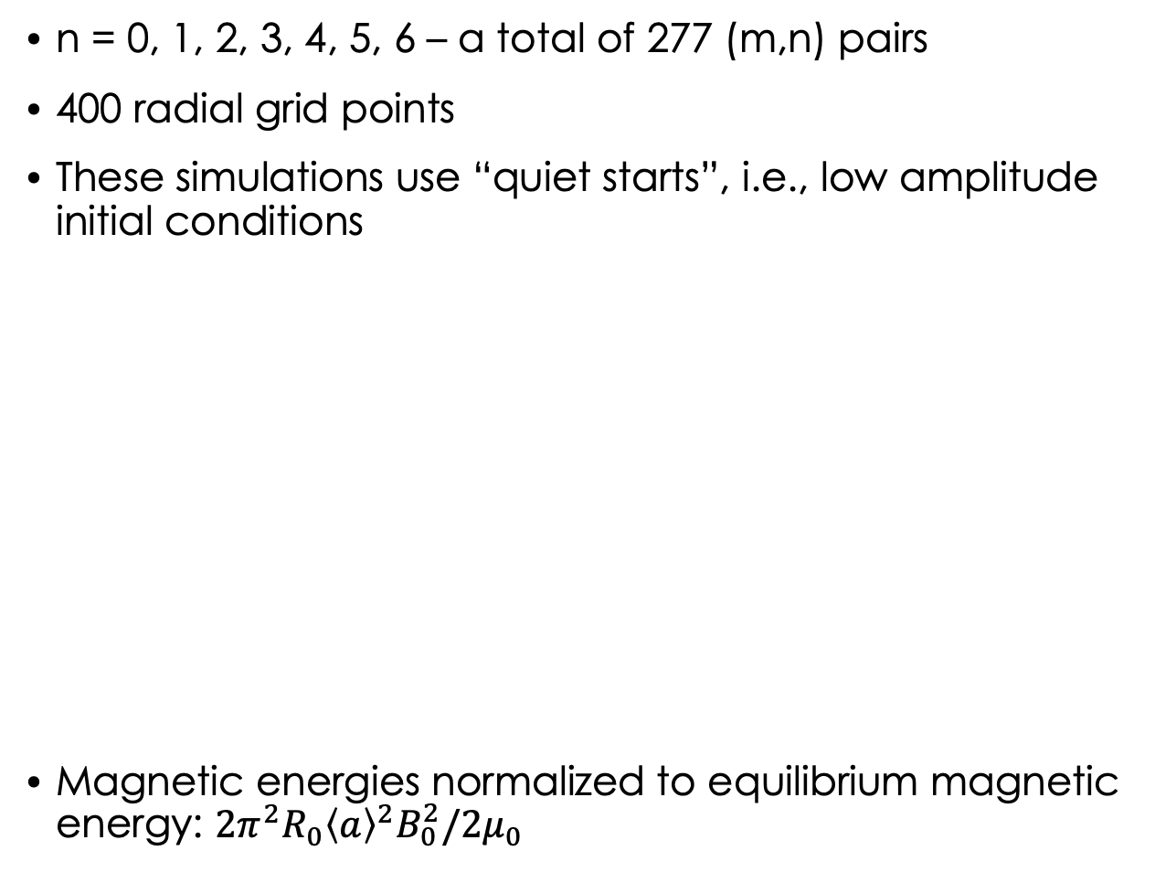
Energy evolution shows a steady saturated state with strong coupling between different n’s
n = 0, 1, 2, 3, 4, 5, 6 – a total of 277 (m,n) pairs
400 radial grid points
These simulations use “quiet starts”, i.e., low amplitude initial conditions
Magnetic energies normalized to equilibrium magnetic energy: $2π^{2}R_{0}{\left\langle a\right\rangle }^{2}B_{0}^{2}/2μ_{0}$
n = 0
Time(msec)
Time(msec)

Slide 11
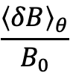
The simulation goes from the linear growth phase far into the nonlinear saturated regime. It settles into a coherent frequency mode similar to experiment
Simulation
Magnetic fluctuations at 𝜌 = 0.2
$$\frac{{\left\langle δB\right\rangle }_{θ}}{B_{0}}$$
Linear
phase
Steady frequency regime
Energy equilibration
phase
Time (msec)
250
200
150
100
Simulation
Frequency (kHz)
50
0
Experiment
After startup transients, this shows dominant activity at ~100 kHz similar to the experiment

Slide 12
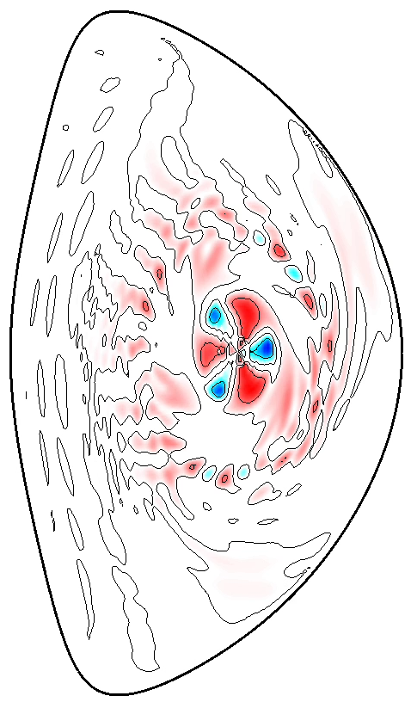
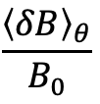
Animation: nonlinear mode structure evolution shows
Outer TAE (m ~ 16) and inner mode (m = 3)
Radial mode shearing from zonal flows
Nonlinear energy transfers between different n’s
Variation in amplitudes and radial position
$$\frac{{\left\langle δB\right\rangle }_{θ}}{B_{0}}$$
Time (msec)
Time interval of animation
Time (msec)

Slide 13
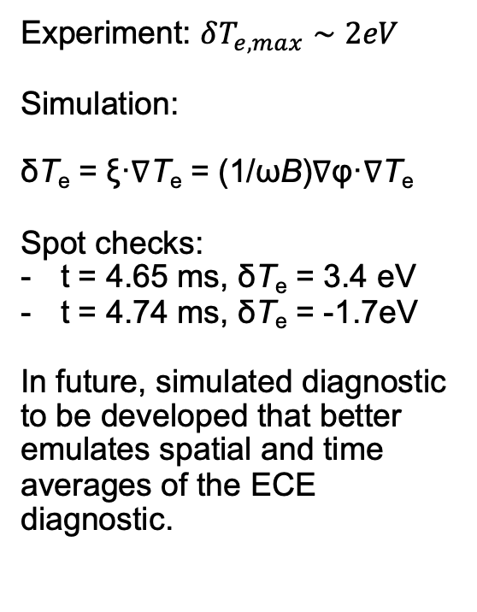
After doing the same time averaging and normalizing as experiment, the simulated 𝜹B_{𝜽}/B fluctuations show similar time variability as measurements
Modulations in simulation
driven by nonlinear energy
transfers, zonal flow/current
Predator-prey dynamics
Experiment: $δT_{e,max}∼2eV$
Simulation:
δT_{e} = ξ·∇T_{e} = (1/ωB)∇φ·∇T_{e}
Spot checks:
t = 4.65 ms, δT_{e} = 3.4 eV
t = 4.74 ms, δT_{e} = -1.7eV
In future, simulated diagnostic to be developed that better emulates spatial and time averages of the ECE diagnostic.
Amplitude (arb.)

Slide 14
EP transport effects are evident in the fast ion density profile – critical gradient effect – and vary dynamically
EP density
n_{EP}(t=0) + n(m=0,n=0,t)
t = 0
Evolving fast ion density
Normalized fast ion density
t = 5.35 msec
Flattened gradient region (see below)
𝜌/𝜌_{edge}
-EP density gradient
-(d/d𝜌)[n_{EP}(t=0) + n(m=0,n=0,t)]
t = 0
-Normalized fast ion density gradient
𝜌/𝜌_{edge}
t = 5.35 msec
Time (msec)
Flattened gradient region
𝜌/𝜌_{edge}

Slide 15
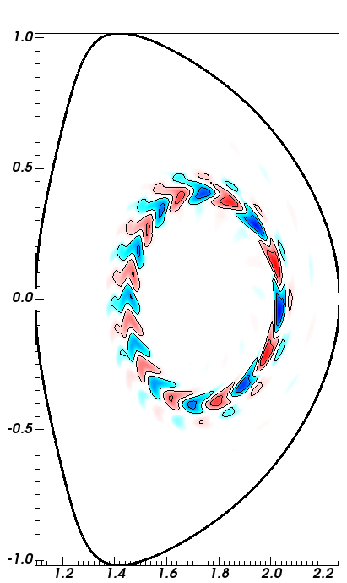


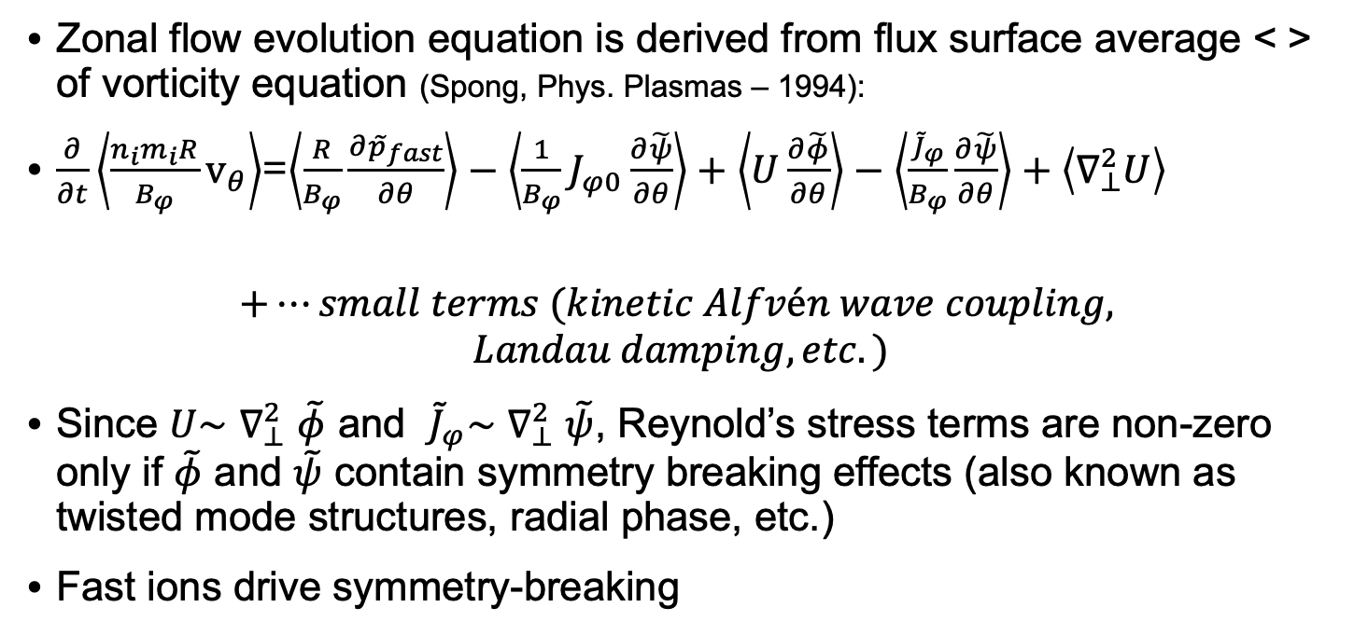
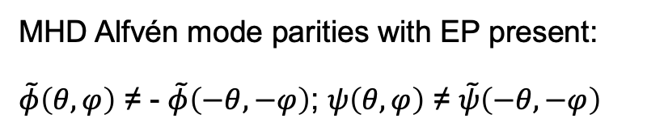
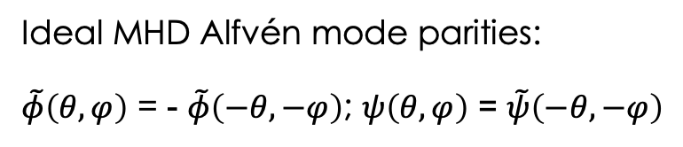

Zonal flows/currents are driven by EP induced symmetry-breaking effects
Zonal flow evolution equation is derived from flux surface average < > of vorticity equation (Spong, Phys. Plasmas – 1994):
$\frac{∂}{∂t}\left\langle \frac{n_{i}m_{i}R}{B_{φ}}{\text{v}}_{θ}\right\rangle$=$\left\langle \frac{R}{B_{φ}}\frac{∂{\tilde{p}}_{fast}}{∂θ}\right\rangle −\left\langle \frac{1}{B_{φ}}J_{φ0}\frac{∂\tilde{ψ}}{∂θ}\right\rangle +\left\langle U\frac{∂\tilde{φ}}{∂θ}\right\rangle −\left\langle \frac{{\tilde{J}}_{φ}}{B_{φ}}\frac{∂\tilde{ψ}}{∂θ}\right\rangle +\left\langle ∇_{⊥}^{2}U\right\rangle$
$$+⋯small terms (kinetic Alfvén wave coupling,$$
$$Landau damping, etc.)$$
Since $U\sim$ $∇_{⊥}^{2}$ $\tilde{φ}$ and ${\tilde{J}}_{φ}\sim ∇_{⊥}^{2} \tilde{ψ}$, Reynold’s stress terms are non-zero only if $\tilde{φ}$ and $\tilde{ψ}$ contain symmetry breaking effects (also known as twisted mode structures, radial phase, etc.)
Fast ions drive symmetry-breaking
~ 0
~ 0
Reynold’s stress terms
EP Alfvén mode
with symmetry
Breaking
Reynold’s stress ≠ 0
Ideal MHD
Alfvén mode
Reynold’s stress ~ 0
Ideal MHD Alfvén mode parities:
$\tilde{φ}\left(θ,φ\right)$ = - $\tilde{φ}\left(−θ,−φ\right)$; $ψ\left(θ,φ\right)$ = $\tilde{ψ}\left(−θ,−φ\right)$
$$sin\left(mθ+nφ\right)$$
cos$\left(mθ+nφ\right)$
MHD Alfvén mode parities with EP present:
$\tilde{φ}\left(θ,φ\right)$ ≠ - $\tilde{φ}\left(−θ,−φ\right)$; $ψ\left(θ,φ\right)$ ≠ $\tilde{ψ}\left(−θ,−φ\right)$
A cos$\left(mθ+nφ\right)$ + B $sin\left(mθ+nφ\right)$

Slide 16
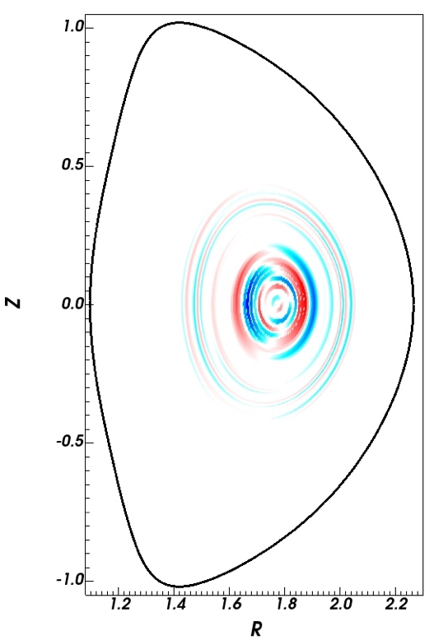
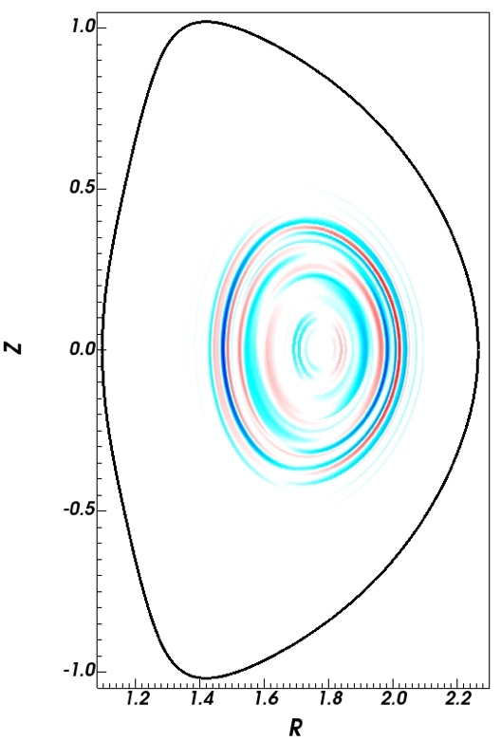
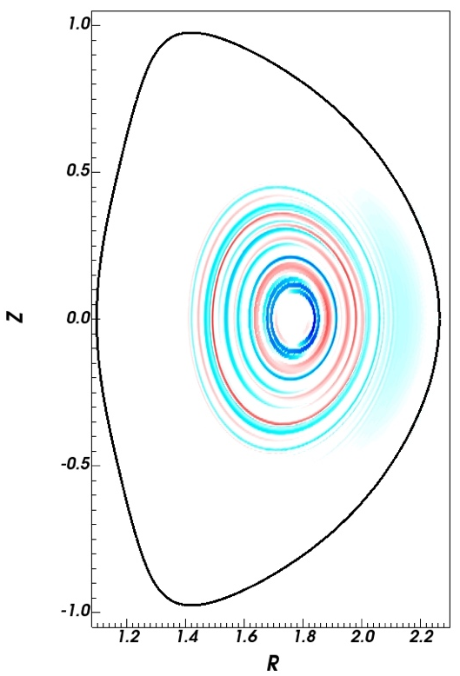
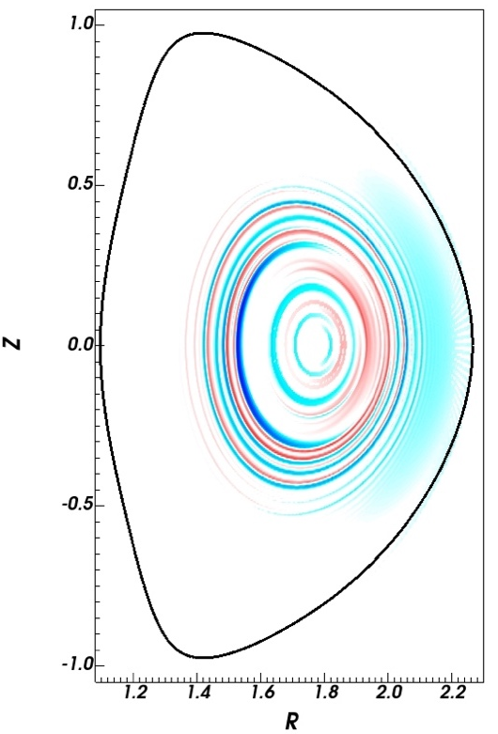
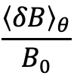
2D plots of n = 0 fields show zonal flow and current structures: amplitude and radial location vary with instability amplitude
𝜹v_{𝜽}(t=t₁)
𝜹v_{𝜽}(t=t₂)
These regulate the amplitude and intermittency of the fluctuations
$$\frac{{\left\langle δB\right\rangle }_{θ}}{B_{0}}$$
Time (msec)
𝜹J^{𝛇}(t=t₁)
𝜹J^{𝛇}(t=t₂)
t₁
t₂

Slide 17
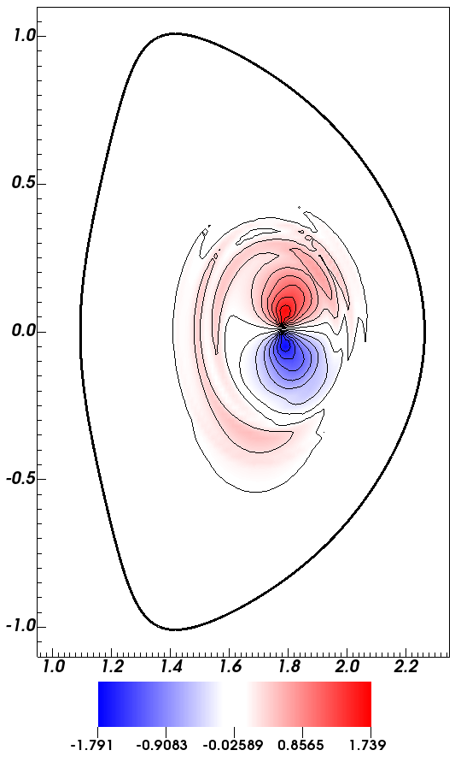
Effective transport coefficients derived from dividing 0,0 fluxes by density gradient => show strong intermittency
Taking into account m > 0 terms, the 2D variation of 𝛤_{𝜌} can be re-constructed
Average = 1.6 m²/sec
Time (msec)
Average = 3.6 m²/sec
Time (msec)
Average = 3.5 m²/sec
Time (msec)
Average = 1 m²/sec
Time (msec)

Slide 18
Intermittency in transport is correlated with rapid zonal flow variations
Cross-correlation coefficient
between integrated zonal flows and EP transport at different radii
Time (msec)
Volume Integrated m = 0/n = 0 components
Drives zonal flows
Time (msec)
Drives zonal currents
Drives n_{fast} flattening
Lag time (msec)
EP radial flux peaks lead
zonal flow by ~ 1 to 2 msec

Slide 19
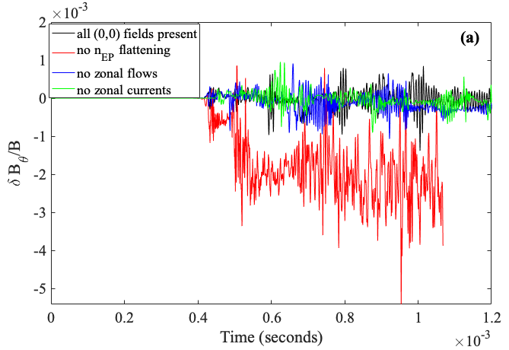
Different saturation mechanisms can be turned on and off (n = 0 couplings)
fast ion density flattening has most impact on saturation levels

Slide 20
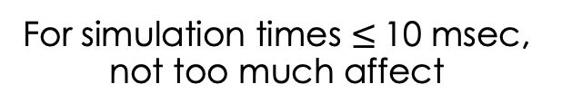
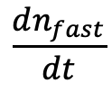
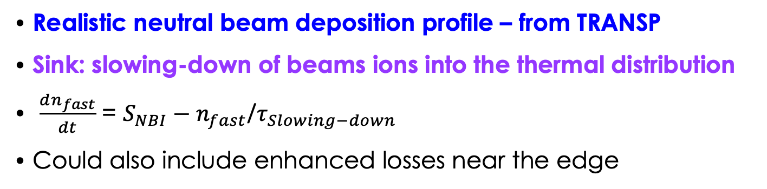

Source/sink modeling: effects accumulate over longer times
Realistic neutral beam deposition profile – from TRANSP
Sink: slowing-down of beams ions into the thermal distribution
$\frac{dn_{fast}}{dt}$ = $S_{NBI}−n_{fast}$/$τ_{Slowing−down}$
Could also include enhanced losses near the edge
$$\frac{dn_{fast}}{dt}$$
$$ρ/ρ_{edge}$$
For simulation times $≤$10 msec, not too much affect

Slide 21
Conclusions
Feasibility of long nonlinear simulations with FAR3d demonstrated
  Mode activity is in similar frequency range as experiment
  Computational methods scale to ITER regime with many toroidal n’s
The beam pulse experiments provide a good test case for transport studies
  Steady frequency Alfvén mode
  Saturation level seems most influenced by fast ion profile flattening
  Intermittency driven by
    zonal flow predator-prey phenomena, diffusion (spatial) across resonances, nonlinear energy transfers
Future (ongoing work)
  Couple to tracer particle model for detailed transport analysis
  Higher order moments models => improved EP physics
  Parameter/profile scans => package results using deep-learning networks for integrated simulations
This work is documented in: D. Spong, et al., Nonlinear dynamics
and transport driven by energetic particle instabilities using a
gyro-Landau closure model, Nuclear Fusion 61 116061 (2021)

