Slide 1
State-of-the-art
turbulent heat flux modelling
for low-Prandtl flows
Technical Meeting on State-of-the-art Thermal Hydraulics of Fast Reactors
ENEA Brasimone, Italy
26-30 September 2022
Akshat Mathur, Ferry Roelofs
Matilde Fiore, Lila Koloszar
EU DuC = N

Slide 2
Contents
Introduction
Models
Standard Gradient Diffusion Hypothesis (SGDH)
Algebraic closures
Second-order closures
Assessment
Future perspective

Slide 3
Introduction

Slide 4
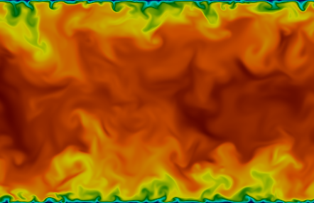
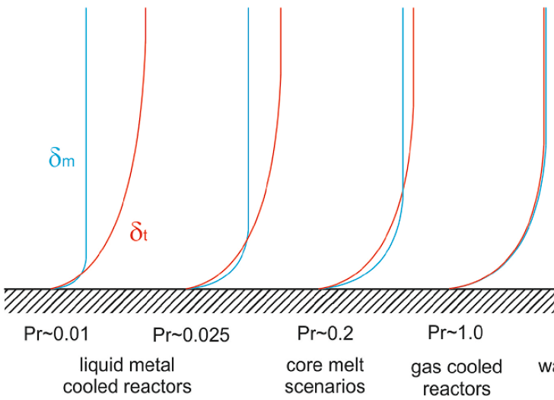
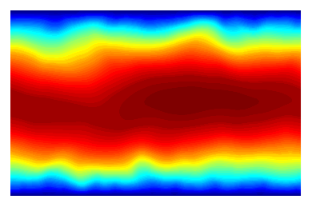
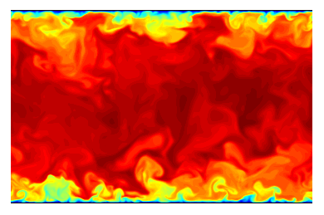


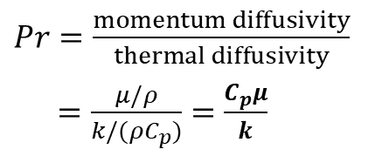
Heat Transport
Instantaneous Velocity
$Pr=\frac{momentum diffusivity}{thermal diffusivity}$
$=\frac{μ/ρ}{k/(ρC_{p})}=\frac{C_{p}μ}{k}$
Water/Gas – strong coupling of momentum and thermal diffusion
Liquid Metals – uneven coupling of momentum and thermal diffusion
$Pr$ = 0.01
Instantaneous Temperature
$Pr$ = 1.0
Tiselj & Cizelj (2012)

Slide 5
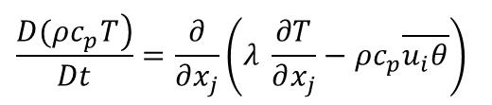
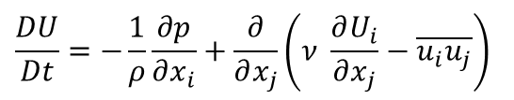
RANS based turbulence modelling
Reynolds-Averaged Momentum Transport
$$\frac{DU}{Dt}=−\frac{1}{ρ}\frac{∂p}{∂x_{i}}+\frac{∂}{∂x_{j}}\left(ν \frac{∂U_{i}}{∂x_{j}}−\overline{u_{i}u_{j}}\right)$$
Reynolds-Averaged Energy Transport
$$\frac{\left.D(ρc_{p}T\right)}{Dt}=\frac{∂}{∂x_{j}}\left(λ \frac{∂T}{∂x_{j}}−ρc_{p}\overline{u_{i}θ}\right)$$

Slide 6

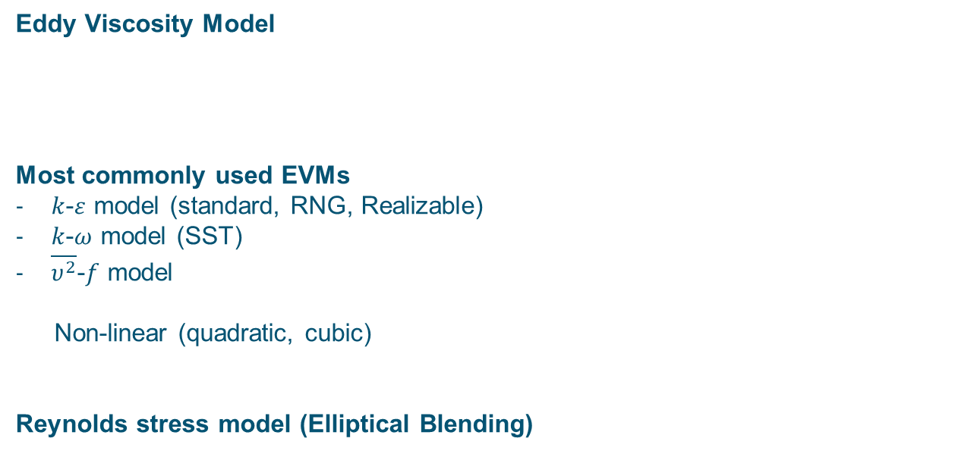
Turbulent Momentum Flux Modelling
Eddy Viscosity Model
Most commonly used EVMs
$k$-$ε$ model (standard, RNG, Realizable)
$k$-$ω$ model (SST)
$\overline{υ^{2}}$-$f$ model
Non-linear (quadratic, cubic)
Reynolds stress model (Elliptical Blending)
$$−ρ\overline{u_{i}u_{j}}=2μ_{t}S_{ij}−\frac{2}{3}ρkδ_{ij}$$

Slide 7


Turbulent Heat Flux Modelling
works well for near-unity Prandtl number flows
breaks down for low Prandtl numbers
Standard Gradient Diffusion Hypothesis (SGDH)
Reynolds Analogy
$$−\overline{u_{i}θ}=α_{t}\frac{∂T}{∂x_{i}}$$
$$α_{t}=\frac{ν_{t}}{{Pr}_{t}}$$

Slide 8
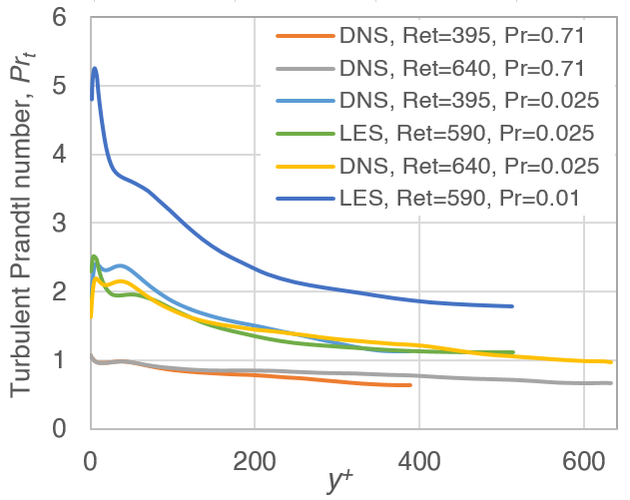


Standard Gradient Diffusion Hypothesis (SGDH)
Constant Turbulent Prandtl Number
Turbulent Channel Flow
$${Pr}_{t}=0.85$$
(Water/Gas)
$${Pr}_{t}=2.0$$
(Liquid Metals)

Slide 9
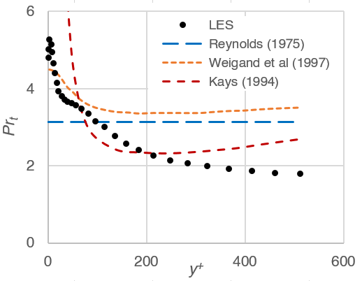

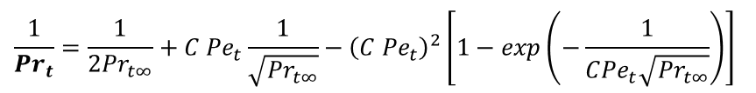

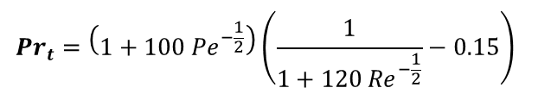
Standard Gradient Diffusion Hypothesis (SGDH)
Reynolds (1975)
Turbulent Channel Flow, $Re_{τ}=590$
$${Pr}_{t}=\left(1+100 {Pe}^{−\frac{1}{2}}\right)\left(\frac{1}{1+120 {Re}^{−\frac{1}{2}}}−0.15\right)$$
Kays (1994)
$${Pr}_{t}=0.85+\frac{0.7}{{Pe}_{t}}$$
Weigand et al. (1997)
$$\frac{1}{{Pr}_{t}}=\frac{1}{2{Pr}_{t∞}}+C {Pe}_{t}\frac{1}{\sqrt{{Pr}_{t∞}}}−{\left(C {Pe}_{t}\right)}^{2}\left[1−\exp\left(−\frac{1}{C{Pe}_{t}\sqrt{{Pr}_{t∞}}}\right)\right]$$

Slide 10




Algebraic Closures
General Gradient Diffusion Hypothesis (GGDH)
Daly (1970)
$$\overline{u_{i}θ}=−C_{θ}\frac{k}{ε} \left(\overline{u_{i}u_{j}}\frac{∂T}{∂x_{i}}\right)$$
Explicit Algebraic Heat Flux Model (AHFM)
Manservisi & Menghini (2014)
$$α_{t}=C_{θ}kτ_{lθ}$$
$$\frac{Dk_{θ}}{Dt}=\frac{∂}{∂x_{i}}\left[\left(α+\frac{α}{σ_{k_{θ}}}\right)\frac{∂k_{θ}}{∂x_{i}}\right]+P_{θ}−ε_{θ}$$
$$\left.\frac{Dε_{θ}}{Dt}=\frac{∂}{∂x_{i}}\left[\left(α+\frac{α}{σ_{ε_{θ}}}\right)\frac{∂ε_{θ}}{∂x_{i}}\right]+\frac{ε_{θ}}{k_{θ}}\left(C_{p1}P_{θ}−C_{d1}ε_{θ}\right)+\frac{ε_{θ}}{k}(C_{p2}P_{k}−C_{d2}ε\right)$$

Slide 11
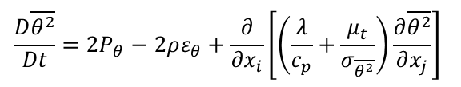

Algebraic Closures
Implicit Algebraic Heat Flux Model (AHFM)
Kenjeres et al. (2005)
$$\overline{u_{i}θ}=−C_{t0}\frac{k}{ε} \left(C_{t1}\overline{u_{i}u_{j}}\frac{∂T}{∂x_{i}}+C_{t2}\overline{u_{j}θ}\frac{∂U_{i}}{∂x_{i}}+C_{t3}βg_{i}\overline{θ^{2}}\right)+C_{t4}α_{ij}\overline{u_{j}θ}$$
$$\frac{D\overline{θ^{2}}}{Dt}=2P_{θ}−2ρε_{θ}+\frac{∂}{∂x_{i}}\left[\left(\frac{λ}{c_{p}}+\frac{μ_{t}}{σ_{\overline{θ^{2}}}}\right)\frac{∂\overline{θ^{2}}}{∂x_{j}}\right]$$
Performance highly sensitive to model coefficients
Calibration of coefficients required

Slide 12
Algebraic Closures
Performance highly sensitive to model coefficients
Calibration of coefficients required
A priori knowledge of flow parameters required
Not compatible with an integral setting (such as reactor pool)
Ill definition of flow parameters (such as Reynolds/Rayleigh numbers)

Slide 13
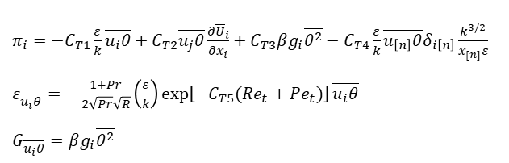
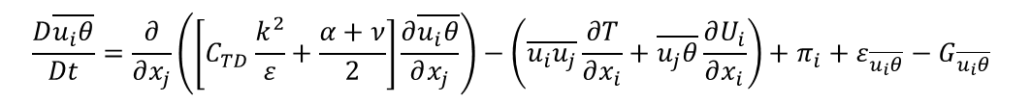
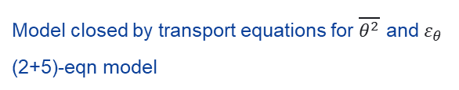
Turbulent Model for Buoyant Flows (TMBF)
Carteciano et al. (1997)
$$\frac{D\overline{u_{i}θ}}{Dt}=\frac{∂}{∂x_{j}}\left(\left[C_{TD}\frac{k^{2}}{ε}+\frac{α+ν}{2}\right]\frac{∂\overline{u_{i}θ}}{∂x_{j}}\right)−\left(\overline{u_{i}u_{j}}\frac{∂T}{∂x_{i}}+\overline{u_{j}θ}\frac{∂U_{i}}{∂x_{i}}\right)+π_{i}+ε_{\overline{u_{i}θ}}−G_{\overline{u_{i}θ}}$$
$π_{i}=−C_{T1}\frac{ε}{k}\overline{u_{i}θ}+C_{T2}\overline{u_{j}θ}\frac{∂{\overline{U}}_{i}}{∂x_{i}}+C_{T3}βg_{i}\overline{θ^{2}}−C_{T4}\frac{ε}{k}\overline{u_{\left[n\right]}θ}δ_{i\left[n\right]}\frac{k^{3/2}}{x_{[n]}ε}$
$ε_{\overline{u_{i}θ}}=−\frac{1+Pr}{2\sqrt{Pr}\sqrt{R}}\left(\frac{ε}{k}\right)\exp\left[−C_{T5}(Re_{t}+Pe_{t})\right]\overline{u_{i}θ}$
$G_{\overline{u_{i}θ}}=βg_{i}\overline{θ^{2}}$
Model closed by transport equations for $\overline{θ^{2}}$ and $ε_{θ}$
(2+5)-eqn model

Slide 14




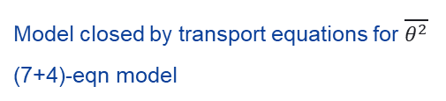

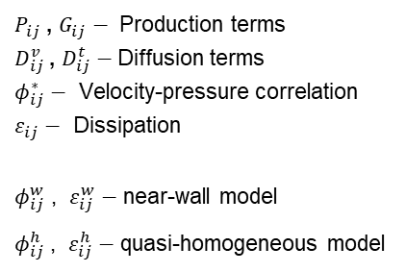
Elliptical Blending Differential Flux Model (EB-DFM)
Shin et al. (2008), Dehoux et al. (2017)
Elliptical Blending Reynolds Stress Model (EB-RSM)
Manceau (2015)
$P_{ij}$ , $G_{ij}$ $−$ Production terms
$D_{ij}^{v}$ , $D_{ij}^{t}$ $−$Diffusion terms
$φ_{ij}^{∗}$ $−$ Velocity-pressure correlation
$ε_{ij}$ $−$ Dissipation
$φ_{ij}^{w}$ , $ε_{ij}^{w}$ $−$ near-wall model
$φ_{ij}^{h}$ , $ε_{ij}^{h}$ $−$ quasi-homogeneous model
$$\frac{D\overline{u_{i}u_{j}}}{Dt}=P_{ij}+G_{ij}+φ_{ij}^{∗}−ε_{ij}+D_{ij}^{v}+D_{ij}^{t}$$
$$φ_{ij}^{∗}−ε_{ij}=\left(1−α^{3}\right)\left(φ_{ij}^{w}−ε_{ij}^{w}\right)+α^{3}\left(φ_{ij}^{h}−ε_{ij}^{h}\right)$$
Additional transport equation for $ε$
$$\frac{D\overline{u_{i}θ}}{Dt}=P_{iθ}+G_{iθ}+φ_{iθ}^{∗}−ε_{iθ}+D_{iθ}^{v}+D_{iθ}^{t}$$
$$φ_{iθ}^{∗}=\left(1−α_{θ}\right)φ_{iθ}^{w}+α_{θ}φ_{iθ}^{h}$$
$$ε_{iθ} =\left(1−α_{θ}\right)ε_{iθ}^{w} +α_{θ}ε_{iθ}^{h}$$
Model closed by transport equations for $\overline{θ^{2}}$
(7+4)-eqn model

Slide 15
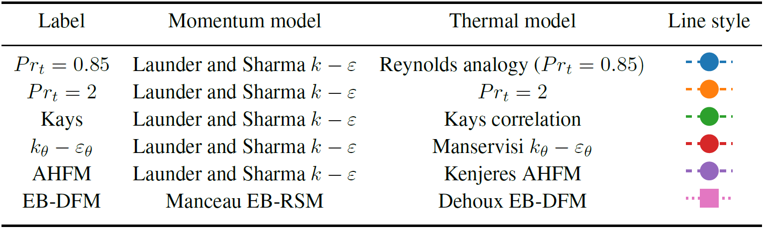
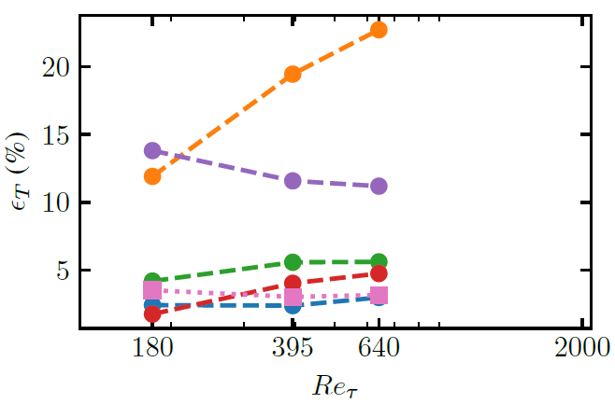
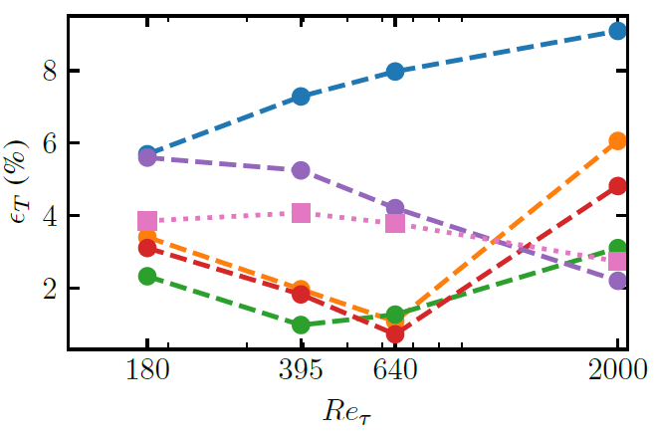
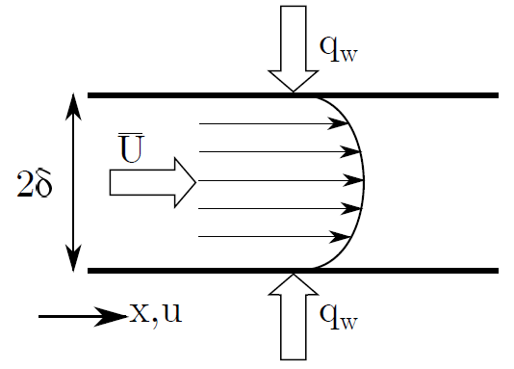


Model Performance
Assessment for forced convection
Ortiz et al. (2022)
Turbulent channel flow with constant heat flux
$$Pr=0.71$$
$$Pr=0.025$$

Slide 16
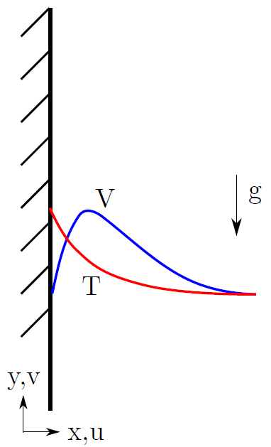
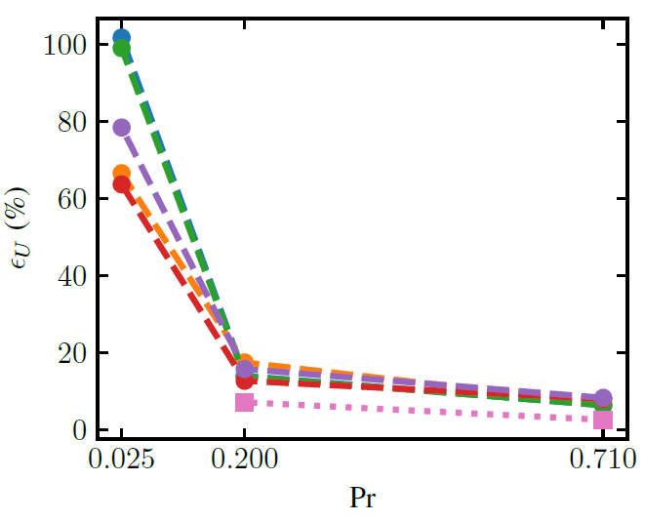
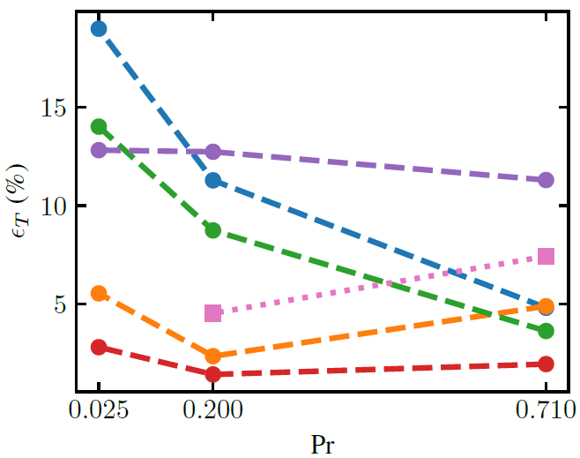

Model Performance
Assessment for natural convection
Ortiz et al. (2022)
Natural convection boundary layer, $Ra$ ~ 10¹¹
Velocity
Temperature

Slide 17
Turbulent Heat Flux Modelling
Academic Models
Too complex, numerically unstable
Not suitable for reactor-scale simulations
Not available in commercial codes
Engineering Closures
Reynolds analogy – not applicable to liquid metals
Calibration necessary
Require a priori knowledge of flow parameters
Not applicable in integral settings

Slide 18
Turbulent Heat Flux Modelling
Universal applicability without calibration
Not reliant on global flow parameters
Integral setting – all flow regimes
Reactor-scale
Non-linearity
Numerical stability

Slide 19
Future Perspectives
High-resolution data analyses
Bhushan et al. (2022)
Model training using Machine Learning strategy
Fiore et al. (2022)
Development of robust models
Su et al. (2022)
European PATRICIA project
Automization of implicit and explicit AHFM closures
Anisotropic modelling
Development of Wall functions

Slide 20
Thank you!

Slide 21
Disclaimer
Goods labeled with an EU DuC (European Dual-use Codification) not equal to ‘N’ are subject to European and national export authorization when exported from the EU and may be subject to national export authorization when exported to another EU country as well. Even without an EU DuC, or with EU DuC ‘N’, authorization may be required due to the final destination and purpose for which the goods are to be used. No rights may be derived from the specified EU DuC or absence of an EU DuC.

