Slide 1
Technical Meeting on State-of-the-art Thermal Hydraulics of Fast Reactors
C. R. ENEA, Camugnano, Italy and Virtual, September 26-30, 2022.
Development of Plant Lifecycle Optimization Method,
ARKADIA for Advanced Reactors
Akihiro Uchibori¹, Joji Sogabe¹, Yasushi Okano¹, Takashi Takata²,
Norihiro Doda¹, Masaaki Tanaka¹, Yasuhiro Enuma¹, Takashi Wakai¹,
Tai Asayama¹, Hiroyuki Ohshima¹
¹Japan Atomic Energy Agency
²The University of Tokyo

Slide 2
Contents
Development of ARKADIA
  Development motivation
  Evaluation flow and system structure
  ARKADIA-Design and -Safety
Simulation technologies of ARKADIA-Design
  Module structure
  Validation analyses
Simulation technologies of ARKADIA-Safety
  Development motivation
  Numerical models
  Functional test analysis
Summary

Slide 3
Development of ARKADIA
  Development motivation
  Evaluation flow and system structure
  ARKADIA-Design and -Safety
Simulation technologies of ARKADIA-Design
  Module structure
  Validation analyses
Simulation technologies of ARKADIA-Safety
  Development motivation
  Numerical models
  Functional test analysis
Summary

Slide 4
What is ARKADIA ?
Advanced Reactor Knowledge- and AI-aided Design Integration Approach through the whole plant lifecycle
Knowledge base that stores insights from past nuclear reactor development projects and R&D
State-of-the-art computational methods linked with the knowledge base and AI*
Automatic optimization of plant design including safety measures from various perspectives such as safety and economics
* Artificial Intelligence

Slide 5
Development motivation
Support evaluation of various innovative reactor concepts represented by SFRs*
Optimize plant lifecycle of advanced reactors automatically by using state-of-the-art simulation technologies and knowledge
Keep and transfer technology bases including knowledge
Develop human resources
* Sodium-cooled fast reactors

Slide 6
Evaluation flow and system structure
Start
Steps (1), (2), (4)
(1) Set objective
EAS
(Enhanced and AI-aided
optimization System)
(2) Obtain related information and select evaluation condition
KMS
Step (3)
VLS
(Virtual plant
Life System)
New design, improve safety, etc.
(3) Evaluate
KMS
(Knowledge
Management
System)
Change condition
(4) Confirm
achievement
of objective
AI-aided platform
Finish
Three systems that comprises ARKADIA
Apply to actual plant
Generalized evaluation flowchart

Slide 7
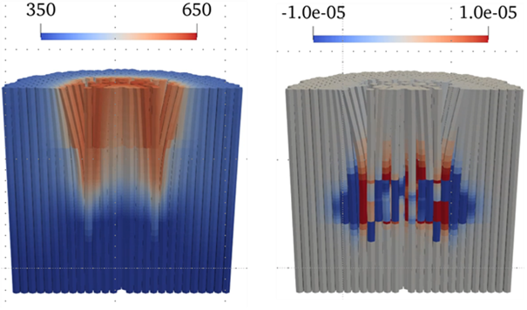
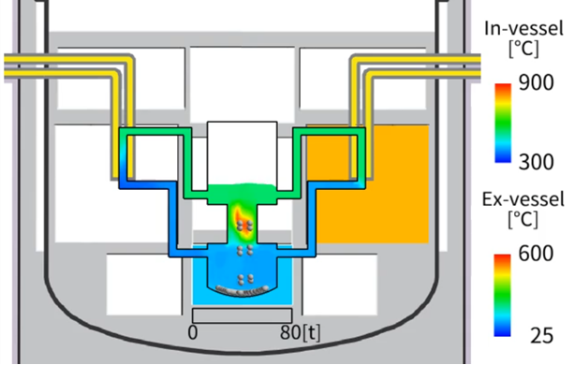
ARKADIA-Design and -Safety
ARKADIA-Design
ARKADIA-Safety
optimizes core design, plant structure design, and maintenance program
provides design satisfying requirements of
safety and economics from SA* simulation
Example coupled simulation by VLS
(Neutronics, thermal hydraulics, structure)
Example SA simulation by VLS
(hypothetical condition)
[°C]
[¢/cm³]
Pipe break
Core temperature
Core reactivity
Coolant and atmosphere temperature
during loss of reactor level event
Individual development in the first phase
Integration into a single system in the second phase
* Severe accidents

Slide 8
Development of ARKADIA
  Development motivation
  Evaluation flow and system structure
  ARKADIA-Design and -Safety
Simulation technologies of ARKADIA-Design
  Module structure
  Validation analyses
Simulation technologies of ARKADIA-Safety
  Development motivation
  Numerical models
  Functional test analysis
Summary

Slide 9
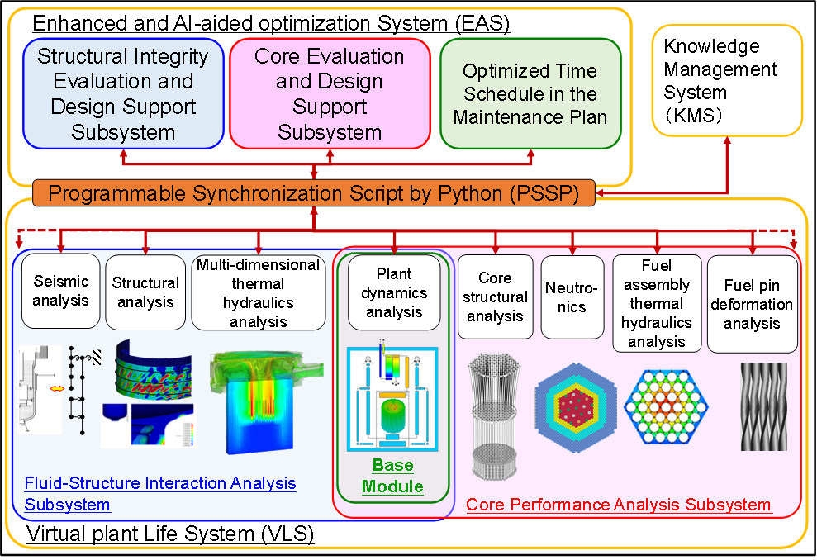
Module structure of ARKADIA-Design
Implementation mainly in conceptual design stage within design base events
Support of design optimization in the fields of core, structure, maintenance
Composed by PSSP for controller, EAS for evaluation, VLS for virtual plant, and KMS for knowledge base
Virtual Plant in VLS
Multi-level & multi-physics approaches
“multi-code connection (MCC)” methodology with modules(codes) for various scales and physics
A coupling methodology

Slide 10
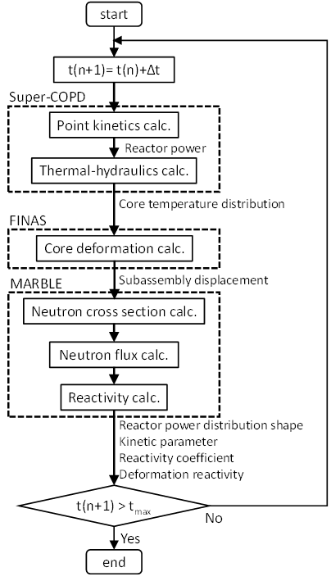
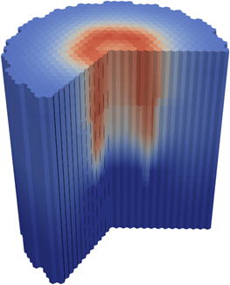
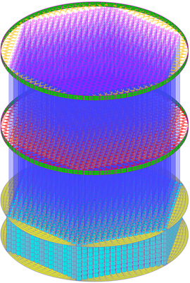
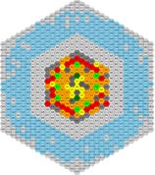
Core deformation reactivity analysis (1/2)
Evaluate reactivity feedback due to core deformation in abnormal transient conditions or a significant temperature rise of the core in accidents.
Time-marching procedure
The three codes run sequentially
Data exchange as boundary conditions of each analysis

Slide 11

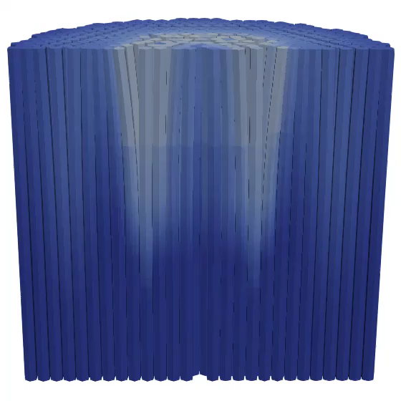
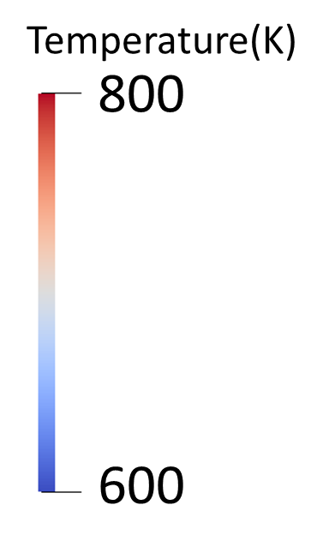
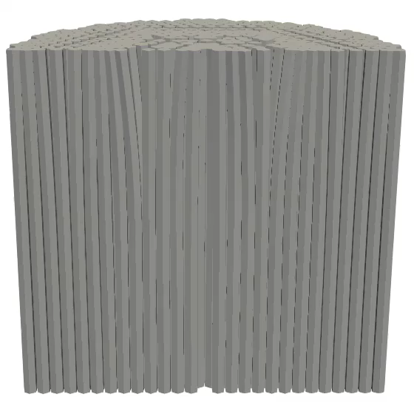
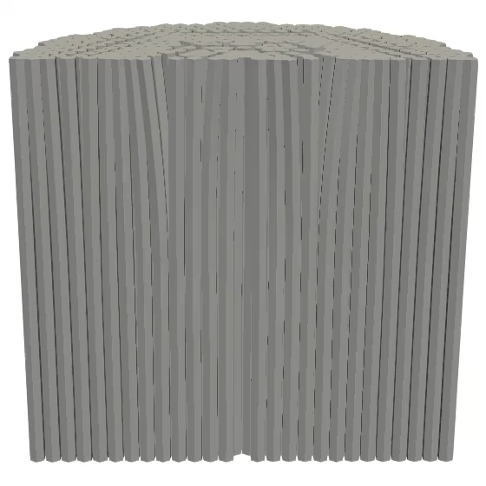
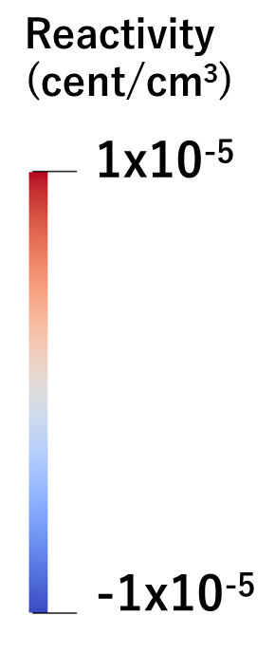
Core deformation reactivity analysis (2/2)
Coupled analysis of EBR-II SHRT-45R test
Magnified displacements (x20)
Magnified displacements (x20)
Fuel region
Fuel region
Fuel region
(Fuel)
(Structural material)
Whole core temperature and core deformation
Core deformation reactivity distribution
Subassembly bows toward the
colder side
4th-row subassemblies: inward
6th-row subassemblies: outward
Negative reactivity contribution due to outward displacements of reflector SAs as well as fuel SAs
10

Slide 12
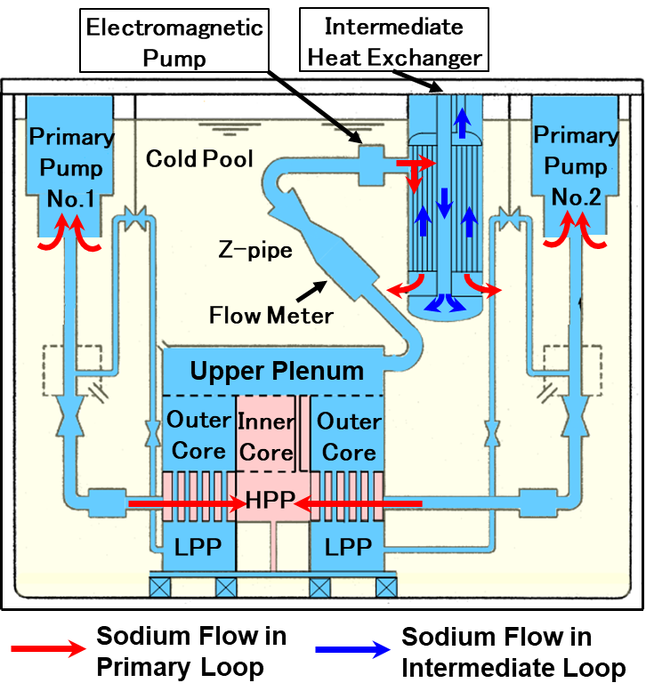
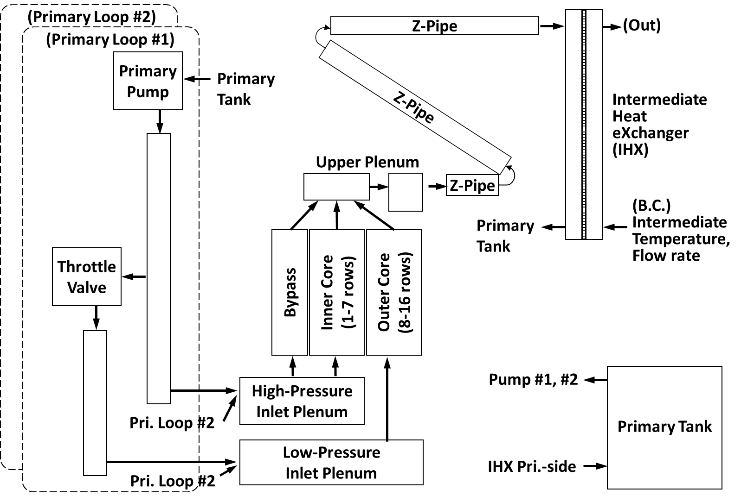
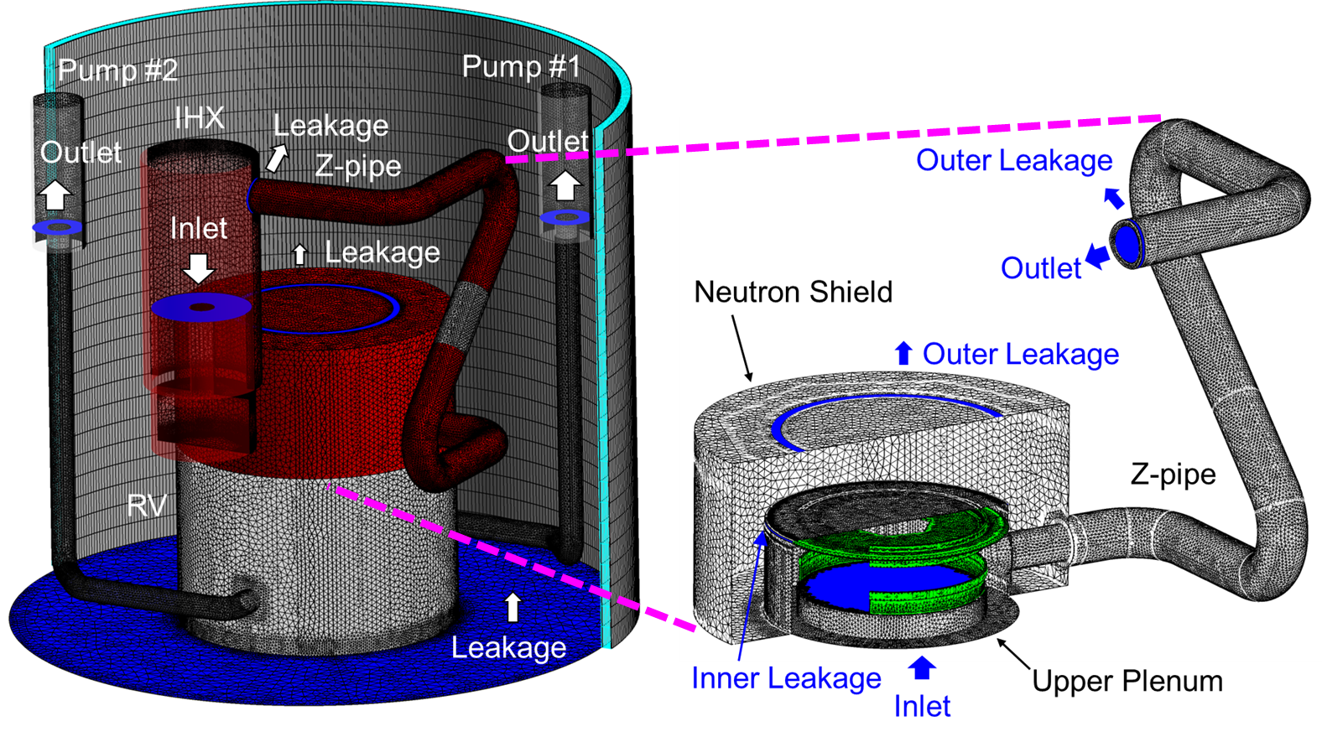
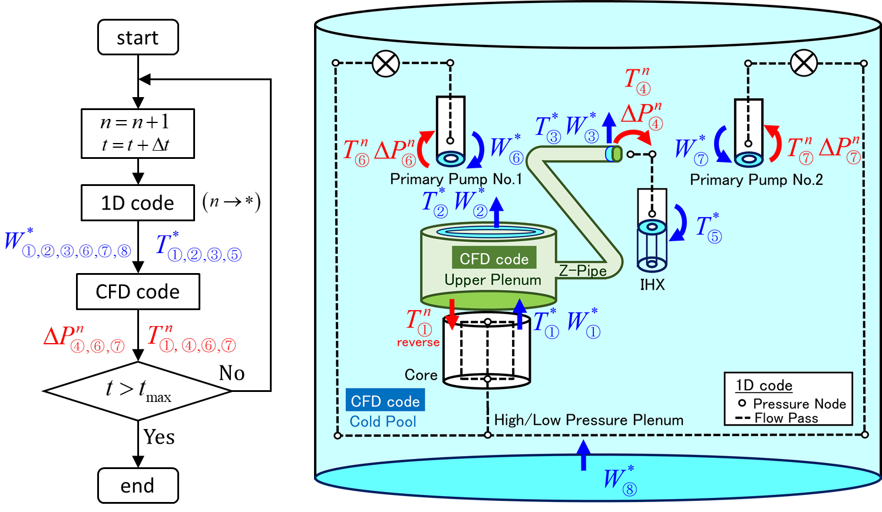
1D-CFD analysis model (SHRT-17 in EBR-II)
Trip
CFD code: ANSYS Fluent
Total cell number: 5 million
(Tetra formed meshes)
Flow network model for
plant dynamics analysis code (1D)
3D detailed model for CFD code
Outline of SHRT-17 test in EBR-II
Outline of CFD analysis conditions
Pressure-velocity coupling scheme |  | Coupled
Turbulence model |  | Realizable k-ε (Buoyancy effect: ON)
Wall function |  | Standard wall function
Discretization scheme | advection term | 2nd-order upwind
 | diffusion term | 2nd-order central-difference
Time scheme |  | 1st-order implicit
Time step |  | 0.1 s
: mass flow rate
: temperature
: pressure difference
Coupling method (sequential 2-way method)

Slide 13
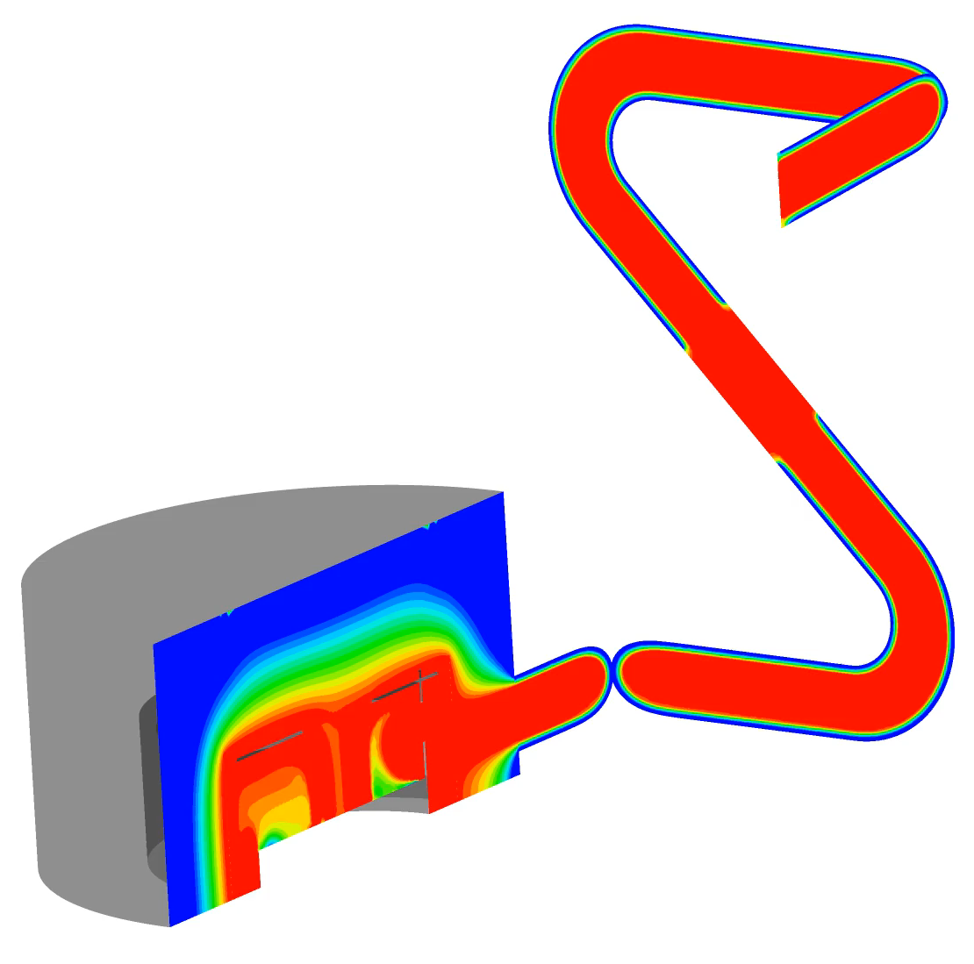
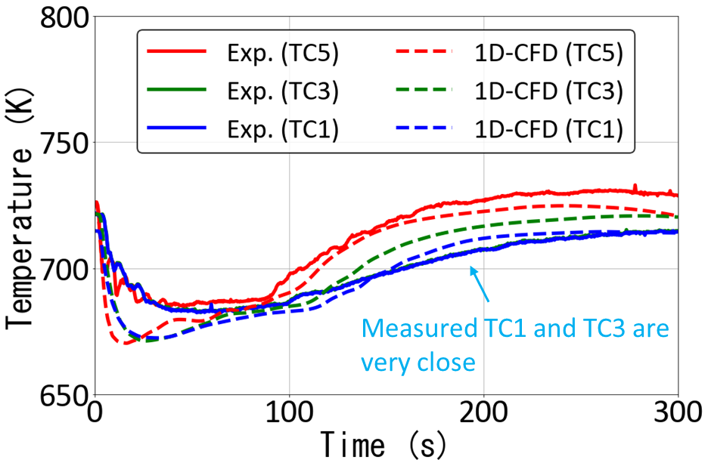
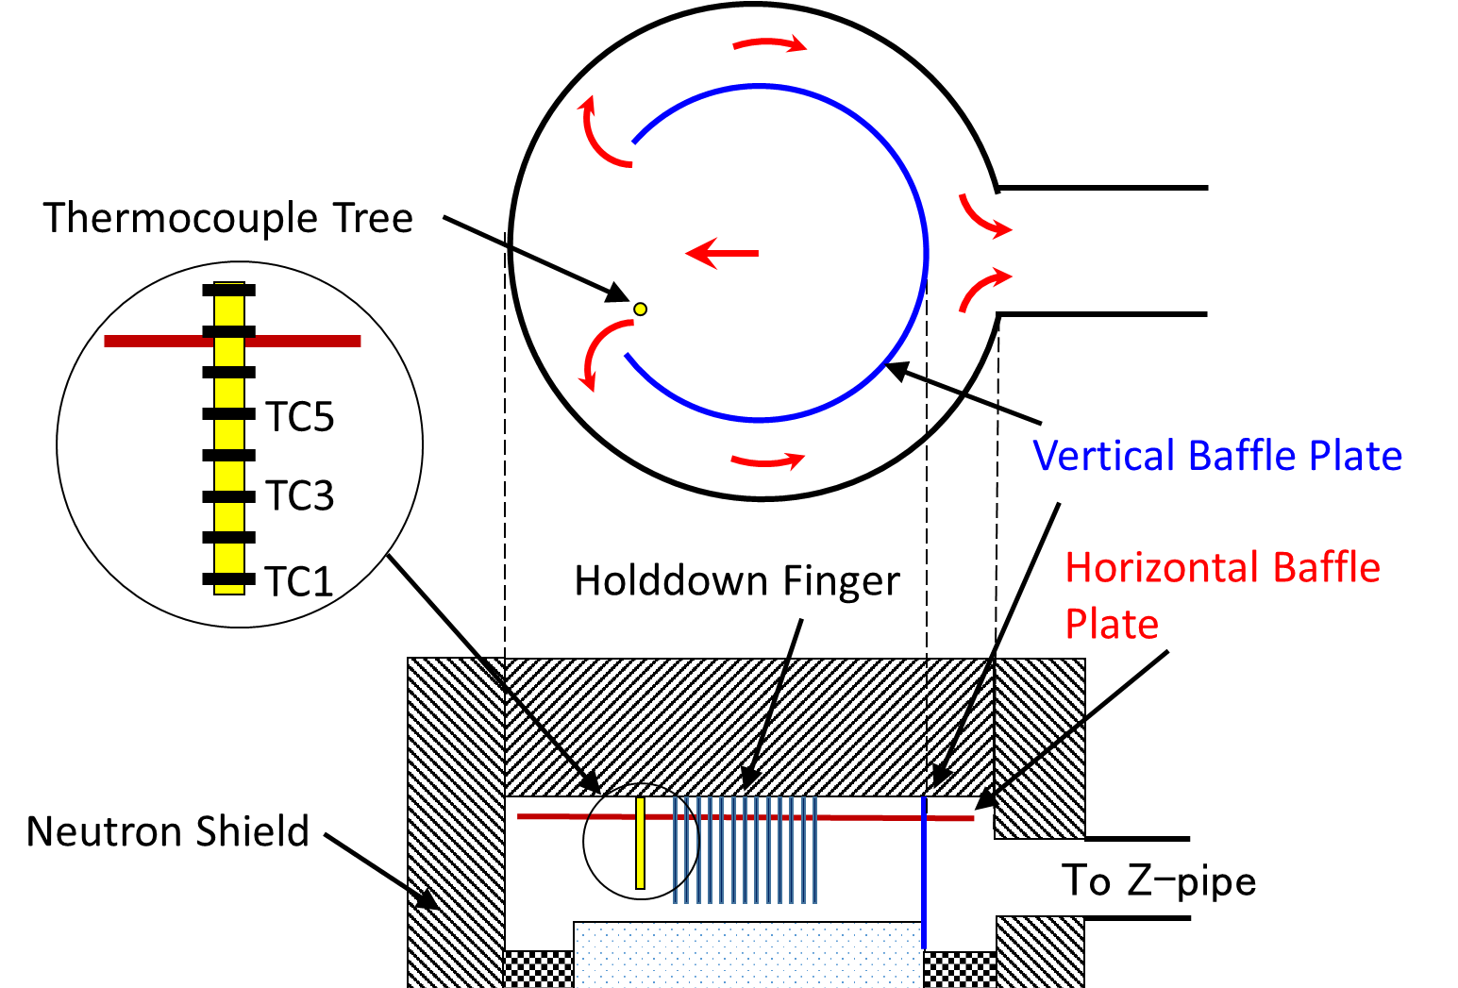
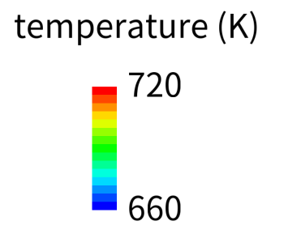

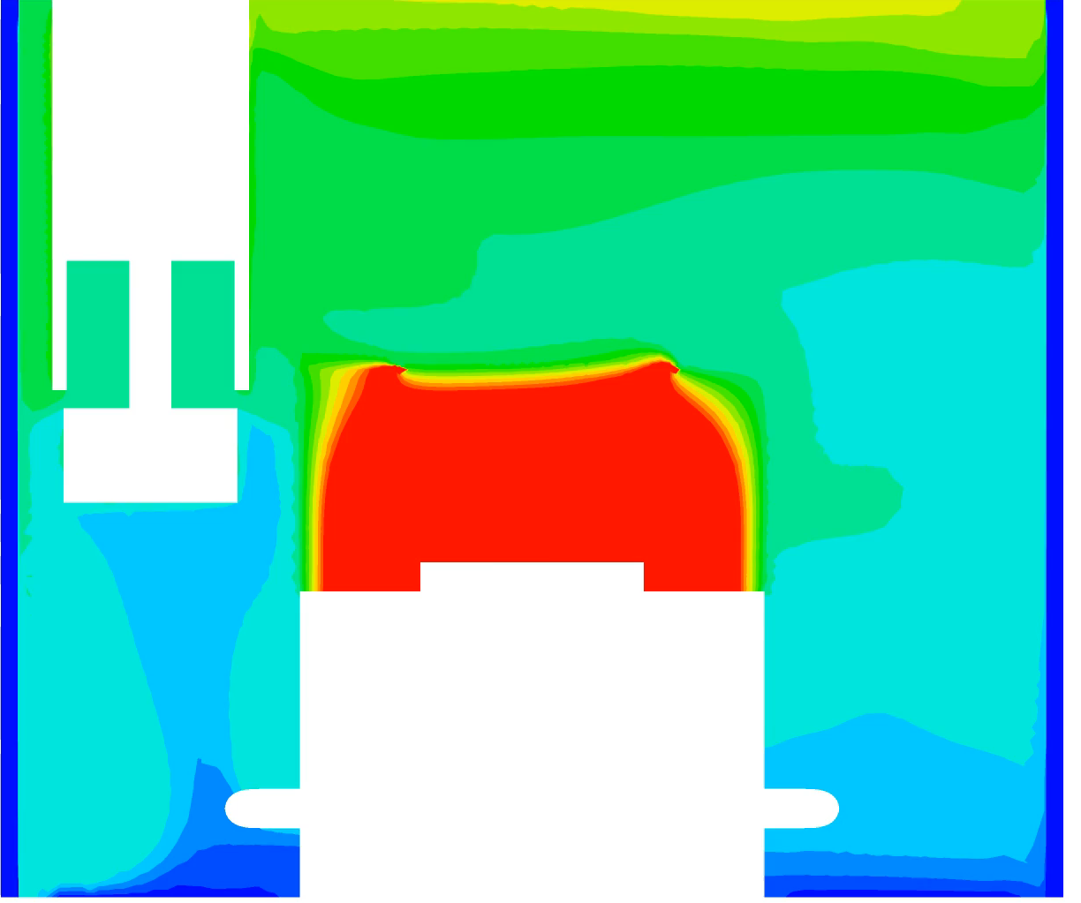
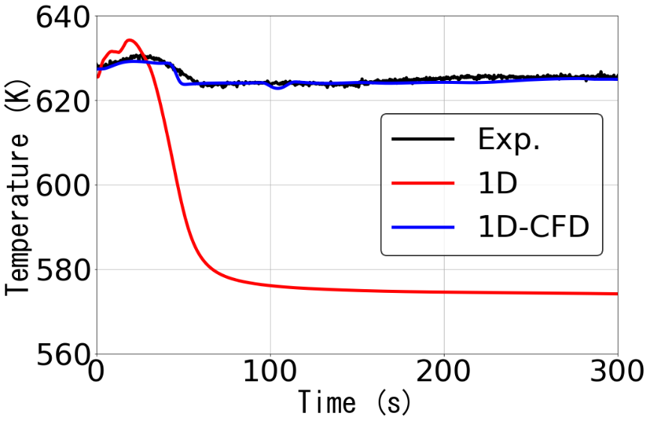
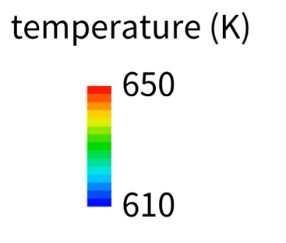
1D-CFD analysis results (SHRT-17 in EBR-II)
Measured TC1 and TC3 are very close.
TC tree location in UP
Temperature distribution in UP+Z
Results on TC tree
Temperatures on TC tree in UP was traced measured data except in initial 50 s in forced circulation condition.
IHX outlet temperature was captured well by 1D-CFD coupling analysis. Behavior of sodium flow discharged from IHX was not captured by 1D analysis.
:TC
Temperature distribution in CP
IHX outlet temperature
[UP: Upper Plenum, Z: Z-pipe, CP: Cold Pool, TC: Thermocouple]

Slide 14
Development of ARKADIA
  Development motivation
  Evaluation flow and system structure
  ARKADIA-Design and -Safety
Simulation technologies of ARKADIA-Design
  Module structure
  Validation analyses
Simulation technologies of ARKADIA-Safety
  Development motivation
  Numerical models
  Functional test analysis
Summary

Slide 15
Base module of ARKADIA-Safety
EAS
(Enhanced and AI-aided
optimization System)
VLS
(Virtual plant
Life System)
KMS
(Knowledge
Management
System)
AI-aided platform
ARKADIA-Safety
SPECTRA code for integrated analysis of in- and ex-vessel phenomena during SAs in SFRs
(Severe-accident PhEnomenological Computational tool
for TRansient Assessment)

Slide 16
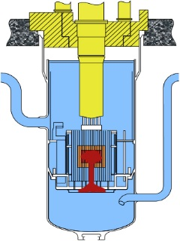
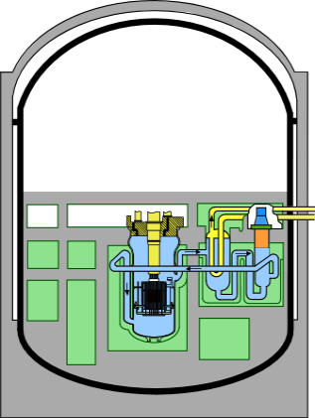
Development motivation
Initiating phase
Transition phase
PAMR/PAHR*
Ex-vessel phenomena
Event
progress
during SA
in SFR
Penetration
Results
Conventional
method
Code A
Code B
Code C
Code D
Evaluate in- and ex-vessel phenomena consistently by a single code
SPECTRA
Evaluation of multiple SA scenarios and parametric analyses by this single code
Optimization of a plant design from safety evaluation
* Post-Accident-Material-Relocation/Post-Accident-Heat-Removal

Slide 17
Selected phenomena during SA
: In-vessel
Atmospheric chemical reaction
Transport of fission products
: Ex-vessel
: Already incorporated
into the code
Containment vessel
Ex-vessel thermal hydraulics
Sodium fire
Secondary
cooling loop
In-vessel thermal hydraulics
Transport of fission products
Intermediate
heat exchanger
Neutronics and core disruption
Molten core relocation
Reactor vessel
Sodium-concrete interaction
Debris-concrete interaction

Slide 18


Analytical models
In-vessel
Behavior of coolant (base model)
  Fully-implicit, single-pressure, multi-component, multi-fluid CFD model
Molten core relocation
  Dissipative Particle Dynamics (DPD) method
Coupling of CFD and DPD
  Porosity and permeability in CFD
  Exchange of momentum and energy
Behavior of multi-component gas and aerosol (base model)
  Fully-implicit, lumped mass model considering compressibility
Sodium fire
  Spray and pool fire models
Sodium-concrete interaction
Debris-concrete interaction
Ex-vessel
Sodium
debris
Spray fire
Concrete
Pool fire

Slide 19
Functional test analysis (1/3)
In- and ex-vessel integrated analysis for hypothetical LORL* event
Upper part of CV**
70000[m³]
Air
1.0×10¹⁰
[m³]
0 s
Rated operation
Circulating pump trips
Heat removal by IHX stops
Sodium fire starts →(1)
200 s
Sodium-debris-concrete interaction starts →(2)
Air
2D Cartesian region
Circulating pump
Intermediate heat
exchanger
Air
1.0×10¹⁰
[m³]
(1)
Decay heat
Compartment
5000[m³]
N₂: 97mol%
O₂: 3mol%
(2)
*Loss Of Reactor Level
**Containment Vessel
N₂
Lower part of CV 1500[m³]

Slide 20
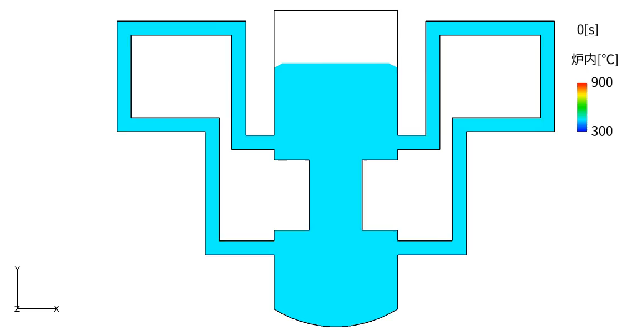
Functional test analysis (2/3)
This analysis starts from the condition of a uniform temperature.
The liquid surface fluctuation and the temperature change disappeared within a certain time.
The reached steady-state was used as an initial condition of LORL analysis.

Slide 21
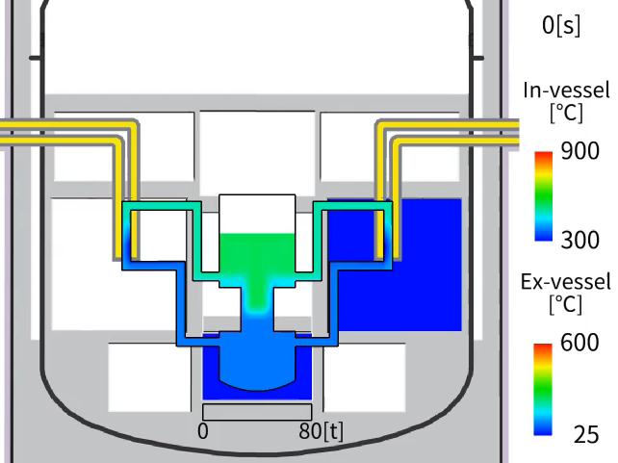
Functional test analysis (3/3)
In-vessel
Coolant level drops
Temperature in core region rises and molten core falls
Cooling path fails completely and coolant temperature rises
Ex-vessel
Atmosphere temperature rises due to sodium fire and sodium-debris-concrete interaction
Total mass of leaked debris
The SPECTRA code can evaluate the overall complex
thermal hydraulics phenomena.

Slide 22
Summary
ARKADIA
  ARKADIA has the computational methods linked with the knowledge base and AI to optimize plant design based on safety evaluation automatically.
Simulation technologies of ARKADIA-Design
  Technologies have been developed for design optimization of core, structure, and maintenance.
  As one of the technologies, the coupled analysis method for neutronics, core deformation, and thermal hydraulics, and also the 1D-CFD coupled thermal hydraulics analysis method was developed and applied to the existing experiments.
Simulation technologies of ARKADIA-Safety
  SPECTRA has been developed for integrated analysis of in- and ex-vessel phenomena during SAs in SFRs.
  The functional test analysis for the hypothetical LORL event was performed.
This work was partially supported by MEXT Innovative Nuclear Research and Development Program Grant Number JPMXD0220354598.

Slide 23
Appendix

Slide 24
Structure of KMS
Information Infrastructure
Design Criteria
Judgment Conditions
Evidence, etc.
To Support
designers evaluate and study designs
Technological achievements made through the development of MONJU
Database Group
Databases are organized to enhance usability
Design Documents
ARKADIA
-Design
ARKADIA
-Safety
Design Information
DB
R&D reports
Test Data DB
Knowledge Group
Systematizes large amounts of data on the basis of design approaches
Trouble / Maintenance DB
Domestic and Foreign Trouble Cases
To Support verification and validation of numerical analyses
・・・
3D Plant Data
Modeling Information
Test Data, etc.
・・・
Notes:
Knowledge management system, KMS consists of three layers.
Information infrastructure includes mainly documents of technological achievements made through development of prototype fast breeder reactor, MONJU, in Japan. For example, this layer includes design documents, R&D reports, and domestic and foreign trouble cases.
These information is compiled into a database and stored in the second layer. Second layer is called database group. In this group, databases are organized to enhance usability. This group includes design information database, test data database, and trouble / maintenance database, and so on.
Moreover, the database is systemized and stored in the knowledge group to support designers. This group systematizes large amounts of data on the basis of design approaches.
The knowledge group provides required information for ARKADIA-Design and –Safety.
Information infrastructure and database group will be utilized to support verification and validation of numerical analyses.

Slide 25
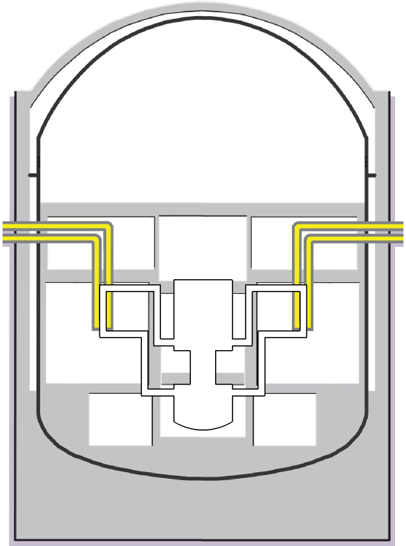
Example of optimization problem
Postulated event during SA
(1) Sodium leakage and combustion
(2) Increase of temperature and pressure
(3) Failure of containment vessel
(3)
Optimization of CV design considering SA
(2)
Size | Measures against sodium fire
Size A | Measure 1
Size B | Measure 2
・・・ | ・・・
Design
parameters
(1)
What is a best design?
Constraint condition
Satisfy requirements on safety and economics
Objective
Find best solutions (minimize objective function)
Reactor vessel (RV)
Containment vessel (CV)

Slide 26
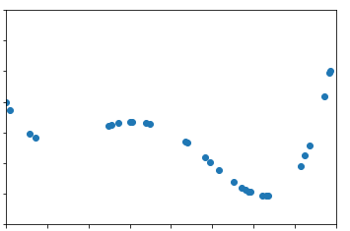
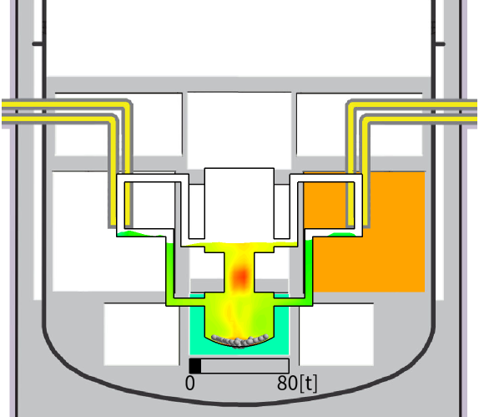
Optimization process
Neural Network
h₁
x₁
y₁
h₂
x₂
y₂
h₃
x₃
y₃
h₄
learning & searching
Objective function
Simulation
Design condition
Optimum solution

Slide 27
Dissipative particle dynamics
Dissipative particle dynamics (DPD) is an off-lattice mesoscopic simulation technique which involves a set of particles moving in continuous space and discrete time.
Particles represent whole molecules or fluid regions.
The particles’ internal degrees of freedom are integrated out and replaced by simplified pairwise dissipative and random forces, so as to conserve momentum locally and ensure correct hydrodynamic behavior.
The main advantage of this method is that it gives access to longer time and length scales than are possible using conventional MD simulations.
(https://en.wikipedia.org/wiki/Dissipative_particle_dynamics)

Slide 28
Validation of sodium fire model (1/2)
Sodium leak conditions:
3.3 g/s, 1505 s, 505°C
Computational setup
Pool fire experiment
Notes:
I will explain one example of validation of sodium fire model. Pool fire experiment was analyzed in this example.
Left figure illustrates test apparatus consisting of the stainless-steel vessel, liquid sodium discharging system, catch pan, air ventilation lines.
505°C liquid sodium was discharged from 0.1 m-height nozzle to the catch pan with the average leak rate of about 3.3 g/s for 1505 seconds. Liquid sodium fell with a column shape and formed a pool at the center of the catch pan. Air in the vessel was ventilated with a steady flow.
Computational model of this experiment consists of three control volumes and two flow paths as shown in right figure. The control
volume corresponding to the test vessel shown in left figure is connected to two environmental volumes. All parameters, such as temperature,
pressure, and gas composition are constant in the two environmental volumes. Velocity at the flow path connected to downstream side is kept
to constant, which corresponds to experimental condition. Liquid sodium is discharged as droplets at 0.1 m height from the catch pan for 1,505 s. Pool spreading on the catch pan is calculated by conservation equation.

Slide 29

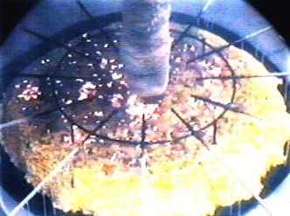
Validation of sodium fire model (2/2)
Rapid increase by combustion flame
Sodium leakage duration
Increase of
combustion rate
SPECTRA reproduced pool temperature transition reasonably except for the rapid increase by the combustion flame
Decrease by the effect of the combustion products
Notes:
This slide shows comparison of numerical results with experimental data. Numerical results by existing sodium fire analysis code, SPHINCS, are also plotted.
Left figure shows pool combustion rate and right figure shows pool temperature against time.
SPECTRA reproduced increase of combustion rate in early stage of this experiment. After sodium leakage finished, pool combustion rate decreased with a relatively high speed. This is due to the effect of the combustion products which covered the pool. Numerical analysis could not reproduce this behavior because this effect is modeled by simple assumption.
In the right figure, you can see rapid increase of pool temperature. This seems to be due to combustion flame. SPECTRA reproduced pool temperature transition reasonably except for the rapid increase by the combustion flame.
Numerical results by two codes almost completely agreed each other.

Slide 30
Current model for sodium-debris-concrete interaction
Sodium-concrete
interaction model (1D)
Debris-concrete
Interaction model (2D r-z)
The current model is unsuitable for a coexistence state of
sodium, debris, and concrete.

Slide 31
Design of ex-vessel integrated model
Sodium pool
Sodium-concrete interaction
Debris-concrete interaction
Non-damaged concrete
Transport calculation module
Individual phenomena calculation module
conditions
Atmosphere
(energy and mass)
Sodium pool fire
(heat and mass source)
Sodium-concrete interaction
(heat and mass source)
Sodium pool and concrete
(energy and mass)
Heat and
mass source
Debris-concrete interaction
(heat and mass source)

