Slide 1
Estimation of FPs Release
From Sodium Pools under BDBA conditions
In a Sodium Fast Reactor
Monica Garcia and Luis E. Herranz
Unit of Nuclear Safety Research
CIEMAT (Spain)
ESFR-SMART Horizon 2020 (contract number 754501)

Slide 2
CONTENTS
INTRODUCTION
DATA & MODEL ASSESSMENT
CIEMAT’s MODEL
RESULTS
FINAL REMARKS

Slide 3
INTRODUCTION

Slide 4
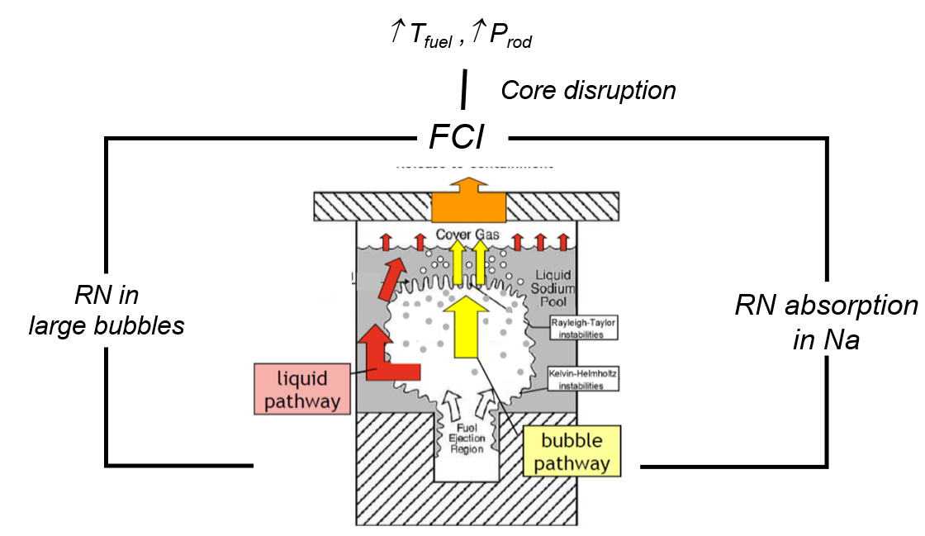
Source Term in BDBAs
Major Sources
“The bubble pathway”
Na-concrete interaction
Sodium fires
Transfer from hot sodium pools

Slide 5
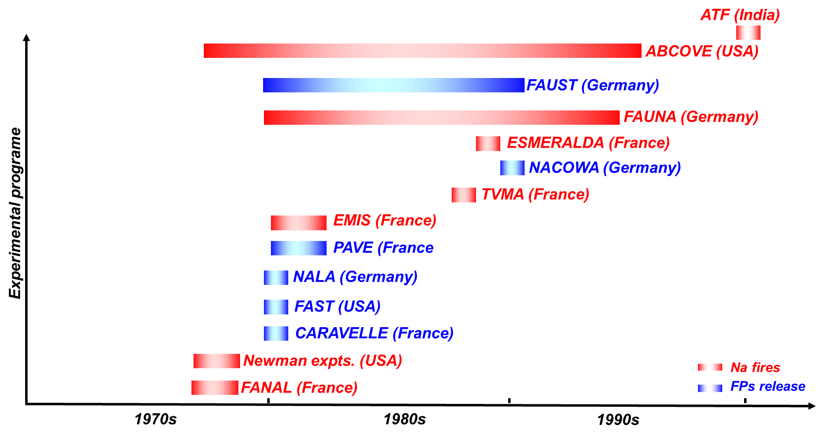
Database

Slide 6
DATA
&
MODEL ASSESSMENT

Slide 7
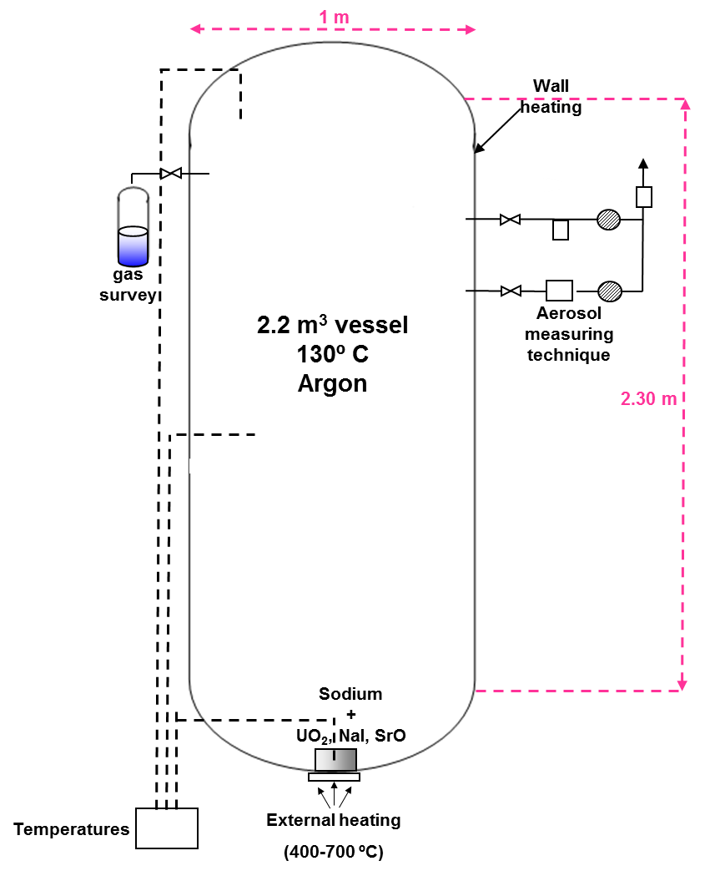
NALA Program
NALA II
Geometry | Values
Na pool area | 531 cm² (26 cm dia.)
Vessel | 2.2 m³ 2.30 m high
Tests conditions
Na | 1 kg
Na T | 600-900 K
Atm. gas | 400 K (Ar)
Contaminants | UO₂, NaI, SrO
NaI Tests
Exp. | T(K) | Na (g) | NaI (g)
T1 | 835.15 | 258 | 1.00
T2 | 905.15 | 1100 | 1.06
T3 | 754.15 | 1315 | 1.00
T4 | 769.15 | 1322 | 10.00
T5 | 837.15 | 1146 | -
T6 | 823.15 | 1321 | 0.20
T7 | 830.15 | 1007 | -

Slide 8
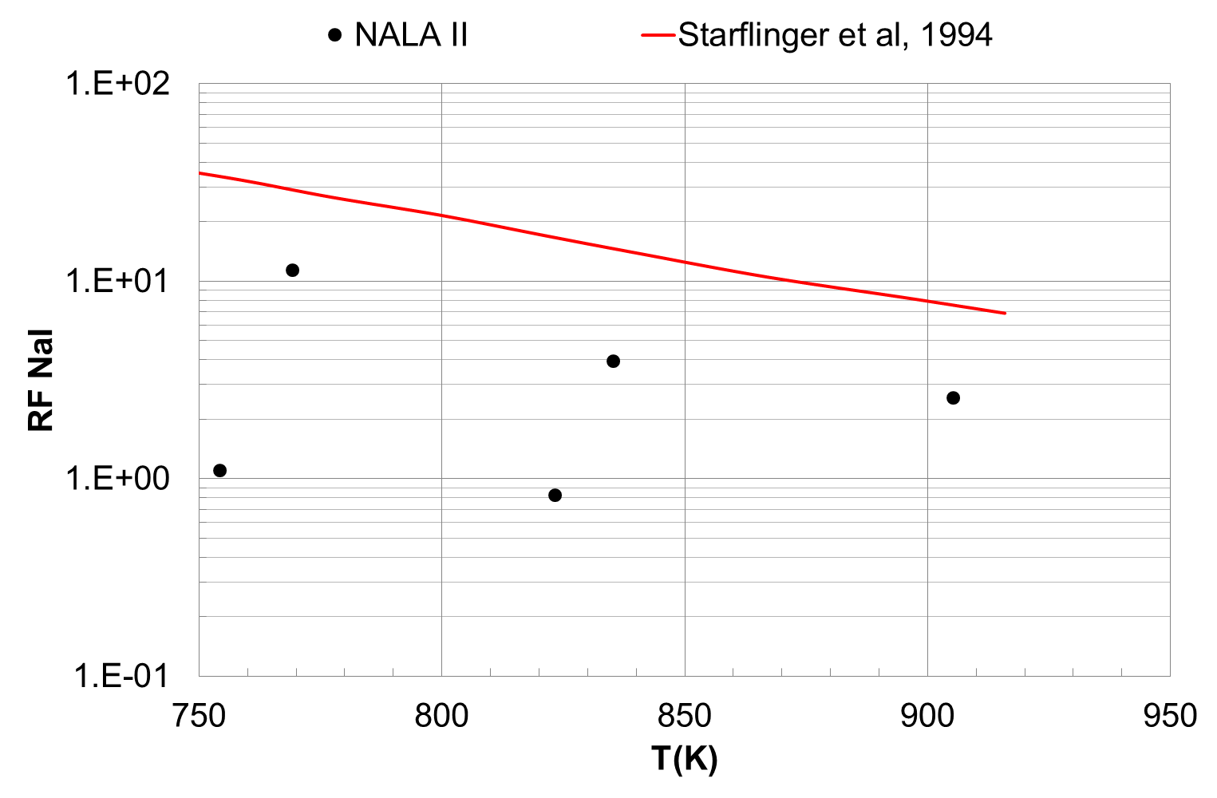
Results & Earlier Modeling
$$RF=\frac{{i_{Na}}/{m_{Na}}}{{i_{fp}}/{m_{fp}}}$$

Slide 9
Results & Earlier Modeling
$$RF=\frac{{i_{Na}}/{m_{Na}}}{{i_{fp}}/{m_{fp}}}$$
x 30
Fitted-to-data Sh_{Na}

Slide 10
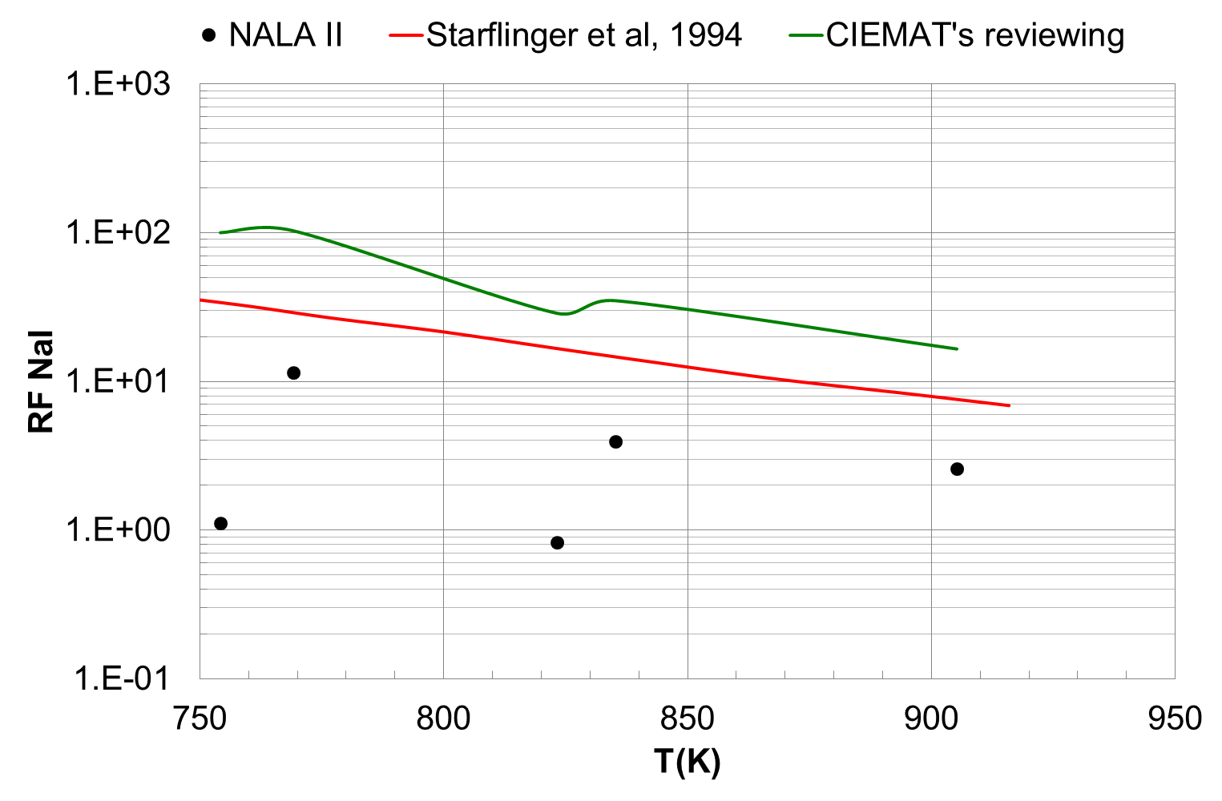
Model Assessment

Slide 11
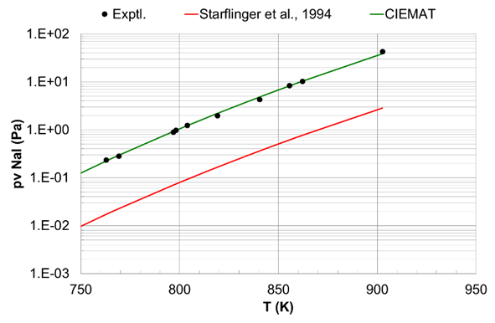
Model Assessment

Slide 12
CIEMAT’S MODEL

Slide 13
Extended Gas Mass Transfer model (EGMT)
Diffusion
Entrainment
HMT analogy
Raoult’s law
Nucleation φ_{Na}

Slide 14
RESULTS

Slide 15
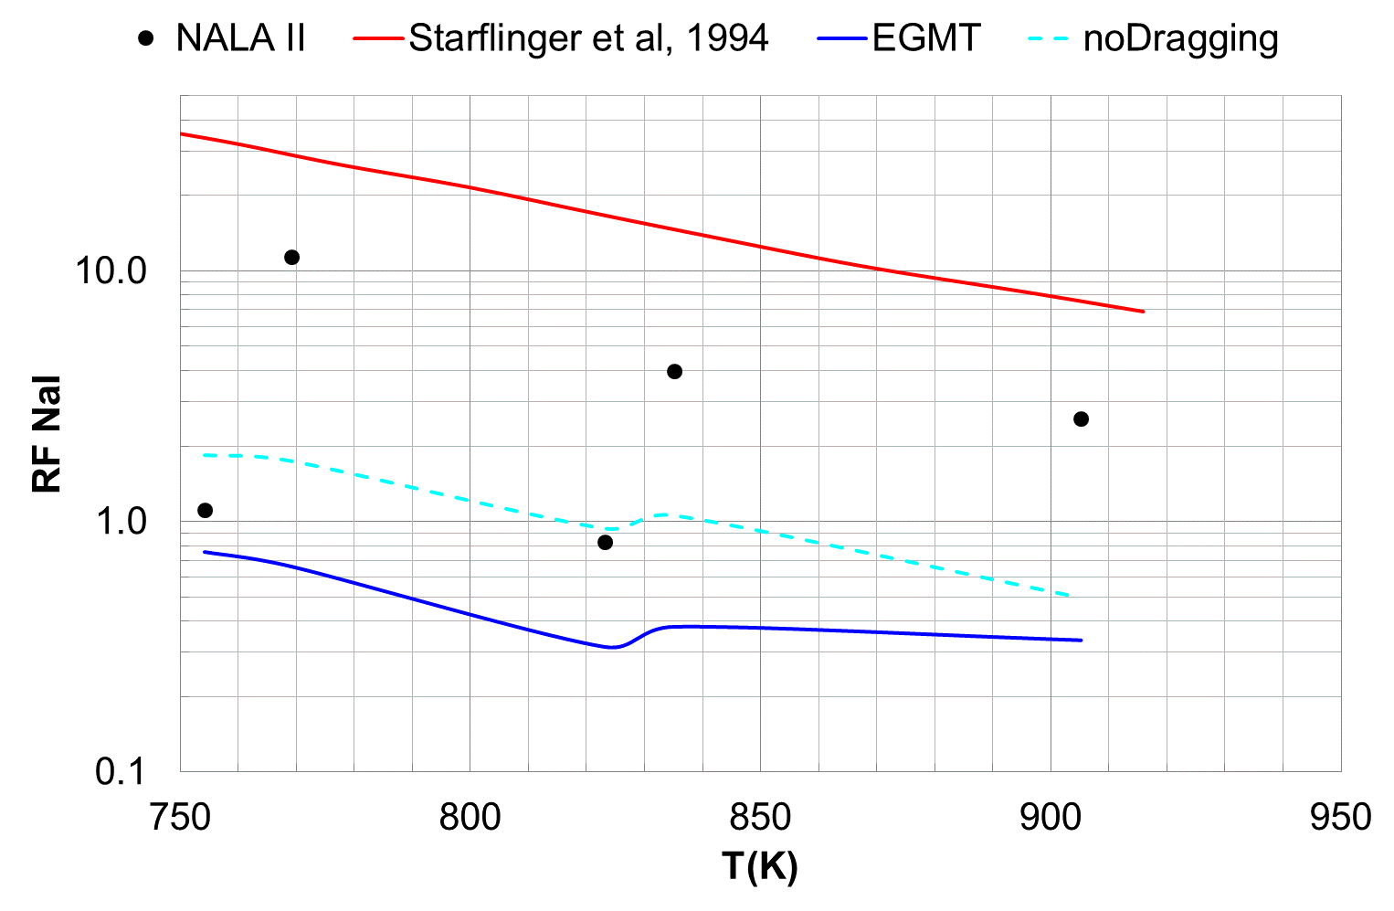
Model Benchmarking
x 15

Slide 16
FINAL REMARKS

Slide 17
An Extended Gas Mass Transfer model for volatile FPs (NaI) release from hot sodium pools has been proposed.
Enhancement achieved with respect to previous modeling:
- No fitting to data
- Consistency of the fundamentals
- Conservative nature (improvable accuracy)
Still room for enhancements (data limited; symptoms-based).
Extension of validation to NALA I conditions and other RN (Cs).

Slide 18
Thank you for your attention!

