Slide 1
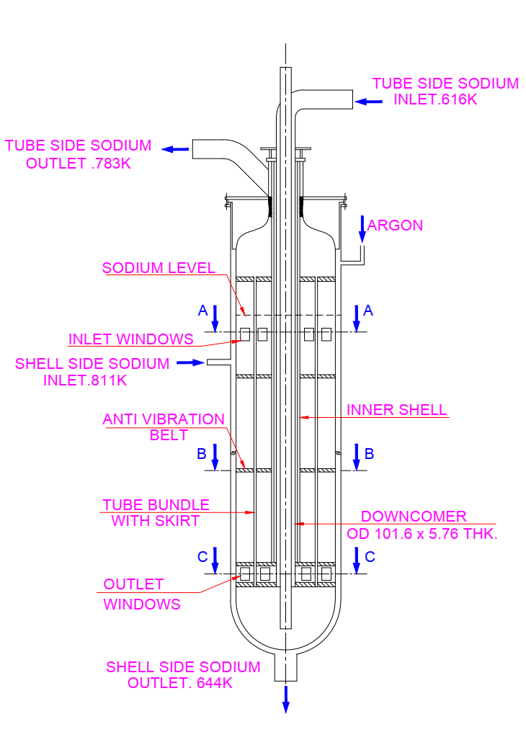
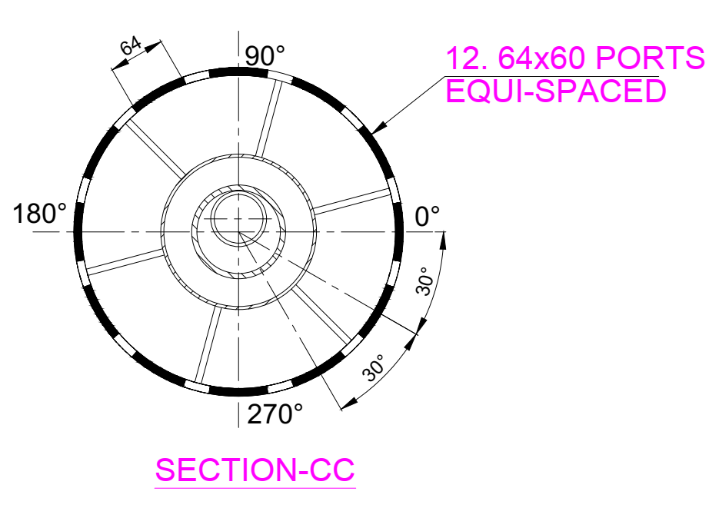
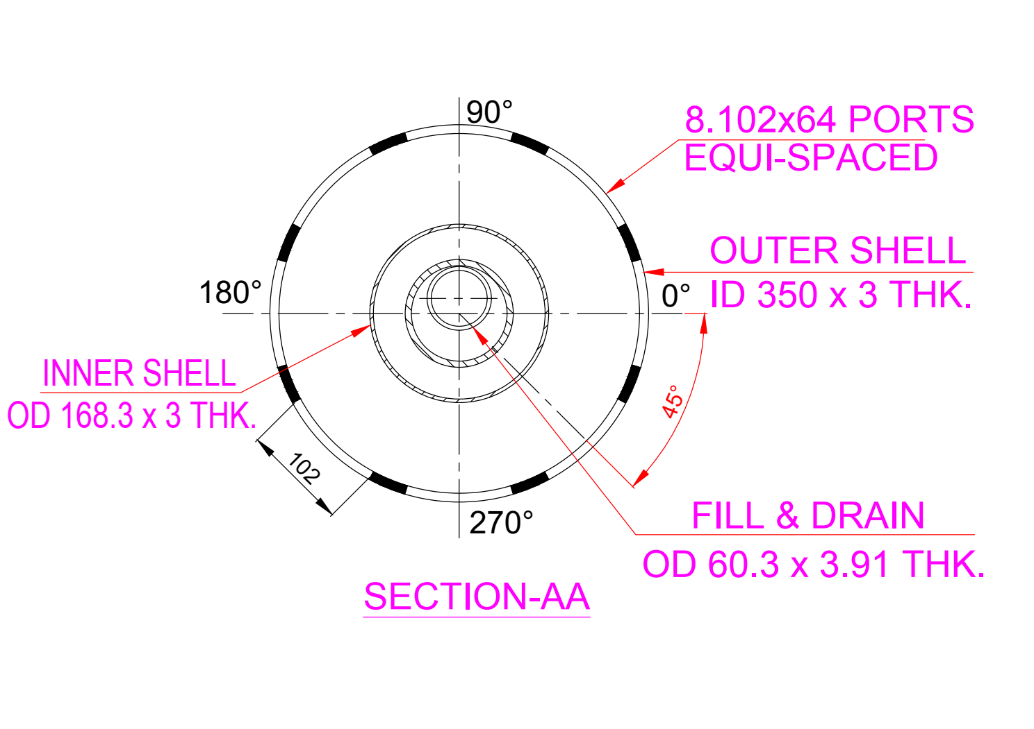
STANDARD CFD TECHNIQUE FOR SODIUM TO SODIUM HEAT EXCHANGERs
V. Sudharshan, Amzad Pasha, U. Partha Sarathy, S. Raghupathy, IGCAR, India
Sodium to sodium Heat Exchangers (HEs) are used for exchanging heat with primary system to minimize possibility of Sodium to Air/Water interaction.
The HEs are designed for the nominal conditions using the correlations available for the heat transfer and pressure drop estimations.
Detailed assessments of the HEs are required to confirm the design as there are uncertainties in the correlations, assumptions in the design and deviations in the geometries vis-à-vis the correlations etc.
A mathematical model would help in checking the ability of HEs to perform during their intended service conditions. Computational Fluid Dynamics (CFD) is an effective technique for the above mentioned purpose.
HE from reported literature is taken and the test conditions are simulated a standard CFD method for validation and results are reported.

Slide 2
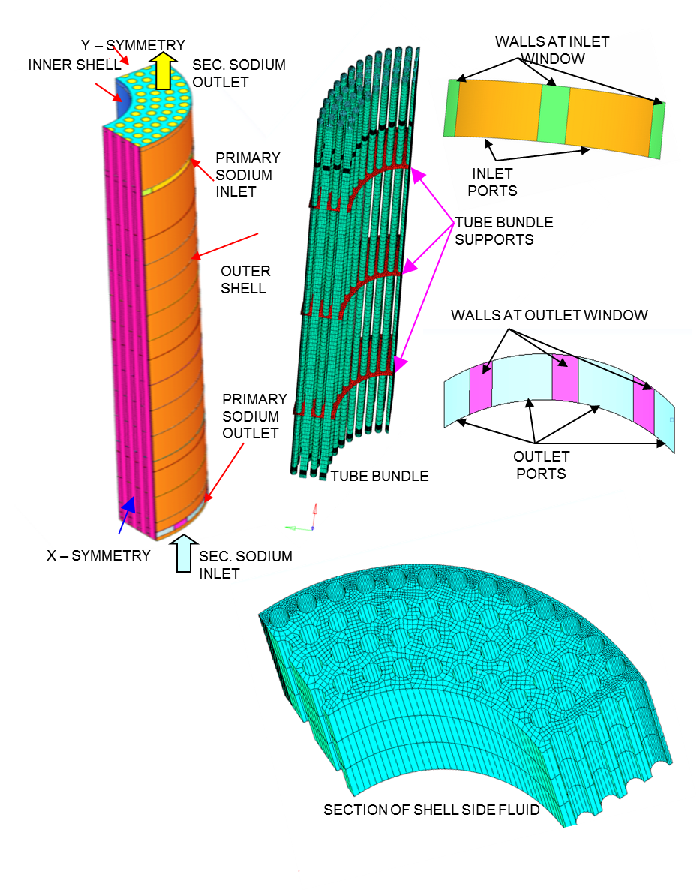
Description of the heat Exchanger
The HE is of vertical counter-current unit with a removable tube bundle installed in the loop such that the sodium flows in hot and cold conditions through the shell side and the tube sides respectively.
At maximum tested conditions, 10.86 kg/s sodium at 811 K flows into the shell side of the HE through the 8 No. of 102 mm wide x 64 mm height equi-spaced inlet ports, gets cooled and exits the HE through the 12 No. of 64 mm wide x 60 mm height equi-spaced outlet ports. Cold sodium at 616 K enters the tubes from the bottom tube sheet, flows upwards gets heated and leaves the HE through the top tube sheet.
Temperatures are maintained constant at the inlets to shell side. The outlet temperatures are measured for estimating the capacity of the HE.
GEOMETRY MODELLING
A 90° sector model of the HE between the top and bottom tube sheets is used for the study.. Both shell side and tube side fluids are considered for the study. The pressure drop offered by tube bundle supports at three locations is modelled using porous jump model with a specified pressure drop coefficient. Totally 48 tube surfaces are modelled with 6 semi tubes in consistency with symmetry of the arrangement. Shell side sodium region is discretized such that there are 3 cells between the tube surfaces, tubes are modelled as 16 node polygons with zero thickness. The number of cells used in the model are 6.6 lakhs.
Primary/shell side inlet (2.715 kg/s & 811 K)
Sec. / tube side inlet (2.715 kg/s & 639 K)

Slide 3
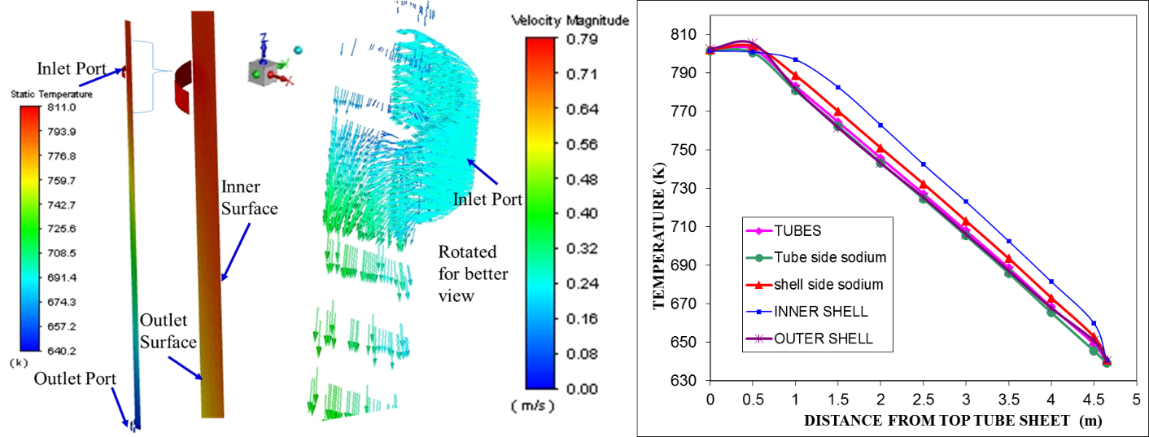
Boundary conditions & solution
Results and Observations
Conclusions
3 – D conservation equations are solved using FVM and steady conjugate heat transfer analysis of the HE is carried out.
.Boussinesq approximation s used for considering density changes.
The SIMPLE algorithm with first order up winding scheme is used for convective and diffusive fluxes at the interfaces. The k – ɛ realizable model with enhanced wall function is used. The y+ values are in the range of 2-394. The convergence criteria is set at 10⁻⁶ for the residue terms.
Uniform mass flux normal to the boundary along with the temperature are given as inlet conditions and pressure outlet boundary condition is specified at the outlets for both shell side and tube side fluids.
Tubes are defined as coupled walls with 0.91 mm thickness on the inner side. Inner-shell, outer-shell, top of bottom tube sheet, bottom of top tube sheet are defined as adiabatic walls.
The maximum error in predicting the heat transfer capacity is 3.8%.
Flow and Temperature distributions can be predicted with the methodology.
Higher temperature of the inner shell is due to the radial momentum of sodium in the inlet region.
13 K difference on the shell side exit is due to exit of hotter sodium from periphery.
Sodium from the tubes facing the hot sodium at inlet ports are more (4 K maximum).
The solution can be improved by modelling the inlet regions of the HE.
Evolution of temperatures in the HE
Evolution of temperatures in the outlet regions
Parameter | Literature | CFD | Error%
Shell side outlet temperature (K) | 654 | 649.2 | - 0.7
Shell Side heat transfer (kW) | 2160 | 2240 | + 3.7
Tube Side outlet temperature (K) | 795 | 801.7 | + 0.8
Tube side heat transfer (kW) | 2158 | 2239.9 | + 3.8

