Slide 1
K-ε POD ROM
Jorge Yanez

Slide 2
Introduction
Past: nuclear reactor design was based exclusively in experiments
Future: Experimental / Numerical approach
CFD predictions: describe accident scenarios complex transients
CFD based design CREDIBILITY
requires assessment of sensitivity on:
a) parameters
b) initial and boundary conditions
Strategy for error quantification:
post-processing CFD results
create very fast-running surrogate model
run the surrogate model for numerous varying cases

Slide 3
Introduction
Standard k-ϵ model workhorse of turbulent flow simulation
POD-Galerkin ROM suited for creation of surrogate model
Our model applies in nuclear field
Transient of natural convection refrigeration pools
Thermal-hydraulics of Lead-Cooled Fast Reactor, the Molten Salt Reactor and the Sodium-Cooled Fast Reactor

Slide 4
Model
Method of Snapshots, create data basis, for each variable, $v$, $T$, $k$, $ε$ separately at times $\left\{t_{1},…,t_{n}\right\}$
Matrix formed by snapshots + gradients. Carry out Singular Value Decomposition
Orthogonal basis of dimension n − j project n dimensional vector space in n − j reduced–sub-space
Rewrite equations into variational formulation. Re-express them in reduced order basis
Utilize a Hiper-reduction method to deal with non-linear terms
Obtain the final, linear model

Slide 5
Hiper-reduction model
Non-linear quantities in k-ϵ model: $ν_{t}=c_{μ}k^{2}/ε$ and $ε/k$
Treated utilizing Discrete empirical interpolation method (DEIM)
Calculating the values non-linear magnitudes in the CFD snapshots
Method of Snapshots: create a reduced basis of the non-linear variable
Calculate the variables in a set of points, the so called magic points
Resolve amplitudes in the reduced basis with set of magic points
Overdetermined: solution obtained through least squares
Cardinality of magic points is larger, but of similar order, than the reduced basis of the non-linear magnitude, and much smaller than the CFD calculation
Determined: Magic points selected utilizing a Greedy algorithm

Slide 6
Hiper-reduction model
Magic-points with point oversampling + random distribution strategy
DEIM methodology with rational functions = huge problems
k and ε are positive, large variation.Tiny denominator inaccuracy trigger 1/0
Inaccuracies coming from:
The deficiencies of the standard k-ε model
Numerical mistakes coming from the CDF
Mistakes coming from the ROM
Solution strategy
Identify domains where the mistake is high in snapshots
Exclude these domains from the reduced basis generation
Disregard the magic points included in these areas
Details in [31]

Slide 7
Final model
Final numerical system simple in spite of complex and tedious derivation
Matrices D, E, F, J and G complexity = reduced basis (25x25)
Linear system that can be solved efficiently
$$\left(D+\frac{Δt}{2}E+\frac{Δt}{2}FJ\right)\left(\begin{matrix}\vec{δu} \\ \vec{δT} \\ \vec{δk} \\ \vec{δε}\end{matrix}\right)−ΔtG=0.$$

Slide 8
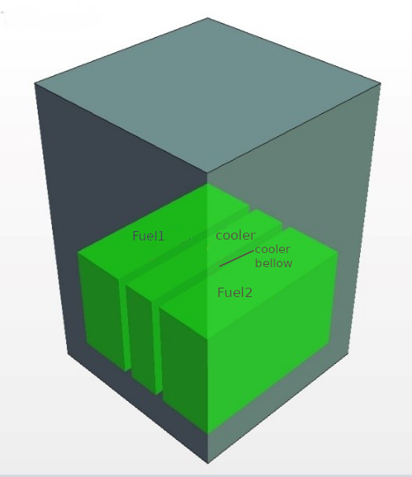
Spent fuel pool pools: cooling of the fuel rods
Short-lived isotopes decay
Reduces the ionizing radiation
Decay heat emanating from the rods, may generate heat transcients to be controlled

Slide 9
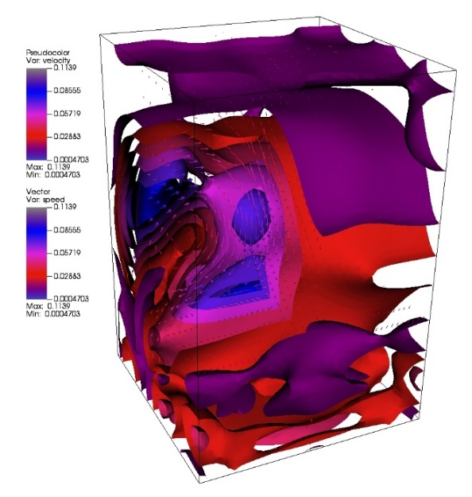
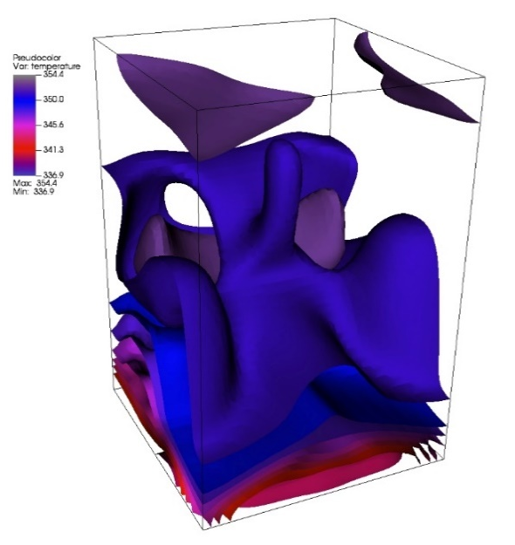
Initial conditions
Stagnant Initial conditions
In high-fidelity solver set up the sources and sinks
Run for a period of 150s
the flow has been established but still not stationary
Collect then our snapshots for the next 50s
Conditions at 150s, left

Slide 10
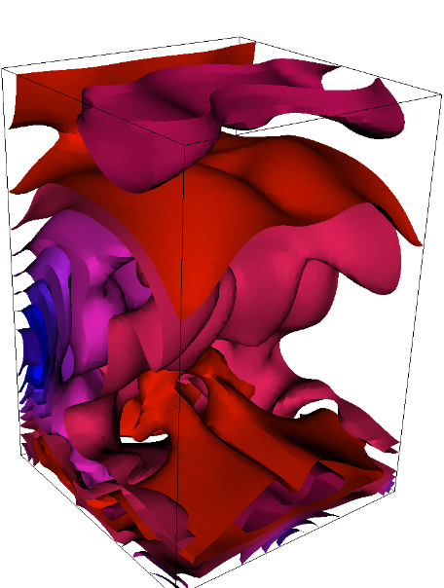
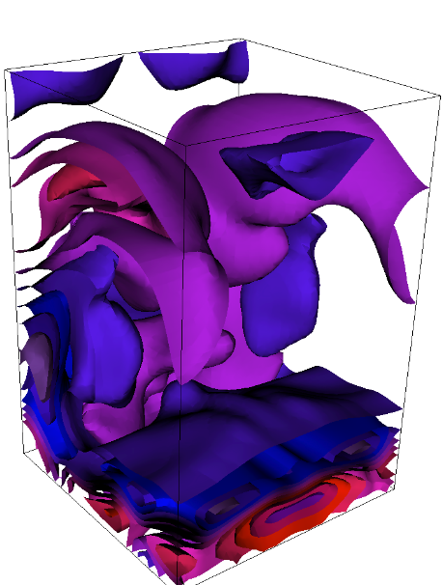
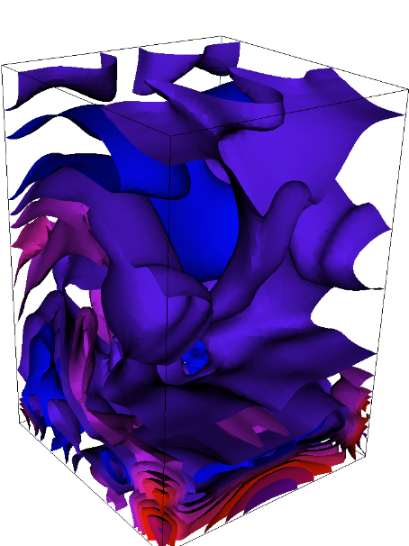
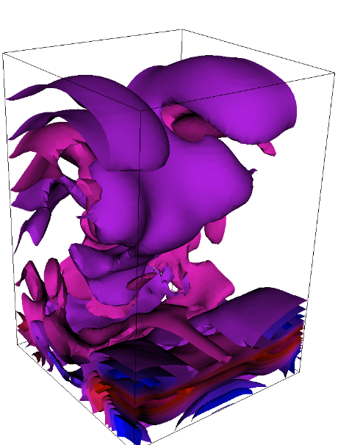
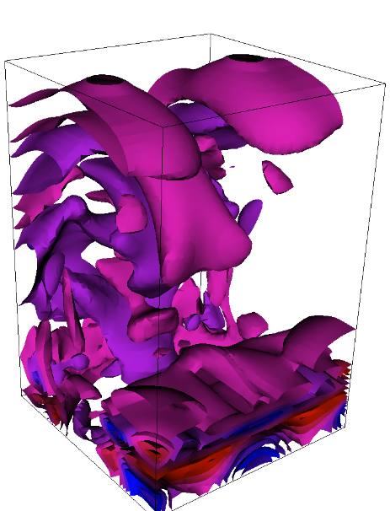
Reduced Basis
Dimensions: 5, 3, 5, 6, 5, 5, for V, T, k, ϵ, k²/ϵ, ϵ/k
Secondary: mistake analysis 6, 4, 7, 8, 6, 7, for V, T, k, ϵ, k²/ϵ, ϵ/k
First five basis vectors for the variable simulation for ε/k

Slide 11
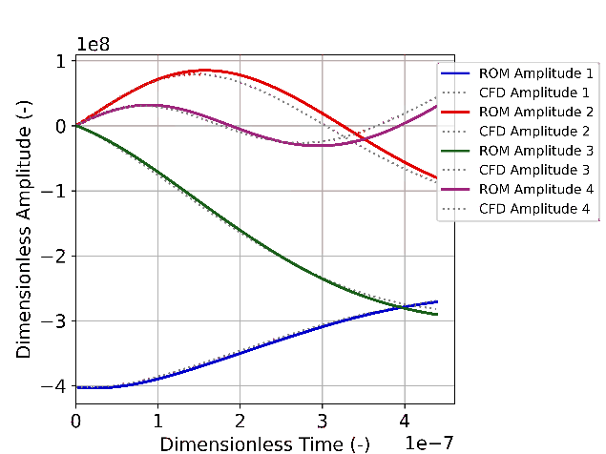
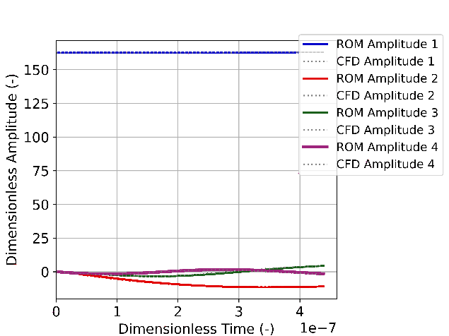
Results
Velocity
Temperature

Slide 12
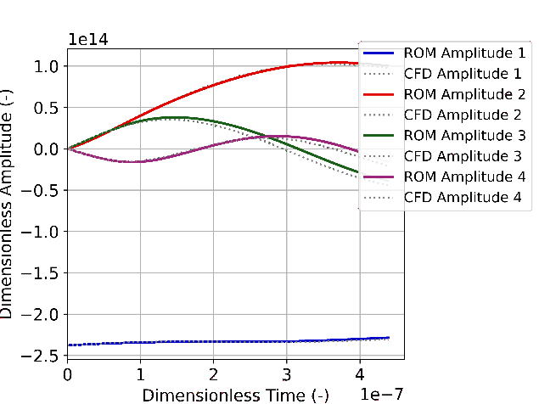
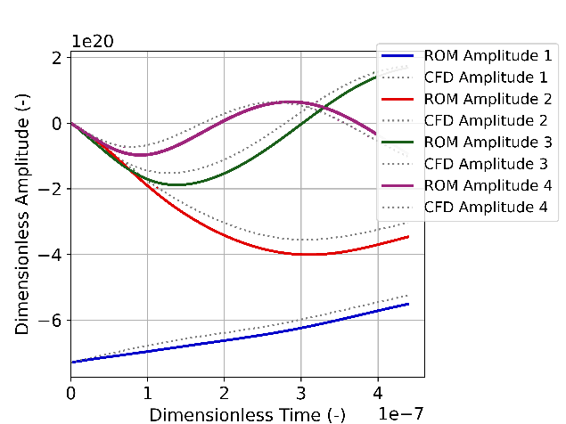
Results
k
ϵ

Slide 13
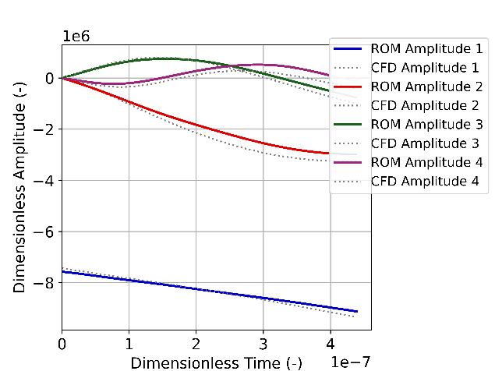
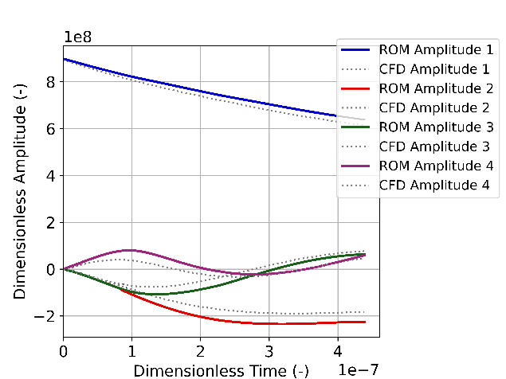
Results
k²/ϵ
ϵ/k

Slide 14
Conclusions
Successful creation reduced order model standard k-$ε$ turbulence
Complex formulation, tedious derivation BUT model adopts simple expression
On-line operations have only complexity of the reduced basis. Usage of DEIM methodology allowed treating complex non-linear terms efficiently
Usage of DEIM was difficult. Complex heuristic procedure developed allowed for practical usage. See [31] for details
Reproduced very well the CFD data with complexity of 25x25 system
Model to be extended to deal with complex boundary conditions
Suitable to assess the uncertainty quantification for those reactors utilizing uncompressible refrigerants, where the Boussinesq approximation is reasonable: Lead-Cooled Fast Reactor, Molten Salt Reactor and Sodium-Cooled Fast Reactor

