Slide 1
SAFETY REVIEW AND ASSESSMENT OF CORE THERMAL HYDRAULICS OF PFBR
ANANYA MOHANTY
SCIENTIFIC OFFICER-E
NUCLEAR PROJECT SAFETY DIVISION
ATOMIC ENERGY REGULATORY BOARD ,INDIA
IAEA Technical Meeting on State-of-the-art Thermal Hydraulics of Fast Reactor, September 26-30, 2022, C.R. ENEA, Camugnano, Italy
ATOMIC ENERGY REGULATORY BOARD,INDIA

Slide 2
Outline
Brief Description of PFBR
Thermal Hydraulic challenges
Safety Review Basis
Safety analysis and safety review of the following issues:
Thermal striping at core outlet
Stratification in pool
Free level fluctuations
Cellular convection
Natural convection and role of Inter-wrapper flow in decay heat removal
Summary

Slide 3
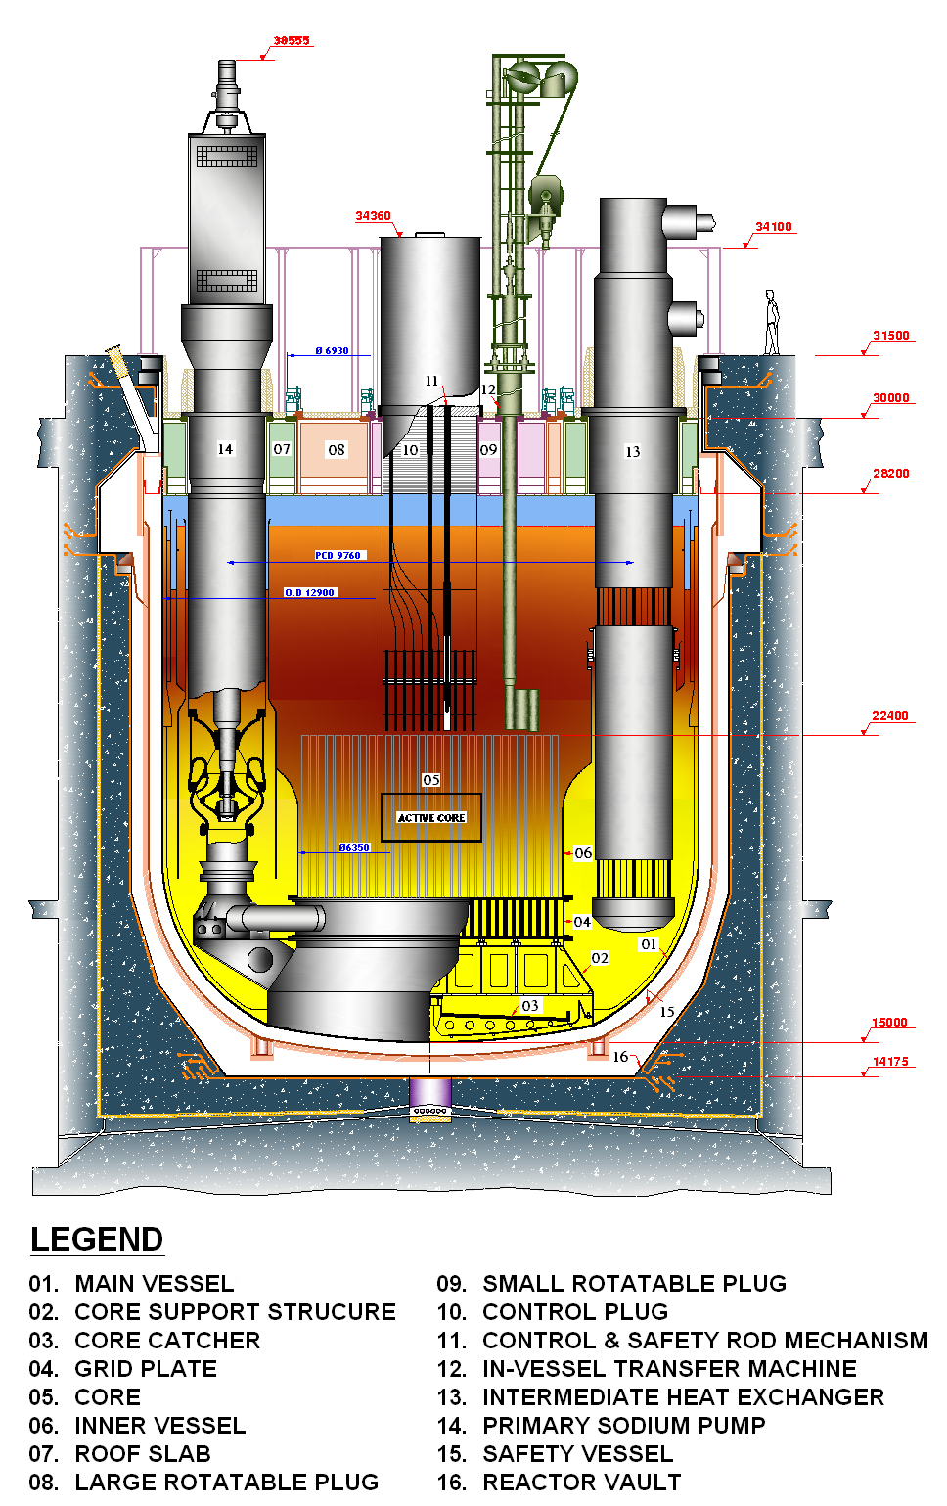
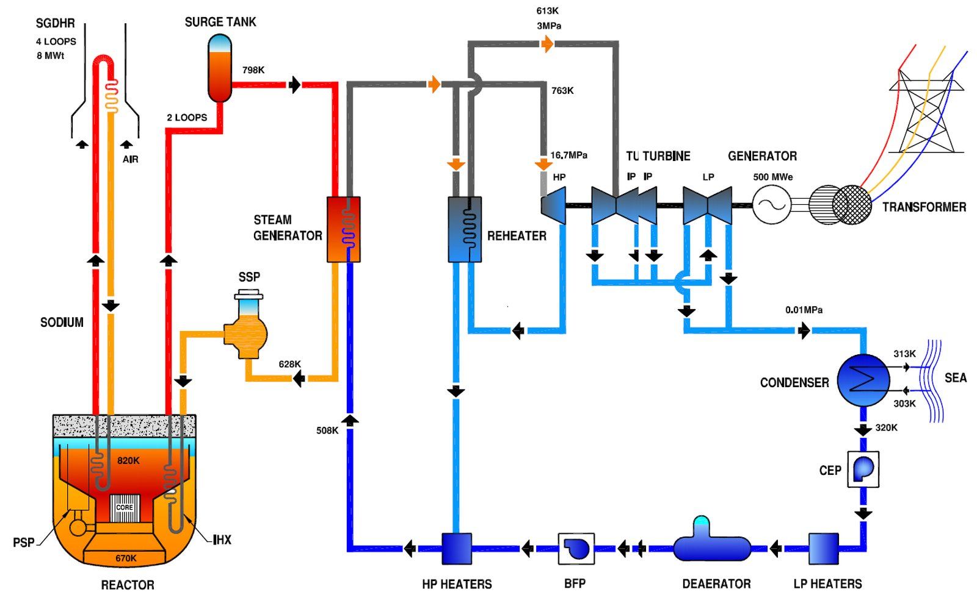
PFBR –Brief Description
Reactor Assembly
Heat transport circuits of PFBR

Slide 4
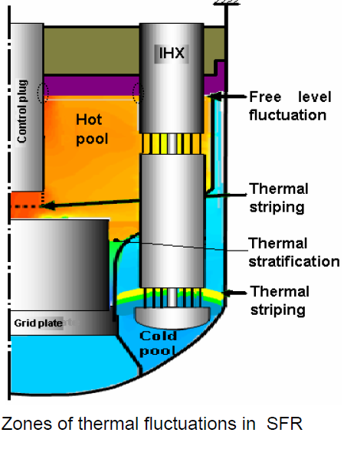
Thermal Hydraulic challenges
Higher operating temperature (~800 K)
Large temperature difference hot and cold sodium pools (150 K)
High thermal conductivity of liquid sodium
High heat transfer Coefficient (Bi~1)
Core components made up of austenitic stainless steel (high thermal expansion coefficient and low thermal diffusivity)
Interface with cover gas and high free surface velocity
Coexistence of forced and Natural convection
Gas entrainment
Risk of Reactivity transients
Role of Inter wrapper flow
Satisfying Design safety limits during accident

Slide 5
Safety Review
The guidance document - “Safety Criteria for design of PFBR” extensively followed.
Also, compliance with then “IAEA safety standard NS-R-1, Safety of Nuclear Power Plants: Design” was verified.
Multi-tier review in specialist group carried out of the TH design along with supporting experimental and analytical findings.
A separate task force reviewed computer codes (THYC 2D,3D,SWEPT etc) used for thermal hydraulics analysis-
Focus on code capability for analysing various event scenarios, modelling details, numerical methods used, validation problem definition and sensitivity studies
Benchmark experiments and Large scale water experiments for validation.
Structural design based on the French Code RCC-MR.
Safety code for Design of Fast Breeder Reactors (AERB/NPP/FBR/SC-D) is under development –
Review experience of PFBR and FBTR
Operating experience feedback ,Post Fukushima recommendations
Assessment of changes in national and international regulations etc.

Slide 6
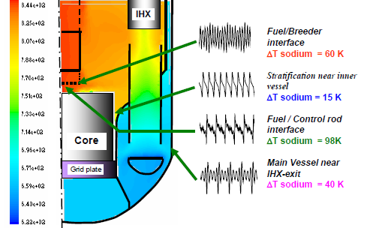
THERMAL STRIPPING at CORE OUTLET
Global conjugate 3-D simulation of symmetric sector of hot and cold pools to identify locations prone to thermal striping-
Fuel-breeder interface around the lattice plate
Fuel-breeder interface around the CCP
Bottom portion of ARDM
Main vessel near IHX outlet
DNS performed at these locations to predict detailed flow and temperature fluctuations.
Code validated with experiments conducted on lattice plate geometry which simulates the core cover plate of the control plug and parallel water jet model in collaborative study with IIT-Madras
The frequency of fluctuations 0.01 Hz to 10 Hz
ARDM shroud ∆Tsodium = 98 K , ∆Tsurface = 44 K
Lattice plate ∆Tsodium = 60 K , ∆Tsurface = 24 K
Main vessel ∆Tsodium = 40 K , ∆Tsurface = 20 K only at IHX outlet.
The peak to peak temperature fluctuations on structures has to be limited to 60 K for control plug and 40 K for main vessel and inner vessel
Key findings :

Slide 7
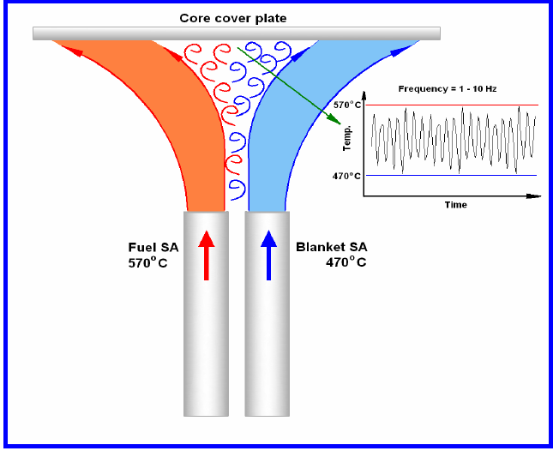
THERMAL STRIPPING at CORE OUTLET
Design criteria:
Mean coolant outlet temperature from SA shall not differ by more than 100 K
Fuel pin bundles incorporated in source SA as heat generation is low.
The Safety criteria for Design of PFBR:
“Components constituting the reactor core shall be designed and mounted in such a way that they withstand the static and dynamic loading expected in all operational states and accident conditions so that core integrity is maintained to ensure safe shutdown and adequate cooling is maintained so that design limits are not exceeded”.
The latest AERB draft Safety Code for Fast breeder reactors:
“The reactor assembly components shall be designed with due account taken of the creep properties, thermal striping, fast neutron induced changes, other ageing effects, and the material compatibility with sodium and its compounds. The design shall take into consideration the behaviour of boundary material under operational, maintenance and testing conditions and in design basis accidents, taking into account the expected end of life properties (which are affected by creep properties, erosion, thermal striping, fast neutron fluence, and other ageing effects, as well as its compatibility with sodium, and with thermal stress and dynamic load on thin-walled structures used under low pressure and high temperature conditions), any uncertainties in determining the initial state of the components, and the rate of possible deterioration” .
Regulatory requirements

Slide 8
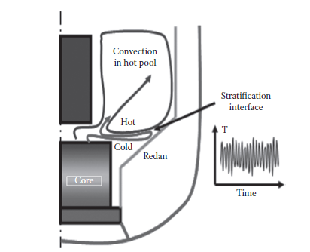
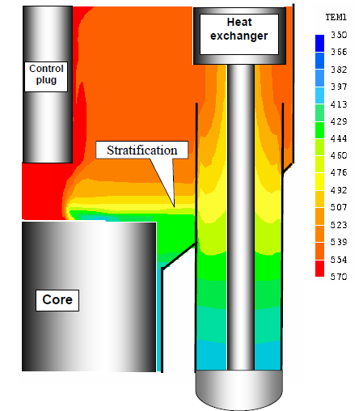
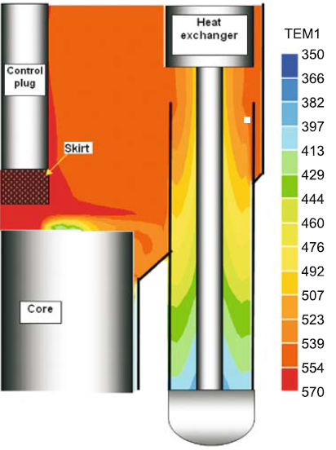
Stratification in pool
Hot pool temperature field (⁰C) without skirt [11]
Hot pool temperature field (⁰C) with skirt [11]
Large ∆T between the hot pool (820 K) and cold pool( 670 K).
The redan portion of IV most affected location.
Stratified layers oscillates over the range of 50-150 mm with frequencies of 0.1 Hz to 1 Hz.
Develop T-H limits for IV
The 3-D TH code PHOENICS
Initially , stratification observed even at full power conditions with a Richardson number (Ri) ~ 0.25.
A perforated shroud with 10 % porosity introduced at the bottom of the control plug.
The Ri with skirt reduced to ∼ 0·065
Conjugate heat transfer analyses indicate gradient of 100 K/m at critical junction between the lower shell and the redan.(< 300 K/m)
The maximum temperature drop across the thickness of the vessel is 64 K
Creep fatigue damage is 0.1

Slide 9
Stratification in pool
Initial design : Core flow proportional to reactor power to maintain (∆T ~150K ) at all power levels
Stratification at low flow conditions even with skirt.
Change in operating philosophy : Choice of core flows such that the Ri is same as that in full power (∼0·065).
The core sodium flow rate is not proportional to reactor power.
The flow fraction at part load condition is always more than the power fraction ,∆T is less at low power than at full power.
Regulatory requirements
The Safety criteria :
“Components constituting the reactor core shall be designed and mounted in such a way that they withstand the static and dynamic loading expected in all operational states and accident conditions so that core integrity is maintained to ensure safe shutdown and adequate cooling is maintained so that design limits are not exceeded”.
AERB/NPP/SFR/SC-D :
“Design of the reactor core components shall account for the static and dynamic loadings expected under operational states and design basis accidents with due regard to the effects of temperature, pressure, irradiation, ageing, creep, corrosion, erosion, vibrations, fatigue etc”.

Slide 10
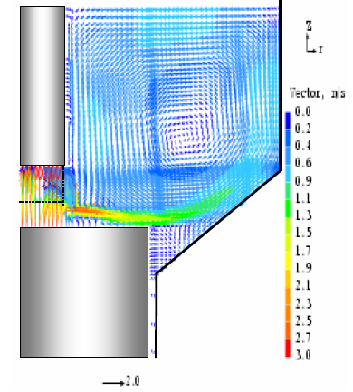
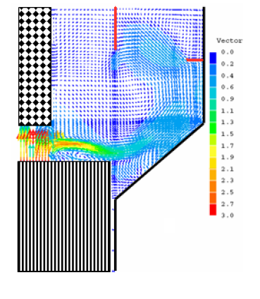
Free level fluctuations
Investigations for gas entrainment
Experiments in SAMRAT- ¼ scale water model of PFBR
Horizontal jet velocity of entering hot pool is 3 m/s ,Max horizontal velocity is 1 m/s at the surface.
Free surface velocity (Vfs) < 0·5 m/s to avoid gas entrainment.
Baffle plates were introduced on IV to break the jet velocity.
Flow fluctuation by varying the plate shape, size and location performed by 3-D CFD code PHOENICS
A horizontal baffle (0.5 m) on IV upper shell & lowering the RS inner shell upto IHX inlet, resulted in Vfs ~ 0.4 m/s
Flow distribution in a vertical plane between 2 IHX [11]

Slide 11
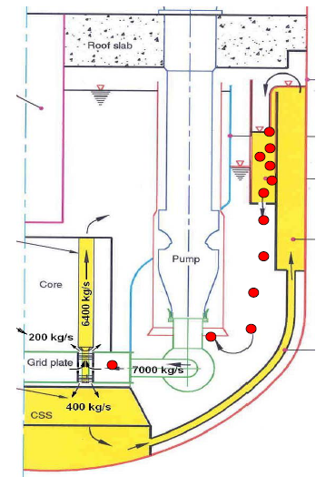
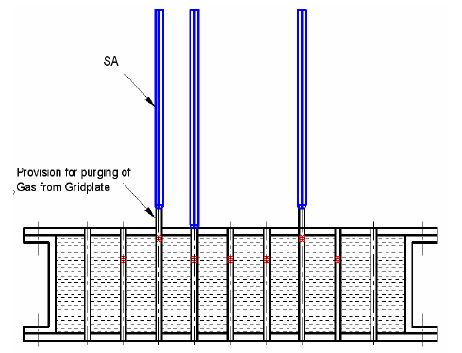
Gas entrainment through MV cooling weir
Full scale slab model experiments indicated
Gas bubbles entrain for all heights > 100 mm
All entrained gas bubbled out to free surface after (penetration depth 700 mm)
Sufficient (~ 3 m) height available in collector plenum
The possibility of argon gas entering the pool due to differential solubility and leakage through T/Cs or ARDM – will bubble to the cover gas directly.
6 Purger SAs provided at the core periphery in case of gas entry into the grid plate

Slide 12
Investigations for structural integrity of IV
Experiments on scaled down models: oscillations of the hot pool mean level is of the order of 40 mm and frequency ~1 Hz.
Fatigue analysis indicated that amplitude of level oscillations < 55 mm, to prevent failure due to thermal striping in IV.
The level oscillations can be measured with hot pool level detectors.
Regulatory requirements
AERB/NPP/FBR/SC-D:
“The primary coolant circuit shall be designed to prevent ingress of oil or gas into it. In case of insertion of gas or oil, the likelihood of which shall be remote, the resulting reactivity change shall be within the capabilities of the shutdown systems”.

Slide 13
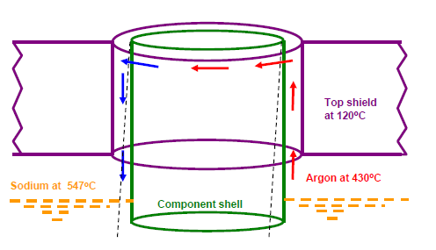
CELLULAR CONVECTION
Reactor Top shield is in contact with cover gas at ~ 700 K at the bottom and RCB atmosphere at the top.
A warm roof concept has been adopted in PFBR-Air cooling system is in each compartment to maintain T ~393 K.
This is achieved by provision of a cooling system within top shield using air as the coolant
The penetrations in RS (CP-SRP ,LRP-SRP, Pump-IHX) form annular enclosures with large aspect ratios ( H=2 m, w = 10-20 mm) resulting in asymmetric convection.
Investigations
Analysed using in-house developed code THYC-2D and by commercial CFD code STAR-CD.
Circumferential ∆T in gas decreases with height and ∆Tmax occurred at the bottom of the annulus.
For primary pump penetration, the mean circumferential ∆T in the pump penetration shell in RS (which is cooled by air) is 18 K and that in the shell forming part of the pump (where there is no cooling) is 38 K
Thermal stress analysis indicate max. stress at the vicinity of the bottom plate ~ 34 MPa.
Along with NC ,surface radiation plays an important role.

Slide 14
CELLULAR CONVECTION
The radial temperature gradient in the sectors is estimated to be ~12 K against the acceptable limits of 30 K.
The 3-D CFD simulations validated against the experiments carried out in full scale model of Large component Test Rig (LCTR) at IGCAR and the COBA experimental facility .
The circumferential ∆T observed in the experiments ~10 to 15 K
Regulatory requirements
AERB/NPP/SFR/SC-D :
“Auxiliary cooling circuits (like reactor assembly top shield cooling, reactor vault concrete cooling) shall be designed with sufficient capacity and redundancy to remove the heat from the sources to the ultimate heat sinks without exceeding the specified limits during all the operational conditions and design basis events. Considerations shall be given for the compatibility of fluids in the two circuits”

Slide 15
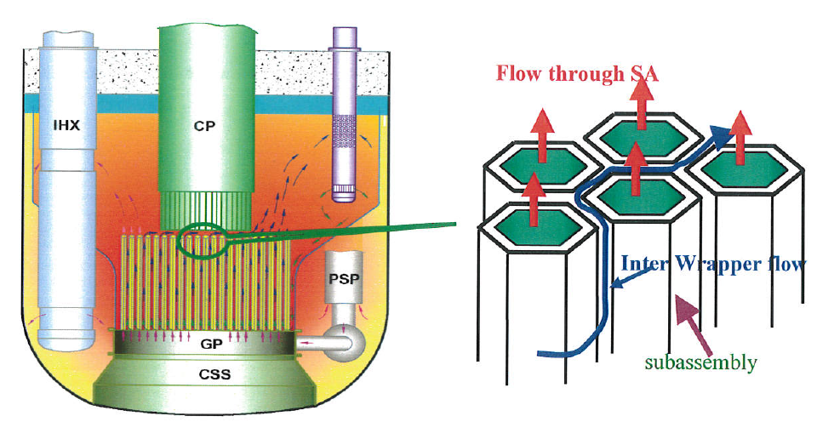
NATURAL CONVECTION AND ROLE OF INTER-WRAPPER FLOW IN DECAY HEAT REMOVAL
Initial 1-D studies indicated that heat removal by the IWF is significant and can reduce SA peak temperatures especially during the onset of natural circulation.
Extensively reviewed by AERB,
Multiscale problem : IWF (order of 3mm) w.r.t hot pool (dimensions in order of 10 m) and needs 3-D analysis and validation against experimental data.
Conduct various SGDHR experiments demonstrating NC inside the reactor pool, carry out parametrical studies of natural circulation and address all the uncertainty in parameters
The event of SBO ,analysed by 3-D coupled CFD code STAR-CD validated against Phenix data.
A 360 degree sector model for hot pool and cold pool integrated with 1-D model of secondary sodium circuit
Investigations

Slide 16
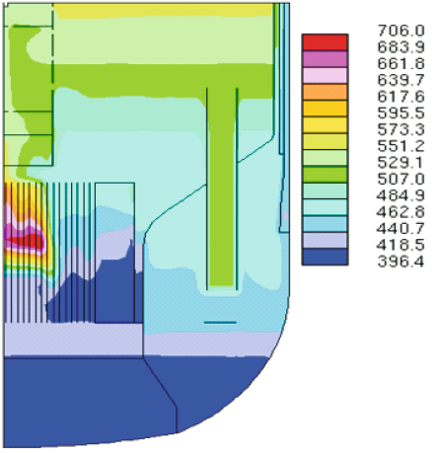
NATURAL CONVECTION AND ROLE OF INTER-WRAPPER FLOW IN DECAY HEAT REMOVAL
For IWF : Porous body approach ,pressure drop and heat transfer correlations have been developed by detailed 2-D CFD analysis.
KEY FINDINGS
The Toutlet of FSAs & BSAs marginally lower (3-5 K) compared to those estimated by heat balance calculations.
The Toutlet from peripheral SAs are higher (by 3K-13K) - heat absorption from IW sodium to the sodium flowing inside SAs.
Reduction in peak temperature by about 20 K in the fissile core and 60 K in the blanket zone.
20% uncertainty in pressure drop and heat transfer correlations resulted in negligible variation in fuel SA and hot pool temperatures.
Pool temperature (⁰C) at 490 s after the event.[11]

Slide 17
NATURAL CONVECTION AND ROLE OF INTER-WRAPPER FLOW IN DECAY HEAT REMOVAL
Safety review
A quantitative estimation should be carried out by experiment :
IWF plays a major role in satisfying design thermal limits of fuel SAs during certain categories of events, (e.g. for the case of Station Black-out and both the pony motors not operating)
The storage SA temperature limits respected with the consideration of IWF only, during decay heat removal by SGDHRS.
Experiments
To study the pool hydraulics during SBO ,experiments were carried out in SAMRAT experimental facility (1/4th scale model PFBR) using water as stimulant.
In case of heat removal by IWF alone there was a 20% rise in the temperature gained by the water in core compared to normal case which indicates the significance of heat removal by IWF
An IWF Slab Model (Water Model) which is a 1:1 scaled slab model of the reactor with fuel and blanket SA was simulated. The approximate contribution of the IWF to the core heat removal was found to be 25 % as per Particle Image Velocimetry (PIV) measurements.

Slide 18
NATURAL CONVECTION AND ROLE OF INTER-WRAPPER FLOW IN DECAY HEAT REMOVAL
Regulatory requirements
The Safety criteria :
“At least 2 diverse decay heat removal systems shall be provided to transfer heat from the core to ultimate heat sink under shut down condition, at a rate such that specified limits on Fuel, Clad and Coolant are not exceeded with one system not available and with single failure in the operating system. The non-availability in the DHR function should be less than 10 E-7 /reactor year. Suitable redundancy shall be provided in each system to fulfil these requirements, assuming a single failure.”
Additional requirements with consideration of latest IAEA Safety Standard Series No. SSR-2/1 & SDC for Gen-IV safety systems
design for external events
prevention of freezing of sodium coolant to avoid blockage of coolant circulation
use of passive mechanism to the extent possible
provision of core cooling under postulated plant conditions with core degradation etc.
FOAK system since they are not proven by operating experience, are required to be qualified by prototype or scaled experimentation and/or by analysis for establishing their ‘basis of acceptance’ before putting into reactor use.

Slide 19
SUMMARY
The TH features of SFRs such as thermal striping, stratification, free level fluctuations, cellular convection, IWF & challenges in safety review and evolution of safety requirements.
TH limits established for various parameters specific to PFBR design based on safety analysis with in-house as well as commercial TH codes, large scale water experiments, limited sodium experiments, extensive literature review and OE feedback.
Multi-tired safety review based on standard codes and guides by expert groups have been carried out for acceptance of the TH limits
These design limits will be further confirmed during the ongoing commissioning tests.
Improvements in regulatory requirements (SFR code) incorporated based on the safety review experience.

Slide 20
Thank You

