Slide 1


Technical Meeting on State-of-the-art Thermal Hydraulics of Fast Reactors in Brasimone, Italy
on 26 -30 September 2022
Experimental thermal hydraulic studies in large scale model test facilities towards development and validation of SFR components
Presented by
Vinod. V
Indira Gandhi Centre for Atomic Research,
Kalpakkam, India, 603 102.
vvinod@igcar.gov.in

Slide 2


INTRODUCTION
Prototype Fast Breeder reactor (PFBR) is a 500 MWe Sodium cooled Fast Reactor (SFR) which is under commissioning at Kalpakkam, India.
Experimental thermal hydraulic studies in reactor systems include various testing and simulation in both water and sodium.
The hydraulic responses of the sodium can be precisely predicted by testing in water with suitable similarity criteria.
The thermal response of the sodium systems is obtained by experiments in sodium.
Hydraulic experiments in large scale water models
5/8 ^{th} Scale model of reactor hot pool of SFRs
5/8 ^{th} Scale model of surge tank
1/4 ^{th} Scale model of secondary circuit for pressure transient studies
Experiments in Sodium
Studies on cellular convection in the annular spaces of high temperature sodium test vessels

Slide 3
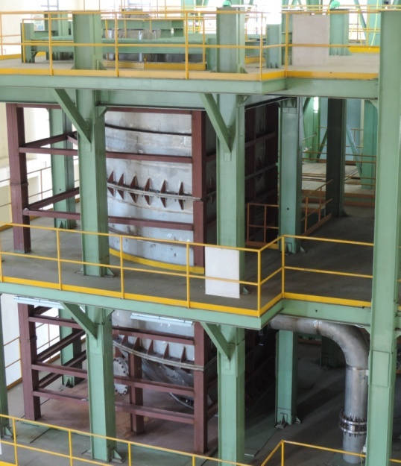
5/8 ^{th} Scale Model of Reactor Hot Pool
Reynolds Number (Re) – Required to simulate the effect of viscosity on flow field and viscous drag force acting on bubbles.
Weber Number (We) and Froude Number (Fr) is used to simulate the free surface behavior (shape and size of waves, vortex etc., and formation of bubbles).
A scale size of 5/8 will simulate both Froude number (Fr) and Weber number (We) between water model and prototype (sodium).
Flow mapping in the primary pool of FBR
Development and testing of devices to mitigate gas entrainment from hot pool free surface of the reactor
Velocity distribution around IHX inlet window
Measurement of velocity distribution around Control plug
Measurement of amplitude and frequency of free level fluctuation at various operating conditions of reactor

Slide 4
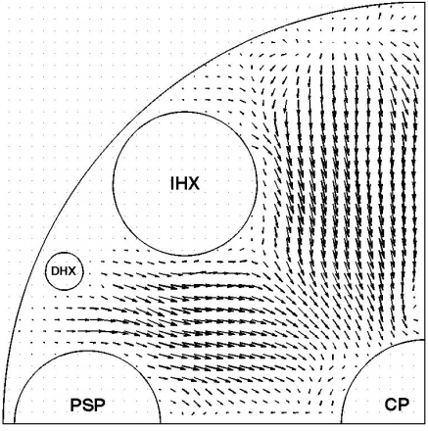
Flow mapping in the primary pool of FBR
The velocity mapping at the free surface of hot pool using Ultra sonic Velocity Profiler (UVP) and Propeller Anemometer
Fluid velocities just beneath the free surface were measured in different points.
The max. free surface velocity at the nominal power condition of the reactor was 1.24 m/s.
The velocity magnitude at the free surface was quite high and caused high turbulence .
These disturbances at the free surface in turn entraps gas bubbles from cover gas.
Further developmental studies to reduce the free surface velocity and hence to avoid gas entrainment.
Radial and tangential component of entry velocity to IHX inlet window was helpful to assess the design of tubes against FIV.
Contour and vector plot of velocity at free surface as obtained from experimental measurement
Radial velocity mapping at reference free surface
Velocity mapping around IHX

Slide 5
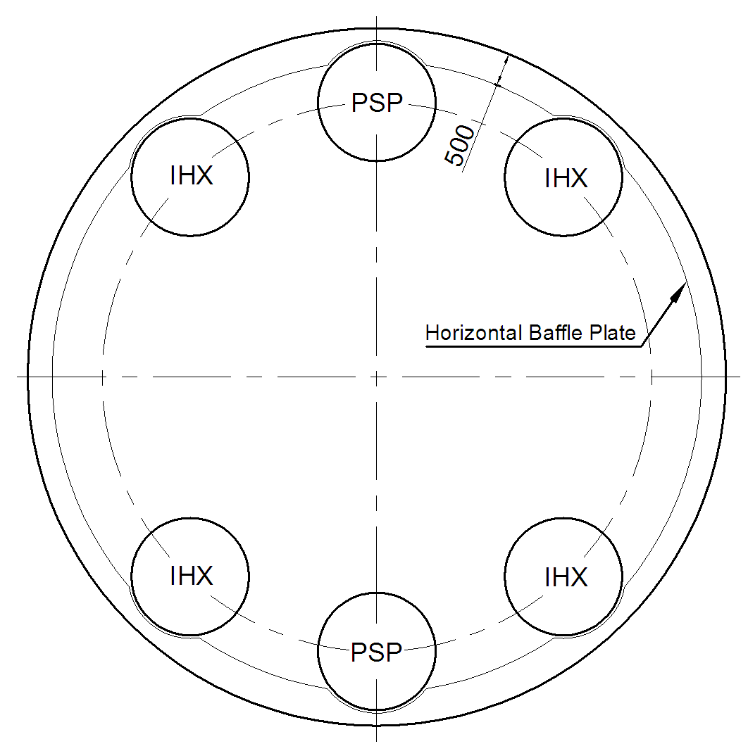
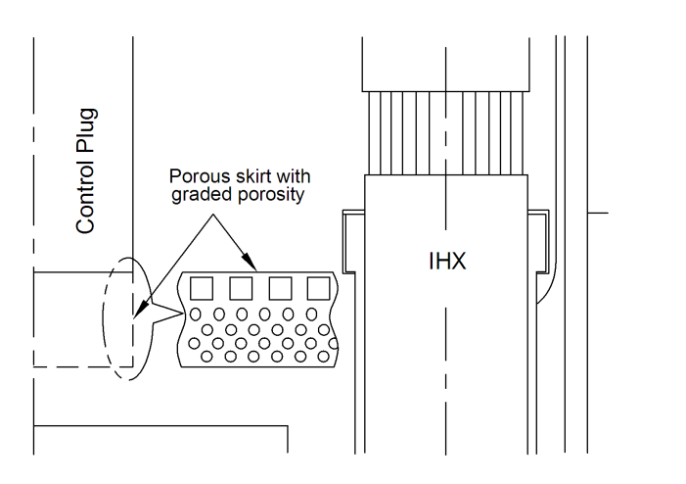
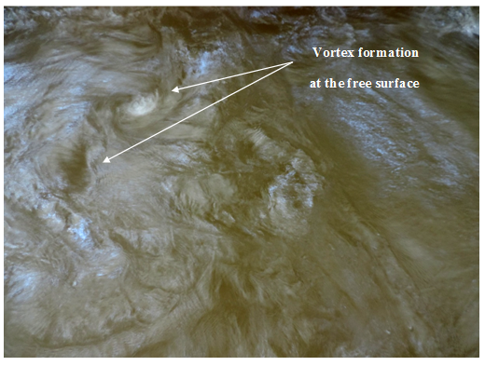
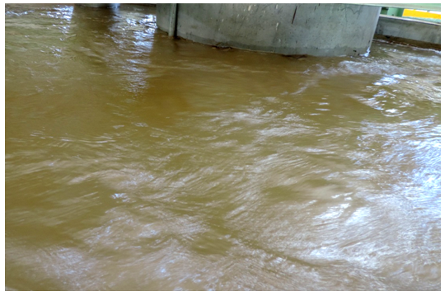
Gas entrainment mitigation studies in the
primary pool of FBR
High fluid velocity at free surface combined with immersed component in the pool is the primary cause of gas entrainment.
The gas entrainments phenomena is highly geometry dependent hence the mode of entrainment varies for various geometry.
Gas entrainment mitigation devices have been developed using CFD studies. Performance of these devices are tested in this model.
Effect of baffle plates, porous skirt for control plug and its combination on the gas entrainment from hot pool were studied.
The addition of horizontal baffle plates and with graded porous skirt of control plug resulted in a significant reduction of the fluid velocity at the free surface.
Baffle plates and Graded porous skirt for control plug
Free surface texture before and after introduction of baffle plate

Slide 6
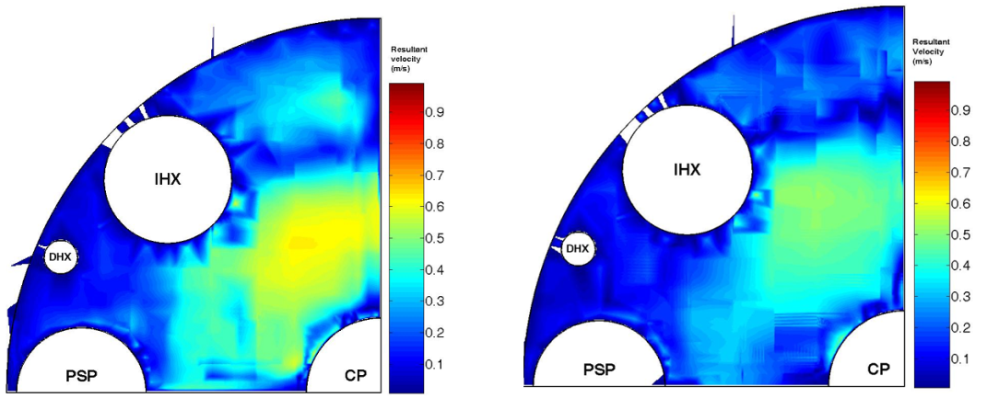
Gas entrainment mitigation studies in the
primary pool of FBR
A horizontal baffle plate attached to the inner vessel reduces the free surface velocity by 42% .
Free surface velocity was further reduced with the combination of baffle plate and graded porous skirt.
By modifying the design of the skirt to a graded porous skirt, the maximum free surface velocity was reduced by 52% with respect to the reference design case.
Risk of gas entrainment was reduced with these devices.
Reference case
Horizontal baffle plate
Horizontal baffle plate with graded porosity skirt of CP
Velocity contour plots at free surface as obtained from experimental measurement

Slide 7
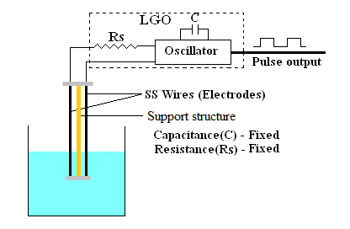
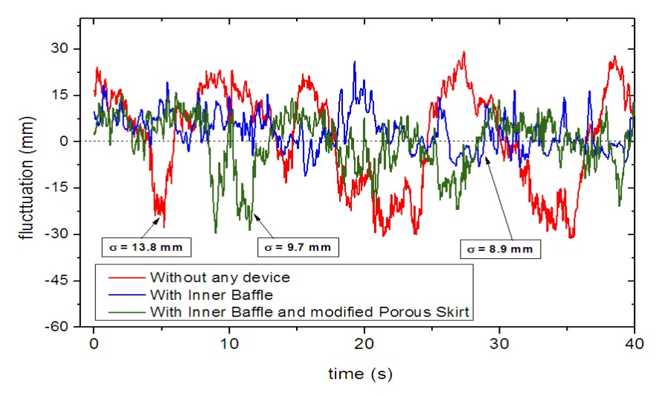
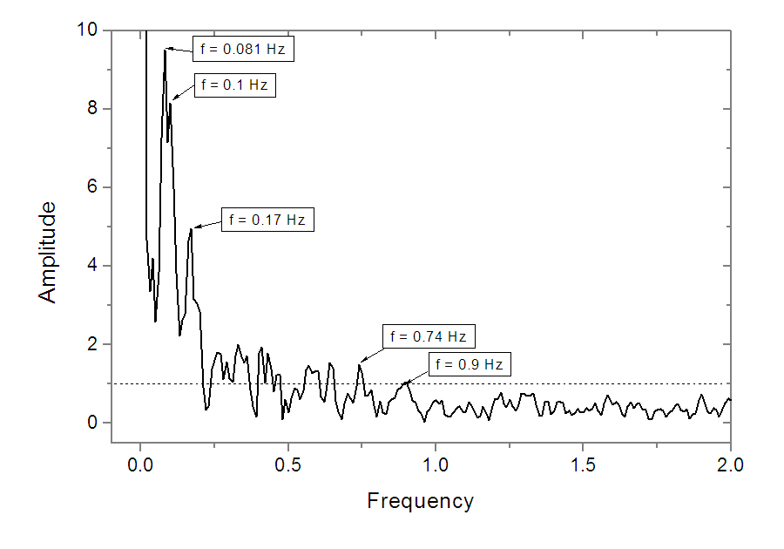
Free level fluctuation in hot pool
Fluctuations in the sodium free surface occur due to the interaction of axial flow velocity with the free surface and flow induced vortex shedding of the immersed components in the hot pool.
The components immersed in the hot pool will be subjected to temperature fluctuations at the sodium – argon interface.
This leads to thermal fatigue loading on the immersed components.
It is important to measure the amplitude and dominant frequency range of free level fluctuation.
High amplitude of fluctuation at free surface also can lead to gas entrainment.
Schematic of Conductance Wave Gauge level sensor probe
FFT plot for the maximum fluctuation data for Reference case
Free level fluctuation for different cases

Slide 8
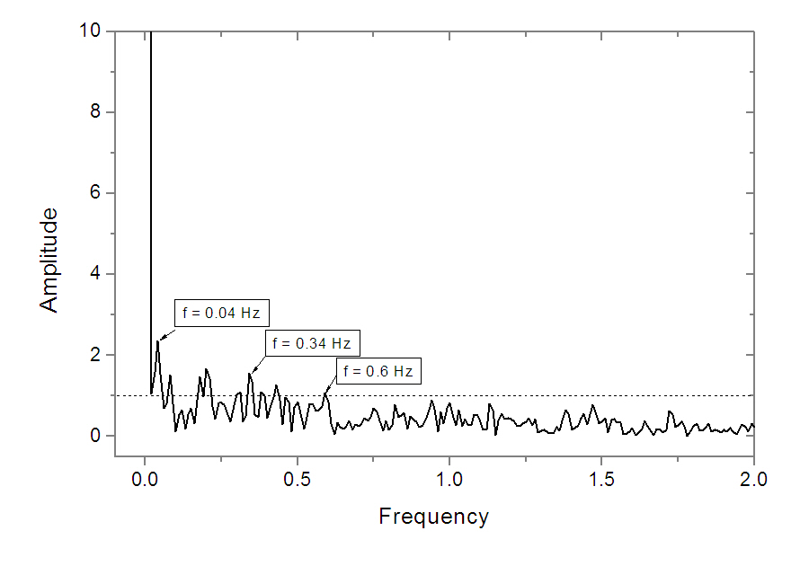
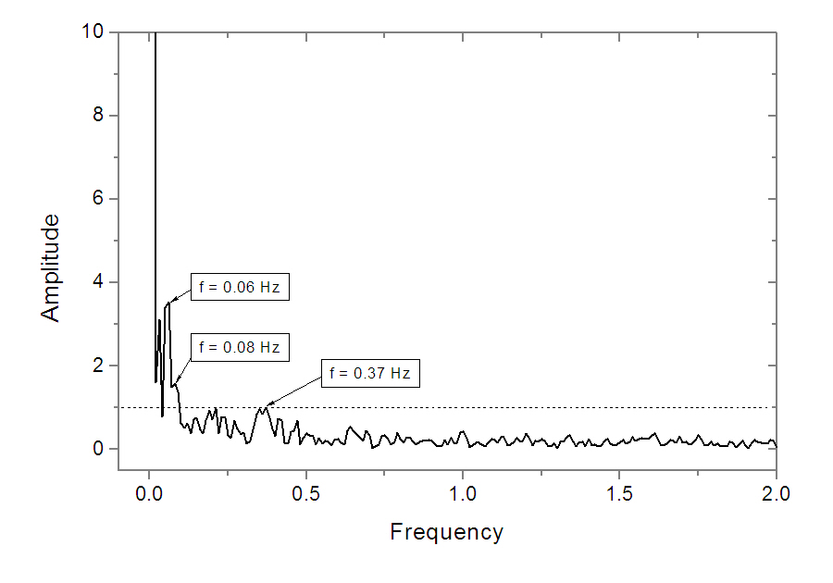
Free level fluctuation in hot pool
The maximum free level fluctuation for the reference case was 88 mm with dominant frequency range of 0.05-0.8 Hz.
With the deployment of a horizontal baffle plate, the amplitude was reduced to 57 mm with dominant frequency range of 0.02-0.4 Hz.
When a horizontal baffle plate along with a 25% porous skirt with graded porosity was deployed, the amplitude was found to be 62 mm with dominant frequency range of 0.02-0.4 Hz.
The increase of amplitude of free level fluctuation by 5 mm due to change in reference design skirt to graded porous skirt is insignificant to reactor scale.
FFT plot for the maximum fluctuation data for case with Inner Baffle
FFT plot for the maximum fluctuation data for the case with baffle plate and 25% porous skirt

Slide 9
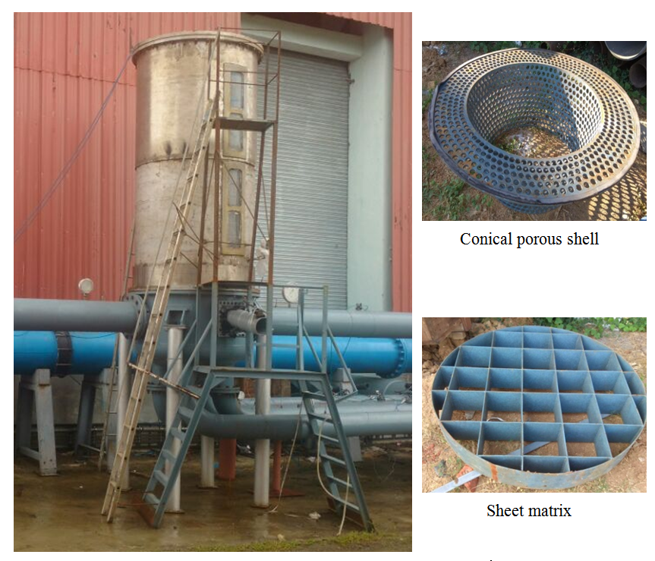
5/8 Scale Model of Surge Tank
The gas entrainment from the free surface of surge tank is a concern.
Flow distribution devices are kept inside the surge tank to eliminate the gas entrainment at the cost of pressure drop.
In order to reduce the pressure drop, design optimisation of the surge tank was carried out.
Through numerical simulation, the flow pattern inside the surge tank and effect of new flow distributing devices were studied.
The final performance evaluation of modified geometry was carried out in 5/8 scale model of surge tank.
Side inlet and bottom outlet configuration of surge tank along with two new devices was found to be effective with GE mitigation with low additional pressure drop.
The pressure drop was reduced by 48% with the new surge tank geometry.
This reduced the secondary sodium pump duty by 5.5 % of its nominal capacity.
The escape probability of entrapped gas bubbles in the loop from surge tank to cover gas was also studied.
5/8 scale model of surge tank

Slide 10
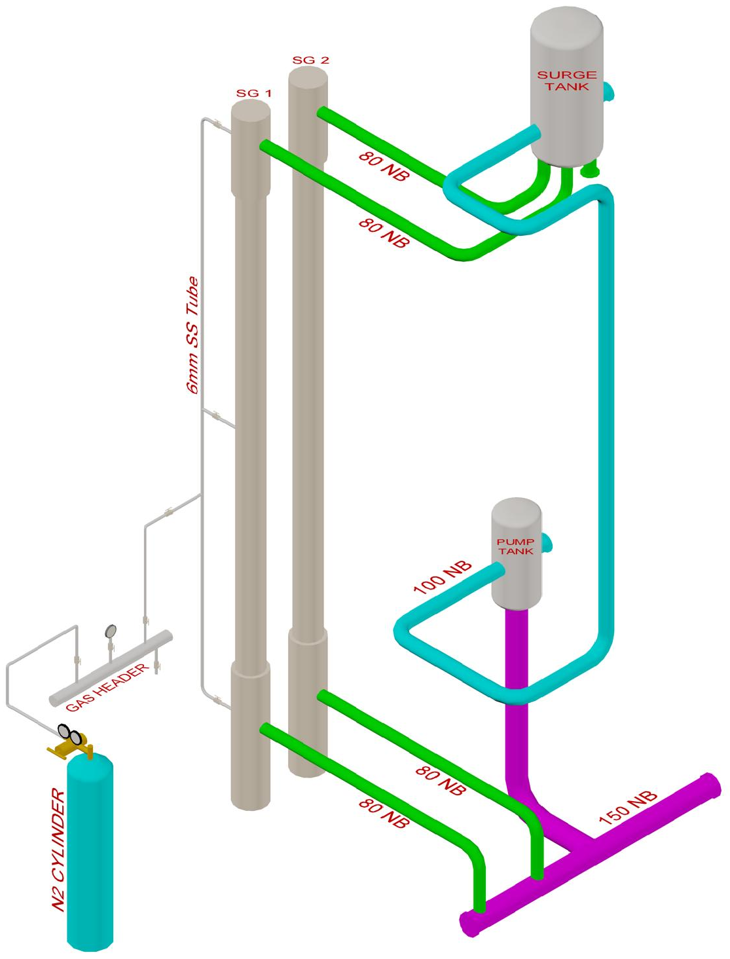
1/4 ^{th} scale model of secondary circuit for
pressure transient studies
The most common way of analysing the pressure transient phenomena due to sodium-water reactions (SWR) in steam generator and its effect in secondary circuit is through analytical codes.
A new attempt was made to create pressure surges in water which is similar to that produced during SWR.
Water was used as simulant in the loop.
The pressure surges were made in water by bursting of rupture disc at high pressure.
The release of gas from rupture disc to water simulates the hydrogen release during SWR and a similar pressure surge but of lower magnitude is generated in water.
Theses pressure surges in pipe was measured using piezoelectric transient pressure sensors with a response time of 1.5 microseconds.
Hydraulic experiments were carried out in a loop simulating Secondary Sodium Main Circuit (SSMC) with two SGs, pump tank and surge tank.
3 D model of ¼ scale model of SSMC for pressure transient studies

Slide 11
1/4 ^{th} scale model of secondary circuit for
pressure transient studies
The major objectives of the study were to
investigate the effect of surge tank during pressure transients
effect of gas entrainment mitigation devices on pressure surge absorption capability of surge tank.
Propagation of pressure surge in the loop and the effect of surge tank on its attenuation were studied.
The efficiency of side inlet and bottom outlet configuration of surge tank (with and without devices) on pressure surge absorption was studied.
The pressure pulses were completely absorbed in surge tank.
No adverse effect was found due to insertion of gas entrainment mitigation devices.
Pressure surge absorption in ST during rupture of 60 bar RD at SG top and no devices in ST
Pressure surge absorption in ST during rupture of 60 bar RD at SG top and with devices in ST

Slide 12
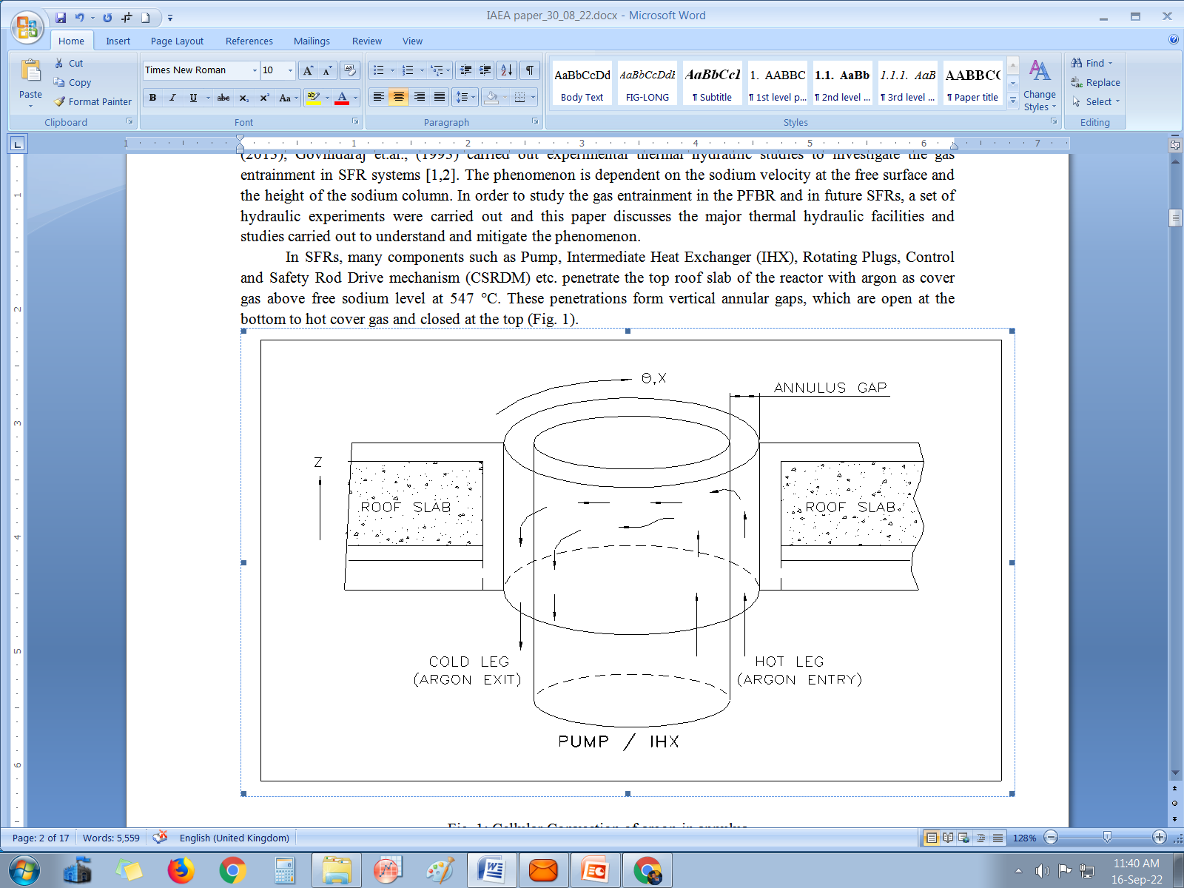
EXPERIMENTS IN SODIUM
Cellular convection in the annular spaces
of high temperature sodium test vessels
Components such as Pump, Intermediate Heat Exchanger (IHX), Rotating Plugs, Control and Safety Rod Drive mechanism (CSRDM) etc. penetrate the top roof slab of the reactor.
These penetrations form vertical annular gaps, which are open at the bottom to hot cover gas and closed at the top .
Temperature difference sets up cellular convection and non-uniform circumferential temperature distribution in the penetrating component.
The circumferential temperature gradient can result in deflection of the component and its functional impairment.
The experimental setup for testing and qualification of absorber rod drive mechanisms (ARDM) of PFBR in sodium at 550°C, consists of two annular vessels.
The outer vessel Test Vessel-1 (TV-1) and an inner vessel that houses the ARDMs.
The lateral deflection of TV-1 due to circumferential temperature distribution resulted in difficulty in gripping the absorber rod by ARDM.
It was planned to estimate the circumferential temperature distribution in the annular space between TV-1 and its inner vessel and the defection of the test vessel.
Numerical estimation and experimental validation of the effect of baffles on the cellular convection in the annular space were carried out.

Slide 13
Cellular convection in the annular spaces
of high temperature sodium test vessels
Numerically estimated and experimentally observed values of circumferential temperature gradient with and without baffles were compared.
The results obtained from CFD was found to be satisfactory.
There was significant reduction in the circumferential temperature gradient by providing baffles plates.
Based on the this investigation, baffles were provided in all other sodium test vessels in the large component test rig (LCTR) at IGCAR
Comparison of circumferential temperature difference by theoretical and experimental with baffles
Sl.No | Temp. of test vessel-1 | Avg. Circumferential temperature gradient |  | Deflection of the vessel
 |  | Numerical estimation | Experimental | Numerical estimation | Experimental
Without any baffle
1 | 550° C | 28.25 °C | 30°C | 16.5 mm | 18 mm
With baffle plates
2 | 550° C | 20.5° | 20.5° | 11.75 mm | 11.0 mm

Slide 14
CONCLUSION
Experimental thermal hydraulic studies in SFR systems include various testing and simulation in both sodium and water.
The hydraulic responses of the sodium by - testing in water with suitable similarity criteria.
The thermal response of the sodium systems by - experiments in sodium.
Large scale model test facilities for carrying out various thermal hydraulic tests were presented
Velocity at the free surface in the hot pools of FBR were studied by velocity mapping in 5/8 scale hydraulic model using ultrasonic velocity profiler.
The maximum free surface velocity was reduced by 42% with the deployment of horizontal baffle plates and by 52% with an additional graded porosity skirt with respect to the reference design case.
Reduction in maximum free surface velocity reduced the risk of gas entrainment.
With the deployment of gas entrainment mitigation devices, the amplitude and dominant frequency of free level fluctuation was also reduced.
An optimized design of the surge tank was arrived where the pressure drop in the system was reduced by 48 % of the reference design. This resulted in a reduction in the secondary sodium pump duty by 5.5 % of its nominal capacity.
From pressure transient experiments, the influence of gas entrainment mitigation devices on pressure surge absorbing capability of a surge tank was found to be insignificant.
The circumferential temperature distribution in the sodium test vessels were reduced by incorporating baffle plates in the annular spaces in the sodium test vessels.

Slide 15
Thank you

