Slide 1
Review and main outcomes From the experimental program carried on the PLATEAU facility
David GUENADOU
P. AUBERT, J-P. DESCAMPS, L. CACHON, G. CHIARA, T. GILARDI, M. SADEK, U. BIEDER, H. BHATIA
27/09/2022

Slide 2
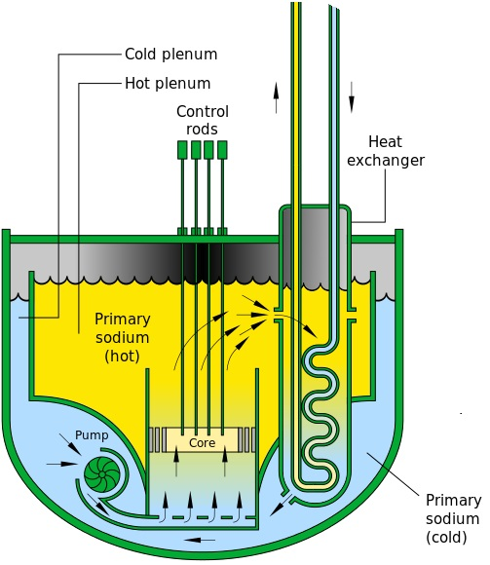
ISSUES OF THE ASTRID PROTOTYPE STUDIED ON THE PLATEAU LOOP
Validating the code calculations
Experimentations
DANAH
Studying the new design choices
Sodium Gas Heat Exchanger:
Maldistribution of the flow
MICAS
Experimentations with sodium are very complex
Hot Plenum:
Gas entrainment, temperature and velocity fields, stability of the outlet core jet
Pipes:
Leak, sodium fire
JETSER
ρ(Na), μ(Na) ≈ ρ(H₂O), μ(H₂O)
Experimentations with water
Pump-diagrid pipe:
Cavitation
4 mock-ups
CALIMEREAU

Slide 3
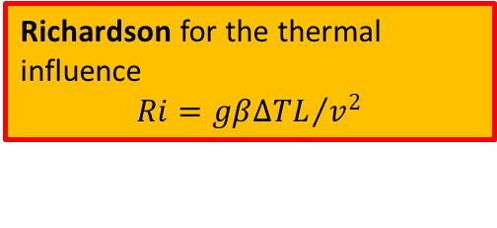
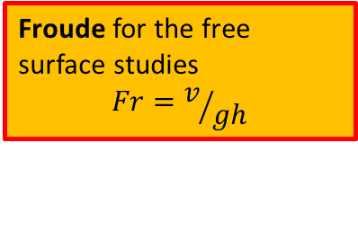
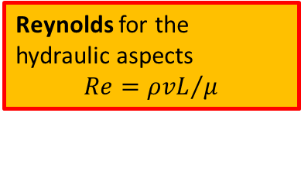
WATER/SODIUM SIMILITUDE
Similitude
Equivalence in phenomenology
Froude for the free surface studies
$$Fr=v/{gh}$$
Richardson for the thermal influence
$$Ri={gβ∆TL}/{v^{2}}$$
Reynolds for the hydraulic aspects
$$Re={ρvL}/μ$$
Difficulty to fit the experimental conditions in order to observe all the dimensionless numbers.
Distortion of the other dimensionless numbers.

Slide 4
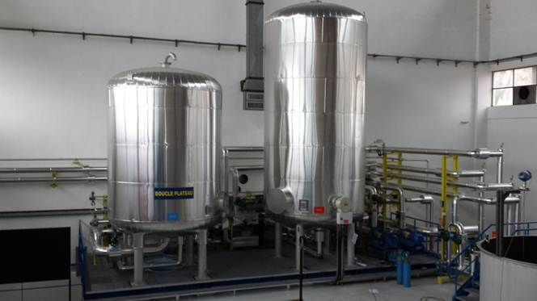
THE PLATEAU LOOP
T(°C)<60°C
TA01
TA02
T(°C)=10°C
Mock-up
3
2
1
HSC
P01
P02
CSC
MCM
EX01
TIC
P03
Hydraulic (T1=T2=T3(°C))
HEAT01
Qmax=400m³/h
Thermohydr. (T1≠T2=T3(°C))
3 modes
Transitory (T1  or , T2=T3(°C))

Slide 5
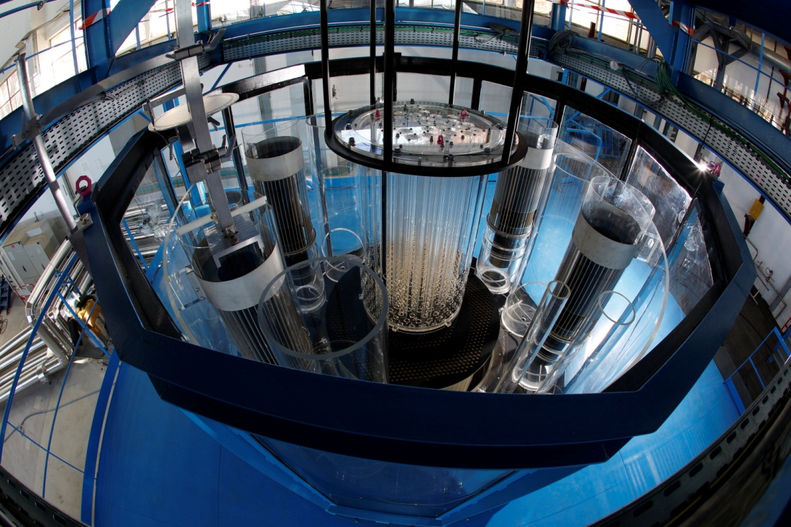
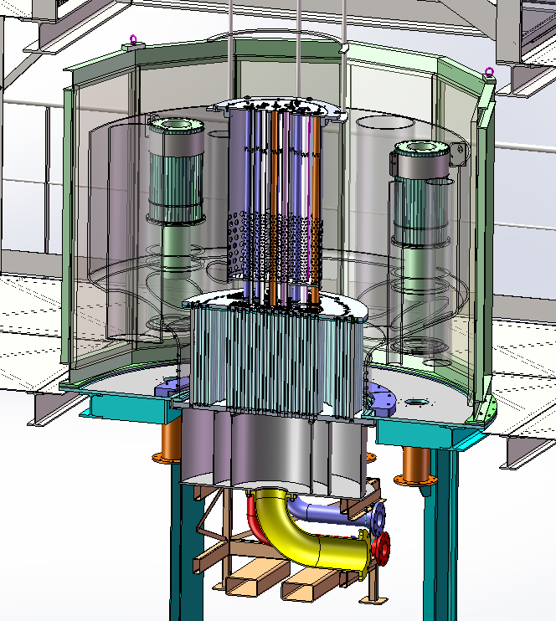
MICAS MODEL – HOT PLENUM
External vessel
IHX2
P02
P01
IHX3
ACS
ACS
IHX
IHX1
Pump pit
IHX4
P03
Core
ACS: Above Core Structure
IHX: Intermediate Heat Exchanger
P0x: Pump n°x
Core
Sector : 360° ; Scale : 1/6
3 flow distribution zones in the MICAS core: fission zone, reflector and internal assembly storage.
Built in transparent polymer (PMMA) for optical measurements
External vessel made of 12 plane walls to enhance the optical access
Int. Stor.
Fission
Reflector

Slide 6
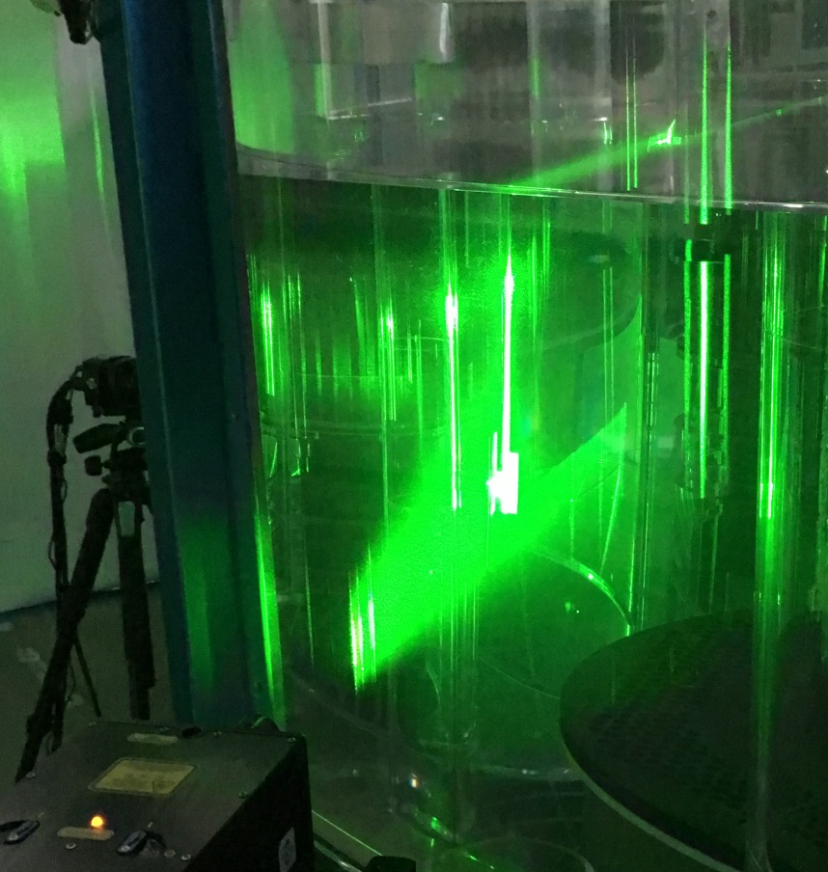
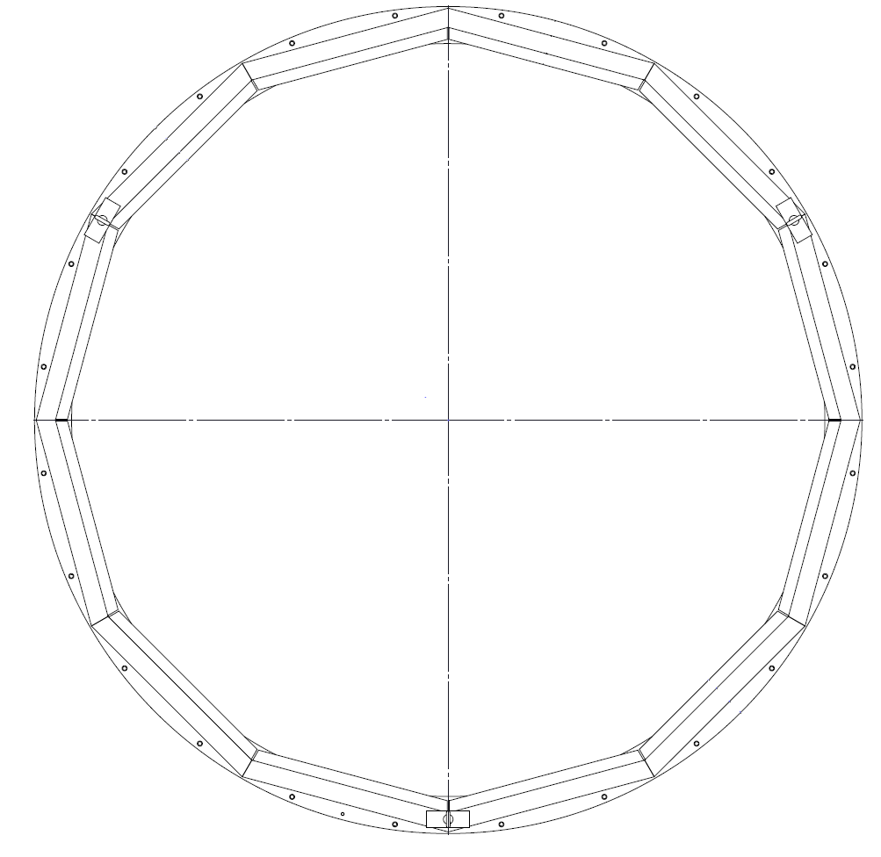
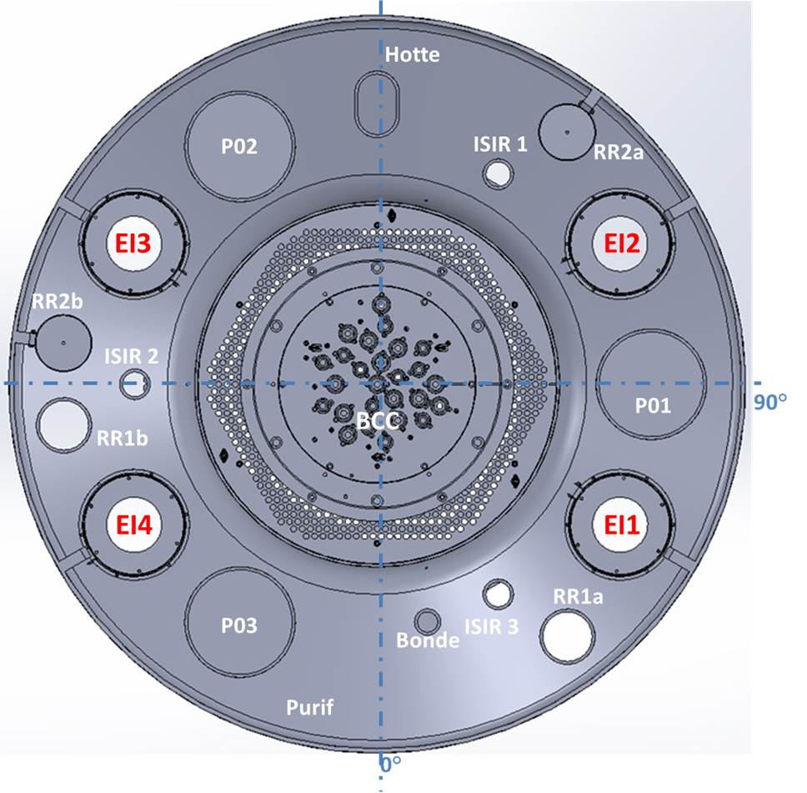

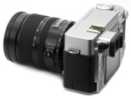
VELOCITY MEASUREMENT - EXPERIMENTAL SETUP
Particle Image Velocity
Average velocities (10 s at 15 Hz)
External pool
External pool
Cask
P02
IHX3
Core
IHX2
Camera
Laser sheet
270°
P01
90°
ACS
Laser
IHX4
IHX1
The external pool reduces the optical deformations
P03
Plug
Double pulse laser
Optical access lessened by obstacles (immerged components…)
0°
CD camera (4 Mpix)

Slide 7
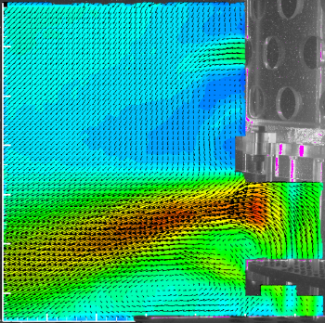
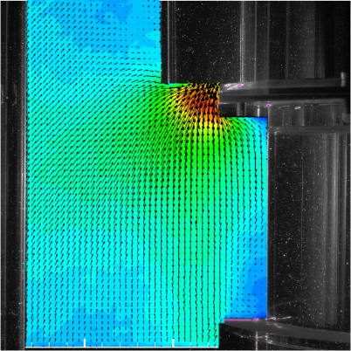
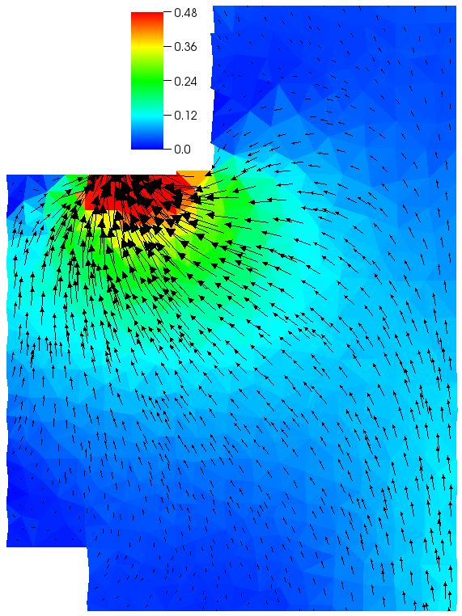
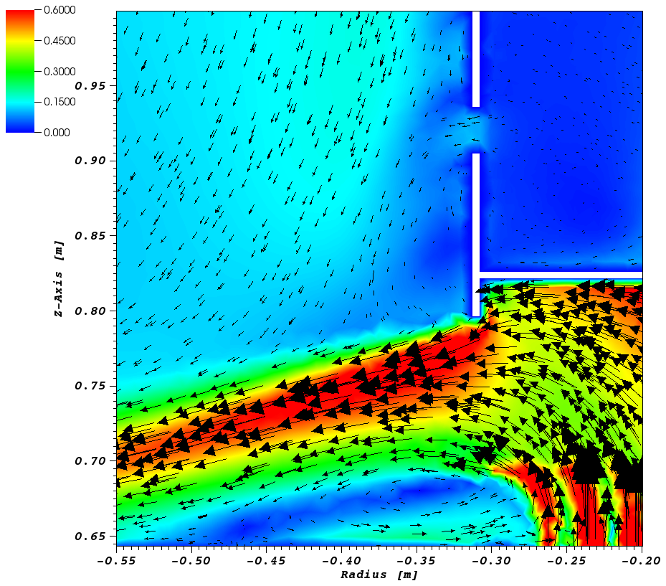
CODE VALIDATION
Computations proceed with TrioCFD prior the experimental campaign in order to avoid any influence
Slight differences, but rather good accordance in terms on flow direction and magnitude
Experimental
Numerical

Slide 8
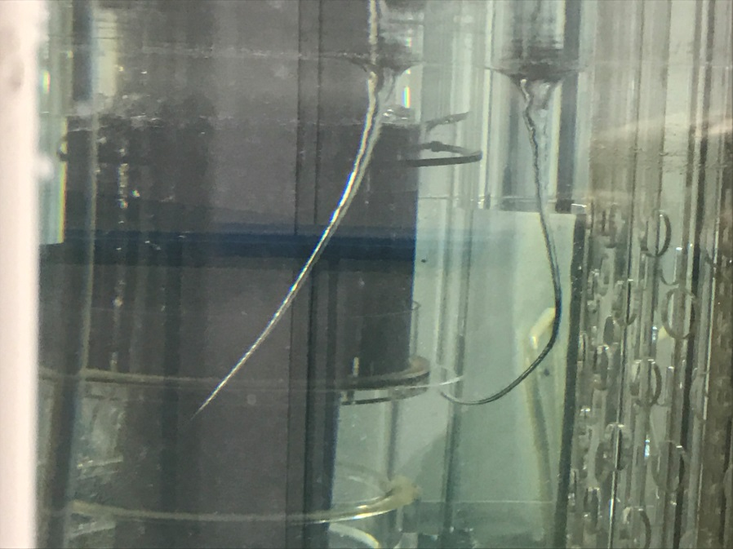
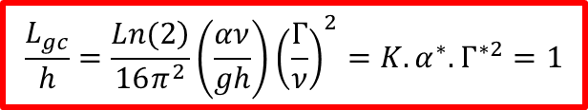
GAS ENTRAINEMENT
Gas accumulation in the diagrid may lead to safety problems if a gas pocket is released into the core (positive reactivity effect)
One of the origins of gas due to vortices created at the free surface in the upper plenum
CFD codes do not handle vortex in complex structures because of the multiphase flow aspect
Development of a simple model based on the Burger vortex model
Gas entrainment when the vortex length L_{gc} reaches the outlet depth h
$$\frac{L_{gc}}{h}=\frac{\left.Ln(2\right)}{16π^{2}}\left(\frac{αν}{gh}\right){\left(\frac{Γ}{ν}\right)}^{2}=K.α^{∗}.Γ^{∗2}=1$$
Need of α and Γ

Slide 9
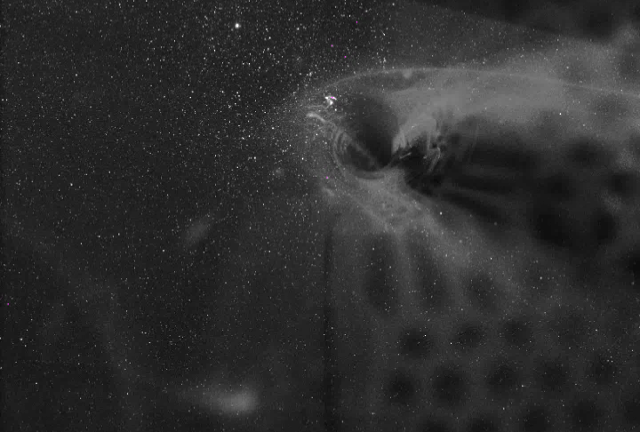
GAS ENTRAINEMENT
Vortex center
Derivative null at the maximum velocity
α, Γ
No gas entrainment for α.Γ²<4.5
Theoretical value α.Γ²<228

Slide 10
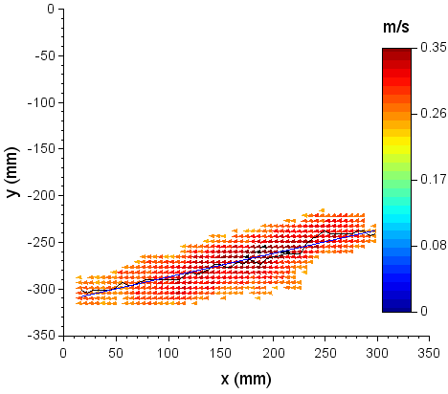
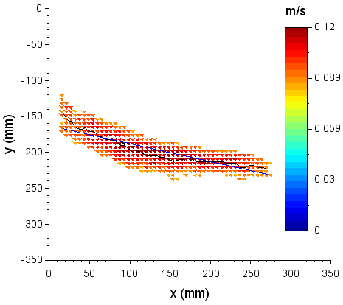
FLOW BEHAVIOR VS OPERATING CONDITIONS
Flow fluctuations in the upper plenum induce thermal oscillations in the immerged components that lead to thermal fatigue and reactor lifetime decrease
Jet outgoing the core subject to oscillation when it rises to the surface
Experiments carried out on the MICAS mock-up to investigate the range of the operating conditions for which it occurs
Study based on the Richardson number and PIV measurements
Ri’=25
Ri’=1
α
α

Slide 11
FLOW BEHAVIOR VS OPERATING CONDITIONS
Transition to a rising jet for a value between 13<Ri’<27
Ongoing studies to identify if this result can be transposed to higher scales

Slide 12
SODIUM GAS EXCHANGER
Gas turbine (Brayton cycle) to avoid Na/water issues
Gas pumping power has a first order impact on the Brayton cycle efficiency
Optimisation of the sodium/gas heat exchanger
72 Na channels layers intercalated with 72 gas channel layers
Maldistribution of the sodium flow rate in the Na channels
Decrease of the global efficiency of the exchanger
2.2m
3 x 6 mm2 Na cross section
Optimization of the geometry of the Na header using CFD (ANSYS-Fluent)
Needs of experimental validations

Slide 13
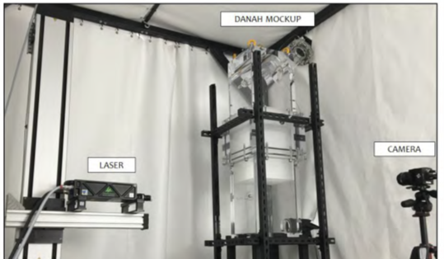
DANAH MOCK-UP
Header
Inlet
Channels
ΔP
Outlet
Scale 1 the inlet header
Half of the channels bundle with a representative pressure loss
Possibility to change the header geometry
Built in PMMA
Velocity measured by both PIV and LDV technics

Slide 14
SIMULATION VS EXPERIMENT
Header
Outlet
Experiment
Optimizing the geometry of the SGE with CFD
Good agreement
Maldistribution
25%➔2%
Simulation

Slide 15
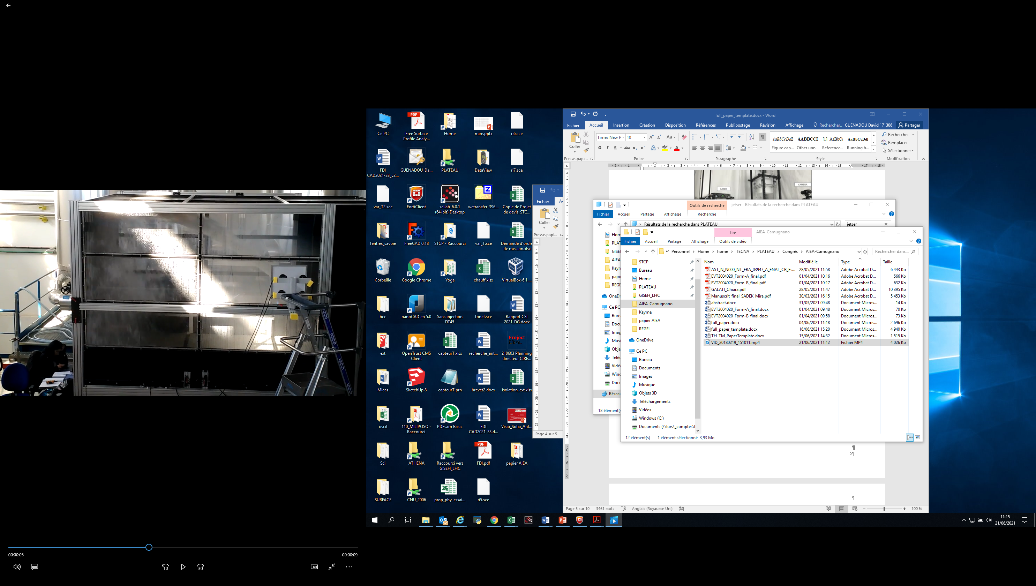
SODIUM LEAKAGE
Sodium jet may burn in contact with air in respect of the flow behavior
The intensity of the fire depends mainly on the degree of fragmentation, which impacts on the surface of contact with air
First step: experiment with water in JET-SER (Na at IGCAR)
Hydrophobic windows for visualisation of the jet
Shadowscopy device to measure the shape of the jet and the droplets size in the whole mock-up volume
Influence of the angle of the jet, the nozzle diameter and the flow rate
Jet
Lighting device

Slide 16
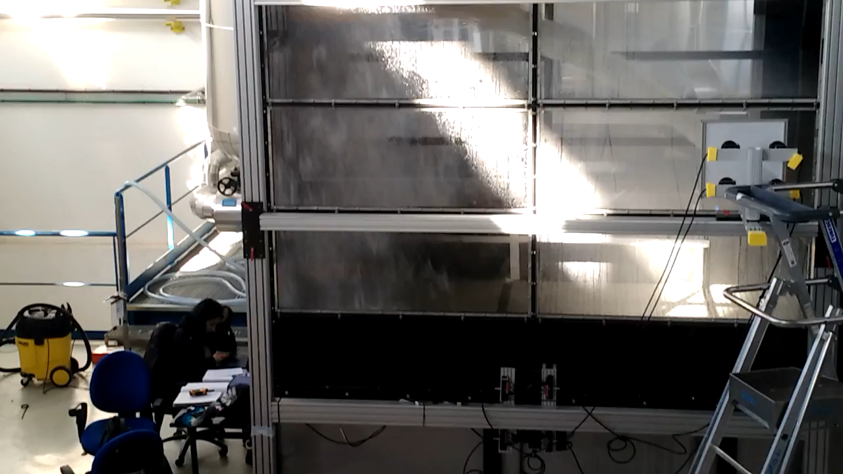
JET BREAK-UP

Slide 17
JET BREAK-UP
Growth of the amount and the size of droplets along the jet.
An increase of the velocity at the nozzle exit enhances the fragmentation by generating smaller and more numerous droplets that leads to higher surface of exchange.
Correlation of the model developed by Wu with a slight adjustment parameters for downward jets
For horizontal and upward jets when the gravity takes place, the Wu model only valid near the nozzle exit (gravity induces smaller fragmentation)
Nozzle outlet
Good agreement with the experimental results in terms of droplet diameter with preliminary calculations proceeded with NEPTUNE_CFD

Slide 18
CAVITATION IN THE PUMP-DIAGRID PIPES
ASTRID pump-diagrid pipe ram shaped design (to spare space)
Cavitation in the elbows prohibited because of the erosion by gas bubbles
Onset of the cavitation?
Record of the noise induced when the cavitation occurs by fast pressure sensors and accelerometers
Pump
Cavitation
Diagrid
Diagrid
(Actual design property of Framatome)
Fast pressure sensors

Slide 19
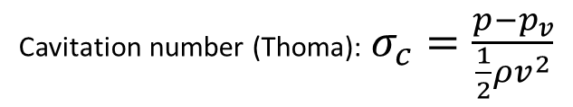
CAVITATION IN THE PUMP-DIAGRID PIPES
Saturation pressure
Cavitation number (Thoma): $σ_{c}=\frac{p−p_{v}}{\frac{1}{2}ρv^{2}}$
2 geometries tested: 1 or 2 legs
Onset of the cavitation for a value around 7 for the one leg configuration
Cavitation not reached for 2 legs (flow limit of the pump)
Transposition to the Na case to be studied

Slide 20
CONCLUSION
Hot plenum (MICAS mock-up): Experimental vs numerical ➔ code validation; Model to forecast the gas entrainment
Sodium gas exchanger optimization: Validations from the experiments of the CFD calculations
Pipe leakage in the framework of sodium fire: Study of the droplet sizes and velocities during the jet break-up; Good correlation with a model from the literature; Implementation of this model in a CFD code
Cavitation in pump diagrid pipe: investigation with accelerometer and pressure sensors; Cavitation for σ=7
Transposition of these results to higher scale (?)
PLATEAU loop applicant in the framework of EU program to welcome new experiment or mock-up from EU labs.

Slide 21
Thank you for your attention

Slide 22
22
22

Slide 23
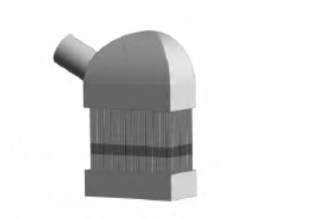
DANAH CFD Calculations
Symmetry
Non slipping walls
Mass flow inlet (25 kg/s)
Porous media
(30 mm ➔ DP=5000 Pa)
Pressure outlet
(0 Pa)

Slide 24
Break-up calculations
NEPTUNE_CFD code
Implentation of the Wu model to calculate the droplet diameter

