Slide 1
Forced to natural circulation transients in wire-spaced fuel pin bundle
Ivan Di Piazza, Ranieri Marinari, Daniele Martelli, Mariano Tarantino
ENEA, September 26th 2022
Tec. Meeting on Sate-of-the-art Thermal Hydraulics of Fast Reactors
Fusion and Technology for Nuclear Safety and Security Department (FSN)

Slide 2
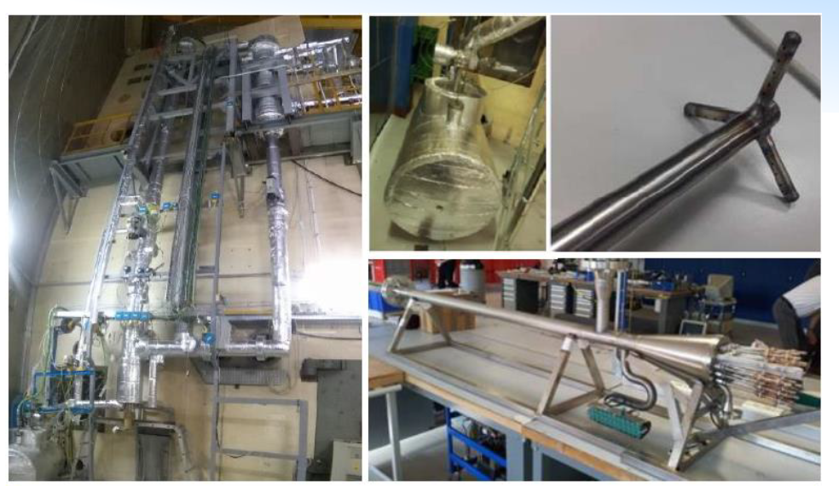
Forced to natural circulation transients in wire-spaced fuel pin bundle
Some experimental test on transition from forced to natural circulation in wire-spaced FPS have been carried out in the NACIE-UP facility at the ENEA Brasimone Research Centre
2 parts:
NACIE-UP Overview
Experimental Results
Status of NACIE CRP

Slide 3
Part 1: Overview of NACIE-UP facility
NACIE-UP is a rectangular loop in which there is a difference in heigth (about 5 m) between heat source (FPS) and heat sink (HX): this allows Natural circulation
Forced circulation is guaranteed by a gas-injection (Argon) in the riser of the facility: the gas will lighten the riser and the hydrostatic unbalance between the two columns will provide a positive pressure head. This method is called gas-lift.
A prototypical thermal flow meter will measure mass flow rate
Thermocouples will provide temperature distribution in the loop
The FPS test section is highly instrumented with about 70 TCs
Overview of NACIE-UP facility

Slide 4
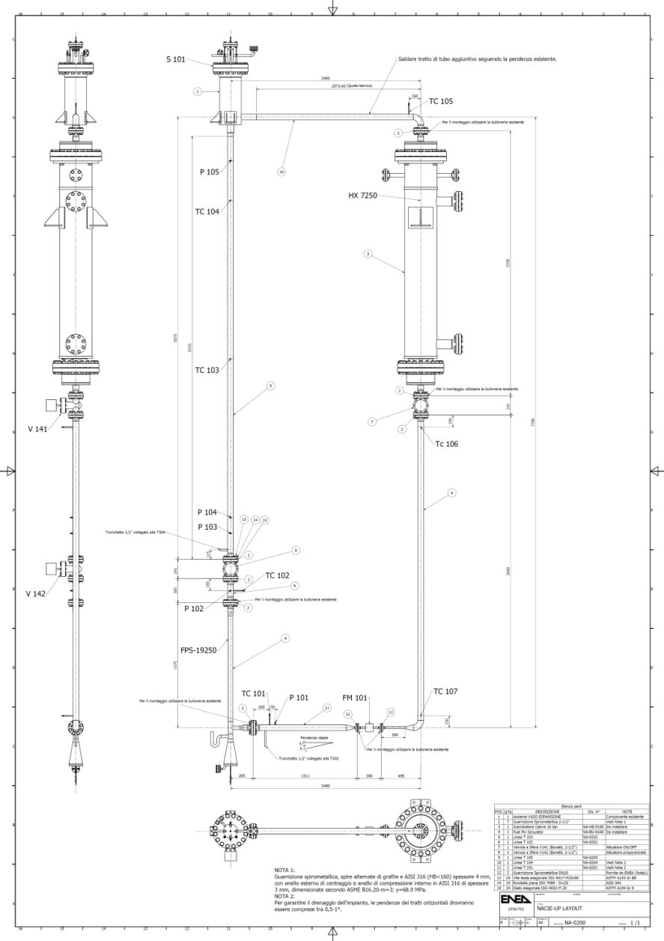
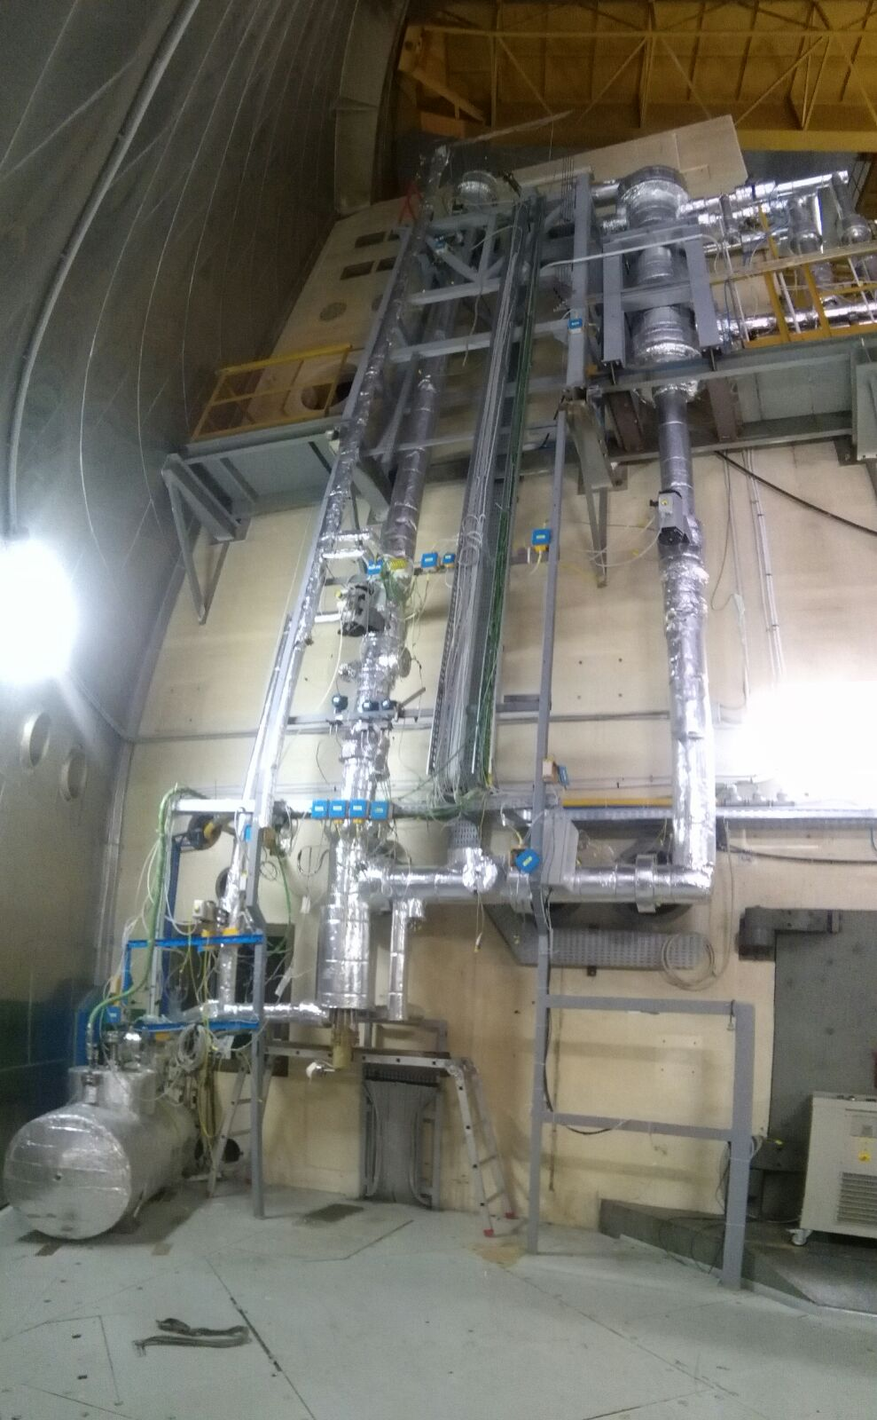
Introduction: NACIE loop
Exp
Vessel
HX
  Instrumented Bundle
  FPS
  (19 pins, 250 kW)
TFM
NACIE-UP Facility – Primary loop (LBE)
Composed by heat source (FPS), heat sink (H₂O Hx), expansion vessel, prototypical thermal flow meter (TFM)
Overview of NACIE-UP facility

Slide 5
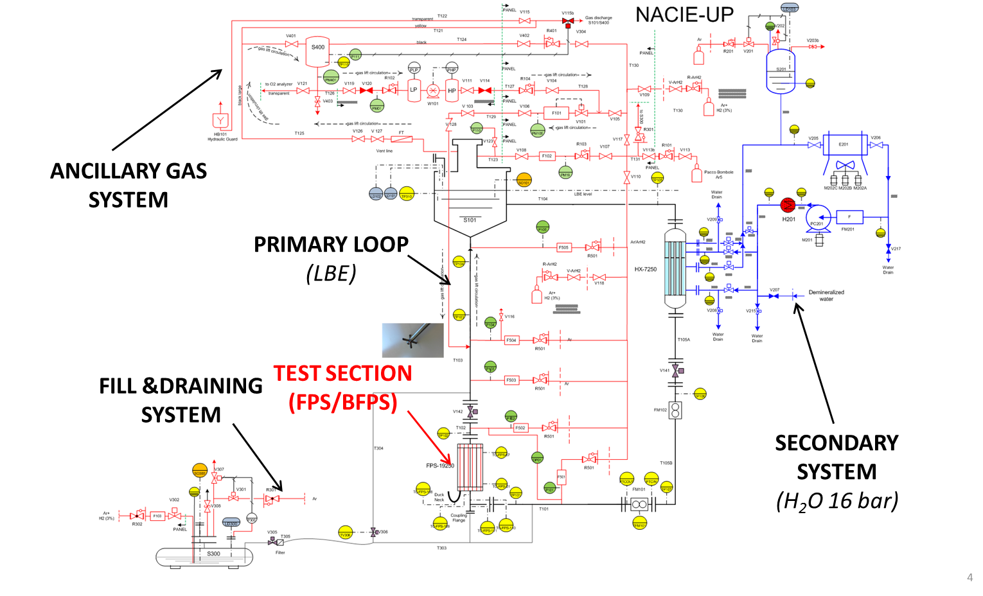
Introduction: NACIE loop P&ID
Overview of NACIE-UP facility

Slide 6
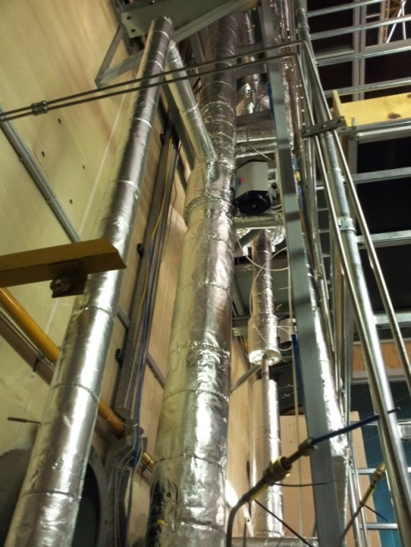
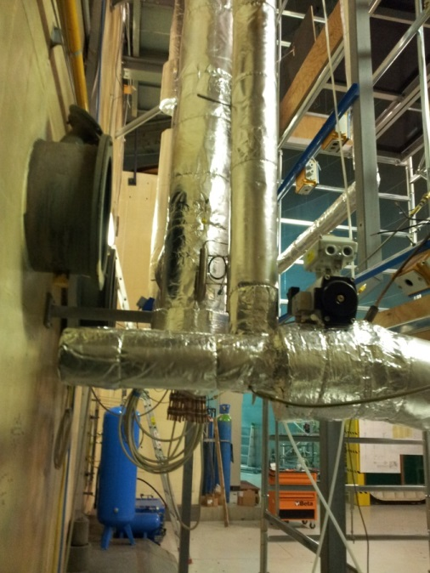
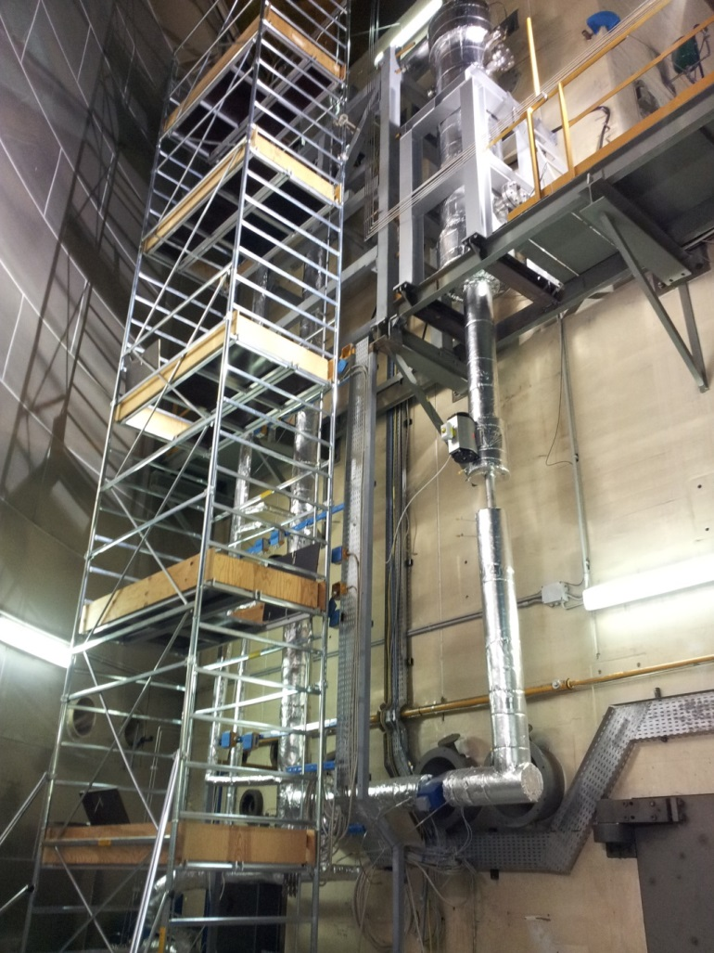
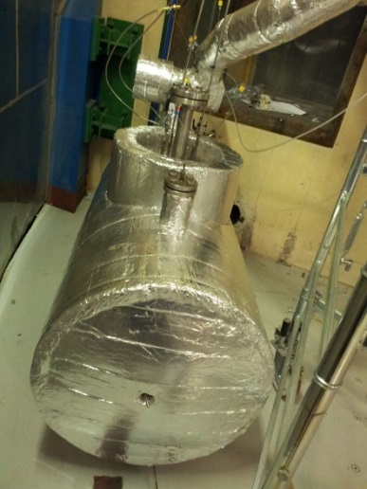
NACIE-UP PRIMARY SIDE
Overview of NACIE-UP facility

Slide 7
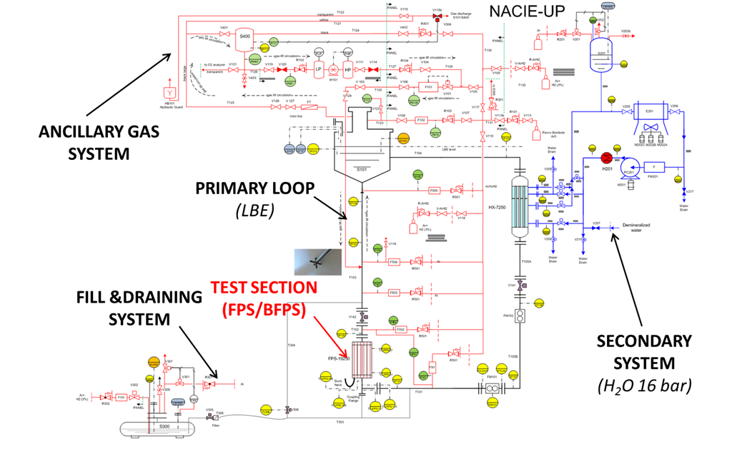
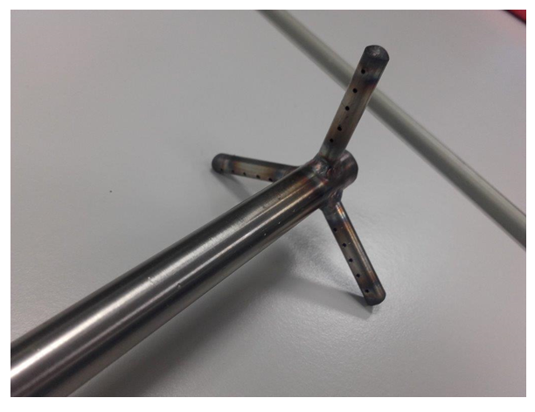
NACIE-UP: Gas-lift
Forced circulation is guaranteed by a gas-injection (Argon) in the riser of the facility: the gas will lighten the riser and the hydrostatic unbalance between the two columns will provide a positive pressure head. This method is called gas-lift.
Overview of NACIE-UP facility

Slide 8
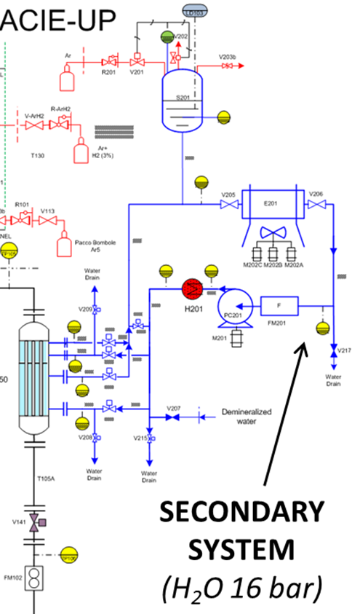
NACIE-UP: Secondary side
Components:
Pump PC201
Heater H201
Pressurizer S201 (16 bar)
Air cooler E201
Ultrasonic Flow meter FM201
A PID regulates the temperature of the loop by acting on H201 and/or E201
A PID regulates mass flow rate acting on PC201
Thermal equilibrium with primary side for stationary cases
Overview of NACIE-UP facility

Slide 9
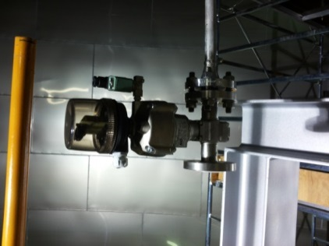
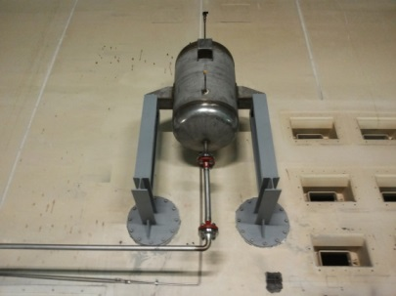
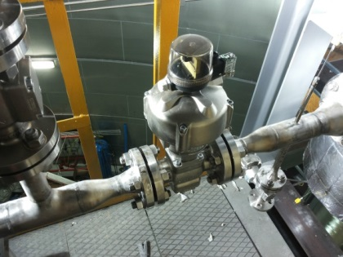
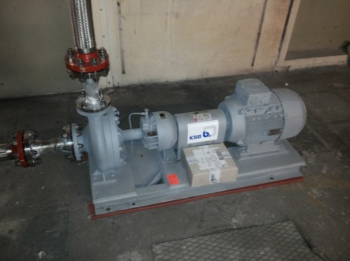
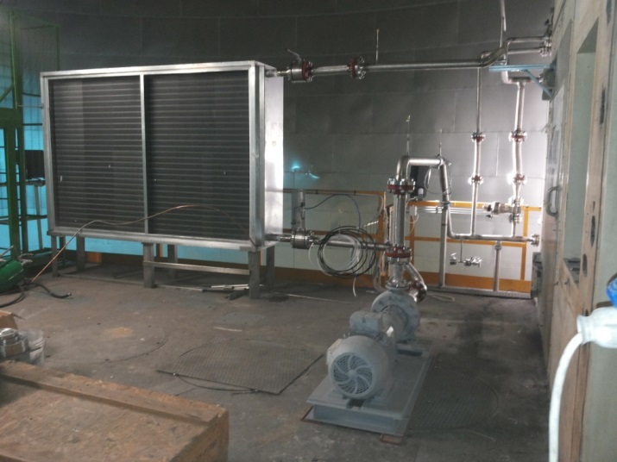
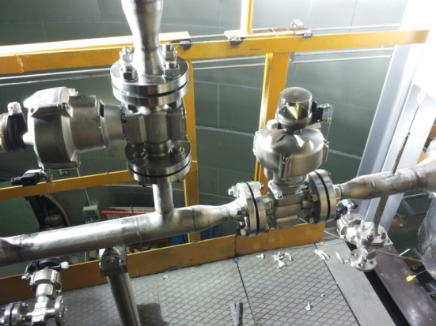
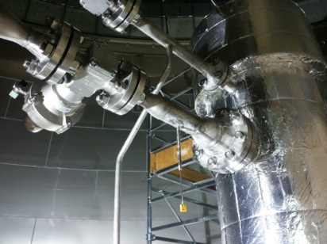
NACIE-UP SECONDARY SIDE
Overview of NACIE-UP facility

Slide 10
Instrumentation
A prototypical thermal flow meter for liquid metals was developed by ENEA in collaboration with Thermocoax and was used in the experimental campaign
Thermocouples in the loop (TP101-TP107, TP310)
Thermocouples in the Fuel pin bundle (70)
Overview of NACIE-UP facility

Slide 11
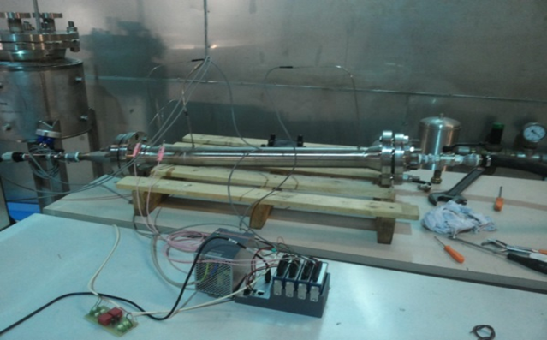
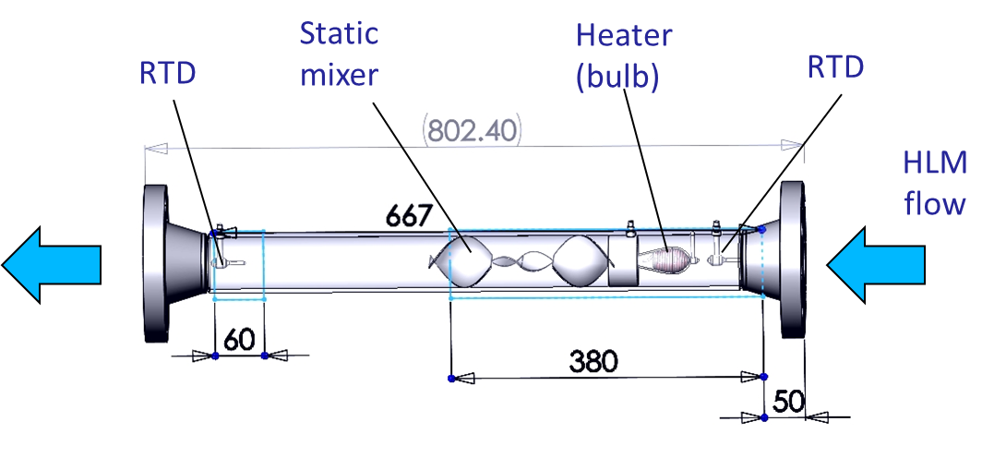
Thermal Flow meter
A prototypical thermal flow meter for liquid metals was developed by ENEA in collaboration with Thermocoax and was used in the experimental campaign
It is made by a flanged pipe (SS) with a heater technological development by THX (a few kW), a static mixer, 2 RTD and an internal RTD in the bulb
Low pressure losses
No limiting working temperature
Specific DACS developed, power supply unit necessary
Accurate even at low and medium flow rates (0-15 kg/s)
Overview of NACIE-UP facility

Slide 12
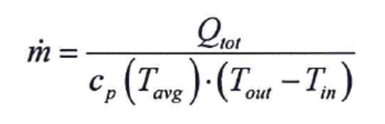
NACIE-UP: Thermal Flow meter
Basic concept:
Energy balance ‘Thermal method’
PID on bulb heater to keep a constant bulb-fluid temperature difference
Inlet-outlet RTD measure with compensation for the travelling time of the fluid
Overview of NACIE-UP facility

Slide 13
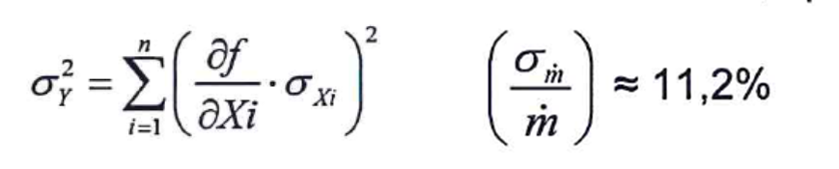
NACIE-UP: Thermal Flow meter
The thermal flow meter with ‘thermal balance’ showed good features in stability and repeatability, good response to transients
It was successfully tested in heavy liquid metal, but in principle it is applicable to other LM
The accuracy was evaluated by the error propagation theory and the maximum relative error is around 11%
No need of calibration because it is based on basic conservation laws
The power released by the flow meter must be kept into account and will be released for the post-test phase
Overview of NACIE-UP facility

Slide 14
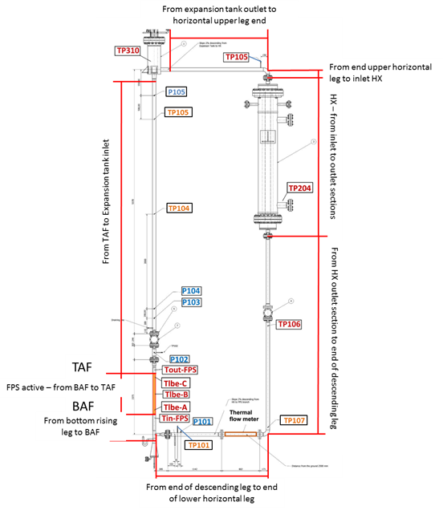
Loop thermocouples
8 loop thermocouples will monitor temperature in the different branches
All the thermocouples have a diameter of 3 mm and are of K type Class 1. Therefore the accuracy of the thermocouples according to the rule IEC 60584-3 (2007) are:±1.5 °C from -40°C to +375°C; ±0.004 t from 375°C to 1000 °C.
The error of the measurement chain has been verified separately for the thermocouples and it was found negligible
Overview of NACIE-UP facility

Slide 15
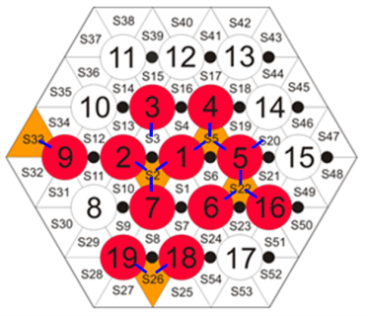
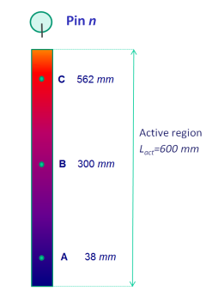
The Fuel Pin Bundle Simulator
  A 19-pin MYRRHA-like 250 kW FPS was designed, procured and installed in the NACIE-UP facility
  The FPS is wire-spaced
  It reproduces the MYRRHA pin
  The bundle is highly instrumented
D_{pin} | 6.55 mm
P | 8.4 mm
P/D | 1.2824
d | 1.75 mm
P_{wire} | 262 mm
L_{tot} | 2000 mm
L_{active} | 600 mm
D_{H,nom} | 3.84 mm
q’’_{max} | 1 MW/m²
  11 instrumented pins
  52 TCs (0.35 mm thick) - wall embedded thermocouples location
  15 TCs (0.5 mm thick) - 5 instrumented sub-channels
  Instrumentation distributed along three axial positions (A, B, C): z = 38, 300, 562 mm
  from the beginning of the active length
  Pin 3 instrumented with wall embedded TCs every 43.66 mm (13 TCs)
Overview of NACIE-UP facility

Slide 16
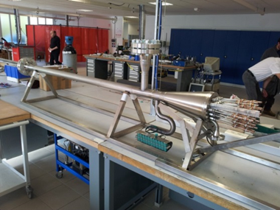
The Fuel Pin Bundle thermocouples
All the bundle thermocouples are of K type Class
Therefore the accuracy of the thermocouples according to the rule IEC 60584-3 (2007) are:±1.5 °C from -40°C to +375°C; ±0.004 t from 375°C to 1000 °C.
The error of the measurement chain has been verified and it was found negligible.
Overview of NACIE-UP facility

Slide 17
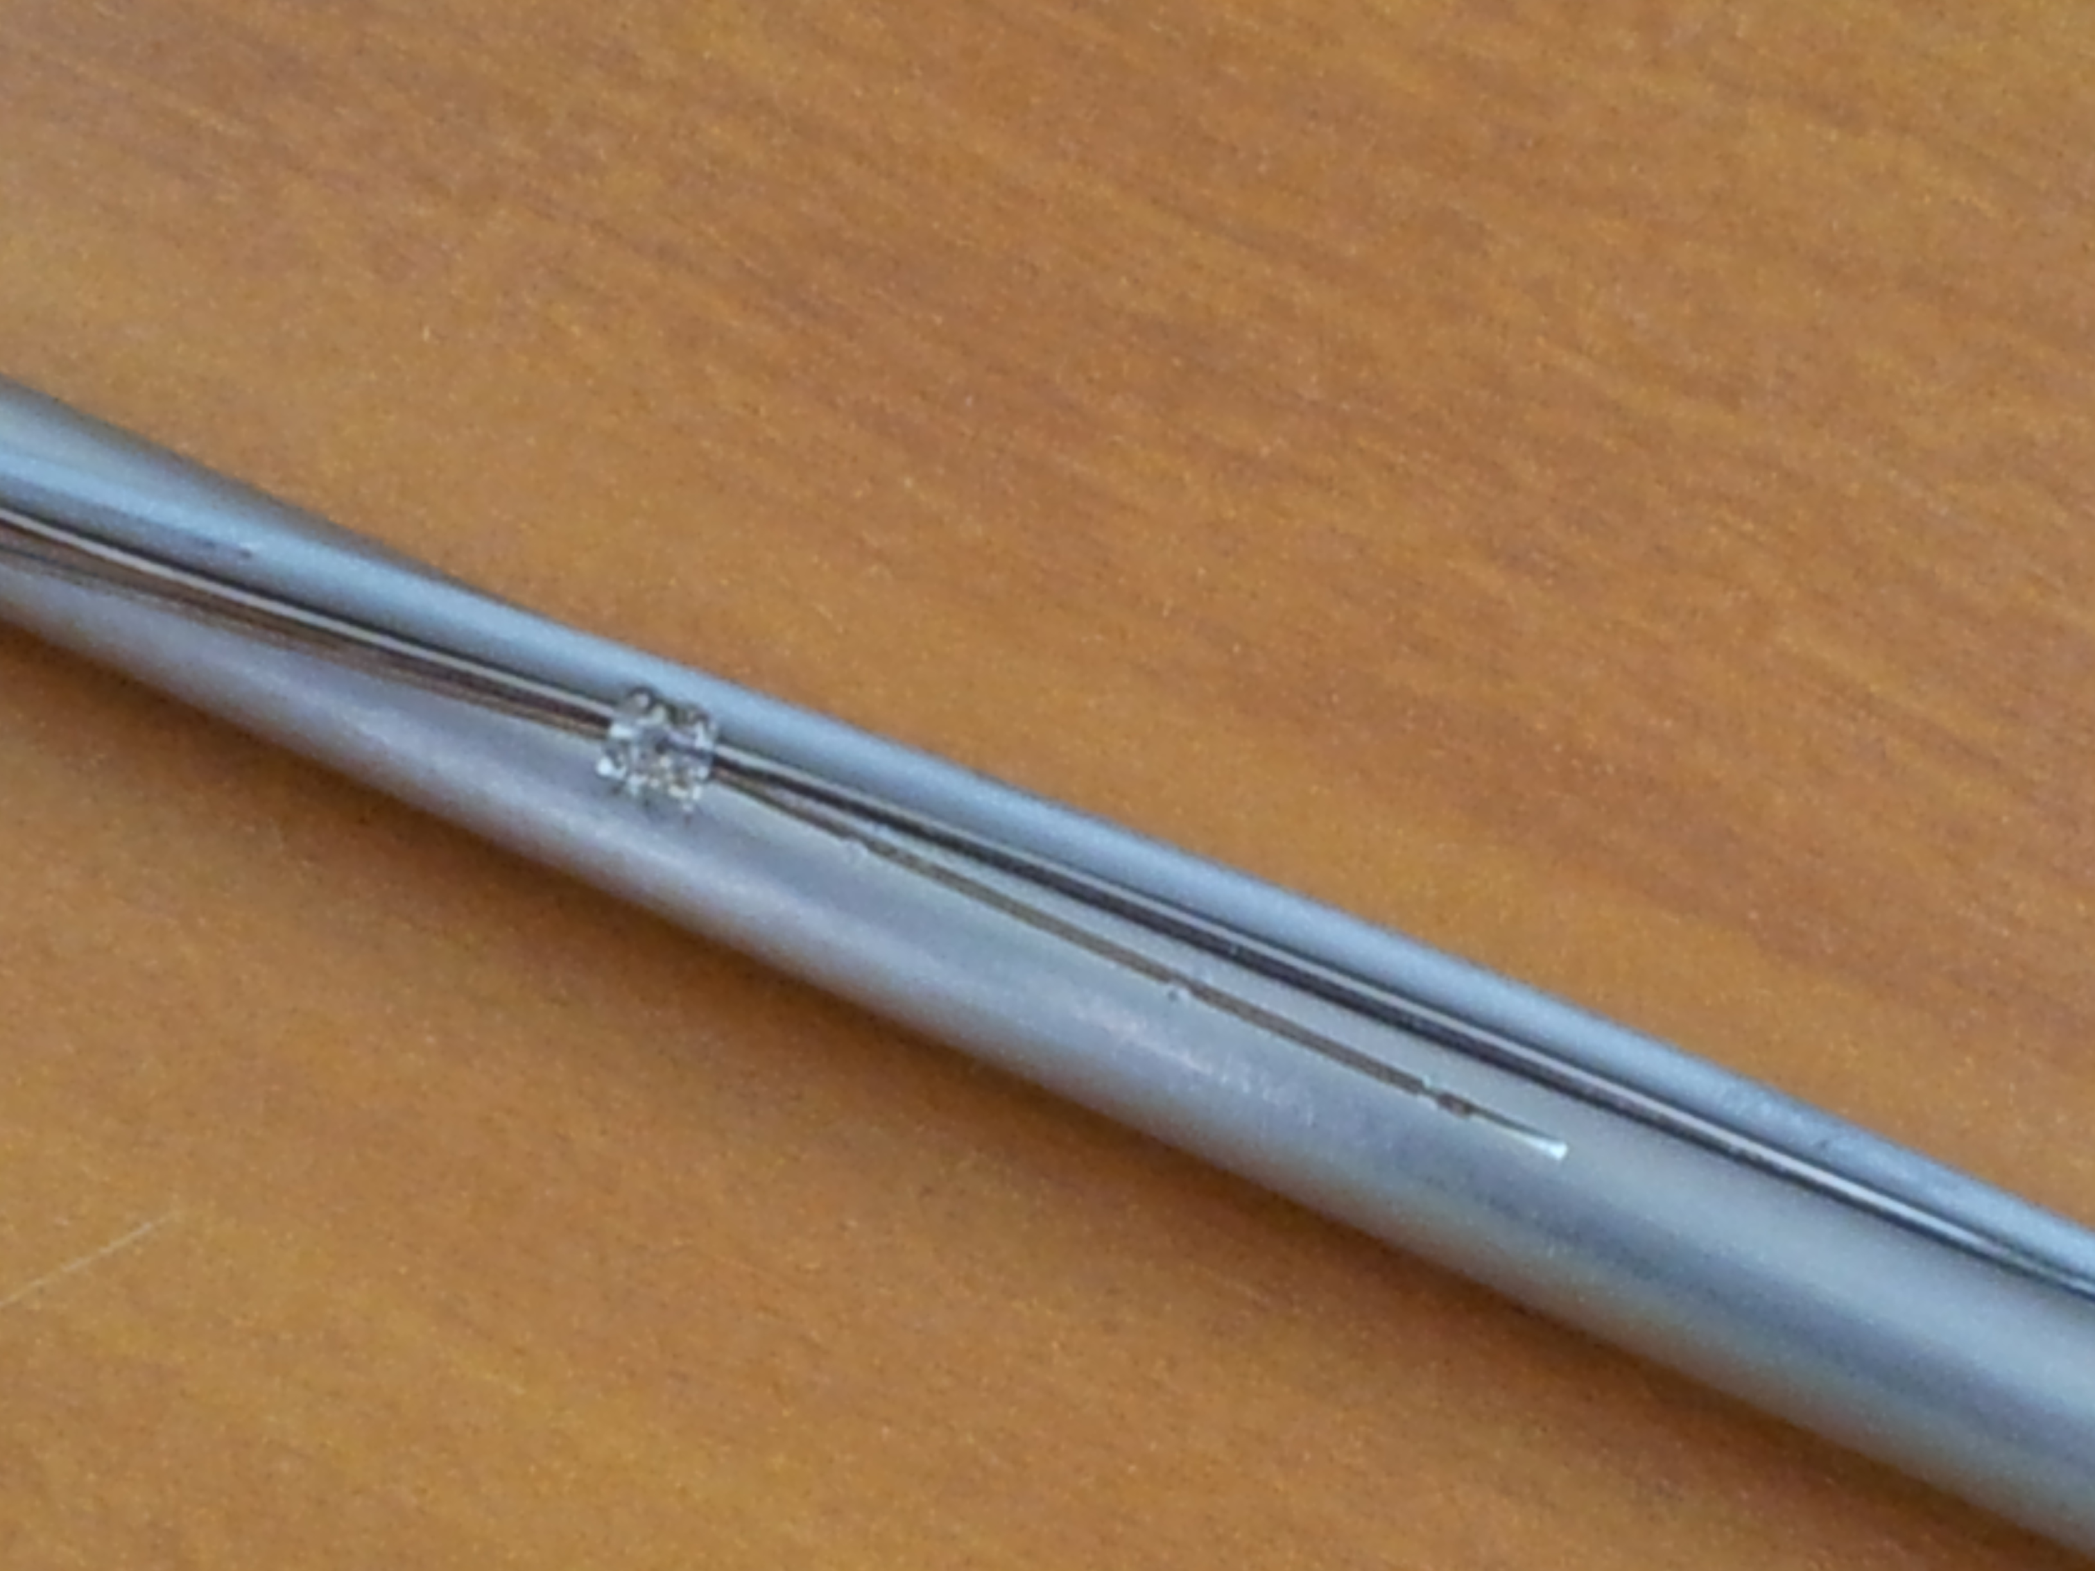
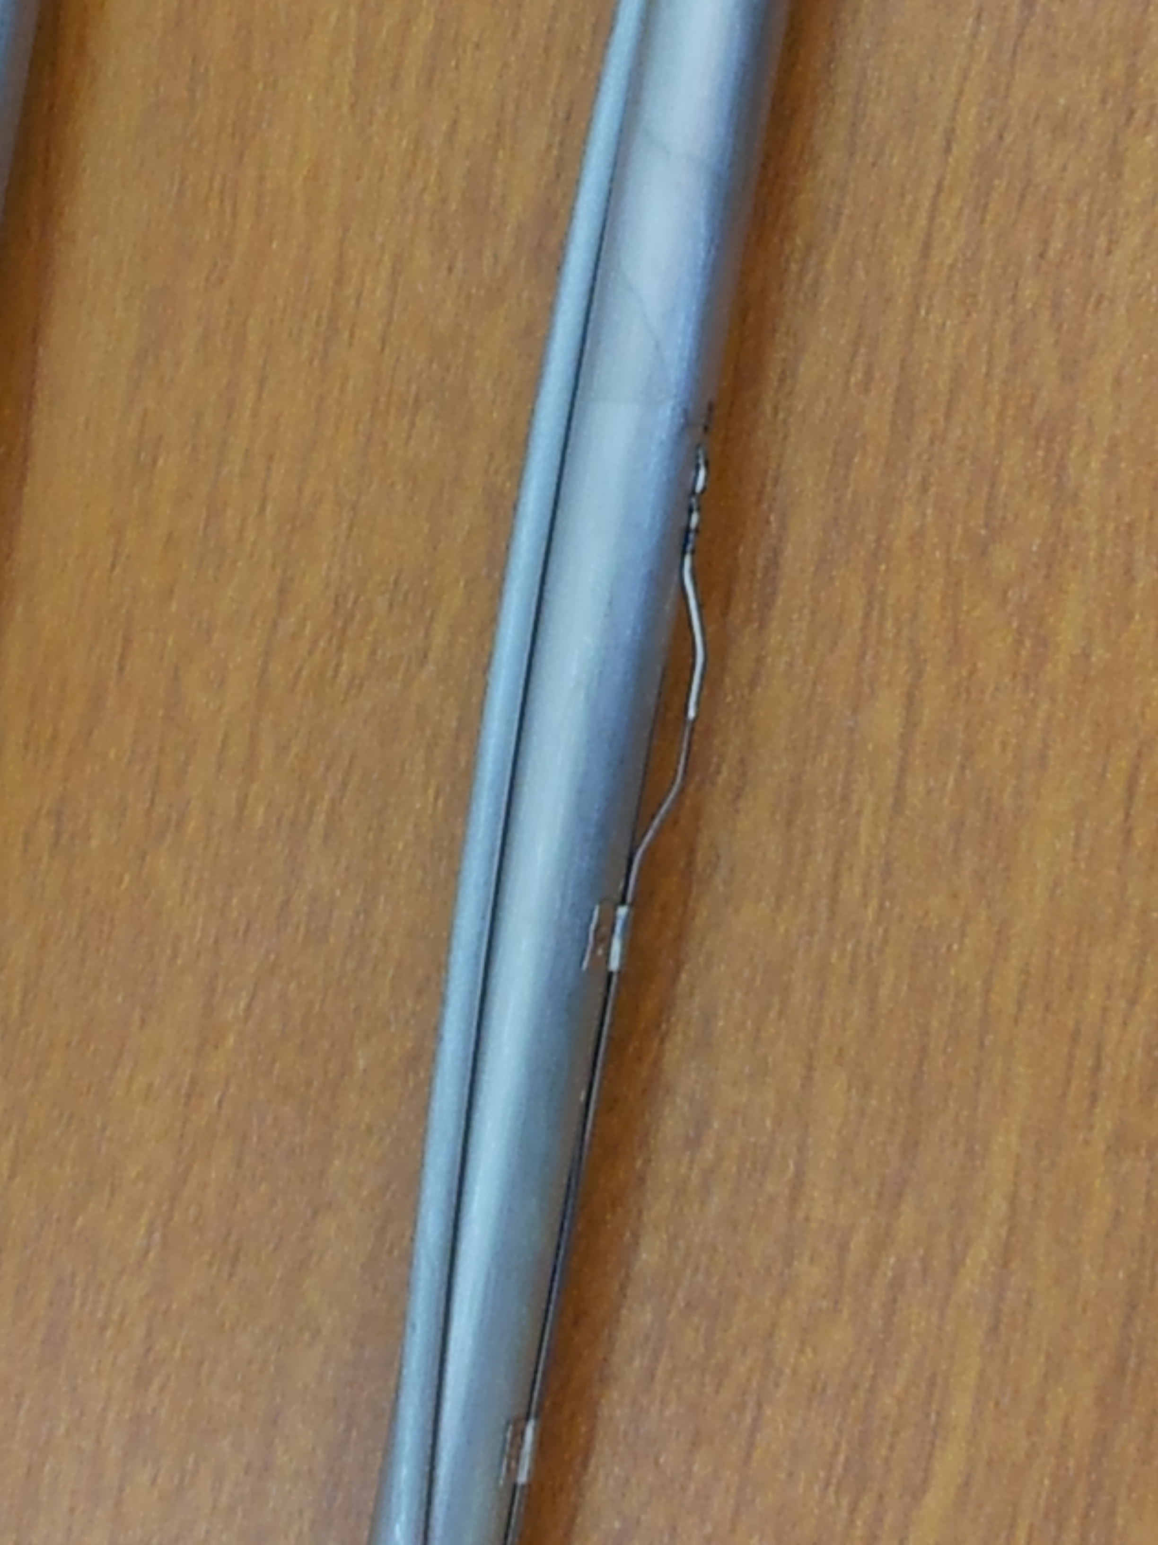
Wire-spaced FPS
Wall thermocouples are wall-embedded in a groove
Bulk thermocouples have a prolonged region to fix the position
Overview of NACIE-UP facility

Slide 18
Part 2: Experimental tests
The present paper describes experimental results obtained from the 2017 campaign performed with the NACIE-UP (NAtural CIrculation Experiment- UPgraded) facility, located at ENEA Brasimone Research Centre, in the framework of the SESAME HORIZON2020 project.
These experiments provide system data to qualify STH codes, but also more detailed information on the wire-spaced fuel bundle test section, such as wall temperatures, sub-channel temperatures and heat transfer coefficient (HTC), allowing to test and qualify CFD codes and coupled STH/CFD methods for HLM systems.
The NACIE-UP facility was designed to operate in natural and gas-lift enhanced circulation regimes allowing to cover the low Péclet (0-400) range of experiments.
Experimental tests

Slide 19
Part 2: Experimental tests
The fundamental test 3 consisted in both FPS power and gas-lift transition.
The nominal FPS power was initially set at 100 kW and decreased in 10 s to 10 kW at time t = 1335 s from the beginning of the transient.
The decrease of gas flow rate from 20Nl/min was triggered after that the power transition was completed, in order to avoid high peak clad temperatures and to preserve the bundle integrity (Protected loss of flow).
Experimental tests

Slide 20
Part 2: Experimental tests
Figure on the right shows the time trend of the LBE mass flow rate obtained during the test in the loop.
After the power and gas transition, the LBE mass flow rate decreased sharply;
then there is a local relative maximum followed by a smooth decrease.
MFR is measured by the Thermal Flow meter
Experimental tests

Slide 21
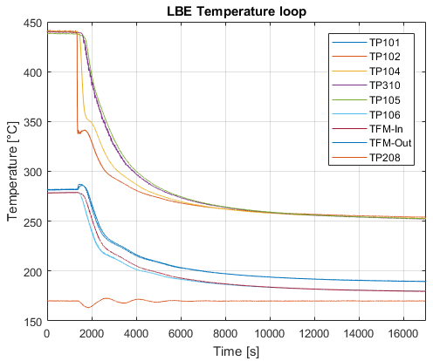
Part 2: Experimental tests
The time trend of the LBE temperature inside the main loop is illustrated in the Figure
The water temperature at the inlet of the HX (TP208) was set to 170°C and the DACS regulates the secondary side pre-heater (PID) in order to obtain the desired value
The coldest part of the loop is the lower part, while the hottest part of the loop is downstream the FPS
When the gas was switched off, the LBE mass flow rate suddenly decreases, and it caused a small peak in the LBE temperature at the thermal flow meter outlet
Experimental tests

Slide 22
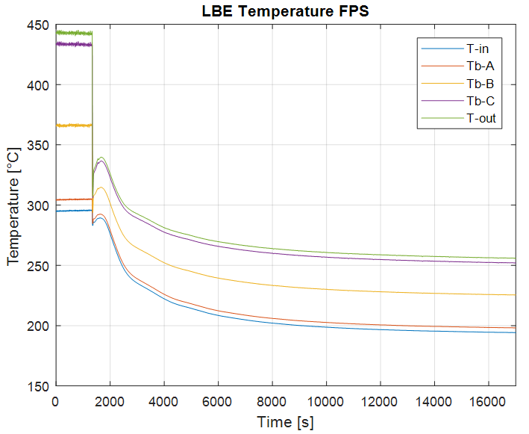
Part 2: Experimental tests
The section-averaged LBE temperature at the inlet, at the outlet of the active region of the bundle and at the three monitored sections is shown in the Figure
The LBE temperature inside the FPS decreased in accordance with the reduction of the FPS power, then a peak in all the temperatures occurred when the gas flow rate was switched off.
This peak is due to the onset of the natural circulation with a minimum in the LBE mass flow rate
After the transition the LBE temperatures stabilized to new lower values; The new steady state was reached after several hours.
Experimental tests

Slide 23
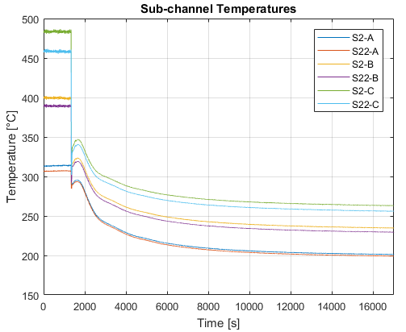
Part 2: Experimental tests
Figure on the right illustrates the LBE temperature in the monitored sub-channels S2 (central subchannel) and S22 (peripheral subchannel)
The temperature difference between the two sub-channels, at each section, decreased from the first to the second steady due to the reduction of the power generated inside the pins
Moreover, the temperature difference between central subchannel (S2) and peripheral subchannel (S22) increased going from section A to section C;
this is due to the fact that the thermal fields develops along the heated length; this remarkable result is found experimentally
Experimental tests

Slide 24
Part 2: Experimental tests
For further analysis, the average Nu versus Pe from all the three fundamental tests is reported in the Figure
Uncertainty analysis was applied to propagate uncertainty
The general trend is in accordance with Kazimi-Carelli correlation for the more developed sections B and C
Section A shows coherently higher values, since it is located at the beginning of the active region and the temperature difference between the wall and the LBE is relatively small because the thermal boundary layer is not developed
According to these results, the Kazimi-Carelli correlation seems to be more in accordance with experimental data and should be used for predictions in wire spaced HLM bundles with P/D around 1.28.
Experimental tests

Slide 25
Conclusions 1/2
This paper describes the main outcomes of the experimental campaign performed in the NACIE-UP facility at ENEA Brasimone R.C. for the SESAME EU project
The three fundamental tests concerned transients respectively with gas lift transition, power transition and the combination of the two
Only the third test (PLOFA) was presented in detail in this work
Both the loop and the FPS test section are instrumented with thermocouples and the mass flow rate is measured by innovative thermal mass flow meter
Temperatures showed a sharp decrease in the transition followed by a local maximum and a final steady state with values lower than the initial steady state
Forced to natural circulation transients in wire-spaced fuel pin bundle

Slide 26
Conclusions 2/2
Further, the analysis of the initial and final steady states was performed with uncertainty analysis and the Nusselt number is in accordance with Kazimi-Carelli correlation for Pe 0-400
A strong subchannel rank effect emerges from the experimental data, with the central subchannels hotter than the peripherals ones
As it was expected, the temperature difference increases going from section A to section C due to the developing thermal conditions
Lots of data, both integral and local, were produced and published; the aim is that this information can be used to qualify STH codes, verify CFD codes and coupled STH/CFD methods for HLM systems.
Forced to natural circulation transients in wire-spaced fuel pin bundle

Slide 27
Ivan Di Piazza
ivan.dipiazza@enea.it
Forced to natural circulation transients in wire-spaced fuel pin bundle

