Slide 1
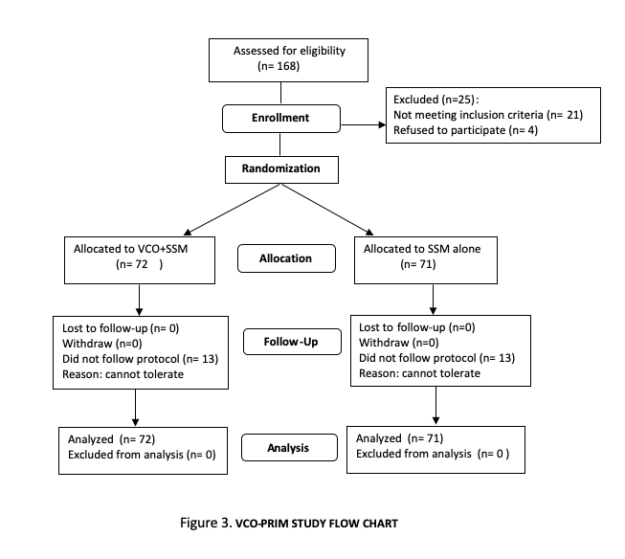
Randomized Controlled Trial Comparing Virgin Coconut Oil and Salt and Soda Mouthwash Versus Salt and Soda Mouthwash Alone In Preventing Grade 2 and Above Radiation- Induced Mucositis In Patients With Nasopharyngeal Carcinoma (VCO-PRIM STUDY)
Authors: M. Cruzª, E. Tangco^{b}, M.A. Habana^{c}, C. Cordero^{c}, J. Mantaring^{c}, G. Banuelos^{d}, T. Sarmiento^{e}, M. Olvinaª, C. Aguilarª, C. Tan-Pusag^{d}
a.Cancer Institute, Sacred Heart Medical Center, Angeles City Philippines. b. Department of Radiation, Oncology, St. Frances Cabrini Medical Center, Batangas City Philippines
c. Department of Clinical Epidemiology, UP Manila, Philippines d. Department of Radiation Oncology, Chinese General Hospital and Medical Center, Manila, Philippines
e. Department of Radiation Oncology, Dee Hwa Liong Foundation Medical Center, Angeles City, Philippines
* Corresponding author: micru694@gmail.com
Background and Objective
Determine the efficacy and safety of combining Virgin Coconut Oil (VCO) with Salt and Soda Mouthwash (SSM) compared to SSM alone in preventing grade 2 and above radiation-induced mucositis (RIM) in Nasopharyngeal Carcinoma (NPC) patients.
Results and Discussion
Table 1. Incidence of grade 2 and above radiation-induced mucositis
143 out of 168 enrolled patients were randomized. 72 to the VCO+SSM group and 71 randomized to the control group (Fig1). There were no withdrawals and losses to follow-up but 13 (18%) patients in VCO+SSM and in SSM did not strictly follow protocol. These patients were included in the ITT analysis. Baseline characteristics are comparable. Incidence of Grade 2 and above RIM is 4% less in the VCO group than the control [95% CI: -19, 12. p=0.64] (Table 1). Mucositis-related pain was less in VCO+SSM group compared with the SSM alone group [p=0.03] (Table 2). There was delay in the development of RIM in the VCO+SSM compared to SSM group [p =0.21]. Toxicity grading was less in the VCO+SSM group [p= 0.41]. All the seven serious adverse events are not related to interventions.
 | VCO+SSM (n=72) | SSM (n=71) | P-value
Cumulative Incidence | 45 (62.5%) | 47 (66.2%) | 0.64
Absolute Risk Difference | 3.7% (95% CI: -19.4, 12.0)
Relative Risk | 0.94 (95% CI: 0.74, 1.20)
Incidence rate (density) | 0.137 | 0.164
Time at risk (person-years) | 329 | 286
Time to develop RIM
Median (95% CI) | 5 (4,6) | 4 (3,5)
Methods
From May 2009 to February 2013 all patients with NPC were invited to participate in the study. This is a randomized single-blind (assessor blinded) trial. Block randomization was done to achieve an equal number of participants. Allocation concealment was done by a third party using opaque sealed envelopes. Treatment group were instructed to use both VCO with SSM while control group use SSM alone. Outcome assessment was based on NCI-common toxicity criteria ver 2.0. Outcome measure includes incidence of RIM, time to develop, adverse events and serious adverse events. Intention to treat analysis (ITT) was done for all primary outcomes. Chi square test, Mann Whitney rank sum test, t-test and likelihood ratio test were used to compare groups. Relative risk (RR), absolute risk reduction (ARR) and relative risk reduction (RRR) were estimated at 95% confidence level. An informed consent was obtained and all study data were kept confidential. The study was conducted according to the ICH-GCP standards.
Table 2. Mucositis related pain by treatment group
Grading of Mucositis Related Pain | VCO+SSM (n=72) | SSM (n=71)
0 16 (22.22%) 8 (11.27%)
1 51 (70.83%) 53 (74.65%)
2 4 (5.56%) 9 (12.68%)
3 1 (1.39%) 1 (1.41%)
4 0 (0%) 0 (0%)
Rank Sum 4784 5512
Expected 5184 5112
p= 0.0386: Result of Two-sample Wilcoxon rank-sum (Mann-Whitney) test for mucositis related pain with treatment group
Figure 1. VCO-PRIM study flow chart
Conclusions
Statistically, there is no definite evidence to show that using VCO as adjuvant with SSM in NPC patients can prevent the development of grade 2 and above RIM or decrease its incidence, delay the time of its development, and lower its toxicity grading. Clinically, there is a trend favoring benefit in using VCO+SSM at the start of the treatment for NPC patients. The 4% absolute reduction in risk and the delay in onset of having RIM maybe considered small but this minimal clinical important difference may change the concept of radiation oncologist in their patient management. More importantly, VCO+SSM can decrease mucositis-related pain in patients with NPC undergoing radiation treatment with or without chemotherapy. This finding is both statistically significant and clinically relevant because it is the primary trigger for treatment delays, treatment interruptions, hospitalizations and possible treatment failure.
[1] SHIH A, MIASKOWSKI C, DODD M et al. Mechanism for radiation-induced oral mucositis and the consequences. Cancer Nursing 2003; 26(3):222-225
[2] Madan PD, Sequeira PS, Shenoy K, Shetty J. The effect of three mouthwashes on radiation-induced mucositis in patients with head and neck malignancies: a randomized control trial. J Cancer Res Ther 2008; 4(1):3-8
References

