Slide 1
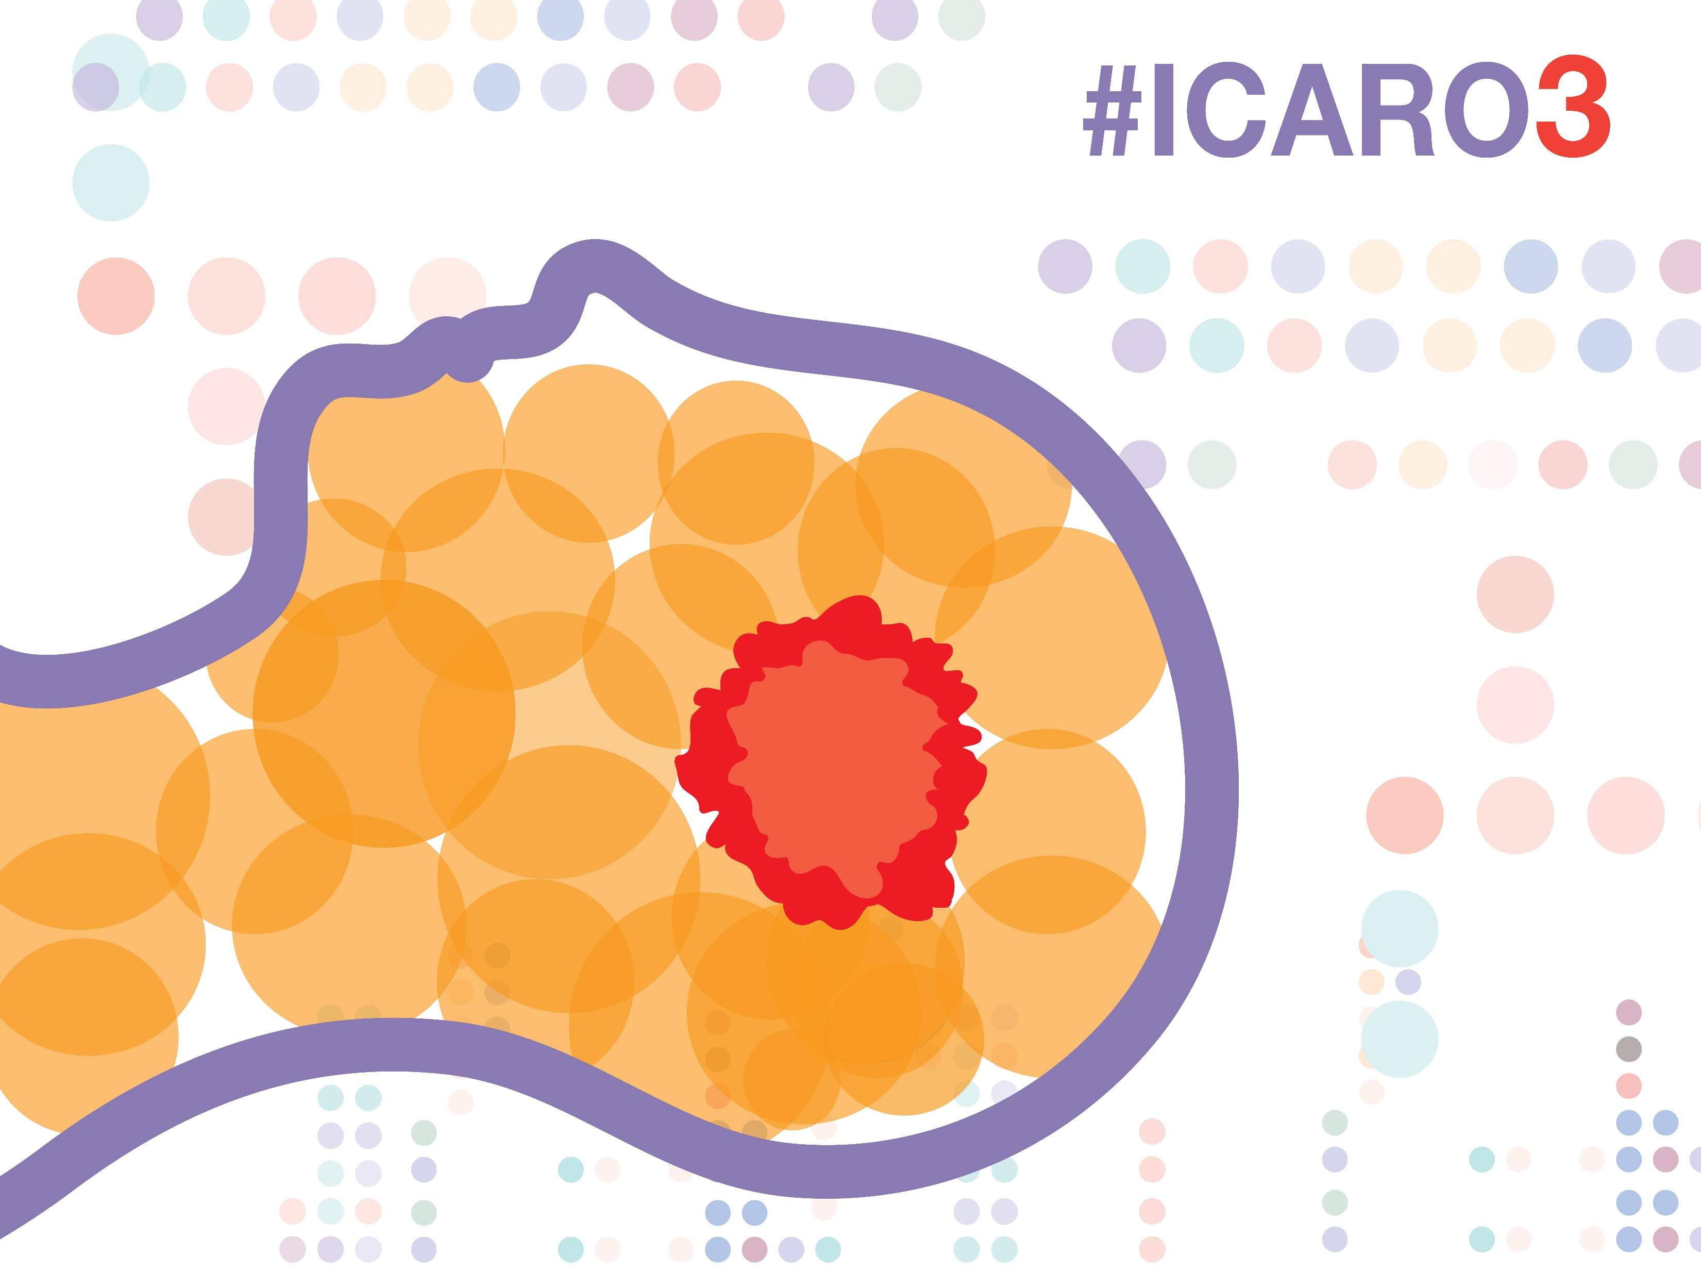
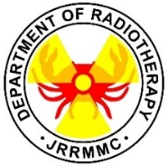
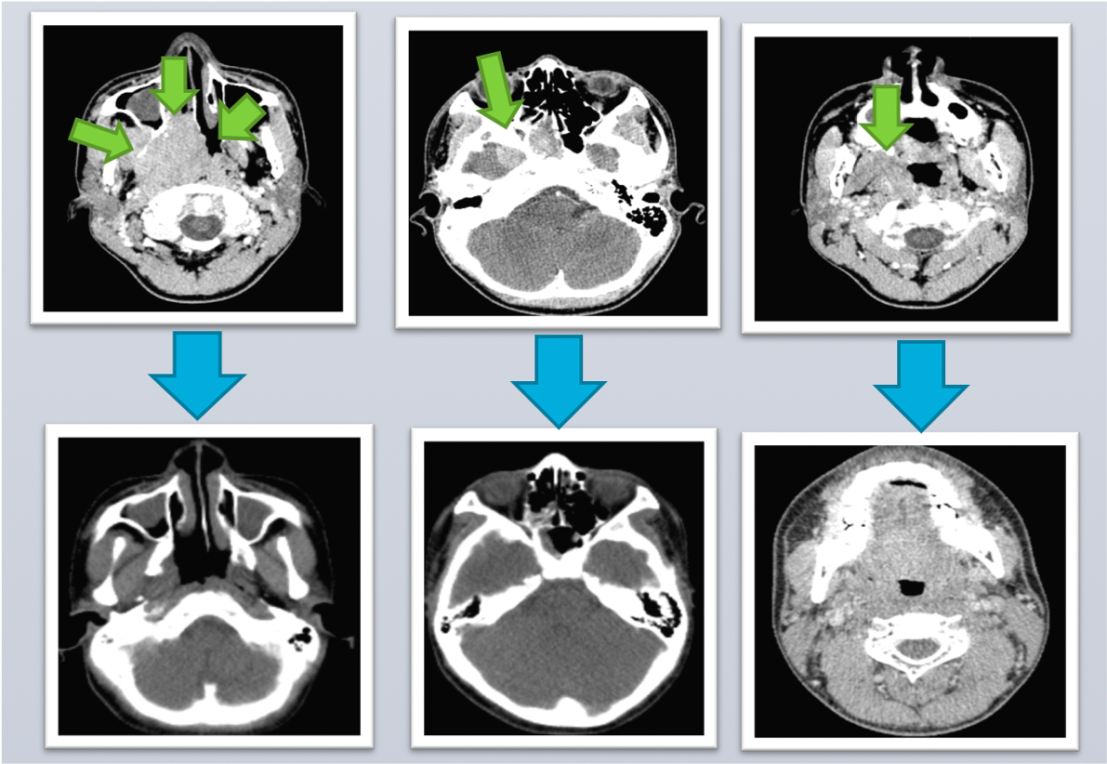
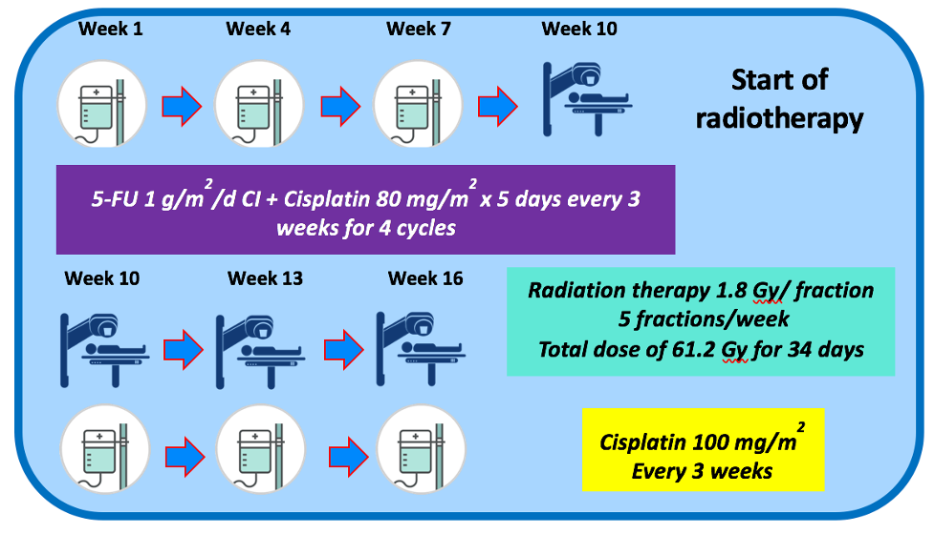
INDUCTION CHEMOTHERAPY FOLLOWED BY CONCURRENT CHEMORADIOTHERAPY IN A 14 YEAR OLD PATIENT WITH POORLY DIFFERENTIATED NASOPHARYNGEAL CARCINOMA: JRRMMC EXPERIENCE OF THE ARAR0331 PROTOCOL
Authors, M.V., BARCELONA, MD^{1,*}; J.A. FLORES, MD, DPBR-RO¹; M. GO, JR., MD, DPBR-RO¹; J. ESTANISLAO, MD, DPPS, DPSHBT, DPSPH, FPSPO²
1 Department of Radiotherapy, Jose R. Reyes Memorial Medical Center, Rizal Avenue, Sta. Cruz, Manila, Philippines
2 Section of Pediatric Hematology-Oncology- Department of Pediatrics, Jose R. Reyes Memorial Medical Center, Rizal Avenue, Sta. Cruz, Manila, Philippines
* Corresponding author: marcvincentbarcelona@yahoo.com
Background and Objective
A major issue of radiotherapy in children is toxicity. Adults with nasopharyngeal carcinoma (NPCA) usually receive concurrent chemoradiotherapy with or without adjuvant chemotherapy as standard treatment.¹
The ARAR0331 protocol published by the Children’s Oncology Group noted good overall and event-free survival rates.²
The objective was to discuss a case report of a 14 year old male patient with stage IV-A nasopharyngeal carcinoma in terms of tumor response, RTOG toxicity, and follow-up laboratories and ancillaries using the ARAR0331 Protocol.
Results and Discussion
Table 2. RTOG Toxicity Grading during the six-week treatment and post-treatment
As the patient was classified as Stratum B. Patient was planned to undergo 3 cycles of 5-fluorouracil 1 g/m²/day with cisplatin 80 mg/m² for the first 5 days of each cycle every 3 weeks. Patient was re-assessed post-treatment. Endoscopy revealed disappearance of previously noted mass. A repeat CT scan of the head and neck was also done revealing the disappearance of the mass at the right nasopharynx; disappearance of the previous superior extension; and a complete regression of the right cervical level II lymph node.
 | Week |  |  |  |  |  | Post-Treatment
RTOG toxicities | 1 | 2 | 3 | 4 | 5 | 6 | 1 mo | 6 mos | 1 yr | 3 yrs
Skin | 0 | 1 | 1 | 1 | 1 | 1 | 1 | 0 | 0 | 0
Mucous Membrane | 0 | 0 | 0 | 0 | 1 | 1 | 0 | 0 | 0 | 0
Eye | 0 | 0 | 0 | 0 | 0 | 0 | 0 | 0 | 0 | 0
Ear | 0 | 0 | 0 | 0 | 0 | 0 | 0 | 0 | 0 | 0
Saliva | 0 | 1 | 1 | 1 | 1 | 1 | 1 | 1 | 1 | 1
Pharynx | 0 | 1 | 1 | 1 | 1 | 1 | 0 | 0 | 0 | 0
Larynx | 0 | 0 | 0 | 0 | 1 | 1 | 0 | 0 | 0 | 0
Figure 1. Nasal Endoscopy with Punch Biopsy Left photo, showing a polypoid nasopharyngeal mass (green arrow) extending into the right nasal cavity before treatment in July 2016 Middle photo, showing disappearance of previously noted mass (red arrow) posttreatment in January 2018 Right photo, showing a poorly differentiated type of squamous cell carcinoma on histopathology
The ARAR0331 Treatment Protocol
Table 1. Risk Stratification of ARAR0331 Protocol²
Most of the side-effects observed were RTOG Grade 1 toxicities
Methods
The patient and his grandmother sought consulted at our institution with a chief complaint of a small, painful, palpable mass in his right neck, of one year duration, which was noted to have increased in size to around 5 x 5 cm around 5 months prior to consult. There was no associated fever or epistaxis.
Endoscopy was done which revealed a polypoid nasopharyngeal mass extending into the right nasal cavity. Punch biopsy revealed squamous cell carcinoma, poorly differentiated (see Figure 1). CT scan of the head and neck area revealed a lobulated mass at the right nasopharyngeal region, right masticator space, right pterygoid bone; same mass was extending to the right temporal lobe and sphenoid sinus; an enlarged level II lymph node on the right (2x3 cm) was noted. (see Figure 2)
Working diagnosis: Squamous cell carcinoma, poorly differentiated, nasopharynx, Stage IVA (T4N1M0).
Initially, patient was advised referral for intensity modulated radiation therapy (IMRT) due to concerns of late toxicity which would be decreased by the use of more conformal forms of radiation therapy; however, the patient’s grandmother was concerned with potential costs of treatment and both the grandmother and patient made the decision to be treated at our institution. Both were duly appraised and were instructed about the potential toxicities of 2D conventional radiation therapy. Consent to treatment at our institution was given.
MDT Consensus: INDUCTION CHEMOTHERAPY FOLLOWED BY DOSE-ADAPTED CHEMORADIOTHERAPY (ARAR0331 PROTOCOL)
Stratum | Target Volume | Dose
Stratum A | Nasopharynx LN regions I-III, upper ½ IV-V | Stage I: 61.2 Gy Stage II: 66.6 Gy
Stratum B | Nasopharynx LN regions I-V | Stages IIb-IV (dose dependent on response to induction chemo) CR/PR: 61.2 Gy SD: 70.2 Gy
Table 3. Results of Laboratory and Ancillary Procedures (Post-treatment)
 | Results
Bone scan | No distinct scintigraphic evidence of bone metastasis
Chest X-ray | Normal chest findings
Whole Abdominal UTZ | Normal findings
Audiogram | Normal hearing threshold, bilateral
Dental Evaluation | Gums and teeth are in good condition. No signs of osteoradionecrosis
Blood Chemistry | Results Normal Values Creatinine 75.91umol/L 62-123 umol/L TSH 3.03 uIU/mL 0.25-4.0 uIU/mL FT3 4.2 pg/mL 2.0-4.25 pg/ml FT4 12.87 pg/mL. 7.0-18.0 pg/ml
CBC | Hemoglobin 14.4g/dL 14.1-18.1 Hematocrit 44.0 % 43.5-53.7 % WBC 8.27 4.7-6.1 RBC 5.08 4.6-10.2 Platelet 298 130-400
MMSE and MOCA-P Tests | Score of 30 (normal/no cognitive impairment)
Patients in Stratum A are prescribed doses depending on their stage. Stratum B patients receive doses depending on their response with complete or partial responders receiving a “de-escalated dose”
Figure 2. CT scan of the Head and Neck Area Top row from left to right (pre-treatment, July 2016): A lobulated mass at the right nasopharyngeal region, right masticator space, right pterygoid bone; same mass extending to the right temporal lobe and sphenoid sinus; an enlarged level II lymph node on the right (2x3 cm). Bottom row from left to right (post-treatment, January 2018): no mass at the right nasopharyngeal region; disappearance of the previous superior extension; complete regression of the right cervical level II lymph node.
Conclusions
Patient completed treatment with no adverse events. Follow-up after 3 years has shown no recurrence of the tumor, no distant metastases, and with old mild RTOG Grade 1 xerostomia
To our knowledge, this is the first reported use of the ARAR0331 protocol for a case of pediatric NPCA in the country and it illustrates its feasibility and medium-term effectiveness. It also highlights the protocol as an avenue for dose adaptation to possible reduce radiation late effects to pediatric patients.
[1] Al-Sarraf, M., LeBlanc M., Giri P.G., et al. Chemoradiotherapy versus radiotherapy in patients with advanced nasopharyngeal cancer: phase III randomized Intergroup study 0099. J Clin Oncol 1998;16:1310-1317.
[2] Rodriguez-Galindo, C., Krailo, M., Krasin, M., McCarville, M., Hicks, J., Pashankar, F. & Pappo, A. (2016) Treatment of childhood nasopharyngeal carcinoma (cNPC) with neoadjuvant chemotherapy (NAC) and concomitant chemoradiotherapy (CCRT): Results of the Children’s Oncology Group ARAR0331 study. Journal of Clinical Oncology 2016 34:15_suppl, 10513-10513.
References

