Slide 1
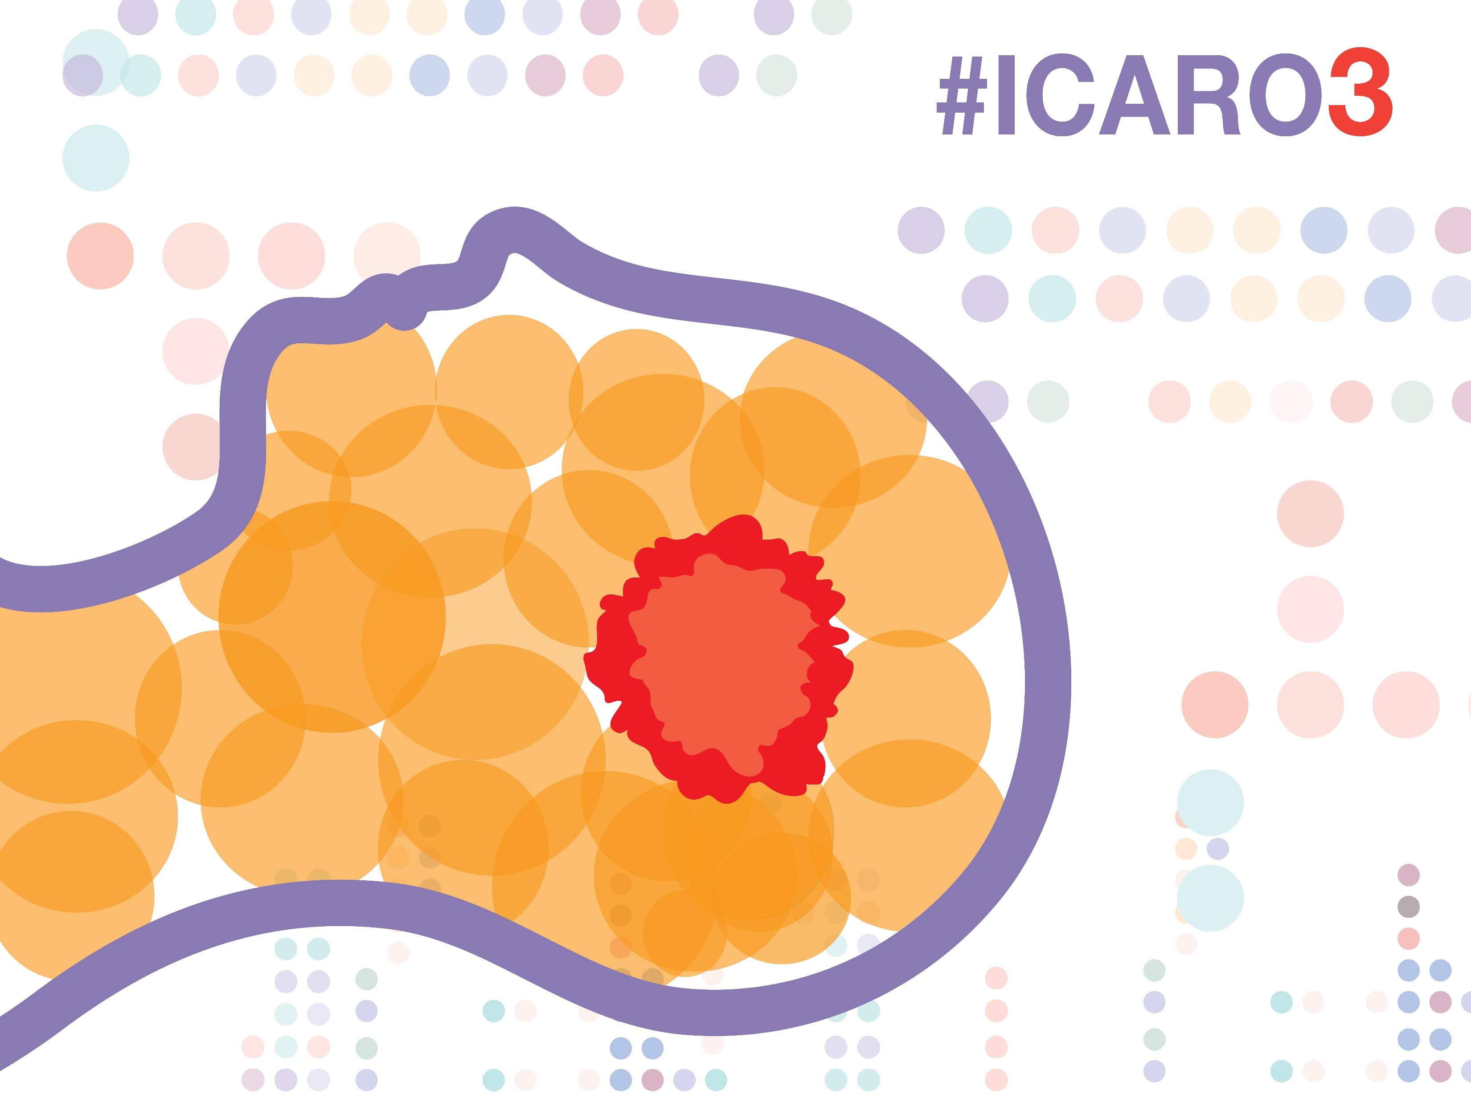
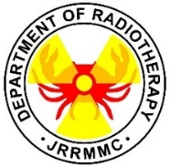
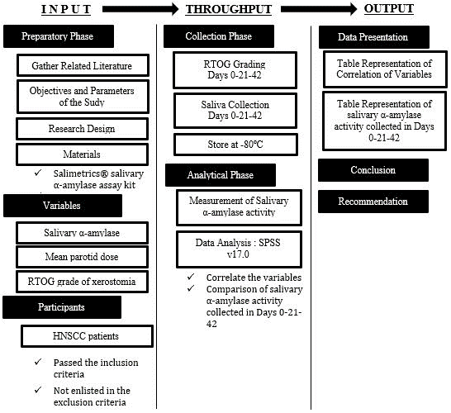
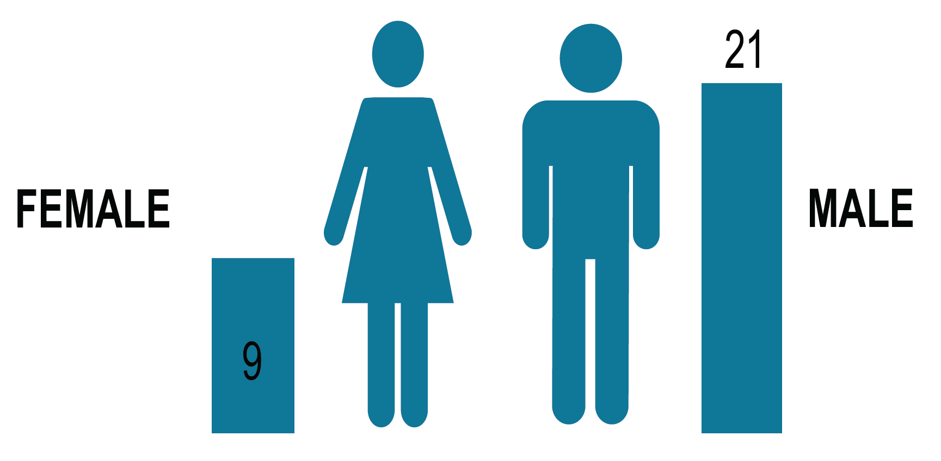
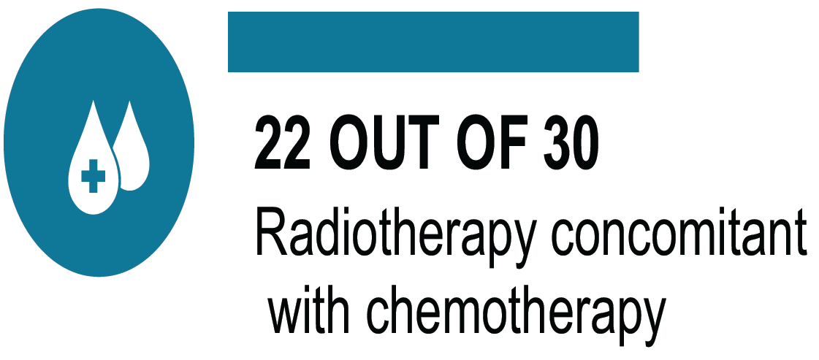
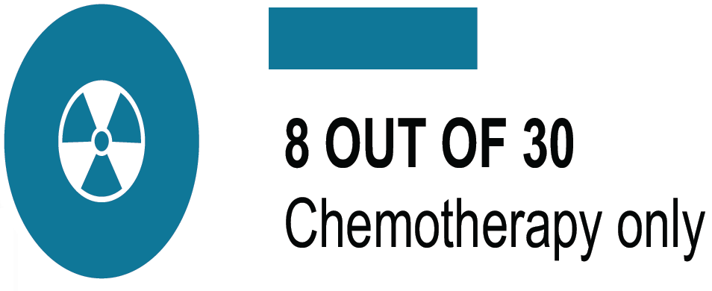
CORRELATION BETWEEN THE LEVELS OF SALIVARY α-AMYLASE ACTIVITY AND XEROSTOMIA IN HEAD AND NECK CANCER PATIENTS UNDERGOING RADIATION THERAPY
Authors: J.A. FLORES, MD, FPCR¹; E.M. CHIONG, MD¹., M. GO, JR., MD, DPBR-RO¹, R. Vasquez, PhD², A.R. Flores, MPH²
1 Department of Radiotherapy, Jose R. Reyes Memorial Medical Center, Rizal Avenue, Sta. Cruz, Manila, Philippines
2 Faculty of Pharmacy, University of Santo Tomas, Espana, Manila
* Corresponding author: edwinmarkchiong@gmail.com
Introduction
One main toxicity induced by radiotherapy to HNSCC patients are the destruction of salivary glands, especially the parotid gland.
The destruction of salivary glands causes xerostomia among patients which is commonly termed as “dry mouth”.
In this study, the levels of α-amylase, which is a major enzyme found in saliva, are correlated with the degree of xerostomia among patients undergoing radiotherapy.
Objectives
To measure and compare the enzymatic activity of salivary α-amylase at Day 0, Day 21, and Day 42.
To determine the degree of xerostomia among HNSCC undergoing radiotherapy.
To correlate the mean parotid dose and mean salivary α-amylase activity
To determine whether salivary α-amylase is an effective marker for toxicity
Methods
Source |  | Type III Sum of Squares | Df | Mean Square | F | Sig
Day | Greenhouse-Geisser | 368918.228 | 1.202 | 306996.160 | 166.283 | 0.000
PERARSON CORRELATION RESULTS FOR MEAN α-AMYLASE AND MEAN PAROTID DOSE
There is a significant decrease in amylase concentration in patients during their course of radiotherapy session.
Variables |  | MPD
MAA | Pearson Correlation | -.966**
 | Sig. (2-tailed) B | .000 -.021
 | Sum of Squares and Cross-products | -695494.832
 | Covariance | -23982.580
 | N | 30
PAIRWISE COMPARISON FOR α-AMYLASE CONCENTRATIONS PER COLLECTION PERIOD
AMYLASE CONCENTRATIONS BY COLLECTION PERIOD |  | MEAN DIFFERENCE (I-J) | Std Error | SIGNIFICANCE | 95% CONFIDENCE INTERVAL FOR DIFFERENCE
 |  |  |  |  | LOWER BOUND | UPPER BOUND
I | J
DAY 0 | DAY 21 DAY 42 | 151.741 110.177 | 9.819 10.544 | 0.000 0.000 | 126.792 83.386 | 176.690 136.967
DAY 21 | DAY 0 DAY 42 | -151.741 -41.564 | 9.819 3.779 | 0.000 0.000 | -176.690 -51.167 | -126.792 -31.962
DAY 42 | DAY 0 DAY 21 | -110.177 41.564 | 10.544 3.779 | 0.000 0.000 | -136.967 31.962 | -83.386 51.167
The result of the Pearson correlation is -0.966.
Hence, there is a strong negative correlation between the two variables. This means that as one increases the dose of radiation given to the patients, the levels of amylase decrease by 0.021 U/mL as reflected by the Bvalue.
Results
DEMOGRAPHICS
This indicates that the salivary α-amylase activity decreases as radiotherapy progresses but when it reaches the Day 42 the leve ls would s lightly elevate but not equal to or greater than its baseline, the Day 0.
Conclusions
In comparison to the baseline, there was a decrease in the levels of salivary α-amylase on the Day 21. The posttreatment levels of salivary α-amylase on the Day 42 measured to be greater than that of the Day 21 but with high variations from each other.
As the radiotherapy continues, the probability of having a RTOG Grade of 1 and 2 is greater than having a RTOG Grade of 0.
The levels of salivary α-amylase and the mean parotid dose showed an inverse relationship that as the dose administered to the patients increases, the levels of salivary α-amylase decreases.
Based on the study conducted and the established relationship between the variables, the quantitation of salivary α-amylase is an effective predictive marker for radiation induced salivary gland toxicity in HNSCC patients.
Jose R. Reyes Memorial Medical Center
AMYLASE CONCENTRATION LEVELS AND RTOG GRADING OF XEROSTOMIA
INCLUSION
1. Biopsy proven malignancy of the head and neck, stage I-IVB
2. Early and advance head and neck cancer patients treated with concurrent chemoradiotherapy
3. Early stage head and neck cancer patients treated with radiation therapy alone
4. Cleared by the dentist
EXCLUSION
1. Had xerostomia prior to treatment
2. History of salivary gland disease
3. Blood contamination
4. Recurrent HNC patients
5. Metastatic disease
6.Elevated hepatic and renal enzymes prior to treatment
7. History of disease of pancreas or hepatobiliary tract
RTOG |  | B | Std. Error | Wald | df | Sig. | Exp(B) | 95% CI for Exp(B)
 |  |  |  |  |  |  |  | Lower Bound
1 | Intercept | -2.920 | 2.508 | 1.356 | 1 | .244
 | AMYLASE | -.036 | .017 | 4.207 | 1 | .040 | .965 | .933
 | Radiotherapy Period | 2.928 | 1.117 | 6.867 | 1 | .009 | 18.682 | 2.092
2 | Intercept | -3.232 | 2.572 | 1.579 | 1 | .209
 | AMYLASE | -.040 | .018 | 4.631 | 1 | .031 | .961 | .927
 | Radiotherapy Period | 3.151 | 1.175 | 7.198 | 1 | .007 | 23.367 | 2.338
30 Head and Neck Cancer Patients ( April 2018 to November 2018)
References
PANTEGHINI, M., BAIS, R., Serum enyzmes. Tietz Textbook of Clinical Chemistry and Molecular Diagnostics, 6th edn, Elsevier Inc (2017)
PINNA, R., CAMPUS, G., CUMBO, E., MURA, I., MILIA, E., Xerostomia induced by radiotherapy: An overview of the physiopathology, clinical evidence, and management of the oral tongue, Therapeutics and Clinical Risk Management (2015)
VEDAM, V.K.V., BOAZ, K., NATARAJAN, S., GANAPATHY, S., Salivary Amylase as a Marker of Salivary Gland Function in Patients Undergoing Radiotherapy for Oral Cancer, Journal of Clinical Laboratory Analysis (2017)
SALIMETRICS. Salivary α-Amylase Kinetic Enzyme Assay Kit (2018) p1-17, retrieved from https://salimetrics.com/wp-content/uploads/2018/03/alpha-amylase-saliva-elisa-kit.pdf

