Slide 1
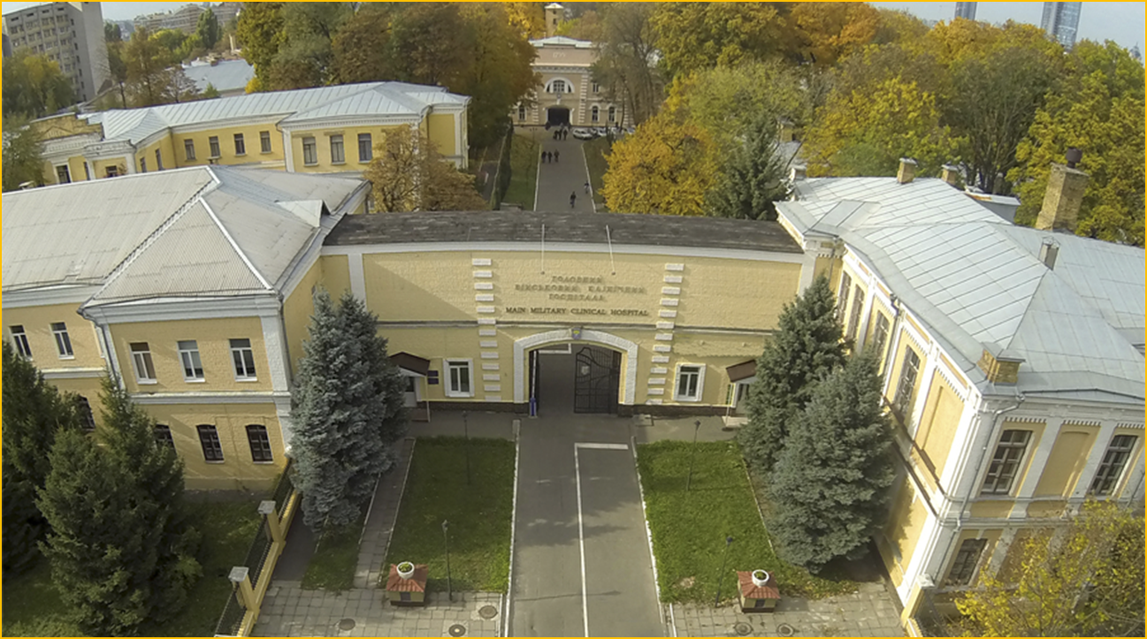


Concomitant boost in preoperative radiation of rectal cancer Indico #3
National Military Medical Clinical Center
"Main Military Clinical Hospital“, Kyiv, Ukraine
Elena Yermilova, Head of the Radiation Therapy Department
Oksana Kozak, PhD, medical physicist
Anastasiia Karnaukhova, medical physicist
Notes:
Hello dear colleges.
Let me introduce myself. I am Elena Yermilova, head of the Radiation Therapy department of National Military Medical Clinical Center "Main Military Clinical Hospital“ in Kyiv in Ukraine.
I and my team want presented our work Concomitant boost in preoperative radiation of rectal cancer

Slide 2
INTRODUCTION
Rectal cancer ranks 4th in the causes of death from cancer in the population of Ukraine.
Pre-surgical radiation therapy for rectal cancer patients is widespread in Ukraine.
Gamma therapy devices with a cobalt source are still the main source of radiation for patients in Ukraine.
The aim of our work was to assess the degree of tumor regression after irradiation using an additional local dose of 0.3 Gy per irradiation session in comparison with the standard fractionation of 2 Gy in pre-surgical irradiation of rectal cancer.
Notes:
Rectal cancer ranks 4th in the causes of death from cancer in the population of Ukraine.
Pre-surgical radiation therapy for rectal cancer patients is widespread in Ukraine.
The question of delivery of concomitant boost – additional small dose about 0.3 Gy locally to the tumor in the same fraction of external irradiation - is still under consideration
An obvious obstacle to this regime of irradiation is the additional time spent on an additional planning involving medical physicist and radiotherapist and additional load on the accelerator.
Nevertheless, the analysis of the results in comparing of the treatment with and without concomitant boost could be of help in gaining deeper knowledge in radiobiology of tumor response to different regimes.
The aim of the work was to evaluate tumor regression after irradiation of the rectal cancer with and without additional dose 0.3 Gy locally in the same radiation session.

Slide 3
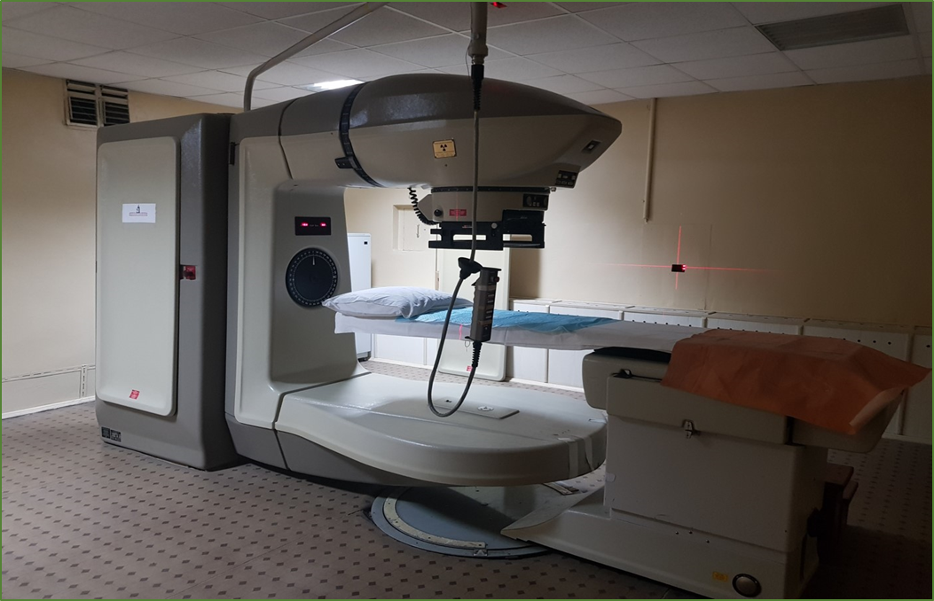
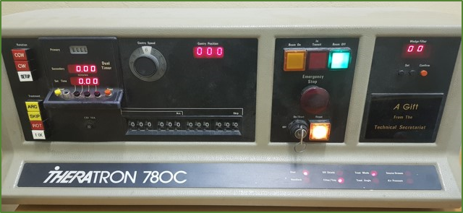
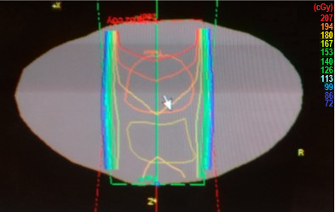
METHODS
Patients are irradiated using a gamma therapeutic apparatus “THERATRON 780-C” (⁶⁰Co source)
Dosimetryс plans was carried out using the "TheraPlan+" Treatment Planning System
Patient groups:
The study involved 39 patients with histologically confirmed diagnosis of rectal cancer and the same clinical status.
According to CT and MRI:
abnormal lymph nodes were not found in 17 patients; 22 patients were diagnosed with from one to two affected lymph nodes in the iliac region (N1-N2).
Tumor sizes ranged from T1 to T3.
No distant metastases were found (M0).
The patients were divided into two randomized groups (group I :19 people and group II : 20 people) according to a random sample.
Group II
1.8 Gy x 23 fr., in total 41.4 Gy for the whole pelvis (opposite fields)
+
0.3 Gy x 23 fr. integrated boost locally on the rectum (three-field method), in total 48.3 Gy (equivalent dose in 2 Gy fractions = 50 Gy)
Group I
2 Gy x 23 fr., in total 46 Gy for the whole pelvis (opposite fields)
Notes:
The study involved 39 patients with histologically confirmed diagnosis of rectal cancer and the same clinical status have been involved into the study.
Colonoscopy has been performed followed by histological analysis.
In all patients histological examination confirmed squamous cell carcinoma.
In CT and MRI studies pathological lymph nodes in the iliac region have been diagnosed in 22 patients (N1-N2), in 17 patients the affected lymph nodes were absent at CT/MRI studies.
No distant metastases were detected.
Patients are irradiated using a gamma therapeutic apparatus “THERATRON.
Dosimetriс plans was carried out using the "TheraPlan +" Treatment Planning System
The patients were divided into two randomized groups (group first:19 people and group second: 20 people) according to a random sample.
The first group before the operation received 2 Gy for the small pelvis by opposite fields up to 46 Gy. In the second group after delivery of 1.8 Gy to the small pelvis by opposite fields, rectum was irradiated locally by three fields technique up to 0.3 Gy.
The dose was administered over 23 fractions 5 times per week. Thus, in the second group the pelvis received 41.4 Gy and the rectum – 48.3 Gy respectively.

Slide 4
RESULTS 1
The assessment of the degree of tumor regression was carried out by comparing MRI or CT studies before and after irradiation.
Surgical evaluation of treatment results was also taken into account.
Maintenance therapy was the same in the first (I) and second (II) groups.
No significant difference in the number of radiation reactions during irradiation was observed in the first and second groups. Vomiting, frequent urination, and problems with emptying were virtually equal in percentage terms.
73.68% of patients in group 1 (14 people) and 75% of patients in group 2 (15 people) experienced discomfort during irradiation with the indicated symptoms.
Notes:
The degree of tumor response was assessed by comparing CT/MRI scans before irradiation and two weeks after it.
Surgical evaluation of treatment outcomes was also taken into account.
Supportive care was the same in the first and the second groups. 5-FU with the aim of immunomodulation was prescribed in both groups according to protocol.
Vomiting, frequent urination, problems with bowel emptying in a percentage value was actually equal in both groups.
About 75 % of patients in the both groups experienced discomfort with the indicated symptoms during the treatment period. Nevertheless, patients in the second group not reliably were in a better state during irradiation.

Slide 5
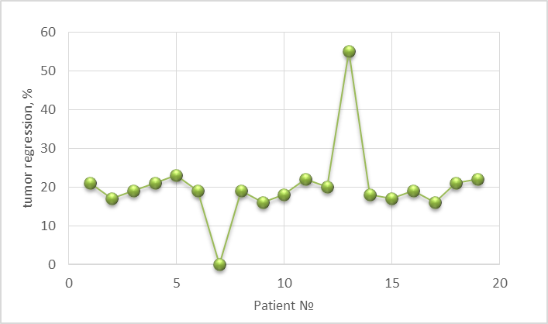
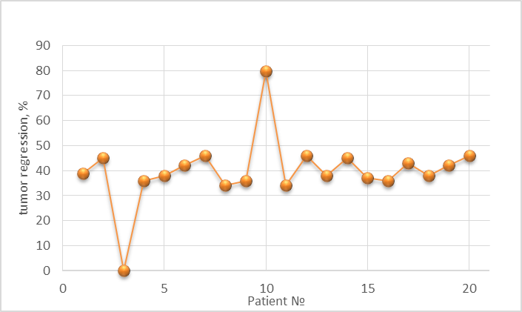
RESULTS 2
In group I, where patients received standard fractionation (2 Gy x 23 fr., I.e. 46 Gy), the degree of regression averaged 20.16 % of the initial volume (from 0 to 55%). In the group II (1.8 Gy x 23 fr., in total 41.4 Gy for the whole pelvis (opposite fields) + 0.3 Gy x 23 fr. integrated boost locally on the rectum ) - on average 39.72 % (from 0 to 79.6%).
Group I
Group II
Also, after the operation, an independent evaluation of the surgeons showed that preference was given to the second radiation regime with a local additional dose.
We also used an additional dose subsequently in inoperable patients with combined radiation therapy. It is interesting to note that the significant degree of tumor regression after remote irradiation facilitates brachytherapy. If in case of large tumors it is necessary to insert needles into the pararectal tissue for uniform irradiation of the focus, then with good regression it is sufficient to carry out intracavitary therapy.
Notes:
In the first group where patients received standard fractionation, the degree of tumor regression amounted to 20 % of the initial volume in average (from 0 to 55 %). In the second group – up to 40 % in average (from 0 to 80%).
Also, after the operation, an independent evaluation of the surgeons showed that preference was given to the second radiation regime with a local additional dose.
We also used an additional dose subsequently in inoperable patients with combined radiation therapy. It is interesting to note that the significant degree of tumor regression after remote irradiation facilitates brachytherapy. If in case of large tumors it is necessary to insert needles into the pararectal tissue for uniform irradiation of the focus, then with good regression it is sufficient to carry out intracavitary therapy.

Slide 6
DISCUSSION / CONCLUSION
Integrated boost locally on the rectum (three-field method) of 0.3 Gy in one session of preoperative radiation therapy leads to more significant tumor regression compared to standard fractionation.
Patients tolerate this regimen with the same degree of radiation reactions as in the usual regimen.
Additional radiation can be used prior to brachytherapy, allowing for more localized dose delivery in brachytherapy.
Notes:
In conclusion we can see that Integrated boost locally on the rectum (three-field method) of 0.3 Gy in one session of preoperative radiation therapy leads to more significant tumor regression compared to standard fractionation. Patients tolerate this regimen with the same degree of radiation reactions as in the usual regimen.
Additional radiation can be used prior to brachytherapy, allowing for more localized dose delivery in brachytherapy.
Thank you for your attention

