Slide 1
The 3rd International Conference on Advances in Radiation Oncology (ICARO-3)
#INDICO NUMBER 44:
A study on the determination of relative output factors for very small fields in stereotactic radiosurgery
D. D. Chi^{a,b}, T. N. Toan^{b}, R. Hill^{c,d}
ª108 Central Military Hospital, 1 Tran Hung Dao street, Hai Ba Trung district, Hanoi, Vietnam.
^{b}Vietnam Atomic Energy Institute, 59 Ly Thuong Kiet street, Hoan Kiem district, Hanoi, Vietnam.
^{c}Chris O’Brien Lifehouse, 119 – 143 Missenden Road, Camperdown NSW 2050, Australia
^{d}Institute of Medical Physics, School of Physics, The University of Sydney NSW 2006, Australia.
Email address of Corresponding Author: chidd108@gmail.com
16–19 Feb 2021

Slide 2
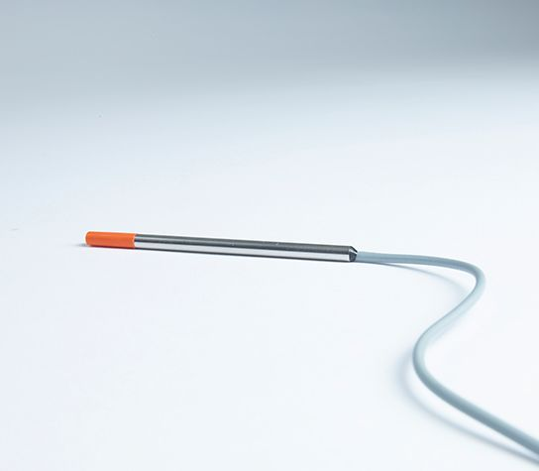
Introduction
Large uncertainties in relative output factor (ROF) small fields dosimetry motivated multicentric studies.
The IAEA TRS-483 Code of Practice (COP) provides advice on how to measure small field data as well as correction factors for commonly used detectors for a range of field sizes and beam energies.
However, the COP does not include data for recently released detectors such as the IBA Razor diode and there is minimal data for very small fields with dimensions less than 1cm.
The purpose of this work was to determine ROFs $Ω_{Q_{clin},Q_{msr}}^{f_{clin},f_{msr}}$ for SRS cone defined fields and determine correction factors $k_{Q_{clin},Q_{msr}}^{f_{clin},f_{msr}}$for the IBA Razor diode using the TRS-483 COP and Gafchromic EBT3 film.

Slide 3
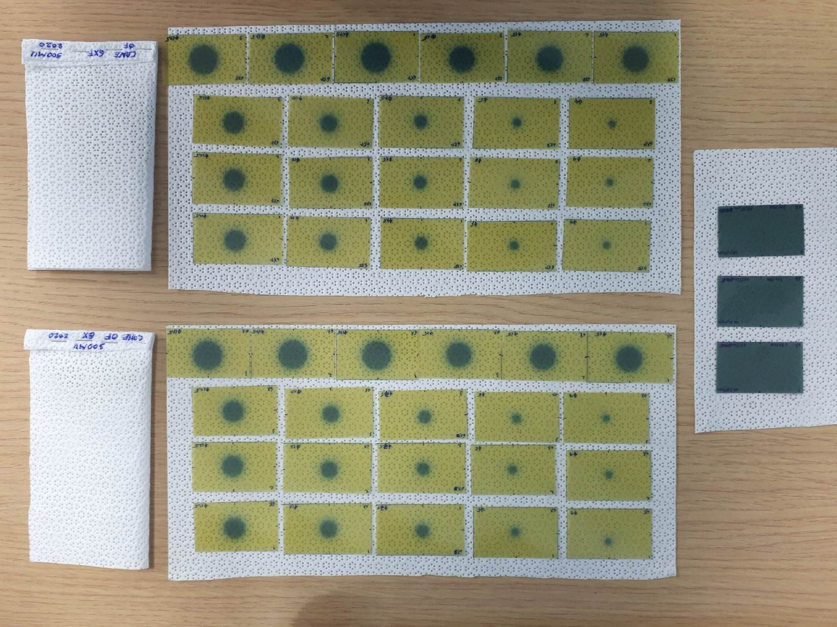
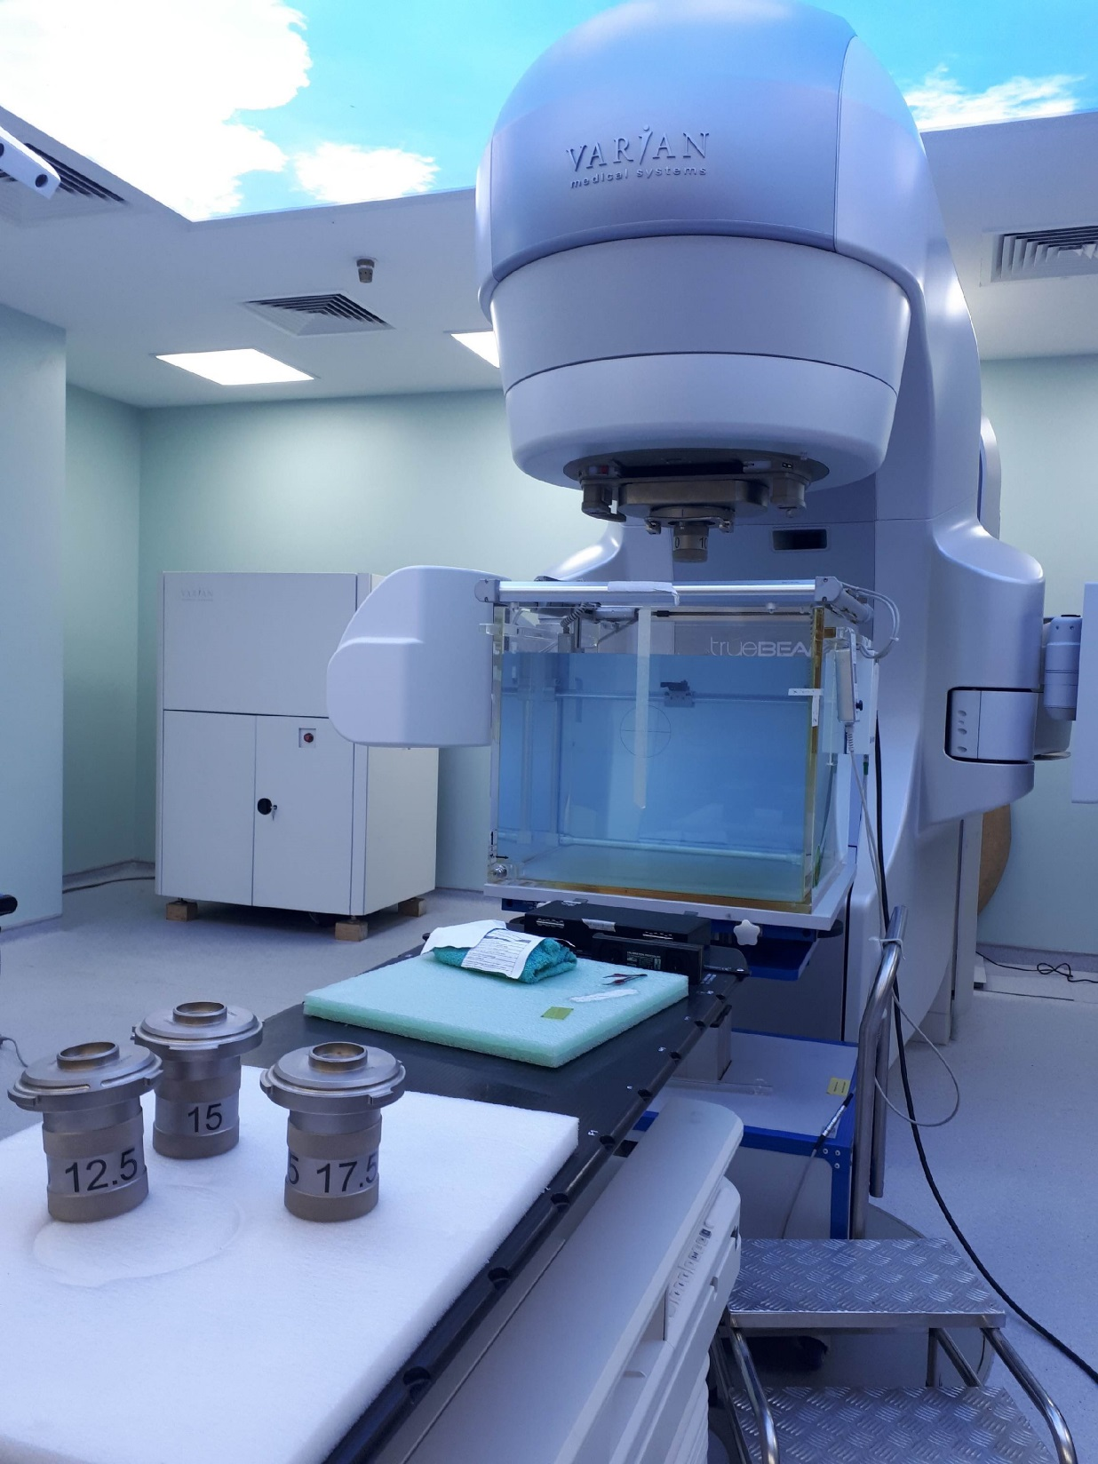
Materials & Method
All measurements were performed on Varian TrueBeam STx under 6X-WFF and 6X-FFF beams and SRS cone diameter 4 ÷17.5 mm, in the Blue Phantom 2 (IBA), SSD95cm, depth 5cm.
The Razor diode is p-type unshielded silicon diode which was introduced by IBA as a replacement for their earlier model IBA SFD.
The Gafchromic EBT3 film was taken as the reference dosimeter and were scanned using an Epson Scanner Expression 11000XL with 1200 dpi resolution 24 hours after exposure to radiation to allow the film to completely developed.
Each film was irradiated using 300MU. For building of film calibration curve, 30, 50, 100, 200, 500, 700 MU were used under 6X-WFF beam of reference conditions as in TRS-398.
ImageJ 1.53a (National Institute of Health, USA) software with a mean filter width of 0.2mm was used for film analysis. The calibration curve was fitted in forth order polynomials.
Output correction factors $k_{Q_{clin},Q_{msr}}^{f_{clin},f_{msr}}$ for the IBA Razor diode were determined using the TRS-483 [1]:
$$Ω_{Q_{clin},Q_{msr}}^{f_{clin},f_{msr}}=\frac{D_{{w,Q}_{clin}}^{f_{clin}}}{D_{{w,Q}_{msr}}^{f_{msr}}}=\frac{M_{{w,Q}_{clin}}^{f_{clin}}}{M_{{w,Q}_{msr}}^{f_{msr}}}k_{Q_{clin},Q_{msr}}^{f_{clin},f_{msr}}$$

Slide 4
Results
Table 1: $Ω_{Q_{clin},Q_{msr}}^{f_{clin},f_{msr}}$ of different cone diameters (normalized to 10×10 cm2 field) using EBT3
Cone (mm) | 4 | 5 | 7.5 | 10 | 12.5 | 15 | 17.5 | 100 (square)
6X-WFF | 0.54 | 0.58 | 0.68 | 0.74 | 0.78 | 0.81 | 0.83 | 1
6X-FFF | 0.57 | 0.61 | 0.68 | 0.76 | 0.82 | 0.82 | 0.84 | 1
Fig. 1: output correction factors $k_{Q_{clin},Q_{msr}}^{f_{clin},f_{msr}}$ by cone diameter for the IBA Razor diode under 6X-FFF and 6X-WFF beams.

Slide 5
Discussion
6X-FFF
There was a good agreement between our measurements of the ROFs with the IBA Razor diode as compared to data provided by Cheng et al [2] which was measured with the earlier IBA SFD. There was a maximum difference of about 1.5% for the 4 mm diameter cone.
However, there are larger differences between the ROFs measured with the Razor diode in comparison to the representative data provided by Varian.
Comparison of ROFs measured by EBT3 was made for 6X-WFF beam showed generally a good agreement with results from Peyton Irmen et al [6] for most of the SRS cones sizes with less than 1% difference.
However, there were differences of up to 5.8% for the smallest cone and 2.5% for the largest cone. A similar pattern was found for the 6X-FFF beam where there was a maximum difference of 5% for the smallest cone (Table.3).
6X-WFF
Fig. 2: ROF curves of TruebeamSTx cones (Varian) normalized to 5×5 cm2 6X-FFF (upper) and 6X-WFF (lower) field at the same setup (95cm SSD, 5cm depth in water)

Slide 6
Discussion
Our results continue suppose that a national audit program for small-field dosimetry is essentially required, boosted multi-center dosimetric inter-comparison to identify dosimetric uncertainties [9], not only for conical collimator [10][11][12][13].
Our result showed a good agreement between the ROFs which measured by Razor diode and SFD provided by Cheng et al [5] and Giacomo et al [16]. The result also showed a good agreement with other limited works on Razor diode [14][15].
These results suppose the k correction factor for SFD could be used universally for Razor diode in the absence of its tabulated data in TRS-483 COP.
Table 2: Differences in output factor calculated by EBT3 film for different cone diameters
Cone diameter (mm) | 4 | 5 | 7.5 | 10 | 12.5 | 15 | 17.5
6X-WFF EBT3 (108MH vs P.Irmen) | 5.75% | 0.31% | -0.44% | -0.33% | -0.77% | -0.83% | -2.45%
6X-FFF EBT3 (108MH vs P.Irmen) | 4.96% | 2.22% | -1.63% | 0.99% | 2.66% | 1.64% | 1.36%

Slide 7
Conclusion
This work has demonstrated that the IBA Razor diode is suitable for the dosimetry of very small radiation fields as found in SRS and consistent in response to the earlier IBA SFD.
There is however the need for additional work to determine suitable correction factors for this detector within the methodology of the TRS-483 COP in order to provide accurate radiation dosimetry.

Slide 8
REFERENCES
[1] IAEA, “Dosimetry of Small Static F ields Used in External Beam Radiotherapy”, TRS-483, 2017.
[2] J. Y. Cheng et al., “Output factor comparison of Monte Carlo and measurement for Varian TrueBeam 6 MV and 10 MV flattening filter-free stereotactic radiosurgery system,” J. Appl. Clin. Med. Phys., vol. 17, no. 3, pp. 100–110, 2016.
[3] P. Irmen, “Verification of representative data for output factors of SRS cones utilizing IAEA TRS 483 recommendations,” Phys. Med. Biol., vol. in press, pp. 0–31, 2019.
[4] G. Azangwe et al., “Detector to detector corrections: A comprehensive experimental study of detector specific correction factors for beam output measurements for small radiotherapy beams,” Med. Phys., vol. 41, no. 7, 2014.
[5] C. G. Cranmer-sargison, “Clinical use of diodes and micro-chambers to obtain accurate small field output factor measurements,” 2015.
[6] H. Benmakhlouf, J. Sempau, and P. Andreo, “Output correction factors for nine small field detectors in 6 MV radiation therapy photon beams: A PENELOPE monte carlo study,” Med. Phys., vol. 41, no. 4, 2014.
[7] P. Z. Y. Liu et al., “Can small field diode correction factors be applied universally?,” Radiother. Oncol., vol. 112, no. 3, 2014.
[8] S. Clemente et al., “A multi-center output factor intercomparison to uncover systematic inaccuracies in small field dosimetry,” Phys. Imaging Radiat. Oncol., vol. 5, no. March, pp. 93–96, 2018.
[9] K. Muralidhar et al., “Small field dosimetry and analysis of FFF beams in truebeam system,” J. Cancer Res. Ther., vol. 11, no. 1, p. 136, 2015.
[10] G. P. Beyera, “Commissioning measurements for photon beam data on three TrueBeam linear accelerators, and comparison with Trilogy and Clinac 2100 linear accelerators,” J. Appl. Clin. Med. Phys., vol. 14, no. 1, pp. 273–288, 2013.
[11] Y. Akinoet al., “Small-field dosimetry of TrueBeamTM flattened and flattening filter-free beams: A multi-institutional analysis,” J. Appl. Clin. Med. Phys., vol. 21, no. 1, pp. 78–87, 2020.
[12] K. Chełmiński and W. Bulski, “A multi-centre analytical study of small field output factor calculations in radiotherapy,” Phys. Imaging Radiat. Oncol., vol. 6, no. March, pp. 1–4, 2018.
[13] G. Reggiori et al., “Characterization of a new unshielded diode for small field dosimetry under flattening filter free beams,” Phys. Medica, vol. 32, no. 2, 2016.
[14] P. Z. Y. Liu et al., “Small field correction factors for the IBA Razor,” Phys. Medica, vol. 32, no. 8, pp. 1025–1029, 2016.
[15] A. Girardi et al., “[P179] Small field correction factors determination for the IBA razor nano chamber and the IBA razor chamber,” Phys. Medica, vol. 52, no. 2 mm, pp. 151–152, 2018.

Slide 9
