Slide 1
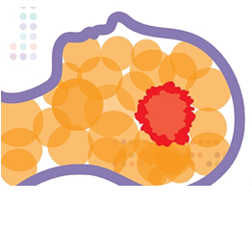



Characterization of helical tomotherapy plans complexity
Tania Santos^{1,2}, Tiago Ventura², Josefina Mateus², Miguel Capela²
¹ Physics Department, University of Coimbra, Portugal
² Medical Physics Department, IPOCFG, E.P.E., Portugal
ICARO-3
16-19 February, 2021
# INDICO 16

Slide 2
Conflict of interest statement
The authors have no conflict of interest to declare.

Slide 3

Objectives
The aim of this work was to evaluate the complexity of helical tomotherapy (HT) plans using some metrics recently published and assess their potential to predict the plan deliverability.

Slide 4
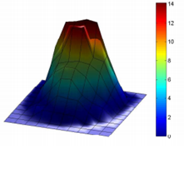
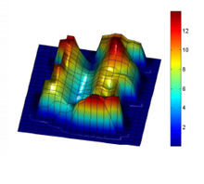
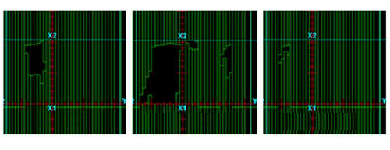
What is a complex treatment plan?
Fluence variability
Small, narrow, irregularly shaped and off-axis apertures
H Rocha, et al., 2010, Towards efficient transition from optimized to delivery fluence maps in inverse planning of radiotherapy design, ISSN: 1645-2631
Weiliang Du, et al. Quantification of beam complexity in intensity-modulated radiation therapy treatment plans, 2014, Med. Phys. 41 (2)

Slide 5
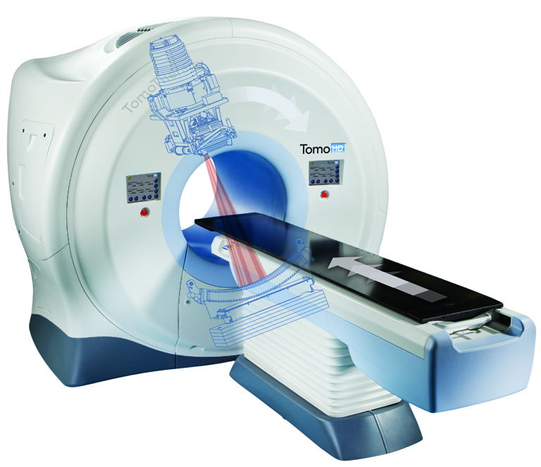
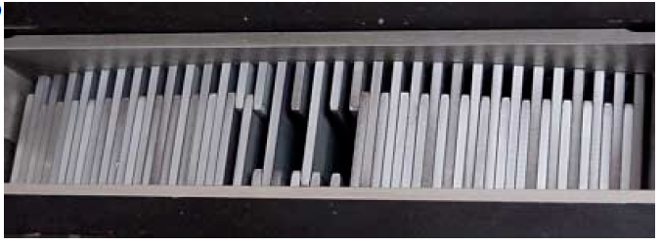
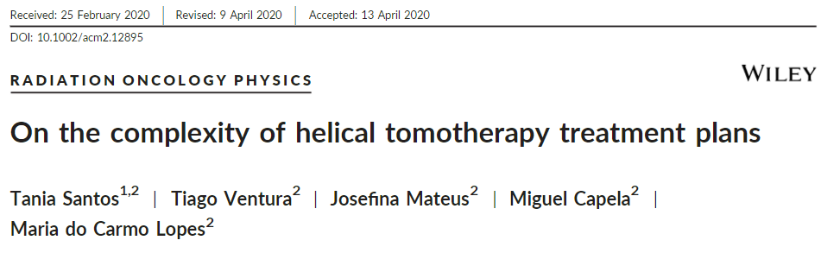
What is a complex treatment plan?
Other technologies such as Tomotherapy?

Slide 6
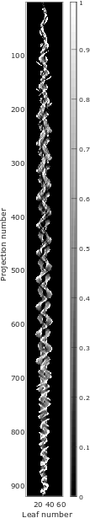

Methods
6 complexity metrics were calculated from the planned sinogram of 100 head and neck HT plans
the modulation factor (MF) = $\frac{{LOT}_{max}}{{LOT}_{mean}}$
%LOT < 100 ms
%LOT > pT-20 ms
indices to assess the leaf open time variations in the sinogram, adapted for HT¹:
LOTV: Leaf Open Time Variability
PSTV: Plan Time Sinogram Variation
MI: Modulation Index
¹ Santos T, et al. On the complexity of helical tomotherapy treatment plans. J. Appl. Clin. Med. Phys. 21:7 (2020) 107-118

Slide 7
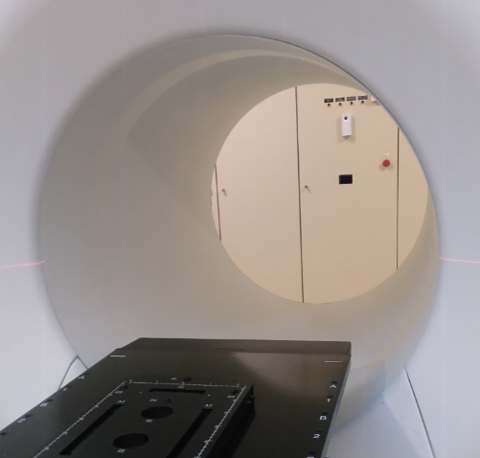
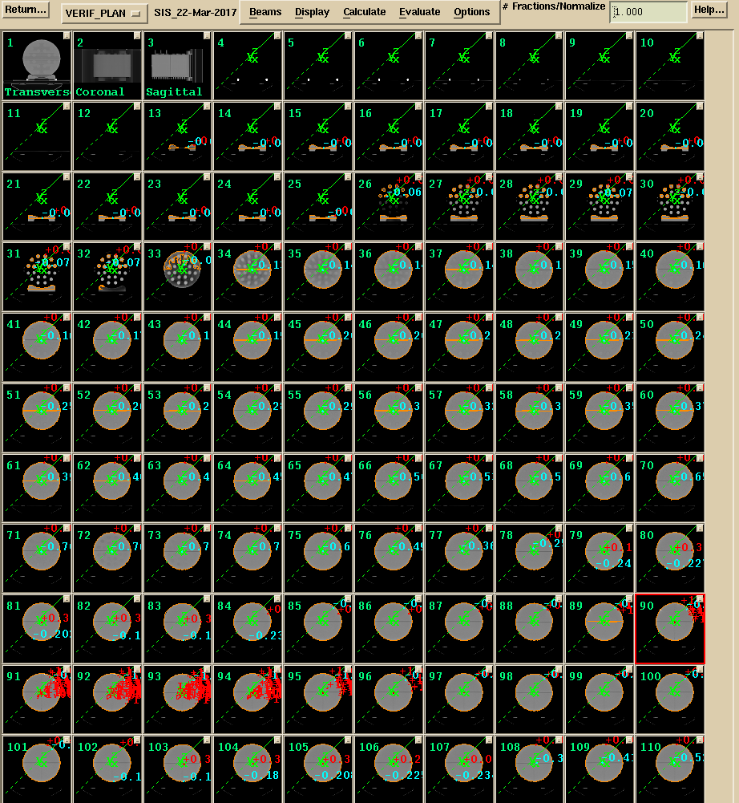
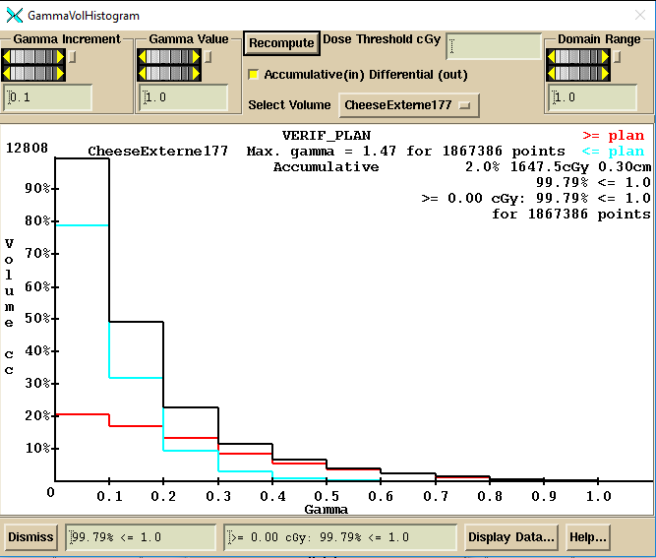
Methods
Dosimetry Check software (Math Resolutions, USA) in pre-treatment mode was used to reconstruct the measured dose distribution from the detector signal.
3D global gamma analysis was performed with a 3%/3 mm and 10% threshold (TH) criteria, for a passing rate acceptance limit of 95%. More stringent criteria were also adopted:
  - 3%/2 mm 10% TH
  - 2%/2 mm 10% TH
  - 2%/1 mm 10% TH
The correlation between the complexity metrics and the pre-treatment verification results was investigated using the Spearman’s rank correlation coefficients r_{s}.
Notes:
.

Slide 8
Results
%LOT > pT-20 ms=8.658 ± 3.746
MF=2.096 ± 0.175
%LOT< 100 ms=27.792 ± 3.571
PSTV=5.406 ± 0.729
LOTV=0.931 ± 0.010
MI=10.726 ± 0.895

Slide 9
Results
All plans were considered clinically deliverable, with an average passing rate of 98.6 ± 1.0 % (3%/3 mm, 10% TH) for the entire group. The use of more stringent criteria for gamma analysis, resulted in a wider spread in the passing rates, as expected.
Table 1 – Correlation coefficients between the γ passing and the complexity indicators for the HT plans.
 | 3%/3 mm 10%TH |  | 3%/2 mm 10%TH |  | 2%/2 mm 10%TH |  | 2%/1 mm 10%TH
 | r_{s} | p-val | r_{s} | p-val | r_{s} | p-val | r_{s} | p-val
MF | 0.102 | 0.312 | 0.059 | 0.562 | -0.072 | 0.474 | -0.111 | 0.271
%LOT < 100 ms | -0.193 | 0.054 | -0.193 | 0.055 | -0.003 | 0.973 | -0.022 | 0.831
%LOT > pT-20 ms | -0.272 | 0.006 | -0.245 | 0.014 | -0.075 | 0.459 | -0.044 | 0.661
LOTV | 0.366 | 0.000 | 0.346 | 0.000 | 0.178 | 0.076 | 0.154 | 0.125
PSTV | -0.347 | 0.000 | -0.337 | 0.001 | -0.139 | 0.169 | -0.128 | 0.206
MI | -0.157 | 0.119 | -0.162 | 0.108 | -0.070 | 0.487 | -0.103 | 0.306
The lack of correlations may be explained by the homogeneity of the considered set of plans, which led to a limited variation of both the complexity indicators and the deliverability results.

Slide 10
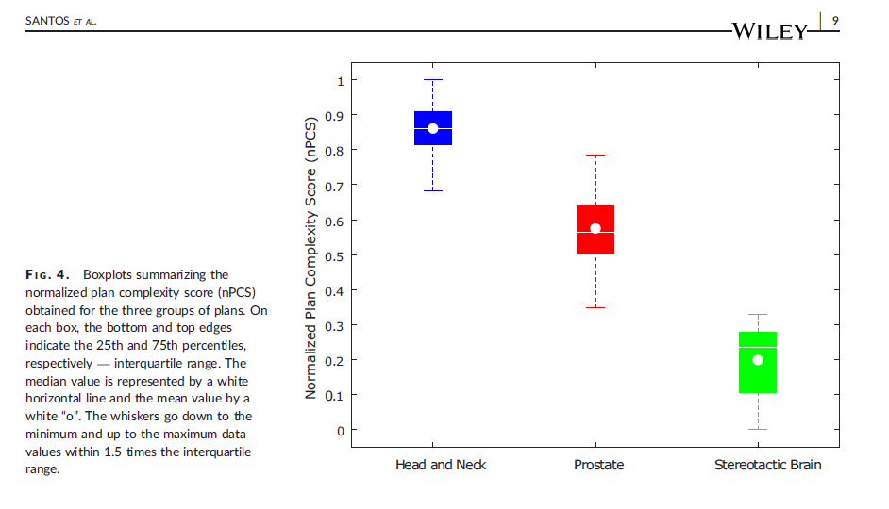
Results
¹ Santos T, et al. On the complexity of helical tomotherapy treatment plans. J. Appl. Clin. Med. Phys. 21:7 (2020) 107-118
² Santos T, et al. Evaluation of the complexity of treatment plans from a national IMRT/VMAT audit – Towards a plan complexity score. Phys. Med. 70 (2020) 75-84

Slide 11
Conclusions
Despite the reported lack of correlations, the complexity indicators values (mean ± standard deviation) can be taken as reference in our clinic to evaluate future plans, given that the pre-treatment QA results of the entire set were all clinically acceptable. This is in line with AAPM recommendations on the need to quantify plans complexity ^{1,2}.
Treatment plans with a complexity out of these limits for any of the computed metrics should be further evaluated and eventually be subjected to a more rigorous QA.
¹ Ezzell, G.A., et al. IMRT commissioning: Multiple institution planning and dosimetry comparisons, a report from AAPM Task Group 119. Med. Phys. 36 (2009) 5359-5373
² Miften, M., et al. Tolerance limits and methodologies for IMRT measurement‐based verification QA: Recommendations of AAPM Task Group No. 218. Med. Phys. 45 (2018) 53-83

Slide 12




Thank you for your attention!
This work was supported by the Portuguese Foundation for Science and Technology through a PhD grant, SFRH/BD/118929/2016.
UNIÃO EUROPEIA
Fundo Social Europeu

