Slide 1

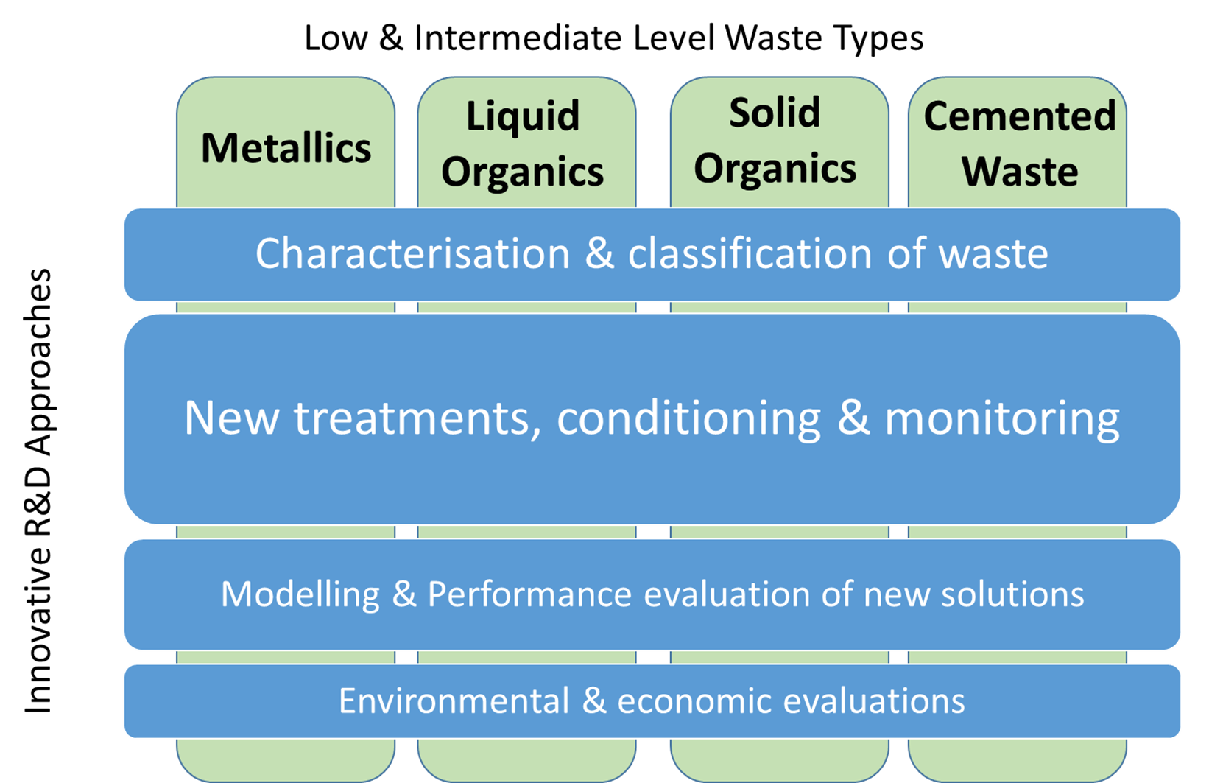
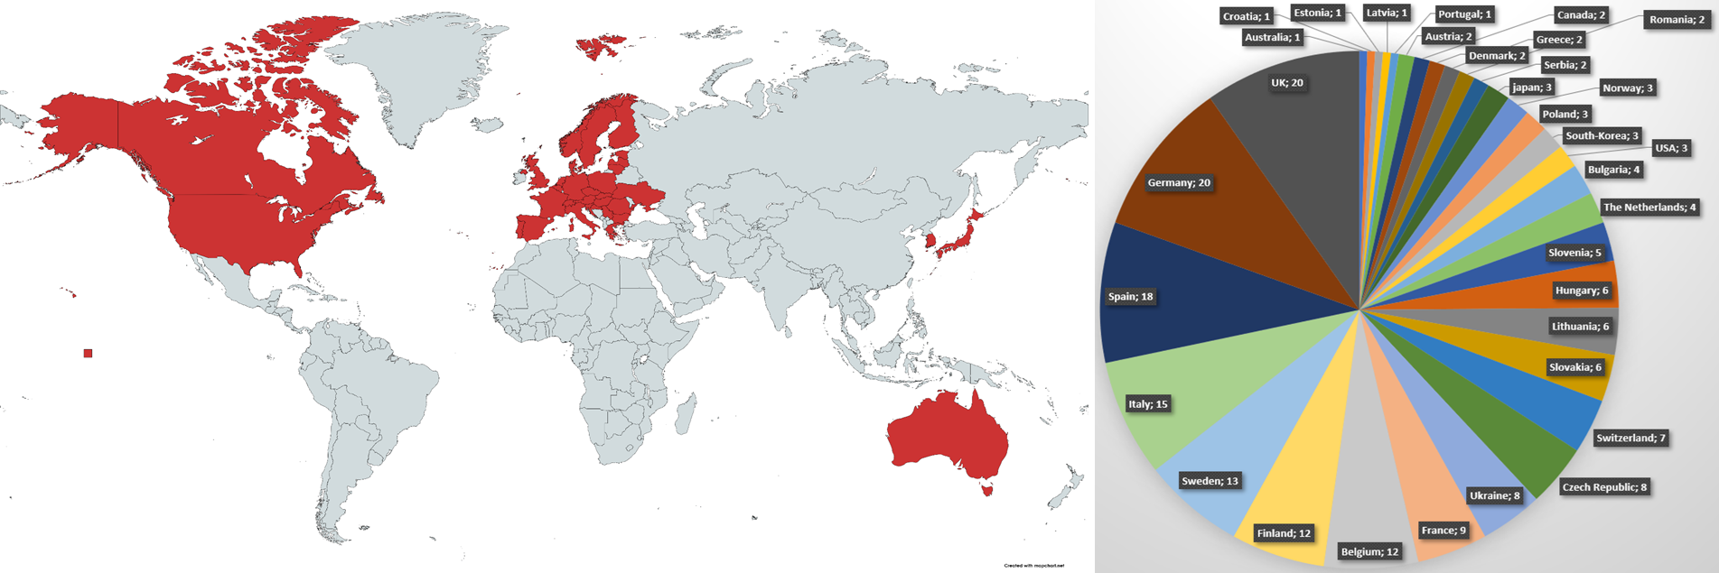

International cooperation on pre-disposal waste management innovation in the PREDIS project: Addressing technology gaps and common industrial challenges Erika Holt and Maria Oksa, VTT, Finland Anthony Banford, NNL, UK erika.holt@vtt.fi
GAP ANALYSIS AND SRA DEVELOPMENT
INTRODUCTION
IAEA-CN294-ID: 247
“PREDIS: Predisposal Management of Radioactive Waste’ project addresses innovation and break-through technologies for better handling of low-level and intermediate-level radioactive wastes
4-year Euratom project, started in September 2020
Project budget is 23.7 M€, of which 14 M€ by the EC
47 consortium partners from 17 countries
25 industrial partners via the End User Group (EUG) advise on needs and challenges to ensure high impact of the project results.
A gap analysis (GA) was performed to identify predisposal technology gaps, their urgency and importance and the current technology readiness of potential solutions.
Existing Strategic Research Agendas (SRAs) were reviewed, then discussions and surveys took place to assess scientific impacts and the technology gaps. GA report published May 2021 (public).
A new PREDIS baseline SRA covering predisposal issues was published (public) in August 2021, with focus on the consolidation of the existing European and worldwide SRAs in this domain.
Both the GA and SRA address the scientific and technical domains and needs of common interest in predisposal management issues.
The final predisposal SRA will be published in spring 2024.
TECHNICAL RD&D OVERVIEW
The PREDIS RD&D project focuses on treatment and improved handling of waste, and digital solutions for improved safety and efficiency for:
metallic materials
Liquid-organic and solid-organic wastes and
cemented-waste packages.
KNOWLEDGE MANAGEMENT (KM)
Sharing and easing access to information are important activities, closely linked with Knowledge Management within the EURAD programme.
KM and dissemination achievements to date include:
establishing predisposal Roadmap guidance documentation
preparing of training program and implementing the mobility program
interactive webinars with over 1000 participants in 2021.
CONCLUSION
PREDIS project develops technological innovations for predisposal management with focus on metallic, organic and cemented waste, and digital solutions.
Project has strong EU and international cooperation to accelerate useful technology development and avoid work duplication.
Please visit https://predis-h2020.eu/ for more information.
ACNOWLEDGEMENTS
This project has received funding from the Euratom research and training programme 2019-2020 under grant agreement No 945098.
VIDEO
RECORDING LINK
Project scope, addressing waste streams and approach.
Mapped individual stakeholders and end users (by PREDIS WP2).

