Slide 1
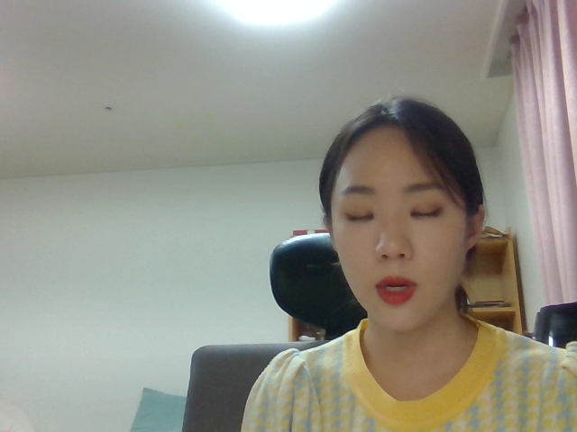
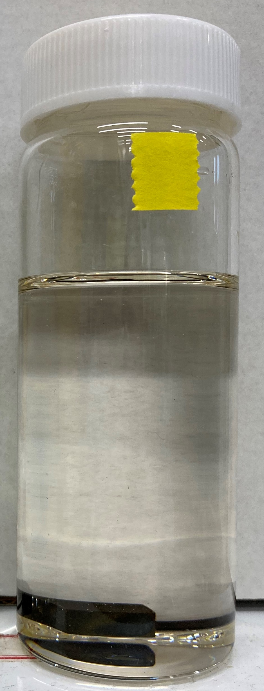
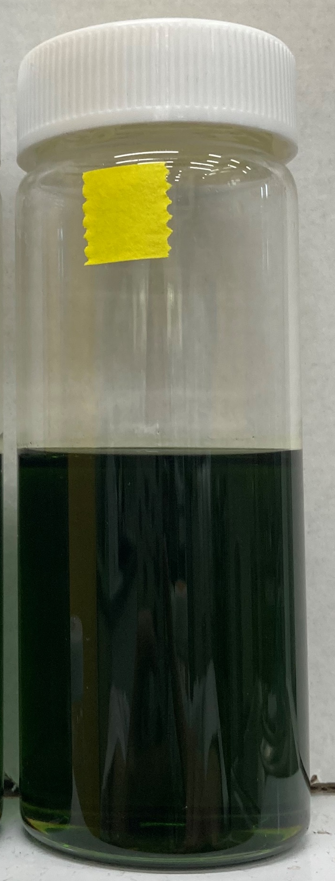
CHOLINE-CHLORIDE BASED
DEEP EUTECTIC SOLVENTS
AS AN ALTERNATIVE
DECONTAMINATION AGENT FOR
RADIOACTIVE METAL WASTES
0
Nayoung Kim, James Amphlett, Wonseok Yang, Sungyeol Choi
KAIST
RESULTS
ABSTRACT
ID: 268
Decontamination of stainless-steel (STS) wastes is vital to reduced radioactivity for safety and volume for cost.
Metal oxide solubility in different solvents was studied to study the decontamination efficiency.
Decontamination using ChCl:PtsA, a deep eutectic solvent (DES) of choline chloride (ChCl) and p-toluenesulfonic acid monohydrate (PtsA) is simulated and assessed.
Metal oxide solubility investigation
Solubility in ChCl:PtsA increased with hydration for CoO and NiO.
Solubility in ChCl:PtsA decreased with hydration for Cr₂O₃ and Fe₃O₄.
For all metal oxides, the solubility was greater in ChCl:PtsA compared to PtsA, showing the effect of eutectic formation on solubility.
Solubility in ChCl:PtsA of NiO is comparable to and Fe₃O₄ is greater than HCl.
Leaching
Oxide layer was adequately removed within 300 minutes in 10 wt%-hydrated ChCl:PtsA at 60°C with stirring at 400 rpm.
10 wt%-hydrated ChCl:PtsA is efficient enough to completely remove the contaminant layer on the metallic wastes.
METHODS
Metal oxide solubility was measured for CoO, Cr₂O₃, Fe₃O₄ and NiO by centrifuging in different solvents.
Oxide film on STS304 specimens was simulated by high-temperature oxidation (at 1000°C for 30 minutes) in an air atmosphere.
Oxidized STS304 specimens were submerged in 10 wt%-hydrated ChCl:PtsA at 60°C with stirring at 400 rpm.
BACKGROUND / INTRODUCTION
Stainless-steel 304 (STS304) wastes are generated in great amounts due to the use in core structures or primary piping in pressurized water reactors.
By removing high-energy γ emitters (⁵⁸Co, ⁶⁰Co, ⁵¹Cr, ⁵⁹Fe) and long-lived activation products (⁵⁹Ni, ⁶³Ni), STS304 wastes can be disposed as low-level wastes instead of intermediate level wastes, thereby reducing cost and enhancing safety.
Current decontamination agents such as strong acids and bases, molten salts or ionic liquids are toxic, flammable, and expensive.
DES has outstanding metal oxide solubility, good biocompatibility, and cheap production cost which is perfect for efficient, eco-friendly and economic decontamination process.
Metal oxide solubility of CoO, Cr₂O₃, Fe₃O₄ and NiO in different solvents
CONCLUSION
Metal oxides dissolve readily in ChCl:PtsA.
Hydration improves the solubility of majority of metal oxides.
Oxide layer was adequately removed within 300 minutes in 10 wt%-hydrated ChCl:PtsA at 60°C with stirring at 400 rpm.
Line EDS along STS304 cross-section
ACNOWLEDGEMENTS / REFERENCES
T. Allen, J. Busby, M. Meyer, D. Petti, Materials challenges for nuclear systems, Materials Today, 13 (2010) 14-23.
International Atomic Energy Agency, Derivation of activity limits for the disposal of radioactive waste in near surface disposal facilities, in, IAEA, Vienna, Austria, 2003, pp. 150.
U.S. Nuclear Regulatory Commission, Low-Level Radioactive Waste Classification, Characterization, and Assessment: Waste Streams and Neutron-Activated Metals, in, NRC, 2000, pp. 95.
SPACE FOR VIDEO
RECORDING
ChCl:PtsA before (left) and after (right) leaching

