Slide 1
Apr 19 – 22, 2022, Vienna, Austria
DESIGN, MANUFACTURING AND IN-SODIUM TESTING OF AM350-WELDED DISC BELLOWS FOR FBTR CONTROL ROD DRIVE MECHANISM
By
Dr. KUMAR KROVVIDI S C S P
RAMESH E, SHOBIT VERMA, GIRIBABU R, CHANDRAMOULI S, NAGARAJA BHAT Y V, SUNDARRAJ S I, Dr. SREEDHAR B K, Dr. NASHINE B K, SURESHKUMAR K V, RAGHUPATHY S
IGCAR, KALPAKKAM, INDIA

Slide 2
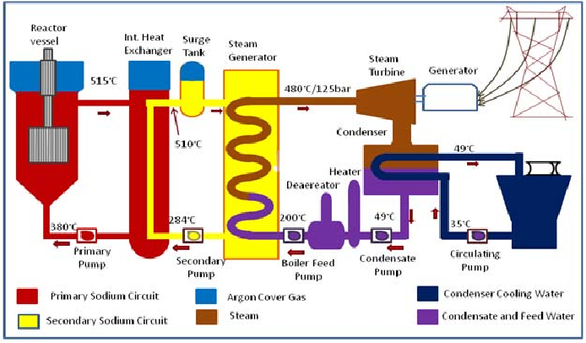
Introduction
Fast Breeder Test Reactor
FBTR is Operational for the past 36y at Kalpakkam, India.
40 MW(th) loop type sodium cooled fast reactor
Mixed Carbide Fuel of Pu &U
6 CRDMs along with (enriched B¹⁰₄C) CRs for reactor power control and SCRAM

Slide 3
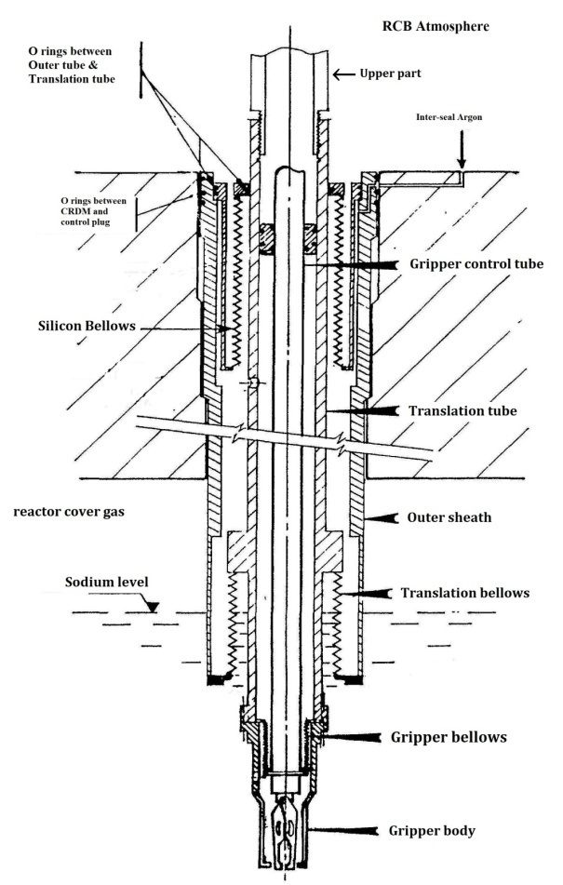
Introduction
Control Rod Drive Mechanism
The upper part of the mechanism houses the electromagnet and dashpot.
The lower part of the mechanism is partially immersed in sodium
Lower part of the mechanism consists of three concentric tubes viz. tube sheath, translation tube and gripper control tube.
Entry of sodium in the annular spaces can result in increased friction due to sodium aerosol deposition and increase drop time.
Welded disc bellows are used to prevent the entry of sodium in the annular spaces of CRDM

Slide 4
Introduction
Translation bellows
The bellows which prevents the entry of sodium between the translation tube and tube sheath are called translation bellows.
During SCRAM, translation tube moves at a peak speed of 2.4m/s for a maximum travel of 500mm.
The stiffness of the bellows should be as low as possible so that the drop time during SCRAM should not be effected.
Hence nested ripple type welded disc bellows are used.

Slide 5
Specifications of translation bellows
S. No. | Parameter | Value
1 | External / internal pressures | 1240 /1090 mbar abs
2 | Temperature | 530°C
3 | Travel | 500 mm
4 | Outer / inner diameters | 101.6 / 76.2 mm ( ± 1 mm)
5 | Peak speed during SCRAM | 2.5 m/s
6 | Speed during CR retrieval | 1 mm/s
7 | Material of construction | AM350
8 | Thickness of ply | 0.127 mm
9 | Number of convolutions | 720 (i.e. 720 circumferential welds)

Slide 6
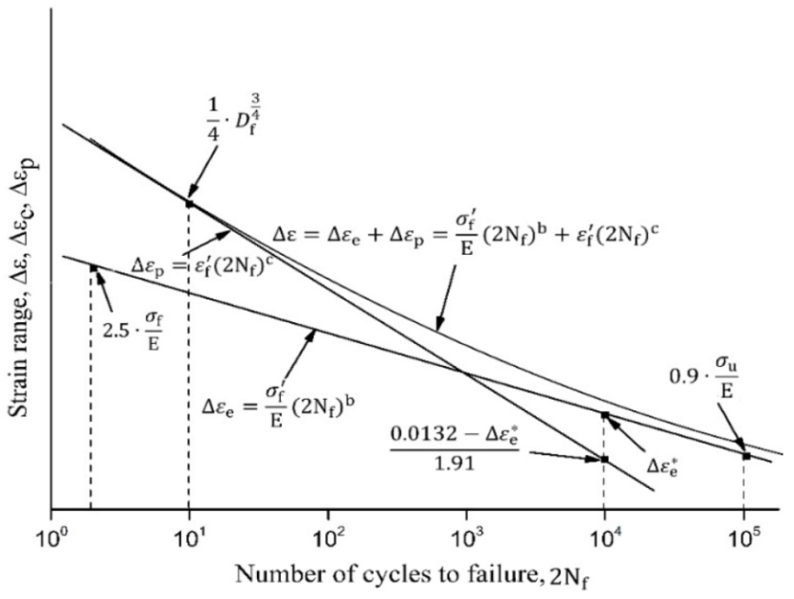
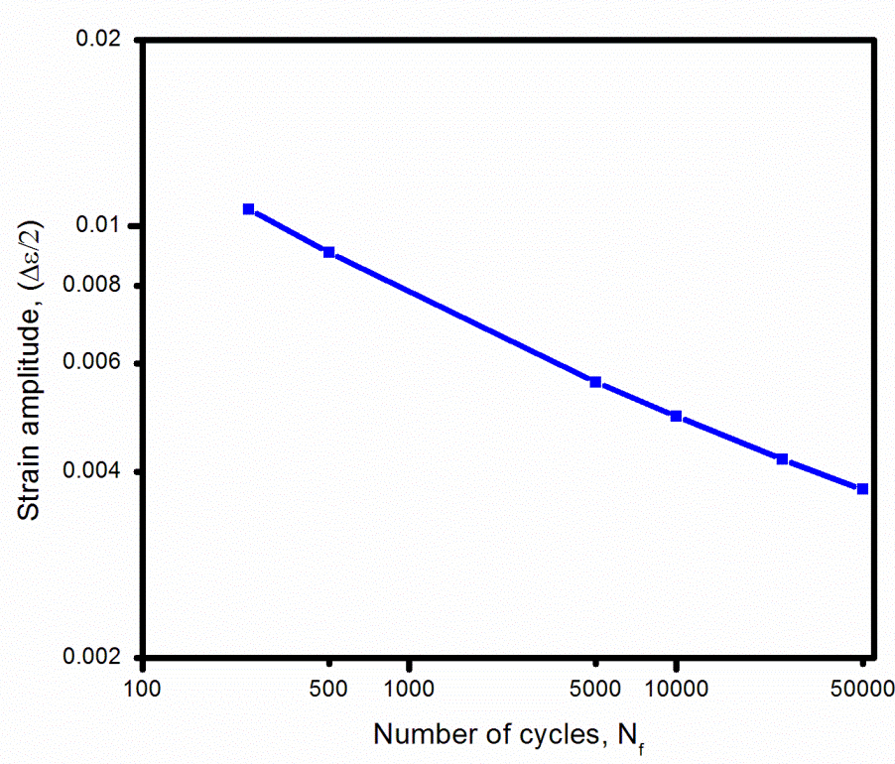
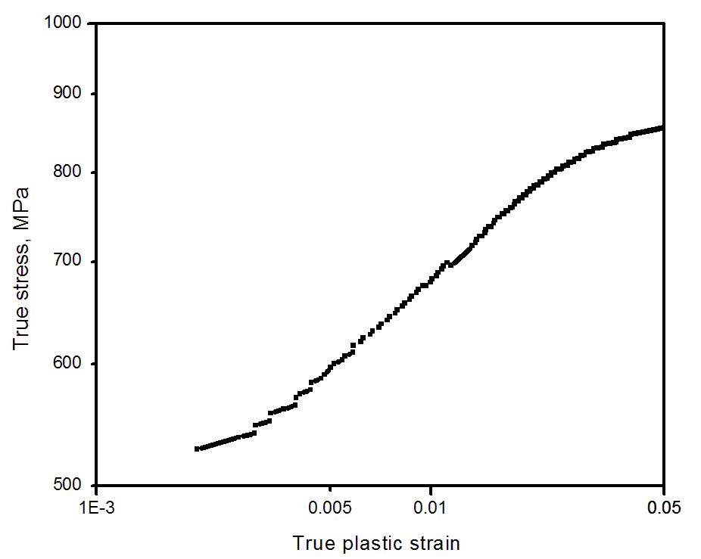
Design of the bellows
Material Data Required for Design:
Tensile testing of AM350-SCT1000 was carried out at 530°C.
True stress-true plastic strain curve was used as material model in plastic range
Using 4-point correlation method, Coffin-Manson plot was generated.

Slide 7
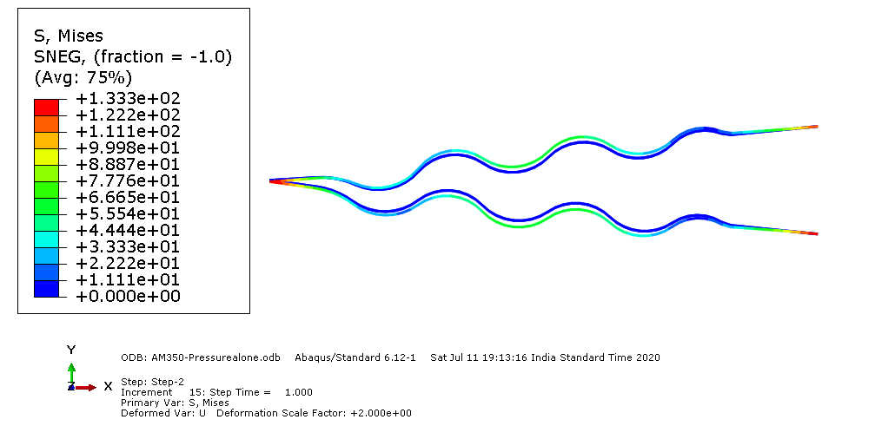
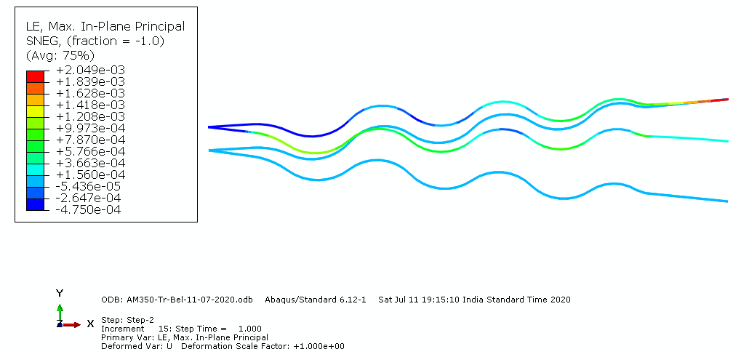
Design of the bellows
Bellows were modeled in ABAQUS using Axisymmetric shell-SAX1 element
Loading and boundary conditions
Stresses due to pressure
Strain due to pressure +Deflection
The analytical life of the bellows was found to be 5×10⁴ cycles

Slide 8
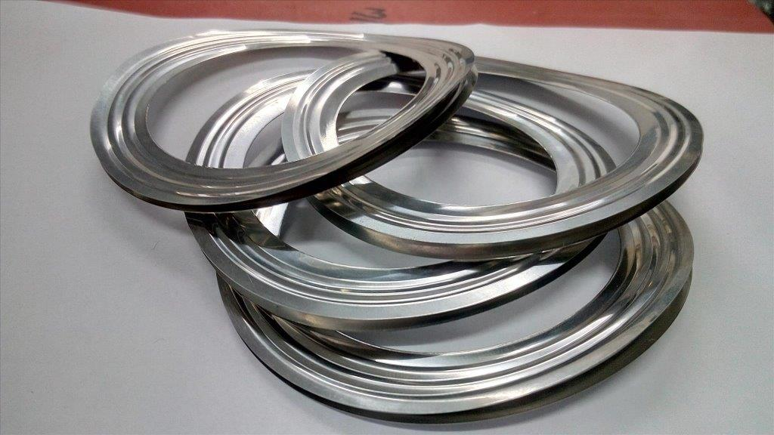
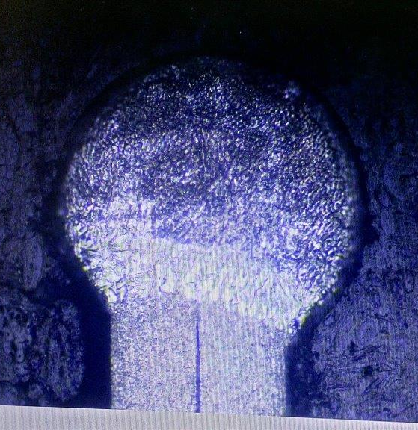
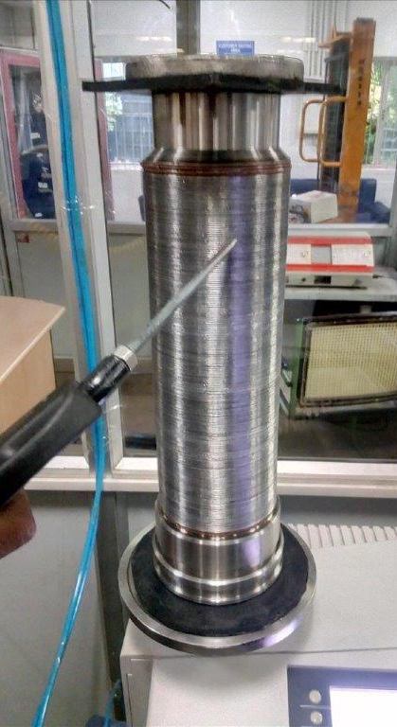
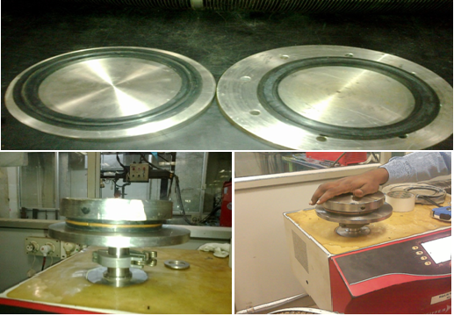
Manufacturing of translation bellows
Individual convolutions after ID welding
Weld profile
Fixture for heat treatment of Bellows
HLT of Individual convolutions
HLT of Bellows

Slide 9
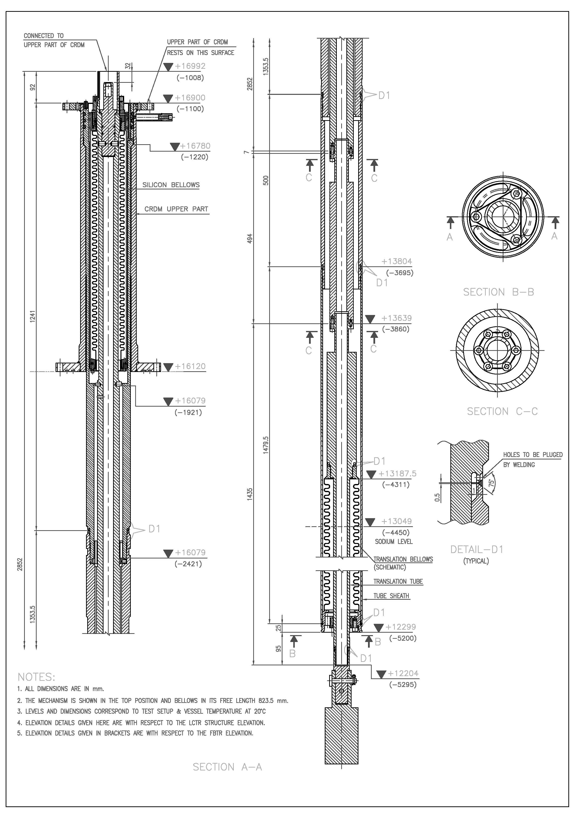
Testing of translation bellows
Phase 1: In air at room temperature
A simplified lower part was made for testing of translation bellows
It is interfaced to actual upper part for simulating SCRAM loading.
A dummy weight was attached to simulate the weight of CR.
Arrangements to measure the drop time and peak acceleration were provided.

Slide 10
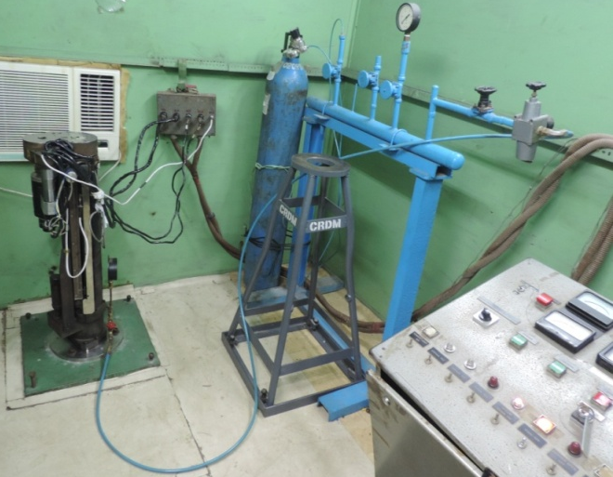
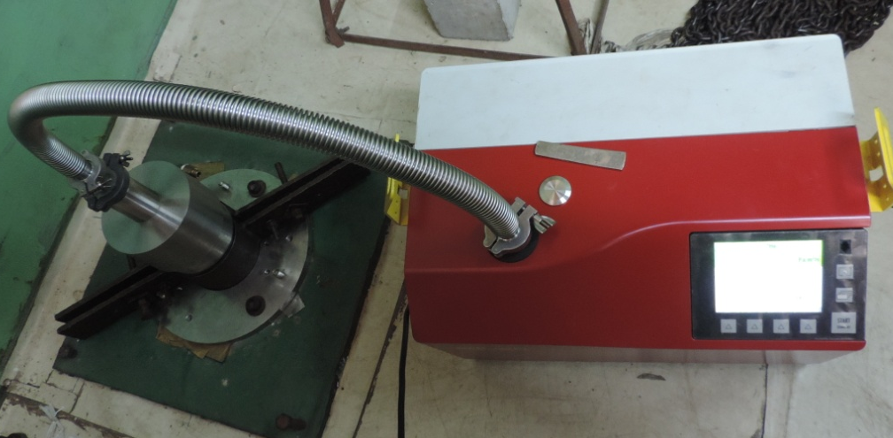
Testing in air (Phase 1)
500 SCRAM cycles were carried out.
After every 25 cycles pressure hold test for 12 hrs was done.
Pressure hold test
After 500 cycles, bellows were found leak-tight by HLT
Arrangement for HLT of the lower part

Slide 11
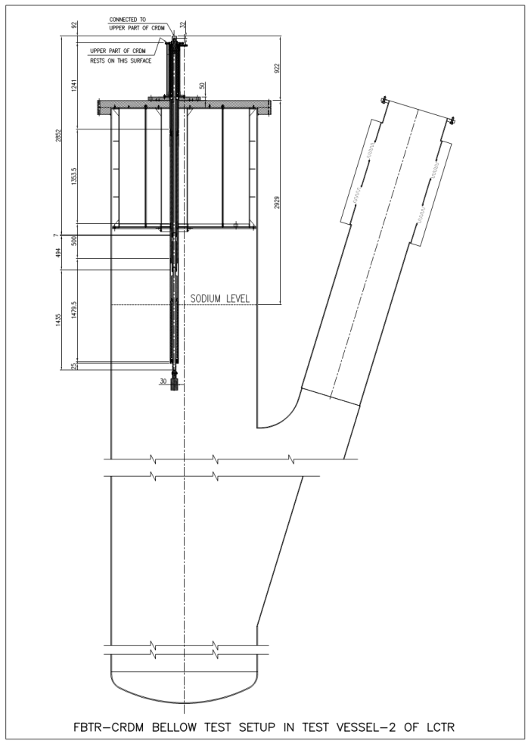
Testing of translation bellows
Phase 2: In Sodium at 530°C
Testing was done in Test Vessel-2 of Large Component Test Rig.
In the test setup, the following are simulated
Temperature
Sodium level
Cover gas pressure
Inter seal Argon pressure
SCRAM from 450 mm height
275 cycles of testing was carried out including 170 cycles in sodium

Slide 12
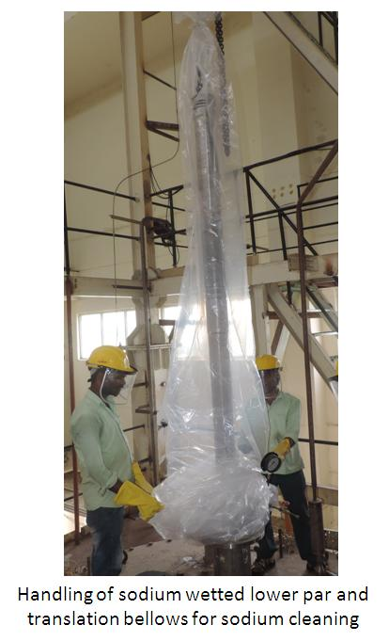
In-Sodium Testing of the Bellows
Testing was stopped after 275 cycles.
The envisaged SCRAMs during the remaining 10 Rys of FBTR are 50
The bellows were qualified as per ASME section-III, div-1, Appendix-II (experimental stress analysis)
The bellows were found leak tight by HLT.
Sodium cleaning of the bellows were carried out using WV-CO2 process.
The design of the bellows was validated for their use in FBTR.

Slide 13
Conclusions
No standard design codes for welded disc bellows and the design was carried out by inelastic analysis.
Material data required for design was generated by tensile testing AM350-SCT1000 at 530°C.
Fatigue data was generated by 4 point correlation method. FOS-20 was applied as suggested in design codes.
Bellows were manufactured in India.
With 720 circumferential welds, around 300 m of weld, 0.2 mm depth of penetration and requirement of heat treatment, this work was first of its kind in India.
Bellows were tested in air & in sodium and the design was qualified for deployment in reactor.

Slide 14
Thank You

Slide 15
Appendix : Experimental stress analysis
ASME section-III/ Div-I, Appendix-2:
Design qualification by testing, applicable for components subjected to cyclic loading.
The design life N_{design-Expt} = N_{testing} / K_{n}
K_{n} = (K_{s})^{4.3}
K_{s} = K_{sl} . K_{sf} . K_{st} . K_{ss}. K_{sc}
K_{sl} = Size factor = 1.5 – 0.5 (Scale factor)
K_{sf} = Surfce finish factor = 1.175-0.175 (SF_{M}/SF_{P})
K_{st} = temperature factor = S_{alt-Test}/S_{alt-Actual}
K_{sc} = Factor to account statistical scatter
= 1.47-0.043(No. of samples tested)

