Slide 1
AN EXPERIMENTAL STUDY ON SECONDARY SODIUM SYSTEM
BASED DECAY HEAT REMOVAL CIRCUIT OF A SODIUM
COOLED FAST REACTOR
FR 21: IAEA-CN-291-476
S.P. Pathak, K. Natesan, V.A. Suresh Kumar, B.K. Nashine, S. Raghupathy
Reactor Design and Technology Group
Indira Gandhi Centre for Atomic Research, Kalpakkam, India

Slide 2
CONTENTS
INTRODUCTION
TEST SET UP
BRIEF ABOUT AHX
EXPERIMENT
EXPERIMENTAL OBSERVATION
SUMMARY
REFERENCES

Slide 3
INTRODUCTION
The heat produced due to radioactive decay of fission product after reactor shutdown is known as Decay heat.
To maintain the reactor internals below their admissible design safety limits, the decay heat needs to be removed continuously.
The failure of decay heat removal system needs to be practically eliminated.
Normally, Sodium cooled Fast Reactor (SFR) has two diverse and independent paths for decay heat removal.

Slide 4
-Continue
Operation Grade Decay Heat Removal (OGDHR) system
Decay heat removal from the reactor core to steam water system through steam generators.
Meeting the requirement of bringing down the sodium system temperature at a controlled rate.
Maintaining the plant at hot shutdown condition for up to 8 hours and maintaining the plant at cold condition at 200 ˚C for longer period to carry out maintenance / fuel handling operations.
Safety Grade Decay Heat Removal (SGDHR) system
Meets all safety aspects and the decay heat removal relies completely on natural circulation of sodium as well as air.
The SGDHR system can satisfy all the requirements with respect to those specified in the safety criteria for defense in depth system credited to multiple levels and systems intended for Design Extended Condition (DEC).
4

Slide 5
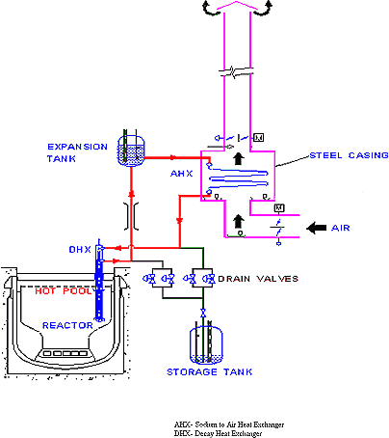
-Continue
Need for additional decay heat removal system
Due to such a high demand on SGDHR, the failure of decay heat removal function is highly unlikely to be regarded as Practically Eliminated.
To meet these safety and reliability aspects, it is envisaged to adopt an additional decay heat removal system which is known as Secondary Sodium based Decay Heat Removal System (SSDHRS).
The proposed SSDHR system is planned as a forced cooling type of sodium to air heat exchanger (AHX), operating in parallel to steam generators in the secondary sodium main circuit of the reactor
Safety Grade Decay Heat Removal System
5

Slide 6
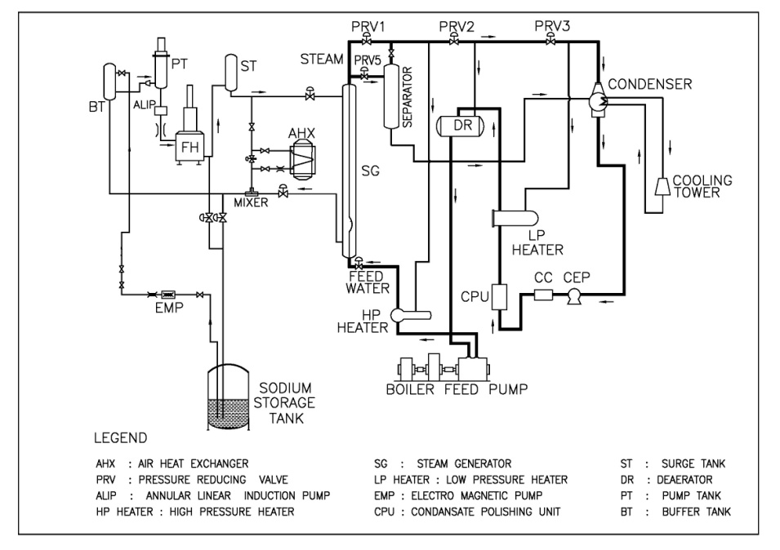
TEST SET UP
Schematic of test facility
A 2 MWt capacity Sodium to Air heat exchanger (AHX) is in parallel to Steam Generator (SG) of 5.5 MWt capacity.
The heat source of the facility is furnace oil fired heater which heats sodium to the desired temperature.
A 170 m³/h Electromagnetic pump (ALIP) is used for circulation of sodium.
6

Slide 7
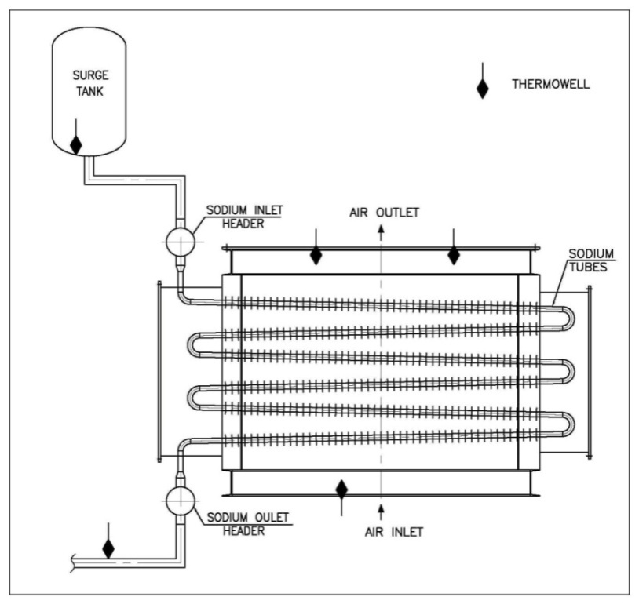
Brief about AHX
Table 1 Model AHX design data
Geometrical Parameter | Value
Tube outside diameter (mm) | 38.1
Tube thickness (mm) | 2.6
Fin outside diameter (mm) | 64.1
Fin height (mm) | 12.5
Fin thickness (mm) | 1.22
Transverse pitch (mm) | 85
Schematic of sodium to air heat exchanger (AHX)
AHX is a cross flow heat exchanger with sodium on the tube side and air in cross flow across finned tubes.
Sodium and air circulation through AHX is by forced circulation.
The heat transfer from the sodium to air involves multiple resistances, viz., from tube to fin and fin to air and directly from tube to air.
7

Slide 8
EXPERIMENT
(i) Maintaining hot shutdown condition at various temperatures.
(ii) Maintaining cold shutdown condition.
(iii) Cool down phase following SCRAM replicating the operation grade decay heat removal (OGDHR) deployment.
The tests were performed by simulating the three operating phases of SSDHRS;
Decay heat power evolution in the core was simulated by varying the heater power of oil fired heater in the facility (representing the decay power evolution in core) and controlled cooling of the system was established by varying the heat removed by adjusting the air flow rate through AHX.
Considering all the constraints, the maximum heat removal capacity is estimated as 264 kW (t) for simulating SSDHRS operating conditions in experimental loop.
8

Slide 9
EXPERIMENTAL OBSERVATION
Hot shutdown condition at various temperatures
Parameters recorded in the facility during the test on
maintaining hot shutdown temperature of 350°C in the hot leg
Parameters recorded in the facility during the test on
maintaining hot shutdown temperature of 300 °C in the hot leg
The decay heat source in the experiment is simulated through heat added by the oil fired heater.
It is established from the test that hot shutdown condition at any desired temperature can be maintained under varying heat source condition by adjusting the air flow rate through the AHX.
9

Slide 10
-Continue
Cold shutdown condition
Cold shutdown condition in the reactor corresponds to maintain the temperature of loop sodium at ~ 200 ˚C.
At a constant AHX inlet sodium temperature of 200 ˚C, air flow rate was varied in multiple steps to achieve desired AHX outlet sodium temperatures of 192 ˚C, 195 ˚C and 198 ˚C respectively.
Experiment revels that the cold shutdown condition can be maintained under varying heat source condition by adjusting the air flow rate through the AHX.
Parameters recorded in the facility during the test on maintaining cold shutdown temperature of 200 °C in the hot leg
10

Slide 11
-Continue
Cool down phase following SCRAM replicating the operation grade decay heat removal (OGDHR) deployment
Fired heater power and heat removal through AHX were adjusted simultaneously to simulate the decay heat removal condition along with cool down of the system at a desired rate.
The heater power was reduced from 264 kW (t) to 142 kW (t) (53.8 %) within four and half hours.
The feasibility of cooling down the reactor system at a desired rate without violating the thermal constraints is established through this test.
Parameters recorded in the facility during the simulation of cool down transient in the reactor post shutdown condition
11

Slide 12
SUMMARY
Preliminary experimental studies have been carried out to understand the controllability and operability of secondary circuit based decay heat removal system before adopting in reactor.
Ensured maintainability of hot and cold shutdown conditions in reactor by varying the air flow rate through the AHX.
It can be concluded that the proposed SSDHR system is also capable of maintaining the cool down phase following SCRAM replicating the OGDHR deployment.
A variable frequency drive motor for AHX fans is found to be very useful in controlling the heat removal performance of the system in a very effective manner.
It is seen that the desired hot leg temperature can be maintained by adjusting air flow through AHX using either manual or auto control mode.
12

Slide 13
REFERENCES
[1] Kugeler, K. 1992. Principles of decay heat removal in reactor technology- Present status and Future prospects, IAEA-TECDOC-757, Proceedings of a specialists meeting held in Jolich, Germany, 6-8 July.
[2] Chetal, S.C., 2015. Safety aspects of Intermediate heat transport and decay heat removal systems of sodium-cooled fast reactors, Nucl. Eng Techno (47), 260-266.
[3] Pathak, S.P. et al., “Experimental investigation of transients in SFR steam generators during decay heat removal condition”, Proceedings of the 25thNational and 3rdInternationalISHMT- ASTFE Heat and Mass Transfer Conference (IHMTC-2019), December 28-31, 2019, IIT Roorkee, Roorkee, India.
[4] Somavathi et al., Control of decay heat removal through alternate system in PFBR, Nuclear Engineering and Design 259 (2013), 8-13.
[5] Ashurko, I. Decay heat removal system in the secondary circuit of the sodium cooled fast reactor and evaluation of its capacity, IAEA-CN245-161.
[6] Satya P. Pathak, et al. 2014. “Numerical and Experimental Investigations of Heat Removal Performance of Sodium to Air Heat Exchanger used in Fast Reactors”, Heat Transfer Engineering, 36:5, 439-451.
[7] Vinod, V.et al., 2013. Experimental evaluation of sodium to air heat exchanger performance, Annals of Nuclear Energy 58, pp.6-11.
[8] Chetal, S.C. and Chellapandi, P., 2013. Indian fast reactor technology: Current status and future programme, Indian Academy of Sciences Vol (38) part 5, pp.795-815.
13

Slide 14
THANK YOU
14

