Slide 1
Physical modeling of hydrodynamics and heat exechange in fast reactors with liquid metal coolants
International Conference on Fast Reactors and Related Fuel Cycles: Sustainable Clean Energy for the Future (FR22) /
April 19–22, 2022, IAEA in Vienna, Austria
Sorokin Aleksandr Pavlovich
Chief Researcher, Dr. Sci.(Tech.)

Slide 2
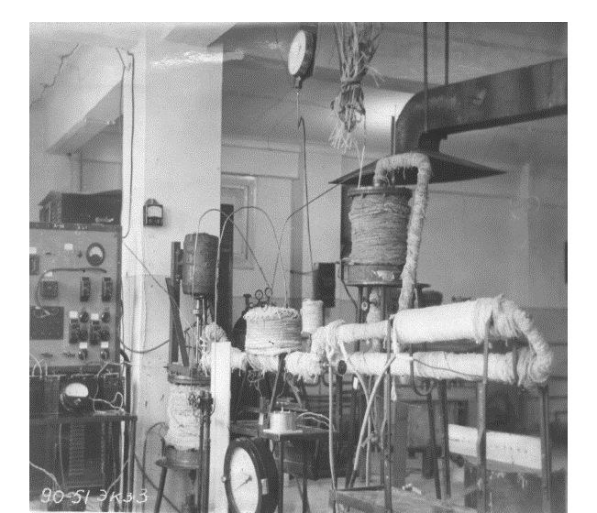
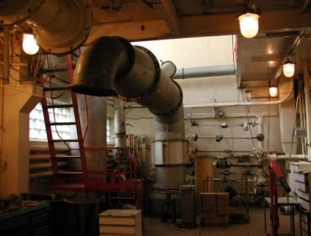
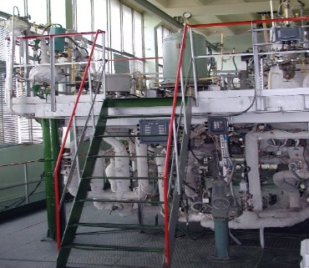
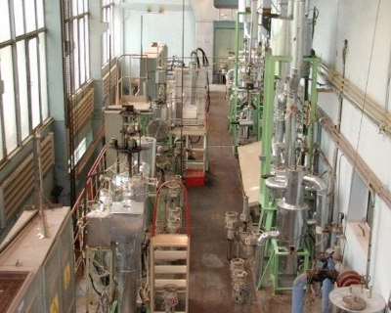
Experimental studies are the basis for solving thermophysical problems in fast reactors
One of the most important problems in design and development of new type fast reactors always has been the thermophysics problems: the choice and mastery of coolants, the heat exchange and hydrodynamics study.
The needs to develop methods for numerical simulation of hydrodynamics and heat transfer require experimental studies
to obtain data on the physical laws
of thermophysical processes, characteristics of hydrodynamics and heat transfer in reactor facilities
First Pb-Bi facility
(1951)
Aerodynamic facility «SGDI»
the relations for closing the equations
of numerical models
verification of computational codes.
To solve these problems, a complex of experimental liquid-metal test facilities was constructed, the equipment, modeling methods, experimental techniques and measurement procedures, as well as sensors and automation tools for the acquisition and processing of experimental information were developed.
«TT-1M» facility with Pb and Pb-Bi for technological studies
«6B» facility with Na and Na-K
for thermohydraulic studies

Slide 3
The problems of the modeling theory for thermophysical processes
When thermophysical experiments are prepared and conducted, one of the most important issues is fulfillment of the conditions of mechanical, thermal and thermodynamic similarity, which establishes the dependence of the physical properties of a moving heat-conducting medium on the parameters of the state and the most general dependences for describing heat transfer in various liquids under a wide variety of conditions of hydrodynamics and heat transfer in the objects under study.
The similarity analysis and the following criteria and asymptotic solutions should be applied in full.
In the event that a sufficiently complete analytical solution or numerical study of a mathematical model is possible, the purpose of the experiments is to test its basic premises and also to refine the calculated coefficients.
Over the past decades, many monographs and textbooks have been written on this topic.
At the same time, S.S. Kutateladze notes that the external simplicity of the basic analysis and the ever-increasing multiparametric nature of the problems of physical and mathematical modeling lead to a lot of misunderstanding and direct errors.
The aim of this work is to analyze the application of the principles of modeling the processes of hydrodynamics and heat transfer in liquid metal coolants and the theory of the similarity of thermophysical processes when experimental studies are conducted on the models with the use of other media to substantiate hydrodynamics and heat transfer in reactors with liquid metal coolants and to transfer data to the reactor conditions.

Slide 4
Features of liquid (molten) metals
Liquid (molten) metals (Li, Na, K, Cs, Pb, Bi, Hg, Ga, In, and their alloys (Na–K, Pb–Bi, Pb–Li in terms of heat transfer form a special class of coolants with significant volumetric heat capacity and high thermal conductivity. Their coefficient of kinematic viscosity is much lower than the coefficient of thermal diffusivity or, which is the same, the Prandtl number is much lower than one (Pr << 1).
In liquid metal thermal perturbations associated with molecular thermal conductivity propagate deep into the flow at a much greater distance than perturbations of the velocity fields caused by the action of molecular friction. The dynamic boundary layer "drowns" in the thermal boundary layer, and the notion of a thermal boundary layer that extends to the channel center loses its meaning.
Due to a good thermal conductivity induced by electronic conductivity, they are characterized by a high heat transfer coefficient, thus ensuring temperature conditions acceptable for operation of heat transfer surfaces at a high heat flux density.
Liquid metals have a high boiling point and do not require a lot of pressure to prevent boiling.
For most liquid metals, the disadvantage is their high reactivity when they interact with atmospheric oxygen, water, and structural materials. Under certain conditions, this fact will impair heat transfer.
A feature that should be taken into account during heat transfer in liquid metals in the region of the heat-release surface is the state of the impurity composition of the liquid-metal coolant during its circulation close to the heat transfer surface under nominal conditions and in case of deviations from the normal operation conditions.

Slide 5
Principles and conditions for physical modeling of hydrodynamics and heat exchange processes
Direct physical modeling consists in the fact that the process of the same physical nature as in a full-scale specimen is reproduced, but the characteristics of the same name are changed (reduced or increased) by some constant factors. In other words, any two physically similar phenomena can form a pair: a full-scale specimen – a model.
Hence the fundamental rule of modeling formulated by M.V. Kirpichev and A.A. Gukhman is the following: the systems of the same physical nature are similar if their single-valuedness conditions are similar, and the criteria of the same name, composed of the conditions of single-valuedness, are numerically the same.
For complete similarity of the model to a full-scale specimen, the following conditions must be fulfilled:
The process reproduced in the model belongs to the same class of physical phenomena as the process in a full-scale specimen both processes obey the same equations and are characterized by the same physical quantities.
The model is geometrically similar to a full-scale specimen.
Dimensionless boundary conditions in a full-scale specimen and the model are the same qualitatively and numerically.
Dimensionless independent variables (determining criteria), variables in a full-scale specimen and a model in pairs have the same numerical value.
When these conditions are fulfilled, the simulation is direct and complete.

Slide 6
Fulfillment of conditions for physical modeling of hydrodynamic and heat transfer processes
Direct physical modeling consists in the fact that the process of the same physical nature as in a full-scale specimen is reproduced, but the characteristics of the same name are changed (reduced or increased) by some constant factors. In other words, any two physically similar phenomena can form a pair: a full-scale specimen – a model.
Physical modeling with fairly well-defined confidence boundaries of the results obtained with its help is possible only on the basis of some pre-selected mathematical model.
In practice, direct modeling can be unlimitedly applied only to the processes, whose determined similarity numbers are functions of only the geometric simplices of the system and one determining criterion. The presence of two defining criteria, such as the Re and Pr numbers during heat transfer, significantly complicates the simulation. With three defining criteria, direct modeling is usually not feasible. In such cases, it is necessary to set up systematic multivariate experiments.
The purpose of such modeling experiments is to actually reveal the effects permitted by a very general mathematical model, but not reproducible at the modern level of mathematical technologies, neither analytically or in numerical studies. For example, elucidation of complex vortex structures in viscous fluid flows, correlation functions of specific turbulent flows, etc.
In this paper, we present the results of an analysis of the features of the application of the similarity theory of thermophysical processes to modeling:
Hydrodynamics and heat transfer in liquid metals are presented for channels of a complex shape.
Thermal hydraulics in rod systems with liquid-metal coolants (core and heat exchangers of fast reactors).
Temperature and velocity fields in hot chamber of the reactor in various operating modes.

Slide 7
Basic definitions in modeling of the thermophysical processes
The motion of a viscous and heat-conducting liquid is described by the Navier-Stokes equations, continuity, heat transfer, and thermodynamic equations (equations of state and expressions for the specific enthalpy i or entropy s in terms the thermodynamic parameters p, T). In most cases, the motion parameters (velocity w, pressure p, density ρ, liquid temperature T) vary continuously over time τ.
The equations of motion and heat transfer for a viscous and heat-conducting liquid are reduced to a dimensionless form with introduction of dimensionless variables determined by the following conditions:
x*=x/l; z*=z/l; τ=(τw₀)/l; w_{x}*= w_{x}/w₀,
where l is characteristic size, m; w₀ is characteristic velocity, m/s; T_{w} – T₀ is characteristic temperature difference,°С; p₀ is characteristic pressure, Pа. For transient processes, the number of dimensionless parameters includes Fo = at₀/l² – the Fourier number.
The quantities l, w₀, T_{w} – T₀, ν, a are called characteristic, since they determine the conditions under which the fluid moves. In this case, l, w₀, T_{w} – T₀ are set arbitrarily, and ν, a characterize the properties of the liquid. The thermal diffusivity coefficient characterizes the ability of the medium to react to passage of the heat flux by changing the temperature. The kinematic viscosity coefficient characterizes the ability to react to passage of the momentum flux by changing the velocity.
The sets of parameters in the equations are dimensionless and are called similarity criteria:
Re = w₀l/ν is Reynolds number, Pe = w₀l/a is Peclet number, Pr = Pe/Re = ν/a is Prandtl number, Nu = al/λ is Nusselt number,
Ma = w₀/c is Mach number, Eu = ρ₀/(ρw₀²) is Euler's number, Ga = (gl³)/ν² is Galileo number,
Ar = (gl³Δδ)/(ν²ρ) is Archimedes number, Fr = w₀²/(gl) is Froude number.
Similarity criteria set up a dynamic or kinematic similarity, the essence of which is that with the same value of the criteria, the ratios of two physical characteristics (for example, forces) with the same geometry of flows have the same value. Similarity criteria determine the relative influence of both the forces acting in the flow and the transfer processes occurring in the flow (momentum transfer due to viscosity and heat transfer due to thermal conductivity).

Slide 8
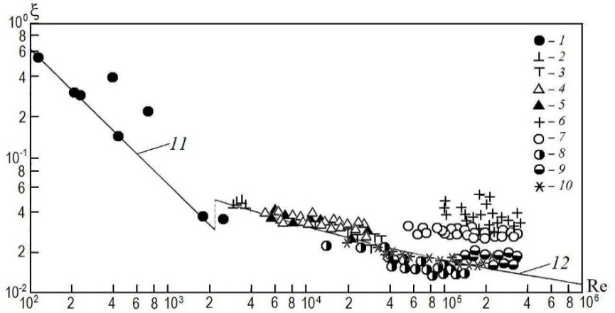
Modeling of liquid metals hydrodynamics in channels
It should be noted that in the 1930s, the first activities were carried out that showed that liquid metals belong to Newtonian fluids. The characteristic criterion for modeling hydrodynamic processes in channels of a complex shape is the Reynolds criterion. In the 1940s, the identity of the velocity profiles for the flow of mercury and ordinary liquids in pipes was shown in M.A. Styrikovich work. Later it was confirmed by studies V.M. Borishansky and C.C. Kutateladze.
The NPO CKTI (Joint Stock Company “Polzunov Central Boiler and Turbine Institute”) obtained the data on the mercury flow in glass tubes. No deviations from the Blasius formula were noted.
In the 1950s, similar results were obtained for mercury and tin flowing in smooth steel pipes. Similar experiments were performed with molten iron and cast iron in ceramic pipes. Tolstoy D.M. theoretically and experimentally found out that sliding occurs during the movement of mercury, but it affects only in case of its movement in pipes of a very small diameter. For example, for a pipe with a diameter of d = 7 microns, the volumetric sliding effect is about 28 %, and for d = 26.6 microns, it is about 6 %.
The experiments showed that the numerical values of the friction coefficients for mercury and mercury-magnesium amalgam in the pipes is the same as for the motion of ordinary liquids.
High thermal conductivity and weak dependence of thermophysical characteristics of liquid metals on temperature results in a weak dependence of the temperature profile in the liquid flow on the heat flux magnitude. Therefore, the heat flux has little effect on hydraulic resistance of liquid metals flow. The data by M.A. Stirikovich et al for rough pipes did not demonstrate any specific features of liquid metals flow either.
This fact makes it possible to simulate the dynamics of liquid metals with water and gases.
Comparison of dependences for the hydraulic frictional resistance coefficients ξ on the movement condition for water, mercury and mercury-magnesium amalgam

Slide 9
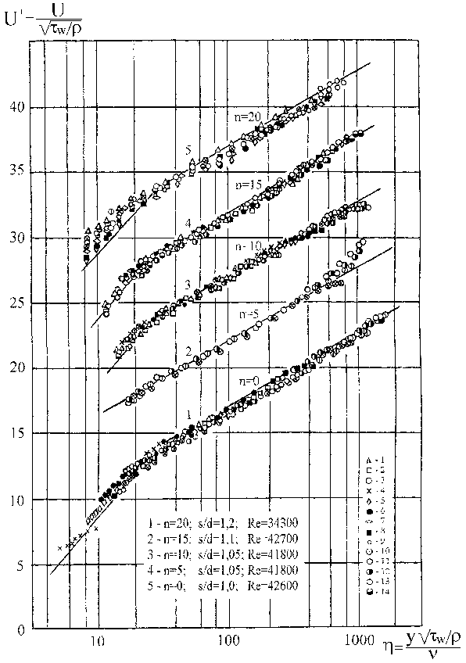
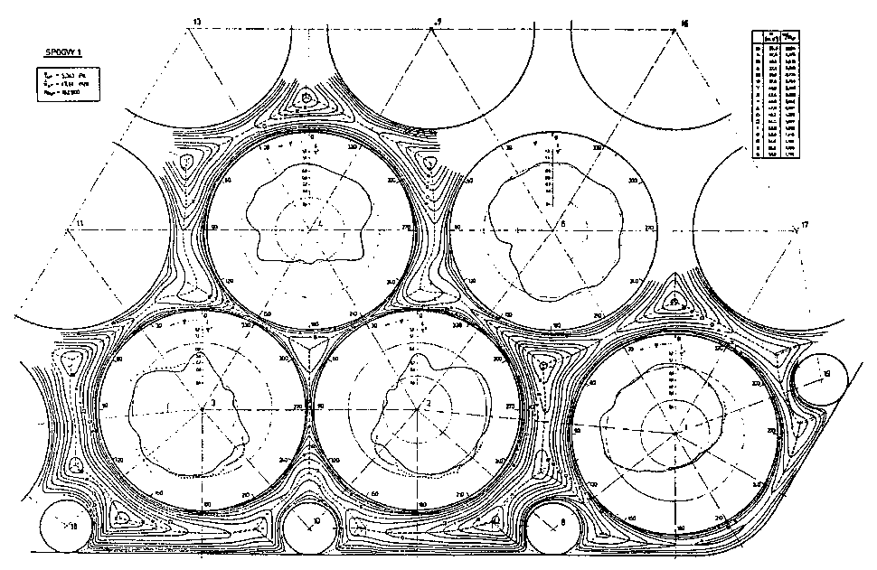
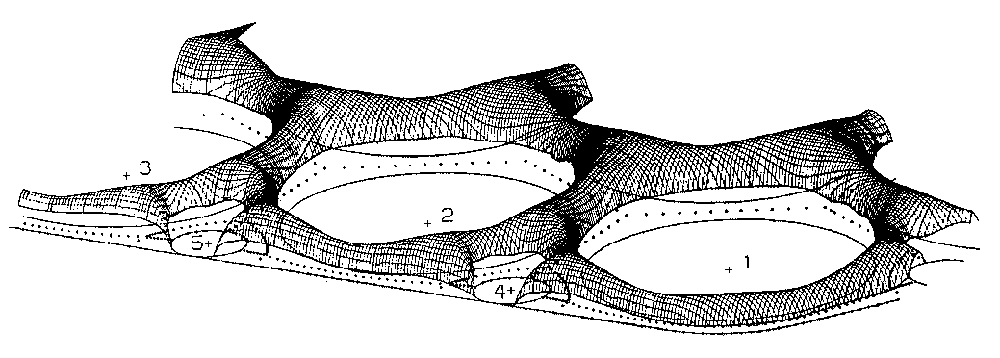
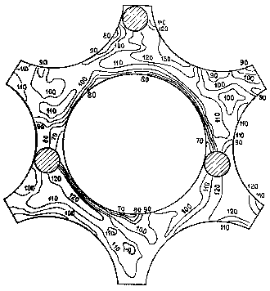
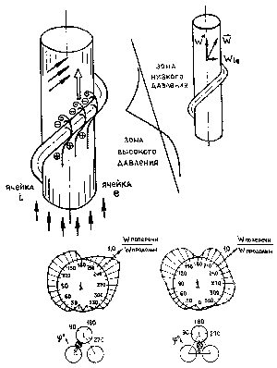
Modeling of liquid metal hydrodynamics in rod bundles
Distribution of velocity and shear stresses in the cross section of a smooth rod bundle with lattice deformation
The velocity profiles on the normal to the channel walls for liquid metal flow described by the universal Prandtl-Karman law
Coolant velocity distribution in the FA model with wire wrap spacing

Slide 10
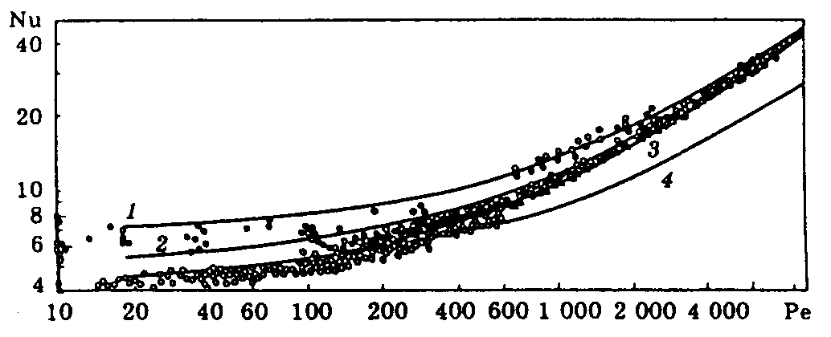
Modeling of liquid metal heat transfer in pipes
When heat transfer is studied in liquid metals for a steady-state flow, the hypothesis is used that the Reynolds numbercan be approximately excluded in the criterion equation Nu = f(Re, Pe). The works that could indicate additional errors in case of its use are unknown.
Using the integral calculation method and the condition of the turbulent Prandtl number equal to unity, Lyon (1951) obtained the ratio for heat transfer in pipes
Nu = 7 + 0.025Pe^{0.8}.
Intensive research into heat transfer in liquid metals began in the 1950s in connection with nuclear power development and design of Pb-Bi reactors for submarines. Systematic studies had been carried out since 1953 under the scientific supervision of V.I. Subbotin.
In 1956–1959, large test facilities were constructed at the IPPE, with the help of which a great number of data on heat transfer in Hg, Pb-Bi, Na, Na-K, Li, Cs and other coolants was obtained. The research work went on thereafter, up to the present time.
Difference between Lyon theoretical formula and other formulas is explained by the difference in the boundary conditions on the heat transfer surface.
it was shown that the main cause of thermal contact resistance is the deposition of solid particles suspended in a liquid metal flow on the heat transfer surface.
There is no contact thermal resistance when the concentration of impurities in the coolant does not exceed their solubility at the temperature of the circulating liquid metal.
Heat transfer calculated with the formulas of Nu = 7+0.025Ре^{0.8} (1),
Nu = 5.2+0.025Pe^{0.8} (2), Nu = 4.3+0.025Pe^{0.8} (3), Nu = 5+0.014Pe ^{0.8} (4)
and measured in mercury-nickel (△), mercury-stainless steel (▲), sodium potassium-copper (● ), mercury (◌) in round pipes
For purified from impurities liquid metal Nu = 5 + 0.025Pe^{0.8}.

Slide 11
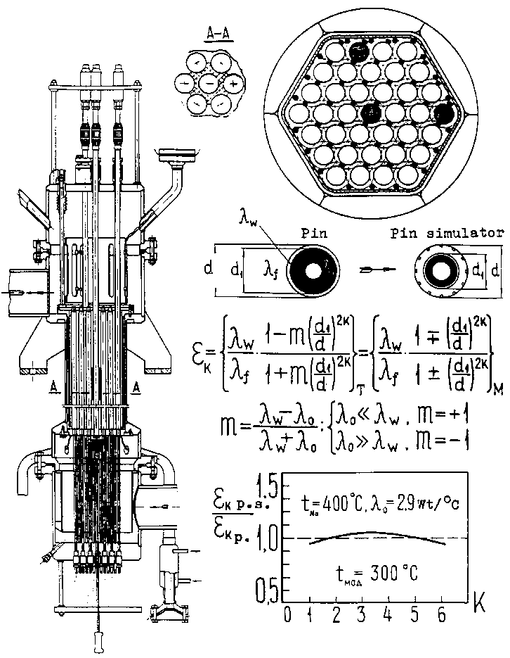
Modeling of thermal hydraulics in fast reactor fuel assemblies
When setting the tasks for convective heat transfer, V.I. Subbotin and his collaborators focused on development of the approximate thermal modeling theory as applied to reactor cores, i.e. modeling of fuel elements with multilayer or single-layer tubes with electric heating from the inside.
P.A. Ushakov has shown that convective heat transfer in channels of fuel assembly should be considered together with heat transfer by thermal conductivity in the walls, that is, the «conjugate problem» of heat transfer from fuel elements is solved in fuel elements
of reactors.
The temperature distribution of the fuel elements in the bundle depends not only on the classical similarity criteria, but also on the design and thermophysical characteristics of the fuel elements and the assembly. The relation for the coolant temperature has the form:
The essence of the approximate thermal similarity consists in taking into account only the fundamental harmonic in the Fourier series. The value is called the criterion of approximate thermal similarity of fuel elements.
The main harmonics are: k₀ = 6 for triangular and k₀ = 4 for square latticies, k₀ = 1 for eccentric annular channels and fuel elements near a flat wall.

Slide 12
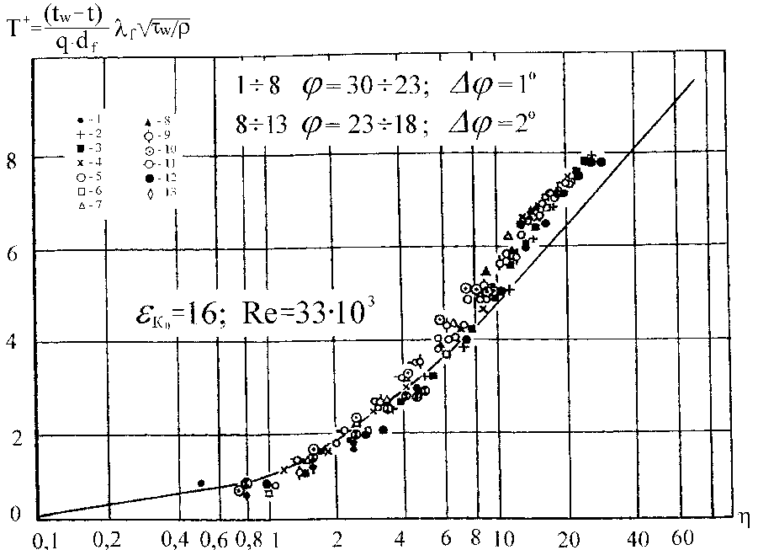
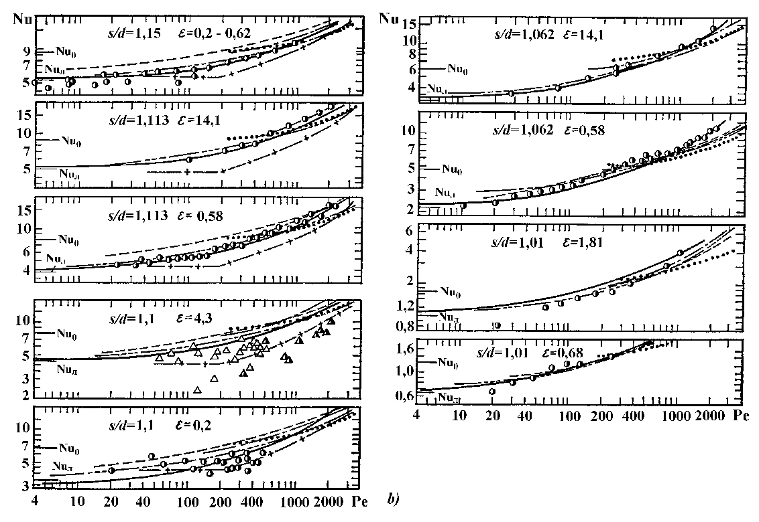

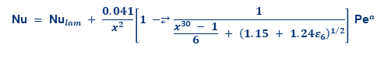
Heat transfer in triangular lattices of cylindrical fuel elements
The quasi-universality of the dimensionless temperature profile on the normals to the channel walls is confirmed in the case of heat transfer by liquid metals.
A.V. Zhukov and others, generalized dependences were recommended to calculate heat transfer and temperature fields in the channels of a complex shape, with regard to the influence of fuel elements' geometry and materials:
$$T^{+}=4.75 \ln{η}−7.5$$
$$\text{Nu} = \text{N}{\text{u}}_{lam} + \frac{0.041}{x^{2}}\left[1 −⥂\frac{1}{\frac{x^{30} − 1}{6} + {\left(1.15 + 1.24ε_{6}\right)}^{1/2}}\right] \text{P}{\text{e}}^{a}$$
1 < x = s/d <2; 1 < Ре < 4000; 0.01 < ε₆ < ∞

Slide 13
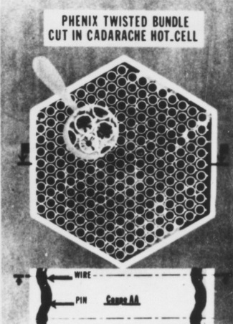
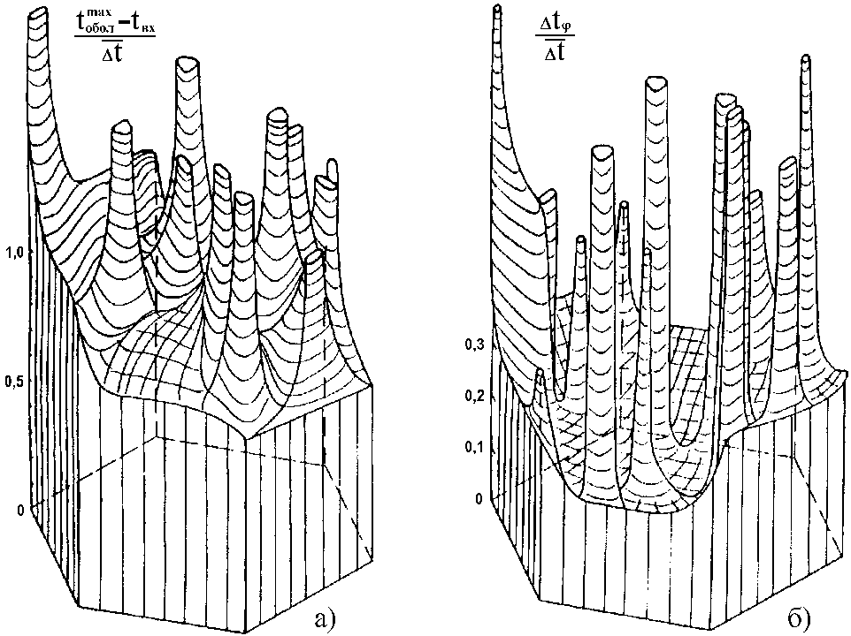
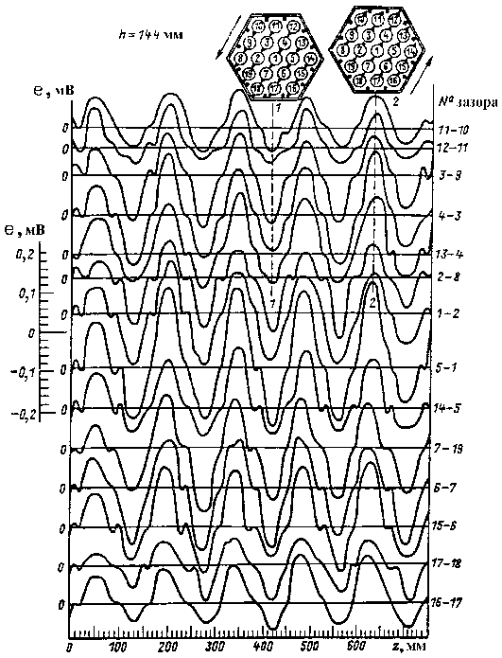
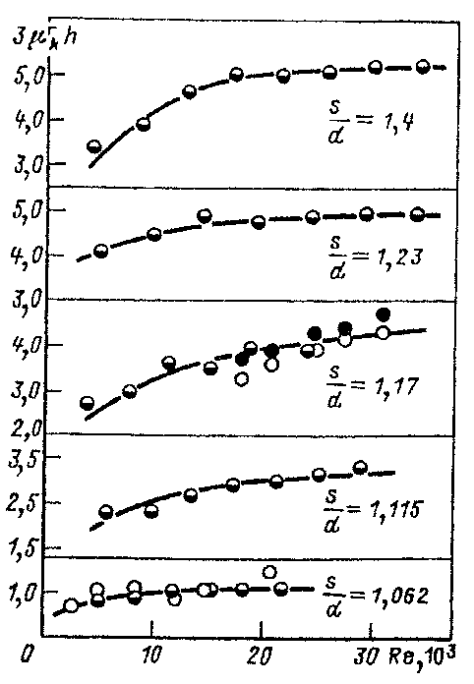

Convective Inter-channel exchange in fuel assemblies
An essential feature of the thermal hydraulics of fuel rod assemblies is the influence on the velocity and temperature distribution of inter-channel mass and heat transfer.
The intensity of interchannel transfer plays a significant role in flattening the temperature in “hot spots” or temperature non-uniformity in the presence of non-standard cells.
Convective inter-channel transfer in fuel rod bundles
is provided by wire wrape spacing. Thermal and electromagnetic methods, the Freon tracer method were developed for measuring of the inter-channel interaction coefficients.
It is not yet possible to flatten the temperature at the outlet of the wrapper-tubes-free cores and even individual fuel assemblies with wrapper pipes.
$$μ_{к}^{м} =⥂\frac{1}{3h}Φ_{∗}\left(x\right) Ψ\left(Re() \text{and} _{∗}\left(x\right)\left(x\right)\exp{ }\left(−D\right)\right)$$
1.01 < x < 1.4; 2 < h/d < 50; 2∙10³ < Re < 2∙10⁵
The temperature field of the fuel assemblies of the PHENIX reactor at the end of the campaign, due to significant shaping of the fuel assemblies, is characterized by large irregularities in the temperature field of the coolant, significant overheating of the fuel cladding and azimuthal non-uniformity of temperature "in hot spots"

Slide 14
Modeling of thermohydraulic processes in fast reactors vessel
The primary coolant circulation loop (vessel structure) of a fast reactor is a complex combination of elements connected in series and in parallel, with their different orientations in the gravitational field and with geometric characteristics of flow cross-sections changing sharply in the direction of flow motion.
The errors (uncertainties) in modeling thermal hydraulics by means of fragmentary sector models with isothermal flows primarily result from the neglect of spatial 3D effects and temperature inhomogeneity of the flow.
Making use of large-scale models with nature coolant leads to a high cost of test facilities and research work.
1 – intermediate heat exchanger (IHX); 2, 3 – main and safety cases, respectively; 4 – support belt; 5 – pressure chamber;
6 – corium trap (pallet); 7 – reactor core; 8 – pressure pipeline;
9 – MCP-1; 10 – autonomous heat exchanger (AHX);
11 – overload mechanism; 12 – rotary plugs

Slide 15
Modeling of thermohydraulic processes in fast reactors vessel
Accurate modeling of hydrodynamics and heat transfer in small-scale models with a nature coolant (liquid metal) is impossible because of noncompliance with a few of the most important similarity criteria at the same time, i.e. Reynolds numbers (Re = wl/ν), Peclet (Pe = wl/a), Froude (Fr = w²/gβΔTl).
The studies performed have shown that at Re>10⁴, the sizes of stagnant and recirculating zones do not change at the Froude number values equal for the model and the reactor (Fr_{model} = Fr_{reactor}). Thus, no modeling with Reynolds number is required.
In this case, in a viscous fluid, it is possible to model with Froude and Richardson numbers without the Reynolds number preserved.
Approximate modeling of full-scale circulation conditions is provided by conservative modeling with Euler's number Eu = ΔР/ρW².

Slide 16
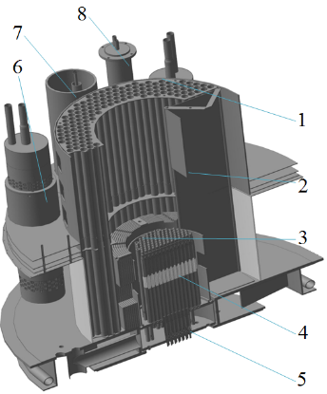
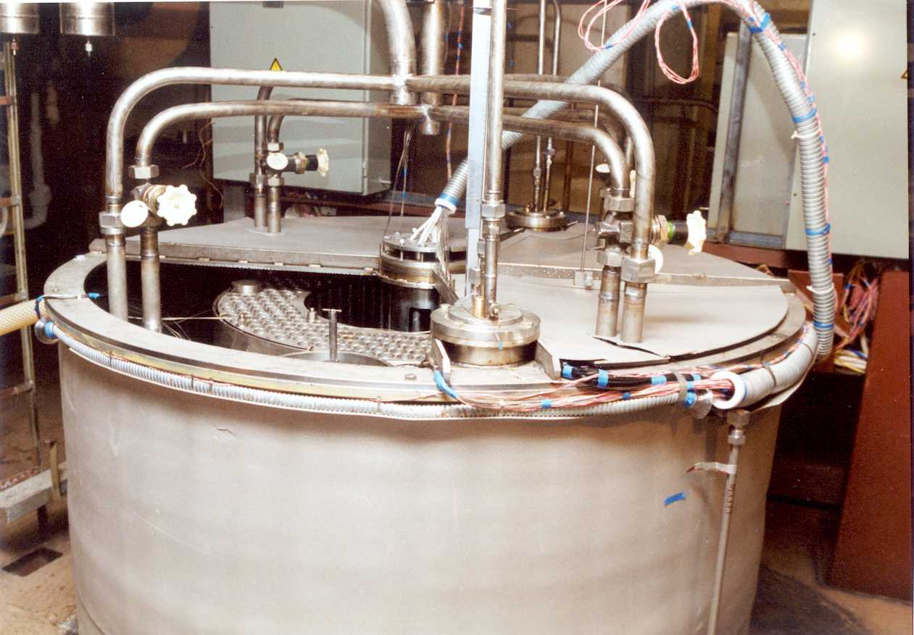
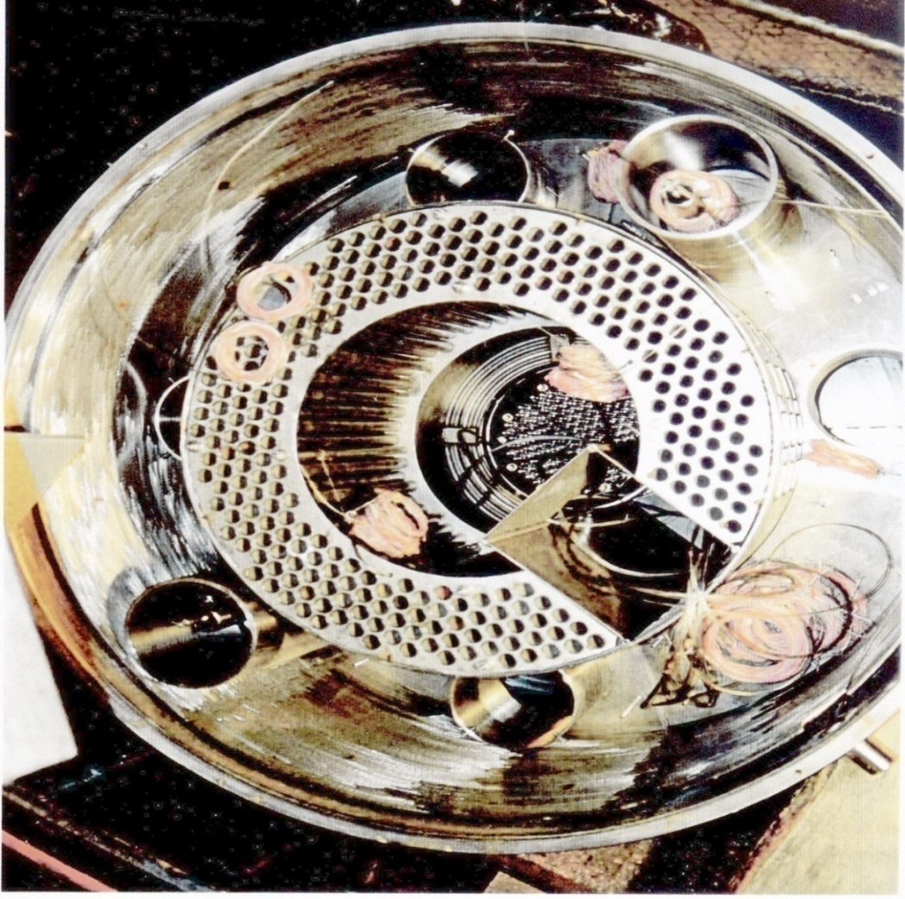
Pool-type fast reactor model on the water facility
«V-200»
Thermal hydraulics were studied in the model of the primary circuit of a pool-type fast reactor with liquid metal coolant, in the scale of ~ 1:10.
General view
of the experimental model
In-vessel equipment
of the experimental model
1, 6 – intermediate heat exchanger; 2 – elevator recess;
3 – in-vessel protection elements; 4 – core (fuel element simulators);
5 – pressure chamber; 7 – MCP-1 simulaor;
8 – autonomous heat exchange

Slide 17
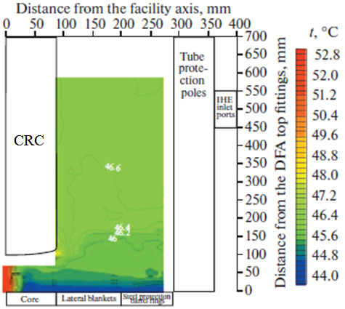
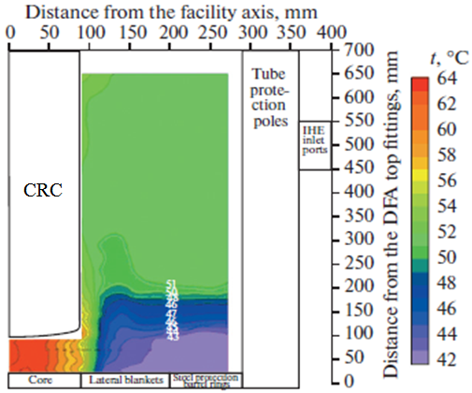
Cartogram of thermohydraulic processes in the reactor vessel in the nominal and steady statecondition of natural convection
The results of experimental showed that the effect of thermogravitational forces leads to temperature stratification with formation of stagnant and recirculating zones, to restructuring of the flow pattern and temperature regime.
The most common characteristic stratified flow are Vaisal-Brent frequency N² = (g/ρ)(∂ρ/∂z)⁻¹ and buoyancy scale l_{b} = ρ(∂ρ/∂z)⁻¹.
In a stably stratified turbulent flow the maximum size of the vortices can not exceed the buoyancy scale. Therefore large-scale vortices larger than the buoyancy scale are suppressed and spread along the stratified region of separation in the form of internal waves. Internal waves cause temperature pulsations in the material of the equipment walls with frequency f ≤ N.
This leads to thermal fatigue of the construction materials and a reduction in the lifetime of the reactor equipment.
The steady state regime of natural circulation (cooling down the reactor
by natural convection) is characterized by considerably smaller temperature gradients in the vertical direction above lateral blankets.
Averaged temperature of the coolant in the upper chamber with mobile temperature probes moving along the height under nominal and steady-state conditions of cooling down with natural convection

Slide 18
Conclusion
When an experimental study is planned and its results are generalized, the analysis of similarity and the following from its criteria and asymptotic solutions should be applied in full.
Direct modeling can be unlimitedly applied only to the processes, whose determined similarity numbers are functions of only the geometric simplices of the system and one determining criterion.
The presence of two defining criteria, such as the Re and Pr numbers during heat transfer, significantly complicates the simulation.
With three defining criteria, direct modeling is usually not feasible. In such cases, it is necessary to set up systematic multivariate experiments.
Experimental thermophysical studies carried out using the theory of physical modeling of hydrodynamics and heat transfer in liquid metals made it possible to obtain data not only on physics, but also on the characteristics of thermophysical processes in the fuel assemblies of the core and equipment units of reactors with liquid metal cooling.
These data are the basis for the development of both approximate engineering methods for the thermal-hydraulic calculation and precision methods and three-dimensional thermal-hydraulic codes.

Slide 19
Thank you
for your attention
Sorokin Aleksandr Pavlovich
Chief Researcher, Dr. Sci.(Tech.)
Тел.: +7 (484) 399 84 47
Моб. тел.: +7 (905) 641 20 99
E-mail: sorokin@ippe.ru
www.ippe.ru
20.04.2022

