Slide 1
Transmutation of minor actinides in a fast reactor with uranium-curium fuel
International Conference on Fast Reactors and Related Fuel Cycles FR22: Sustainable Clean Energy for the Future
A.M. Terekhova,
Yu.E. Zhakova,
V.V. Korobeinikov
19–22 Apr 2022, Vienna

Slide 2
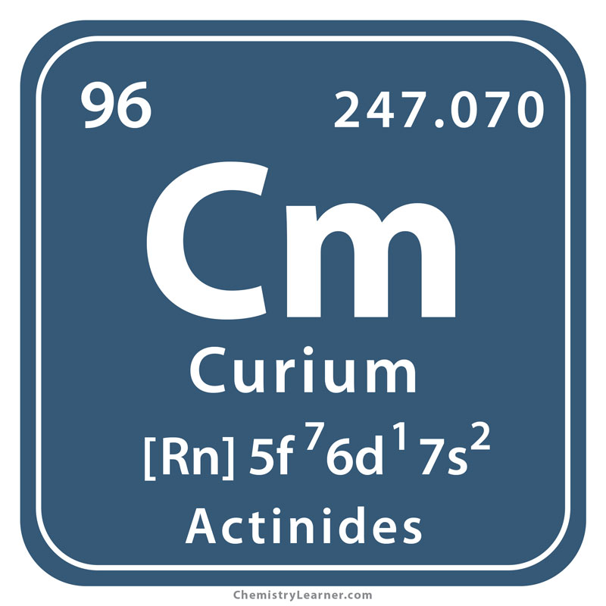
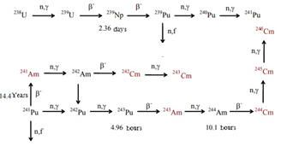
Curium
Curium is 96th element of the periodic table, synthesized transuranic element. There are 14 known curium isotopes with mass numbers of 238 - 250, and the most interesting from the point of view of nuclear energy are ²⁴³Cm, ²⁴⁴Cm, and ²⁴⁵Cm.

Slide 3
THE ISOTOPIC COMPOSITION OF THE FUEL
For analyse, three types of fuel were taken:
(U-Pu)O₂: fuel of uranium-plutonium fuel (mixed oxide fuel) with a volume fraction of plutonium 37.1% (uranium dioxide from depleted uranium with 0.1% enrichment);
(U-Cm)O₂: fuel of UO₂ (uranium from depleted uranium with 0.1% enrichment) and Cm₂O₃ (volume fraction 59%). Curium consists of 90% ²⁴⁴Cm and 10% ²⁴⁵Cm;
(U-Cm244)O₂: fuel from UO₂ (uranium from depleted uranium with 0.1% enrichment) and Cm₂O₃ (volume fraction 93%). Curium consists of 100% ²⁴⁴Cm.

Slide 4
RESULTS CULCULATION

Slide 5
CUNCLUSIONS
Curium has neutron-physical properties that allow a fast neutron reactor with a curium fuel to achieve greater criticality than a reactor with a uranium oxide fuel. But at the same time, additional features in the design of the heat removal and the removal of gaseous fission fragments are necessary for the stationary operation conditions of the nuclear reactor on fast neutrons with curium fuel. The operating time of breeding gain of minor actinides in such a reactor is significantly less than in a fast reactor with uranium-plutonium fuel. The fuel is a mixture of curium isotopes can be made critical, and its multiplying properties will be significantly increased than in uranium-oxide fuel.

Slide 6
Thank you for your attention

