Slide 1
Evaluation of an increase of the power density for the French commercial Sodium Fast Reactor and optimization study at 1100 MWe with the SDDS tool
PowerPoint 2007
Pour appliquer ce modèle à une présentation existante :
supprimez toutes les diapos de ce document,
puis, onglet [Accueil],
"Nouvelle diapositive",
"Réutiliser les diapositives",
dans le volet Office à droite, cliquez sur [Parcourir],
"Rechercher le fichier",
une fois le fichier sélectionné, clic droit sur une de ses miniatures,
"Insérer toutes les diapositives".
NB : ne pas cocher "Conserver la mise en forme source" en bas du volet d'insertion.
D GÉRARDIN, S. POUMEROULY, L. ANDRIOLO EDF-R&D
International Conference on Fast Reactors and Related Fuel Cycles: Sustainable Energy for the Future
19-22 April 2022

Slide 2
I. Context

Slide 3
Context
Reduction of SFR cost
Reduction of the vessel size
Reduction of the core size
Increase of the power density
Concept of short secondary loops
Etc.
Reduction of the size of the neutron protection
Reduction of the pump size
Etc.
1)
French commercial SFR under definition at EDF since 2017
Objective: Enhanced competitiveness with reduced construction costs
Several options identified to reduce SFR costs that needs further R&D studies
Conception and optimisations studies performed at EDF-R&D with SDDS tool
Study performed in 2018 for a 1000 MWe SFR
2 designs (12 SA rings or 13 SA rings) pre-selected as they offered good compromise between safety performances and reduced core diameter
Study performed in 2020 considering a 10% increase of nominal power
1000 MWe (2400 MWth) →1100 MWe (2640 MWth)
Questions to be answered:
Are the trends of the study at 1000 MWe still the same at 1100 MWe?
Is it possible to find a design at 1100 MWe that meet the safety criteria and the limited core diameter objective ?
Complementary studies to test some evolutions of the variable parameters or selection criteria
2)

Slide 4
II. method

Slide 5
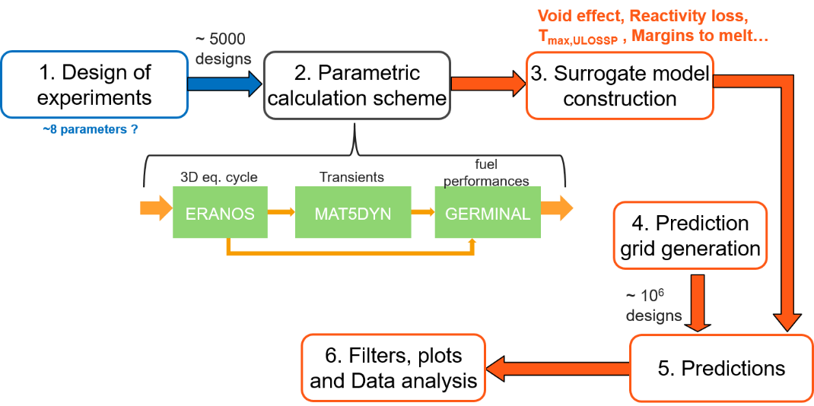
SDDS
Tool to help the conception and the optimisation of SFR cores
Developed at EDF since 2009

Slide 6
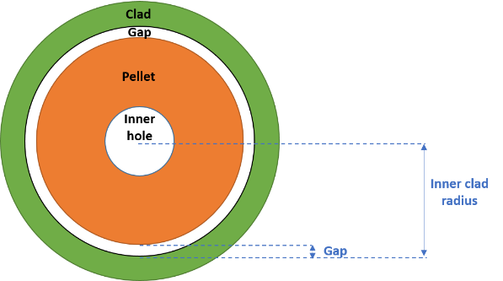
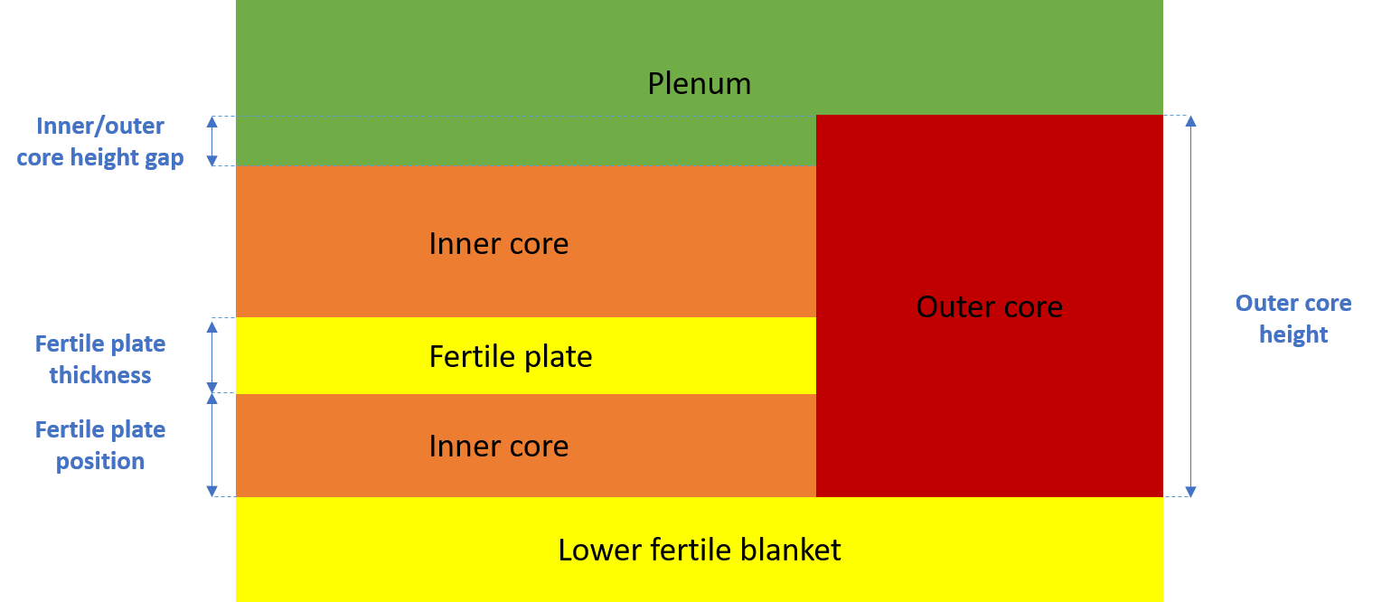
Specification of the study
Low sodium void effect core geometries
Heterogenous core with fertile plate, height gap between inner and outer core and plenum
Variation range allows to go up to homogeneous core geometry
Additional constraints/filters before creating the surrogate models
French commercial SFR specifications: power density in [250 ; 375] W/cm³
Core viability: Margin to fuel melting in nominal conditions > 0
Parameter | Range
Number of fuel sub-assembly rings | 12 or 13
Number of pins per sub-assembly | 217 or 271
Pellet/cladding (radial) gap (mm) | [0 ; 0.11]
Inner clad radius (cm) | [0.35 ; 0.5]
Outer core height (cm) | [90 ; 110]
Outer/inner core height gap (cm) | [0 ; 20]
Fertile plate position (% of inner core height) | [0 ; 50]
Fertile plate thickness (cm) | [0 ; 20]

Slide 7
III. Results of the SDDS method at 1100 MWe

Slide 8
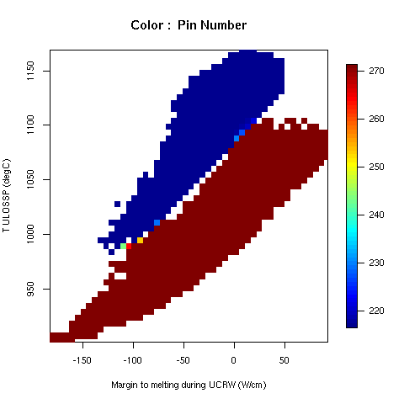
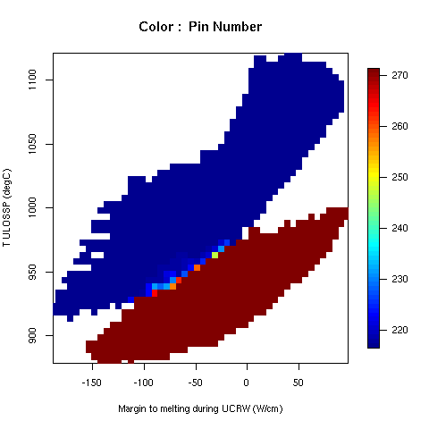
Results of the SDDS study at 1100 MWe
Colour : number of pins per assembly
Results presented in (Margin to fuel melting during UCRW, sodium temperature in ULOSSP)
Degradation of the safety performances compared to previous study at 1000 MWe
12 assembly rings
TULOSSP in [901 ; 1170] °C & Margin to fuel melting in UCRW [-189 ; 98] W/cm
No design avoiding boiling in ULOSSP in the studied space
13 assembly rings
TULOSSP in [878 ; 1122] °C & Margin to fuel melting in UCRW [-189 ; 98] W/cm
Designs avoiding fuel melting in UCRW and designs avoiding boiling in ULOSSP but not both simultaneously
Best designs on the safety point of view located on the Pareto front
Colour of each point indexed on the mean value of the studied parameter
Number of pins
Designs on Pareto front with a high number of pins per assembly (271 rather than 217)
12 rings
Enhanced safety
13 rings

Slide 9
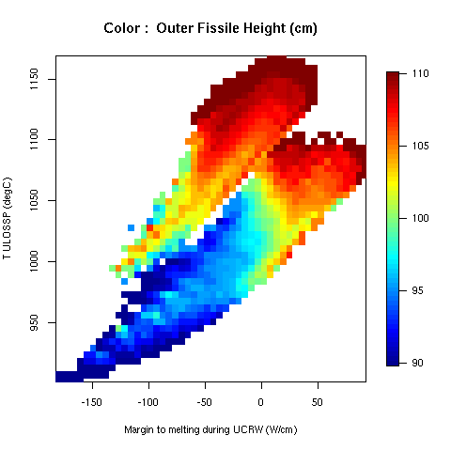
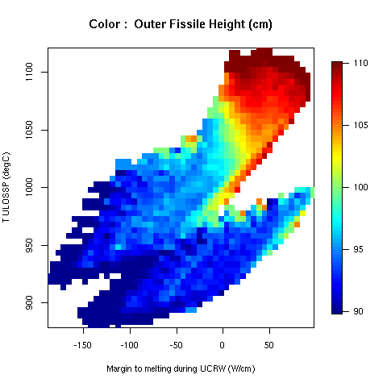
Results of the SDDS study at 1100 MWe
Colour : outer core height
Outer core height
Gradient colinear to Pareto front → either small outer core to enhance ULOSSP or a large outer core to enhance UCRW
For other parameters, designs on the Pareto front with
Thin pins ~8 mm diameter → due to the filtering of the low power density cores
Relatively small inner/outer core height gap
Large fertile plate (15-20 cm) either located at the bottom of the core to enhance ULOSSP or at the middle of the core to enhance UCRW
Similar trends than the ones observed in the study at 1000 MWe
12 rings
13 rings

Slide 10
IV. Selection of a 1100 Mwe core

Slide 11
Selection of a 1100 Mwe core Criteria and optimisation objectives
Criteria (safety related criteria)
Margin to fuel melting in nominal conditions > 300 °C (Standard conception criteria)
Margin to fuel melting in case of UCRW > 20 W/cm (to take into account the surrogate models' uncertainties)
Optimisation objectives
Safety objectives: Sodium temperature in ULOSSP at core outlet as low as possible
Economical objective: Core diameter as small as possible
12 SA rings configurations : no core configuration selected at 1100MWe because of poor safety performances (in the studied space)

Slide 12
Selection of a 1100 Mwe core
13 SA rings configurations
Core selected in 2018 re-evaluated at 1100 MWe does not meet the non-melting criteria in UCRW
Core selected with the new optimisation at 1100 MWe
Meet the safety criteria regarding non fuel melting
Same core radius as the core selected in 2018
Core selected in 2018 re-evaluated at 1100 MWe
Core on the Pareto front of the SDDS study at 1100 MWe
Parameter | 13-Ref | 13-C5
Outer pellet radius [cm] | 0.346 | 0.3455
Inner clad radius [cm] | 0.35 | 0.35
Outer core height [cm] | 94 | 92
Outer/inner core height gap [cm] | 5 | 0
Inner fertile zone position (% of inner core height) | 5 | 18
Inner fertile zone height [cm] | 20 | 15
Number of pins per SA | 271 | 271
Fissile core radius [cm] | 203 | 203
Power density [W/cm3] | 304 | 302
Margin to fuel melting in nominal conditions [°C] | 356 | 431
Margin to fuel melting in UCWR [W/cm] | -3 | 29
Asymptotic temperature in ULOSSP [°C] | 915 | 922
Does not avoid sodium boiling in ULOSSP
SDDS models : Simplified thermohydraulic, natural convection but no passive protection system
Need more precise modelling and additional protection system

Slide 13
V. Complementary studies at 1100MWe

Slide 14
Complementary studies
Test of some evolutions of the variable parameters or selection criteria
Increase of the number of pin per assembly
Variation range shifted from {217 ; 271} to {271 ; 331} to access core configurations with better behaviour in ULOSSP and in UCRW
Significative improvement of the safety performances (particularly in ULOSSP) but :
Designs with 13 SA rings and 331 pins : too large core radius (too low power density) do not meet the French commercial SFR specifications
Designs with 12 SA rings and 331 pins : lower safety performances than the 13 SA rings and 271 pin designs and equivalent core radius
Addition of technical and economical criteria
Campaign length > 1500 JEPN
Maximal damage on the cladding < 150 dpa
Increased number of designs are eliminated (some of them being on the Pareto front and with a low sodium temperature in ULOSS)

Slide 15
VI. Conclusions & Perspectives

Slide 16
Conclusions & Perspectives
Several constraints
Safety performances : some of the geometrical characteristics that enhance ULOSSP tend to degrade UCWR (and vice versa)
Economical objectives (reduction of the core radius and high power density) opposed to safety objectives
10% increase of the power
Similar trends at 1000 MWe and 1100 MWe (core on Pareto front with similar characteristics)
Degradation of the safety performances for ULOSSP and for UCRW
One 13 assembly rings design with 271 pins per assembly pre-selected
Further studies of the selected design
Selected design does not avoid sodium boiling in ULOSSP with the models of SDDS
Implementation of passive safety rods and more precise modelling => CATHARE study
Evaluate the severe accident behaviour and the need for mitigation devices implementation => SIMMER study
No fixed design
More precises studies of the pre-selected design foreseen => feedback on the design => iterative procedure
Possible future evolution of the criteria and optimisation objectives of the French commercial SFR

Slide 17
THANK YOU!

