Slide 1

BOR-60 reactor operating experience, work on improving safety and extending lifetime
International Conference on Fast Reactors and Related Fuel Cycles:
Sustainable Clean Energy for the Future (FR22),
19-22 April 2022, Vienna, Austria
A.L. Izhutov, A.L. Petelin, Yu.M. Krasheninnikov, I.Yu. Zhemkov, V.B. Kharlov
Research Institute of Nuclear Reactors, State Scientific Centre, Joint-Stock Company (RIAR JSC)

Slide 2
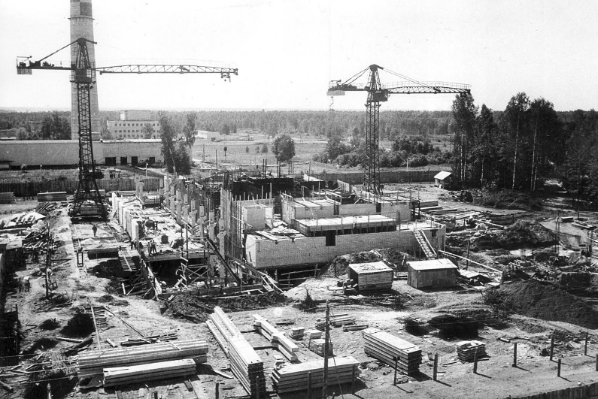

Milestones of the BOR-60 reactor construction:
the USSR Council of Ministers issued a decree on the BOR-60 reactor construction;
September 1964
beginning of earth construction;
May 1965
pre-nuclear commissioning of the BOR-60 reactor;
December 1968
commissioning of the start-up facilities at phase 1 construction work;
30 December 1968
14 December 1969
BOR-60 attained its first criticality;
28 December 1969
BOR-60 power start-up with heat removal to the air heat exchanger;
commissioning of the BOR-60 plant on a full scale, output of generated electrical power into the Ulyanovskenergo system.
28 December 1970
In December 2020 reactor celebrated 51-year anniversary of its power startup.
Despite its honorable age (>51 y.), the reactor remains in demand to this day.

Slide 3
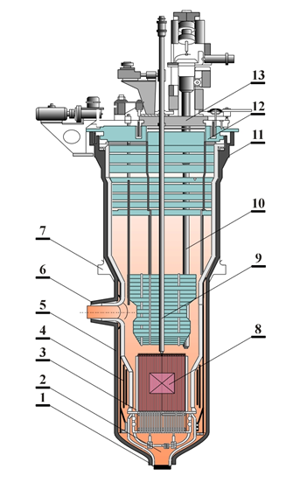
BOR-60 design configuration
1 – coolant inlet nozzle;
2 – high-pressure device;
3 – basket;
4 – thermal protection and neutron shielding of the reactor vessel;
5 – containment vessel;
6 – outlet nozzle;
7 – vessel flange;
8 – in-core FAs and FAs in the lateral blanket;
9 – control rod drive mechanism;
10 – fuel loading duct;
11 – supporting flange;
12 – large rotating flat plug;
13 – small rotating flat plug.

Slide 4







BOR-60 core arrangement
I heard you threw your gamepad
Control road
Standard fuel assembly
Experimental fuel assembly
Experimental non-fuel assembly
Neutron source
Blanket assembly (steel)
Instrumented irradiation position D23

Slide 5
Main operational parameters of the BOR-60 reactor
Thermal power output, MW | Up to 60
Electrical power output, MW | 12
Cogeneration plant capacity, Gcal/h | 25
Maximal neutron flux density, cm⁻²·s⁻¹ | 3.7⋅10¹⁵
Coolant | sodium
Sodium flow rate through the reactor, m³/h | Up to 1100
Coolant temperature, ºС: at the reactor inlet, at the reactor outlet, | 360 515
Sodium velocity in the core, m/s | Up to 8
Sodium flow rate in two secondary loops, m³/h | Up to 1400
Output of the sodium-to-air heat exchanger, MW | 30
Reactor operation cycle, days | Up to 90
Shutdown time between the reactor operation cycles, days | 20 and 45
Damage dose rate, dpa/yr | Up to 20

Slide 6
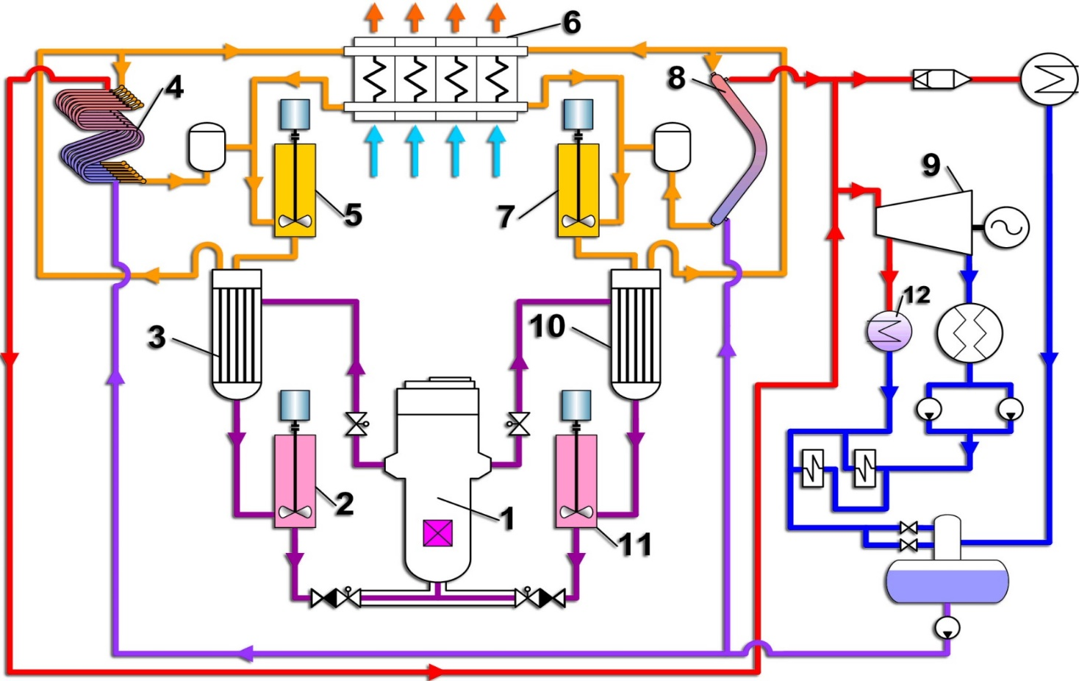
BOR-60 flow diagram
1 – reactor;
2, 5, 7, 11 – primary and secondary pumps;
3, 10 – intermediate heat exchangers;
4, 8 – steam generators;
6 – air heat exchanger;
9 – turbine;
12 – cogeneration plant for district heating.

Slide 7
Main operational performance data of BOR-60
Performance indicator | 2016 | 2017 | 2018 | 2019 | 2020
Effective full power hours, h | 5365 | 5669 | 5157 | 5249 | 5078
Installed capacity utilization factor | 0.63 | 0.65 | 0.59 | 0.6 | 0.57
Maximal power output of the reactor, MW | 50 | 50 | 50 | 50 | 50
Heat generation, GW·h | 245 | 265 | 223 | 220 | 222
Electric power generation, GW·h | 34.7 | 38.5 | 32.1 | 28.5 | 29.6
Heat generated by cogeneration plant, Gcal | 31560 | 37779 | 34991 | 27153 | 24657
The number of reactor shutdowns: total scheduled outages unplanned outages | 8 8 0 | 5 4 1 | 9 9 0 | 4 4 0 | 6 6 0
Outages hours due to unplanned reactor shutdowns, h |  | 40

Slide 8
Experimental capabilities of the BOR-60
The main directions of irradiation testing and work at the reactor:
Inserting experimental fuel assembles and materials test rigs both in the core and lateral blanket;
Large-scale irradiation tests of fuel rods with various fuel compositions;
Irradiation testing of neutron absorbing materials;
Irradiation position to insert instrumented materials test rigs, fuel assemblies or independent loop channels so that to obtain experimental data during irradiation testing;
Irradiation tests of structural materials for fuel rods, absorber rods, fuel test rigs as well as testing of vessels, equipment and pipe ducts for different reactors;
Experiments in support of reactor safety to cope with the abnormal operating occurrences;
Irradiation testing of specimens in dry horizontal
(2 pcs.) and vertical (9 pcs.) channels outside the reactor vessel;
Experiments focused on sodium-cooled reactor technology (sodium purity, purification of sodium coolant and removal of radionuclides, cleaning of equipment from sodium and radioactive sodium among other things, sodium waste removal, etc.);
Simultaneous testing of prototype equipment intended for operation in sodium-cooled circuits as well as diagnostic and safety systems.
Testing of reactor operation in the NPP mode for which a steam turbine makes a part of the reactor.

Slide 9
The main experiments and irradiation tests conducted in the BOR-60 reactor in recent years
Irradiation testing of materials test rigs with structural materials test specimens (zirconium alloys and structural materials for components of different reactors) in a temperature range of 320÷650°С;
Irradiation testing of absorber rodlets with high-enriched boron carbide and prototype fuel rods for the SVBR-100 reactor;
Irradiation testing of the BREST-OD-300 absorber rodlets filled with boron carbide pellets and lead bonding, dysprosium hafnate pellets and helium bonding;
Irradiation testing of prototype BREST-OD-300 nitride fuel rods;
Irradiation testing of zirconium alloys under the Contract with EDF (France);
Irradiation testing of structural materials test specimens under the Contracts with CEA (France), Terra Power (USA) and KAERI (the Republic of Korea);
Irradiation testing of radiation shielding material (granular corundum) for the MBIR reactor;
Irradiation testing of vibropack MOX prototype fuel rods for the MBIR reactor;
Irradiation testing of absorbing materials specimens under the Contract with СЕА (France);
The number of test rigs under irradiation testing in the core and lateral blanket ranged from 15 to 24.

Slide 10
Work on extending the service life and improving the safety of the BOR-60
It is worth to highlight the following among the most significant activities undertaken in recent years to enhance the reactor safety:
Replacement of the obsolete measuring equipment of the process control system;
Replacement of the obsolete equipment of the electrical heating control system for sodium circuits;
The process control system of the III circuit was upgraded;
Four power transformers were replaced from 2014 to 2017;
In 2017 an automatic dry chemical fire suppression system was installed in the cable corridor;
In 2018 the following equipment was installed and put into operation: storage battery with a capacity of 920 A•h; 108 cells with voltage output of 220 V; two charging units for storage batteries; electric power supply system of the BOR-60 data acquisition and measurement system;
In 2019 ASUZ-22R equipment was put into operation;
In 2020 the following equipment was replaced and new one was put into operation:
Four power transformers;
Uninterruptable power supply units of emergency power supply system;
Radiation monitoring system of the BOR-60 reactor;
Two water heaters for the III circuit;
Fittings for the III circuit (18 pcs.).

Slide 11
Prospects of the BOR-60 reactor
From 2018 to 2019 the BOR-60 reactor was inspected holistically. The results of this inspection were used as a basis to make a decision to extend the life of the reactor till December 31, 2025. The documents pertinent to the BOR-60 life extension were submitted to specialized organization for expertize and its conclusion was favorable for granting the license to extend the BOR-60 life till the end of 2025.
Nowadays the BOR-60 reactor is in great demand to conduct irradiation tests for both Russian and foreign customers.
Most of the experiments are long-term. The BOR-60 reactor has secured contracts for the next few years and irradiation tests will continue until it is decommissioning. It is therefore important to ensure its safe and efficient operation during its extended life and to optimize the reactor loading in order to make more rational use of the core to meet the demand for irradiation tests.

Slide 12
Thank you
for your attention
Alexey Izhutov
Deputy Director, Science&Research
RIAR JSC, Dimitrovgrad
Tel.: +7 (84235) 7-93-40
E-mail: adm@niiar.ru

