Slide 1
Development of an Artificial Neural Network for predicting spatial interdependencies of reactivity effects in Sodium Fast Reactors
A. Jiménez-Carrascosa¹, J. Krepel², A. Ponomarev², K. Mikityuk², N. García-Herranz¹
¹Universidad Politécnica de Madrid (UPM), Spain
²Paul Scherrer Institut (PSI), Switzerland
FR22 – International Conference on Fast Reactors and Related Fuel Cycles: Sustainable Clean Energy for the Future
Austria, Vienna, April 19-22
Notes:
1

Slide 2
Outline
Introduction
ESFR-SMART core discretization
Data acquisition
Artificial Neural Network
Results
Summary
Notes:
2

Slide 3
1. Introduction
The Horizon2020 ESFR-SMART project was launched in September 2017 with the aim of further improving the safety level of the commercial-size ESFR.
The safety level of ESFR is directly related with reactivity feedbacks and, specifically, the sodium void reactivity.
The ESFR core, as a low-void concept, relies on the upper sodium plenum with neutron absorber above it to minimize the global sodium void reactivity.
Safety analyses under transient condition usually rely on point-kinetics-base transient codes.
As input, they receive maps with spatial distributions of reactivity feedbacks which are precalculated using neutron transport code.
This approach assumes that coefficients are independent and additive.

Slide 4
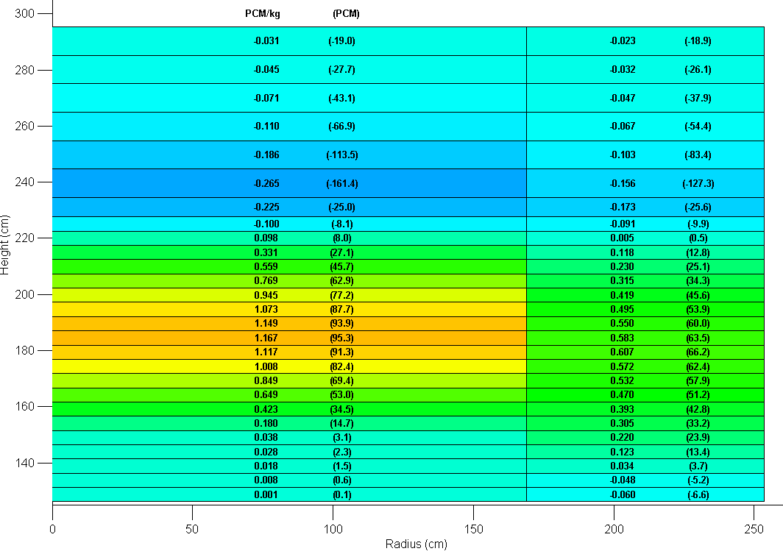
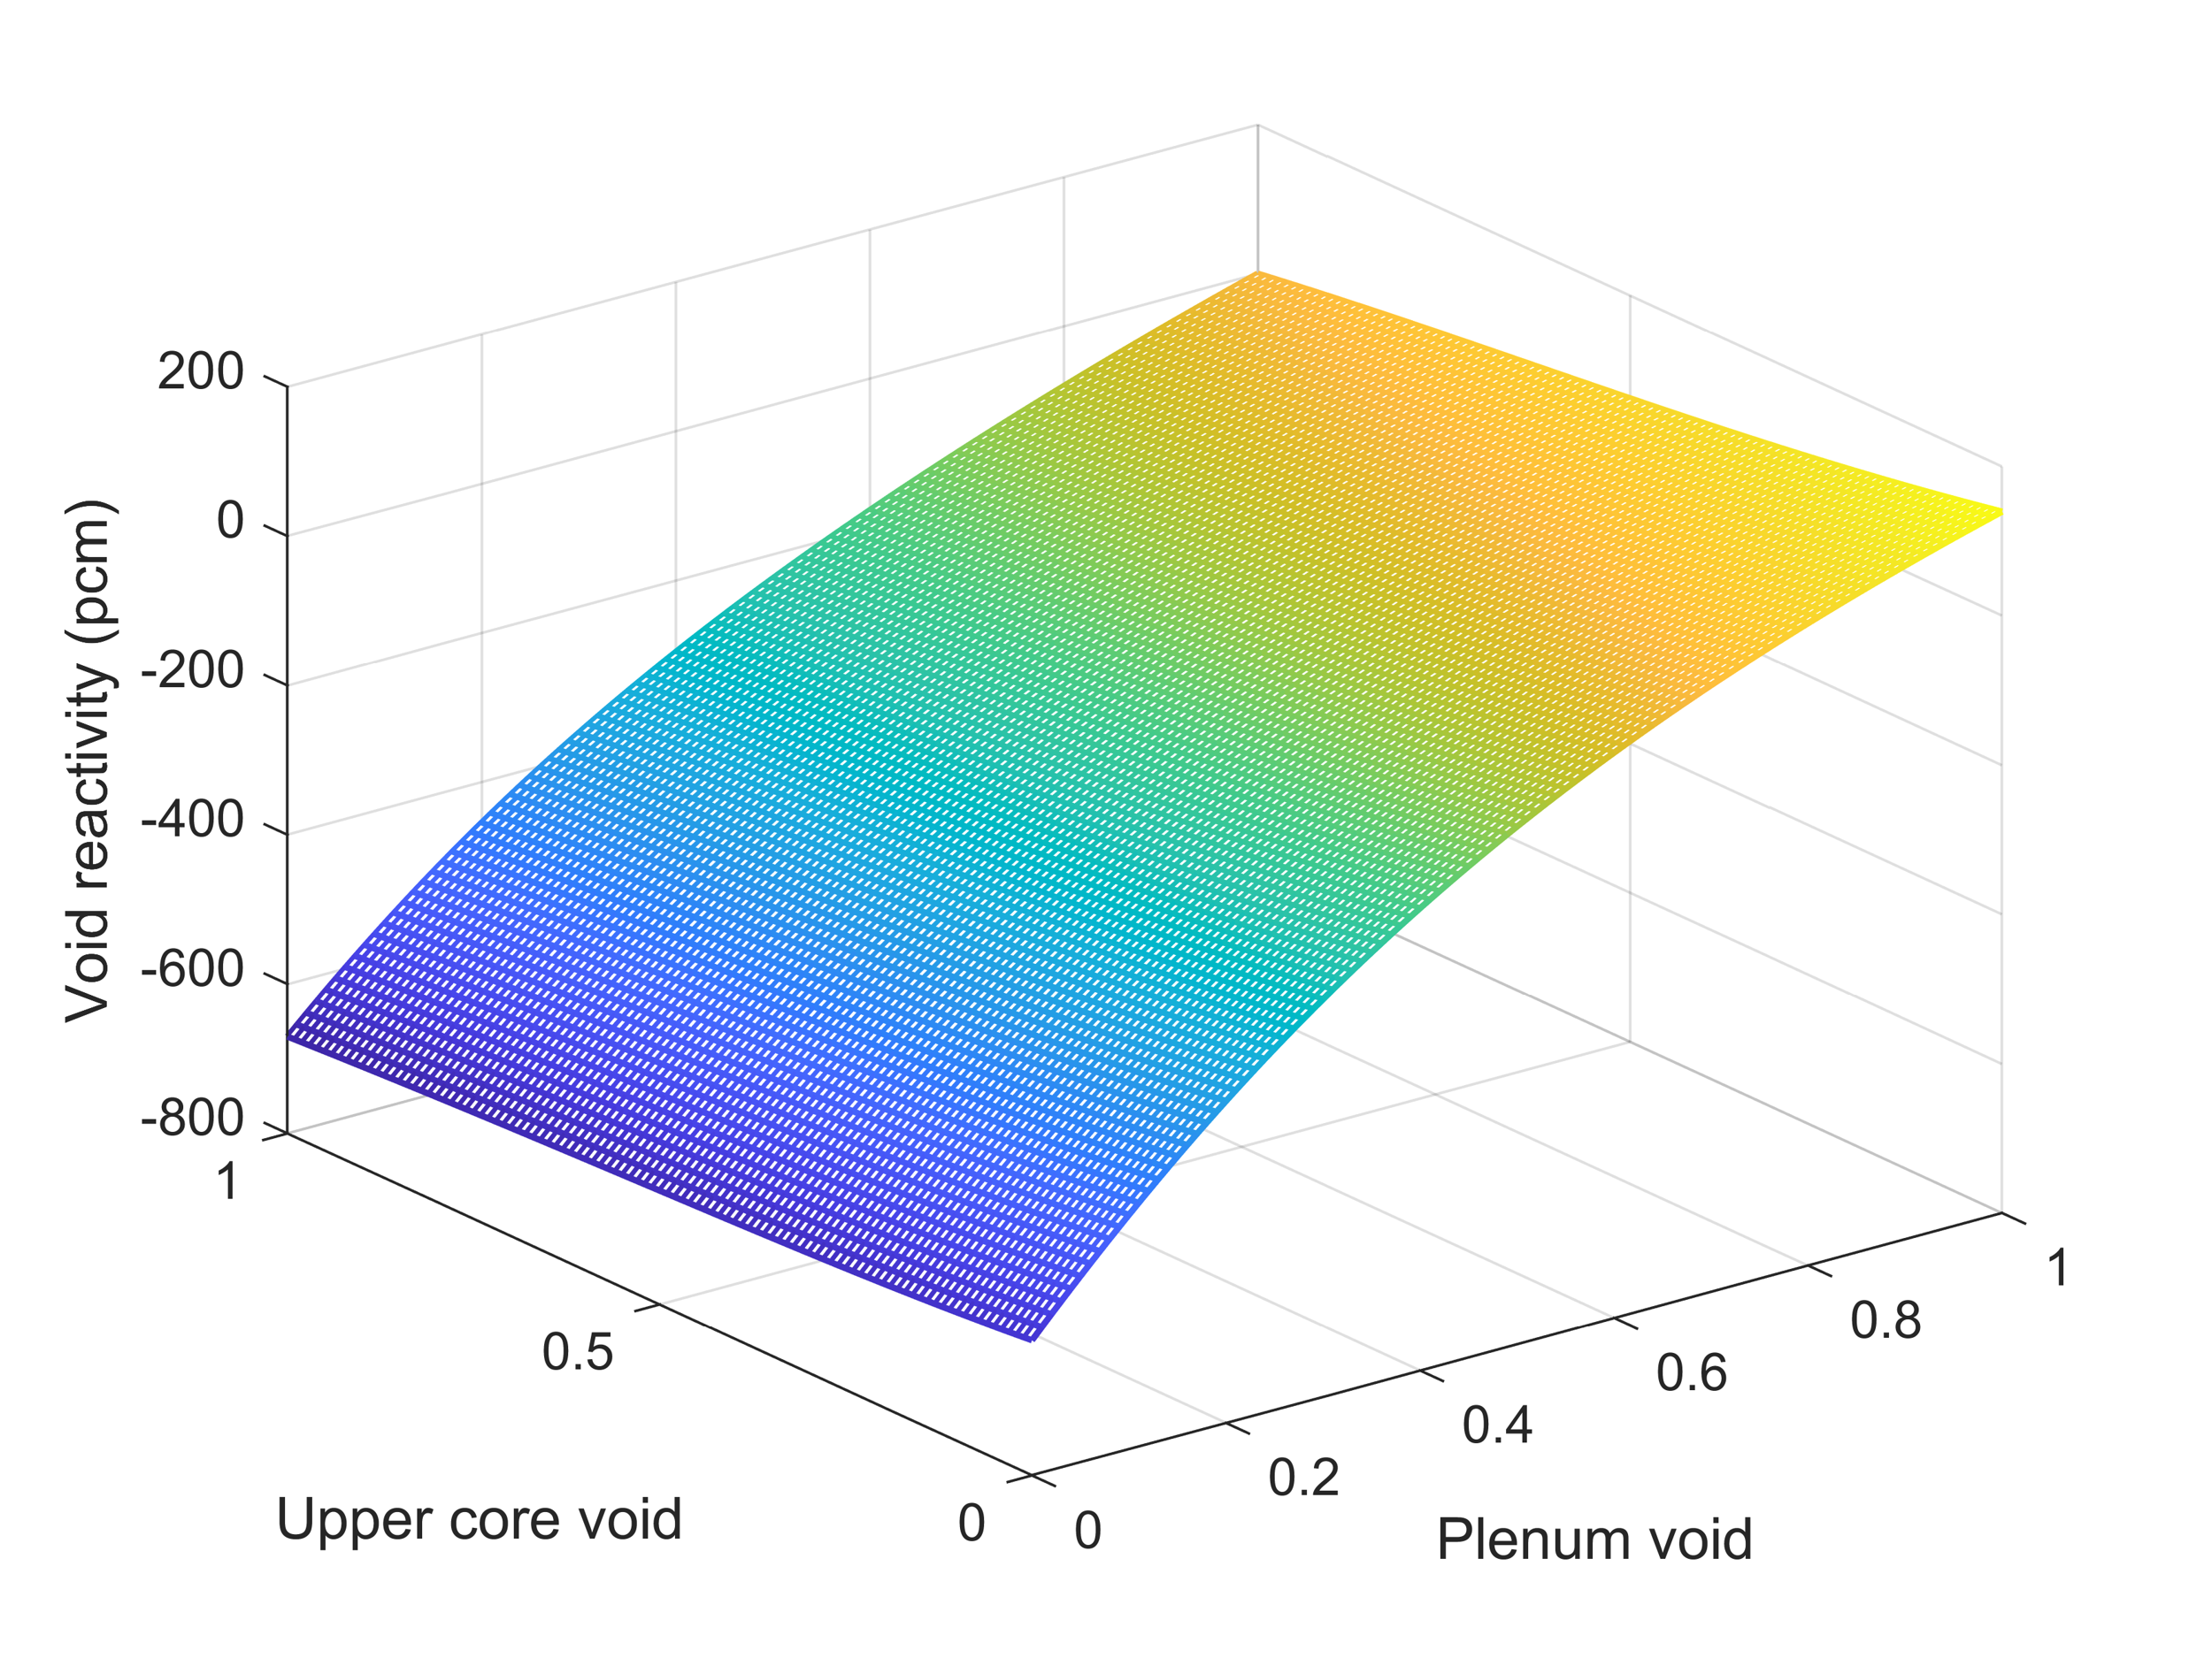
1. Introduction: problem description
Under certain conditions (e.g., sodium boiling occurs), that methodology may neglect the effect of the strong spatial correlation between the upper active core part and the sodium plenum as well as additivity effects (Krepel et al.,).
Consequently, accounting for the spatial correlations appears to be mandatory for an appropriate quantification of the global sodium density-related effect.
In this work, we propose a surrogate model able to predict the global sodium density effect with region-wise sodium density variation as input.
With that goal, a set of cases is prepared for training an Artificial Neural Network (ANN).
  J. Krepel, A. Ponomarev, K. Mikityuk, “Spatial interdependencies of safety related effects in ESFR-SMART core,” In FR22, Vienna (Austria), April 19-22, 2022.

Slide 5
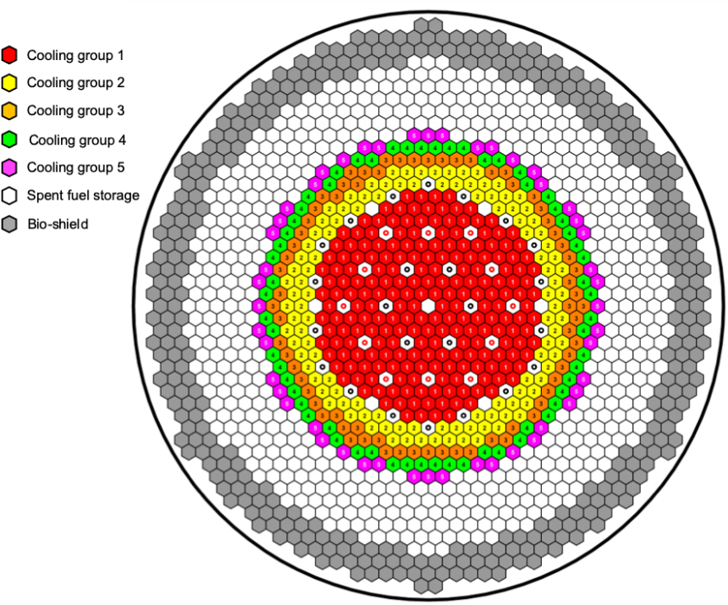
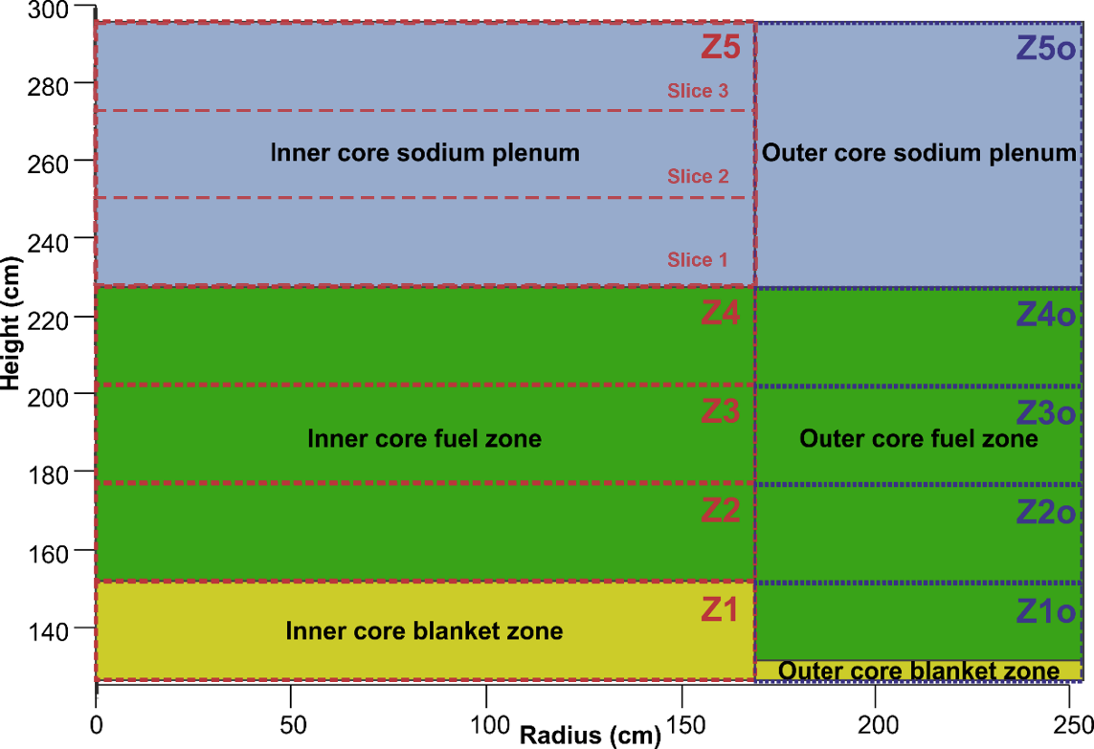
2. ESFR-SMART core discretization
The ESFR-SMART core at EoC state is selected since it will be subsequently the reference model for transient analyses.
The core is discretized aiming to be consistent with transient codes’ models. Then, different zone-wise perturbations are applied to capture both spatial interrelations and non-linear effects concerning sodium void worth.
ESFR-SMART radial discretization: 5 cooling groups
ESFR-SMART axial discretization: 5 axial zones + 3 subregions for inner core sodium plenum

Slide 6
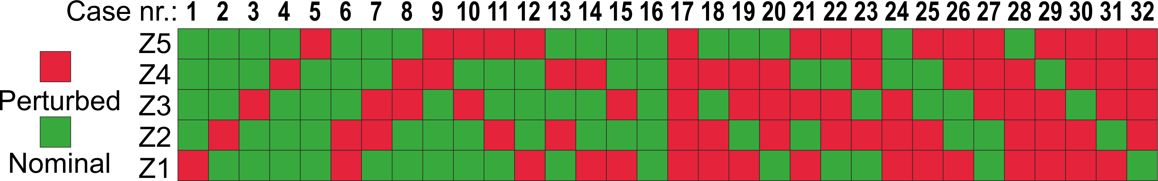
3. Data acquisition
Our discretization relies on 27 nodes and the dataset should account for all the axial and radial interactions taking place in the core for the sodium void effect.
The database for the training of the ANN is generated using ERANOS2 code for 329 scenarios:
  32 cases for every cooling group (CG1-CG5) covering all the axial interrelations,
  32 cases combining the main radial cooling groups: CG1 and CG2,
  35 cases combining all the radial cooling groups for obtaining global values,
  Additional dataset for capturing non-linearities of the sodium void worth in the sodium plenum and its dependency on the upper core part. Partial void values are also included for those sub-regions that describe the sodium plenum of the CG1.

Slide 7
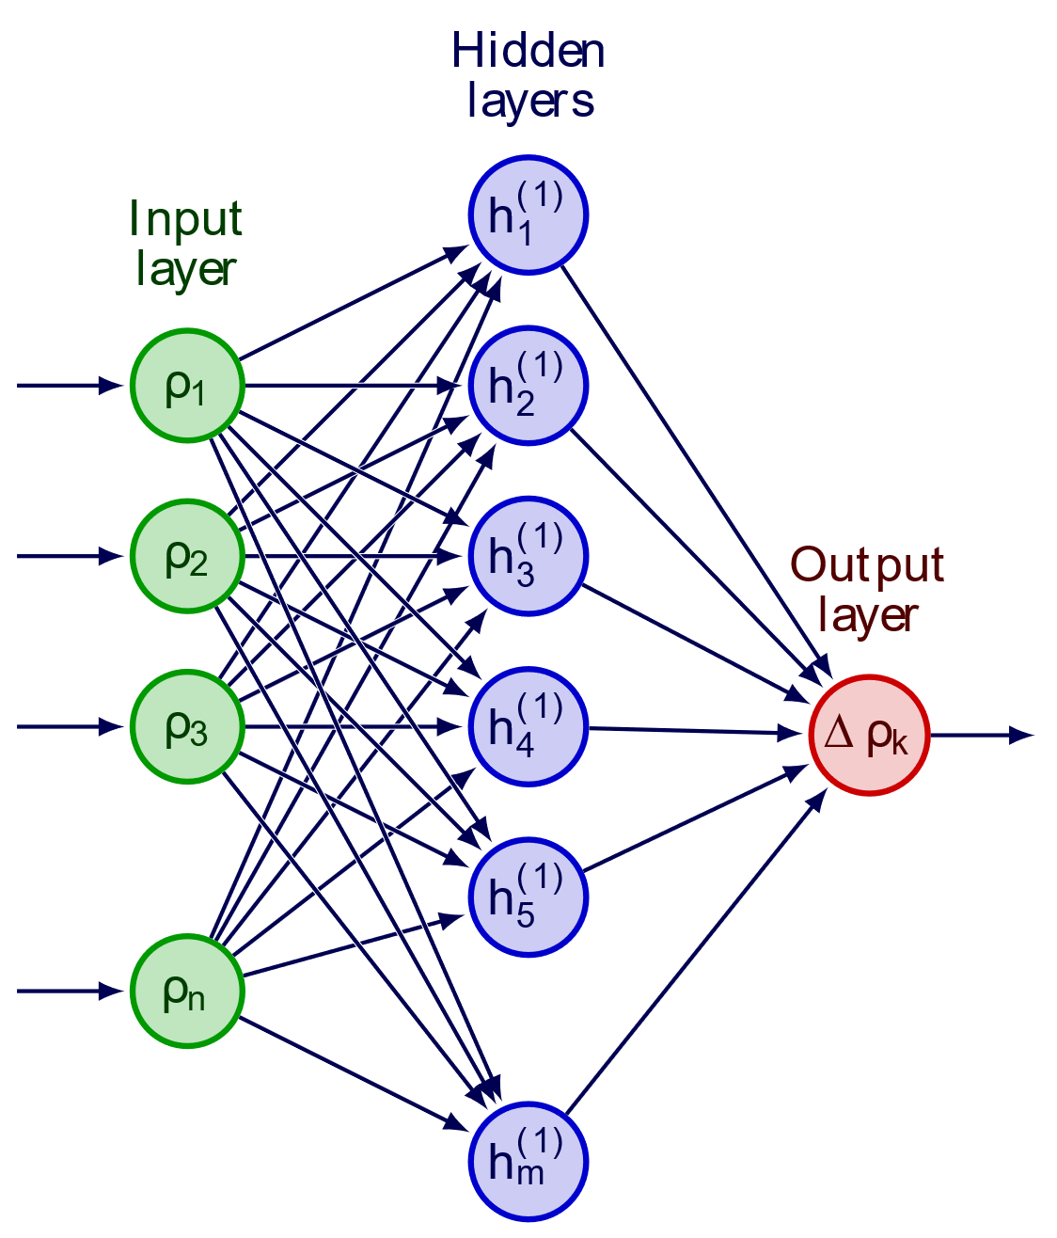
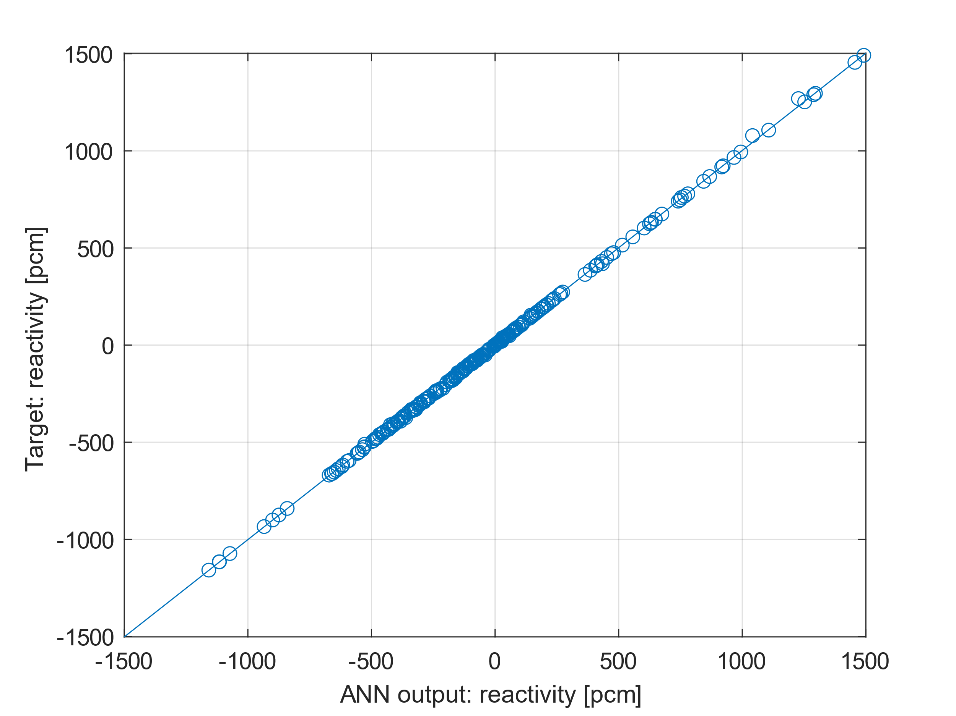
4. Artificial Neural Network development
A Deep Neural Network (DNN) is constructed to predict the global sodium void coefficient based on an input vector of 27 locations. Each one corresponds to normalized sodium density at every core region are varies between 0 (full void) and 1 (flooded and nominal state).
1 hidden layer with 50 nodes
MSE as cost function
Bayesian regularization back-propagation training algorithm
ReLU activation function

Slide 8
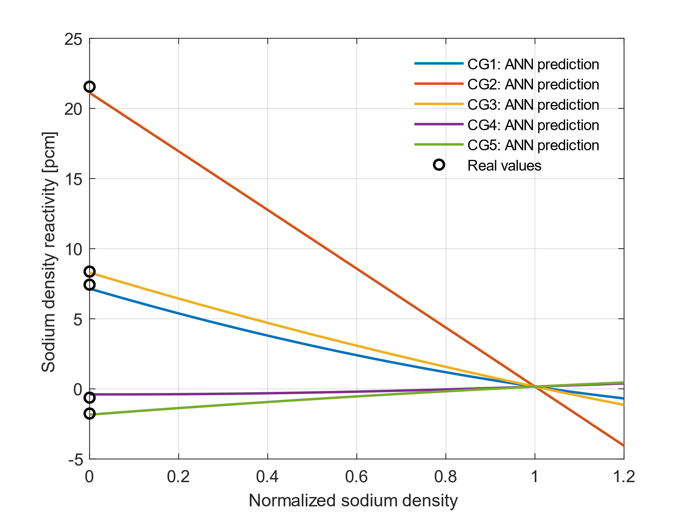
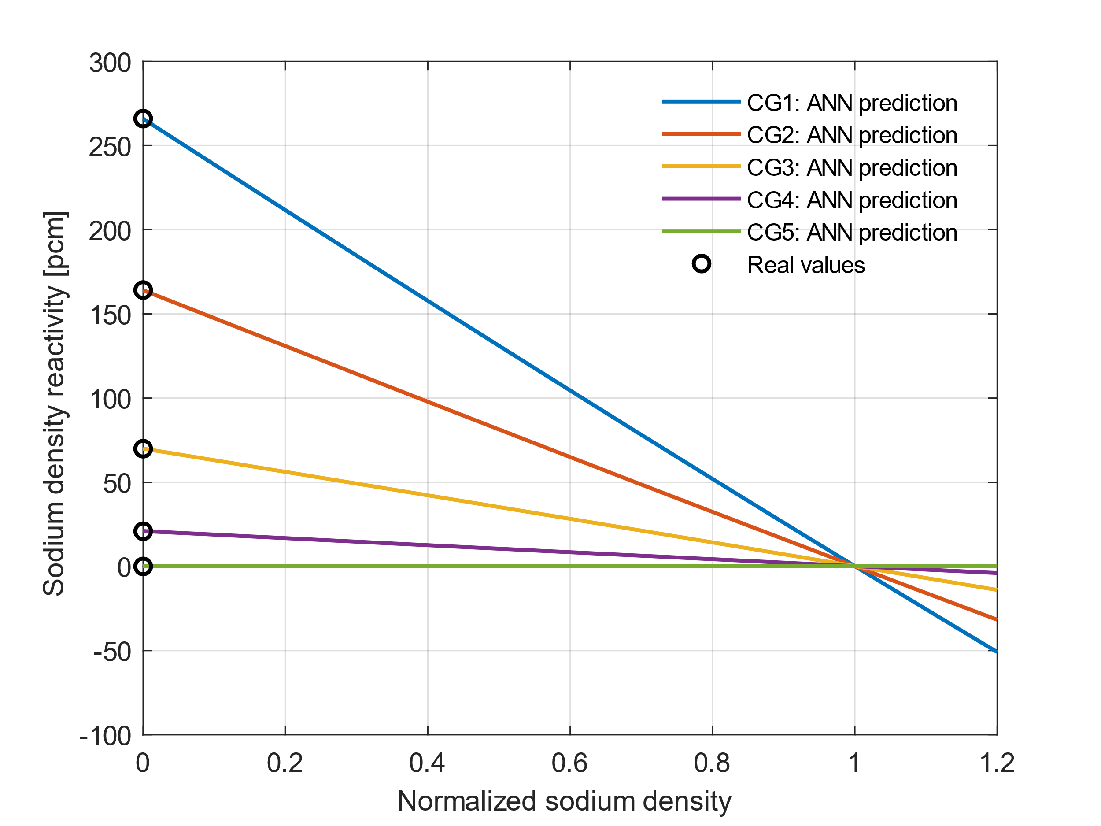
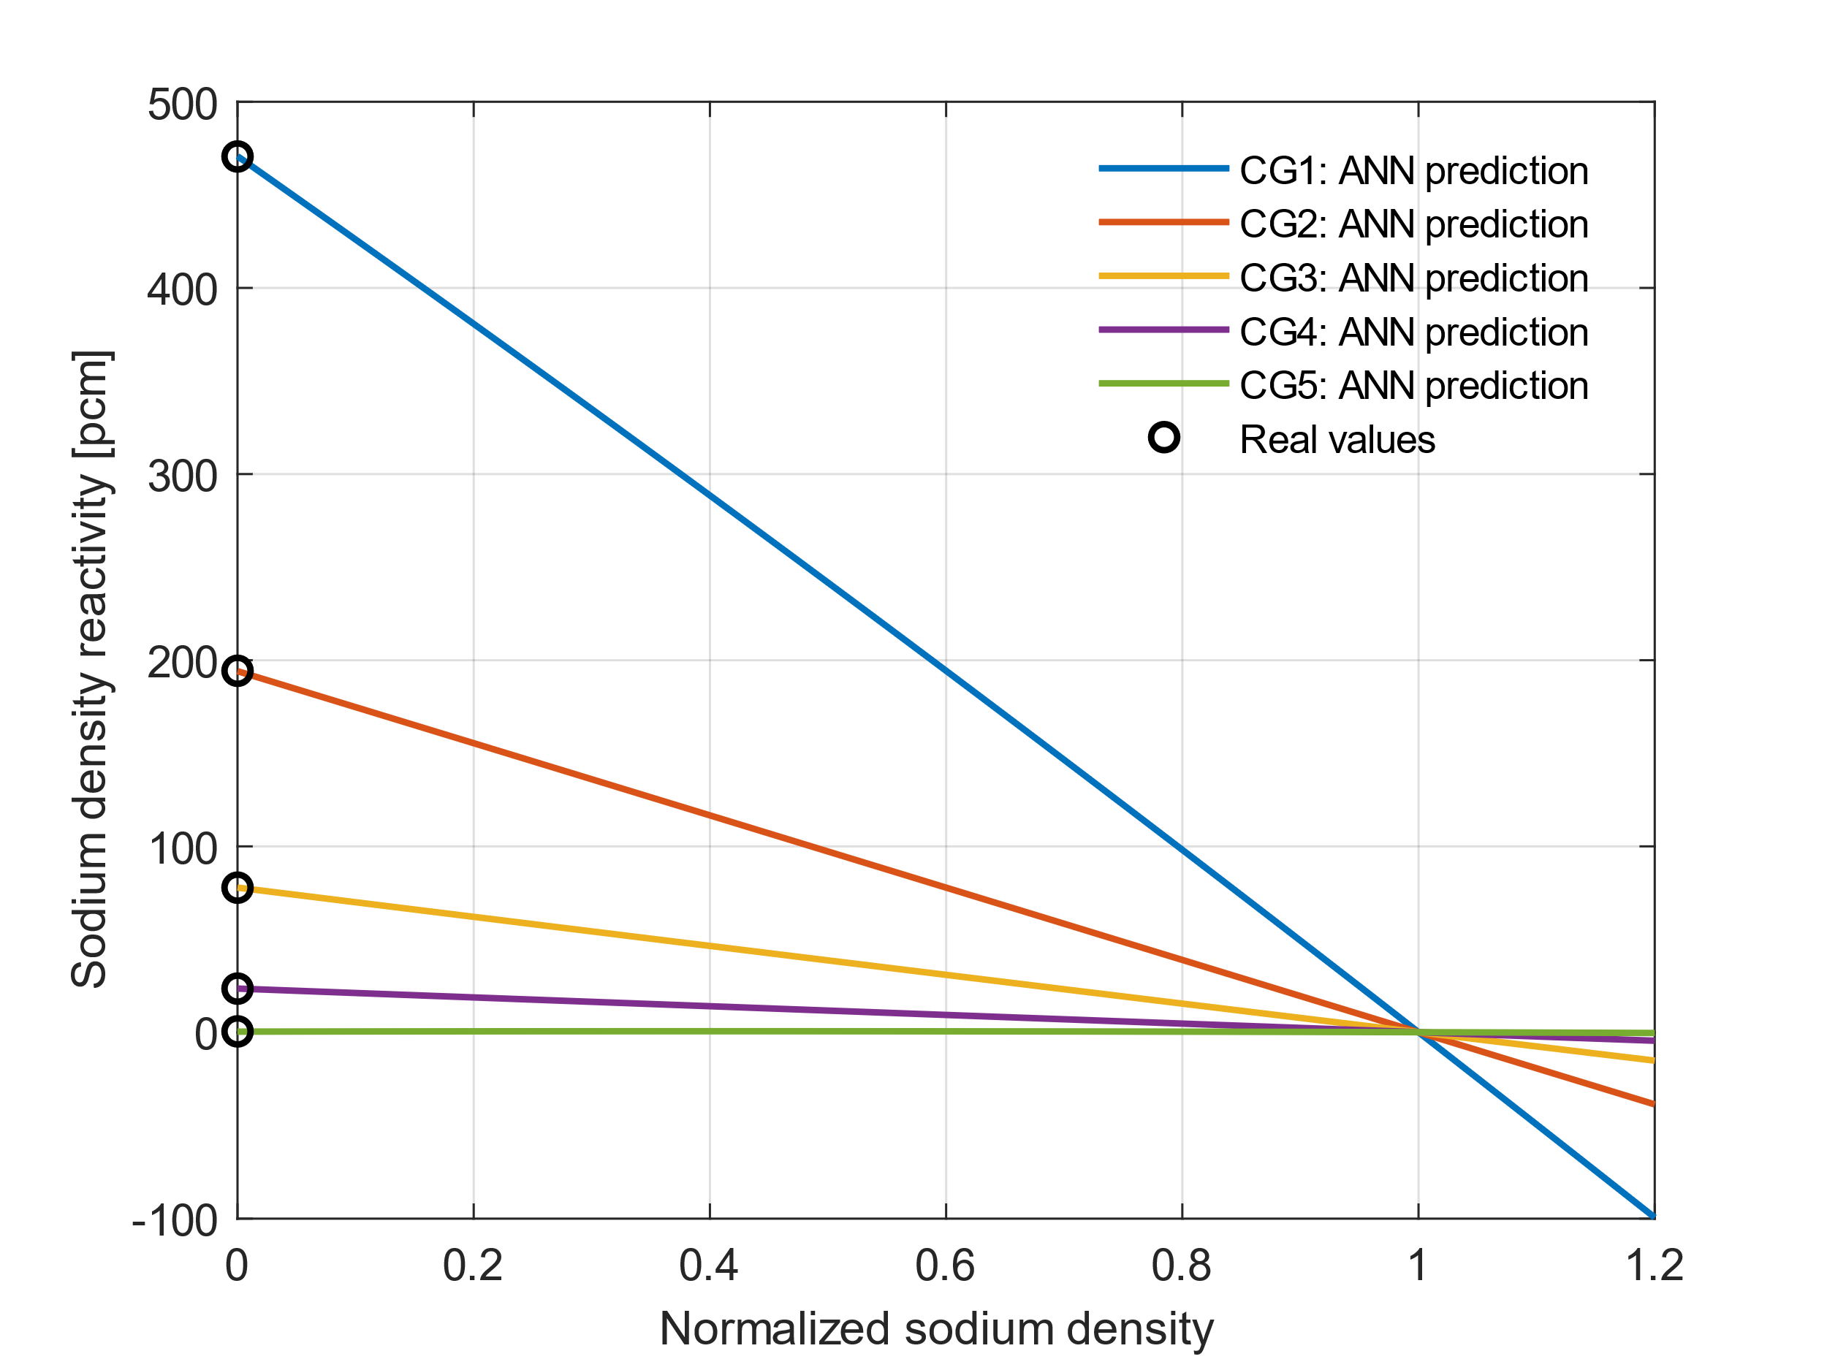
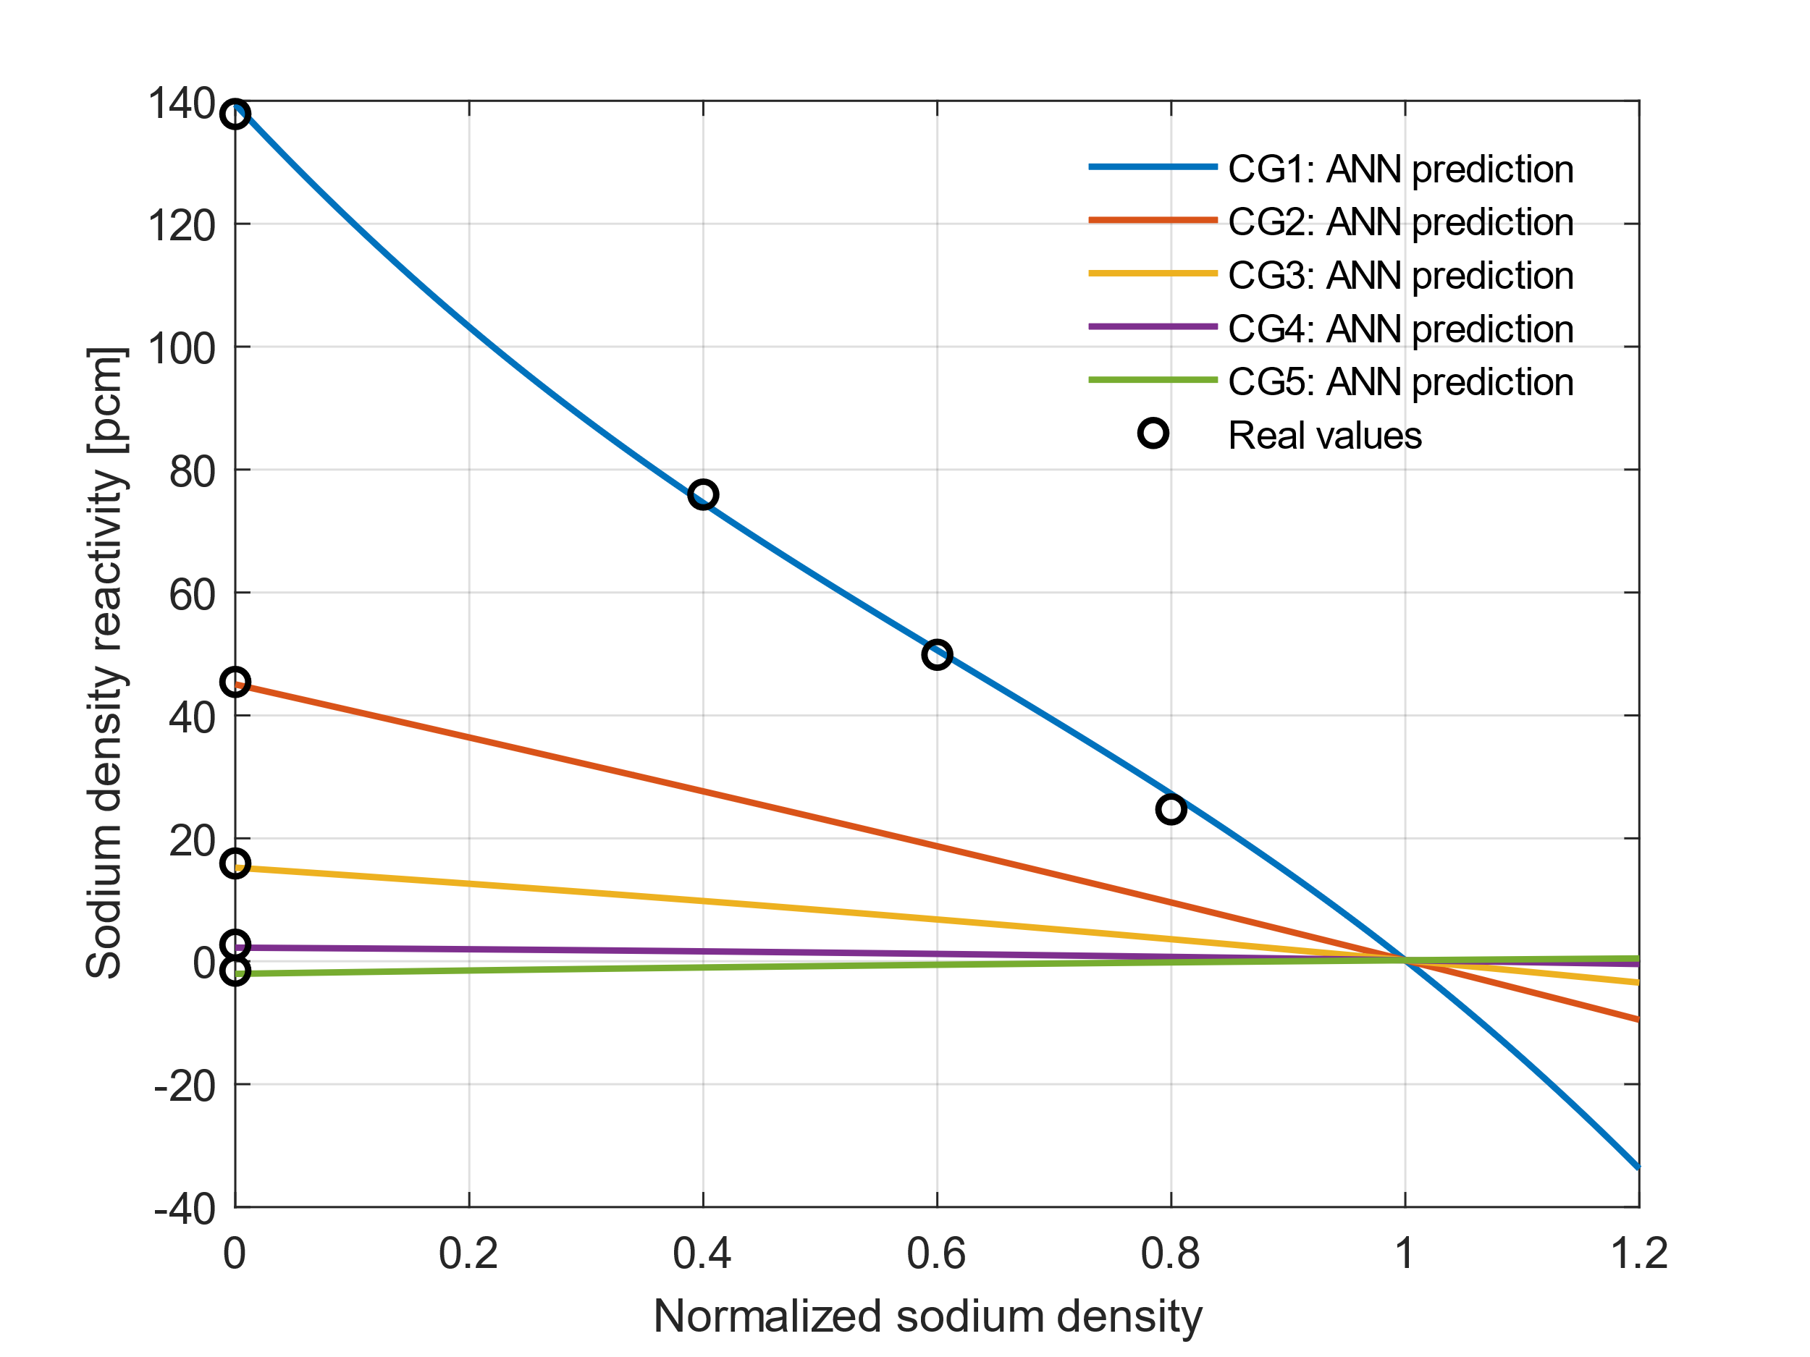
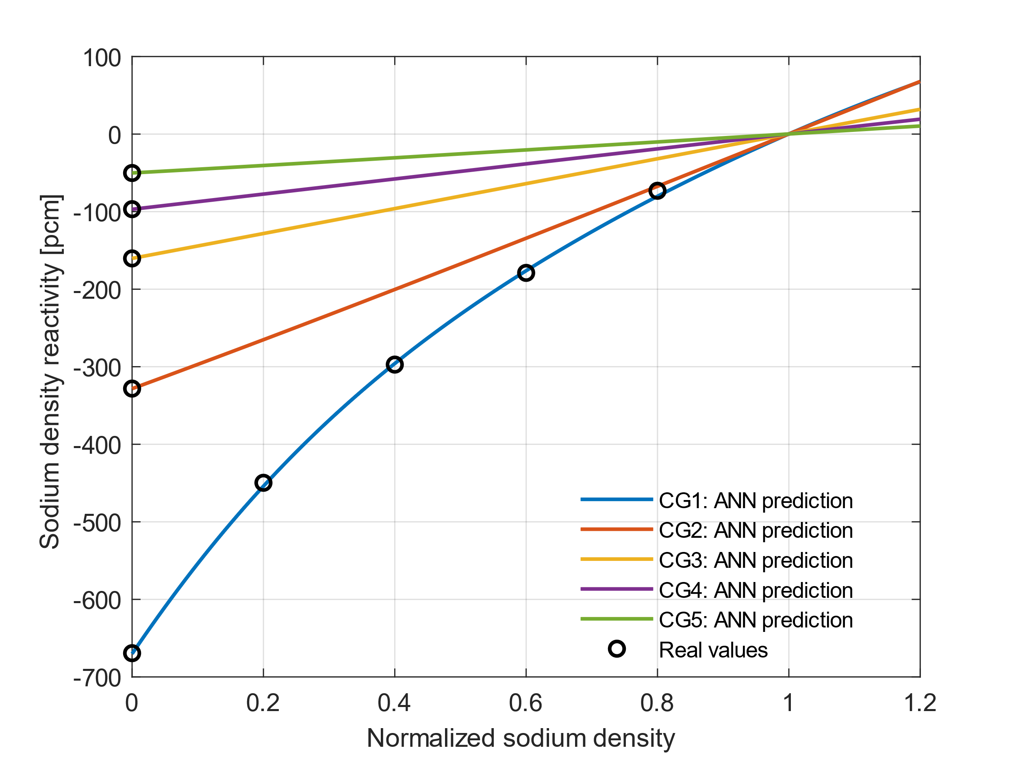
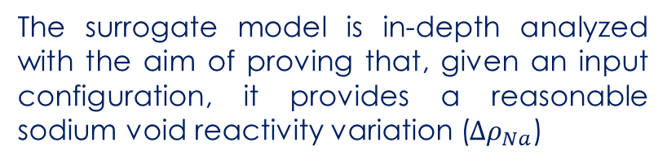
5. Results and discussion
The surrogate model is in-depth analyzed with the aim of proving that, given an input configuration, it provides a reasonable sodium void reactivity variation ($Δρ_{Na}$)
Axial node Z1
Axial node Z2
Axial node Z3
Axial node Z4
Axial node Z5: plenum

Slide 9
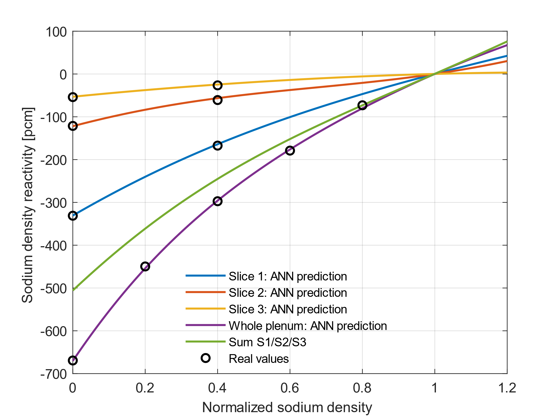
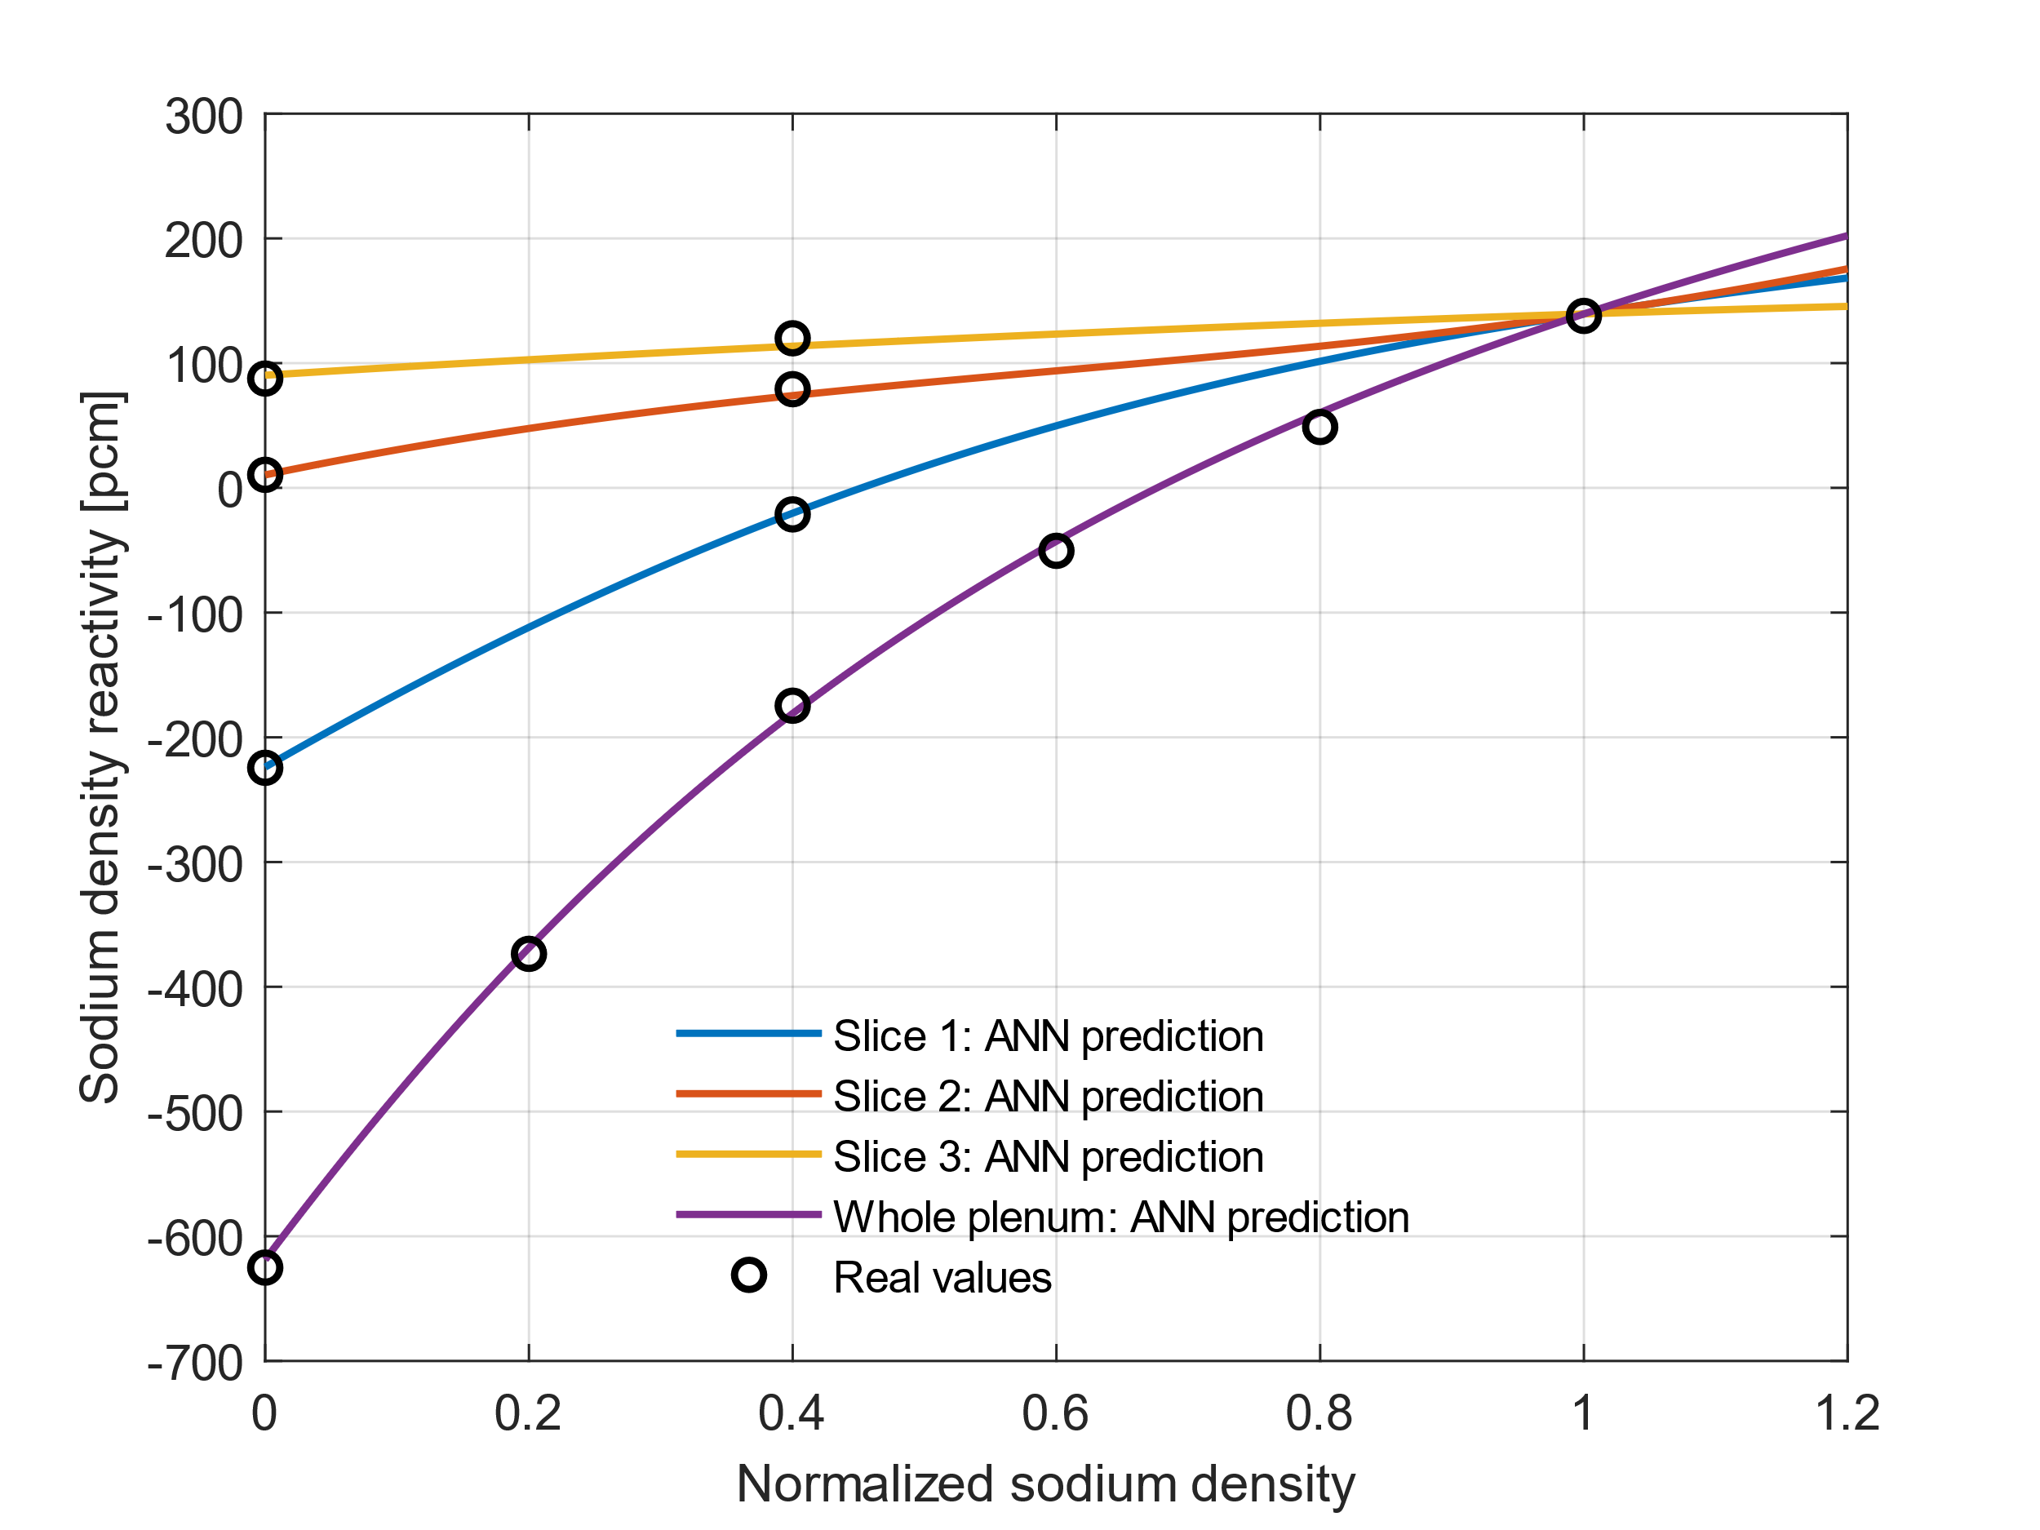
5. Results and discussion
Sodium plenum CG1: additivity effects.
Sodium plenum CG1 when upper core node (Z4) is voided: interrelation effects.

Slide 10
5. Summary
Spatial correlations can play a relevant role when computing reactivity effects for SFRs that includes upper sodium plenum.
In transients with sodium boiling, their characterization appear to be mandatory in order to provide realistic sodium void reactivity effects.
Our proposal to address this issue is a surrogate model trained with a wide dataset that allows us to account for interdependencies and non-linearities.
That model appears to work properly providing a global sodium density effect based on region-wise sodium density variation.
It is important to note that linear effects dominate for several regions so a more simplified model may be developed to capture essentially the interaction of the sodium plenum and the upper core part, both axially and radially.
Further verification activities should be carried out towards the final goal: the coupling of the model to the transient code.
This will provide information about the impact of the spatial correlations on realistic transient scenarios.

Slide 11
Acknowledgments
This work is part of the EU Project ESFR-SMART which has received funding from the EURATOM Research and Training Programme 2014-2018 under the Grant Agreement No. 754501.

Slide 12
Thank you! Questions?
A. Jiménez-Carrascosa¹, J. Krepel², A. Ponomarev², K. Mikityuk², N. García-Herranz¹
¹Universidad Politécnica de Madrid (UPM), Spain
²Paul Scherrer Institut (PSI), Switzerland
FR22 – International Conference on Fast Reactors and Related Fuel Cycles: Sustainable Clean Energy for the Future
Austria, Vienna, April 19-22
Notes:
12

